Slide 1
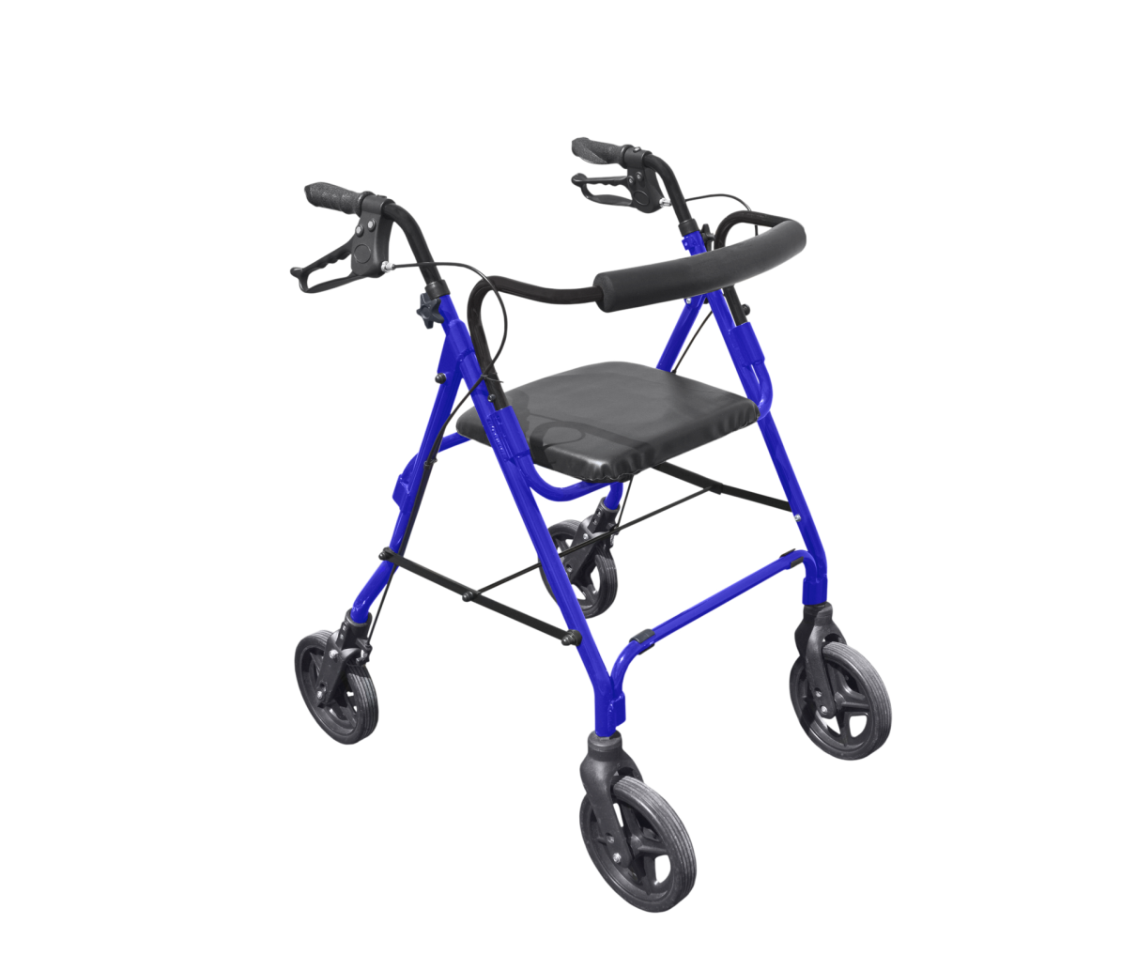
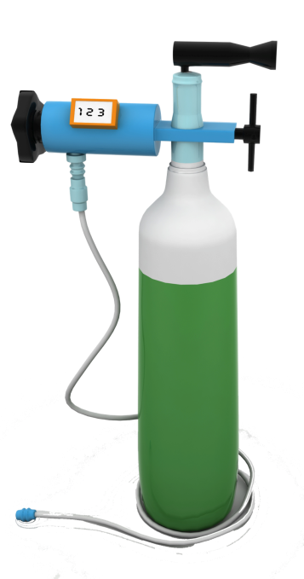
The Durable Medical Equipment, Prosthetics, Orthotics, and Supplies (DMEPOS) Competitive Bidding Program
What You Need to Know

Slide 2
Competitive Bidding– A Better Way to Pay
Program started in January 2011 for certain DMEPOS in nine areas of the country (Round 1)
Program helps people with Medicare
Save money
Get quality equipment, supplies and services
Program strengthens protections against Medicare fraud
Notes:
In January 2011, Medicare started a new competitive bidding program for certain durable medical equipment, prosthetics, orthotics, and supplies (DMEPOS) in nine areas of the country. These nine areas are the Round 1 areas. There will be some changes to the program in the Round 1 areas starting on January 1, 2014. This training will help explain what people with Medicare need to know about the upcoming changes.
In July 2013, Medicare expanded the competitive bidding program to more areas of the country, called the Round 2 areas, and also implemented the national mail-order program for diabetic testing supplies. It is important to know that neither Round 2 nor the national mail-order program are changing.
This program changes the amount Medicare pays for certain DMEPOS, and makes changes to which suppliers Medicare will pay to supply these items to beneficiaries. The program replaces the outdated, inflated fee-schedule prices Medicare used to pay with lower, more accurate prices. Under this program, suppliers submit bids to provide certain medical equipment and supplies. Medicare uses these bids to set the amount it will pay for those equipment and supplies under the competitive bidding program. Qualified, accredited suppliers with winning bids are chosen as Medicare contract suppliers. The program:
Helps beneficiaries and Medicare save money
Ensures that beneficiaries have access to quality medical equipment, supplies, and services from suppliers they can trust
Helps limit fraud and abuse in the Medicare Program

Slide 3
How the Program Works
DMEPOS suppliers submit bids
Suppliers must submit a bid to be considered for contract award
Payment amounts based on bids
Contracts are awarded to winning suppliers to sell/rent DMEPOS
Contract suppliers must
Meet eligibility, quality, and financial standards
Be accredited by an independent organization
Notes:
Under the DMEPOS competitive bidding program, Medicare beneficiaries with Original Medicare who live in competitive bidding areas – or CBAs - pay less for certain DMEPOS items and services. DMEPOS suppliers that want to furnish certain DMEPOS items and services in a CBA must submit a bid in order to be considered for a contract to sell or rent to people with Medicare. The bids from winning suppliers are used to set a “single payment amount” for each item which replaces the “fee schedule” amount. The “single payment amount” must be lower than the “fee schedule amount.” All suppliers are thoroughly screened to make sure they meet Medicare requirements before they are considered for contract award. Contracts are only awarded to qualified suppliers that meet Medicare’s eligibility, quality and financial standards and that are accredited by an independent accrediting organization.
In addition to saving money for the Medicare program (and taxpayers), the program helps save money for beneficiaries because when Medicare pays less, the beneficiary’s 20% coinsurance payment will be less too.

Slide 4
How the Program Works
In most cases, only contract suppliers can
Provide competitively bid DMEPOS items
File claims with Medicare for payment of competitively bid items and services
Contract supplier charge cannot exceed
Single payment amount based on bids received for an item
Medicare fee schedule allowed amount
Notes:
In most cases under the Competitive Bidding Program, only contract suppliers can provide people with Original Medicare in CBAs with certain DMEPOS items and file claims with Medicare for payment. There are a few exceptions to the requirement to use a contract supplier – I will discuss these a little later. The program doesn’t change the types of items Medicare will cover. It only changes the prices Medicare pays and the specific suppliers that are authorized to provide competitively bid items. It’s important for beneficiaries in CBAs to make sure they obtain competitively bid items from a supplier that Medicare can pay to furnish competitively bid items - usually a contract supplier. If a beneficiary obtains a competitively bid item in a CBA and doesn’t use a contract supplier, Medicare probably won’t pay for the item and the beneficiary will likely pay full price. Beneficiaries can continue to use any Medicare-enrolled suppliers for DMEPOS items that are not included in the program. It’s important for beneficiaries to know if they’re affected by this program to make sure Medicare will pay the supplier they use and to avoid any disruption of service.
Contract suppliers can’t charge more than the single payment amount set by Medicare based on the bids received for an item, and this price can’t be higher than the Medicare fee schedule allowed amount.

Slide 5
Round 1 Rebid
Round 1 Rebid resulted in savings of 35% below fee schedule
Savings for first two years over $400 million
Notes:
The round of the program that started on January 1, 2011 in the nine Round 1 areas is known as the Round 1 Rebid. The Round 1 Rebid resulted in average savings of 35 percent below the fee schedule rates. The Round 1 Rebid has saved more than $400 million in the first two years of operation while preserving beneficiary access to quality items.
Beneficiaries are expected to save an estimated $17.2 billion between 2013 and 2022 as a result of the competitive bidding program.

Slide 6
Round 1 Recompete
Current competitive bidding program supplier contracts in Round 1 areas end December 31, 2013 (national mail-order program remains in effect)
Round 1 Recompete contracts go into effect on January 1, 2014 in same nine areas
Round 1 Recompete projected to result in savings of 37% compared to fee schedule
Notes:
Medicare is required to recompete competitive bidding program contracts at least once every three years. The current competitive bidding program supplier contracts in Round 1 areas will end on December 31, 2013. On January 1, 2014, Medicare will start new contracts for the Round 1 Recompete with suppliers in these nine CBAs. It’s important to know if beneficiaries are affected by these changes to make sure Medicare will help pay for their item and to avoid any disruption of service. As I indicated earlier, please note that the national mail-order program for diabetic testing supplies that went into effect on July 1, 2013 isn’t changing, so the national-mail-order program contracts remain in effect.
Medicare announced the new contract suppliers for the Round 1 areas on October 31, 2013. You can find the contract suppliers on Medicare.gov/supplier. Beneficiaries may also call 1-800-MEDICARE (1-800-633-4227) for help finding a contract supplier. TTY users should call 1-877-486-2048.
Beneficiaries in the Round 1 areas will continue to save when the new contracts start on January 1, 2014. The new prices are projected to result in savings of 37% compared to the fee schedule.

Slide 7
Round 1 Rebid Products 1/1/11-12/31/13
Products Included in Round 1 Rebid
Oxygen, oxygen equipment, and supplies
Enteral nutrients, equipment, and supplies
Continuous Positive Airway Pressure (CPAP) devices and Respiratory Assist Devices (RADs), and related supplies and accessories
Hospital beds and related accessories
Walkers and related accessories
Support surfaces (Group 2 mattresses and overlays) (in Miami area only)
Standard power wheelchairs, scooters, and related accessories
Complex rehabilitative power wheelchairs and related accessories (Group 2)
Note: Round 1 mail-order diabetic supply contracts ended on December, 31 2012
*
Notes:
The items included in the program are grouped into product categories. These are the competitive bidding product categories that were included in the Round 1 Rebid as required by law.

Slide 8
Round 1 Recompete Products 1/1/14-12/31/16
Products Included in Round 1 Recompete
Respiratory Equipment and Related Supplies and Accessories includes oxygen, oxygen equipment and supplies; continuous positive airway pressure (CPAP) devices and respiratory assist devices (RADs) and related supplies and accessories; and standard nebulizers
Standard Mobility Equipment and Related Accessories includes walkers, standard power and manual wheelchairs, scooters, and related accessories
General Home Equipment includes hospital beds and related accessories, group 1 and 2 support surfaces, transcutaneous electrical nerve stimulation (TENS) devices, commode chairs, patient lifts, and seat lifts
Enteral Nutrients, Equipment and Supplies
Negative Pressure Wound Therapy Pumps and Related Supplies and Accessories
External Infusion Pumps and Supplies
Notes:
There are some changes to the items included in the program in the Round 1 areas starting January 1, 2014. You’ll see that there are some additional items and that we have grouped certain similar items and accessories in larger, more consolidated product categories.

Slide 9
Who will be Affected?
Round 1 areas:
Charlotte-Gastonia-Rock Hill (North Carolina and South Carolina)
Cincinnati-Middletown (Ohio, Kentucky and Indiana)
Cleveland-Elyria-Mentor (Ohio)
Dallas-Fort Worth-Arlington (Texas)
Kansas City (Missouri and Kansas)
Miami-Fort Lauderdale-Pompano Beach (Florida)
Orlando-Kissimmee-Sanford (Florida)
Pittsburgh (Pennsylvania)
Riverside-San Bernardino-Ontario (California)
Medicare Advantage enrollees use suppliers designated by their plan
Notes:
The Competitive Bidding Program applies to beneficiaries who have Original Medicare and whose permanent residence is in a ZIP Code that is part of a CBA, or if they get certain items while visiting a CBA. A beneficiary’s permanent residence is the address where Social Security mails his or her benefits check.
Here is a list of the Round 1 areas. Beneficiaries can find out if a ZIP Code is in a CBA by visiting www.medicare.gov/supplier or by calling 1-800-MEDICARE (1-800-633-4227). TTY users call 1-877-486-2048.
Medicare Advantage enrollees can use any suppliers designated by their plan. Their plan will notify them if their supplier is changing. If beneficiaries aren’t sure if they need to change, they should contact their plan.

Slide 10
Using Contract Suppliers
Must almost always use contract supplier if
Items and services are included in Competitive Bidding Program where a beneficiary lives
Traveling to or visiting a CBA
Doctors, treating practitioners, and hospitals can supply certain items (ex: walkers, folding manual wheelchairs and external infusion pumps) without being contract suppliers
Nursing Facility can supply directly to its own residents only if it becomes a contract supplier
Notes:
If the equipment or supplies ordered by a beneficiary’s physician or treating practitioner are included in the Competitive Bidding Program where the beneficiary lives or visits, the beneficiary must almost always get his or her equipment or supplies from a contract supplier for Medicare to help pay. Treating practitioners include physician assistants, clinical nurse specialists, and nurse practitioners.
However, the beneficiary’s doctor or treating practitioner can sometimes supply a walker, folding manual wheelchair or external infusion pump to the beneficiary when he or she is getting other medical care even if the doctor or practitioner isn’t a contract supplier. Similarly, if a beneficiary is hospitalized and needs a walker, folding manual wheelchair or external infusion pump, the hospital can supply these items while the beneficiary is admitted or on the day the beneficiary is discharged from the hospital. The Medicare payment amount will be the new, lower competitive bidding payment amount.
If the beneficiary lives in a Skilled Nursing Facility or Nursing Facility, the facility may be able to supply enteral equipment or supplies directly to its own residents if it becomes a contract supplier. If the facility does not become a contract supplier, it must use a contract supplier from the CBA.

Slide 11
Identifying Contract Suppliers
Visit the DMEPOS Supplier Locator tool
www.medicare.gov/supplier
Call 1-800-MEDICARE (1-800-633-4227)
TTY users call 1-877-486-2048
Notes:
Beneficiaries in a CBA who need to locate a contract supplier can visit www.medicare.gov/supplier on the web or call 1-800-MEDICARE (1-800-633-4227). TTY users call 1-877-486-2048.
The supplier locator tool allows you to find suppliers that currently have contracts and suppliers that will have contracts starting January 1, 2014. If a beneficiary currently needs an item that won’t be in the program until January 1, he or she can use any enrolled supplier until January 1. If a beneficiary currently needs an item that is now in the program, he or she should select a current contract supplier. If a beneficiary needs a competitively bid item on or after January 1, 2014, he or she should select a supplier that has a new contract for the Round 1 Recompete.

Slide 12
Stay With Current Supplier
Can stay with current supplier that doesn’t have a new contract if (ALL of the following):
Supplier elects to become “grandfathered”
Beneficiary permanently resides in a CBA
Renting certain equipment or oxygen when program starts in CBA
If current supplier did NOT win a new contract AND elects NOT to become “grandfathered”
Must generally use a supplier that has a new contract
Notes:
If a beneficiary’s current supplier has a new contract, the beneficiary can continue to use that supplier. Beneficiaries who are renting certain medical equipment or oxygen as of January 1, 2014 may have the choice to stay with their current supplier even if that supplier doesn’t have a new contract. Suppliers that did not win a new contract can become “grandfathered” suppliers and continue to rent items to people with Medicare who permanently live in a CBA if they are renting the item(s) to the person as of January 1, 2014. When beneficiaries use grandfathered suppliers, they are still responsible for their 20% coinsurance and any unmet Part B deductible.
If a beneficiary is currently using a contract supplier that doesn’t have a new contract and isn’t going to be a grandfathered supplier, the beneficiary needs to transition to a Round 1 Recompete contract supplier for Medicare to help pay unless one of the exceptions we just discussed applies.

Slide 13
Grandfathering
Non-contract supplier
Issues written notice saying if it is willing to continue renting equipment
Works with contract supplier to get new equipment to beneficiary if beneficiary switches to contract supplier
Beneficiary
May continue getting services from grandfathered supplier until rental period ends OR
May switch to a new contract supplier
Notes:
“Grandfathered” suppliers must provide beneficiaries renting durable medical equipment or oxygen with written notice at least 30 business days before the start of the program. This notice should ask beneficiaries whether they want to continue renting the equipment from the grandfathered supplier. Beneficiaries may continue using a grandfathered supplier until the rental period for their equipment ends. If beneficiaries use oxygen and decide to use a grandfathered supplier, the Medicare payment amount will be the new, lower competitive bidding payment amount. If beneficiaries use other rented durable medical equipment, the Medicare payment amount will be either the competitive bidding payment amount or the current amount, depending on the particular type of item they are renting. Beneficiaries can ask their grandfathered supplier what their copayments will be if they continue to use that supplier instead of switching to a new contract supplier.
If beneficiaries choose not to continue using their grandfathered supplier, or their supplier chooses not to become a grandfathered supplier when the new contracts go into effect on January 1, 2014, they generally must use a Round 1 Recompete contract supplier for Medicare to help pay.
A supplier that decides not to become a grandfathered supplier is required to pick up items from beneficiaries’ homes after the program begins and the beneficiaries have been notified. The supplier must notify each beneficiary three times before it can pick up the item:
1. The supplier must send the beneficiary a letter at least 30 business days before the program begins indicating that it will no longer provide rental items after a certain date. This letter will tell the beneficiary the date on which a new Medicare contract supplier must begin to furnish the rented item.
2. Before the supplier can pick up its equipment, it must call the beneficiary 10 days prior to picking up the item.
3. The supplier must call the beneficiary again two business days prior to picking up the item.
A supplier that chooses not to grandfather isn’t allowed to pick up a medically-necessary item(s) before the end of the last rental month for which the supplier is eligible to receive a rental payment. If the beneficiary changes to a Medicare contract supplier, the old supplier should work with the contract supplier so there isn’t a break in service.
If the beneficiary switches to a new contract supplier instead of using a grandfathered supplier, this may extend the rental period and result in additional months of coinsurance.

Slide 14
Have Other Insurance?
Medicare may make payment to a non-contract supplier if required by primary policy
Non-contract supplier must
Be accredited
Have valid Medicare billing number
Be eligible to receive secondary payments
Notes:
If a beneficiary’s primary insurance policy requires use of a non-contract supplier, Medicare may make a secondary payment to a non-contract Medicare-enrolled supplier if required by the policy. The supplier must be accredited, have a valid Medicare billing number, and be eligible to receive secondary payments. For more information, beneficiaries should check with their benefits administrator, insurer or their plan provider.

Slide 15
Non-contract Supplier
A non-contract supplier generally may not furnish competitively bid items in a CBA
If non-contract supplier used and no exception applies, beneficiary not responsible for payment unless supplier issues Advance Beneficiary Notice (ABN)
Says Medicare will not pay
By signing ABN, beneficiary agrees to pay entire amount
Notes:
Non-contract suppliers may not furnish competitively bid items to people with Original Medicare who live in or visit a competitive bidding area unless they are a “grandfathered” supplier or fall under one of the other exceptions we have discussed.
If a non-contract supplier in a CBA furnishes a competitively bid item to beneficiaries and no exception applies, the beneficiary is not responsible for payment unless the supplier issues the beneficiary an Advance Beneficiary Notice – or ABN.
As a reminder, this notice says Medicare will not pay for the item or service. By signing an ABN, the beneficiary is agreeing to pay the entire amount for the item or service. If a beneficiary doesn’t sign an ABN, he or she is not responsible for payment for the item or service.

Slide 16
Changing Suppliers Scenario
Obtaining DMEPOS items from a new contract supplier
Mildred’s permanent residence is in Miami, FL which is a Round 1 CBA. She is currently renting her Continuous Positive Airway Pressure (CPAP) device from ABC company, which has a Round 1 Rebid contract but not a Round 1 Recompete contract. Mildred receives a notice from ABC company informing her that they won’t be a contract supplier after December 31, 2013 and that they also won’t be a grandfathered supplier starting January 1, 2014. Mildred must transition to a Round 1 Recompete contract supplier for Medicare to help pay.
Notes:
Changing Suppliers Scenario
Obtaining DMEPOS items from a new contract supplier
Mildred’s permanent residence is in Miami, FL which is a Round 1 CBA. She is currently renting her Continuous Positive Airway Pressure (CPAP) device from ABC company. ABC company has a Round 1 Rebid contract but not a Round 1 Recompete contract. ABC company decides not to become a grandfathered supplier. Mildred receives a notice from ABC company informing her that they won’t be a contract supplier after December 31, 2013 and that they also won’t be a grandfathered supplier. Mildred must transition to a Round 1 Recompete contract supplier for Medicare to help pay. ABC company must give Mildred two additional notices before picking up its equipment . These notices should occur 10 days before the equipment is picked up and two days before the equipment is picked up. ABC company and Mildred’s new contract supplier must coordinate with Mildred to pick up her current CPAP device and deliver the new one.

Slide 17
Traveling Beneficiaries
To CBA:
Must generally use contract supplier for that CBA
If non-contract supplier used and no exception applies, beneficiary not responsible for payment unless supplier issues Advance Beneficiary Notice (ABN)
To non-CBA:
Can use any Medicare-enrolled supplier
Notes:
If beneficiaries travel to or visit an area where the Competitive Bidding Program has started and need to get equipment or supplies that are part of the Competitive Bidding Program for that area, they must almost always get those items from a contract supplier for that area.
Remember, if a non-contract supplier in a CBA furnishes a competitively bid item to beneficiaries and no exception applies, the beneficiary is not responsible for payment unless the supplier issues the beneficiary an ABN.
Beneficiaries who travel to a non-CBA can use any Medicare-enrolled supplier.

Slide 18
Specific Brands
Doctor must prescribe in writing
Medical record must reflect need
Contract supplier must
Furnish the specific brand or form as prescribed OR
Work with doctor or treating practitioner to find suitable alternative and obtain a revised prescription OR
Help locate another contract supplier that can furnish the specific brand or form as prescribed
Notes:
The Competitive Bidding Program has special protections to make sure beneficiaries get the specific types of medical equipment they need to protect their health. If a beneficiary needs a specific brand of equipment or supplies, or needs an item in a specific form, the doctor must prescribe the specific brand or form in writing. The doctor must also document in the medical record that the beneficiary needs this specific item or supply for medical reasons. In these situations, a Medicare contract supplier is required to: furnish the exact brand or form of item the doctor prescribed; or work with the doctor to find an alternate brand or form that is safe and effective for the beneficiary and obtain a revised prescription; or help the beneficiary find another contract supplier that offers the brand or form prescribed.

Slide 19
Equipment Repair & Replacement
For owned medical equipment
Any Medicare-enrolled supplier can make necessary repairs
For replacement must use contract supplier
For warranty repairs, follow the warranty rules
For rented equipment
Repairs are included in rental payment – the supplier must fix at no charge
Notes:
If beneficiaries own medical equipment that is included in the program, they can use any Medicare enrolled supplier (even a non-contract supplier) for repairs or replacement parts needed for the repair of their equipment. Before the equipment is serviced, beneficiaries should make sure the supplier is Medicare-enrolled so Medicare can help pay.
If beneficiaries need to replace their medical equipment, they must use a Medicare contract supplier for Medicare to help pay for the equipment.
Medicare doesn’t pay for repairs that are covered under a manufacturer’s or supplier’s warranty. If beneficiaries need warranty repairs, they must follow the warranty rules.
If beneficiaries are renting medical equipment, the cost of needed repairs is included in the rental payments. The supplier renting the equipment must fix it at no additional charge to them.

Slide 20
Deductible and Coinsurance
After beneficiaries pay their annual Part B deductible
Medicare pays 80% of the Medicare-approved amount for equipment, supplies and services
Beneficiaries are responsible for a 20% coinsurance
Contract suppliers cannot bill for more than these amounts
For suspected overpayment or fraud call
1-800-MEDICARE (1-800-633-4227)
TTY users call 1-877-486-2048
Fraud Hotline of the HHS Office of Inspector General at 1-800-447-8477.
Notes:
Under this program, beneficiaries are still required to meet their annual deductible. After they have paid their annual Part B deductible, Medicare pays 80% of the Medicare-approved amount for equipment, supplies and services, and beneficiaries are responsible for a 20% coinsurance.
It is important to remember that for any equipment or supplies that are included in the Competitive Bidding Program, the contract supplier cannot charge the beneficiary more than the 20% coinsurance and any unmet annual deductible. If beneficiaries suspect that they are paying more coinsurance than the Medicare allowed amount, they can call 1-800-MEDICARE (1-800-633-4227) or call the Fraud Hotline of the HHS Office of the Inspector General at 1-800-447-8477.

Slide 21
Points to Remember
Program does NOT affect which physicians or hospitals beneficiaries use
Generally must use contract supplier for Medicare to help pay
May be able to stay with current supplier if renting from supplier who has new contract or elects to become “grandfathered”
If in Medicare Advantage plan, beneficiary should check with the plan
Notes:
Following are some points to remember:
The Competitive Bidding Program does not affect which doctors or hospitals beneficiaries can use.
Beneficiaries with Original Medicare in CBAs generally must obtain competitively bid items from contract suppliers. If beneficiaries live in or visit a Round 1 CBA and their current supplier is not a Round 1 Recompete contract supplier, they will likely need to use a supplier with a Round 1 Recompete contract for Medicare help pay for an item included in the program.
If beneficiaries live in a Round 1 CBA and are renting certain medical equipment or oxygen as of January 1, 2014, they may have the choice to stay with their current supplier if the supplier has a new contract or chooses to become a “grandfathered” supplier.
The competitive bidding program applies to people in Original Medicare. If beneficiaries are enrolled in a Medicare Advantage Plan, their plan will notify them if their supplier is changing. If beneficiaries are not sure, they should contact their plan.

Slide 22
What Beneficiaries Need To Do
Beneficiaries who live in or will visit a CBA and need medical items included in the program, should
Find out if the ZIP Code where they live or visit is included in a CBA
Find out if the items they need are included in the Medicare Competitive Bidding Program in that area
Find out which suppliers are contract suppliers for their items for the Medicare Competitive Bidding Program
Visit www.medicare.gov/supplier or
Call 1-800-MEDICARE (1-800-633-4227) to find this information
TTY users call 1-877-486-2048
Notes:
If beneficiaries live in or will visit a competitive bidding area and need medical items included in the program, they should
Find out if the ZIP Code where they live or visit is included in a CBA
Find out if the items they need are included in the Medicare competitive bidding program for that area
Find out which suppliers are contract suppliers for their items for the Medicare competitive bidding program in that area
Beneficiaries can find this information by visiting www.medicare.gov/supplier or by calling 1-800-MEDICARE.

Slide 23
Questions?
Visit www.medicare.gov/supplier
DMEPOS Supplier Locator Tool
Visit www.medicare.gov website
Consumer information
Call 1-800-MEDICARE (1-800-633-4227)
TTY users should call 1-877-486-2048
Beneficiary’s physician or supplier
Medicare’s local information resources
(SHIPs, ACL, etc)
Notes:
For more information or to answer questions about Medicare’s Competitive Bidding Program, beneficiaries can visit www.medicare.gov, which has a Supplier Locator Tool to help them identify Medicare contract suppliers in their area along with consumer information on the Competitive Bidding Program and Medicare Coverage of Durable Medical Equipment.
Or beneficiaries may call 1-800-MEDICARE (1-800-633-4227), TTY users should call 1-877-486-2048. This toll-free number is available 24 hours a day, 7 days a week.
Beneficiaries can also get information from their physician, supplier, hospital discharge planner, social worker or anyone who helps them get medical equipment or supplies.
And Medicare has local information resources to answer beneficiary questions including the State Health Insurance and Assistance Program (SHIP), Administration for Community Living (ACL) and other senior and consumer assistance organizations in their community.

Slide 24
Stay Informed
Visit www.cms.gov/Medicare/Medicare-Fee-for-Service-Payment/DMEPOSCompetitiveBid
Notes:
Referral agents can sign up for the CMS DME Referral Agent Electronic Mailing List at www.cms.gov/Medicare/Medicare-Fee-for-Service-Payment/DMEPOSCompetitiveBid. Referral agents play a critical role in providing information and services to Medicare beneficiaries. To ensure you give Medicare patients the most current DMEPOS Competitive Bidding Program information, CMS strongly encourages you to sign up for this electronic mailing list. In addition, please share the information you receive from the mailing list and the link to the “mailing list for referral agents” subscriber web page with others who refer Medicare beneficiaries for DMEPOS.

