Slide 1
New Medicare Card Project
Open Door Forum
02/06/19

Slide 2
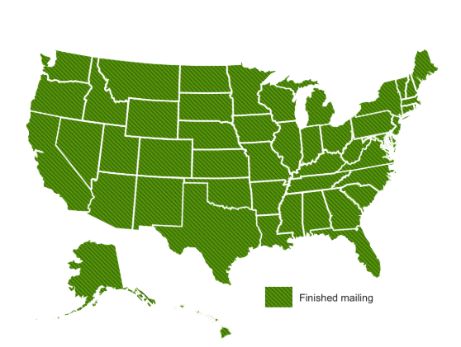
New Medicare Card Mailing Complete
We’ve finished mailing new cards to people with Medicare across all U.S. states and territories, completing the wave mailing ahead of schedule.
Over 61 million beneficiaries got new cards in the mail since April 2018.
  Includes people new to Medicare and existing beneficiaries
All Beneficiaries and Providers should be using MBIs Now!

Slide 3
Card Mailing Update
Card Mailing Strategy: https://www.cms.gov/Medicare/New-Medicare-Card/NMC-Mailing-Strategy.pdf
Wave | States Included | Cards Mailing
Newly Eligible People with Medicare | All - Nationwide | April 2018 - Ongoing
1 | Delaware, District of Columbia, Maryland, Pennsylvania, Virginia, West Virginia | Beginning May 2018 COMPLETE
2 | Alaska, American Samoa, California, Guam, Hawaii, Northern Mariana Islands, Oregon | Beginning May 2018 COMPLETE
3 | Arkansas, Illinois, Indiana, Iowa, Kansas, Minnesota, Nebraska, North Dakota, Oklahoma, South Dakota, Wisconsin | Beginning June 2018 COMPLETE
4 | Connecticut, Maine, Massachusetts, New Hampshire, New Jersey, New York, Rhode Island, Vermont | Beginning July 2018 COMPLETE
5 | Alabama, Florida, Georgia, North Carolina, South Carolina | Beginning August 2018 COMPLETE
6 | Arizona, Colorado, Idaho, Montana, Nevada, New Mexico, Texas, Utah, Washington, Wyoming | Beginning September 2018 COMPLETE
7 | Kentucky, Louisiana, Michigan, Mississippi, Missouri, Ohio, Puerto Rico, Tennessee, Virgin Islands | Beginning October 2018 COMPLETE

Slide 4
Key Points to Reinforce with Beneficiaries
If someone with Medicare says they haven’t received a new card by now, they should:
Look around their house for any old or unopened mail. Their new Medicare card was mailed in a plain white envelope from the Department of Health and Human Services.
Sign into MyMedicare.gov to see their Medicare number or print their official card. They’ll need to create an account if they don’t already have one.
Call 1-800-MEDICARE (1-800-633-4227) where we can verify their identity, check their address and help them get their new card. There might be something that needs to be corrected, like their mailing address.
Use their current card to get health care services (until January 1, 2020).

Slide 5
Key Points to Reinforce with Beneficiaries
Beneficiaries should:
  Start using their new Medicare card right away
  Safely destroy their old cards to protect their personal information.
  Continue to protect their new Medicare number.
CMS will never call beneficiaries uninvited for their Medicare number or other personal information. Beneficiaries who think their number is compromised should call 1-800-MEDICARE.
The letters O and I are never used in the new Medicare Number so they should not be confused with numbers 0 and 1 which may be included, when signing up for or logging into MyMedicare.gov

Slide 6
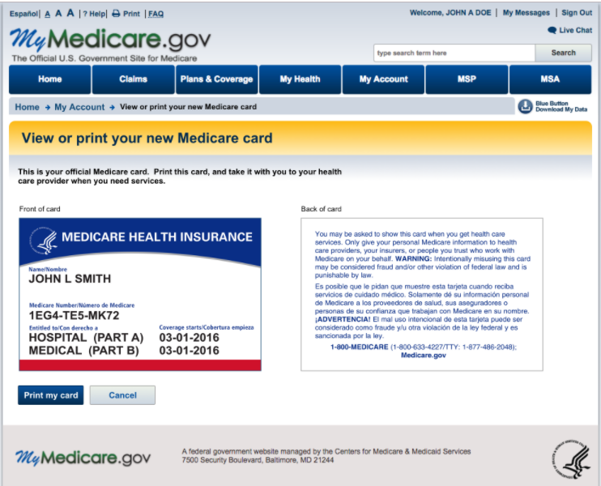
MyMedicare.gov - View or Print new Medicare card
Log into or sign up for MyMedicare.gov. Accounts are password-protected and secure.
Beneficiaries can view Medicare numbers/print a card, even if they didn’t get their new card in the mail.
This page is available to view on smaller devices like cell phones.

Slide 7
Solution Concept for the New Medicare Cards
CMS has completed the following:
Generated Medicare Beneficiary Identifiers (MBI) for all beneficiaries
Modified systems and business processes to accommodate receipt, transmission, display, and processing of the MBI
Issued new, redesigned Medicare cards

Slide 8
Transition Period (OCCURING NOW)
April 1, 2018 – December 31, 2019
Transition Period (OCCURING NOW)
April 1, 2018 – December 31, 2019

Slide 9
Transition Period Milestones
April 1, 2018- January 1, 2020
April 1, 2018
All systems & processes able to accept MBI. Mailing new Medicare cards to newly eligible people with Medicare. BEGIN TRANSITION PERIOD
May 2018
Continue mailing new Medicare cards with MBI to 60M beneficiaries
Jun 2018
Launch of provider
look-up tool
Oct 2018
Return MBI on remittance advice
MBI shared with downstream partners
Apr 16, 2019
Deadline for issuance of new Medicare cards
Jan 1, 2020
END OF TRANSITION PERIOD. Use the MBI on data exchanges

Slide 10
Using the New Medicare Number – During Transition
The transition period runs from April 1, 2018 through December 31, 2019
CMS is accepting, using for processing, and returning to stakeholders either the MBI or HICN, whichever is submitted on the claim, during the transition period.
All stakeholders who submit or receive transactions containing the HICN are strongly encouraged to start submitting or exchanging the MBI now.
CMS is actively monitoring the use of HICNs and MBIs to ensure that everyone is ready to use MBIs only by January 1, 2020
Over 60% of Medicare fee-for-service claims now include the MBI!

Slide 11
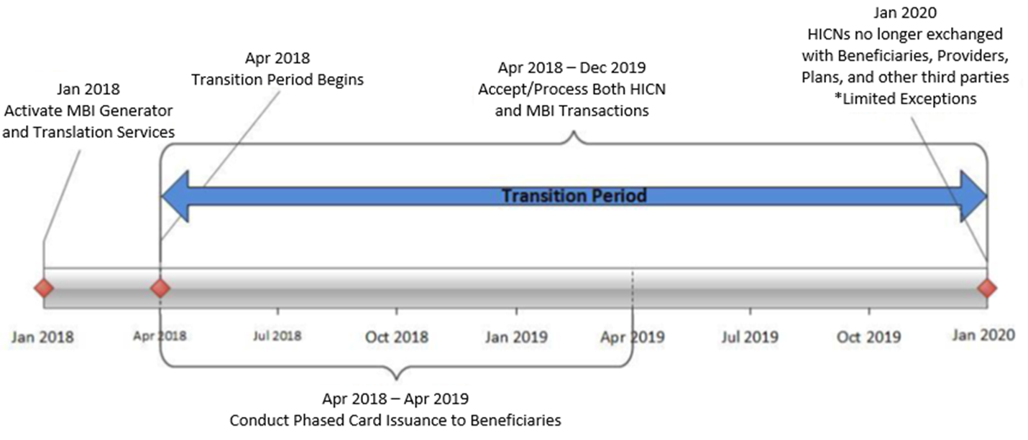
Transition Period Timeline
Transition period: April 1, 2018 – December 31, 2019

Slide 12
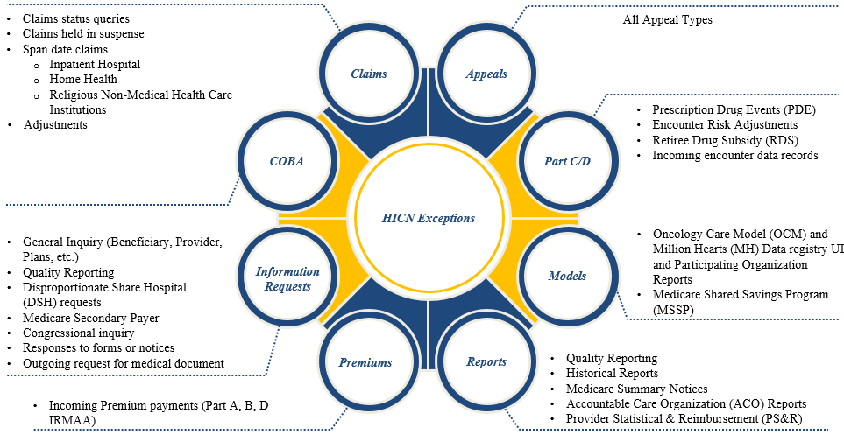
New Medicare Number HICN Exception Usage
After the Transition Period
Beginning January 1, 2020, CMS will only accept the MBI for external data exchanges. CMS will continue to accept the HICN on the following data exchanges after January 1, 2020.
Note: CMS, Federal Partners and States will continue to use HICN for internal processing during and after the transition period.

Slide 13
Key Points for Providers
Providers Should Use the MBI Now!
Providers have 3 ways to get the new MBI:
  Patient presents the card at time of service
  Provider gets it through the a secure web portal with the MAC
  Provider gets it through the remittance advice (through the end of the transition period)
Medicare patients are successfully using their new cards in doctor’s offices and other healthcare facilities.
  More than 60% of Medicare fee-for-service claims now include the MBI, demonstrating people are getting and using their new cards.
  All Beneficiaries and Providers should use MBIs as soon as possible!

Slide 14
Using the New Medicare Number – Providers
  Providers/Suppliers can use a MAC portal to look up any beneficiary’s MBI
  Providers must enter a valid National Provider ID (NPI) and enter a valid user ID and password to look up a beneficiary’s MBI via the Provider Lookup Tool in the MAC portals
  Providers/Suppliers will need the following beneficiary information to look-up MBIs:
    Patient SSN, Last Name, First Name and Date of Birth
    (Reminder - An individual’s HICN may not always be their own SSN if benefits are tied to a spouse. Thus, using the numerical part of a HICN will not always return a response in the MBI look-up tools. Instead, use the individual’s specific SSN)
  Additional information can be found under the Provider tab at www.CMS.gov/newcard (providers can also reference the portal instructions sent in September 2017)

Slide 15
Using the New Medicare Number – Providers (2)
  When a provider checks a beneficiary’s eligibility, the CMS HIPAA Eligibility Transaction System (HETS) returns a message on the response that says, "CMS mailed a Medicare card with a new Medicare Beneficiary Identifier (MBI) to this beneficiary. Medicare providers, please get the new MBI from your patient and save it in your system(s)."
  Through the end of the transition period, when a provider submits a valid and active HICN on Medicare fee-for-service claims, CMS will return both the HICN and the MBI on the remittance advice
  Providers have resources when they talk to people with Medicare about the new Medicare cards: https://www.cms.gov/Medicare/New-Medicare-Card/Outreach-and-Education/Products-to-share-with-beneficiaries.html

Slide 16
Using the New Medicare Number – Plans / Pharmacies
Plans
  All Medicare Advantage plans received a HICN to MBI crosswalk file prior to the start of the transition period (April 1, 2018)
  The MARx User Interface (UI) is now showing both the HICN and the MBI during the transition, but only the MBI when the transition’s over
  Prescription Drug (Part D) Plans may submit either the Health Insurance Claim Numbers (HICN) or Medicare Beneficiary Identifiers (MBI) both during and after the transition period
  CMS has provided information regarding the systems changes via the Health Plan Management System (HPMS) memos that have been released for the systems impacted
  For beneficiaries enrolled in Medicare Advantage Plans, they should use their new card to enroll in a Medicare Advantage or Prescription Drug Plan
  All Medicare beneficiaries who are enrolled in a Medicare Advantage and/or a Prescription Drug Plan will still receive an insurance card from their Plan that they must continue to use when obtaining services while enrolled in the Plan
E1 Transactions for Pharmacies
  Both the Part D and A/B E1 transactions will return the MBI
  Pharmacies may submit the HICN or MBI now and after the transition

Slide 17
Using the New Medicare Number – Other Stakeholders
Accountable Care Organizations (ACOs)
  ACOs get MBI information for their assigned Medicare beneficiary populations
  CMS includes Both HICNs and MBIs in the Claims and Claims Line Feed Files (CCLFs) until December 2019
Crossover Claims Processing
  During the transition period, CMS is processing and transmitting Medicare crossover claims using either (HICN) or (MBI)
Medicaid Agencies – Dual Eligible Medicare and Medicaid beneficiaries
  State Medicaid Agencies get both HICNs and MBIs in their system exchanges with CMS
    State Third Party Buy-In Dual Eligible beneficiaries will continue to use HICN now and post transition

Slide 18
Using the New Medicare Number – Other Stakeholders (2)
Private payers
  For non-Medicare business, private payers won’t have to use the MBI. For Medicare, we’ll continue to use supplemental insurer’s unique numbers to identify customers, but after the transition period, supplemental insurers must use the MBI for any Medicare transactions where they would have used the HICN
Third Party Group Payers
  Third Party Group (TPG) Payers systems accept either the MBI or the HICN throughout the transition period
    However, after the transition period—as of January 1, 2020, TPG Payers must use the MBI for any Medicare transactions where they would have used the HICN

Slide 19
Electronic Remittance Advice (ERA)
CMS updated the following ERAs to also include the MBI when a provider submits a valid and active HICN:
  Medicare Remit Easy Print (MREP): We changed the current MREP Remittance Advice HICN label to Medicare ID (MID) and added a new MID label and field to show the MBI number
  PC Print (Medicare Part A Providers & Facilities): We changed the current PC Print Remittance Advice HICN label to Medicare ID (MID) and added a new MID Corrected (MID COR) label and field
View samples at: https://www.cms.gov/Medicare/New-Medicare-Card/Providers/Getting-MBIs.html

Slide 20
Paper Remittance Advice
Standard Paper Remits (SPRs): We updated the SPRs to include the MBI when providers submit a claim with a valid and active HICN.
  View samples at: https://www.cms.gov/Medicare/New-Medicare-Card/Providers/Getting-MBIs.html

Slide 21
Railroad Retirement Board (RRB) Beneficiaries
  RRB mailed cards to their beneficiaries with the RRB logo, but you can’t tell from looking at the MBI if beneficiaries are eligible for Medicare because they’re railroad retirees
  We return a message on the HETS eligibility transaction response to alert the provider it’s an RRB patient. The message says, "Railroad Retirement Medicare Beneficiary”
  Medicare Providers must program their systems to identify RRB beneficiaries so they know to send those claims to the Specialty Medicare Administrative Contractor (SMAC)

Slide 22
Final Thoughts
Thank you for participating in this discussion today. There’s more information about the New Medicare Card on our websites:
  For stakeholder/operational information go to: https://www.cms.gov/newcard
  For beneficiary focused information go to: https://www.medicare.gov/newcard
For resources to use when you talk to people with Medicare about the new Medicare cards: https://www.cms.gov/Medicare/New-Medicare-Card/Partners-and-Employers/Partners-and-employers.html
Please submit any additional comments or questions to the New Medicare Card team mailbox: NewMedicareCardSSNRemoval@cms.hhs.gov
Notes:
CMS is actively accepting and processing claims using the MBI.
All Beneficiaries and Providers should use MBIs as soon as possible!
Remember the transition ends December 31, 2019
Providers Should be Using the MBI Now!

