Slide 1
Social Security Number Removal Initiative (SSNRI)
Provider Open Door Forum
June 8, 2017

Slide 2
Background
The Health Insurance Claim Number (HICN) is a Medicare beneficiary’s identification number, used for processing claims and for determining eligibility for services across multiple entities (e.g., Social Security Administration (SSA), Railroad Retirement Board (RRB), States, Medicare providers, and health plans)
The Medicare Access and CHIP Reauthorization Act (MACRA) of 2015 mandates the removal of the Social Security Number (SSN)-based HICN from Medicare cards to address current risk of beneficiary medical identity theft
The legislation requires that CMS mail out new Medicare cards with a new Medicare Beneficiary Identifier (MBI) by April 2019

Slide 3
SSNRI Program Goals
Primary goal: To decrease Medicare Beneficiary vulnerability to identity theft by removing the SSN-based HICN from their Medicare identification cards and replacing the HICN with a new Medicare Beneficiary Identifier (MBI)
In achieving this goal CMS seeks to:
Minimize burdens for beneficiaries
Minimize burdens for providers
Minimize disruption to Medicare operations
Provide a solution to our business partners that allows usage of HICN
and/or MBI for business critical data exchanges
Manage the cost, scope, and schedule for the project

Slide 4
Complex IT Systems Affecting Providers, Partners, and Beneficiaries
Along with our partners, CMS will address complex systems changes for over 75 systems, conduct extensive outreach and education activities, and analyze the many changes that will be needed to systems and business processes
Affected stakeholders include:
Federal partners, States, Beneficiaries, Providers, and Plans
Other key stakeholders, such as billing agencies, advocacy groups, data warehouses, etc.
CMS has been working closely with business partners and stakeholders to implement the SSN Removal Initiative

Slide 5
Implementation of SSNRI

Slide 6
Solution Concept: Medicare Beneficiary Identifier (MBI)
The solution for SSNRI must provide the following capabilities:
Generate MBIs for all beneficiaries: Includes existing (currently active, deceased, or archived) and new beneficiaries
Issue new, redesigned Medicare cards: New cards containing the MBI
to existing and new beneficiaries
Modify systems and business processes: Required updates to
accommodate receipt, transmission, display, and processing of the MBI
CMS will use an MBI generator to:
Assign 150 million MBIs in the initial enumeration (60 million active and 90 million deceased/archived) and generate a unique MBI for each new Medicare beneficiary
Generate a new unique MBI for a Medicare beneficiary whose identity has been compromised

Slide 7
HICN and MBI Number
Health Insurance Claim Number (HICN)
Primary Beneficiary Account Holder Social Security Number (SSN) plus Beneficiary Identification Code (BIC)
9-byte SSN plus 1 or 2-byte BIC
Key positions 1-9 are numeric
Note: Identifiers are fictitious and dashes for display purposes only; they are not stored in the database nor used in file formats
Medicare Beneficiary Identifier (MBI)
New Non-Intelligent Unique Identifier
11 bytes
Key positions 2, 5, 8, and 9 will always be alphabetic

Slide 8
MBI Characteristics
The Medicare Beneficiary Identifier will have the following characteristics:
The same number of characters as the current HICN (11), but will be visibly distinguishable from the HICN
Contain uppercase alphabetic and numeric characters throughout the 11-digit identifier
Occupy the same field as the HICN on transactions
Be unique to each beneficiary (e.g., husband and wife will have their own MBI)
Be easy to read and limit the possibility of letters being interpreted as numbers (e.g., alphabetic characters are upper case only and will exclude S, L, O, I, B, Z)
Not contain any embedded intelligence or special characters
Not contain inappropriate combinations of numbers or strings that may be
offensive
CMS anticipates that the MBI will not be changed for an individual unless the MBI is compromised or other limited circumstances still undergoing review

Slide 9
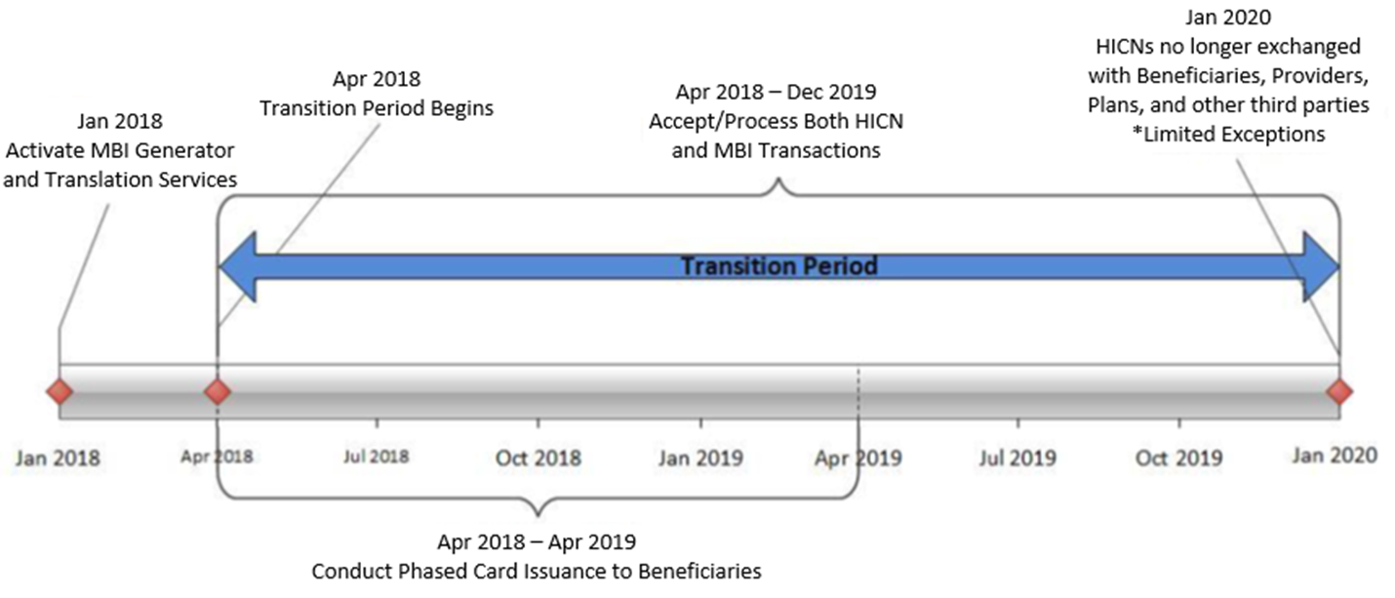
MBI Generation and Transition Period

Slide 10
SSNRI Transition Period
The transition period will run from April 2018 through December 31, 2019
CMS will complete its system and process updates to be ready to accept
and return the MBI on April 1, 2018
All stakeholders who submit or receive transactions containing the HICN must modify their processes and systems to be ready to submit or exchange the MBI by April 1, 2018. Stakeholders may submit either the MBI or HICN during the transition period
CMS will accept, use for processing, and return to stakeholders either the
MBI or HICN, whichever is submitted on the claim, during the transition period
CMS will actively monitor the transition and adjustment to the new MBIs to ensure adoption so Medicare operations aren’t interrupted and that everyone is ready to use only MBIs by January 2020

Slide 11
SSNRI Transition Period
Beginning October 2018 through the end of the transition period, when a valid and active HICN is submitted on Medicare fee-for-service claims both the HICN and the MBI will be returned on the remittance advice
The MBI will be in the same place you currently get the “changed HICN”: 835 Loop 2100, Segment NM1 (Corrected Patient/Insured Name), Field NM109 (Identification Code)
Use of HICN and MBI for the same patient on the same batch of claims
During the transition period, we’ll process all claims with either the HICN or MBI, even when both are in the same batch
Medicaid and supplemental insurers
We will give State Medicaid Agencies and supplemental insurers the MBIs for Medicaid-eligible people who also have Medicare before we mail the new Medicare cards. During the transition period, we’ll process and transmit Medicare crossover claims with either the HICN or MBI

Slide 12
SSNRI Transition Period
Railroad Retirement Board (RRB) beneficiaries
We’ll return a message on the eligibility transaction response for an RRB beneficiary. The RRB will continue to send cards with the RRB logo, but you can’t tell from looking at the MBI if beneficiaries are eligible for Medicare because they’re railroad retirees
Medicare Providers must program their systems to identify RRB beneficiaries so they know to send those claims to the Specialty Medicare Administrative Contractor (SMAC)
Private payers
For non-Medicare business, private payers won’t have to use the MBI. We’ll continue to use supplemental insurer’s unique numbers to identify customers, but after the transition period, supplemental insurers must use the MBI for any Medicare transactions where they would have used the HICN

Slide 13
SSNRI Transition Period
In addition, CMS is working to develop capabilities where providers will be able to access a beneficiary’s MBI through a secure look up tool at the point of service
In instances in which a beneficiary does not have a new Medicare card at a provider’s office, we believe this look up tool will give providers a mechanism to access a beneficiary’s MBI securely without disrupting workflow
CMS is making systems changes so that when a provider checks a beneficiary’s eligibility, the CMS HIPAA Eligibility Transaction System (HETS) will return a message on the response indicating that CMS mailed that particular beneficiary’s new Medicare card

Slide 14
SSNRI Exceptions After the Transition Period
Once the transition period is over, you’ll still be able to use the HICN in these situations:
Plans:
Appeals
Appeal requests and related forms will be accepted with either a HICN or MBI
Adjustments
HICN can be used indefinitely for certain systems (i.e., Drug Data Processing System, Risk Adjustment Processing system and Encounter data system) for all records, not limited to adjustments

Slide 15
SSNRI Exceptions After the Transition Period (cont.)
Claims and Other types of Exceptions:
Incoming Information Requests (i.e., inquiries, Medicare Secondary Payer information requests, Requests for Medical Documentation)
Incoming Premium Payments (i.e., Part A premiums, Part B premiums, Part D income related monthly adjustment amounts)
Span-date claims (FFS)
11X-Inpatient Hospital, 32X-Home Health and 41X-Religious Non-Medical Health Care Institution claims with a “From Date” prior to the end of the transition period (12/31/19)
Reports (FFS)
Incoming Reports to CMS* (i.e., Quality reporting, Disproportionate Hospital data requests)
Outgoing Reports from CMS (i.e., Provider Statistical and Reimbursement Report, Accountable Care Organization Reports)
*Note: We will use the HICN on these reports until further notice

Slide 16
SSNRI Card Issuance
CMS will begin mailing new cards in April 2018 and will meet the congressional deadline for replacing all Medicare cards by April 2019
The gender and signature line will be removed from the new Medicare cards
The Railroad Retirement Board will issue their new cards to RRB
beneficiaries
We will work with states that currently include the HICN on Medicaid cards
to remove the Medicare ID or replace it with an MBI
CMS will conduct intensive education and outreach to all Medicare beneficiaries, their families, caregivers, and advocates to help prepare for this change

Slide 17
Outreach and Education
CMS will provide outreach and education to:
Approximately 60 million beneficiaries, their families, advocacy groups, and caregivers
Health Plans
The provider community (1.5M providers)
States and Territories
Other business partners, including vendors
CMS will involve all business partners in our outreach and education efforts through their existing vehicles for communication (e.g., Open Door Forums, HPMS notices, MLN Connects)

Slide 18
Beneficiary Outreach and Education
Beneficiaries will get information about the new card in the 2018 Medicare & You handbook they will receive this October
Once they receive their new cards, beneficiaries will be instructed to safely and securely destroy their old Medicare cards and keep the new MBI confidential
A robust, broad-based outreach and education campaign aimed at beneficiaries will begin with the mailing of the Medicare handbook in September 2017 and continue through April 2019
CMS is also working to develop a secure way for beneficiaries to be able to access their MBIs when needed

Slide 19
What You Need to Know to Get Ready for the New MBI
Subscribe to the weekly MLN Connects newsletter for updates and new information
Verify your patients’ addresses:
If the address you have on file is different than the address you get in electronic eligibility transaction responses, ask your patients to contact Social Security and update their Medicare records.
This may require coordination between your billing and office staff
Get ready to use the new MBI Format:
Ask your billing and office staff if your system can accept the 11 digit alpha numeric MBI
If you use vendors to bill Medicare, ask them about their MBI practice management system changes and make sure they are ready for the change

Slide 20
Medicare Beneficiary Identifier (MBI) Implementation Milestones
2016-2017
2018-2020
March 2016 – Launch Phase I SSNRI Web Content on cms.gov
March to August 2016 – Conduct listening Sessions with External Stakeholders
August 2016 – Launch Phase II SSNRI Web Content on cms.gov
September 2016 – MBI Generator in Testing Environment
May 2017 – MBI Development Complete
September 2017 – Medicare &You Handbook mailed with information about New Medicare Card, beginning robust beneficiary education and outreach
April 2018 – All Systems & Processes able to Accept MBI
April 2018 – Begin Distributing Medicare Cards with MBI to 60M beneficiaries
October 2018 - MBI To Be Returned on the Remittance Advice
October 2018 – Expected Launch of Provider Look-Up Tool
April 16, 2019 – Statutory deadline for Issuance of New Medicare Cards
January 2020 – HICN No Longer Exchanged, with Limited Exceptions

Slide 21
Final Thoughts
Thank you for participating in this discussion today, to learn more about SSNRI you can:
Participate in our Open Door Forums. We will let you know when calls are scheduled in MLN Connects
Check our SSNRI website for other information:
http://go.cms.gov/ssnri
Please access HPMS for technical information related to Plans
Please submit any additional comments or questions to the SSNRI team mailbox at: SSNRemoval@cms.hhs.gov

