Slide 1
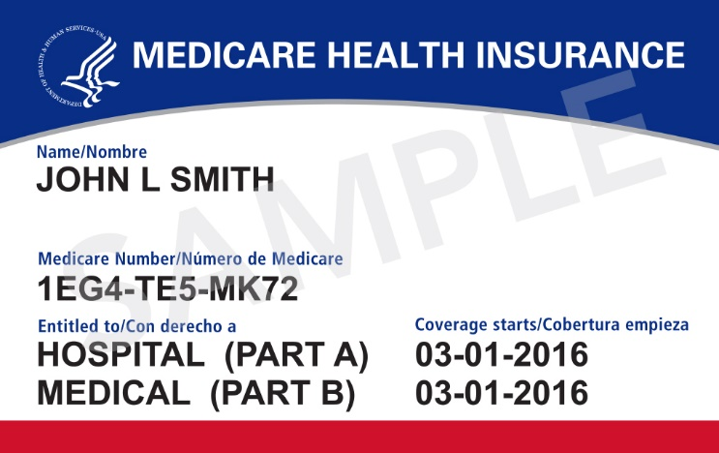
New Medicare Card
Information for Partners & Stakeholders
April 2018

Slide 2
Communications & Outreach Approach
Raise awareness that new cards are coming and direct people to Medicare.gov/NewCard to find out when cards are coming to their area.
Communicate core messages:
New cards protect your identity by removing social security numbers.
New cards have a unique number that is unique to you.
Your new Medicare card will automatically come to you – you don’t need to do anything.
Tiered levels of personalized communications
Audiences: People with Medicare, Caregivers, Stakeholders

Slide 3
New Medicare Card Mailing
Wave | States Included | Cards Mailing
Newly Eligible People with Medicare | All – Nationwide | April 2018 - Ongoing
1 | Delaware, District of Columbia, Maryland, Pennsylvania, Virginia, West Virginia | Beginning May 2018
2 | Alaska, American Samoa, California, Guam, Hawaii, Northern Mariana Islands, Oregon | Beginning May 2018
3 | Arkansas, Illinois, Indiana, Iowa, Kansas, Minnesota, Nebraska, North Dakota, Oklahoma, South Dakota, Wisconsin | After June 2018
4 | Connecticut, Maine, Massachusetts, New Hampshire, New Jersey, New York, Rhode Island, Vermont | After June 2018
5 | Alabama, Florida, Georgia, North Carolina, South Carolina | After June 2018
6 | Arizona, Colorado, Idaho, Montana, Nevada, New Mexico, Texas, Utah, Washington, Wyoming | After June 2018
7 | Kentucky, Louisiana, Michigan, Mississippi, Missouri, Ohio, Puerto Rico, Tennessee, Virgin Islands | After June 2018

Slide 4
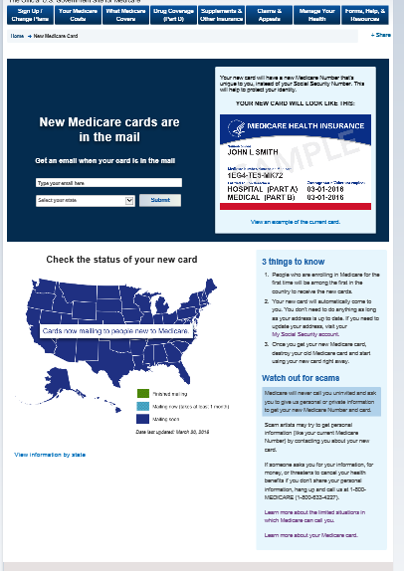
Medicare.gov/NewCard

Slide 5
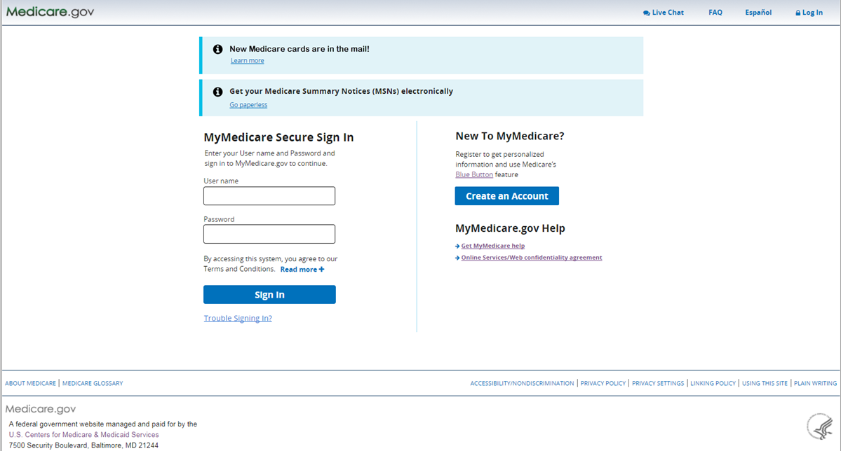
MyMedicare.gov Login page – Regular User

Slide 6
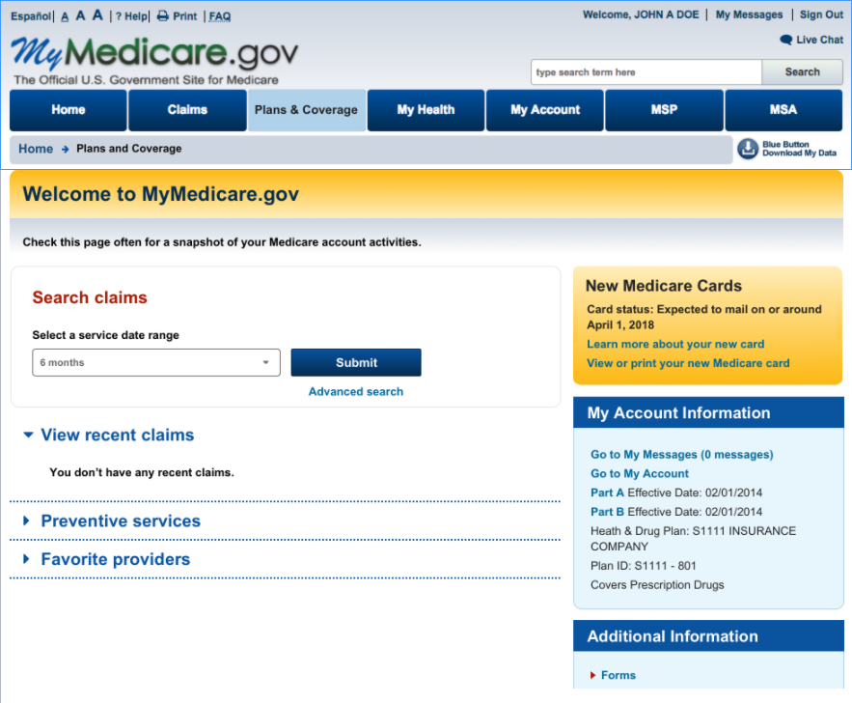
MyMedicare – Dashboard Page
Users see this page after logging in/creating an account.
The yellow “New Medicare Cards” widget will display for all users.
Card status message is dynamic based on whether their card has mailed yet:
“Your card has not yet mailed”
“Expected to mail on or around <date>”
“Learn more” links to the campaign page.
“View or print” link only displays for beneficiaries who have had their card mailed and have an MBI.

Slide 7
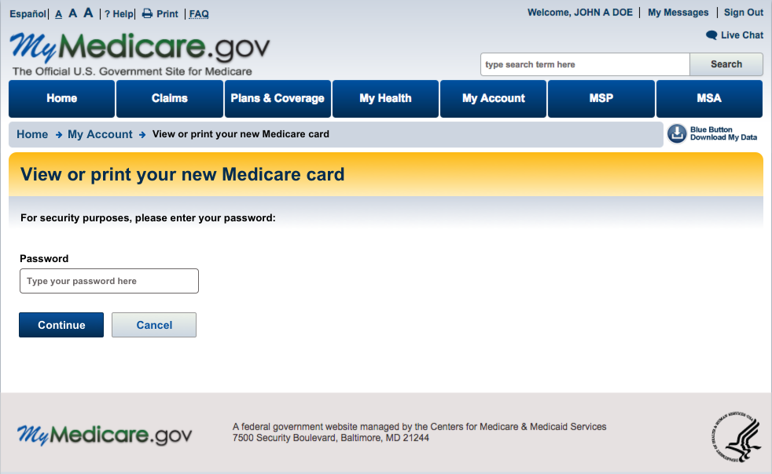
View or print your new Medicare card – enter password
Users are required to re-enter their MyMedicare.gov password to view or print their new card.

Slide 8
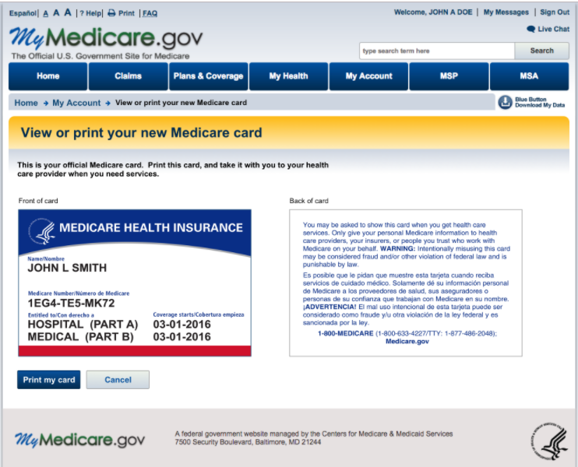
View or Print Card
Part A and Part B display logic:
If either date is not available or is terminated, the label and the date will not display (the line will be blank).
Selecting the “Print my card” button launches the print function in a browser.
Railroad Retirement Board (RRB) card will display for RRB beneficiaries.
This page was built to be mobile responsive so that it is available to view on smaller devices like cell phones.

Slide 9
Outreach & Education Materials on CMS.gov/NewCard
Order free copies of most materials at Productordering.cms.hhs.gov
Job aid for Partners
Includes key messages to communicate to people with Medicare
*Tear-off Pads for Provider Offices
For provider office staff to give to people with Medicare
Contain an image of the card and a reminder to make sure your mailing address is up to date with Social Security
*Small Posters for Provider Offices
Messaging similar to tear-off sheets
*Conference cards to hand out at events
To give to people with Medicare with similar messaging
*A "10 Things to Know About Your New Medicare Card" handout
Audio public service announcements script
To run in National pharmacy chains
Widgets
Partner focused with link to CMS.gov/newcard
*Available in English, Spanish, Arabic, Burmese, Chinese, Gujarati, Haitian-Creole, Hmong, Japanese, Korean, Nepali, Polish, Russian, or Vietnamese

Slide 10
Earned & Paid Media
Begins with wave mailings:
Satellite Media Tours and Radio Media Tours (SMT/RMT) at launch of each wave
Ongoing pitching to broadcast, print and online outlets to continue the media coverage throughout the wave
PSA and matte release distribution
Amplify earned media tactics through limited geo-targeted paid advertising to coincide with mailing waves (radio, digital, local print)

