Slide 1
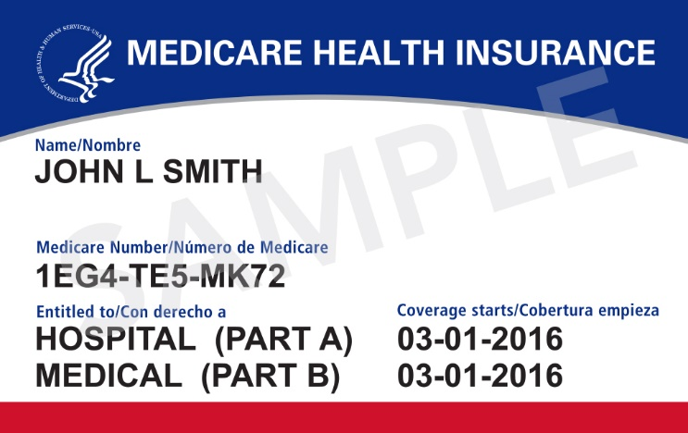
New Medicare Card
Information for Partners & Stakeholders
January 2018

Slide 2
Background
The Health Insurance Claim Number (HICN) is a Medicare beneficiary’s identification number, used for processing claims and determining eligibility for services across multiple entities (e.g., Social Security Administration (SSA), Railroad Retirement Board (RRB), States, Medicare providers & health plans)
The Medicare Access and CHIP Reauthorization Act (MACRA) of 2015 requires removal of the Social Security Number (SSN)-based HICN from Medicare cards to address current risk of beneficiary medical identity theft
MACRA requires that CMS mail out new Medicare cards with a new Medicare Number by April 2019
The new Medicare numbers won’t change Medicare benefits. People with Medicare can start using their new Medicare cards right away.

Slide 3
New Unique Medicare Number
New Medicare Number
  New Non-Intelligent Unique Identifier
  11 bytes
  Key positions 2, 5, 8 & 9
  will always be alphabetic

Slide 4
New Medicare Card Survey Findings: Oct 2017
There was a three-fold increase in awareness of the new Medicare card between first survey completed Aug 2017 (11%) and second completed Oct 2017 (36%)
  Most who have heard about the new Medicare card (69%) heard about it on television
  Among those who have heard about it, about half (52%) have heard that Social Security Numbers are being removed
Receipt of the Medicare & You 2018 handbook and awareness of the CMS Fraud television ad were associated with increases in awareness of the new Medicare card
  Almost half of those who received the new Handbook (47%) were aware of the new card, compared to less than one-third (31%) of those who hadn’t received the Handbook
  The vast majority (79%) of those who saw the fraud ad were aware of the new card, compared to only about one-third (36%) of those who hadn’t seen the ad
Overall positivity toward removal of Social Security Numbers increased from
first survey (88%) to second survey (92%)
When asked about specific potential concerns, greatest concerns continue to be:
  Potential cost of replacing all cards (56%)
  Potential inability to find lost Medicare numbers (40%)
There is still room for education about specifics about the new card, including when new cards will be mailed
Notes:
National survey conducted by telephone and online in October 2017 with a total of 612 current Medicare beneficiaries.
Purpose: examine awareness and expectations about the new Medicare card project

Slide 5
More New Medicare Card Surveys
January 2018: Survey measured understanding of the initiative and message awareness levels prior to increased national and regional outreach efforts supporting the new card mailing.
End of March – beginning of May: Survey will focus on the start of the card mailing and will have a national comparison group.
End of May – beginning of July: Survey will focus on the continued card mailing and will have a national comparison group.

Slide 6
Sending New Medicare Cards
Medicare starts mailing new cards in April 2018
  Newly-eligible beneficiaries will get a card with a unique number, regardless of where they live
  Existing beneficiaries will get a new card over a period of approximately 12 months
  Distribution of cards will be randomized by geographic location
Starting in April, people with Medicare will be able to go to Medicare.gov/newcard to sign up for emails about the card mailing and to check the card mailing status in their state
People with Medicare should use the new card once they get it, but either the SSN-based or the new random alphanumeric-based numbers can be used through December 2019
Beginning January 1, 2020 only the new card will be usable
Notes:
Beginning April 2018, Medicare cards with Social Security Numbers will stop.
Once the art switches formally in April 2018, all cards produced will be the new card with the random number
New beneficiaries will get a card with the random number, regardless of where they live
Existing beneficiaries will get a new card over a period of approximately 12 months
Medicare cards will be mailed by the U.S. Post Office via first class mail
A beneficiary who doesn’t get their new card by April 2019, should check their address of record at the Social Security Administration to make sure their address is up to date
Beneficiaries can also obtain a benefit verification notice, which will include the new Medicare number, by visiting their MySocialSecurity.gov account.
Either the SSN-based or the new random number-based cards can be used through December 2019
Beneficiaries can use either number to get services in Original Medicare or to enroll in a Medicare health or drug plan
Beginning January 1, 2020 only the new card will be usable

Slide 7
New Medicare Card Mailing
Wave | States Included | Cards Mailing
1 | Delaware, District of Columbia, Maryland, Pennsylvania, Virginia, West Virginia | April – June 2018
2 | Alaska, American Samoa, California, Guam, Hawaii, Northern Mariana Islands, Oregon | April – June 2018
3 | Arkansas, Illinois, Indiana, Iowa, Kansas, Minnesota, Nebraska, North Dakota, Oklahoma, South Dakota, Wisconsin | After June 2018
4 | Connecticut, Maine, Massachusetts, New Hampshire, New Jersey, New York, Rhode Island, Vermont | After June 2018
5 | Alabama, Florida, Georgia, North Carolina, South Carolina | After June 2018
6 | Arizona, Colorado, Idaho, Montana, Nevada, New Mexico, Texas, Utah, Washington, Wyoming | After June 2018
7 | Kentucky, Louisiana, Michigan, Mississippi, Missouri, Ohio, Puerto Rico, Tennessee, Virgin Islands | After June 2018

Slide 8
New Medicare Card Mailing (continued)
The following slides show what will be included in the mailing:
The envelope
The insert with the new card
A letter with instructions in English, with Spanish on the back
Taglines about how to get help in these other languages: Arabic, Armenian, Chinese, Farsi, French, German, Haitian Creole, Italian, Japanese, Korean, Polish, Portuguese, Russian, Tagalog, and Vietnamese

Slide 9
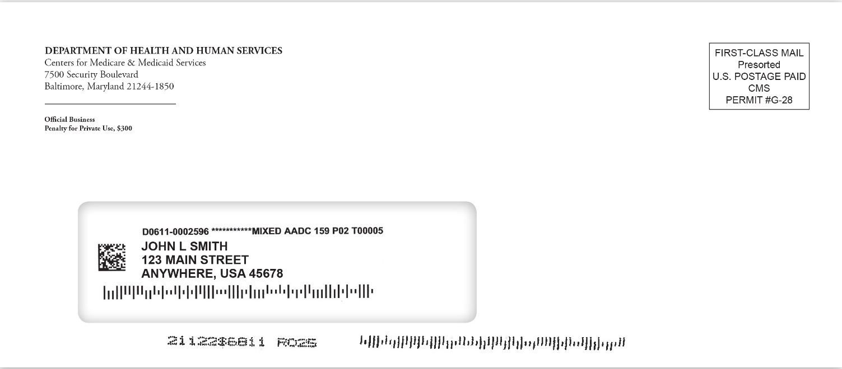
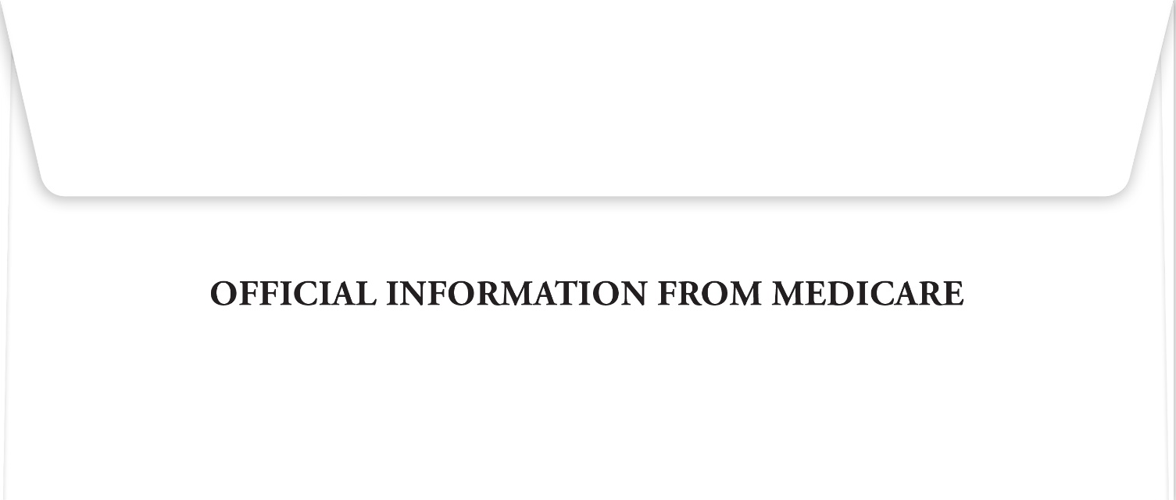
New Medicare Card Mailing - Envelope
front
back

Slide 10
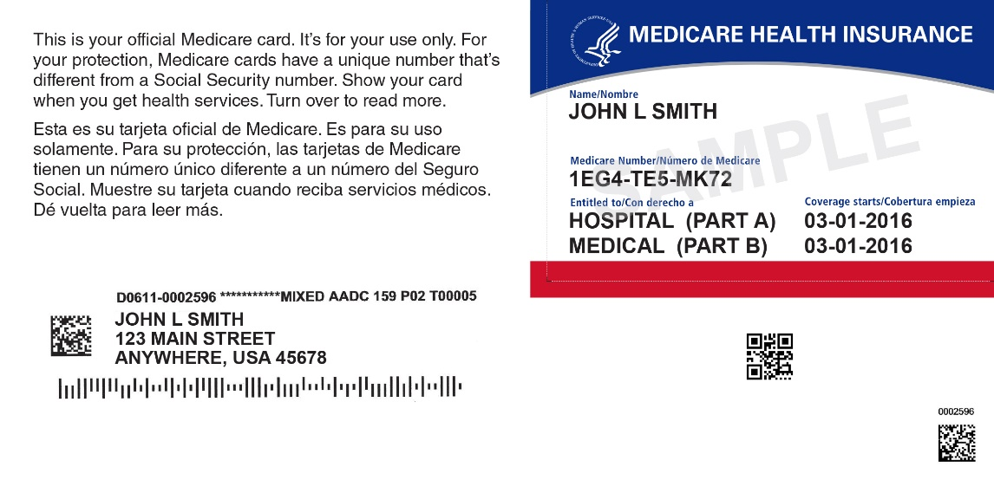
New Medicare Card Mailing - Insert
Notes:
The card is perforated.
Text on the back
Back of card : You may be asked to show this card when you get health care services. Only give your personal Medicare information to health care providers, your insurers, or people you trust who work with Medicare on your behalf. WARNING: Intentionally misusing this card may be considered fraud and/or other violation of federal law and is punishable by law. 1-800-MEDICARE (1-800-633-4227)/TTY: 1-877-486-2048); Medicare.gov
Back surrounding the card: Don’t have Part B? In most cases, if you don’t sign up for Medicare Part B (Medical Insurance) when you’re first eligible, you’ll have to pay a late enrollment penalty for as long as you have Part B. Also, you may have to wait until the Medicare General Enrollment Period (January 1 – March 31) to enroll in Part B and coverage will begin July 1 of that year.
¿No tiene la Parte B? En la mayoría de los casos, si no se inscribe en la Parte B de Medicare (Seguro Médico) cuando es elegible por primera vez, tendrá que pagar una multa por inscripción tardía mientras tenga la Parte B. Además, puede tener que esperar hasta el Período General de Inscripción de Medicare (1 de enero – 31 de marzo) para inscribirse en la Parte B y la cobertura comenzará el 1 de julio de ese año.
More information/Más información: Medicare.gov; 1-800-MEDICARE (1-800-633-4227/TTY: 1-877-486-2048); Medicare & You Handbook/Manual de Medicare y Usted.
如果您，或是您正在協助的個人，有關於聯邦醫療保險的問題，您有權免費 以您的母語，獲得幫助和訊息。與翻譯員交談，請致電 1-800-MEDICARE
(1-800-633-4227).

Slide 11
New Medicare Card Mailing - Letter
front
back

Slide 12
New Medicare Card Mailing – Help in Other Languages
front
back

Slide 13
New Medicare Card Mailing in Alternate Formats
There will be specialized communications for those with alternative format needs. These formats include large print, Braille, audio and data cd.
People with Medicare with alternate format preferences will receive:
  The letter in regular print and in their alternate format of choice.
  The information about getting help in other languages in their alternate format of choice.
  The insert with the new card in regular print.
  A different letter containing the information on the new card insert (i.e., the part of the insert left over after you remove the new card) in their alternate format of choice.
People with a Braille preference will also receive a tactile sticker that they can stick to their new card, and instructions for how/where to do so.
People with alternate format preferences will be mailed their new cards and letters following the same schedule as those with no preference.
Notes:
Includes existing beneficiaries with alternate format preferences in the Medicare enrollment database. As long as the beneficiary’s preference has been changed in the EDB by a week before a mail file is run, the beneficiary will get the alternate format package.
To change their alternate format preference, beneficiaries can
Call 1-800-MEDICARE
Call 1-844-ALT-FORM (1-844-258-3676). TTY: 1-844-716-3676.
Send a fax to 1-844-530-3676.
Send an email to altformatrequest@cms.hhs.gov.
Send a letter to:
Centers for Medicare & Medicaid Services
Offices of Hearings and Inquiries (OHI)
7500 Security Boulevard, Mail Stop S1-13-25
Baltimore, MD 21244-1850
Attn: Customer Accessibility Resource Staff

Slide 14
Replacement Cards and Numbers
People with Medicare should still make sure their current address is correct with the Social Security Administration NOW, as needed
People who lose their Medicare card will continue to be able to get a replacement (duplicate) card
People who believe they are victims of identity theft or Medicare fraud will be able to get a different new Medicare number by contacting 1-800-MEDICARE
Notes:
Beneficiaries should make sure their address is correct in Social Security’s files
CMS mails cards based on the address of record at SSA
Can check address and make updates to it via MySocialSecurity.gov – this is the fastest way to check and make changes
Can call SSA’s toll-free helpline or visit a local office.
Beneficiaries who lose their card (or their card gets destroyed – torn, worn out) will continue to be able to get a replacement (duplicate) cards by visiting Medicare.gov, calling 1-800 Medicare, visiting MySocialSecurity.gov or calling SSA’s toll-free helpline.
Once their card is mailed, someone with Medicare can also access their new Medicare Number on a Medicare Summary Notice or through MyMedicare.gov
Don’t encourage beneficiaries to request replacement cards to get the new Medicare card quickly
We will be producing large volumes of cards as quickly as possible
Surges in replacement card requests will not be able to be delivered
The current card is usable until January 2020
Beneficiaries who believe their new, random Medicare number has been compromised (e.g., stolen, victim of identity theft, Medicare fraud) will be able to get a new MBI number by contacting 1-800-Medicare
All Medicare numbers are random and no requests for specific number can be granted

Slide 15
Your Guide for Outreach
  January – October 2018
    National Outreach with drumbeat messaging, changing over time
    Dial up the outreach and messaging! Card mailing moves to forefront of messaging for people with Medicare through all communications channels.
      January 23 to Mid-March:
        Messaging about mailing address accuracy and protection from fraudsters
      Mid-March – October:
        Intensive earned media and local outreach kicks off, coordinated with card mailing
        Messaging about when to expect new cards, what to do with old (and new) cards, and what to do if you don’t receive a card or need help

Slide 16
Your Guide for Outreach (continued)
Specific messaging for people with Medicare
January to Mid-March
New Medicare cards with new Medicare Numbers are coming, starting in April 2018
Make sure the Social Security Administration has your current mailing address
Beware of scam artists contacting you about your new card
Mid-March to October
MAILING BEGINS APRIL 1!
Find out when your card is mailed by visiting Medicare.gov and signing up for email
What to do if you don’t get your card
Destroy your old card (shred)
Once your card has been mailed, you can look up your Medicare Number or print a card on MyMedicare.gov

Slide 17
Your Guide for Outreach Overview
2018 | Mid-January | February |  | March | April
Products | Print ad for local distribution Medicare.gov blog, widget, fact sheet Video: informational for beneficiaries Audio PSA for major pharmacy chains Poster in post offices MSN message |  |  | Videos: Animated “destroy” for beneficiaries, video in provider waiting rooms New poster in post offices
Medicare.gov | Post blog, add Medicare card message to homepage Promote go.medicare.gov/newcard and new beneficiary widget available on CMS.gov/newcard |  |  | Prominently feature new card image Launch Medicare Number look up and replacement card features in MyMedicare.gov Launch mailing status page
Call Center | Continue queue messages updated after Medicare Open Enrollment |  | Update scripts & queue messages | Deploy updated scripts with card mailing
National Press |  |  |  | Announce “new cards start mailing” with key mailing details
Digital, Paid & Earned Media | Begin weekly Facebook and Twitter posts Email sends Social media toolkit for partners |  |  | Begin geo-targeted digital media in concert with mailing Paid search ads send beneficiaries to Medicare.gov
Regional Outreach & Partnerships | Distribute messaging, updates, and materials through local partners Use listserv, phone calls, webinars, conferences, First Friday events Continue to develop/identify new partners for beneficiary outreach |  |  | Use press kit for local distribution Issue local press release with mailing Share print ads with local and regional media and information intermediaries Participate in call-in shows Host senior events

Slide 18
Outreach & Education Materials on CMS.gov/newcard
Materials for people with Medicare
  One-Page Flyer
    Stand-alone reprint handout of Medicare & You inside cover page
    Available in English, Spanish, Korean, Chinese, Japanese, or Vietnamese
  Fact Sheet
    Information addressing common things to know about the new card
  Widgets
    With link to go.medicare.gov/newcard
Informational Video
    Animated video about the new card and what to expect
Notes:
Most products are also available to order free copies at Productordering.cms.hhs.gov.

Slide 19
Outreach & Education Materials on CMS.gov/newcard
  Partner materials
  Job aid for Partners
  Includes key messages to communicate to people with Medicare
  *Tear-off Pads for Provider Offices
  For provider office staff to give to people with Medicare
  Contain an image of the card and a reminder to make sure your mailing address is up to date with Social Security
  *Small Posters for Provider Offices
  Messaging similar to tear-off sheets
    *Conference cards to hand out at events
    To give to people with Medicare with similar messaging
  Audio public service announcements script
  To run in National pharmacy chains
  Widgets
  Partner focused with link to CMS.gov/newcard
    *Available in English, Spanish, Korean, Chinese, Japanese, and Vietnamese
Notes:
Most products are also available to order free copies at Productordering.cms.hhs.gov.

Slide 20
Medicare & You page/Flyer
Outreach & Education Materials - Fact Sheet

Slide 21
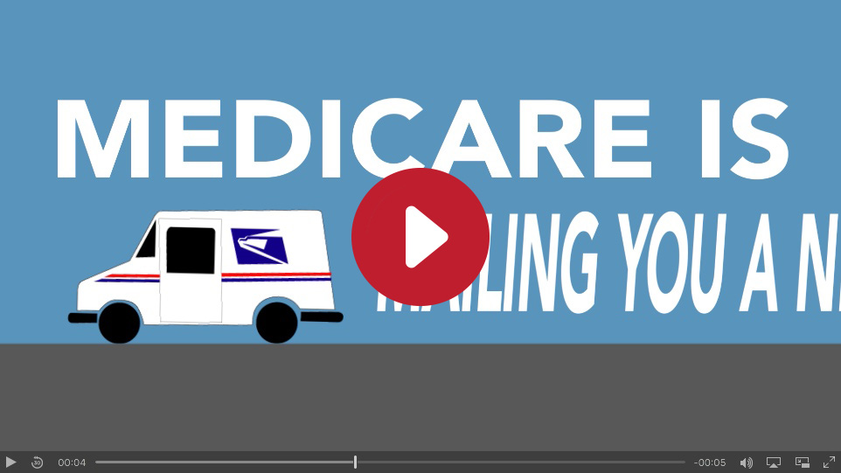
Medicare & You page/Flyer
Outreach & Education Materials - Video
https://youtu.be/DusRmgzQnLY

Slide 22
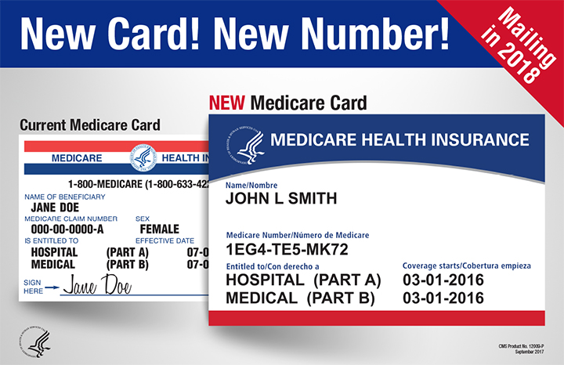
Tear-off for provider offices
Outreach & Education Materials - Poster

Slide 23
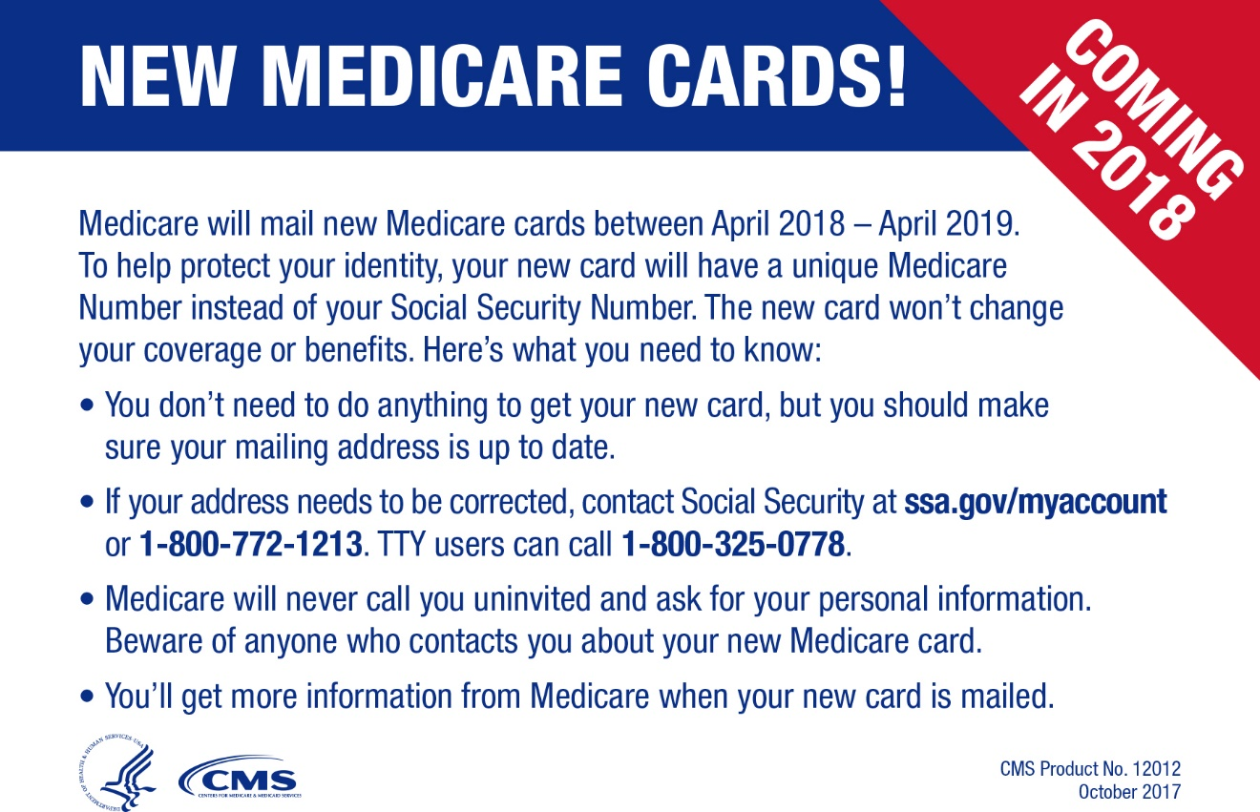
Outreach & Education Materials - Conference Card

Slide 24
Stay Connected
Find more technical information, detailed updates, training opportunities, and materials to share on the web:
CMS.gov/newcard
Comments and questions are always welcome! Send to: NewMedicareCardSSNRemoval@cms.hhs.gov
Information for people with Medicare:
go.medicare.gov/newcard

