Slide 1
Social Security Number Removal Initiative (SSNRI)
CMS Open Door Forum
11/1/16

Slide 2
Background
The Centers for Medicare & Medicaid Services (CMS) uses the HICN with multiple parties, such as Social Security Administration (SSA), Railroad Retirement Board (RRB), States, Medicare providers, Medicare plans, etc.
The Medicare Access and CHIP Reauthorization Act (MACRA) of 2015 mandates the removal of the SSN-based HICN from Medicare cards to address current risk of beneficiary medical identity theft
Per the legislative requirement, CMS must mail out all Medicare cards with the new Medicare Beneficiary Identifier (MBI) by April 2019

Slide 3
SSNRI Program Goals
Primary goal: To decrease Medicare beneficiaries’ vulnerability to identity theft by removing the SSN-based HICN from their Medicare id cards and replacing the HICN with a new Medicare Beneficiary Identifier (MBI), which does not contain an SSN or other personal information
In achieving this goal CMS seeks to:
  Minimize disruption to Medicare operations
  Minimize burdens for providers
  Minimize burdens for beneficiaries
  Provide a solution to our business partners that allows usage of HICN and/or MBI for business critical data exchanges
  Manage the cost, scope, and schedule for the project

Slide 4
Complex IT Systems that affect Providers,
Partners, and Beneficiaries
  A thoughtful, planned roll-out of the SSNRI is necessary for a successful implementation
  Along with our partners, CMS will address complex systems changes for over 75 systems, conduct extensive outreach & education activities and analyze the many changes that will be needed to systems and business processes
Affected stakeholders include:
  Federal partners, States, Beneficiaries, Providers, and Plans
  Other key stakeholders, such as billing agencies, advocacy groups, data warehouses, etc.

Slide 5
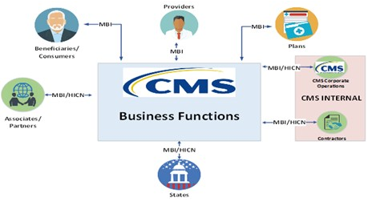
SSNRI Stakeholders
    CMS has identified approximately 90 different stakeholder entities or groups that are impacted by SSNRI, (i.e. currently receive, store, use, and/or provide a HICN today)

Slide 6
Implementation of SSNRI

Slide 7
MBI Solution Concept
The solution for SSNRI must provide capabilities to accomplish the following:
  Generate MBIs for all beneficiaries: Includes existing (currently active and deceased or archived) and new beneficiaries
  Issue new, redesigned Medicare cards: New cards containing the MBI to existing and new beneficiaries
  Modify systems and business processes: Required updates to accommodate receipt, transmission, display, and processing of the MBI
  CMS will use an MBI generator to:
  Assign 150 million MBI’s in the initial enumeration (60 million active and 90 million decease/archived) and generate a unique MBI for each new Medicare beneficiary
  Generate a new unique MBI for a Medicare beneficiary whose identity has been compromised

Slide 8
MBI Characteristics
The Medicare Beneficiary Identifier will have the following characteristics:
      The same number of characters as the current HICN (11), but will be visibly distinguishable from the HICN
      Contain uppercase alphabetic and numeric characters throughout the 11 digit identifier
      Occupy the same field as the HICN on transactions
      Be unique to each beneficiary (e.g. husband and wife will have their own MBI)
      Be easy to read and limit the possibility of letters being interpreted as numbers (e.g. Alphabetic characters are upper case only and will exclude S, L, O, I, B, Z)
      Not contain any embedded intelligence or special characters
      Not contain inappropriate combinations of numbers or strings that may be offensive
    Presently, CMS does not anticipate that the MBI will be changed for an individual unless the MBI is compromised or for other reasons that are still under consideration (e.g. religious reasons)

Slide 9
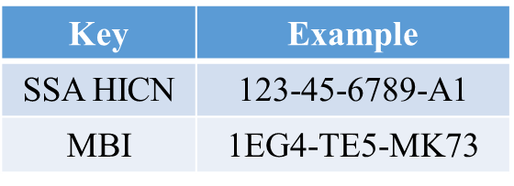
HICN and MBI Number
Health Insurance Claim Number (HICN)
Primary Beneficiary Account Holder Social Security Number (SSN) plus Beneficiary Identification Code (BIC)
9-byte SSN plus 1 or 2-byte BIC
Key positions 1-9 are numeric
Medicare Beneficiary Identifier (MBI)
New Non-Intelligent Unique Identifier
11 bytes
Key positions 2, 5, 8, and 9 will always be alphabetic
Note: Identifiers are fictitious and dashes for display purposes only; they are not stored in the database nor used in file formats

Slide 10
MBI Format
Pos. | 1 | 2 | 3 | 4 | 5 | 6 | 7 | 8 | 9 | 10 | 11
Type | C | A | AN | N | A | AN | N | A | A | N | N
Where:
C – Numeric 1 thru 9
A – Alphabetic Character (A...Z); Excluding (S, L, O, I, B, Z)
N – Numeric 0 thru 9
AN – Either A or N
***NOTE: Alphabetic characters are Upper Case ONLY
Position 1 – numeric values 1 thru 9
Position 2 – alphabetic values A thru Z (minus S, L, O, I, B, Z)
Position 3 – alpha-numeric values 0 thru 9 and A thru Z
(minus S, L, O, I, B, Z)
Position 4 – numeric values 0 thru 9
Position 5 – alphabetic values A thru Z (minus S, L, O, I, B, Z)
Position 6 – alpha-numeric values 0 thru 9 and A thru Z
(minus S, L, O, I, B, Z)
Position 7 – numeric values 0 thru 9
Position 8 – alphabetic values A thru Z (minus S, L, O, I, B, Z)
Position 9 – alphabetic values A thru Z (minus S, L, O, I, B, Z)
Position 10 – numeric values 0 thru 9
Position 11 – numeric values 0 thru 9

Slide 11
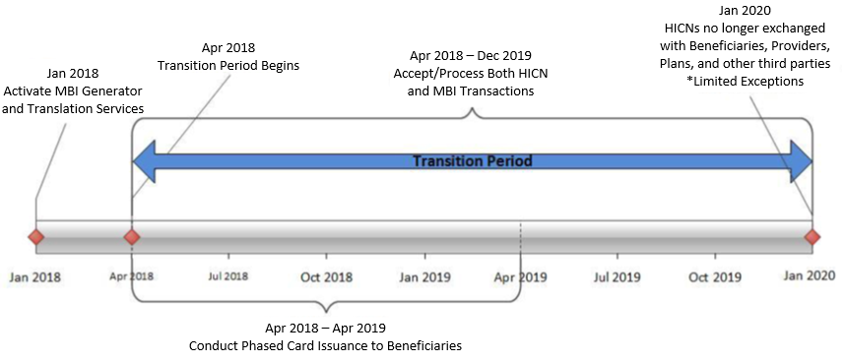
MBI Generation and
Transition Period

Slide 12
SSNRI Transition Period
CMS established a transition period during which the HICN or MBI will be accepted from providers, beneficiaries, plans, and other external stakeholders
CMS expects the transition period to run from April 2018 through December 31, 2019
CMS’ processes and systems will be updated to accept and return the MBI as of April 1, 2018. CMS will accept, use for processing, and return to stakeholders either the MBI or the HICN during the transition period
All stakeholders who submit or receive transactions containing the HICN must modify their processes and systems to submit or exchange the MBI as of April 1, 2018. Stakeholders may submit either the MBI or HICN during the transition period

Slide 13
SSNRI Transition Period
CMS will tell you in the message field on the eligibility transaction responses when we’ve mailed a new Medicare card to each person with Medicare. Your eligibility service provider can give you this information
During the transition period, CMS will return the same beneficiary identifier to you that you submitted on the incoming transaction. Also during the transition period, we’ll return the MBI on the remittance advice starting October 2018 when you submit a claim using your patient’s HICN
After the transition period, affected systems interacting with stakeholders will only use the MBI for most information exchanges
There may be limited exceptions for use of the HICN after transition; (i.e. appeals, adjustments or other scenarios)

Slide 14
SSNRI
Transition Period
What do I need to do?
No earlier than April 2018, CMS will start mailing new Medicare cards with MBIs to people with Medicare. Providers can ask Medicare patients at the time of service if they have a new card with an MBI, or during the transition period, we’ll return the MBI on the remittance advice starting October 2018 when you submit a claim using your patient’s HICN.
When and how do providers use MBIs?
Once patients get their new Medicare cards & MBIs, we encourage you to start using the MBIs as soon as possible, but we’ll continue to accept the HICN through the transition period. We’ll accept either the MBI or the HICN interchangeably during this transition period
Once we start mailing out new Medicare cards, people new to Medicare will only be assigned an MBI. Your systems must be ready to accept the MBI by April 2018

Slide 15
SSNRI Card Issuance
CMS will start issuing new Medicare cards for existing beneficiaries after the initial enumeration of MBIs; roughly 60 million beneficiaries
We will be removing the gender and signature line from the new Medicare cards
We will be working in conjunction with the Railroad Retirement Board who will also issue their own cards
We will be working with states that include the HICN on their Medicaid cards to effectuate a change to remove the Medicare ID or replace it with a MBI
CMS will be conducting intensive education and outreach to our beneficiaries and their agents to help them prepare for this change

Slide 16
Outreach and Education
CMS will provide outreach and education to:
    The provider community (1.5M providers)
    Approximately 60 million beneficiaries, their agents, advocacy groups and caregivers
    States and Territories
    Key stakeholders, vendors & other partners
CMS will ensure that we involve our stakeholder communities in our outreach and education efforts through their existing vehicles for communication

Slide 17
Questions and Discussion

Slide 18
Questions to Consider
Patient
Interactions
How often does a patient not have their Medicare card OR does not know their HICN?
Current Operational Processes
When do you ask for the Medicare card and what do you use Medicare card and HICN for?
How have you handled mass patient identification changes with other insurers?
How do you currently handle Health Insurance Claim Number (HICN) and name changes?
Who do you exchange the HICN with?
What transactions do you use the HICN on?
What do you do when the patient does not have their Medicare card OR does not know their HICN?
What is the impact on the patient who needs service immediately and for whom you don’t have an MBI?
What would you do if a patient has their MBI from a prior visit but not for the current visit?
Do your patients usually bring their health insurance cards with them (Medicare or other patients)?
If the patient is unable to provide you with a MBI, what will you do to ensure they can get the services they need at that visit?
Where do you store the HICN?
What is the percentage of beneficiaries that will be denied services if you cannot obtain their MBI?
Without a HICN, what is the percentage of beneficiaries who are denied services?
IN THE FUTURE:

Slide 19
Questions to Consider
Implementation
What systems and business process impacts do you expect given the change from HICN to MBI?
How much time do you need to implement these changes?
Patient Communication
How do you suggest we communicate with patients about the new card and the associated changes?
How do you think this change will affect your patients?
What are some critical success factors or readiness factors for you?
What performance metrics will reflect a successful SSNRI Implementation?
What other systems issues/implementation are also occurring during the same timeframe?
How do we need to communicate information to you?
What outreach and training will you need to perform to be ready?

Slide 20
Final Thoughts
Thank you for participating in this discussion today
Additional information can be obtained from our SSNRI website using the link provided below:
  http://go.cms.gov/ssnri
Please submit any additional information to the SSNRI team mailbox to the link provided below:
  SSNRemoval@cms.hhs.gov

