Slide 1
Centers for Medicare & Medicaid Services Special Open Door Forum
Development of the CMS Quality Reporting Program for Inpatient Rehabilitation Facilities*
Tuesday, November 29, 2011
2:00–4:00 p.m. EST
*Patient Protection and Affordable Care Act, Section 3004(a)

Slide 2
CMS Web Sites
CMS has created a Web page with the following information:
Background, resources, and updates on the quality reporting program for IRFs, Long -Term Care Hospitals and Hospice programs
Downloads to transcripts to CMS Special Open Door Forums and Listening Sessions
For updates, visit the CMS Web site for Section 3004:
https://www.cms.gov/LTCH-IRF-Hospice-Quality-Reporting/
Also visit the Inpatient Rehabilitation PPS web site:
https://www.cms.gov/InpatientRehabFacPPS/LIRFF/list.asp
https://www.cms.gov/InpatientRehabFacPPS/downloads/IRFPAI_CMS-10036-DRAFT2.pdf

Slide 3
CMS E-mail
For automatic emails of Open Door Forum schedule updates (E-Mailing list subscriptions) and to view Frequently Asked Questions please visit our website at:
http://www.cms.hhs.gov/OpenDoorForums/

Slide 4
Affordable Care Act Section 3004 (a)
CMS to establish quality reporting program for inpatient rehabilitation facilities (IRFs):
Beginning on 10/01/2012, providers must submit data on selected quality measures.
Data collected from 10/01/12 to 12/31/12 will impact the payment determination for FY2014.
Thereafter, data will be collected on a CY basis (01/01 to 12/31), and will affect the payment determination for the FY following the data submission deadlines (Example- data collected in CY2013 will affect the FY2015 payment determination).

Slide 5
Affordable Care Act Section 3004 (a)
CMS to establish quality reporting program for inpatient rehabilitation facilities (IRFs) (continued):
Beginning with FY2014, noncompliance will result in 2% reduction in annual payment update (APU)
Selected measures affecting APU to be published by CMS no later than October 1, 2012
CMS directed to establish procedures (no date specified) to make data available to the public and allow providers to review data before publication

Slide 6
Considerations for Quality Measures
Is the Quality Measure an important indicator of:
better care for individuals that is patient-centered and well coordinated?
better health for populations?
lower cost through improvement?

Slide 7
Quality Measures Focus
High-priority, site-specific, and cross-setting quality measures
Valid, meaningful, reliable, and feasible to collect
Addresses avoidable adverse events, symptom management, patient preferences, and patient goals
Can be collected and generated from standardized data collection elements across settings

Slide 8
Additional Quality Measure Considerations
CMS’ goal is to build on existing measures that
are reliable and valid measures of structure, process, or outcomes of care;
are built on evidence-based measurement science; and
meet reasonable criteria for inclusion.

Slide 9
Stakeholder Engagement in the Quality Measure Development Process
Stakeholder participation is key to the development and implementation of the IRF Quality Reporting Program
CMS held IRF Technical Expert Panel (TEP) meetings, a Special Open Door Forum, and a Listening Session to engage stakeholders:
CMS Listening Session: November 15, 2010
Special Open Door Forum: December 16, 2010
IRF TEP meetings in 2011: February 4th and July 6–7, ongoing

Slide 10
Quality Measures for IRF Quality Reporting Program for FY 2014
In the Inpatient Rehabilitation Facility Prospective Payment System for Federal Fiscal Year 2012 final rule, published on August 5, 2011, CMS finalized two quality measures for IRFs that affect FY 2014 payment update:
Urinary catheter-associated urinary tract infections (CAUTIs)
Percentage of patients with pressure ulcers that are new or have worsened

Slide 11
Quality Measures for IRF Quality Reporting Program for FY 2014 (continued)
The following considerations were applied in selecting the two IRF quality measures for FY 2014:
Whether a measure is included in Quality Reporting Program for other settings
Whether a measure addresses HHS priorities and the National Quality Strategy
Whether a measure is evidence based

Slide 12
Quality Measures for IRF Quality Reporting Program for FY 2014 (continued)
Whether a measure would drive quality improvement within a facility
Whether a measure has low probability of causing unintended adverse consequences

Slide 13
Catheter-Associated Urinary Tract Infections (CAUTI)
Application of National Quality Forum (NQF)-endorsed measure developed by the Centers for Disease Control and Prevention (CDC) (NQF #0138): CAUTI rate per 1,000 urinary catheter days for intensive care unit (ICU) patients
Number of patients who acquired indwelling CAUTIs within a specified time frame
Data collection by CDC via the National Healthcare Safety Network (NHSN)

Slide 14
Catheter-Associated Urinary Tract Infections (CAUTI) (continued)
Metric revision submitted by CDC to NQF
Measure currently undergoing measure maintenance review by NQF for expansion to facility and location types beyond acute-care ICUs
Review may change how CDC calculates the aggregated data from using a rate for CAUTIs to the use of a standardized infection ratio (SIR)

Slide 15
CAUTI Standardized Infection Ratio
SIR of health care-associated CAUTIs in specified monitored location types and summarized across all monitored locations
SIR =
where the expected # of CAUTIs is calculated by multiplying the number of urinary catheter days by the mean NHSN aggregate CAUTI rate for that location type

Slide 16
CAUTI Standardized Infection Ratio (continued)
SIR = 1 signifies that the observed and expected numbers of CAUTIs were the same compared with like locations in the NHSN.
SIR > 1 signifies more observed CAUTIs than expected compared with like locations in the NHSN (i.e., SIR = 1.50 = 50% more CAUTIs).
SIR < 1 signifies fewer observed CAUTIs than expected compared with like locations in the NHSN (i.e., SIR = 0.50 = 50% fewer CAUTIs).

Slide 17
CAUTI: Timeline
NHSN Home URL: http://www.cdc.gov/NHSN/
Currently available: CAUTI surveillance webinar, protocol, report forms, and instructions
January 1, 2012: Lectora – interactive training with post-test (will ultimately require a score of 80% or better to enable participation in CAUTI reporting)
October 1, 2012: Data collection for FY 2014 begins
Details for data submission will be provided by January 31, 2012

Slide 18
Pressure Ulcer Measure
Application of CMS-developed, NQF-endorsed measure for short-stay nursing home residents: Percentage of patients/residents with pressure ulcers that are new or have worsened (NQF #0678)
Includes percentage of patients who have one or more Stage 2–4 pressure ulcers that are new or have worsened from a previous assessment

Slide 19
Pressure Ulcer Measure: Required Data Collection
Pressure ulcer data will be collected using the Inpatient Rehabilitation Facility Patient Assessment Instrument (IRF-PAI)
Final Rule published in Federal Register on August 5, 2011
Further details are posted on the CMS Web site:
https:/www.cms.gov/InpatientRehabFacPPS/04_IRFPAI.asp#TopOfPage/
Data submission via Quality Improvement Evaluation System (QIES)

Slide 20
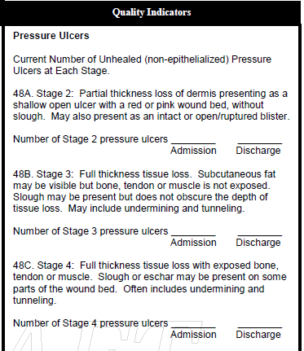
New Pressure Ulcer Data Elements

Slide 21
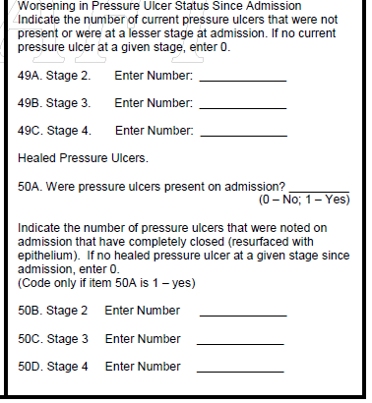
New Pressure Ulcer Data Elements (cont’d)

Slide 22
Pressure Ulcer Measure Timeline (continued)
A Vendor call is planned for the near future
QIES Technical Support Office (QTSO)
Register at https://www.qtso.com/ as an IRF vendor
Obtain user name and password before vendor call
Further details on data submission and technical specifications will be posted by January 31, 2012 at the CMS Web site

Slide 23
Pressure Ulcer Measure: Timeline
Spring 2012: User tool to be posted on QTSO and CMS Web sites
Spring/Summer 2012: Provider training for IRFs
October 1, 2012: Data collection for FY 2014 begins

Slide 24
Special Open Door Forum and Listserv Info
Audio recording and transcript of this Special Open Door Forum will be posted at http://www.cms.gov/OpenDoorForums/05_ODF_SpecialODF.asp
A mailing list notice will be sent when the transcript is available
For automatic e‑mails of Open Door Forum schedule updates (e‑mailing list subscriptions) and to view frequently asked questions, please visit http://www.cms.gov/opendoorforums/

