Slide 1
FAR 42.302, Contract Administration
Presented by:
Mr. Mark Werder
Mark.Werder@cms.hhs.gov
&
Mr. Christopher Hagepanos
Christopher.Hagepanos@cms.hhs.gov
representing
CMS, Office of Acquisition & Grants Management
October 30, 2015
Notes:
Centers for Medicare & Medicaid Services
Mark W. Werder, CPCM/CFCM Director, Division of Financial Services (DFS)/ABSG/OAGM
Mark.Werder@cms.hhs.gov
30+ yrs in Government Acquisitions Pre and Post Award
Mr. Christopher Hagepanos, CPCM
Director, Division of Data Center Contracts (DDCC/ITG/OAGM)
Christopher.Hagepanos@cms.hhs.gov

Slide 2
Agenda
Overview
71 Separate Functions listed under FAR 42.302(a), plus
11 Functions under FAR 42.302(b), and
Additional duties as set forth FAR 42.302( c)
Specific areas of concentration
Pre-Award (overview)
Post-Award
Performance/Modifications
Acceptance
Close-out
Challenges
Questions/Discussion
Notes:
The Agenda should include:
Introductions of key Buyer/Seller personnel
Discussion of mutual expectations
Identify important contract requirements
Contract Performance
Quality Assurance
Inspection/Acceptance
Project Management
Disputes

Slide 3
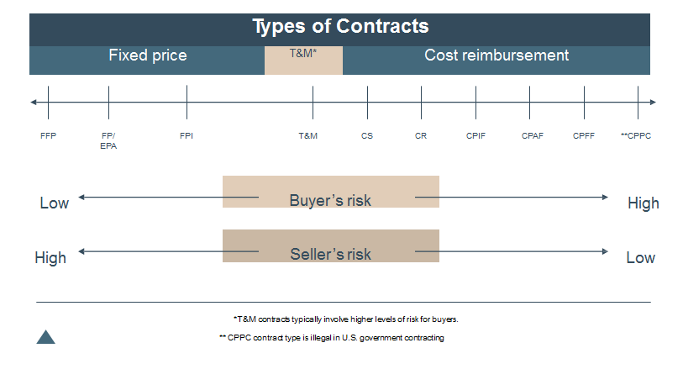
FAR Part 16 – Contract Types Range of Contract Types and Risk

Slide 4
Service Contracts
A contract that directly engages the time and effort of a contractor to perform an identifiable task, rather than to furnish an end item or good. Service contracts can be nonpersonal or personal, professional or nonprofessional.
Performance-based acquisition is the preferred method for obtaining services.
Rely on the private sector for commercial services.
Do not award a contract to perform inherently governmental functions
Notes:
Program officials are responsible for accurately describing the requirement to ensure full understanding and performance by contractors.
Services should be obtained:
In the most cost-effective manner,
Without barriers to full and open competition,
Free of any potential conflicts of interest.
Non-personal Services Contract - A contract under which the personnel providing the services are not subject, either by the contract’s terms or the manner in which it is administered, to the supervision and control usually prevailing in relationships between employers and employees.

Slide 5
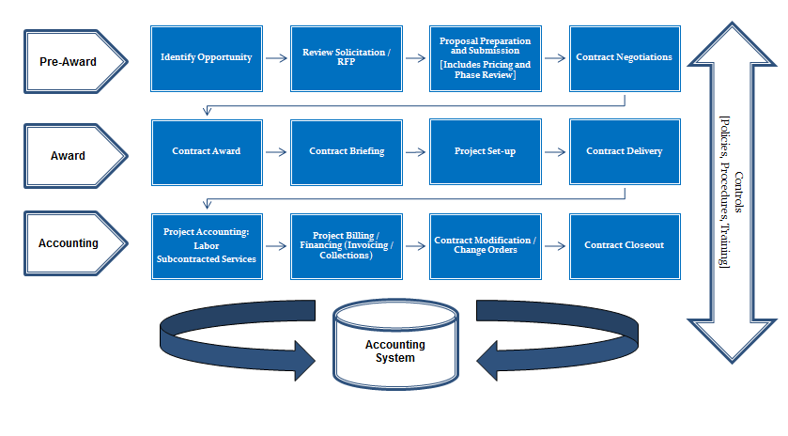
Government Contract Life-Cycle

Slide 6
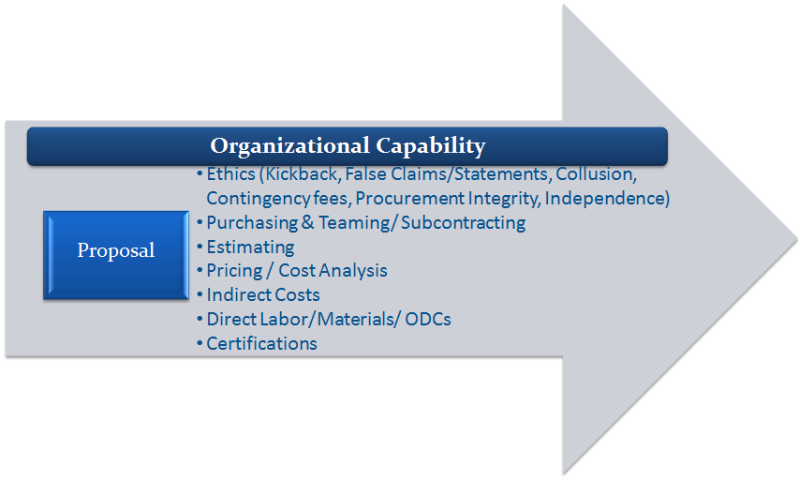
Pre Award and Proposal Activities

Slide 7
Contract Award Activities
Contract Documentation & File
Establish contract file, assign number, and populate with relevant and required proposal and contract award data and documentation
Contract Briefing
Captures important information from the contract including relevant clauses
Information should be stored in a central repository
Assists in the preparation of ICS & Other Federal Reports/Notifications
Contract/Project Kick Off Meetings
Contract Administrator, Subcontract Administrator, Project Manager and other key personnel meet to discuss contract brief, special terms & conditions, reporting requirements and delivery, maintenance, communication, roles & responsibilities & execution plan for contract
Project Set-Up
Internal setup and controls necessary to maintain and monitor for compliance and accountability
Project billing

Slide 8
Contract Award Activities – Cont’d
Contract Delivery
Execution of project scope against project plan and schedule
Monitoring & reporting of actuals to planned/forecasted
Compliance with T&Cs
First Invoice Review
Draft first invoice and proceed with first invoice review procedures with contract and subcontract administrators and project manager to verify accuracy and compliance with contractual requirements
Edit and update to establish precedence/prototype for subsequent invoices to follow

Slide 9
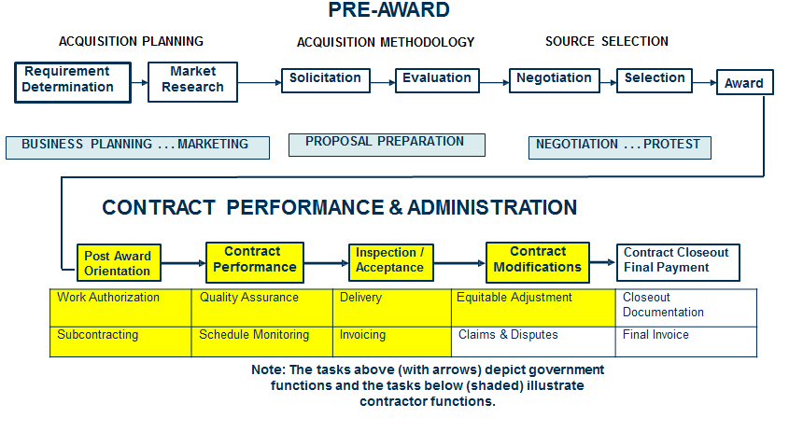
Contract Performance & Administration

Slide 10
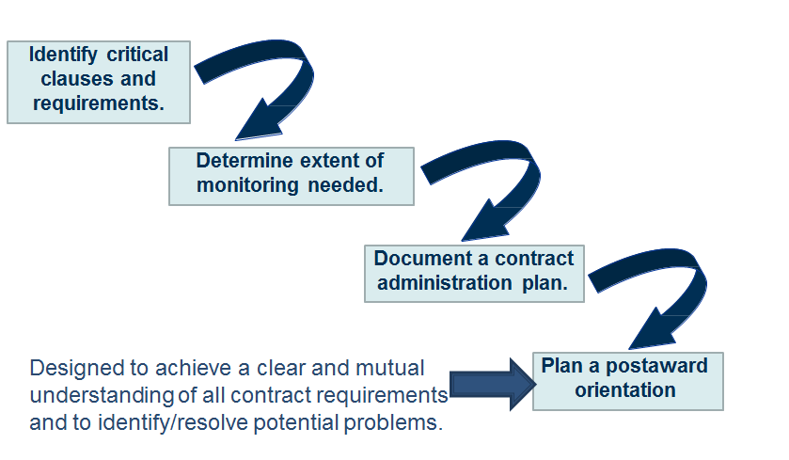
Steps in Contract Administration Planning

Slide 11
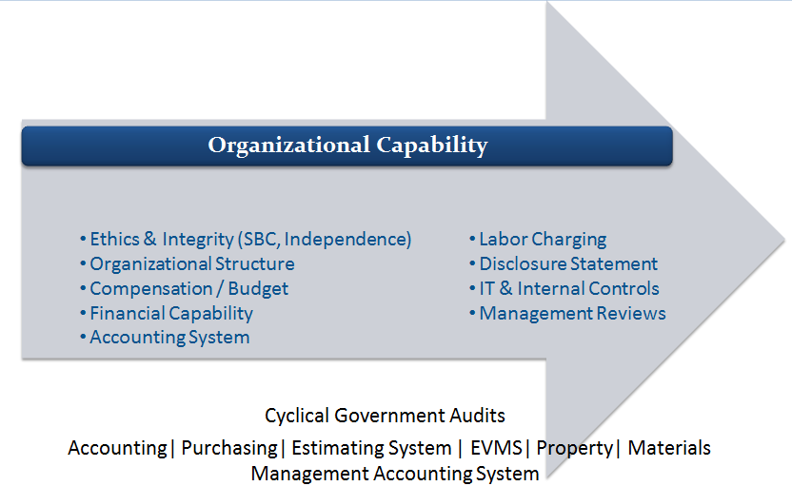
Ongoing Organizational Compliance Activities

Slide 12
Contract Performance Priorities
Cost
Stay within cost estimates on a cost- reimbursement contract
Schedule
Ensure timely delivery or make progress
towards timely delivery
Performance
Deliver supplies or services that meet
contract requirements

Slide 13
Inspection/Acceptance
The Government has the right to inspect all materials and workmanship at any time and any place where work on a contract is being done, provided it does not unduly delay performance.
Inspection means examining and testing supplies or services.
Acceptance means the act of an authorized representative of the buyer/government
government assumes ownership of existing identified supplies tendered or;
approves specific services rendered as partial or complete performance of the contract.
must be identified in the contract
title passes to the buyer and provides the basis for final payment

Slide 14
Who is the Cognizant Federal Agency?
“Cognizant Federal agency” means the Federal agency that, on behalf of all Federal agencies, is responsible for establishing final indirect cost rates and forward pricing rates, if applicable, and administering cost accounting standards for all contracts in a business unit
42.003 Cognizant Federal agency.
For contractors other than educational institutions and nonprofit organizations, the cognizant Federal agency normally will be the agency with the largest dollar amount of negotiated contracts, including options.
(b) Once a Federal agency assumes cognizance for a contractor, it should remain cognizant for at least 5 years to ensure continuity and ease of administration.
Typically this holds true; however if circumstances warrant it, and the affected agencies agree, either prior to or at the conclusion of the 5 yrs., cognizance may transfer.

Slide 15
HHSAR 342.705
HHSAR 342.705 states:
(a) The Division of Cost Allocation, PSC, shall establish indirect cost rates, research patient care rates, and, as necessary, fringe benefit, computer, and other special costing rates for use in contracts awarded to State and local governments, colleges and universities, hospitals, and other nonprofit organizations.
(b) The Division of Financial Advisory Services, NIH, shall establish indirect cost rates, fringe benefit rates, and similar rates for use in contracts awarded to commercial organizations.

Slide 16
Who is the Cognizant Federal Audit Agency?
Normally, the Defense Contract Audit Agency (DCAA) is the responsible Government audit agency for contractors other than educational institutions and nonprofit organizations. Note: CMS uses DCAA for non-profits as well as DCAA and CPA firms for for-profit organizations.
Contract auditor responsibilities.
Submitting information and advice to the requesting activity, based on the auditor’s analysis of the contractor’s financial and accounting records or other related data as to the acceptability of the contractor’s incurred and estimated costs;
Reviewing the financial and accounting aspects of the contractor’s cost control systems; and
Performing other analyses and reviews that require access to the contractor’s financial and accounting records supporting proposed and incurred costs.
Assignment of contract audit services.
CMS enters into annual interagency agreements with DCAA to conduct such services.
CMS has established contracts with CPA firms to conduct these services based upon DCAA’s backlog primarily in the area of incurred cost audits.

Slide 17
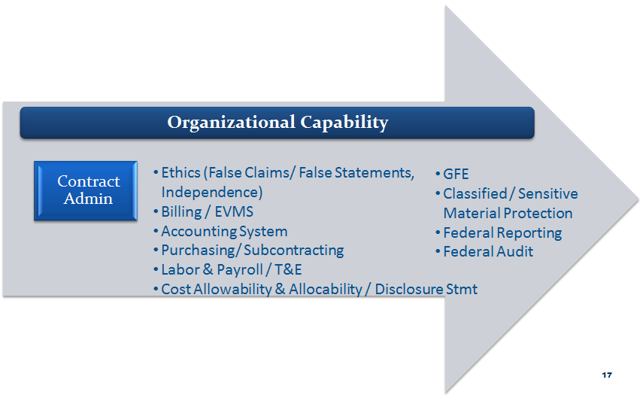
Contract Administration Activities

Slide 18
Contract Administration Activities
Contract Work papers
Deliverables
Evidence of receipt & acceptance
Advance Agreements
Purchasing / Subcontracting
Purchasing & Subcontract Administration, modifications, flow down of clauses
Monitoring & Reporting
Small Business Plan Compliance
Labor & Payroll / T&E
Time reporting and compliance
Expense submission
Accounting
Project and Labor Cost Accounting
Financial Project Cost & Progress Reporting/ETCs
Cost Allowability & Allocability

Slide 19
Contract Administration Activities (Continued)
Ethics
False Claims/ False Statements, Independence
Contract Modification / Change Orders
Written notification from CO (usually via Standard Form 30 “SF 30”)
Contractor must adjust work scope and project accounting to account for changes
Segregate costs of performing changed work
Billing
Invoice Review Checklist
Funding limit maintenance
Invoice preparation and submission

Slide 20
Contract Administration Activities (continued)
Billing (cont’d)
Exclusion of Unallowable and Contract Specific Non-Billable costs
Billing Files
Cumulative reporting & notification of limitation of funding
Collections
Government Property
Disposition, maintenance & reporting of Government Property including GFE & CAP
Classified / Sensitive Material Protection
Classification, disposition, maintenance and reporting secure/cleared contracts

Slide 21
Contract Administration Activities (continued)
Federal Reporting
Limitation of Cost/Funds notifications
Requests for consent
ICS
Forward Pricing & Provisional Rates
Mandatory Disclosures
Federal Reporting (cont’d)
Certifications & Reps/ORCA/FAPIIS
Disclosure Statements (if applicable)
Federal Audits
Ongoing standard audits including audits of indirect rates, post award surveillance reviews, CAS, contract audits, Floor Checks, etc.
System audits including Accounting (Billing, Labor, Indirects & ODCs), Estimating, Purchasing, Property and MMAS/EVMS (if applicable)

Slide 22
42.302 Contract Administration Functions
The contracting officer normally delegates the following contract administration functions to a “Cognizant Federal agency” means the Federal agency that, on behalf of all Federal agencies, is responsible for establishing final indirect cost rates and forward pricing rates, if applicable, and administering cost accounting standards for all contracts in a business unit.
The contracting officer may retain any of these functions, Except:
Negotiate forward pricing rate agreements (see 15.407-3).
Establish final indirect cost rates and billing rates for those contractors meeting the criteria for contracting officer determination in Subpart 42.7.
In connection with Cost Accounting Standards (see 30.601 and 48 CFR Chapter 99 (FAR Appendix))-
Determine the adequacy of the contractor’s accounting system. The contractor’s accounting system should be adequate during the entire period of contract performance. The adequacy of the contractor’s accounting system and its associated internal control system, as well as contractor compliance with the Cost Accounting Standards (CAS), affect the quality and validity of the contractor data upon which the Government must rely for its management oversight of the contractor and contract performance.

Slide 23
Typical US Government System Audits and Organizational Applicability
 | Ethics | Legal | Budget | Recds Mngt | IT | HR | Acctg/ Fin. Compl | Contracts | Estima-ting/ Pricing | Billing | Proj Mngr
Overall Controls | ✓ | ✓ | ✓ | ✓ | ✓ | ✓
Budget |  |  | ✓ |  | ✓ |  |  |  |  | ✓ | ✓
Compensa-tion |  |  |  |  | ✓ | ✓ | ✓
Estimating |  |  |  |  | ✓ |  | ✓ | ✓ | ✓ |  | ✓
Billing |  |  |  |  | ✓ |  | ✓ |  |  | ✓ | ✓
Labor |  |  |  |  |  |  | ✓ |  |  |  | ✓
Indirect/ Direct |  |  |  |  |  |  | ✓ |  | ✓ | ✓ | ✓
Purchasing |  |  |  |  |  |  |  | ✓ | ✓ | ✓ | ✓
IT |  |  |  |  | ✓
MMAS |  |  |  | ✓ |  |  | ✓ | ✓ |  |  | ✓

Slide 24
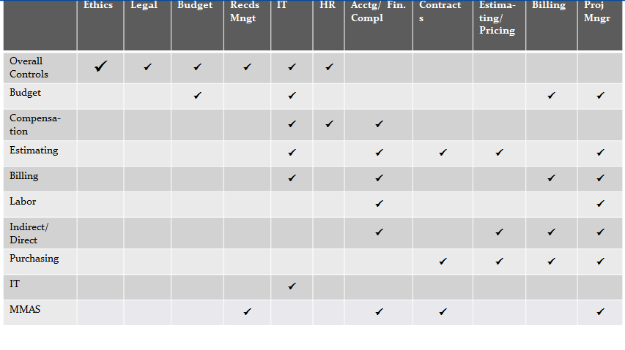
Typical US Government System Audits and Organizational Applicability

Slide 25
What is an indirect cost rate? FAR 42.7
Billing rate means an indirect cost rate established temporarily for the interim reimbursement of incurred indirect costs and adjust as necessary pending establishment of final indirect cost rate.

Slide 26
FAR Part 30: Cost Accounting
Standards and Administration
Cost Accounting Standards
The contracting officer is responsible for
Determining when a proposed contract may require
CAS coverage,
Including the appropriate notice in the solicitation,
Ensuring the offeror has made the required solicitation certifications,
Ensuring the required Disclosure Statements are
Submitted
CAS Administration
CAS administered by the Cognizant Federal Agency Official, who is often the Administrative Contracting Officer
Describes policies and procedures for applying CASB rules and regulations to negotiated contracts and subcontracts
Sealed bid contracts or contracts with small business concerns are exempt

Slide 27
FAR Part 30: Cost Accounting
Standards and Administration
Responsibility
Within 30 days after award of a CAS-covered contract or subcontract, the contracting officer, contractor, or subcontractor making the award shall request the cognizant ACO to perform administration for CAS matters
The contracting officer shall not award a CAS-covered contract until the ACO has made a written determination that the required Disclosure Statement is adequate
A contractor may change it’s disclosed or established cost accounting practices unilaterally
The Government will NOT pay any resulting aggregate increase to cost

Slide 28
FAR Part 30: Cost Accounting
Standards and Administration
The head of the agency may waive the applicability of CAS for a particular contract or subcontract when either of the following situations exists:
the contract or subcontract value is less than $15,000,000, the segment of the contractor or subcontractor that will perform the contract or subcontract is primarily engaged in the sale of commercial items and has not contracts or subcontracts that are subject to CAS.
exceptional circumstances exist whereby a waiver of CAS is necessary to meet the needs of the agency. Exceptional circumstances exist only when the benefits to be derived from waiving the CAS outweigh the risk associated with the waiver.

Slide 29
Contract Changes and Modifications

Slide 30
42.302 Contract administration functions
CMS/COs perform most of the 71 functions plus those under FAR 42.302 (b) as follows:
Negotiate or negotiate and execute supplemental agreements incorporating contractor proposals resulting from change orders issued under the Changes clause. Before completing negotiations, coordinate any delivery schedule change with the contracting office.
Negotiate prices and execute priced exhibits for unpriced orders issued by the contracting officer under basic ordering agreements.
Negotiate or negotiate and execute supplemental agreements changing contract delivery schedules.
Negotiate or negotiate and execute supplemental agreements providing for the de-obligation of unexpended dollar balances considered excess to known contract requirements.
Issue amended shipping instructions and, when necessary, negotiate and execute supplemental agreements incorporating contractor proposals resulting from these instructions.
Negotiate changes to interim billing prices.
Negotiate and definitize adjustments to contract prices resulting from exercise of an economic price adjustment clause (see Subpart 16.2).

Slide 31
42.302 Contract Administration functions
Issue change orders and negotiate and execute resulting supplemental agreements under contracts for ship construction, conversion, and repair.
Execute supplemental agreements on firm-fixed-price supply contracts to reduce required contract line item quantities and de-obligate excess funds when notified by the contractor of an inconsequential delivery shortage, and it is determined that such action is in the best interests of the Government, notwithstanding the default provisions of the contract. Such action will be taken only upon the written request of the contractor and, in no event, shall the total downward contract price adjustment resulting from an inconsequential delivery shortage exceed $250.00 or 5 percent of the contract price, whichever is less.
Execute supplemental agreements to permit a change in place of inspection at origin specified in firm-fixed-price supply contracts awarded to nonmanufacturers, as deemed necessary to protect the Government’s interests.
Prepare evaluations of contractor performance in accordance with Subpart 42.15.

Slide 32
FAR Part 43.1; 43.2; 43.103 Contract Modifications
Only contracting officers acting within the scope of their authority are empowered to execute contract modifications.
Bilateral: Must be used when definitizing a letter contract (includes FAR 8 and FAR 12 change orders)
Unilateral:
Change Orders - changes clause in contract permits the CO to make unilateral changes in designated areas within the contract scope ; Upon receipt of the change order, contractor must comply with the change. Negotiation of equitable adjustments result from change orders.
Administrative Changes - modification used to change a contract in such a way that does not affect the substantive rights of the parties; change in COTR, funding string, paying office, etc.

Slide 33
Contract Changes
Change Authority
Both the buyer and seller should clearly identify the individuals in their respective organizations who have the requisite authority to make changes.
If the buyer and seller agree in advance to honor only changes made by authorized personnel, and to promptly notify the other if unauthorized personnel attempt to make changes, they can avoid many problems.
In Government contracting, only Contracting Officers acting within the scope of their authority may execute contract modifications on behalf of the Government.
Responsibilities
Contractor’s Responsibility
The contractor must continue performance of the contract as changed
Government’s Responsibility
Provide an equitable adjustment in time, money, or both.

Slide 34
Categories of Changes
Additive
Work added to the contract
More money for the contractor
Deductive
Unperformed work deleted from the contract
Reduction in contract price
Substitution (should receive a price/cost proposal indicating adds and deletes)
New work substituted for deleted work
No change in contract price or change tempered by monetary effect of the substitution
41

Slide 35
Constructive Change
Oral or written acts or omissions by employees or agents of the buyer that are of such a nature that they have the same effect as written change orders.
A constructive change generally occurs when the buyer impliedly or expressly orders the seller to perform work that is not in the contract.
In government contracting, equitable adjustment is granted for constructive changes only if the change caused injury or liability to the seller.
Common Causes:
Disagreement between the parties over the contract’s requirements
Defective specifications
Buyer’s interference or failure to cooperate
Excusable Delay – Acceleration

Slide 36
Equitable Adjustment
If any change causes an increase or
decrease in:
Cost of performance
Time required for performance
The contracting officer shall make an equitable adjustment and modify the contract accordingly.

Slide 37
What can be changed? Scope of Contract Issues
Does the changed work represent what both parties
reasonably contemplated at the time of award?
Is the changed work essentially the same that they bargained for?
Is the nature of the requirement altered by the change?
Would this type of change normally be expected for this
kind of requirement?
Was the specification defective?
Cardinal Changes
Changes that are not within the contract’s general scope

Slide 38
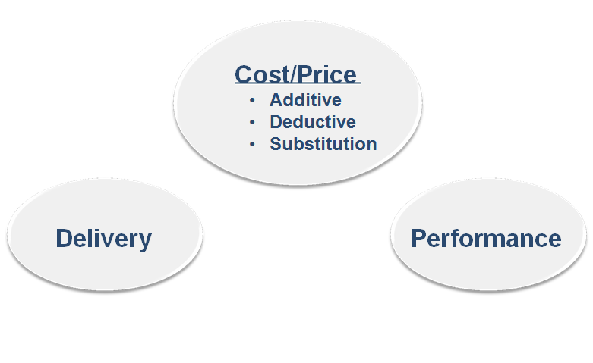
Estimate the Impact of the Change

Slide 39
FAR Part 31: Contract Cost Principles
and Procedures
This Part contains Cost principles and procedures for pricing contracts, subcontracts, and modifications whenever cost analysis is performed and for the determination, negotiation, or allowance of costs when required by a contract clause.
FAR 31.102 Fixed Price Contracts
Application of cost principles to fixed price contracts and subcontracts shall not be construed as a requirement to negotiate agreements on individual elements of cost in arriving at agreement of total price

Slide 40
Contract Pricing (FAR 15.4)
Proposal Analysis (FAR 15.404-1)
Objective - Ensure that the final price agreed upon is fair and reasonable
Techniques
Price Analysis
Cost Analysis
Cost Realism Analysis
Technical Analysis
Profit (FAR 15.404-4)
Statutory limitations to price or fee
15% for R&D efforts on a CPFF contract
10% for all other CPFF type contracts
6% for A-E firms

Slide 41
Contract Pricing (FAR 15.4)
Price
Cost plus any fee or profit applicable to the contract type
Pricing Policy
Purchase from responsible sources at fair and reasonable prices
In establishing reasonableness, contracting officers should minimize the information necessary
When cost or pricing data are not required, rely on the following, in order of precedence
No additional information, particularly if the price is based on adequate price competition
Information other than cost or pricing data
Cost or pricing data

Slide 42
Contract Pricing (FAR 15.4)
Cost or pricing data ($750,000)
All facts that, as of the date of price agreement or, if applicable, an earlier date agreed upon between the parties that are as close as practicable to the date of agreement on price
Factual data, not judgmental; Verifiable
Require certification per FAR 15.406-2
Threshold includes price increases and decreases
Other than cost or pricing data
any type of information that is not required to be certified per FAR 15.406-2 and
Is necessary to determine price reasonableness or realism

Slide 43
Contract Pricing (FAR 15.4)
Prohibition on obtaining Certified Cost or Pricing Data (FAR 15.403-1)
Acquisitions at or below the simplified acquisition threshold
To support any action (contracts, subcontracts, or modifications) when
Prices are based on adequate price competition
Prices set by law or regulation
Commercial items (or modifications to commercial items)
When a wavier has been granted

Slide 44
Option Years
Options are:
unilateral and available at the government’s discretion and judgment.
FAR 17.2 states the CO may only exercise an option if:
Funds are available,
There is a government need,
The option is the most advantageous method of fulfilling the government need when price and other factors are considered, and
The option was synopsized, if required.

Slide 45
Exercising an Option IAW the
Contract
The government needs to exercise unilateral options in strict accord with the contract terms or it is ineffective.
Preliminary notice, if required, must be received on time or the option exercise is ineffective, as it must be received in a timely and correct manner.
Any attempt to alter the conditions of the contractor’s obligation, (eg, period of performance, insertion of an availability of funds, limiting the government’s liability of payment, etc.) renders the exercise of the option conditional and invalid.
Two possibilities exist for a contractor when the government exercises an option outside the terms of the contract.
Reject the option outright, or
Accept the option and demand an equitable adjustment in price—a good strategy in a firm- fixed-price environment when the contract is less profitable than anticipated.

Slide 46
Government’s Unilateral Right to Extend a
Contract for Services up to Six Months
Virtually all contracts for services include the “option to extend services clause,” (FAR 52.217-8) which grants the government the right to extend a contract for services up to six months at the same rates specified in the contract.
The rates may only be adjusted as a result of revisions to prevailing labor rates.
Frequently used to extend performance when there is a bid protest to avoid a break in services.
Notes:
Despite the lack of privity between the government and subcontractors, the government still has an influence in subcontracts through flow-down clauses.
The FAR identifies flow-down clauses, the tier and dollar value of subcontracts to which they apply.

Slide 47
Subcontract Management

Slide 48
FAR Part 44.2 & 44.3 - Subcontracting Policies and Procedures
Subcontract Management
Privity of Contract; Flowdown Clauses
Consent to Subcontract
If contractor has an approved purchasing system, consent is required for subcontract identified by the contracting officer in the subcontracts clause of the contract.
Small Business Subcontracting Plan
Contractor’s Purchasing System Review
If no approved purchasing system, consent is
required for fixed-price efforts that exceed the simplified acquisition threshold or 5% of total estimated cost of the contract or
required for cost- reimbursement, T&M or labor-hour type contracts and unpriced actions
Make-or-Buy; Outsourcing
Notes:
The contracting officer shall insert the clause at 52.244-6 in solicitations and contracts other than those for commercial items.
52.244-6, Subcontracts for Commercial Items
The Contractor shall include the terms of this clause, including this paragraph in subcontracts awarded under this contract.
Note: No dollar threshold
Subcontracting plans must include—
Separate percentage goals for using small business, veteran-owned small business, service-disabled veteran-owned small business, HUBZone small business, small disadvantaged business; women- owned small business concerns as subcontractors; Alaska Native Corporations and Indian Tribes
A statement of the total dollars planned to be subcontracted and a statement of the total dollars planned to be subcontracted
A description of the principal types of supplies and services to be subcontracted and an identification of types planned for subcontracting
A description of the method used to develop the subcontracting goals;
A description of the method used to identify potential sources for
solicitation purposes;

Slide 49
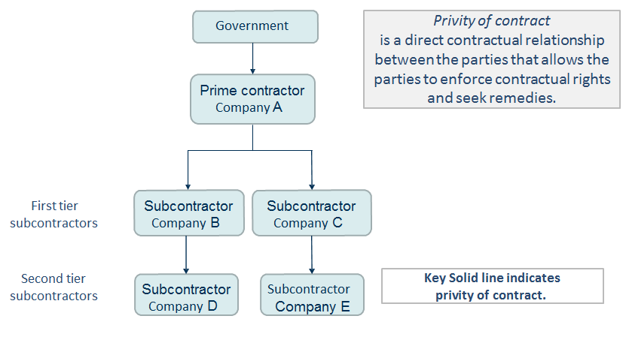
Privity of Contract

Slide 50
FAR Part 32: Contract Financing
Contract Funding (FAR 32.7)
No officer or employee of the Government may create an obligation in excess of funds available, or in advance of appropriations unless authorized by law (Anti-Deficiency Act)
Before executing a contract, the contracting officer must obtain written assurance from responsible fiscal authority that adequate funds are available or expressly condition the contract upon availability of funds IAW FAR 32.703-2
Contract action in support of O&M and continuing services requirements properly chargeable to funds of a new fiscal year must be initiated before these funds are available, provided that the contract includes the prescribed Availability of Funds clause
A contract that is funded by annual appropriations may not generally cross fiscal years; however, indefinite-quantity or requirements contracts for services that are funded by annual appropriations may extend beyond the fiscal year in which they begin, provided that any specified minimum quantities are ordered in the initial fiscal year and the contract includes the prescribed Availability of Funds for the Next Fiscal Year clause

Slide 51
FAR Part 32: Contract Financing
Supplies or services under a contract conditioned on the availability of funds cannot be accepted until the contracting officer has given the contractor notice that funds are available
Contracts that contain the Limitation of Cost or Funds clause
must be monitored closely
The contracting officer, upon learning that the contractor is approaching the estimated cost or limit of the funds allotted must promptly notify the contractor in writing that:
Additional funds have been allotted or the estimated cost increased,
The contract will not be further funded,
The contract is to be terminated, or
The Government is considering whether to allot additional funds or increase the estimated cost

Slide 52
FAR Part 32: Contract Financing
Prompt Payment (FAR 32.9)
Solicitations and contracts must
Specify payment procedures,
Payment due dates, and
Interest penalties for late invoice payments
Payments are generally made on the 30th day after the designated billing office receives a proper invoice from the contractor or the 30th day after government acceptance of supplies delivered or services performed by the contractor, whichever is later
Payment will be based on receipt of a proper invoice and satisfactory performance
Discounts for prompt payment may be taken only when payments are made within the discount period specified by the contractor
Agencies must pay interest for late invoice payments or improperly taken discounts for prompt payment

Slide 53
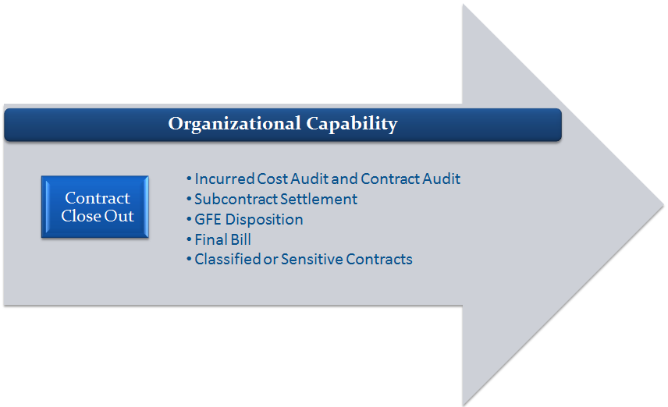
Contract Closeout Activities

Slide 54
Contract Closeout Activities
Completed Contracts:
A contract is considered to be physically completed when:
The contractor completed the required deliveries and the
buyer has inspected and accepted the supplies;
The contractor has performed all services, and the buyer has accepted these services;
All option provisions, if any, have expired;
The buyer has given the contractor a notice of complete termination; or
The contract period of performance has expired.

Slide 55
Contract Closeout Activities
Its purpose is to ensure that each party’s responsibilities are fulfilled, and that the contract file is documented accordingly.
The closeout process should begin as soon as practicable at end of the (POP) of a contract and typically takes several years to complete.
Key documents that are required to be retained during contract closeout and at least 3 yrs beyond include:
Contract and Modifications
Deliverables and Evidence of Government Acceptance
Correspondence Relating to Project/Advance Agreements
Level of Effort certifications
Timesheets/Vouchers etc.
Accounting Records and Financial Status/Progress Reports
Subcontract documentation
Final Rate Determinations/Audit Reports of Incurred Costs

Slide 56
Why is Contract Closeout Important?
Especially important on contracts that have these clauses:
FAR 52.216-7 Allowable Cost and Payment
FAR 52.216-8 Fixed Fee
FAR 52.232-7 Payments under Time-and-Materials and Labor-Hour
Contracts.
For cost-type contracts, the clause requires contractors to withhold 15% of the fixed fee when the contract reaches 85% of the established fixed fee.
For time-and-materials/labor-hour contracts the government may withhold 5% of labor costs up to a maximum of $50,000.

Slide 57
Allowability FAR Part 31: Contract Cost Principles and Procedures
If the contract has FAR 52.216-7, Allowable Cost and Payment
Required to submit an incurred cost proposal to your cognizant Defense Contract Audit Agency (DCAA) office within six months after your fiscal year-end - submission triggers an incurred cost audit.
Reasonable
If the cost does not exceed that which would be incurred by a prudent person in the conduct of competitive business
Allocable
Assignable or chargeable to one or more cost objectives on the basis of relative benefits received or other equitable relationship
Incurred specifically for the contract
Benefits both the contract and other work, and can be distributed to them in reasonable proportion to the benefits received, or
Is necessary to the overall operation of the business

Slide 58
Challenges

Slide 59
Conflict of Interest – What is a Conflict?
Biased Ground Rules (BGR) – An Example is where the contractor helped develop the statement of work (SOW), or technical evaluation criteria, or created source selection material
Concern – May provide an unfair competitive advantage because may have tilted the procurement material to favor, whether intentionally or not, its or an affiliate’s interests, services or products
Usually a procurement integrity COI
Unequal Access to Information (UAI) – An Example is where the contractor obtained government supplied information, to which no other potential contractor has access
Concern – May provide an unfair competitive advantage because the “secret” information provides insight to the government’s needs.
Usually a procurement integrity COI
Impaired Objectivity (IO) – An Example is where the contractor’s other interests may effect decisions it makes or services it provides to the Government
Concern – Risk that performance may not be in best interests of the government, or biased to favor the contractor’s interests
Usually a performance or business risk COI

Slide 60
Novation and Change-of-Name
Agreements
FAR 42.12 - A novation agreement recognizes a successor in interest to Government contracts when the contractor’s assets are transferred.
Effected through execution of a modification.

Slide 61
Suspension of Work, Stop-Work
Orders and Government Delay of Work
Suspension of Work may be ordered by the Contracting Officer for a reasonable period of time.
Stop Work Orders used if it is advisable to suspend work pending a decision by the Government and a supplemental agreement providing for the suspension is not feasible.
Government Delay of Work does not authorize the contracting officer to order a suspension, delay, or interruption of work nor is it to be used as the basis of such an order.
FAR 42.13

Slide 62
FAR Part 49 - Terminations of
Contracts
Termination for Convenience means
convenience of the Government
Termination for Default - If the surety does not arrange for completion of the contract, the contracting officer will normally arrange for completion of the work by awarding a new contract based on the same plans and specifications.
In certain cases, lieu of a termination, a contracting officer may effect a no cost settlement
FAR 49.002; 49.405; 49.109

Slide 63
FAR Part 49 - Excusable Delays
The Contractor shall not be in default because of any failure to perform this contract under its terms if the failure arises from causes beyond the control and without the fault or negligence of the Contractor. Examples of these causes are
acts of God or of the public enemy,
acts of the Government in either its sovereign or contractual capacity,
fires,
floods,
epidemics,
quarantine restrictions,
strikes,
freight embargoes, and
unusually severe weather
FAR 52.249-14

Slide 64
What is a notice of intent to disallow
costs?
The purpose of the notice is to notify the contractor as early as practicable during contract performance that the cost is considered unallowable under the contract terms and to provide for timely resolution of any resulting disagreement.
FAR 42.8

Slide 65
Important Terminology
Dispute
A post-award disagreement when it is first recognized that the Government an a contractor have conflicting points of view.
Claim
A dispute becomes a claim when a written demand is made, as a matter of right, to pay a specific amount of money or other relief.
Appeal
Occurs when the contractor files for consideration with a court or board of contract appeals after the CO denies their claim.
Notes:
A claim is a written demand or written assertion by one of the contracting parties seeking, as a matter of right, the payment of money in a sum certain, the adjustment or interpretation of contract terms, or other relief arising under or relating to the contract. However, a written demand or written assertion by the contractor seeking the payment of money exceeding $100,000 is not a claim under the Contracts Disputes Act of 1978 until certified as required by the Act and FAR 33.207
Final DecisionsWhen a claim by or against a contractor cannot be satisfied or settled by mutual agreement and a decision on the claim is necessary, the matter is resolved through issuance of a contracting officer‘s Final Decision. The contracting officer shall issue the decision within the following statutory time limits: for claims of $100,000 or less - 60 days after receiving a written request from the contractor that a decision be rendered within that period, or within a reasonable time after receipt of a claim if the contractor does not make such a request; for claims over $100,000 - 60 days after receipt of certification; provided, however, that if a decision will not be issued within 60 days, the contracting officer notifies the contractor, within that period, of the time within which a decision will be issued. Failure of the contracting officer to render a Final Decision within the required time period is deemed to constitute denial of the claim thereby authorizing the contractor to file an appeal or suit on the claim.
The Contract Disputes Act of 1978, as amended, establishes procedures and requirements for asserting and resolving claims subject to the Act. It also provides for the payment of interest on contractor claims, certification of contractor claims, and a civil penalty for contractor claims that are fraudulent or based on misrepresentation of fact.
Establishes procedures and requirements for asserting and resolving claims subject to the Act. In addition, the Act provides for—
Paying interest on contractor claims;
Certifying contractor claims; and
Penalizing contractors for claims that are
fraudulent or based on a misrepresentation of fact.

Slide 66
Encouraged to Resolve at Lowest
Level
It is the Government's policy to try to resolve all contractual issues in controversy by mutual agreement at the contracting officer's level.
FAR 33.204

Slide 67
Certification of Claims
Claims in excess of $100,000, or regardless of the amount claimed when using arbitration pursuant to 5U.S.C. 575-580 or any other alternate dispute resolution (ADR) technique, must be accompanied by a certification that states the claim is made in good faith, supporting data are accurate and complete to the best of the contractor's knowledge and belief, and the amount requested accurately reflects the contract adjustment for which the contractor believes the Government is liable.

Slide 68
What is Alternative Dispute Resolution
(ADR)?
Alternative Dispute Resolution (ADR) refers to any procedure or combination of procedures voluntarily used to resolve issues in controversy without the need to resort to litigation.
Types:
Arbitration
Fact Finding
Mediation
Mini Trial
Conciliation
Facilitation
Use of ombudsmen

Slide 69
Questions?

