Slide 1
Contracting with CMS and other Federal Agencies CMS Industry Day October 30, 2015 Anita Allen, Small Business Specialist and Claude Cable, SBA Procurement Center Representative

Slide 2
FAR Requirements
FAR 19.201(a) – It is the policy of the Gov’t to provide maximum practicable opportunities in it acquisitions to small business, veteran owned small business, service-disabled veteran-owned small business, HUBzone small business, small disadvantaged business, and women-owned small business concerns. Such concerns must also have maximum practicable opportunity to participate as subcontractors.

Slide 3
Establishing Goals
The Small Business Act, Public Law 83-163 (15 U.S.C. 644(g)) requires that the President establish annual Government-wide goals for procurement awards to small businesses. The individual agency goals must represent the estimated maximum practicable opportunity for small businesses to participate in the performance of contracts let by the agency. Because of the nature of HHS’ purchases, it continues to strive to meet and exceed the regulatory minimum goals for Small Businesses.

Slide 4
CMS’s FY 2014* Small Business Goals
Small Business Category | Goal *
Small Businesses | 20% (FY15) **
Small Disadvantaged Businesses | 5%
Women-owned Small Businesses | 5%
HubZone Small Businesses | 3%
Service Disabled Veteran Owned Small Business | 3%
*Percentage of total FY 15 contract dollars to be awarded to Small or Small Disadvantaged Business
** FY 16 SB Goal is not official yet

Slide 5
Small Business Goals are Achieved through Collaboration
CMS
Contracting Officer
Head of the Contracting Activity (HCA)
Program Office
SBA
Program Center Representative
OSDBU
Small Business Specialist

Slide 6
FY 2FY 2014 Accomplishments
Notes:
This years numbers have not been finalized. Two weeks ago it was $1,056,390,426

Slide 7
How Goals are Accomplished
CMS relies on processes to maximize achievement of small business contracting goals.
Checks and Balances
Early coordination and communication
Small Business Specialist Review
SBA’s Procurement Center Representation Review

Slide 8
Market Research
Purpose
Determine if there are at least two Small or Small Disadvantaged businesses capable of performing the requirement.
Methods
Sources Sought Notices
Small Business Dynamic Search Tool
Small Business Specialist
Outcome
If two or more small or small disadvantaged businesses deemed capable, the Contracting Officer, must set-aside the procurement.

Slide 9
Vetting the Acquisition Strategy
Reviewed by Small Business Specialist
Reviewed by SBA’s Procurement Center Representative

Slide 10
The Acquisition
Set-aside for small business if two or more capable
May use streamlined acquisition process –
FAR Part 8 – GSA Schedule
FAR Part 16 – IDIQ/GWAC
Small Business Size Standards Apply – NAICS Identified
FAR 52.219-14 Limitations on Subcontracting Applies

Slide 11
The Role of Small Businesses in this Process
Know what we Buy
Know the Rules
Draw Attention
Be Prepared When Opportunity Knocks

Slide 12
Know the Rules
1. LEGISLATIVE GUIDANCE
Statutory Law - http://thomas.loc.gov
Small Business Act (Public Law 85-536, as amended) http://www.sba.gov/sites/default/files/tool_serv_sbact.pdf

Slide 13
Rules – continued
2. Regulatory Guidance
Title 13 of the United States Code of Federal Regulations (13 CFR)
Section 121 – SB Size Regulations
Section 124 – 8(a) BD/SDB Programs
Section 125 – Subcontracting
– Limitations on Subcontracting
– SDVOSB Program
Section 126 – HUBZone Program
Section 127 – WOSB Program (Changes Implemented October 14)
Section 134 – Appeal Procedures
http://ecfr.gpoaccess.gov

Slide 14
Rules - continued
2. Recent Guidance
Small Business Jobs Act of 2010
National Defense Authorization Act of 2013

Slide 15
Draw Attention
Update your company’s information on the SAM & Dynamic Small Business Search
Ensure core capabilities are clearly illustrated
Respond to RFIs, Sources Sought Notices, RFPs, and RFQs
Follow instructions, tailor responses, ensure Quality
Attend Industry Days and other outreach events
Reach out to business partners for teaming/subcontracting arrangements
Research – review FBO, Forecasts of Opportunities, etc.

Slide 16
BE PREPARED WHEN OPPORTUNITY KNOCKS
Be accessible
GSA Schedule, IDIQ contracts, GWACs.
Understand Customer’s Needs
Performance Requirements –
Thoroughly review Solicitation and respond accordingly
Understand Constraints –
IT Security, (e.g. Authority to Operate, CMMI Certifications, ISO 9000…)
Accounting System Adequacy
Do your core competencies align with the requirement? – Can you meet the need?
Consider subcontracting opportunities….

Slide 17
CMS’s FY 2015* Small Business Subcontracting Goals
Small Business Category | Goal
Small Businesses | 33%
Small Disadvantaged Businesses | 5%
Women-owned Small Businesses | 5%
HubZone Small Businesses | 3%
Veteran Owned Small Business | 3%
Service Disabled Veteran Owned Small Business | 3%
* FY 16 Goals are not finalized

Slide 18
Small Business Sub-Contracting
Where to Look for Subcontracting Opportunities
SBA Web site: sba.gov/category/navigation-structure/contracting/contracting-opportunities/sub-contracting
SUB-Net
Subcontracting Opportunities Directory
Contact prime contractors

Slide 19
Sub-Contracting Requirements
FAR 19.702 – The Small Business Subcontracting Program –
Statutory Requirements
Any contractor receiving a contract for more than the simplified acquisition threshold must agree in the contract that small businesses (includes all socio-economic categories) will have the maximum practicable opportunity to participate in contract performance consistent with its efficient performance.
In negotiated acquisitions, each solicitation of offers to perform a contract expected to exceed $700,000 ($1.5M for construction) that has subcontracting possibilities requires awardee to submit a subcontracting plan.
See FAR 19.704 – Subcontracting plan requirements

Slide 20
Sub-Contracting Requirements (continued)
FAR 19.705-5 Awards involving subcontracting plans
Contracting Officer must
Assure that a subcontracting plan is submitted when required;
Ensure an acceptable plan is incorporated into and made a material part of the contract;
Obtain Small Business Specialist’s and SBA PCR’s concurrence with plan.

Slide 21
Accountability for Meeting Small Business Subcontracting Goals
Submission of individual subcontract reports (ISR) via the electronic subcontracting reporting system (eSRS)
Annual Performance Evaluations via the Contractor Performance Assessment Rating System (CPARS)
Past Performance Evaluation as an evaluation factor in competitive acquisitions

Slide 22
Evaluating Small Business Utilization
Annual performance evaluations factors include – utilization of small business
Contracting Officer must assess an adjectival rating and support with narrative
Definitions for adjectival ratings found in FAR 14.503 – Table 42-2

Slide 23
Past Performance – Pre-Award Evaluation Factor
FAR 15.304 –generally, past performance shall be evaluated in all source sections for negotiated competitive acquisitions expected to exceed the simplified acquisition threshold.
Contracting Officer must assess an adjectival rating and support with narrative
Definitions for adjectival ratings found in FAR 14.503 – Table 42-2

Slide 24
Best Practices
BEST PRACTICES
Certification
SAM
VOS
Sources Sought
Strategic Partnering
Industry Days
Rules & Regs
Customer Needs
Business Cards
Mentor- Protégé
Cape Statement
HHS

Slide 25
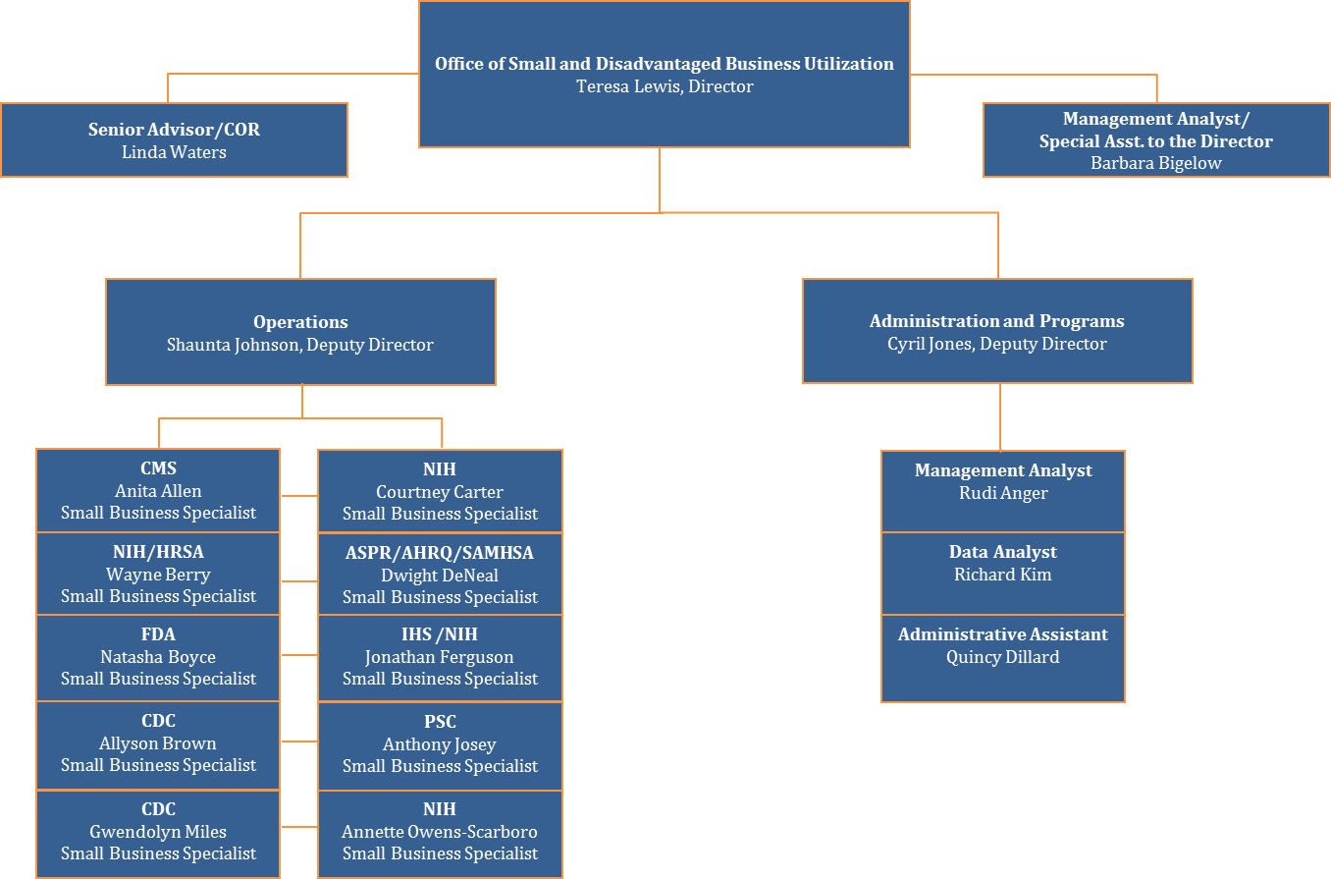
Points of Contacts

Slide 26
CONTACT INFORMATION
Anita Allen
(410) 786-9319
anita.allen1@cms.hhs.gov
Claude Cable
443-966-2303
Claude.cable@sba.gov

Slide 27
Questions
QUESTIONS

