Slide 1
SNP Approval Model of Care Training Elements 1-2 January 12, 2016 3:00 – 4:30pm EST
Brett Kay, NCQA, Susan Radke, CMS,
Sandra Jones, NCQA and Nidhi Dalwadi Mehta, NCQA
Notes:
Good afternoon. On behalf of CMS and NCQA, I’d like to welcome to the first of two trainings for the SNP Model of Care Guidelines. Today we are going to cover Elements 1 and 2, addressing the target population and care coordination. My name is Brett Kay, and I’m the Assistant Vice President for Recognition Program Operations at NCQA and am responsible for the SNP MOC Approval program that NCQA runs under contract with CMS. With me is Sandra Jones, Assistant Director for Accreditation Operations and Nidhi Dalwadi Mehta, a Manager in Accreditation Operations. They will also we presenting this afternoon.
Before I get started, I’d like to introduce Susan Radke, who is our contract officer at CMS, responsible for the SNP MOC approval program on their end. Susan, please feel free to include any information you would like to relay to the participants.
Thanks Susan. Now, let’s jump into today’s training.

Slide 2
Objectives of Special Needs (SNP) Model of Care Review
Comply with statutory requirements of Affordable Care Act
Ensure SNPs have robust Models of Care
Establish frequency for approval review cycle (1-3 years)
Notes:
There are three key goals for today’s training:
Comply with the statutory requirements of the Affordable Care Act (ACA). As you know, there is language in the ACA that states, “SNPs must be approved by NCQA.”
The second goal is to ensure that SNPs fully understand what the MOC requirements are and how to develop an MOC that not only meets the requirements but, more importantly, provides high quality care for beneficiaries.
The statutory requirements established an approval timeframe for plans scoring at certain levels, and this review helps to determine the approval review cycle for each SNP, from 1 to 3 years.

Slide 3
MOC Elements
MOC 1: SNP Population
MOC 2: Care Coordination
Care Transitions Protocol
MOC 3: Provider Network
MOC 4: Quality Measurement
Notes:
Noted on the screen are the 4 MOC Elements. We will get into detailing the subcategories of each element after the introduction.
MOC 1: SNP Population incorporates vulnerable populations
MOC 2: Care Coordination includes the requirements around the HRA, ICP, ICT, and communication network
MOC 3: Provider Network addresses the provider network and MOC training components
MOC 4: Quality Measurement addresses the measureable goals and outcome measurement requirements.

Slide 4
How will NCQA Score the MOC?
MOC elements worth 0-4 points, based on # of factors met.
Total of 60 points (15 elements)
converted to percentage scores
E.g., 50 points = 83.33% (2-year approval)
85%+ --3-year approval
75-84%--2-year approval
70-74%--1-year approval.
Plans scoring <70% after the initial review will have one Cure process. Plans that undergo the Cure, will only receive a 1-year approval, regardless of their final score.
Notes:
The MOCs will be scored on a scale of 1-4 for each element. There are 15 elements, so the maximum score a SNP can receive is 60 points.
Those points will be converted to a percentage score that determines the approval cycle:
85%+ --3-year approval
75-84%--2-year approval
70-74%--1-year approval.
Plans scoring <70% after the initial review will have one Cure process. Plans that undergo the Cure, will only receive a 1-year approval, regardless of their final score.

Slide 5
Project Time Line
February 9 – Technical Assistance call prior to submission
February 17 – SNP and MMP applications submitted to CMS via HPMS
April 18 – CMS issues Notice of Intent to Deny
April 21– TA call for Plans scoring <70%
April 28 - Cure apps due in HPMS
May 25 – CMS issues Denial Notices
June 6 - Bids due to CMS
Notes:
Please note these important dates:
We will hold a call with plans on Feb.9 to answer any questions you have about the MOC scoring guidelines prior to submission.
All MOC submissions for plans seeking to add new SNPs, renew existing ones prior to their SNP approval expiration or for plans seeking to expand service areas must submit their MOC no later than 8:00pm on February 17 via HPMS
You will receive your results from the initial MOC reviews on April 18. For plans scoring <70%, you will have a cure opportunity
All revised MOCs for the cure are due to HPMS on April 28
Final notices of results will be sent on May 25
Final bids are due to CMS on June 6.

Slide 6
Updates for this Review Period
Discontinuing Dual Eligible Special Needs Plans Sub-type Categories
Current D-SNPs under a MA-PD contract do not have to submit separate applications or MOC narratives to offer a different subtype category type.
Current SNPs under a MA-PD contract do not have to submit a MOC for a Service Area Expansion
Notes:
Since this information is already captured in the SMAC, CMS can determine the D-SNP’s enrollment categories independent of any MAO action.

Slide 7
Keep in Mind
SNPs and MMPs must identify all H-numbers that fall under the same MOC on the Matrix Upload document
While the MOC is the same – we want to see specificity on the target population at the local service area (PBP) level, not the national level.
Data and analysis must be relevant to specific populations in each service area
Expectation is for SNPs to submit a new MOC each renewal period with process updates and changes (e.g., changes to goals as a result of analysis of outcomes or process improvements), and not the same MOC previously approved
MOC will receive a new score
Target population description is not your overall/national population
Notes:
When preparing your MOC narrative, here are some points we think you should keep in mind.
If you are submitting multiple SNPs that share a common MOC, please list all of the H-numbers on the Matrix Upload document. This will allow us to group them together during reviews and maintain consistency in scoring.
Each renewal year will be considered a review of a new MOC and as such, it will receive a “new score”. Note that if the health plan submits the same MOC, it may not receive the same score as the previously approved narrative in the event of changes/deletions in the requirements.
If the plan is submitting the same or similar MOC as in previous years for an initial application or a SAE, you should note the H number of the previous submission and realize that you will not necessarily receive the same score on that MOC. Remember, the narrative must detail the target population for that plan.
We will elaborate in more detail during the MOC 1 discussion on target population.

Slide 8
Sandra Jones
MOC 1: Description of SNP Population

Slide 9
MOC 1: Description of SNP Population
Intent: Identify and describe the target population, including health and social factors, and unique characteristics of each SNP type
Focus is on a description that:
Provides a foundation upon which the remaining measures build a complete continuum of care (e.g., end-of-life & special considerations) for current and potential members the plan intends to serve.
Includes specially tailored services for members considered “most vulnerable” (e.g. multiple hospital admissions or excessive spending on medications above set limits)
Notes:
The intent of MOC 1 is for a Plan to identify and describe its target population, including health & social factors, and unique characteristics of each SNP type e.g. Dual, Chronic and/or Institutional.
For MOC 1, we are looking for plans to build a foundation upon which the remaining elements continue to frame the MOC narrative by specifically addressing how it cares for its members or in the case of a new or expanding plan, how it intends to address care needs.
Again, the emphasis is on designing a full continuum of care to address current and any potential issues members may experience through end of life needs & considerations.
This year, CMS and NCQA aligned the Matrix Upload document and the scoring guidelines. We split up the requirements into 2 elements to place emphasis on each requirement in the Upload document and to facilitate scoring.
When you discuss those members considered “especially vulnerable,” use specific terms to define the population e.g. certain diagnosis, members with multiple admissions within a specified timeframe or medication costs exceed certain limits.

Slide 10
MOC 1, Element A: Overall SNP Population
Describe how the health plan staff will determine, verify and track eligibility of SNP beneficiaries.
Describe the social, cognitive and environmental factors, living conditions and co-morbidities associated with the SNP population.
Identify and describe the medical and health conditions impacting SNP beneficiaries.
Define the unique characteristics of the SNP population served.
Notes:
This screenshot shows the factors for MOC 1A. Rather than reciting these to you, we would like to spend the time walking through some examples. Please refer to your Matrix document as well as the scoring guidelines (copies of which will be available on the SNP website after the trainings) as you prepare your narrative. I would like to emphasize that the examples prepared are not all inclusive of the requirements but serve only as guidance (e.g. content) for your descriptions. Let me emphasize that you should not copy these examples because the documentation does not address all of the criteria as set forth in the MOC requirements.

Slide 11
MOC 1, Element A Example- factor 1
D-SNP example: The plan receives enrollment applications directly from beneficiaries via the sales agent. The enrollment data analyst reviews the application and checks eligibility via the Medicaid state system. Beneficiaries who are not identified in the Medicaid system as having a qualifying category of eligibility are pended for 21 days or until the end of the month (whichever is later) at which time the enrollment data analyst reviews the state Medicaid system to confirm eligibility before processing the member’s enrollment request or denying the enrollment request. On a monthly basis, all SNP members’ Medicaid eligibility is verified with the state Medicaid agency. Members identified as not meeting the SNP eligibility requirements are notified and are given a grace period of 90 days, starting the first of the following month, to regain Medicaid eligibility or they will be disenrolled from the SNP plan. Prior to disenrollment, the enrollment data analyst reviews each member identified as losing their Medicaid eligibility by querying the state Medicaid system. The member will either be disenrolled for loss of SNP eligibility or take the necessary action for reinstatement.
Notes:
OK, let me repeat, the examples are provided as guidance only and are not all-inclusive of the requirements for the elements and factors. Additional details and specific documentation may be required.
We are not going to read the example in its entirety, again, they will be available for review on the website. In the factor 1 example as you can see, the intent is to provide information about how your organization will determine, verify and track eligibility. Remember to use the Matrix document and the scoring methodology as a guide. To summarize, the description details specific tasks in the process, staff responsible, timeframe for completion, frequency if applicable, barriers and limitations to completion of the process .

Slide 12
MOC 1, Element A Example- factor 3
Our C-SNP (Diabetes Mellitus) notes: 20% of the population is diagnosed with DM. While CVD, CHF and decreased kidney function diagnoses are often correlated, members with these conditions also tend to have comorbidities including neurological disorders (2%), musculoskeletal disease (2%), pulmonary disease (5%), kidney disease (30%) and psychiatric disorders (25%).
Notes:
The example above for factor 3, although brief, describes the type of medical conditions associated with this C-SNP’s beneficiaries. A plan should also include an approximate percentage of the comorbidities. Let me reiterate, the description details the subset target population, the services and resources not that of the organization’s overall chronic population. If you are a a part of a large corporate entity that includes many plans under a contract, you should include a table or separate paragraph which details the populations in each. And you must continue drawing a correlation between the remaining elements and each target population.

Slide 13
MOC 1, Element B: Most Vulnerable Beneficiaries
Intent: Describe the most vulnerable beneficiaries and how their medical/social factors affect health outcomes and what services/resources the SNP provides to address these factors
Focus:
Important to note that the focus is on population-level, not individual members
Simply put, what makes them “different from the general population”?
Notes:
This year, the Matrix is aligned with the scoring guidelines so there is less confusion between the documents as previously viewed.
Although the definition of “SNP beneficiary” typically implies members requiring additional care and services above and beyond those services provided to the general SNP population. That said, the description focuses on the sickest or most vulnerable SNP members.

Slide 14
MOC 1, Element B: Most Vulnerable Beneficiaries Cont’d.
Defines and identifies the most vulnerable beneficiaries within the SNP population and provides a complete description of specially tailored services for such beneficiaries.
Explains how the average age, gender, ethnicity, language barriers, deficits in health literacy, poor socioeconomic status, as well as other factors, affect the health outcomes of the most vulnerable beneficiaries.
Illustrates a correlation between the demographic characteristics of the most vulnerable beneficiaries and their unique clinical requirements.
Identifies and describes established relationships with partners in the community to provide needed resources.
Notes:
Again the factors are shown for Element B and you may refer to it as we take a look at the example.
When you discuss those members considered “especially vulnerable,” use specific terms to define the population e.g. certain diagnosis, members with multiple admissions within a specified timeframe or medication costs exceeding certain limits. Simply reiterating the services provided to the general population will not satisfy the requirements. You must detail the services and resources your plan makes available/provides to this population sub-type.

Slide 15
MOC 1, Element B Example- factor 2
Our most vulnerable members have multiple chronic and complex medical and behavioral conditions which may lead to multiple hospital re-admissions or complex medication regimens and may experience functional, social, and environmental issues that limit their access to medical services. As this is a service area expansion, we expect to see some common characteristics noted in our plans in surrounding counties e.g., sensory or communication issues such as language, hearing or cognitive difficulties, disability and related issues that impact access to health care services or create specific health challenges such as minimal physical activities, lack of appropriate transportation or impaired mobility, which may increase fall risks. These members may also experience caregiver issues including loss of a caregiver, vulnerability to abuse or neglect and an unstable home environment, low literacy levels resulting in difficulty understanding health issues or how to access care.
Notes:
In this example, the organization provided the demographic characteristics associated with its most vulnerable population. The description includes multiple chronic and complex medical and behavioral conditions which lead to multiple hospitalizations; complex medication regimens; and environmental issues limiting transportation to medical services as well as the resources utilized to address each. It speaks to the socioeconomic concerns of these vulnerable members e.g. caregiver issues such as neglect or abuse; financial concerns, language barriers and transportation concerns. Albeit lengthy in appearance on the screen, all of the requirements are not addressed as shown.

Slide 16
MOC 1, Element B Example- factor 4
SmartHealth has the following resources available to support and assist SNP beneficiaries with clinical, behavioral/mental health, social, environmental/housing, financial and other personal health and supportive needs.
Cell Phone Programs – Free or discounted cellular service for income eligible consumers | Adult Protective Services /Elder Abuse to obtain specific Local Department of Social Services APS
Mobile Crisis Service Center – Services for people experiencing or a risk or a psychological crisis who requires mental health intervention, information and referrals, linkage to appropriated treatment | South Carolina Office of Mental Health
Caregiver Relief Services | Food Bank for South Carolina (Soup Kitchens)
South Carolina Department for the Aging | South Carolina Department of Health and Human Services

Slide 17
Questions

Slide 18
Nidhi Dalwadi Mehta
MOC 2: Care Coordination
Notes:
Now, we are going to move to MOC 2, which addresses care coordination.

Slide 19
MOC 2, Element A: SNP Staff Structure
Intent: Describe administrative/clinical staff roles and responsibilities
Focus:
How care coordination (e.g., health care needs, preferences and sharing information across health care staff and facilities) occurs
All elements must address the SNP’s care coordination activities in detail
Notes:
Element A addresses the staff structure including administrative and clinical roles and responsibilities and how the staff works to provide high quality care for its members.

Slide 20
MOC 2, Element A: SNP Staff Structure
Describe the administrative staff’s roles and responsibilities, including oversight functions.
Describe the clinical staff’s roles and responsibilities, including oversight functions.
Describe how staff responsibilities coordinate with the job title.
Describe contingency plans used to address ongoing continuity of critical staff functions.
Describe how the organization conducts initial and annual MOC training for its employed and contracted staff.
Describe how the organization documents and maintains training records as evidence that employees and contracted staff completed MOC training.
Describe actions the organization takes if staff do not complete the required MOC training.
Notes:
For MOC 2 Element A, the organization must define staff roles and responsibilities across all health plan functions. Staff would be personnel who have direct or indirect affect on a SNP beneficiaries care coordination. The description must differentiate staff that are employed or contracted who perform administrative and clinical functions or both. Furthermore, the MOC must describe who has staff oversight responsibilities that identifies licensing and competencies relating to specific population being served. There must also be descriptions of job titles that correlate to the staff responsibilities. These staff must have both initial and annual MOC training along with documentation of completion as evidence; if the training is not completed, what actions are taken by the organization. And lastly, an organization must also have contingency plans that will ensure continuity of critical staff function.

Slide 21
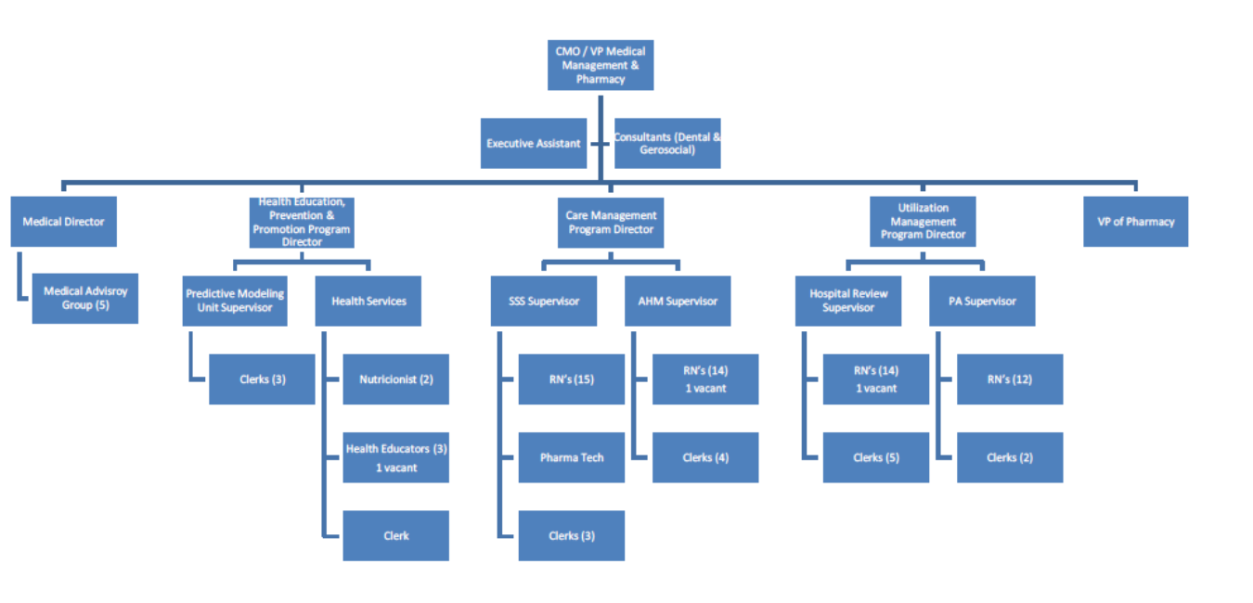
MOC 2, Element A Example- factor 3
Notes:
The example on the screen shows an organizational chart. SNPs/MMPs may provide one overall chart or display one for each unit e.g. business operations, customer service operations or case management to name a few.

Slide 22
MOC 2, Element A Example- factor 5
SmartHealth’s initial and annual MOC training is computer-based. The electronic educational system allows us to log attendance lists and follow up on education delivered. The training incorporates various competencies related to specific job functions. Strategies include web based training modules such as business overview, Integrity and Compliance, Fraud and Abuse, Cultural Competency, HIPPA and Confidentiality. Job function content includes the use of Orientation Guides, directed self- paced learning, didactic modules, and mentoring for a minimum of 4 weeks as well as classroom training.
Notes:
In this written example, MOC training is described. There are details of how the training is completed, the training content, maintenance/documentation of attendance at training and the time frame for completion of training.

Slide 23
MOC 2, Element A Example- factor 7
Failure to complete the training within the designated timeframe may result in corrective actions (CAP) ranging from providing reminder e-mails about trainings, phone calls to the PCP, and other outreach.
Notes:
This is a very small example but there may be several types of actions taken which is dependent upon the significance. For example, complete lack of training or lack of response to completing the orientation exams or attestations. The CAP may be to initially send the staff a letter notifying that the MOC training has not been completed and then a follow-up phone call directly to the staff, if the training is still outstanding.

Slide 24
MOC 2, Element B: Health Risk Assessment Tool
Intent: Describe how the HRAT collects and uses data to assess medical, functional, cognitive, psychosocial and mental health needs of members.
Focus:
How the HRAT is used to develop the Individual Care Plan (ICP)
Dissemination of information to Interdisciplinary Care Team (ICT)
Process for conducting the initial and annual assessments
Methodology used to review, analyze and stratify HRA results
Notes:
This element requires plans to provide a description of the HRAT; specifically how it is used in the coordination of members’ care e.g. the development and updating of the ICP and how it communicates the results to the ICT. The description also includes the process for conducting the initial and annual assessments (noting the timeframe for reassessment), the rationale for reviewing, analyzing and stratifying HRAT results and communicating that information to the member/caregiver & stakeholders.

Slide 25
MOC 2: Element B: Health Risk Assessment Tool
How the organization uses the HRAT to develop and update the Individualized Care Plan (ICP) for each beneficiary (Element 2C).
How the organization disseminates the HRAT information to the Interdisciplinary Care Team (ICT) and how the ICT uses that information (Element 2D).
How the organization conducts the initial HRAT and annual reassessment for each beneficiary.
The detailed plan and rationale for reviewing, analyzing and stratifying (if applicable), the HRA results.
Notes:
This element of the HRAT is not about the reporting requirements, but about the content of the tool. Details such as how is the information gathered and and then utilized to assess and stratify the member and documented with the member's ICP and discussed with the ICT. What are the time frames for reassessing the performance. In addition, a description of when the initial and annual HRAT is performed.

Slide 26
MOC 2, Element B Example- factor 1
SmartHealth utilizes a standardized, comprehensive approach to collecting, analyzing and communicating information collected via the health risk assessment tool (HRAT). The HRAT is a combination of several assessments that focus on the medical, psychosocial, cognitive and functional needs and disabilities of members of our target population and identifies current and future health risks. The HRA is completed by the Care Manager (a Nurse Practitioner (NP), or Registered Nurse (RN)) within 30 days of the member’s enrollment into the plan and is conducted in the member’s home. The assessment includes a full medication review (prescribed, over-the-counter medications, vitamins and herbal supplements; discussions with the member’s PCP occur; review of the HRA for prioritization of problems and interventions and need for community resources, identification of co-morbidities associated with common conditions found in this dual eligible population such as: chronic obstructive pulmonary disease, cardiovascular disease, cerebral vascular disease and diabetes.
Notes:
In this example, it describes who completes the HRA and the time frame for completion. The evaluation also includes but is not limited to an assessment of: medical, psychological, and cognitive functions of the member. Home safety, safety with mobility and notes any equipment in the home, falls risk, functional limitations and decreased activities of daily living and the process for inclusion into the member’s individual care plan (ICP).
In addition to the description, organizations can include screenshots of their HRAT.

Slide 27
MOC 2, Element B Example- factor 4
SmartHealth’s care managers, registered nurses, are responsible for reviewing and analyzing the HRA through the system which has the ability to data mine the specific risk criteria. Others involved in the review of member health care needs are those involved in the member’s ICT such as physicians, nurse practitioners, pharmacists, psychologists, therapists, specialists and social workers. At the member level, the data is reviewed by the ICT which sets the services most appropriate for the member to receive and the frequency of plan to member outreach. This information allows the Care Manager to identify members needing a higher level of care management, services and monitoring. The health risk profile also allows the Care Manager and ICT to be proactive and target interventions. Using a multidisciplinary team approach structured to address the member’s particular needs, the ICT, led by the Care Manager, develops the ICP with the involvement of the beneficiary, to the extent possible. Again, the information in the ICP is maintained in member health records and preserved on the organization’s secure server. Each ICT member or ancillary provider has access as applicable.
Notes:
Once the HRA is complete, organizations need to describe who is responsible for reviewing and what/how the HRAT results are analyzed and then stratified to assist with the development of the ICP. The specific details within the HRA will help determine who should be a part of the ICT as the ICT will be responsible for assisting the member in reaching their goals.

Slide 28
MOC 2, Element C: Individualized Care Plan (ICP)
Intent: Describe how the ICP is developed and communicated
Focus
Describing the essential elements of the ICP
Detail the process for development/modification
Identify staff responsible
How updates to the ICP are:
Documented
Maintained; and
Communicated
Notes:
The intent of Element C is to describe how the SNP develops/updates the ICP.
Focus:
Emphasize that CMS expects an ICP for all SNP beneficiaries but allows flexibility for the SNP to stratify by risk and place priority on high risk/high need beneficiaries

Slide 29
MOC 2, Element C: Individualized Care Plan (ICP)
The essential components of the ICP.
The process to develop the ICP, including how often the ICP is modified as beneficiaries’ health care needs change.
The personnel responsible for development of the ICP, including how beneficiaries and/or caregivers are involved.
How the ICP is documented, updated and where it is maintained.
How updates and modifications to the ICP are communicated to the beneficiary and other stakeholders.
Notes:
The ICP must have details of the beneficiary’s self-management goals and objectives, members personal healthcare preferences, a description of services specifically tailored to the beneficiary’s needs, and identification of goals (met or not met). This should include how the ICP is developed and modified, which personnel is responsible (such as the care manager), how the ICP is documented and where it will be maintained for updates. Lastly, how any modifications of the ICP are then communicated to the beneficiary and other stakeholders such as the ICT.

Slide 30
MOC 2, Element C Example- factor 2
Member care plans are reviewed and revised by the member’s care manager, in coordination with the member’s primary care practitioner. All members of the ICT are involved in the development and review of the ICP. The member, whenever feasible is a vital component of the ICT and is involved in the development and review of his/her plan of care. In addition, specialists involved in the care of the member are involved in the development and review of the plan of care. Revisions are based upon the hanging health needs of the member, as identified in the HRA and feedback from providers. Care plans are reviewed and revised according to the following frequency:
Every six months, following completion of the Health Risk Assessment.
When there has been a change in the member’s condition (i.e. hospitalization, new onset of chronic condition and change in psycho-social function). Included in the ICP revision is an evaluation of the identified goals and whether they are met.
Notes:
The example on the screen shows how the ICP is updated, when and what is involved in developing the ICP. Outside of the original development of the ICP, there may be changes in members health status that creates a situation where a member may not meet a goal and therefore, the ICP can be adjusted accordingly.

Slide 31
MOC 2, Element C Example- factor 4
The member care plan is created, maintained, revised, documented and stored in the electronic care management system. It is available to the internal plan staff that are ICT members, such as care managers, social workers and member services specialists. The plan of care is shared with the external ICT either by fax, secure email, by mail or telephonically. The member is mailed a hard copy of his/her plan of care. External ICT members may also access the member’s plan of care through the secure web portal on the plan website. Revisions to the care plan are shared in similar methods. The care manager is integral to any and all communications as he/she coordinates all services included in the care plan with the providers, the PCP and the member. Communication of the care plan occurs at enrollment and continues every six months during the semi-annual assessment of members, in the event of change in condition, new onset of disease, medication changes, completion of set goals and/or interventions, during/after a hospitalization or change in level of care, and referral to behavioral health services. All members of the ICT have the opportunity to review and provide comment on the ICT. The PCP is faxed a copy which he/she is asked to sign as evidence of collaboration. Once received by the plan, the document is scanned into the member record…
Notes:
This example describes where the ICP is stored, who has access, and how it is shared/accessed by providers involved in the care. Additional information that you cannot see on the screen even stated how the organization maintains policies and procedures relating to HIPAA and information systems back-up and disaster recovery procedures.

Slide 32
MOC 2, Element D: Interdisciplinary Care Team (ICT)
Intent: Describe the key components of the ICT
Focus:
Key members of ICT
Roles/responsibilities
How the ICT contributes to improving beneficiary health status
Communications within the ICT
Notes:
The intent of element D is to describe the key components of the ICT. We also want to clarify that the ICT may meet “virtually” using various forms of communication/technology (face-to-face is not required); however, the description must detail how the meeting occurs, frequency, etc.

Slide 33
MOC 2, Element D: Interdisciplinary Care Team (ICT) Cont’d.
How the organization determines the composition of ICT membership.
How the roles and responsibilities of the ICT members (including beneficiaries and/or caregivers) contribute to the development and implementation of an effective interdisciplinary care process.
How ICT members contribute to improving the health status of SNP beneficiaries.
How the SNP’s communication plan to exchange beneficiary information occurs regularly within the ICT, including evidence of ongoing information exchange.
Notes:
The organization must explain how it facilitates the participation of beneficiaries and their caregivers as members of the ICT and be able to describe the roles and responsibilities of the ICT to determine the composition of the ICT and to make the implementation of the ICP effective.This includes areas where additional team members are needed to meet the unique needs of a beneficiary. As regular communication will be needed among the member and withing the ICT, there must be a description of the type of evidence of information exchange.

Slide 34
MOC 2, Element D Example- factor 1
In addition to the member and family/caregivers, the ICT is comprised of various disciplines whose primary purpose is to coordinate the delivery of services and benefits that address the member’s specific needs. Members of the ICT are determined by analysis of the member’s initial health risk assessment and/or subsequent follow-up assessments as well as the member's care plan. After a member is enrolled in the plan, he/she is assigned to a care manager. The care managers are registered nurses who all have experience throughout the long term care continuum, including home care. SmartHealth makes every effort to match our members with care managers who have similar cultural and lingual attributes to ensure communication between the two is effective. Depending on the unique needs of the members, the care manager determines the other appropriate members of the members care team. The primary care physician is at the core of the team with specialists added. At a minimum, the ICT members include the member, care manager, primary care physician/practitioner, specialists, home and community-based services providers, caregivers and/or family and a medical director. In addition, SmartHealth has access to a wide variety of internal team members e.g. health educators, health coaches, pharmacists, nurse practitioners, social workers and behavioral health specialists. These ICT team members work closely with community based resources that may be added to the ICT as needed….
Notes:
The example shows a description of how the ICT is comprised based on the beneficiaries’ needs. It further details how care managers are assigned upon enrollment and who will determine which practitioners should be involved on a particular ICT. You should be able to describe if any cultural or linguistics needs will be matched up with a care manager with similar attributes. If the PCP is the core team member, the ICT must describe this along with who else will be participating in the ICT such as specialist and home and community based service providers.

Slide 35
MOC 2, Element D Example- factor 3
ICT contribution to improving the health status of the SNP members by:
Analyzing and incorporating the results of the initial and ongoing health risk assessment into an ICP
Collaborating to develop and update an ICP for all members. Managing the medical, cognitive, psychosocial, and functional needs of members in a timely, cost-effective manner.
Communicating and coordinating the care plan with members, providers and their caregivers
Making recommendations for the members to have access to additional needed services, including participation in intensive care management, chronic care disease and other special programs.
After the HRA is complete, the care manager communicates telephonically with the ICT to develop the comprehensive care/service plan for the member… Meetings with the member are prescheduled with the member’s agreement and are coordinated by the care manager. Meetings are scheduled via notices and Microsoft Outlook for all ICT members. Each care manager is responsible for creating the master schedule of ICT meetings for all assigned members as communicating these meetings to the ICT…
Notes:
MOC 2D requires a description of how the ICT contributes to the members health. Details regarding how the results are analyzed and incorporated into the ICP; who is collaborating to develop and update the ICP, making recommendations; and what the ICT does once the HRA is complete. This can included with meetings with the member by the care manager to ensure the member is meeting goals or the ICT may meet to review the members ICP progress.

Slide 36
MOC 2, Element E: Care Transition Protocols
Intent: Describe the SNP’s processes to coordinate care transitions and facilitate timely communications across settings and providers.
Focus:
Describing the type of health care settings and personnel responsible for care transitions
How are elements of the member’s ICP shared between settings and who has access
How member’s and/or caregivers are educated for self-management activities
Describe the point of contact throughout the transition process
Notes:
For MOC 2E, the intent is to address transitions of care and personnel responsible for coordinating those transitions.

Slide 37
MOC 2, Element E: Care Transition Protocols Cont’d.
The process for coordinating transitions
Personnel responsible for coordination efforts
Description of coordination between settings during a care transition
How beneficiaries have access to personal health information to facilitate communication with providers
Education provided to members/caregivers to manage conditions and avoid transitions
Process used to notify members/caregivers of staff assigned to support member through transitions
Notes:
Factor 1: the process for coordinating transitions for example, how is a transition identified? What steps are taken?
Factor 2: What personnel are responsible for coordination efforts? Case manager? Provider? Does the responsibility change per SNP type e.g. I-SNPs or Institutional Equivalent SNPs? Who ensures follow-up services, e.g., scheduling appointments, needed resources
Factor 3. The organization must ensure that elements of the beneficiary’s ICP are transferred between health care settings when the beneficiary experiences a transition in care. The MOC must describe the steps that take place before, during and after a transition in care has occurred for this process.
Factor 4: Beneficiary personnel health information. The organization must describe the process for ensuring that SNP beneficiaries and/or their caregivers have access to and can adequately use personal health information to coordinate care for the beneficiary.
Factor 5: The MOC must describe how beneficiaries and/or their caregivers will be educated about their condition, how they will demonstrate understanding of changes in their condition (improvement, stable or worsening), and use of appropriate self-management activities Self-management activities can include regular assessment of progress, goal setting and problem solving support to reduce crises and improve health outcomes.
Factor 6: The organization must describe the process it uses to notify beneficiaries and/or their caregivers of the personnel responsible for supporting them through transitions between any two care settings.
Simply put, how does the member or his caregiver know which staff serves as the person responsible for addressing their issues, questions or concerns?

Slide 38
MOC 2, Element E Example- factor 2
Health Services Specialists - provide operational and clerical support to the Health Services teams. They distribute faxed clinical review information to nurses; fax the hospital determination log to facilities…
Inpatient Review Nurses - Case Managers are typically on-site at select hospitals and they conduct medical necessity and discharge planning reviews for members who are admitted. They will also provide information to the member and the member’s family on what to expect upon discharge and support the member through the transition and discharge process; makes appropriate CM referrals for post discharge follow up (telephonic review, Care Transition Coaching and others (i.e., Complex Care Management Program, behavioral health…; report any potential Quality of Care issues…
Care Transition Coach (CTC) - is a nurse or social worker who follows patients across care settings after leaving the hospital as part of the Care Transitions Coaching program. SmartHealth's Case Management department has adopted the strategies designed to ensure proper follow up and case management after a hospital stay….
Notes:
Again, this is just a snippet of possible descriptions but the MOC must detail the personnel responsible throughout the entire care transition process; specifically, titles and responsibilities must be provided.

Slide 39
MOC 2, Element E Example- factor 4
Members who complete the HRA tool are mailed care plans and they are encouraged to share them with their providers to facilitate communication during the transition process. These care plans are written at or below a 6th grade reading level to ensure that members are able to use and understand them. In these letters, members are provided with the telephone number and contact information for the Care Management department. Care managers can work with the member or caregiver to update the care plan, mail updated care plans to the member or share care plan information with the member’s PCP or treating physician in any care setting. Members are also encouraged to complete and maintain their Personal Health Record (PHR) which contains member goals, a medication list, allergies, questions for providers, member conditions and “red flags” and should be shared at all visits to the member’s doctor or to the treating facility. SmartHealth works with members to complete the PHRs and ensure that they understand how to use them. Finally, SmartHealth developed an online member portal that has the capability to share care plans with members and caregivers….
Notes:
The MOC must also describe how members have access to their personal health information to facilitate communication with providers in other healthcare settings. Details of how to access the ICP and who to contact if it is not electronic. It is imperative that SNPs ensure that the member understands of what is contained in the ICP in order to speak knowledgeably with other providers during the care transition.

Slide 40
MOC 2, Element E Example- factor 6
The use of SmartHealth’s online portal will allow both members and family members to have access to their medical record, members of their ICT and changes in transition of care. When a member experiences a transition in care, they are immediately transferred to the transition team who contacts the family members as well as the new setting (i.e. hospital, rehabilitation center) to see what the plan of care is as well as a potential discharge date. This is documented in the care management system. A social worker is sent out to the new setting to evaluate member and reach out to the D/C planners to maintain optimal contact/planning. The member’s care manager is the point of contact for the member and/or caregivers throughout the transition process. This is communicated to the beneficiary and family via phone calls by the care manager to stay in touch on a routine basis.
Notes:
The MOC must include a process for the member’s point of contact (who will support them throughout the entire care transition process). Details should include who the contact is; contact phone/email; and the contact person must understand what is needed of them in order to facilitate the care transitions and other questions the receiving facility or member may have.

Slide 41
Questions?

Slide 42
HPMS Review
Susan Radke

Slide 43
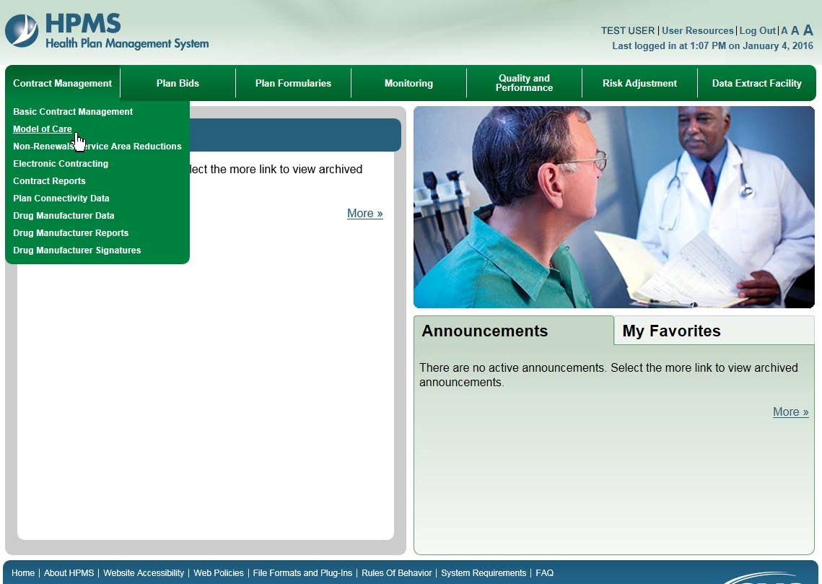
HPMS Review – Contract Management Tab

Slide 44
HPMS Review – Models of Care

Slide 45
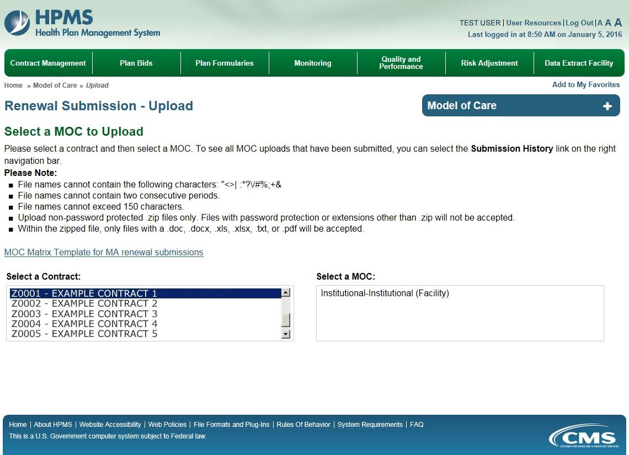
HPMS Review – Select an MOC to Upload

Slide 46
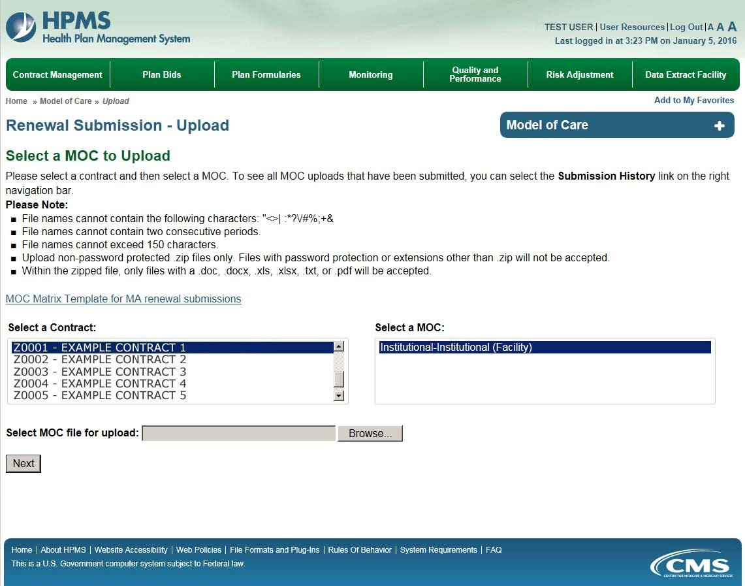
HPMS Review – Select MOC File for Upload

Slide 47
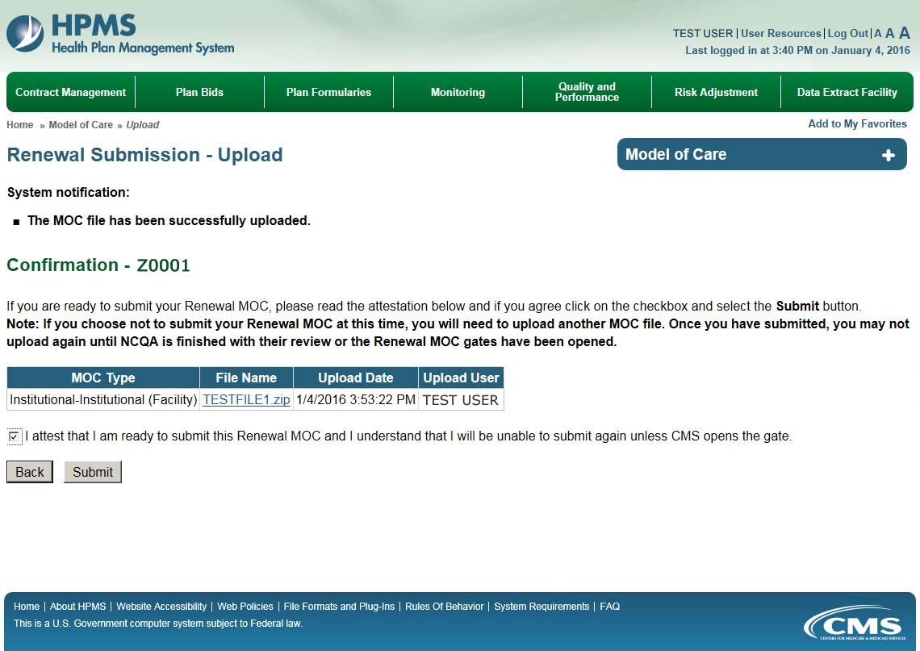
HPMS Review – MOC File Upload Confirmation

Slide 48
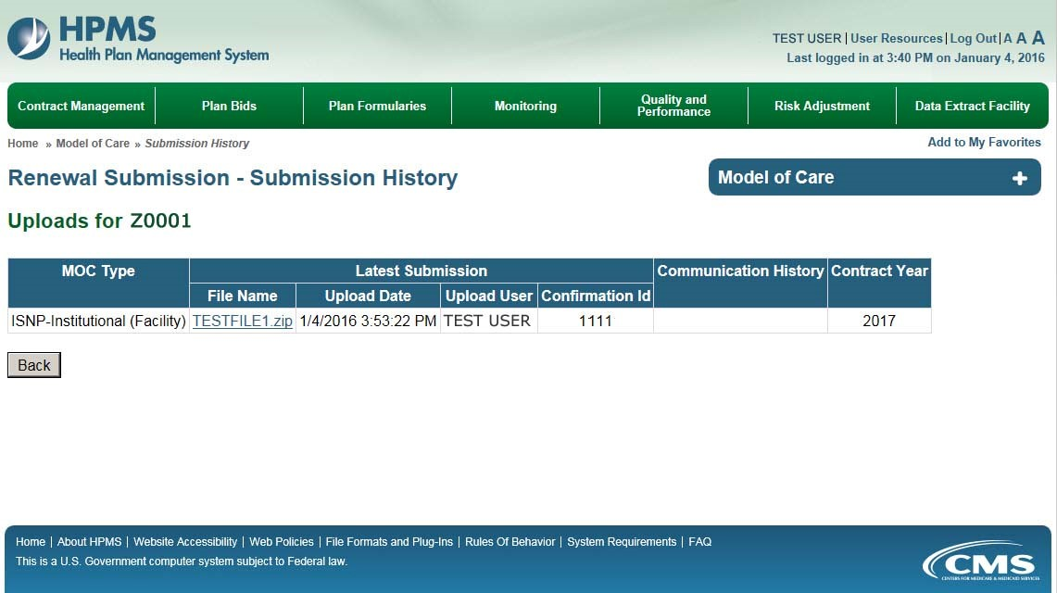
HPMS Review – Submission Renewal

Slide 49
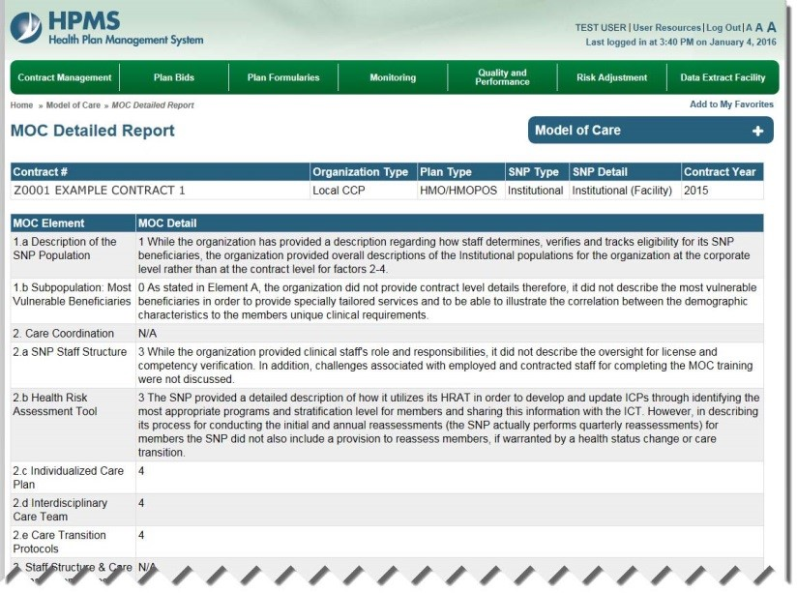
HPMS Review – MOC Detailed Report

Slide 50
Training & Education
Sessions focus on MOC Requirements & Technical Assistance
-- MOC Elements 1 & 2 (1 training)
January 12, 2016, 3:00-4:30pm EST
-- MOC Elements 3 & 4 (1 training)
January 14, 2015, 3:00-4:30pm EST
-- Technical Assistance Calls 3:00–4:30pm EST for SNPs scoring <70%
February 9, 2016
April 21, 2016
Recordings and slides available on NCQA SNP Approval website within one week of call

Slide 51
CMS Contacts
For technical inquires related to the MOC program plan requirements, or other issues related to the SNP approval proposal in the regulations, please contact CMS at: https://dpap.lmi.org. In the subject line enter: SNP MOC Inquiry
For SNP application inquiries via the CMS SNP mailbox: please type https://dmao.lmi.org into your web browser, then select the SNP mailbox. Subject line: SNP Application Inquiry
CMS MMP mailbox: mmcocapsmodel@cms.hhs.gov
Subject line: MMP MOC Inquiry
For training recordings and slides: please visit the NCQA SNP Approval Website at: https://www.snpmoc.org

