Slide 1
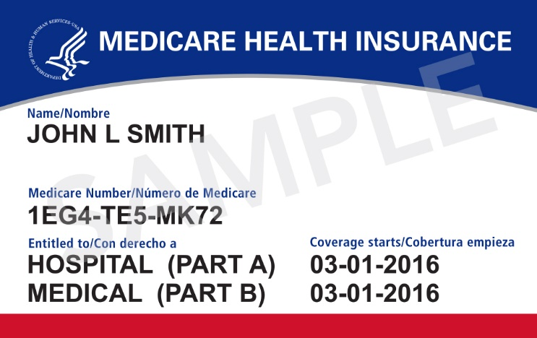
New Medicare Card
Information for Partners & Stakeholders
September 2017

Slide 2
Background
The Health Insurance Claim Number (HICN) is a Medicare beneficiary’s identification number, used for processing claims and determining eligibility for services across multiple entities (e.g., Social Security Administration (SSA), Railroad Retirement Board (RRB), States, Medicare providers & health plans)
The Medicare Access and CHIP Reauthorization Act (MACRA) of 2015 requires removal of the Social Security Number (SSN)-based HICN from Medicare cards to address current risk of beneficiary medical identity theft
MACRA requires that CMS mail out new Medicare cards with a new Medicare Number by April 2019
The new Medicare numbers won’t change Medicare benefits. People with Medicare can start using their new Medicare cards right away.

Slide 3
New Unique Medicare Number
New Medicare Number
New Non-Intelligent Unique Identifier
11 bytes
Key positions 2, 5, 8 & 9 will always be alphabetic

Slide 4
New Card Design
Consumer tested by people with Medicare
Positively reviewed among 10 possible cards designs
Strong preference to maintain red, white and blue palette
Easy to read, copy, scan at provider offices
Smaller size to match the size of a standard credit card
Bilingual in English/Spanish
Gender & signature line won’t appear on new Medicare cards
All cards, including for Puerto Rico, will be printed on
white paper
Notes:
The card has a new look and design
We have removed both the gender field and signature line
Neither item is necessary to be included on the card to obtain Medicare services
Gender information will remain in CMS’ systems and be available to providers through the HETS
With removal of signature line, beneficiaries can laminate their card if they wish
The card is being reduced to match the size of a standard credit card
Its smaller size will fit more easily in a wallet
The cards will now be bilingual in English/Spanish
Cards for Puerto Rico will be printed on white paper
Through industry feedback in Puerto Rico, it was found that there was not a need for the card to be in plastic
CMS considered plastic cards, but paper was selected due to cost
Have to be good stewards of taxpayer dollars and have limited budget to produce 60 million cards and ongoing costs for new beneficiaries and existing beneficiaries who have coverage or other data changes.

Slide 5
Sending New Medicare Cards
Medicare starts mailing New Cards in April 2018
Newly-eligible beneficiaries will get a card with a unique number, regardless of where they live
Existing beneficiaries will get a new card over a period of approximately 12 months
The mailing will include the new Medicare card and a letter with instructions
Distribution of cards will be randomized by geographic location
All existing cards will be replaced by April 2019 statutory deadline
Beneficiaries should use the new card once they get it, but either the SSN-based or the new random alphanumeric-based cards can be used through December 2019
Beginning January 1, 2020 only the new card will be usable
The Railroad Retirement Board will issue new cards to RRB beneficiaries
Notes:
Beginning April 2018, Medicare cards with Social Security Numbers will stop.
Once the art switches formally in April 2018, all cards produced will be the new card with the random number
New beneficiaries will get a card with the random number, regardless of where they live
Existing beneficiaries will get a new card over a period of approximately 12 months
Medicare cards will be mailed by the U.S. Post Office via first class mail
The mailing will include the new Medicare card and a letter with instructions
The distribution of cards will be randomized by states to help stop fraud/bad actors
We will attempt to mail cards to single households at the same time (i.e., spouses get cards at same time/within short time of each other)
A beneficiary who doesn’t get their new card by April 2019, should check their address of record at the Social Security Administration to make sure their address is up to date
Beneficiaries can also obtain a benefit verification notice, which will include the new Medicare number, by visiting their MySocialSecurity.gov account.
Either the SSN-based or the new random number-based cards can be used through December 2019
Beneficiaries can use either number to get services in Original Medicare or to enroll in a Medicare health or drug plan
Beginning January 1, 2020 only the new card will be usable

Slide 6

Common Scenario #1
Mrs. Jones becomes entitled for Medicare in March 2018 and is automatically enrolled. Mrs. Jones will receive her Initial Enrollment Period package with her Medicare card in January 2018. Ms. Jones’ Medicare card includes her Social Security Number. The area where Ms. Jones lives will receive new Medicare cards in May 2018. Mrs. Jones will receive a new Medicare card with a new unique number in May 2018.
Notes:
Under this scenario, Mrs. Jones will receive a Medicare card with the Health Insurance Claim Number (HICN). Mrs. Jones will receive her new random Medicare number in May 2018. The new Medicare cards will be mailed beginning in April 2018. Beneficiaries who receive a Medicare card prior to April 2018 will receive a Medicare card with the Health Insurance Claim number (HICN) and get their new card at the same time as other existing beneficiaries, based on where they reside.

Slide 7

Common Scenario #2
Mr. Smith becomes entitled for Medicare in August 2018. He will receive his Initial Enrollment Period package in May 2018. The area where Mr. Smith where is scheduled to receive the new Medicare cards in September 2018. Mr. Smith’s original Medicare card will be the new design with the new number. Mr. Smith won’t receive another (duplicate) Medicare card in August 2018 when the new Medicare cards are mailed to other people with Medicare in his area.
Notes:
Under this scenario, the Medicare card produced for Mr. Smith occurs in April 2018 when the new Medicare cards are being printed and mailed because Mr. Smith received his IEP prior to the date that the new Medicare Cards were scheduled to mail in his state. Mr. Smith won’t receive another (duplicate) new Medicare card in August 2018 when cards are mailed in his state.

Slide 8

Common Scenario #3
Ms. Green signs up for Part B using a Special Enrollment Period in March 2018. She receives the current Medicare card with the SSN-based number. The area where Ms. Green resides is scheduled to receive the new Medicare cards in September 2018. Ms. Green will receive the new Medicare card in September 2018.
Notes:
Any new enrollment or change in enrollment that occurs prior to the formal art change will get the current card with the SSN-based number. Any enrollment change that occurs after the formal art change will get the new card with the random number. This includes new enrollments, adding or dropping Part B or premium Part A, name changes, and entitlement date changes.

Slide 9
Replacement Cards and Numbers
People with Medicare should make sure their current address is correct with the Social Security Administration NOW, as needed
People who lose their Medicare card will continue to be able to get a replacement (duplicate) card
People who believe they are victims of identity theft or Medicare fraud will be able to get a different new Medicare number by contacting 1-800-MEDICARE
Notes:
Beneficiaries should make sure their address is correct in Social Security’s files
CMS mails cards based on the address of record at SSA
Can check address and make updates to it via MySocialSecurity.gov – this is the fastest way to check and make changes
Can call SSA’s toll-free helpline or visit a local office.
Beneficiaries who lose their card (or their card gets destroyed – torn, worn out) will continue to be able to get a replacement (duplicate) cards by visiting Medicare.gov, calling 1-800 Medicare, visiting MySocialSecurity.gov or calling SSA’s toll-free helpline.
Once their card is mailed, someone with Medicare can also access their new Medicare Number on a Medicare Summary Notice or through MyMedicare.gov
Don’t encourage beneficiaries to request replacement cards to get the new Medicare card quickly
We will be producing large volumes of cards as quickly as possible
Surges in replacement card requests will not be able to be delivered
The current card is usable until January 2020
Beneficiaries who believe their new, random Medicare number has been compromised (e.g., stolen, victim of identity theft, Medicare fraud) will be able to get a new MBI number by contacting 1-800-Medicare
All Medicare numbers are random and no requests for specific number can be granted

Slide 10
New Medicare Card Survey Findings: Sept 2017
Extremely low awareness of upcoming changes to the Medicare card
11% say that they have recently seen, heard, or read something
When informed, response to the project is positive
88% say that they feel this is a positive change
88% support removal of the Social Security Number from Medicare cards
86% agree that a new Medicare number will be more secure
79% agree that a new Medicare number will protect from identity theft
In general, there are no top of mind concerns
75% indicate they have no concerns
When asked about specific potential concerns, greatest concerns were for:
Potential cost of replacing all cards (61%)
Potential inability to find lost Medicare numbers (42%)
Communication Opportunities
Messaging that fills informational gaps and builds on expectations:
Timing – even among the few aware, there is little knowledge about timing
Key message of Social Security Number removal, as this is seen as a positive change
Reinforce what to do once the card is received
Notes:
National survey conducted by telephone and online from July 19, 2017 thru August 6, 2017 with a total of 1,029 current Medicare beneficiaries
Purpose: examine awareness and expectations about the new Medicare card project
Additional survey waves will be fielded following key communication activities

Slide 11
Your Guide for Outreach
October 2017 – December 2017: Open Enrollment
Continue “Card Awareness” outreach through messaging embedded in regular Open Enrollment events and earned media, steady drumbeat messaging via press, social media, speaking engagements, blogs, etc.
Card messaging should supplement, but not supersede “review and compare” actions for Open Enrollment
January 2018 – March 2018: New Cards are Coming!
Ramp up pre-mailing outreach and identify opportunities for sharing messages and materials with providers and people with Medicare
April 2018 – April 2019: Watch for your New Card
Cards are mailed!
Simple, direct instructions included with the new card mailing
Active, localized information sharing
Robust messaging on Medicare.gov, 800-MEDICARE, Medicare social media
Specialized communications for those with limited English proficiency and alternative format needs

Slide 12
Outreach & Education Materials for Public
Materials for People with Medicare:
Medicare & You 2018 Handbook (mailing now)Inside front cover is a “heads up” that new Medicare cards are coming and why, an image of the new card, card mailing timeframes, and basic tips for getting ready, like making sure your address is up to date with Social Security
Medicare 2017-2018 Calendar (Sold Out – more coming soon!)
The March 2018 page includes a reminder that new Medicare cards are coming
One-Page Flyer (available for download this month or order print copies in Oct)
Stand-alone reprint handout of Medicare & You page

Slide 13
Medicare & You page/Flyer
Medicare & You Page/Flyer

Slide 14
Outreach & Education Materials on CMS.gov
Job aid for Partners: Available now
Includes key messages to communicate to people with Medicare
https://www.cms.gov/Medicare/New-Medicare-Card/Partners-and-Employers/NMC-Job-Aid-12003-P.pdf
Tear-off Pads for Provider Offices: Available Mid-Sept
For provider office staff to give to people with Medicare
Will contain an image of the card, card mailing timeframes, and a reminder to make sure your mailing address is up to date with Social Security
Small Posters for Provider Offices: Available in Oct
Messaging similar to tear-off sheets

Slide 15
Tear-off for provider offices
Tear-off for
provider offices

Slide 16
What Providers Can Do to Get Ready
Look for mail coming from CMS that includes instructions about a secure provider look-up tool
Check with your billing vendors if they haven’t already contacted you about system changes
Display posters and place tear-off pads in your offices and waiting rooms
Follow the Medicare Learning Network and look on www.cms.gov/newcard for the latest information about new Medicare cards

Slide 17
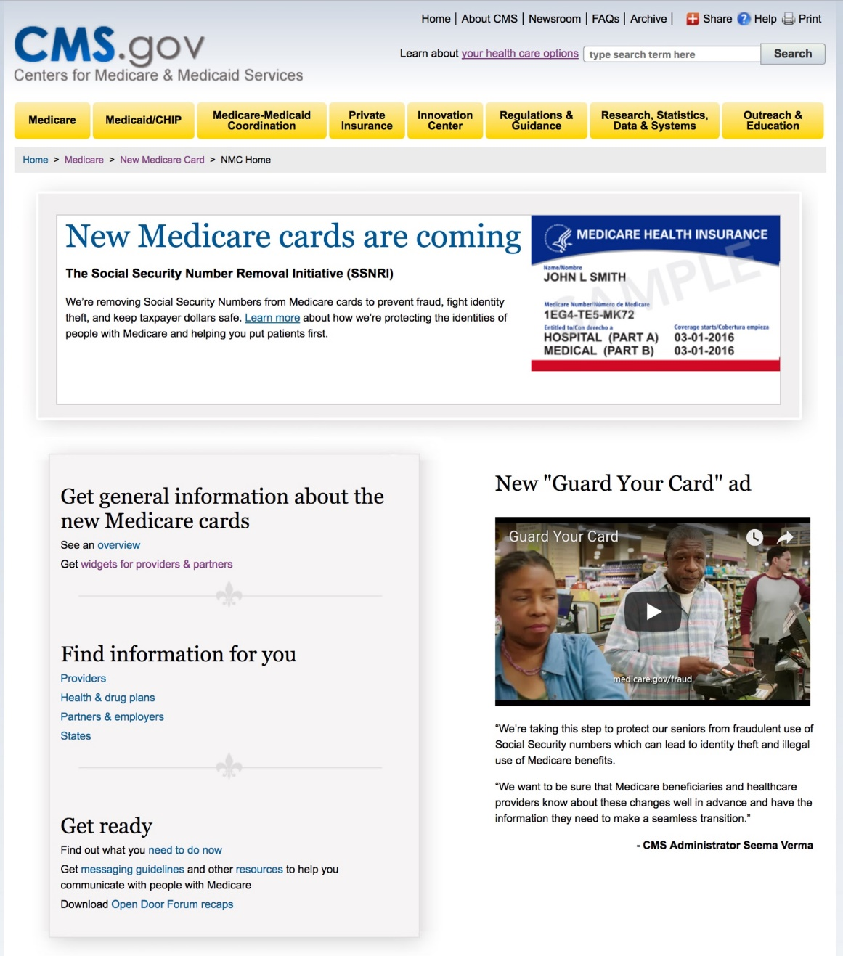
Cms.gov/newcard
Current information available on www.cms.gov/newcard

Slide 18
“Guard Your Card” Campaign
Objectives
Educate people with Medicare about how to identify suspicious activities, particularly during the Open Enrollment period, and prevent fraud by protecting their Medicare number
Alert people with Medicare that new Medicare cards are coming next year to protect their identity and prevent fraud
Tactics
Paid/Earned/Social Media
Updated information channels and educational resources
Training for information intermediaries
Local outreach by Regional Offices, SMPs, SHIPs
Timeline
Aug 21 – Sept 24 Paid Media, Earned & Social Media
Sept 24 – Dec 7 Earned & Social Media
Notes:
Objectives
The Fraud Prevention “Guard Your Card” Campaign is typically conducted before the fall Medicare Open Enrollment Period (Oct 15 – Dec 7) when the risk of scams to fraudulently obtain Medicare numbers increases.
The campaign educates people with Medicare about how to identify suspicious activities, particularly during the Open Enrollment period, and prevent fraud by protecting their Medicare number
It also alerts them that new Medicare cards are coming next year to protect their identity and prevent fraud.
Tactics
Campaign features paid/earned/social media, updated information channels and educational resources, training for partners and other stakeholders, and local outreach by CMS Regional Offices, Senior Medicare Patrols (SMPs), and State Health Insurance Assistance Programs (SHIPs)

Slide 19
“Guard Your Card” Campaign Key Messages
Paid Media
Con artists are trying to get your Medicare number so they can steal your identity and commit Medicare fraud
Guard your Medicare card like it’s a credit card
Give your Medicare number only to those you know should have it
To protect your identity, new Medicare cards without social security numbers will be mailed next year.
Earned & Social Media
Fight fraud by protecting your Medicare number
Medicare won’t call you uninvited for your Medicare number
Be alert about suspicious activities to enroll you in a Medicare plan
Early bird discounts
Limited time offers
Offers of free medical services
Call 1-800-MEDICARE to report suspected fraud
Visit medicare.gov/fraud or your local SMP for more information
Notes:
Here are the key messages contained in the TV ad….
Con artists are trying to get your Medicare number so they can steal your identity and commit Medicare fraud
Guard your Medicare card like it’s a credit card
Give your Medicare number only to those you know should have it
To protect your identity, new Medicare cards without social security numbers will be mailed next year.

Slide 20
Stay Connected
Find more technical information, detailed updates, training opportunities, and materials to share on the web:
https://www.cms.gov/newcard
Comments and questions are always welcome! Send to: NewMedicareCardSSNRemoval@cms.hhs.gov

