Slide 1
Medicare Provider Enrollment 2012
Center for Program Integrity
Centers for Medicare & Medicaid Services
Zabeen Chong
Director of Provider Enrollment Operations Group
Mark Majestic
Deputy Director
Decision Health
October 4th, 2012

Slide 2
Provider Enrollment Focus for 2012
Improve the way providers view and interact with CMS while maintaining the integrity and security of provider information.
Core Areas :
Customer Service
Online Enrollment (PECOS)
Data Accuracy & Integrity (Revalidation)
Strengthen Fraud Prevention

Slide 3
Customer Service
Take a proactive role in helping Providers and Suppliers get answer to questions and work more efficiently

Slide 4


What Providers were saying
  “…oh yea, we all call any MAC at least 3 times if we have a question. Then take the average answer... and you need to make sure you change up the time of day you call to make sure you get a new shift.” (Lack of consistent information to the provider community when they contact a MAC does not create a feeling of confidence or trust.)
  “We have $1M in billing at stake related to a single provider we have been working to enroll for months.” (Providers lose millions of dollars a year due to processing delays.)
  “Processing provider enrollment applications is second only in complexity to auditing Medicare Hospital Cost Reports”…
  -- Senior Executive, Medicare Administrative Contractor

Slide 5
Our Change in Culture
We heard you!
…And we are here to help.
Provider & Medicare Contractor
Focus Groups
New features and changes are based on listening to providers and Medicare contractors and crafting solutions around the needs instead of implementing features or policies that simply meet regulation.
Culture of Customer Service
Changing the attitude of Provider Enrollment at CMS and MACs to one of collaboration and support. Working with the Provider to understand what they have a question about, and providing the correct answer or getting them to the right person, with the first call.
= Changes directly from groups like this in the last 12 months.

Slide 6
Proactive Education & Outreach
List Serv - Notification of program and policy details, updates and announcements, press releases, event reminders, educational material announcements, and other news and information for Medicare FFS providers. To join send an email to FFSProviderRelations@cms.hhs.gov
CMS.gov – Questions about enrollment criteria and links to hot topics like Revalidation, Ordering and Referring, and ADI Accreditation requirements
PECOS Homepage – https://pecos.cms.hhs.gov/ - Redesigned to have quick links to account creation, video tutorials, providers resources , and FAQs.
Medicare Learning Network® MLN Matters® Articles – Articles designed to inform Medicare FFS providers about the latest changes to the Medicare Program. To sign up for MLN Matters® go to https://list.nih.gov/cgi-bin/wa.exe?A0=mlnmatters-l and select ‘Subscribe’ under the ‘Options’ tab on the right side of the page.
National Provider Calls - educational conference calls conducted for the Medicare Fee-for-Service (FFS) provider and supplier community that educate and inform participants about new policies and/or changes to the Medicare program.

Slide 7
Recent Processing Improvement
(to support providers)
Ability to submit enrollment applications and updates 60 days in advance.
Ability to fax certain information to Medicare Contractors.
Require MACs to develop for missing information rather than return the application due to being incomplete.

Slide 8
Recent Processing Improvement
(to speed up processing)
Frequent workgroup calls with all MACs to ensure any policy or direction is communicated consistently and discussed as needed.
Use a central site visit contractor to ensure consistency and timeliness or processing.
E-Signature & Digital Documents

Slide 9
Upcoming Changes
Evaluating Processes – We are reviewing processes such as Survey & Cert to identify areas where processing time can be reduced.
Standardization of Letters – We are standardizing all letters sent by contractors to ensure clarity and consistency.
855 Form Updates – We are updating all of the forms to reduce redundant data collection, and streamline data entry.
  855O July ’12 (Released)
  855S January ’13 (Tentative)
  855A, B, I, and R - January ’14 (Tentative)

Slide 10
Pecos Enhancements
Increase the use of systems and reduce processing time by improving the tools and information available to Providers by enhancing PECOS.

Slide 11
What you had to say about PECOS!
  “The changes you are making [to PECOS] are really great, but if I still need to send in a paper at the end of the process why should I go on line rather than submit paper.” (30% of applications require some form of additional development for missing information.)
  “I like PECOS, but if it takes me 15 minutes to find the record I am looking for to even begin to make a change it is faster for me to just use paper.” (Only 15% of providers are using internet based PECOS to enroll or submit changes to their Medicare enrollment.)
  “…the problem is that Providers are not the ones who update and manage their records, it is their office manager or the credentialing staff at the group they work for that does all the real work.” (Program, processes, and system complexity makes it longer to do anything, and most programs or systems do not account for the reality of how the industry functions.)

Slide 12




Our Solution: Provider Driven Changes
  Increase Usability:
  Evaluate the user experience from start to finish, simplify online registration processes, reduce data entry time, and provide tools for large groups and organizations.
  All Digital Process:
  Remove paper from the enrollment process, leverage new and existing best practice technology, and allow increased connectivity for large providers.
  Transparency:
  Increased access to information and communication about the status of enrollments.

Slide 13
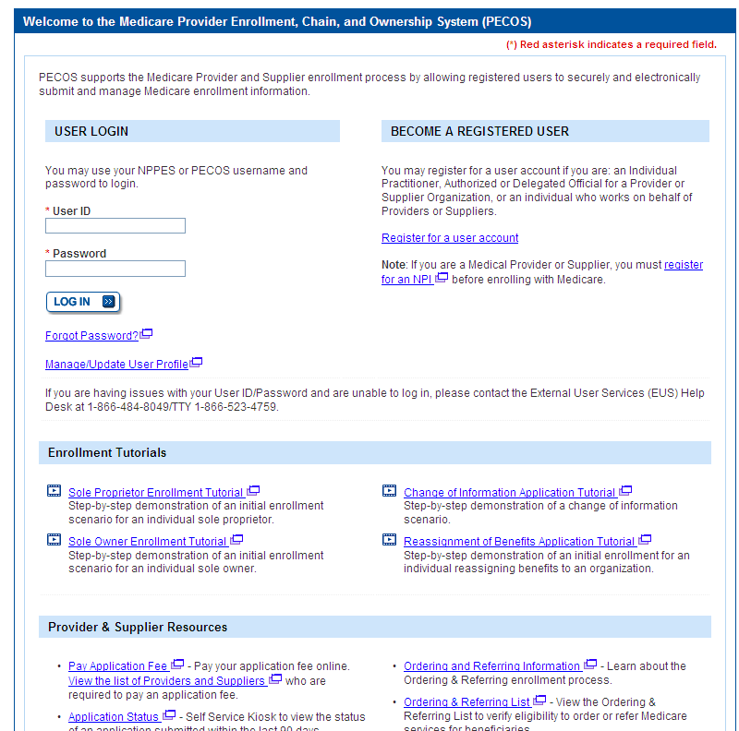
Updated Homepage
Improved homepage layout with quicker access to what provider needs most.
  Access to account information.
  Video walkthroughs of how to enroll or update your information w/PECOS.
  Direct links to resources such as revalidation mailing and ordering & referring lists.

Slide 14
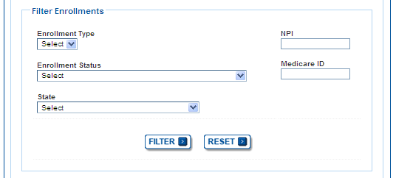
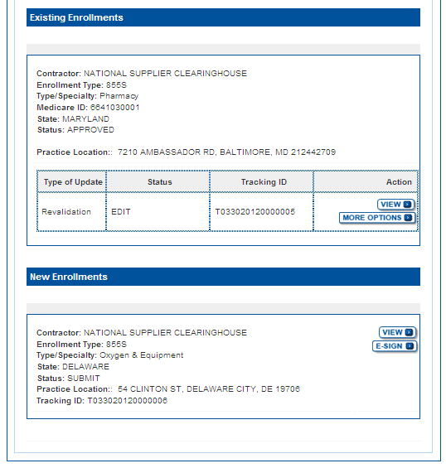
Filter, Search, and Reformat
Allow large groups or chains to quickly find particular enrollments.
  Search & Filter (Enrollment Type, NPI, Status, Medicare ID, State, and Specialty)
  Increased information about each enrollment up front.
  Ability to see the status of changes that have been submitted.
  Ability to see if a request for revalidation has been sent by the MAC.

Slide 15
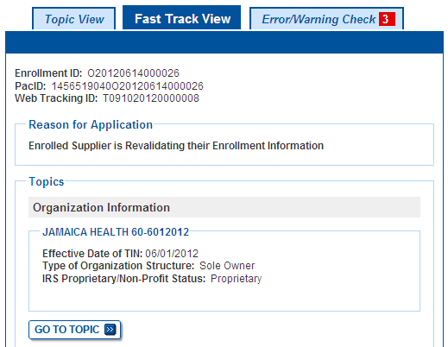
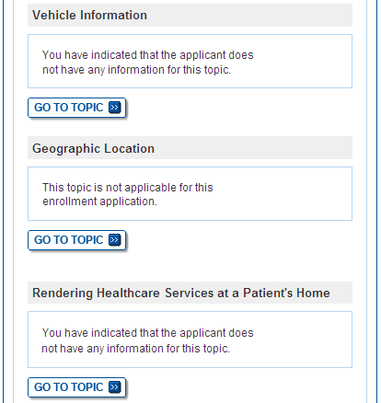
View all current enrollment information on a single screen and quickly update.
The ability to switch between a Topic View (walkthrough driven mode), and Fast Track View (advanced data entry mode).

Slide 16
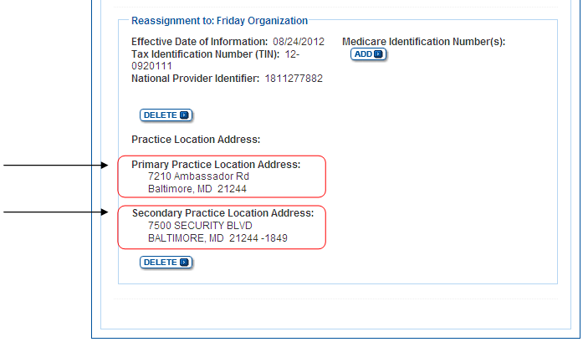
Primary & Secondary Practice Location
Providers can now specify a “Primary and Secondary Practice Location” when reassigning benefits that will then be published to Physician Compare

Slide 17
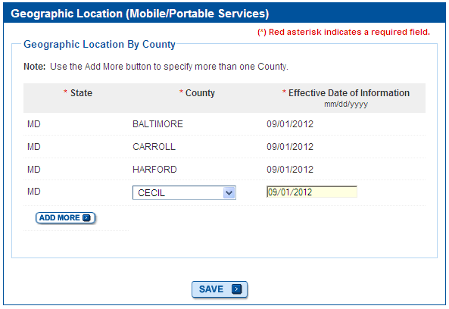
Geo-Location by County
Providers will now have the option to select “County” in the “Geographic Location” topic when identifying the Geographic Location where services are rendered for CMS 855A and CMS 855B enrollment applications

Slide 18
Upload Digital Documents
Ability to upload electronic versions of supporting documents during completion of an enrollment application.
  View a dynamic “required documents list” based on enrollment application type.
  Reduce paper.
  Reduce application processing time.

Slide 19
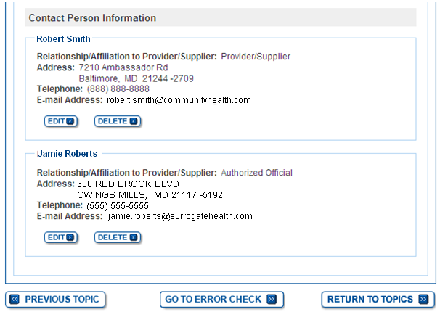
Add & Store Multiple Contacts
Providers will now be able to enter and store multiple contact persons in the Contact Information section.

Slide 20
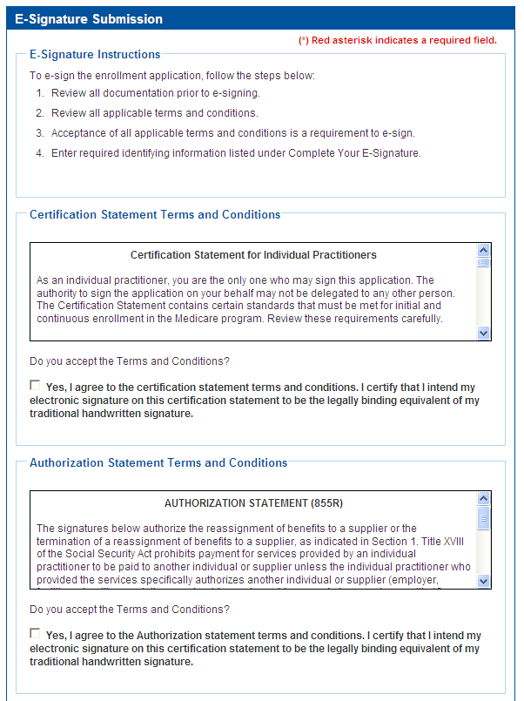
E-Signature
  Ability to electronically sign any application submission (including ones that require multiple signatures)
    Reduces paper.
    Reduces application processing time.

Slide 21
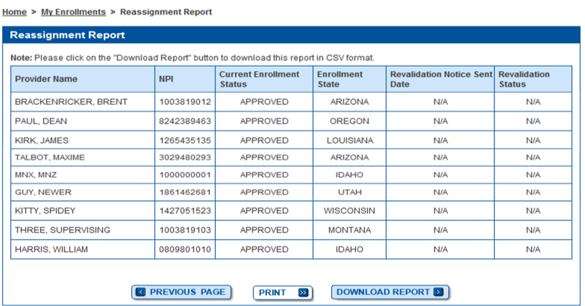
Transparency for Groups Accepting Reassignments
Allow Part B groups to View and Download reports to see a list of all providers that have reassigned benefits to them.

Slide 22
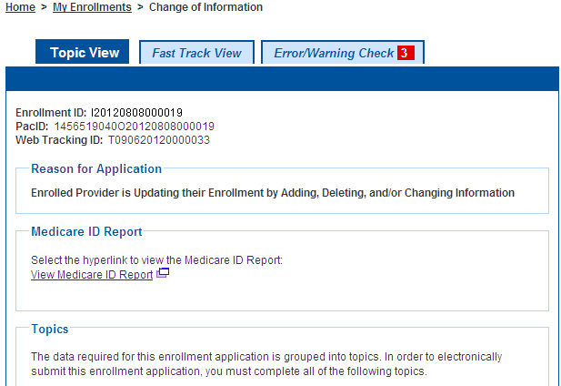
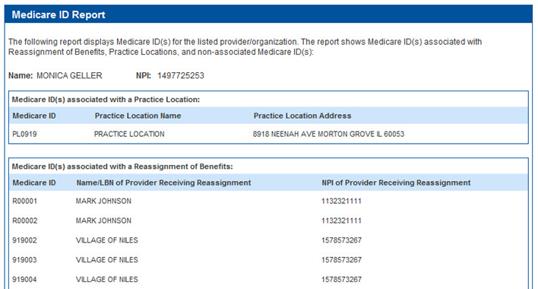
Display all Medicare IDs
Providers will now be able to see a report of all Medicare IDs associated with a particular enrollment record.

Slide 23
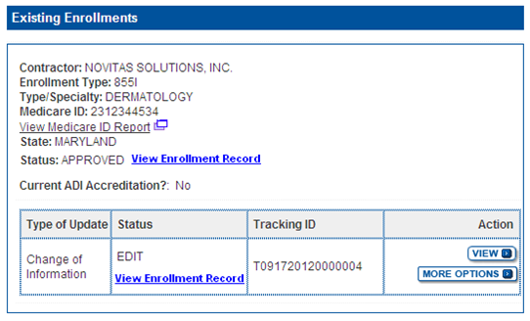
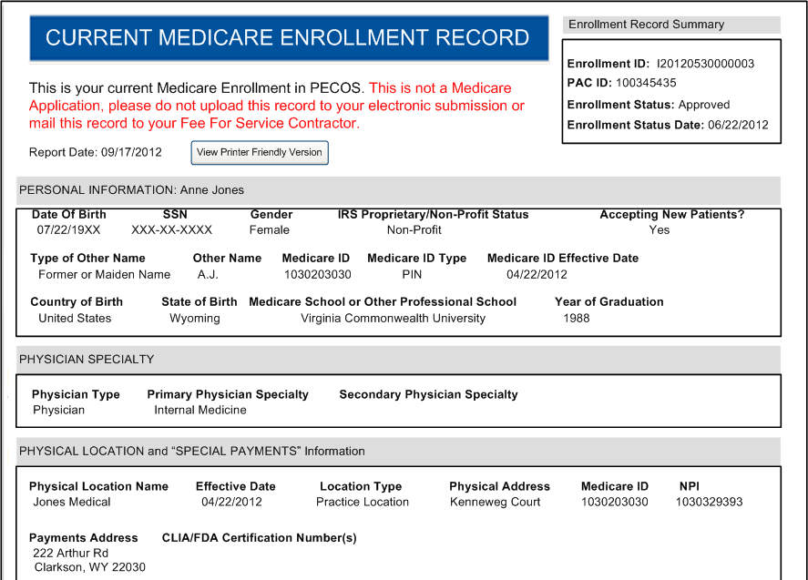
Quick HTML View
Printable HTML Record of the information currently on record with CMS (and any pending submissions)

Slide 24








Simplified Access for Individual Providers, Organizations and Support Staff
Reset forgotten passwords and usernames online, without calling CMS.
Streamlined process for Organizations to register an Authorized Official.
Ability for Organizations and Providers to quickly approve Staff or others to work on their behalf.
Support Staff
Authorized Surrogate

Slide 25





Additional Changes
 | Ability to select previously used address information when completing an application. |  | Reducing the number of screens and steps for frequent changes and Revalidation.
 | Ability to quickly update and resubmit any application returned for corrections. |  | View DME License Information, and ADI accreditation.
 | Ability to electronically submit EFT updates via PECOS as part of any application submission. |  | Ability to convert an 855O registration to an 855I enrollment record.
DME

Slide 26
Data Accuracy & Integrity (Revalidation)

Slide 27
Revalidation: What is it?
  What is the Revalidation Project … and how will it affect me?
  The revalidation project is an effort by CMS, mandated by Section 6401 (a) of the Affordable Care Act, to verify all information on file for existing Medicare Providers, and to ensure they meet all standards associated with the new screening criteria.
  Approximately 1.5 Million Providers & Suppliers must be revalidated by March 25, 2015.
  Sometime in the next 24 months you will receive a request to revalidate the information on your Medicare enrollment(s).

Slide 28
Revalidation: Overview
  All providers/suppliers enrolled with Medicare prior to March 25, 2011, must revalidate their enrollment information.
  Providers/suppliers must submit the revalidation application only after being asked by their MAC to do so.
  Moving forward, all DMEPOS Suppliers must be revalidated every 3 years, and all other providers/suppliers must be revalidated every 5 years.

Slide 29
Revalidation: MAC Customer Service
MACs will conduct multiple outreach attempts before administrative action is taken.
Extensions may be granted by the MAC.
MACs will deactivate instead of revoke if you don’t respond.
MACs will accept Fax/Email submission of supporting documents.
Remove requirement to re-submit documents already on file.

Slide 30
Revalidation: A Structured Process
…to reduce the burden on the providers
    CMS identifies who to revalidate in each phase
    CMS provides the provider list to revalidate to the Medicare Administrative Contractors (MACs)
    MACs mail specific revalidation requests to providers
    Providers act quickly upon the revalidation request to ensure no issues

Slide 31
Revalidation: via Internet Based PECOS
Internet-Based PECOS – The quickest way to revalidate. (https://pecos.cms.hhs.gov)
    Revalidation Dates
    Accessing Sample Revalidation Letters
    Status of your Revalidation Request
    Fast Track View

Slide 32
Revalidation: Outreach
Post revalidation mailing list monthly on CMS.gov
Reference tools (FAQs, MLN articles) available online for providers and MACs
Continue quarterly focus groups with providers/suppliers
  Continue to address provider association workshops/conferences through MAC Sponsored Outreach Events, AMA Workgroups, Open Door Forums, etc.

Slide 33
Revalidation:
Top 10 Questions from Providers & Suppliers
If I have different Enrollments in different states, will I receive all the requests at the same time? – No, each MAC is responsible for sending their own mailings.
How will I know when to expect my letter? – You will receive a notice in a yellow envelope, it will be posted on CMS.gov, and it will be listed on your enrollment in PECOS.
What do I need to do to receive an extension, and what reasons are approved? – Call your MAC. There are a wide number of reasons and CMS has instructed them to accept all reasonable requests.
Does the Application Fee apply to me? – If you are a provider or supplier that meets the requirement listed in CMS 6028, then yes. (see PECOS Homepage for a simple list)
What happens if I don’t reply to a request to Revalidate? – You have 60 days to respond, after which time you will be deactivated.

Slide 34
Revalidation:
Top 10 Questions from Providers & Suppliers
What if I have multiple Medicare IDs, will I get letter for each one? – If you received a notice during Phase I you received a letter for each, however from Phase 2 forward you will receive a letter based on your enrollment (and all associated Medicare IDs).
What if I receive a notice for a Medicare ID I don’t recognize? – Complete your revalidation based on information you know to be correct, and alert your MAC to deactivate any numbers that are no longer valid, or you do not recognize.
Will all of the Members in my group get the letter at the same time? – No. Groups and Individuals that reassign benefits will be sent separate independent notices. Regardless of a providers reassignment status, they are responsible for revalidating their own record.
What address will my Revalidation Notice be sent to? Your revalidation notice will be sent to your Correspondence Address on record or Physical Location.
Where can I go for more information about Revalidation? You can visit the PECOS homepage, or CMS.gov for the list of notices sent, sample revalidation letter, and other helpful tips.

Slide 35
National Fraud Prevention Program
New Programs, updated regulation, and increased awareness to the community to help prevent, detect, and take immediate action toward fraud, waste, and abuse.

Slide 36




National Fraud Prevention Program:
New Programs and Initiatives
 | Automated Provider Screening Uses thousands of independent databases to validate information, in an effort to improve and standardize the enrollment data verification by MACs. |  | Finger Printing and Background Checks Adding requirements for fingerprinting and background checks for High Risk Providers and their owners and managing employees. employees.
 | Increased Identify Verification (Identity Proofing) Add Identity Proofing processes to ensure the person who is logging into an enrollment system is who they say they are. |  | CPI Command Center Cross agency health care investigation teams taking immediate action on Medicare and Medicaid fraud

Slide 37
Fraud Prevention Awareness:
Medical Identity Theft
Process changes to protect Provider’s Enrollment records, and prevent Identity Theft
MACs have been instructed to contact the provider in the original enrollment record prior to adding a new PTAN to the enrollment
Greater care is being taken to revoke only illegitimate PTANs, allowing providers to continue billing through legitimate PTANs
Provider revalidation will close vulnerable or misused PTANS (e.g., locum tenens billing)
Increased identity verification and protection for those who use online PECOS.

Slide 38
National Fraud Prevention Program:
National Site Visit Contractor
The National Site Visit Contractor (NSVC) will conduct all the site visits that are currently conducted by the A/B Medicare Contractor Administrators (MACs) .The purpose of the site visits is to verify information of record about different types of Medicare providers/suppliers and submit its completed reports to CMS.
Answers to Common Questions:
All Providers classified as moderate or high risk as defined by CMS 6028 are subject to a site visit.
All inspectors have a Letter of Authorization written on CMS letterhead and signed by the COR, Nannette Hardouin, and a picture ID. They may or may not have business cards.
If you are temporarily closed when they visit, they will automatically perform a second visit before reporting information and findings back to the MAC.

Slide 39
Updated Regulation:
Ordering & Referring
Ordering & Referring: 6010 requires all Providers who Order or Refer services for certain procedures, services, or medical equipment, must be enrolled or registered with Medicare, or claims by ordering and certifying provider or supplier will be denied.
CMS will give a minimum of 60 days advanced notice to the provider community before the edits are turned on.
CMS is closely monitoring the number of providers not yet enrolled or registered with Medicare, and the number of informational messages.
Interns & Residents will be required to fully enroll or complete 855O (via Paper or through PECOS Web).
DME & HHA Providers are being contacted when there have been Organizational NPIs (Type II NPIs) on the claim.

Slide 40
Updated Regulation:
Ordering & Referring
Requirements: Interns and Residents
  The final rule states that State-licensed residents may enroll to order and/or refer and may be listed on claims.
  Claims for covered items and services from un-licensed interns and residents may still specify the name and NPI of the teaching physician.
  If States provide provisional licenses or otherwise permit residents to practice or order and refer services, interns and residents are allowed to enroll to order and refer consistent with State law.

Slide 41
Wrap Up!
We hear you, and are improving customer service and processing guidance to help.
PECOS has more information about your records on file, has improved with your input, and is now a fully electronic process – ensuring your application will be processed faster than submitting paper.
Revalidation is here, you will receive a notice when it applies to you, and there will be multiple ways to check if a notice was sent to you.
We are taking immediate and collaborative action to investigate and stop fraud waste and abuse.

Slide 42
Questions and Discussion
Questions and Discussion
Zabeen Chong
Director, Provider Enrollment Operations Group
&
Mark Majestic
Deputy Director, Provider Enrollment Operations Group
Center for Program Integrity
Centers for Medicare & Medicaid Services

Slide 43
Disclaimer
This presentation was current at the time it was published or uploaded onto the web. Medicaid and Medicare policies change frequently so links to the source documents have been provided within the document for your reference.
This presentation was prepared as a service to the public and is not intended to grant rights or impose obligations. This presentation may contain references or links to statutes, regulations, or other policy materials. The information provided is only intended to be a general summary. Use of this material is voluntary. Inclusion of a link does not constitute CMS endorsement of the material. We encourage readers to review the specific statutes, regulations, and other interpretive materials for a full and accurate statement of their contents.
Presentation Date: October 4th 2012

