Slide 1

Quality Reporting Program Provider Training
HQRP: Achieving a Full APU – A Bare Bones Overview
Please wait, the webinar will begin shortly.
Cindy Massuda, Brenda Karkos, and
Debra Dean-Whittaker
January 23, 2019

Slide 2
Quality Reporting Program Provider Training
HQRP: Achieving a Full APU – A Bare Bones Overview
Cindy Massuda, Brenda Karkos, and
Debra Dean-Whittaker
January 23, 2019

Slide 3
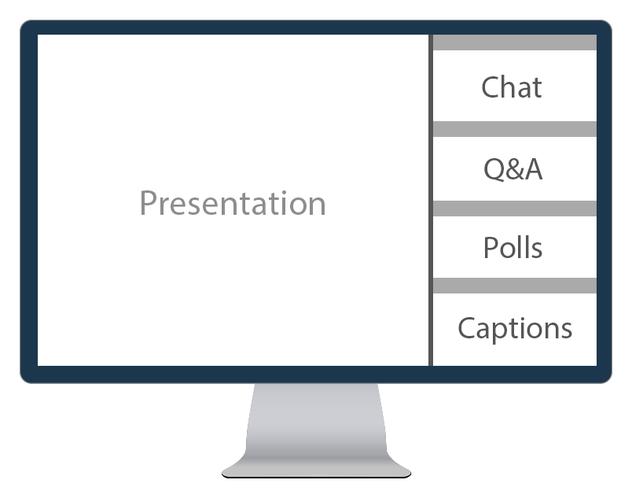

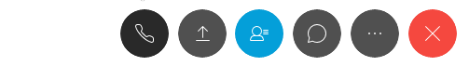
Help During the Presentation
If you need any technical assistance during this webinar, use the Chat panel to the right of the presentation.
If during the webinar you have any content-related questions, please submit those using the Q&A panel.
1
2
Notes:
Sharon:

Slide 4

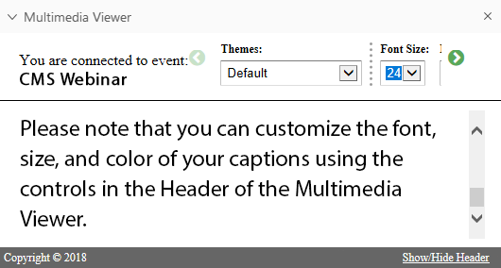
Closed Captioning is Available
Closed captioning is available during this webinar. Captions are found within the Multimedia Viewer panel in the lower right.
You can control the appearance
of captions using the controls
there.
Selecting the “Hide Header”
link will increase the space
available for closed captioning.
1
2
3
Notes:
Sharon:

Slide 5

Acronyms
APU - Annual Payment Update
ASAP - Assessment Submission and Processing
CAHPS® - Consumer Assessment of Healthcare Providers and Systems
CASPER - Certification and Survey Provider Enhanced Reports
CCN - CMS Certification Number
CMS - Centers for Medicare & Medicaid Services
CY - Calendar Year

Slide 6
Acronyms (cont. 1)
FVR - Final Validation Report
FY - Fiscal Year
HIS - Hospice Item Set
HQRP - Hospice Quality Reporting Program
MAC - Medicare Administrative Contractor
NQF - National Quality Forum
PHI - Protected Health Information
PII - Patient Identified Information
QIES - Quality Improvement and Evaluation System

Slide 7
Acronyms (cont. 2)
QIES ASAP - Quality Improvement and Evaluation System Assessment Submission and Processing
QM - Quality Measure
QTSO - QIES Technical Support Office
VR - Validation Report

Slide 8

Today’s Agenda
24
Hospice Quality Reporting Program (HQRP).
The HQRP Life Cycle and Compliance that includes the “Calendar Year Process”:
  Reporting Hospice Item Set (HIS) and Consumer Assessment of Healthcare Providers and Systems (CAHPS®) Data.
  Using Reports to Track Your Hospice’s Data – Certification and Survey Provider Enhanced Reports (CASPER Reports).
  Knowing the Reconsideration Process.
January

Slide 9
Objectives
Recall basic information about the HQRP.
Describe the timeframe and the necessary steps towards HQRP compliance.
Describe the relationship between quality reporting and the Annual Payment Update (APU).
List the steps for reporting using your HIS and CAHPS® data.

Slide 10
Objectives (cont.)
Name at least two Certification and Survey Provider Enhanced Reports (CASPER) to check HIS and CAHPS® compliance.
Recognize how to use reports to check HIS and CAHPS® compliance.
Define the HQRP reconsideration process, including the timeframe and the steps for submitting a request.
Locate resources on the HQRP website.

Slide 11
Icebreaker

Slide 12
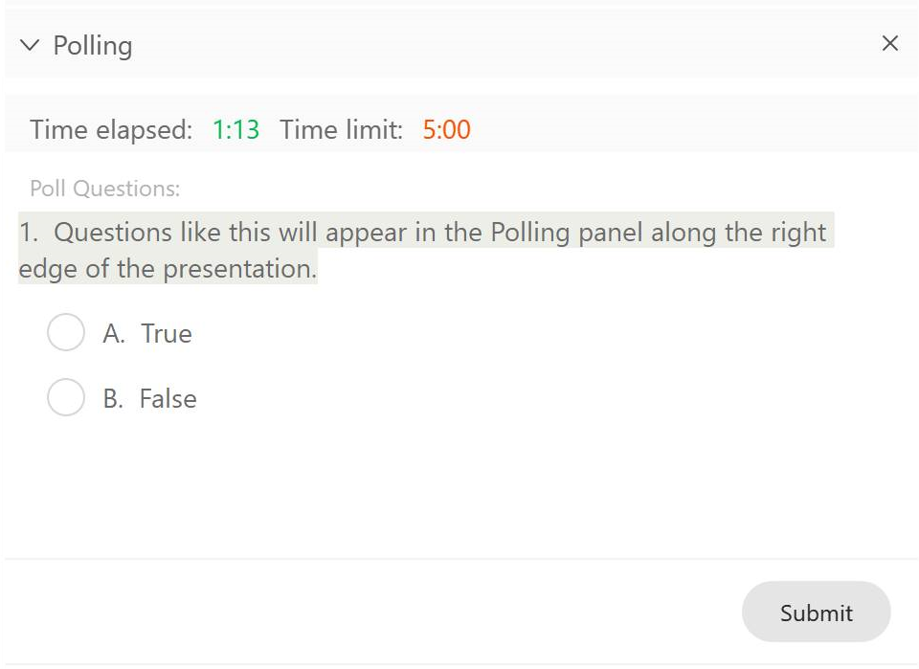
Interactive Polling
During this presentation we will occasionally poll the audience. The polling panel on the right will automatically expand.
  To respond, simply select your response, then click Submit.
  You will have some time to respond to each question.
1
Notes:
Sharon: Let’s give it a try.

Slide 13
How many people (including you) are joining this webinar together in the same room?
1
Just me – I am the only one participating.
Two people.
Three or four people.
Five or more people.

Slide 14
Where in the United States is the very first Hospice that opened in 1974?
2
Boston, MA
Branford, CT
San Francisco, CA
Washington, DC

Slide 15


Where in the United States is the very first Hospice that opened in 1974? (cont.)
2
Boston, MA
Branford, CT
San Francisco, CA
Washington, DC
Notes:
The answer is B- The very first Hospice established in the United States was in Branford, Connecticut.

Slide 16


Today’s Presenters
Cindy Massuda, JD
Senior Technical Advisor
Centers for Medicare & Medicaid Services
Brenda Karkos, MSN, MBA, RN
Associate Nurse Researcher
Abt Associates

Slide 17

Today’s Presenters (cont.)
Debra Dean-Whittaker, PhD
Contracting Officer’s Representative for the CAHPS® Hospice Survey
Centers for Medicare & Medicaid Services

Slide 18
What is the HQRP?
Notes:
Cindy: We are first going to start with what is the HQRP

Slide 19

What is the HQRP?
The HQRP promotes the delivery of person-centered, high-quality, and safe care by hospices.
CMS has adopted measures that were recommended by multi-stakeholder organizations and developed with the input of providers, payers, and other stakeholders.
Notes:
Cindy: So, what is the HQRP? And …Why is this Important?
The Affordable Care Act authorized the establishment of a quality reporting program for Hospices and specifies that hospice programs should submit quality measure data.
The Hospice Quality Reporting Program, or (the HQRP) promotes the delivery of person-centered, high quality, and safe care by hospices.
The Centers for Medicare & Medicaid Services (or CMS) has sought to adopt measures recommended by multi-stakeholder organizations, and developed with the input of providers, purchasers, payers, and other stakeholders.
As a refresher, let’s take a look at what is required…

Slide 20
HQRP Requirements
Currently, there are two requirements for HQRP:
  HIS data collection and submission.
  CAHPS® Hospice Survey submission.
All Medicare-certified hospice providers must comply with these two reporting requirements.
Notes:
Cindy: Currently, there are two requirements for the HQRP:
1.) The Hospice Item Set; you may hear this referred to as both the “H-I-S” and also the “His”…and
2.) The second requirement is the Hospice Consumer Assessment of Healthcare Providers and Systems or (the CAHPS® Hospice Survey).
The H-I-S gathers patient and agency level information on each Hospice Admission and Discharge, while the Hospice CAHPS gathers important input in regard to the patient and family “experience of care” in hospice.
CMS implemented the Hospice Item Set as part of the HQRP in Fiscal Year 2014 and Hospices began data collection using the HIS on July 1st of that year. The National implementation of the CAHPS® Hospice Survey began on January 1st, 2015.
All Medicare-certified hospice providers must comply with these two reporting requirements. We’ll briefly touch on each of these in the next few slides.

Slide 21
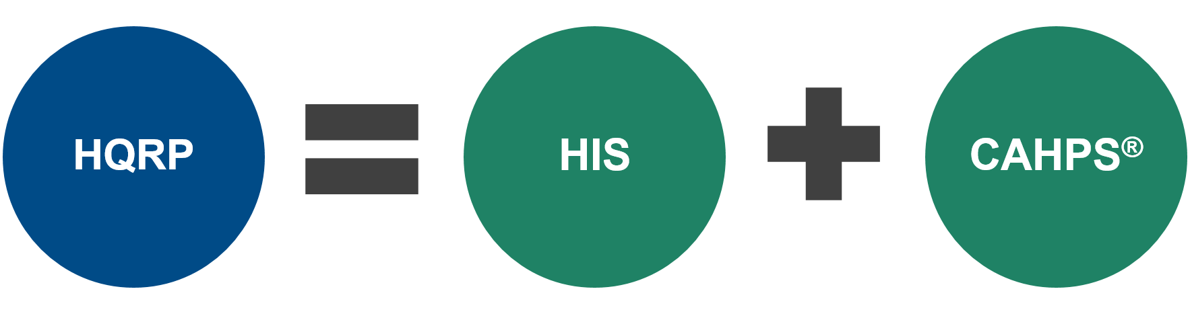
The HQRP
Notes:
Cindy: So, here is a graphic that you probably have seen before; it displays best what comprises the Hospice Quality Reporting Program, or the (HQRP). As we have said, the HQRP includes both the HIS and the CAHPS®.
Compliance with both of these components is necessary to meet the requirements!

Slide 22
Hospice Submission Requirements
Notes:
Cindy: Now let’s spend some time reviewing the submission requirements for the HIS and the CAHPS®.

Slide 23
HIS Submission Requirements
All Medicare-certified hospice providers are required to submit:
  HIS-Admission records.
  HIS-Discharge records.
HIS data are collected and submitted on all patient admissions, regardless of the payer, patient’s age, or location of the receipt of hospice services.
The information captured includes items used in the calculation of eight National Quality Forum (NQF)-endorsed quality measures (QMs).
Notes:
Cindy: We will start with the submission of the HIS portion of the quality reporting program. All Medicare-certified hospice providers are required to submit HIS-Admission records and HIS-Discharge records. HIS data are collected and submitted for ALL patient admissions, regardless of the payer, patient’s age, or the location of the receipt of hospice services.
The Admission – HIS records consist of completing 6 different sections of information that are captured during or upon the admission of a hospice patient. The Discharge HIS consists of 3 sections and this information is captured when the patient is discharged from the hospice.
The information collected is used in the calculation of eight National Quality Forum (or NQF) endorsed quality measures, or QMs. These measures are considered to be consistent with high quality care for hospice patients.
I won’t go into detail today re: the individual components of the HIS, but we will be sharing some resources that are readily available on our website, if you, or some on your staff are not familiar with these.

Slide 24
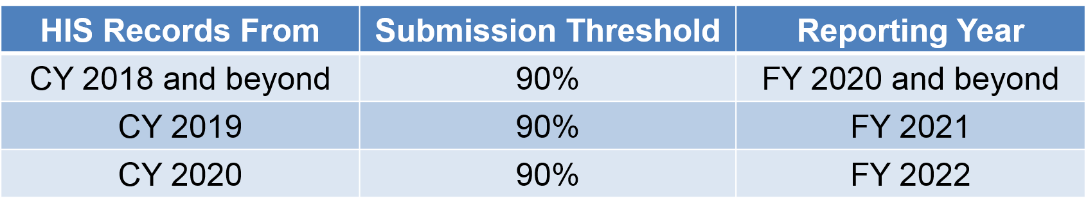
HIS Data Submission
The data collection year runs from January to December.
HIS data needs to be submitted and accepted within the acceptable threshold.
Notes:
Cindy: The data collection year for the HIS runs from January to December. HIS data needs to be submitted and accepted in the system in order to ensure compliance with the HQRP and prevent a reduction in payment. Compliance thresholds have been incrementally increased since 2016 and are now set at 90% for FY 2020 and beyond.
This graphic here shows that the data collected from January through December of 2018 needed to meet the submission threshold of 90%. That is, that 90 % of the data submitted by the hospice needed to be submitted and accepted on time. Compliance is evaluated in 2019, and the actual impact on payment will occur in FY 2020, which starts October 1, 2019.
For a hospice to receive their full payment in 2020, the threshold of 90% of on time submissions had to be met in 2018. All hospices meeting the 90% threshold requirement will avoid the 2 % reduction in their annual payment update (or APU).
So, you can see the same will be expected for this next year; Data will be collected from January through December of 2019; Compliance will be evaluated in 2020 and APU impact will occur in FY 2021, and so on.
This whole cycle spans over a three year period. A failure to meet the submission threshold during the collection year will effect payment in the FY two years later. Now, let’s briefly talk about the submission of the CAHPS® data.

Slide 25

CAHPS® Hospice Survey Submission Requirements
All Medicare-certified hospices must participate monthly (all 12 months) in order to receive their full APU.
Must contract with an approved survey vendor.
Vendor must successfully submit data to the CAHPS® Data Warehouse.
Data collection year January 1 through December 31.
Notes:
Cindy: To comply with the Hospice CAHPS® ALL Medicare-certified hospices must participate monthly (that is all 12 months) in order to receive their full Annual Payment Update (APU).
Each Hospice must contract with an approved survey vendor and this vendor must successfully submit data to the CAHPS Data Warehouse on behalf of the Hospice.
As with the HIS, the data collection year runs from January 1st through December 31st .
Debra Dean Whittaker will review a lot more about the CAHPS a bit later. For now, I will turn it over to Brenda who will review the HQRP life Cycle.

Slide 26
The HQRP Life Cycle -Determining Compliance
Notes:
Brenda: Thank you Cindy! Now lets look at the HQRP Life Cycle. We will talk about the role of Hospice, how and when compliance is determined and how the process leads to an impact on the APU.

Slide 27
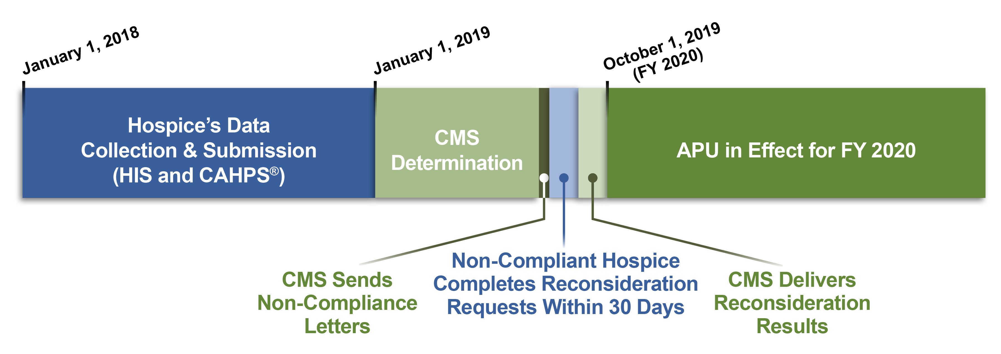
The HQRP Life Cycle
APU calculations:
  Year 1: Data collection and submission.
  Year 2: Compliance determinations.
  Fiscal Year (FY): APU in effect.
Notes:
Brenda: So, Cindy talked about the submission thresholds for the HIS reporting and the submission of CAHPS data. These activities are on a cycle and the cycle spans over a 2-3 year period. This graphic shows the cycle. The first section in blue is showing the Hospice role in data collection and submission during a one year period. This is showing January 2018 through the end of the year to January of 2019. The compliance determinations occur after January of 2019 (the beginning of that next year), and the payment impact occurs on October 1 which is the FY 2020, and goes into the third year. Throughout this cycle there are several time points to be aware, so we will go into more detail using the graphic as a guide.
Let’s take some time to look at the individual components of this cycle.

Slide 28
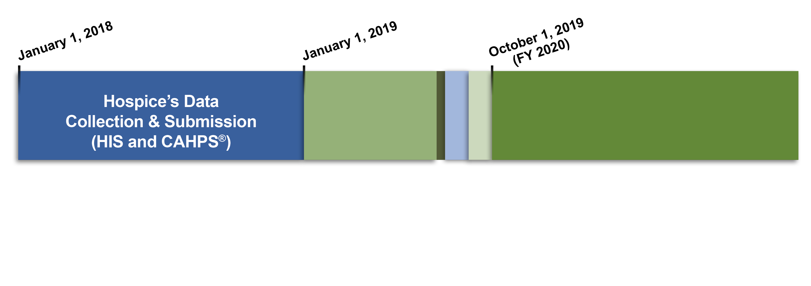
The HQRP Life Cycle: Data Submission
The calculation of the APU includes:
  HIS data.
  CAHPS® data.
Notes:
Brenda: Lets start with the Data Submission to begin this cycle. This includes both the HIS data and the CAHPS® data, those two components of the Hospice Quality Reporting Program. This is the frst part of the cycle and it is up to the hospice to meet the required thresholds. The your Hospice’s submission of both the HIS and CAHPS data will determine your APU in FY 2020.

Slide 29
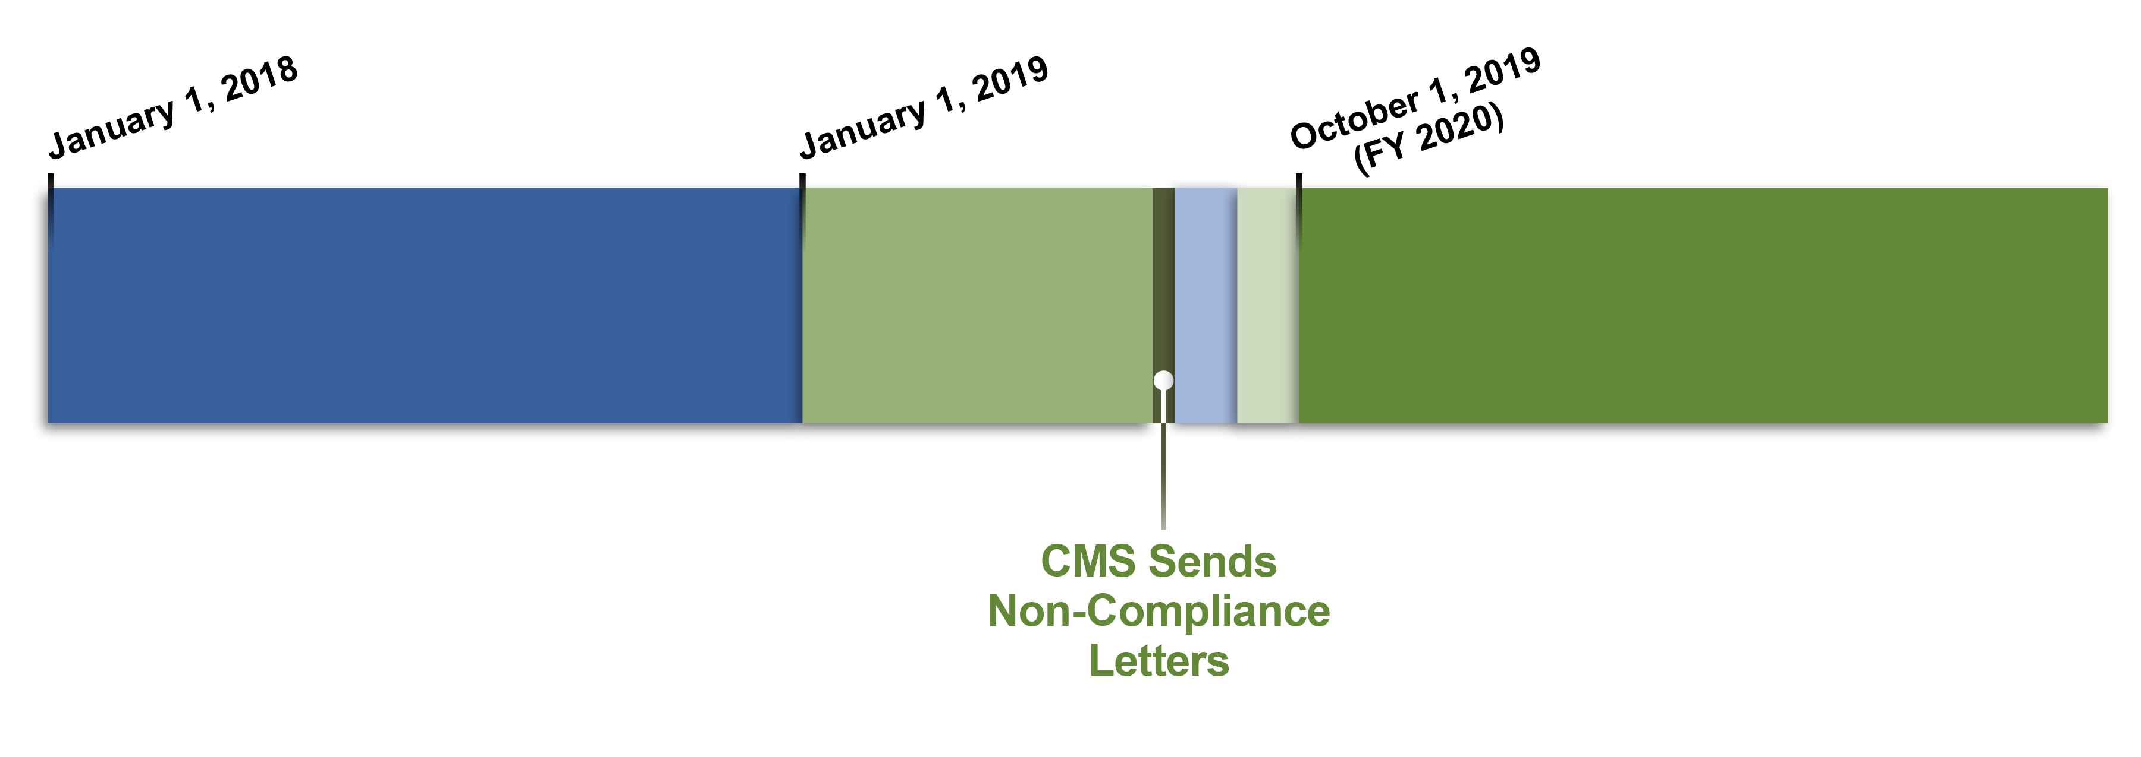
The HQRP Life Cycle: Non-compliance Letters
Non-compliance letters are sent to those who did not meet the HQRP requirements in July.
Notes:
Brenda: The next step in the HQRP life cycle is the compliance determinations which are made by CMS once the data is reviewed. CMS will then sends out letters of NON-compliance for any hospices who have not met the HQRP requirements. These letters are sent in July to the hospices, once the determinations are made by CMS.

Slide 30

HQRP Non-compliance Letters
Non-compliant providers receive notification from CMS via an HQRP non-compliance letter.
CMS sends the non-compliance letters both by your Medicare Administrative Contractor (MAC) via U.S. Postal Service (USPS) and via the CASPER system.
Notes:
Brenda: So, we discussed that compliance is determined in the year that follows the data collection year. If Hospice providers failed to reach the 90% threshold for the HIS submissions or do not comply with the CAHPS survey requirements, they will receive notification from CMS; This notification will be in the form of an HQRP Non-Compliance Letter . CMS sends this letter in tow ways; BOTH by United States Postal Service (or USPS) and via the Certification and Survey Provider Enhanced Reports (or through the CASPER system).
The CASPER letter will also identify why the provider is non-compliant. As providers, you will need to check the CASPER folder to determine if your hospice has received a letter. It is important to be alerted as soon as possible if you are non-compliant as the letter also alerts providers about how to request a reconsideration. We will talk about next and in much more detail a bit later in the presentation.

Slide 31
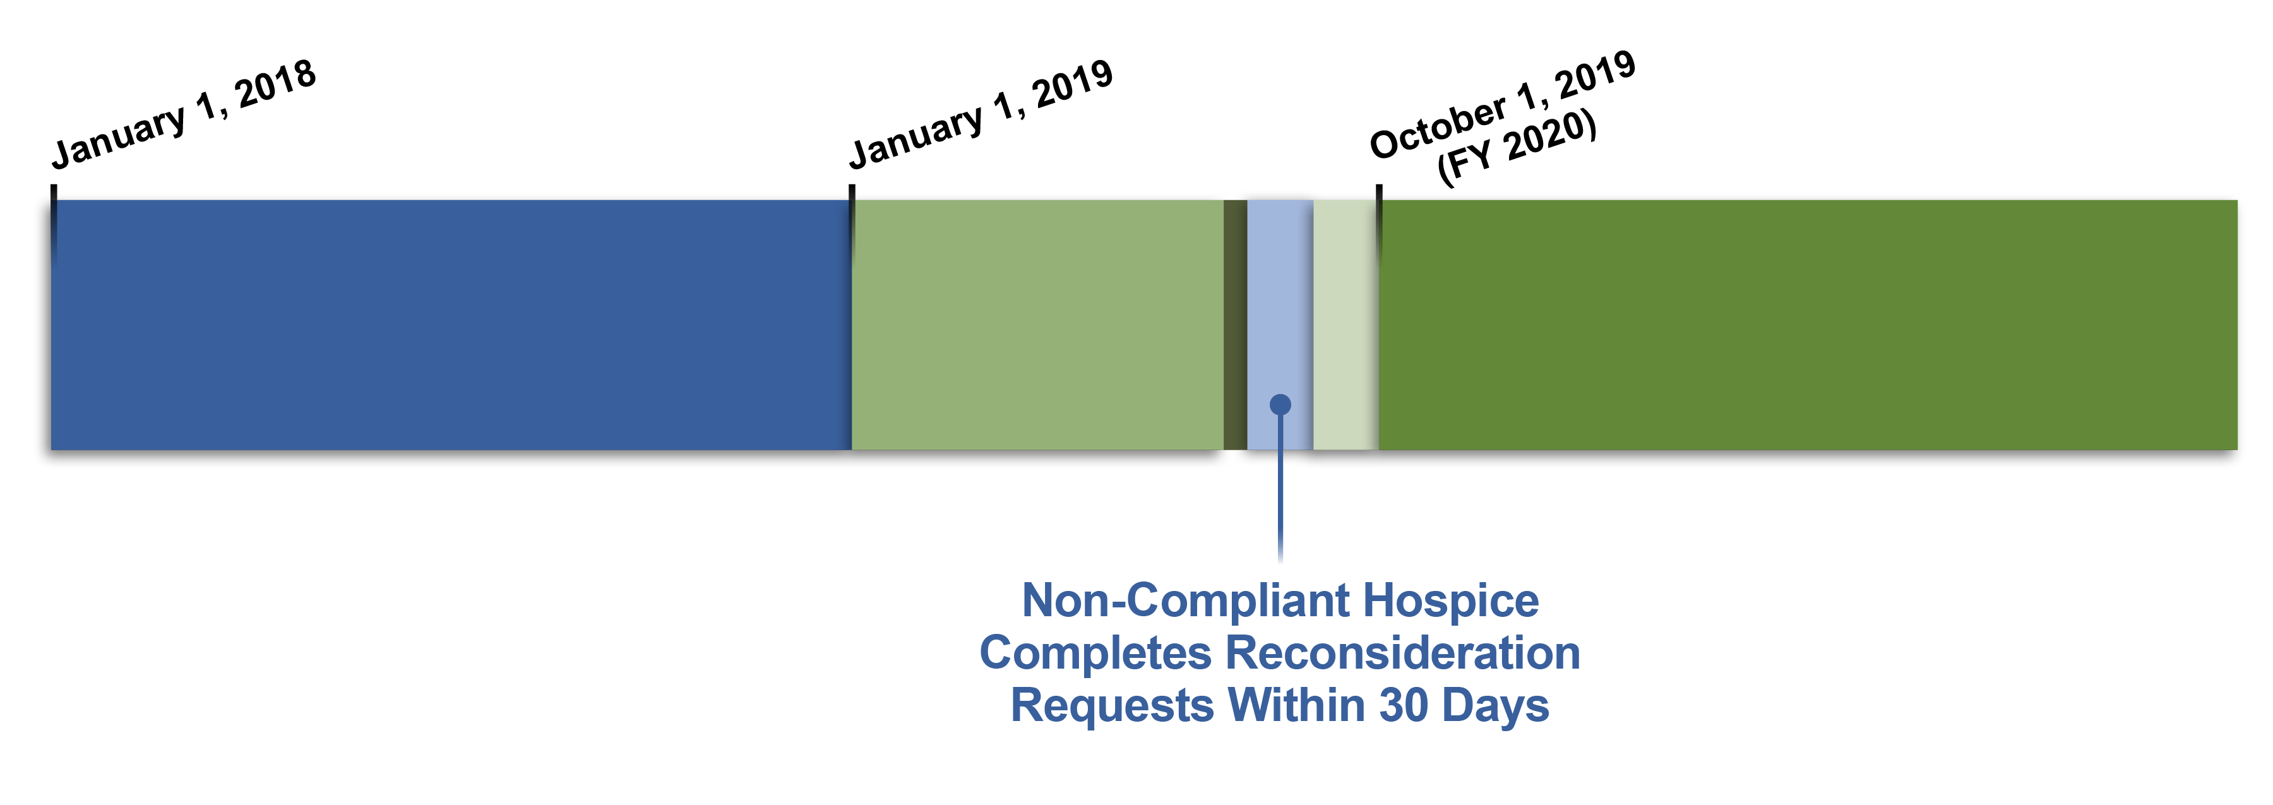
The HQRP Life Cycle: Reconsideration Requests
Providers receiving non-compliance letters may submit reconsideration requests to CMS.
Notes:
Brenda: So, now let’s look at the Reconsideration Requests! Providers receiving non-compliance letters may submit reconsideration requests to CMS and will have 30 days in which to do so.

Slide 32
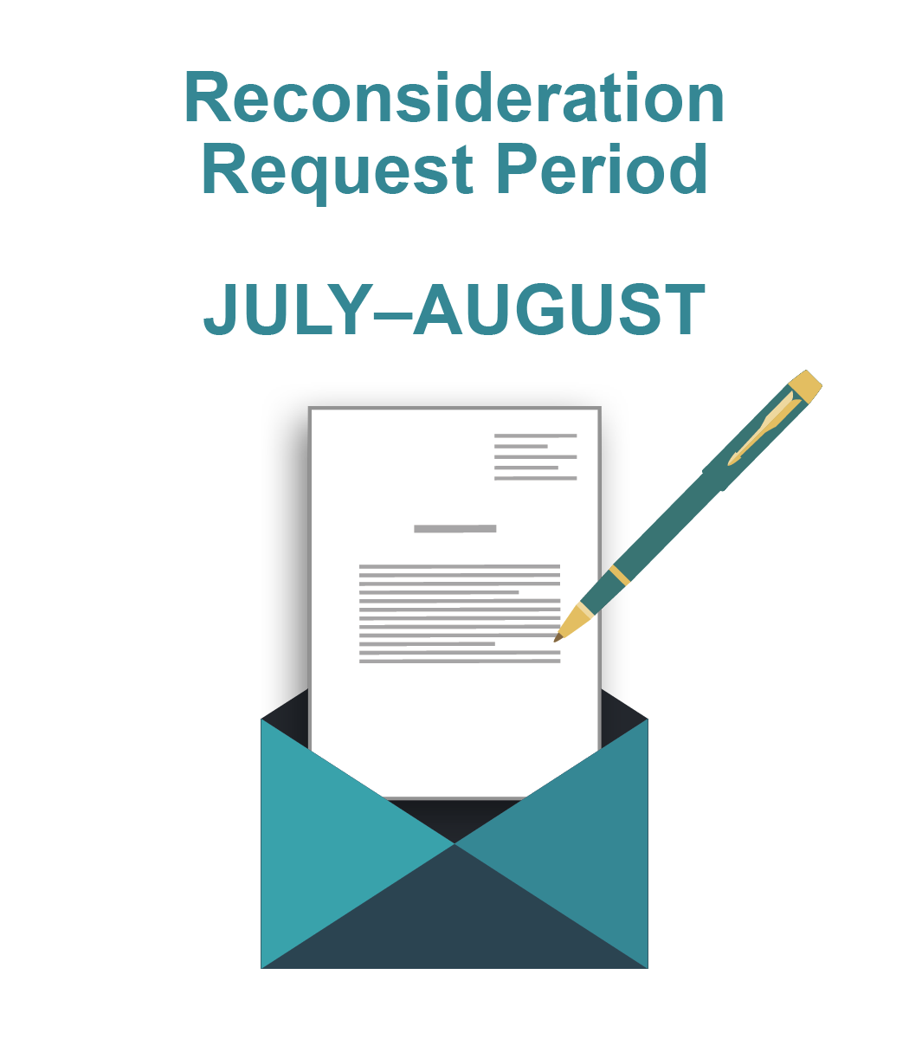
Reconsideration Requests
The reconsideration request period will fall between July and August.
The day that CMS sends the letter begins the 30-day reconsideration request period.
Notes:
Brenda: It is important to know about the noncompliance letters, and to be on the look out for one, if you have any concerns. A Hospice can request reconsideration, but the day that CMS sends the noncompliance letter begins the 30-day reconsideration request period. Since the letters are sent in July; this period will generally fall between July & August.
For example, in 2017, the 30-day period for sending a reconsideration request to CMS began on July 18, 2017 and ended on August 17, 2017. We will get into the entire reconsideration process in much more detail a bit later in this presentation.

Slide 33
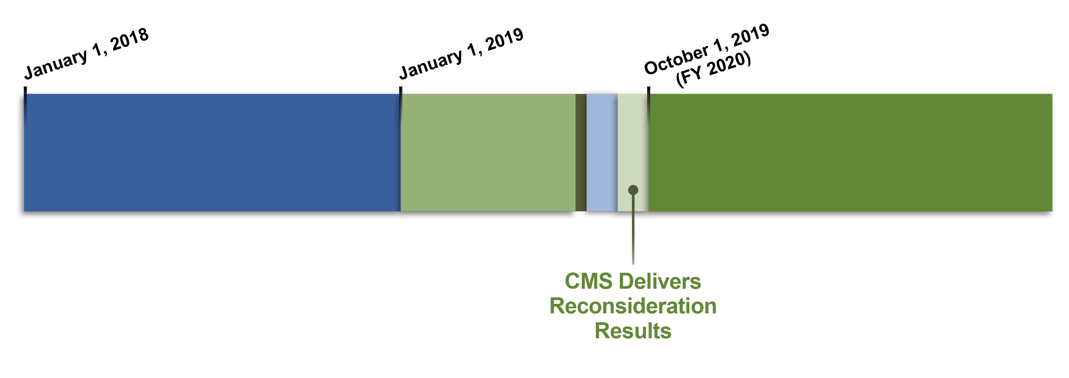
The HQRP Life Cycle: Reconsideration Results
Hospice agencies applying for reconsideration will be notified of the results of the request between August and September.
Notes:
Brenda: If your hospice has applied for a reconsideration, you will be notified about the results by CMS. This notification will fall between August and September.

Slide 34
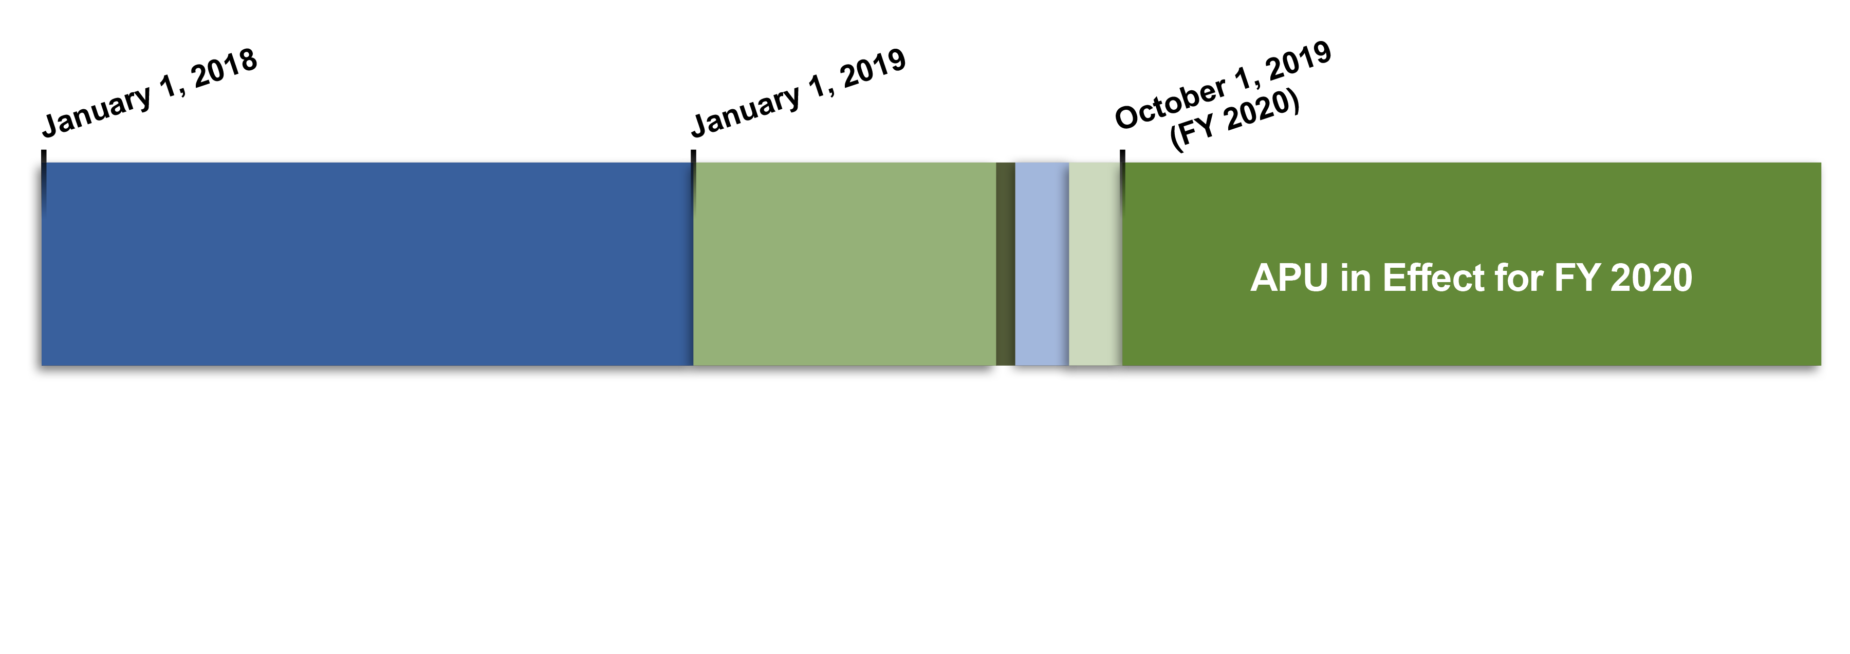
The HQRP Life Cycle: APU Implementation
APUs go into effect on October 1 of each year.
Notes:
Brenda: Once the reconsiderations are reviewed and providers are notified, the APU is determined and implemented. The implementation of the APU occurs on October 1st each year. But, Remember that it reflects the data collection period from almost two years prior (January through December of 2018).

Slide 35

The HQRP Life Cycle: APU Implementation (cont.)
October 1: APU implementation.
It is the act of submitting data (HIS & CAHPS®) and the acceptance of that data that determines compliance.
Failure to comply with the HQRP requirements will result in:
  A 2-percentage point reduction in the APU.
  Impact your results on Hospice Compare.
Notes:
Brenda: Let’s talk a bit more about APU implementation. Compliance with the HQRP impacts your hospice’s Annual Payment Update, or the “APU”.
it is the act of submitting data AND the acceptance of that data that determines compliance with HQRP requirements; It is NOT your actual performance on the Quality Measures or the Hospice CAHPS.
Failure to comply with the HQRP requirements will result in a 2 percentage point reduction in the APU for Hospice providers. Failure to comply also effects your results on Hospice Compare.

Slide 36
The HQRP Life Cycle: APU
Receipt of the full APU is possible for hospice agencies that meet the HQRP requirements.
Notes:
Brenda: This last phase will be the receipt of the APU. So, all of these events in the HQRP life cycle will occur before the hospices can receive their full Annual Payment Update (APU).
Receipt of the full APU is possible for hospice agencies that meet the HQRP requirements. In other words, in order to preserve your full annual payment update, a Hospice must fully meet all the requirements that mandate the collection and submission of HIS-Admission and HIS-Discharge data for ALL patients admitted to their hospice, AND participate in the Hospice CAHPS for all 12 months of the year.

Slide 37
Reporting HIS and
CAHPS® Data
Notes:
Brenda: Now, lets talk about the reporting part for the HIS and the CAHPS.

Slide 38
Reporting HIS and CAHPS® Data
To Meet HQRP Requirements
The Hospice must:
  Meet the requirements for both HIS and CAHPS®.
  Data must be submitted and accepted on time.
Notes:
Brenda: Well, I think you should be clear on the HQRP Requirements now and you know that the Hospice must: 1.) Meet the requirements for both HIS and CAHPS®. And 2.) the Data must be submitted and accepted on time. Lets move on to the submission. …

Slide 39
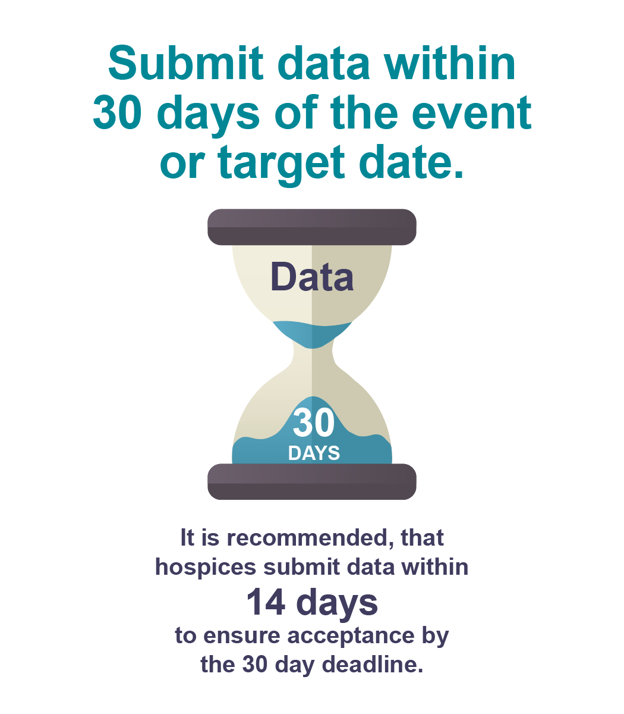
HIS Data: When to Submit Data?
Hospice Admission-HIS and Discharge-HIS data must be submitted for all patients within 30 days of the event or target date.
The act of submission does not equal acceptance.
It is recommended that hospices submit data within 7-14 days to be sure of acceptance by the 30-day deadline.
Notes:
Brenda: So Cindy mentioned what needs to be submitted from the HIS to comply with the HQRP, and that is that all Medicare-certified hospice providers are required to submit HIS-Admission records and HIS-Discharge records for all patients. .. …If you have already been doing this for the last few years, you certainly know what that entails.
But, lets talk now about when to submit the data. For the HIS specifically, this data needs to be submitted and accepted within 30 days after the event date, or target date!
A Hospice has exactly 30 days to accurately submit their Admission-HIS data. This is the same for Discharge-HIS records as well. You may remember that the act of submission does not equal acceptance; so it is highly recommended, that you submit data within the first 14 days (ideally 7-14 days to be safe) and to be sure that it is accepted by the 30 day deadline. If you experience any issues, you still have plenty of time to ensure the acceptance of your data.
Unlike the 14 day recommendation, the actual 30 submission timeframes are requirements; these are not recommendations.
If you need more detail on what to submit, as well as complete information about the HIS and the requirements, we would recommend that you preview some of our previous learning events that can be found on the CMS website. We will share these and lots of other resources with you at the end of the presentation today.

Slide 40
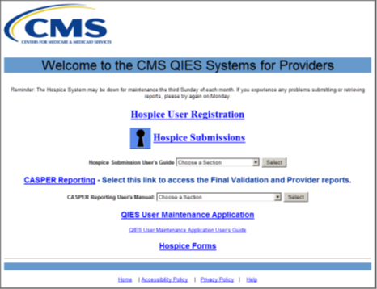
HIS Data: Where Do You Submit Data?
HIS records are submitted into the CMS Quality Improvement and Evaluation System - Assessment Submission and Processing (QIES ASAP) system.
The Hospice Submission User’s Guide is an important resource.
Ensure that your submissions are in the correct format, contain the correct information, and will be accepted by the QIES ASAP system.
Notes:
Brenda: Now lets talk about where to submit this data!
HIS data is submitted into CMS’ Quality Improvement and Evaluation System, or QIES, Assessment Submission and Processing, or ASAP, system. This is referred to as the QIES ASAP system. To submit into the QIES ASAP system, hospice providers need to take several steps, including:
1.) Obtaining a CMSNet User ID and password
2.) Ensuring that the proper software is installed on the computer you plan to use
3.) Obtaining a QIES User ID and password, and…
4.) Ensuring that the HIS records are in the proper electronic file format for submission.
An important resource for submitting HIS data is the Hospice Submission User’s Guide. It will show you how to log in to QIES and walk you step by step through data submission. It is available for download on the Welcome to the CMS QIES Systems for Providers web page & also on the QIES Technical Support Office, or Q-T-S-O, or QTSO website . These links are listed on the slides that you will see in the resource section at the end of the presentation. You will want to make sure that you reference this guide with any questions about the submission process.
Before your data can be submitted, you will have to make sure that the HIS data is in the proper electronic file format (that is, XML ). It is important to receive training to ensure that your submissions are in the correct format, contain the correct information, and will be accepted by the QIES ASAP system. Some agencies have their own software for submission that is part of their electronic medical record, but some hospice providers choose to use the Hospice Abstraction Reporting Tool, or the HART software, which is a free software available from CMS.

Slide 41
HIS Data: How To Ensure That Data Submitted Are Accepted?
The QIES ASAP system:
  Confirms that the submission was received.
  Includes the name of the file that you submitted.
  Does not mean your data were accepted.
The Final Validation Report (FVR) will verify acceptance or rejection of the HIS records.
Print and keep a copy of this confirmation. from FVR. This is your proof of HIS Data Acceptance.
The FVR is the only way to verify that submitted files were also accepted.
Notes:
Brenda: now that we know where to submit the data for HIS records, we would like to talk about how to ensure that your data is submitted and accepted in the system.
Once you submit your records into the QIES-ASAP system, the system will provide an online submission confirmation that the file was received for processing and editing. The system checks, that is, validates the files to make sure they are complete and in the proper format.
It’s important to know that this confirmation does not mean that your data were accepted. So, Even though HIS records are successfully submitted, it does not mean that the records are accepted.
The Online submission confirmation includes the name of the file that you submitted, but since this confirmation does not mean that the data were accepted, it is suggested that you:
Print and keep a copy of this confirmation.
Within 24 hours of successfully being able to process the file, a system-generated Final Validation Report (or the FVR) is created and made available in the CASPER, Reporting application. The Final Validation Report (the FVR) is used to verify whether the HIS records were accepted or rejected.
The FVR is the only way to verify that submitted files were also accepted. Hospices will want to access the FVR to verify whether their HIS records were accepted or rejected and then review to see if any errors are noted. This is important because records that are rejected by the ASAP system are not received by CMS and thus cannot be used for Quality Measure calculations or the compliance determinations.
And now I will turn to Debra Dean Whittaker who will discuss the CAHPS submission process in more detail.

Slide 42

CAHPS® Data: When to Submit Data?
CAHPS® Hospice Survey data is submitted to the CAHPS® Hospice Data Warehouse.
Data submission deadlines occur quarterly on the second Wednesday of the months of February, May, August, and November.
Your survey vendor submits your data on your behalf.
Notes:
Debra: Thank you Brenda. PLEASE Revise as you see fit once the slides are all set.
C
AHPS® Hospice Survey data is submitted to the CAHPS® Hospice Data Warehouse.
Data submission deadlines occur quarterly: Second Wednesday of the months of…February, May, August, and November.
Your survey vendor submits your data on your behalf.
**********************************************************************************
The official Web site for announcements and information pertinent to the CAHPS Hospice Survey is www.HospiceCAHPSSurvey.org.

Slide 43

CAHPS® Data: Where Do You Submit Data?
The act of submitting data ≠ successful submission of data.
Compliance = successful submission of survey data to the CAHPS® Hospice Data Warehouse.
Apply for access to the Data Warehouse so you can get reports about your data submission.
Keep in touch with your vendor.
Notes:
Debra: Revise as you would like
So, now for where this CAHPS data goes? We just mentioned that the data is submitted on a quarterly basis and that this data goes to the CAHPS® Hospice Survey Data Warehouse. Hospices are required to submit 12 months of data to the CAHPS Hospice Survey Data Warehouse.
All hospices and approved survey vendors need to complete essential forms and must be granted access to the CAHPS Hospice Survey Data Warehouse, which is maintained by the RAND Corporation.
As with the H-I-S, the act of submitting data ≠ successful submission of data.
Compliance = successful submission of survey data to the CAHPS ® Hospice Data Warehouse. Your survey vendor will access to the CAHPS Hospice Survey Data Warehouse in order to submit the data files.
As providers, you will want to apply for access to the Data Warehouse so you can get reports about your data submission to ensure that their survey vendor has submitted data on time and without data problems. It is important to Keep in touch with your vendor.

Slide 44
CAHPS® Data: How to Ensure That Data Submitted Are Accepted?
Contract with a CMS-approved survey vendor.
Authorize your vendor so they can submit your data.
Communicate with your vendor.
Monitor data submission. Make sure your data is successfully submitted before the deadline.
Make sure you know how to get reports from the Data Warehouse.
Contact us if you want to change vendors.
Remember – if you buy a hospice, you are buying its CAHPS® status.
Notes:
Debra: Revise as you would like
Contract with a CMS-approved survey vendor.
Authorize your vendor so they can submit your data.
Communicate with your vendor.
Monitor data submission. Make sure your data is successfully submitted before the deadline.
Make sure you know how to get reports from the Data Warehouse.
Contact us if you want to change vendors.
Remember – if you buy a hospice, you are buying its CAHPS® status.

Slide 45
CAHPS® Hospice Survey: Exemptions
Two exemptions from CAHPS® Survey.
  Both are unique to CAHPS® – not for HIS.
    CAHPS® Size Exemption.
    CAHPS® Newness Exemption.
Notes:
Debra: Revise as you would like
Now let’s review the two exemptions from the CAHPS survey for hospices.
Both are unique to CAHPS ® these are not for the HIS.
CAHPS ® Size Exemption
CAHPS ® Newness Exemption

Slide 46
CAHPS® Hospice Survey: Size Exemption
CAHPS® Size Exemption
If your hospice served fewer than 50 survey-eligible patient/caregiver pairs in the reference year, you are eligible to apply for a size exemption.
To apply for the size exemption:
  Go to the survey web site (www.hospicecahpssurvey.org).
  Look for “Participation Exemption for Size.”
  Fill out and submit the form online.
Notes:
Debra: Let’s start with the CAHPS® Size Exemption
If your hospice served fewer than 50 survey-eligible patient/caregiver pairs in the reference year, you are eligible to apply for a size exemption.
To apply for the size exemption:
Go to the survey web site (www.hospicecahpssurvey.org) .
Look for “Participation Exemption for Size.”
Fill out and submit the form online.

Slide 47
CAHPS® Hospice Survey: Size Exemption (cont. 1)
To fill out the form, you count patients in the reference year.
Reference year = previous year.
  Current data collection year: 2019.
  Reference year: 2018.
Exemption good for one year only.
Need to resubmit request annually.
Deadline for requesting size exemption: December 31, 2019 (2019 data collection year).
Notes:
Debra: Revise as you would like
To fill out the form, you count patients in the reference year.
The Reference year = previous year.
If the Current data collection year: 2019, then the Reference year is 2018.
This Exemption good for one year only, so you Need to resubmit this request annually.
The Deadline for requesting a size exemption: December 31, 2019. (2019 data collection year).

Slide 48

CAHPS® Hospice Survey: Size Exemption (cont. 2)
After you submit the form:
  You will get an acknowledgement email.
  Does not mean you are approved.
We check your counts before the APU season and then decide.
Save the acknowledgement email for future reference!
Notes:
Debra: Revise as you would like
A few more details re: the size exemption. After you submit the form…
You will get an acknowledgement email.
This Does not mean you are approved.
We check your counts before the APU season and then make this decision.
You will want to Save the acknowledgement email for future reference

Slide 49

CAHPS® Hospice Survey: Newness Exemption
Second CAHPS®-only exemption: Newness
If you receive a new CCN on or after the start of the data collection year then:
    You are automatically exempted for one year.
    CMS grants the exemption.
We recommend that you save your letter with your new CCN and save the envelope.
Notes:
Debra: Revise as you would like
Now let’s review the Second CAHPS-only exemption: this one is for “Newness”
If you receive a new CCN on or after the start of the data collection year then…
You are automatically exempted for one year.
CMS grants the exemption.
We recommend: save your letter with your new CCN and save the envelope.
And now I will turn it back to Brenda for a few knowledge checks

Slide 50
Where do you submit HIS data for the HQRP?
3
The Hospice Survey Data Warehouse.
The RAND Corporation.
The Quality Manager at your hospice.
The QIES-ASAP system.
Notes:
Brenda: Thank you Debra; now lets answer a few questions to check our knowledge on the information presented thus far.
Where do you submit HIS data for the HQRP?
Is it…..
The Hospice Survey Data Warehouse,
The RAND Corporation,
The Quality Manager at your hospice, or
The QIES-ASAP system?

Slide 51
Where do you submit HIS data for the HQRP? (cont.)
3
The Hospice Survey Data Warehouse.
The RAND Corporation.
The Quality Manager at your hospice.
The QIES-ASAP system.
Notes:
Brenda: The answer is D; The QIES-ASAP system.

Slide 52
Who submits CAHPS® data for the HQRP?
4
The Hospice Survey Data Warehouse.
The RAND Corporation.
The Quality Manager at your hospice.
Your survey vendor submits your data on your behalf.
Notes:
Brenda: Now, let’s do one more before we move on to another topic!
For this question, can you tell us Who submits HOSPICE CAHPS® data for the HQRP?
Is it….
The Hospice Survey Data Warehouse,
The RAND Corporation,
The Quality Manager at your hospice, or
Your survey vendor submits your data on your behalf.

Slide 53
Who submits CAHPS® data for the HQRP? (cont.)
4
The Hospice Survey Data Warehouse.
The RAND Corporation.
The Quality Manager at your hospice.
Your survey vendor submits your data on your behalf.
Notes:
Brenda: The answer is D! The CAHPS data is submitted quarterly by the your hospice vendor on your behalf. That vendor submits your data into the Hospice Survey Data Warehouse.

Slide 54
CASPER Reports
Notes:
Brenda: Now lets move on the CASPER reports.
So today, we will give a brief overview of the reports that you can find in the CASPER Reporting application with some simple explanations of how to use each of them!
Although we won’t go into great detail today, there are a few recent webinars form 2018 that have provided much more detail and related screen shots on all of these available reports. We will provide direction on where to find these more complete trainings on the CMS website in the resource section at the end of this presentation. Let’s get started!

Slide 55
CASPER Reports
Many valuable reports in CASPER.
  Select the CASPER Reporting link on the CMS Quality Improvement and Evaluation System (QIES) Systems for Providers webpage.
  Locate hospice-specific reports in the Hospice Provider and Hospice Quality Reporting Program report categories in CASPER.
  The CASPER Reporting User’s Guide For Hospice Providers is available at https://www.qtso.com/hospicetrain.html.
  Chapter 3 of the guide outlines all reports available via the Hospice Provider report category.
Notes:
Brenda: There are many valuable hospice-specific reports available in the CASPER Reporting application. The CASPER Reporting link is available to providers on the Welcome to the CMS QIES Systems for Providers webpage.
Hospice providers with access will log into the application using your QIES User ID and password credentials. These are the same credentials used to log into the Hospice Submission Systems application where the HIS data are submitted to the Assessment Submission and Processing (ASAP) system. These hospice-specific reports are located in the Hospice Provider and Hospice Quality Reporting Program report categories.
You can obtain more information about the reports highlighted in this presentation in the CASPER Reporting User’s Guide. This user’s guide is available on the CMS QIES Systems for Providers webpage and on the QIES Technical Support Office or QTSO website. The link to the user’s guide on the QTSO website has been provided on this slide.
Now let’s review the reports you will find once you are in CASPER.

Slide 56
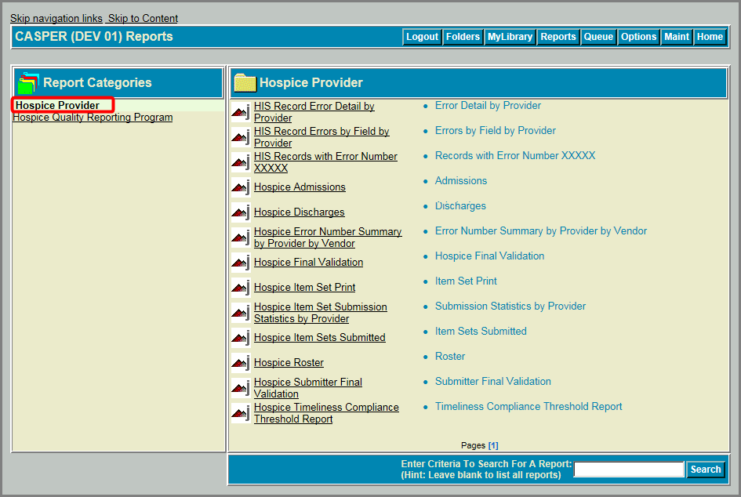
Hospice Provider Reports
Notes:
Brenda: The first thing to know is that there are two report categories; One is called the Hospice Provider report category and the other is the Hospice Quality Reporting Program report category. To find these, you will need to log into the CASPER Reporting application using your QIES user ID and password credentials and the you will select the Reports button. You’ll see these two report categories on the left side of the frame as you can see in the screen shot. .
The Hospice Provider category is listed at the top (circled in RED), so let’s go through that one first! There is a full list here. We will briefly review how each one can help Hospice providers. I may not necessarily follow the exact order, because I have grouped like reports together for ease of the presentation. We’ll start with the Error reports first.

Slide 57
Error Reports
There are four types of error reports:
  HIS Record Errors by Field by Provider.
  HIS Records with Error Number XXXXX.
  HIS Record Error Detail by Provider.
  Hospice Error Number Summary by Provider by Vendor.
Notes:
Brenda: There are four types of Error reports; these are….
The HIS Record Errors by Field by Provider
The HIS Records with Error Number XXXXX,
The HIS Record Error Detail by Provider, and
The Hospice Error Number Summary by Provider by Vendor
I’ll give a brief explanation of each of these!

Slide 58
Error Reports (cont. 1)
HIS Record Errors by Field by Provider.
  Shows, by error number, the number of HIS records where the error was encountered and the percent of HIS records with the error during the specified timeframe.
HIS Records with Error Number XXXXX.
  User-requested, on-demand report in CASPER “Hospice Provider” report category.
  Assists you in researching cause of late submissions by running for errors -3034a and -3034b.
Notes:
Brenda: we will start with the…
HIS Record Errors by Field by Provider.
This report Shows, by error number, the number of HIS records where the particular error was encountered and the percent of HIS records with that Error during the specified timeframe.
The HIS Records with Error Number XXXXX. Is a User-requested, on-demand report. This one assists you in researching cause of late submissions by running for errors, such as “ -3034a and -3034b”.

Slide 59
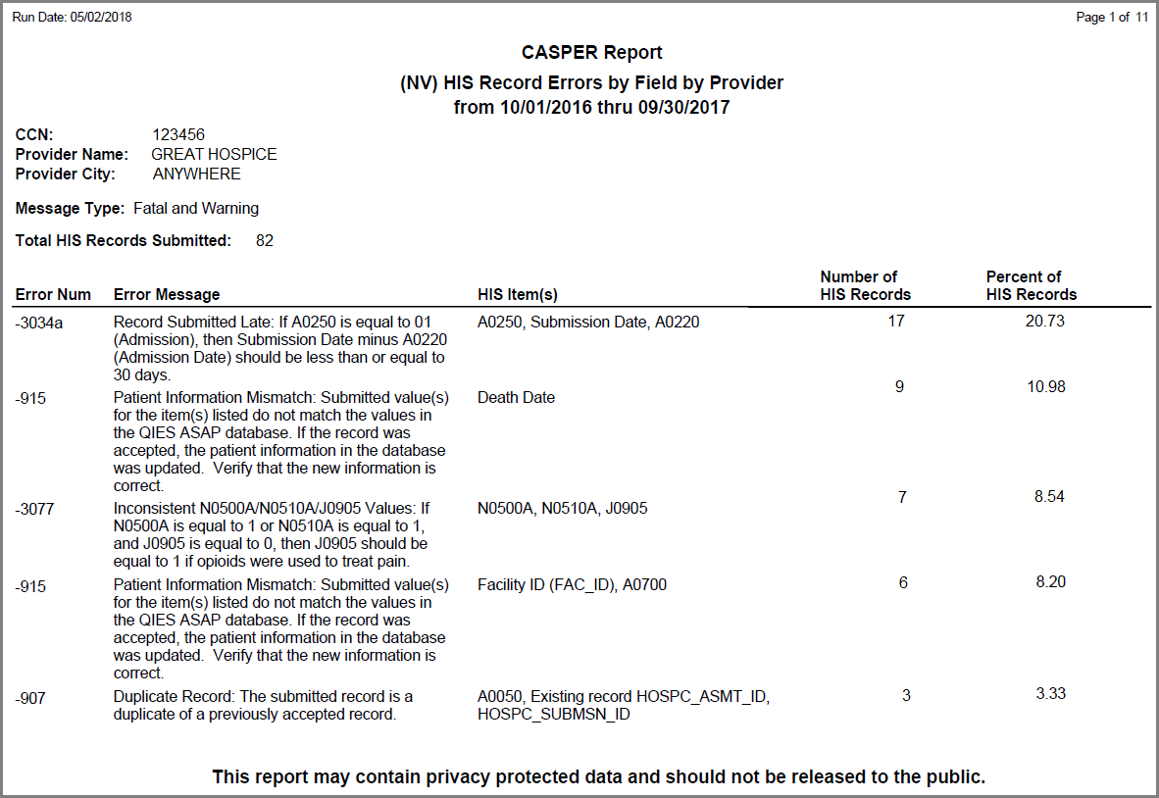
HIS Record Errors by Field by Provider Report
Notes:
Brenda: Here is a sample of the HIS Record Errors by Field by Provider Report : you can see that the first error by number in the first column, is number 304a; The message tells us that the record was submitted LATE. Noting that the date of submission minus the admission date (A0250) was > than the required 30 days. In the fourth column, you can see that this report is indicating that 17 records, (almost 21% as noted in column 5) of those submitted by this hospice encountered error -3034a. The admission HIS records were submitted late. Once you have this information, you can run the other report we talked about; HIS Records with Error Number XXXXX report to get a list of patients and the dates where this error was encountered. And then you can research what might prevent this error from happening in the future.

Slide 60
Error Reports (cont. 2)
  HIS Record Error Detail by Provider.
  Details by HIS ID the errors encountered in Hospice Item Set (HIS) records submitted during a specified period.
  Hospice Error Number Summary by Provider by Vendor.
  Summarizes the errors encountered in HIS records submitted by or on behalf of the provider during a specified period.
Notes:
Brenda: Lets look at two other Error reports! These are the HIS Record Error Detail by Provider & Hospice Error Number Summary by Provider by Vendor
The first is the HIS Record Error Detail by Provider report which gives you details using the by HIS ID of the errors encountered in Hospice Item Set (HIS) records that were submitted during a specified period. The report can help address recurring errors and can also be used in quality assurance (QA) programs to monitor repeated errors.
The second report, the Hospice Error Number Summary by Provider by Vendor report summarizes the errors submitted by or on behalf of the provider during a specified period. It helps to determine and report vendor-specific issues, such as recurring fatal errors.
You can use these two error reports to gain more detail regarding the errors that were encountered during HIS records submission.

Slide 61
HIS Record Error Detail by Provider Report (cont.)
Notes:
Brenda: This screenshot shows the report criteria options for the HIS Record Error Detail by Provider report. The CASPER Report Submit pages for the other Hospice reports may have similar criteria. You can refer to Chapter 3 of the CASPER Reporting User’s Guide to view the specific report criteria options for each report.
To request this report, you can choose the date range on this drop down menu. The HIS Record Error Detail by Provider report can identify which errors occurred.

Slide 62
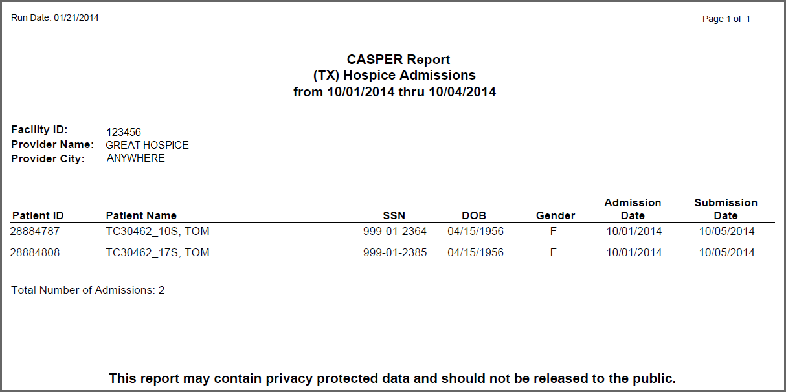
Hospice Admissions Report
Notes:
Brenda: Now lets move away from the Error reports and look at the Hospice Admissions Report. This report is for details regarding patients who were admitted within a specific period!
This lists only patients with an accepted HIS Admission submitted with an Admission date within the specified period. In this report, the date range requested was October 1 to 4 2014. The information on this report includes the Patient ID, (which is the unique ID assigned to the patient in the QIES national database), the Patient Name, Social Security Number (SSN) or Medicare ID #, the Date of Birth (DOB), the Gender, Admission Date, and the Submission Date. This report can be used to verify that an HIS Admission record was submitted to and accepted by the ASAP system for each hospice patient admitted during the specified time period. There is also one for Discharges!

Slide 63
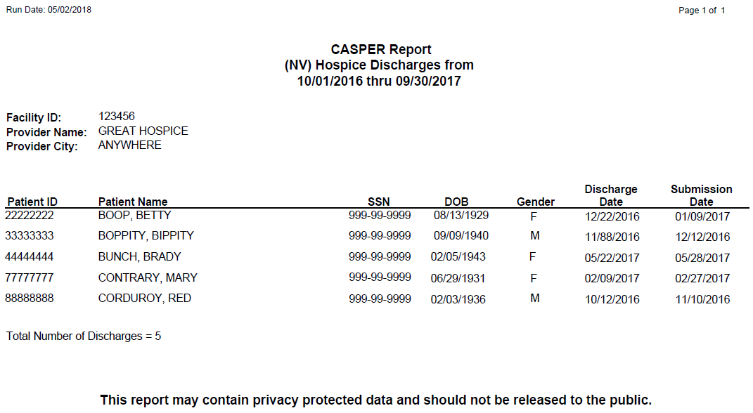
Hospice Discharges Report
Notes:
Brenda: You can see that this one is very similar to the Admission Report. The date range here was from October1st, 2016 thru September 30th 2017. This Hospice Discharge report lists only patients with an accepted HIS Discharge submitted with a discharge date within the specified period. It can be used to verify that an HIS Discharge record was submitted to and accepted by the ASAP system for each hospice patient discharged during the specified time period.

Slide 64
The Hospice FVR
The Hospice FVR provides detailed information about the status of the submission files.
  Indicates whether the records submitted in each file were accepted or rejected and details the fatal error and warning messages encountered.
  Auto-generated for each submission and placed in your provider’s Validation Report (VR) folder in CASPER.
  Automatically purged from the VR folder after 60 days.
  Can be user-generated upon request.
Notes:
Brenda: So, here is a really important report; this is the Hospice Final Validation Report (or the FVR) we spoke about earlier. This report provides detailed information about the status of the select HIS submission files.
We know that it is critical for hospices to ensure that submitted records have been accepted. If a record gets rejected, the hospice must correct the errors that caused the record to be rejected and resubmit the record to the ASAP system. Failure to correct and resubmit the HIS records may jeopardize your HQRP compliance. That is why it is important to submit early, way before the 30 day deadline.
The FVR…
Indicates whether the records submitted in each file were accepted or rejected and details any of the fatal error and warning messages that were encountered.
This report is auto-generated for each submission and placed in your provider’s shared validation report (or VR) folder in CASPER
The ASAP system-generated FVR is automatically purged from the VR folder after 60 days, although….
The Hospice FVR can be user-generated upon request if the system-generated report is removed from the system before it could be printed or saved to the local computer. One might want to do this for a specific submission ID or a date range using the link in the Hospice Provider report category.

Slide 65
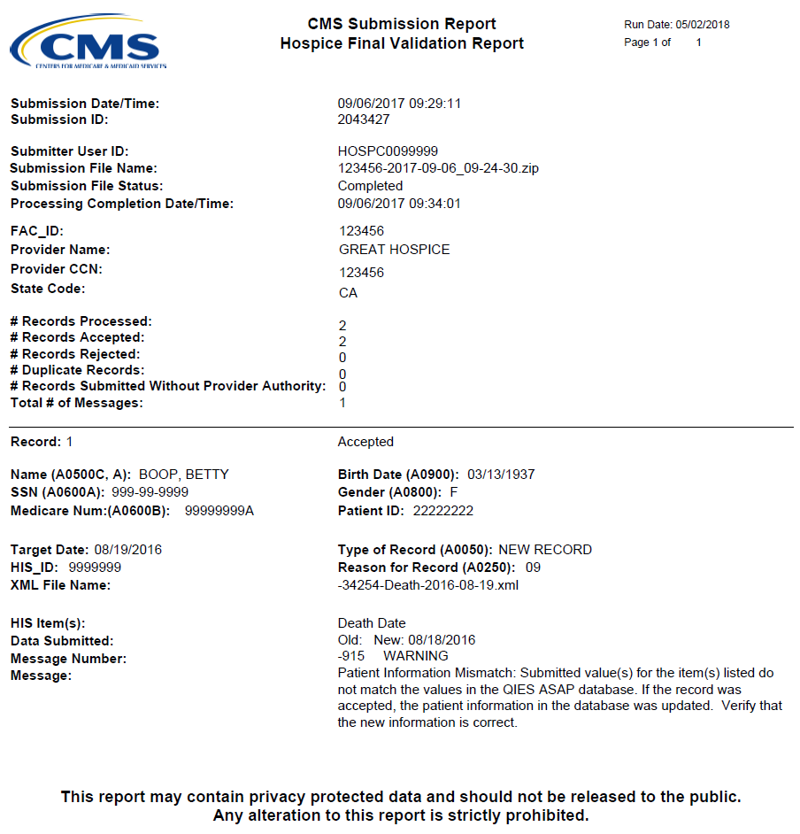
The Hospice FVR (cont.)
Notes:
Brenda: Here is a screenshot of the Hospice Final Validation Report. The top portion of the report contains the details of the file, such as: The date and time the file was submitted, the user ID that submitted the file and some Hospice-specific information. It also includes a summary of the submission statistics for the HIS records contained in the zip file
Beneath this is information about each HIS record processed by the ASAP system, including record & patient-specific information, as well as any Error messages that were returned for the HIS record.

Slide 66
The Hospice Submitter Final Validation Report
The Hospice Submitter Final Validation Report:
  Provides detailed information about the status of submission files.
  Indicates whether the records were accepted or rejected.
  Details the warning messages and fatal errors encountered.
  Can only be requested by the user who submitted the original file.
Request the Submitter Final Validation Report when:
  The QIES ASAP system-generated FVR is not available in the VR folder after 24 hours.
  The total record count on the List of Submissions page in the Hospice File Submission system displays 0.
Notes:
Brenda: The Final Validation Report is automatically generated only for HIS submission files for which the provider of the file could be identified. In contrast, the Hospice Submitter Final Validation Report must be manually requested. The contents of this report are very similar to the ASAP system-generated report, but the submitter report will display error details for records that could NOT be processed by the system because the provider associated to the file could not be identified.
The Hospice Submitter Final Validation Report:
Provides detailed information about the status of select submission files.
Indicates whether the records were accepted or rejected.
Details the warning messages and fatal errors encountered.
Can only be requested by the user who submitted the original file.
Examples of when you would request this report are when:
The ASAP system-generated FVR is not available in the VR folder after 24 hours
The total record count on the List of Submissions page in the Hospice File Submission system displays 0; ….This indicates the presence of a severe error in the submission or XML file that caused file processing to stop
Some Examples of a severe error include: The State code in the XML record being invalid, or The code for the type of record is missing or invalid.

Slide 67
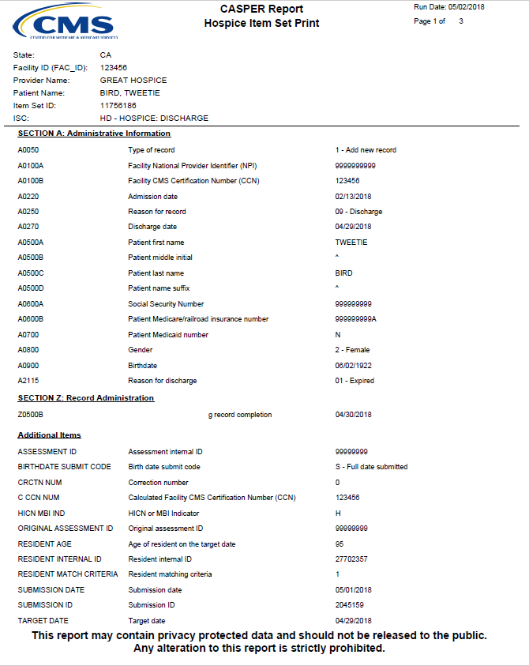
The Hospice Item Set Print Report
The Hospice Item Set Print report:
  Can be requested only for HIS records accepted into ASAP.
  Lists the item number and item responses submitted for a select HIS record.
  Allows for easy viewing of the values submitted for the HIS item in the record.
  May be used to inquire as to why a patient did or did not trigger a hospice quality measure.
Notes:
Brenda: This next report is the Hospice Item Set Print report. It can be requested only for HIS records accepted into ASAP. Lists the item number and item responses submitted for a select HIS record.
Allows for easy viewing of the values that wee submitted for the HIS item in the individual record. This report could be used if the hospice has questions about why a patient did or did not trigger a hospice quality measure.

Slide 68
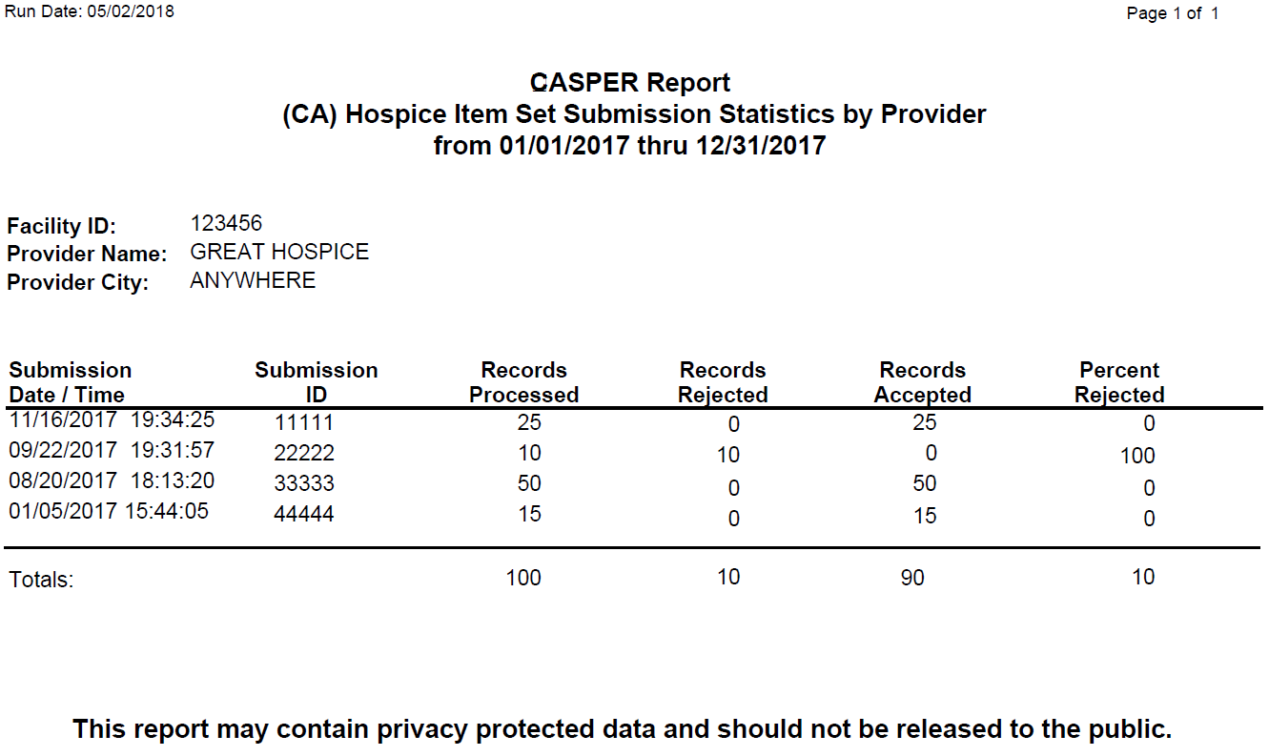
The Hospice Item Set Submission Statistics by Provider Report
Summarizes submissions made during a specified period and the statistics per submission.
Notes:
Brenda: The Hospice Item Set Submission Statistics by Provider report: This one summarizes the submissions made during a specified period and statistics per submission. It allows electronic compilation of information that would otherwise have to be manually retrieved from individual FVRs
In this sample report, you can see that the report displays the Submission date and time; Submission ID and the following information:
# of records successfully processed from the file by the ASAP system
# of records rejected or not saved into the ASAP system because of fatal errors in the record
# of records that passed the ASAP system validation and were saved into the national database
And Percent of records from the submission file that were rejected.

Slide 69
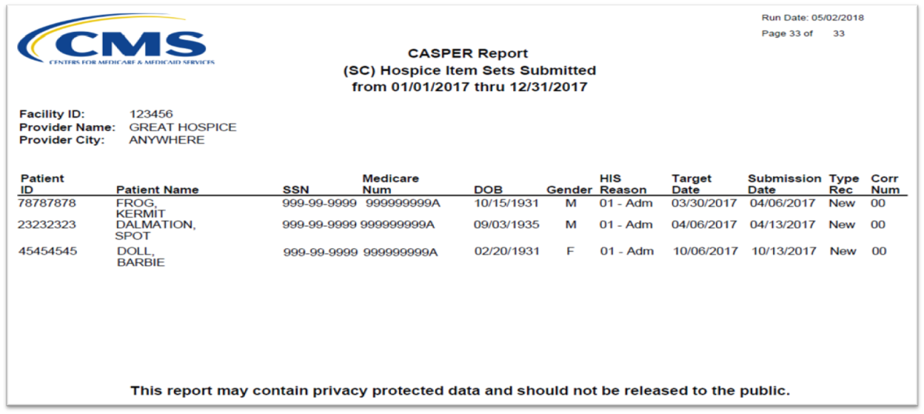
Hospice Item Sets Submitted
Lists the accepted HIS records and inactivation requests submitted by or on behalf of a provider during a specified period.
Includes:
  The patient ID and name.
  The reason for the HIS assessment (admission or discharge).
  The target date, submission date, and record type.
Notes:
Brenda: The Hospice Item Sets Submitted report lists the accepted HIS records and inactivation requests submitted by or on behalf of a provider during a specified period
And here’s a sample Hospice Item Sets Submitted report. This report displays patient-identifying information such as the Patient ID, patient name, SSN, Medicare Number, DOB, and gender.
Also displayed is the HIS reason for assessment value from item A0250 (01 for the admission record, or 09 for the discharge record),
the Target date or event date of the record (for admission records this is the admission date and for the discharge records this is the discharge date
The date the record was submitted to the ASAP system,
The type of record (new record, modification, or inactivation record).

Slide 70
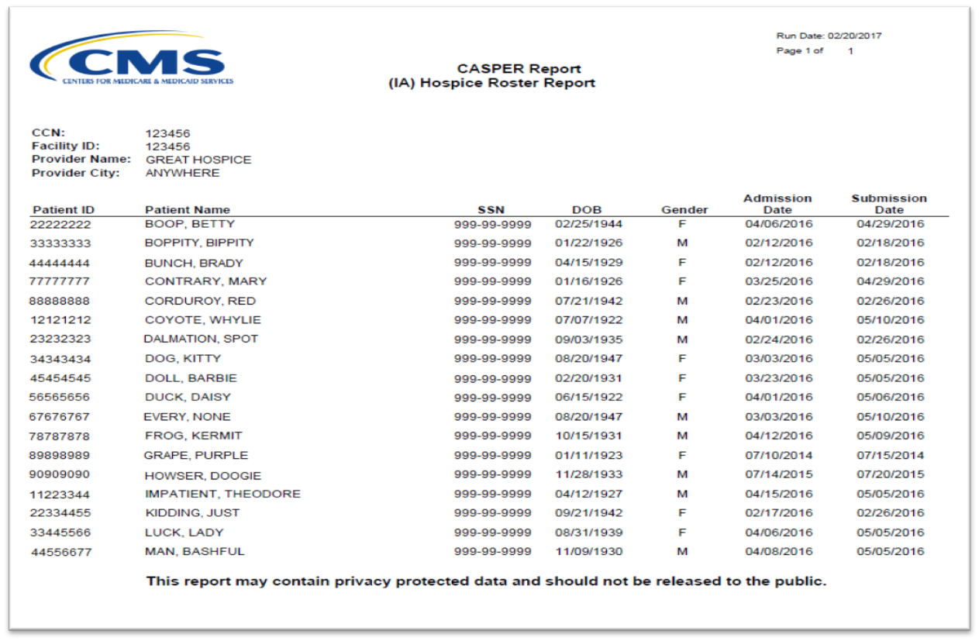
Hospice Roster Report
Lists patients in the hospice on the day the report is run.
Use this to verify that current patients have their HIS-Admission record accepted.
Use to ensure that all discharged patients no longer display (verifies that the discharge record has been submitted).
Can be used as a quality assurance tool.
Notes:
Brenda: The Hospice Roster report is a good reference for you. It helps you verify that all of your current patients have had their appropriate HIS-Admission record accepted, and that all discharged patients no longer display to verify that their discharge record has been submitted. It can be used as a quality assurance tool.
All the patients on this report are considered ‘active patients’ as of the day the report is run. This report is one way to do a quick check to see if there are any discharged patients who have not had their HIS Discharge record submitted, or any active patients for which you have not yet submitted the HIS Admission record who don’t appear on this report.

Slide 71
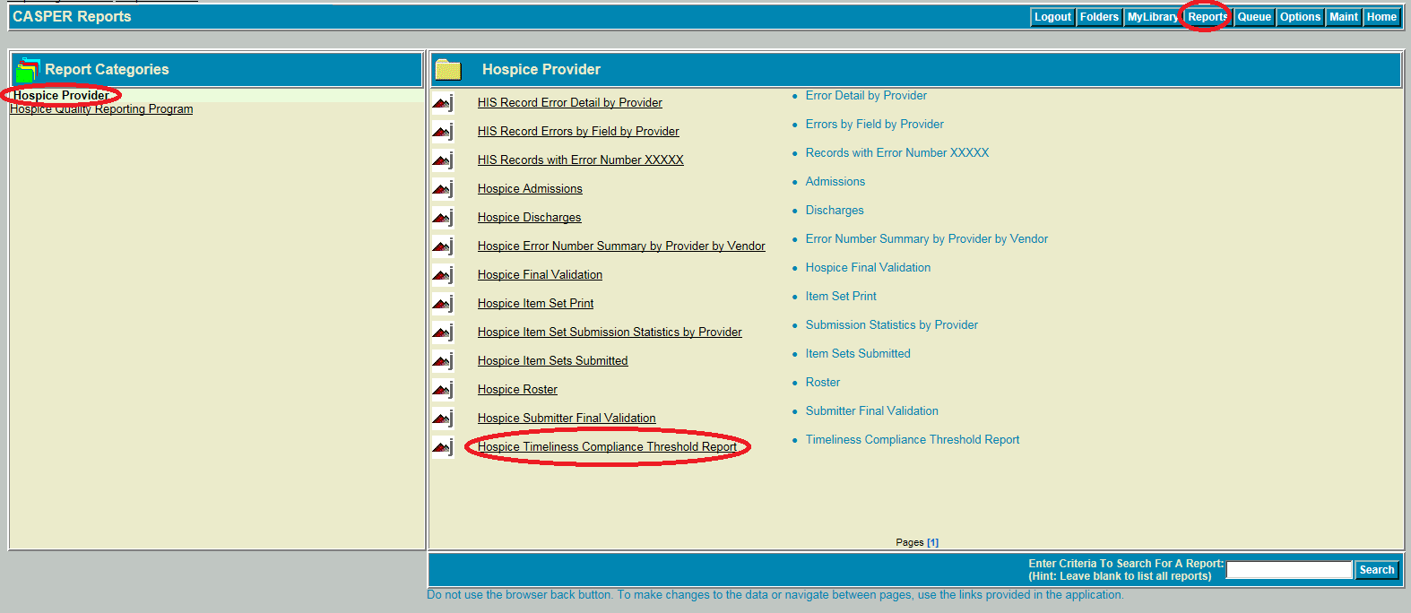
Hospice Timeliness Compliance Threshold Report
Notes:
Brenda: This is the last and one of the most important reports for checking compliance with the HQRP. It’s the Hospice Timeliness Compliance Threshold report. You can see it highlighted here on the list. The Hospice Timeliness Compliance Threshold report is a user-requested, on-demand report in the CASPER “Hospice Provider” report category.

Slide 72
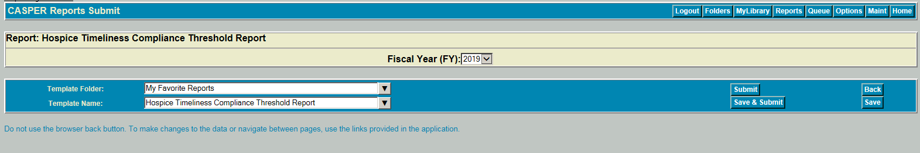
Hospice Timeliness Compliance Threshold Report (cont. 1)
Notes:
Brenda: With this user generated report, the Fiscal Year is only submit criteria. It defaults to current fiscal year, but you can go back and look at previous years.
To request the report, simply select the desired Fiscal Year option and select the Submit button.

Slide 73
Hospice Timeliness Compliance Threshold Report (cont. 2)
The report provides the following information:
  Number of HIS records submitted.
  Number of HIS records submitted on time.
  Percentage of HIS records submitted on time.
  Facility identifiers: CMS Certification Number (CCN) and Facility ID, name, city, and State.
Notes:
Brenda: The report identifies, for the selected Fiscal Year, the required percentage of records that must be submitted successfully on time to avoid the 2–percentage point reduction in APU.
Additionally, this report summarizes the number and percentage of HIS records submitted within the 30-day submission deadline for Annual Payment Update (APU) determination.
The report provides the following information:
Number of HIS records submitted.
Number of HIS records submitted on time.
Percentage of HIS records submitted on time.
Facility identifiers: CCN and Facility ID, Name, City, and State.
90 percent for FY 2020 and beyond.

Slide 74
Hospice Timeliness Compliance Threshold Report (cont. 3)
Provides the percentage of HIS records submitted within the 30-day submission deadline, per fiscal year.
Identifies the required percentage that must be submitted on time to avoid the 2-percentage-point reduction in APU (for selected Fiscal Years (FY), such as 90 percent for FY 2020 and beyond.
Notes:
Brenda: The report identifies, for the selected Fiscal Year, the required percentage of records that must be submitted successfully on time to avoid the 2–percentage point reduction in APU.
Additionally, this report summarizes the number and percentage of HIS records submitted within the 30-day submission deadline for Annual Payment Update (APU) determination.
The report provides the following information:
Number of HIS records submitted.
Number of HIS records submitted on time.
Percentage of HIS records submitted on time.
Facility identifiers: CCN and Facility ID, Name, City, and State.
90 percent for FY 2020 and beyond.

Slide 75
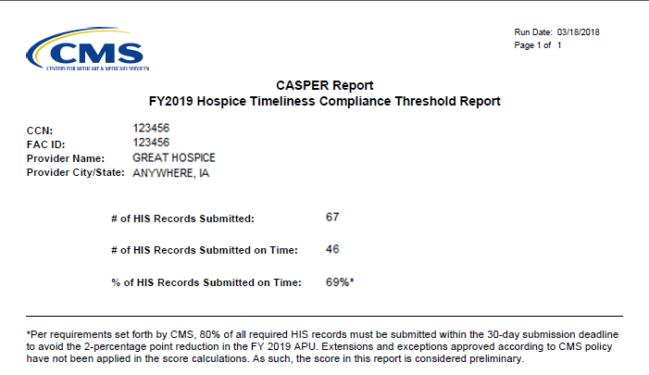
Hospice Timeliness Compliance Threshold Report (cont. 3)
Notes:
Brenda: Here’s a sample Hospice Timeliness Compliance Threshold report, that shows details for FY 2019, which was calendar year 2017 data. This report
Shows the # of HIS Records Submitted, # of HIS Records Submitted on Time, and the % of HIS Records Submitted on time.
The Footnote advises the threshold for that year (80% for FY 2019).
You will note that the Hospice in this report did not meet the 80% threshold requirement for FY 2019 and therefore will be subject to the 2% reduction in their FY 2019 APU.
*You are encouraged to run this report often throughout the year to monitor your status with meeting the threshold requirement.

Slide 76
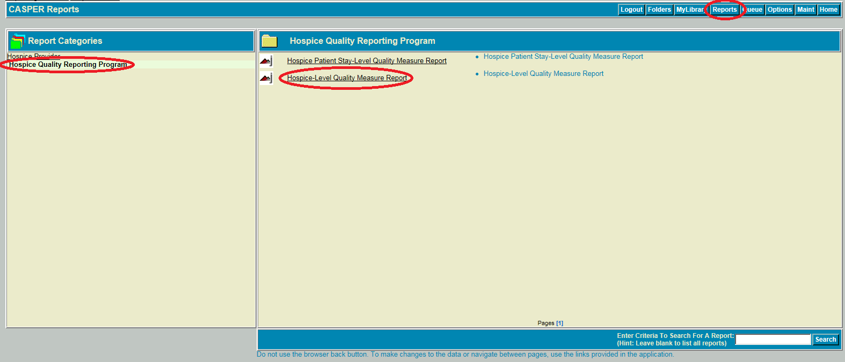
Hospice Quality Reporting Program Reports
Notes:
Brenda: Now, we will move from the Provider reports to the Hospice Quality Reporting Program Report Category. To access this category:
From the Reports tab, you will Select the Hospice Quality Reporting Program category name and a list of reports available in the category will display in the right side of the page.
the Hospice Quality Reporting Program” report category provides the hospice-level quality measure values and patient level values for the HIS-based measures for the requested report period.

Slide 77
Hospice Quality Reporting Program Reports (cont.)
User-requested, on-demand reports in CASPER.
Hospice-Level Quality Measure Report.
  The report shows CMS Measure ID, the Numerator and Denominator, and
  The Hospice Observed Percent, the Comparison Group National Average for the same time period, and the Comparison Group National Percentile for each measure.
Hospice Patient Stay-Level Quality Measure Report.
  Identifies each patient whose qualifying HIS record was included in the QM calculations for the selected report period.
  Includes per patient per measure information such as whether the patient stay triggered or did not trigger the measure or was excluded from the denominator.
Notes:
Brenda: User-requested, on-demand reports in CASPER.
Hospice-Level Quality Measure Report.
The report shows CMS Measure ID, the Numerator, and the Denominator for each measure.
The Hospice Observed Percent, the Comparison Group National Average for the same time period and the Comparison Group National Percentile.
Hospice Patient Stay-Level Quality Measure Report.
Identifies each patient whose qualifying HIS record was included in the QM calculations for the selected report period.
Includes, per patient per measure information such as, whether the patient stay triggered or did not trigger the measure, or was excluded from the Denominator..

Slide 78
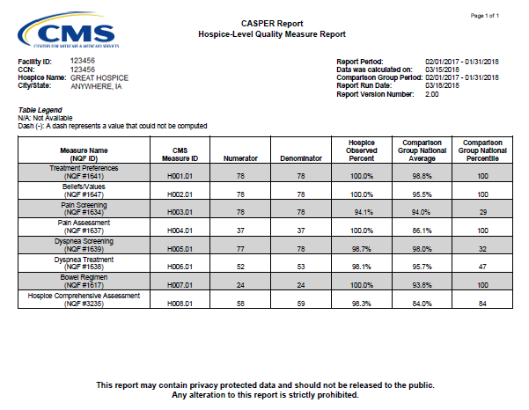
Hospice-Level Quality Measure Report
Notes:
Brenda: Here’s a sample Hospice-Level Quality Measure report.
For each of the 8 measures, the report shows CMS Measure ID, the Numerator, and the Denominator
The Hospice Observed Percent, the Comparison Group National Average for the same time period and the Comparison Group National Percentile
The Comparison Group National Percentile indicates the hospice’s rank nationally. For example, the Pain Screening measure percentile of 29 on this report indicates that 29% of the hospices in the nation had a QM score that was less than or equal to this hospice, or in other words, performed the same as or worse than the hospice. The higher the percentile, the better.

Slide 79
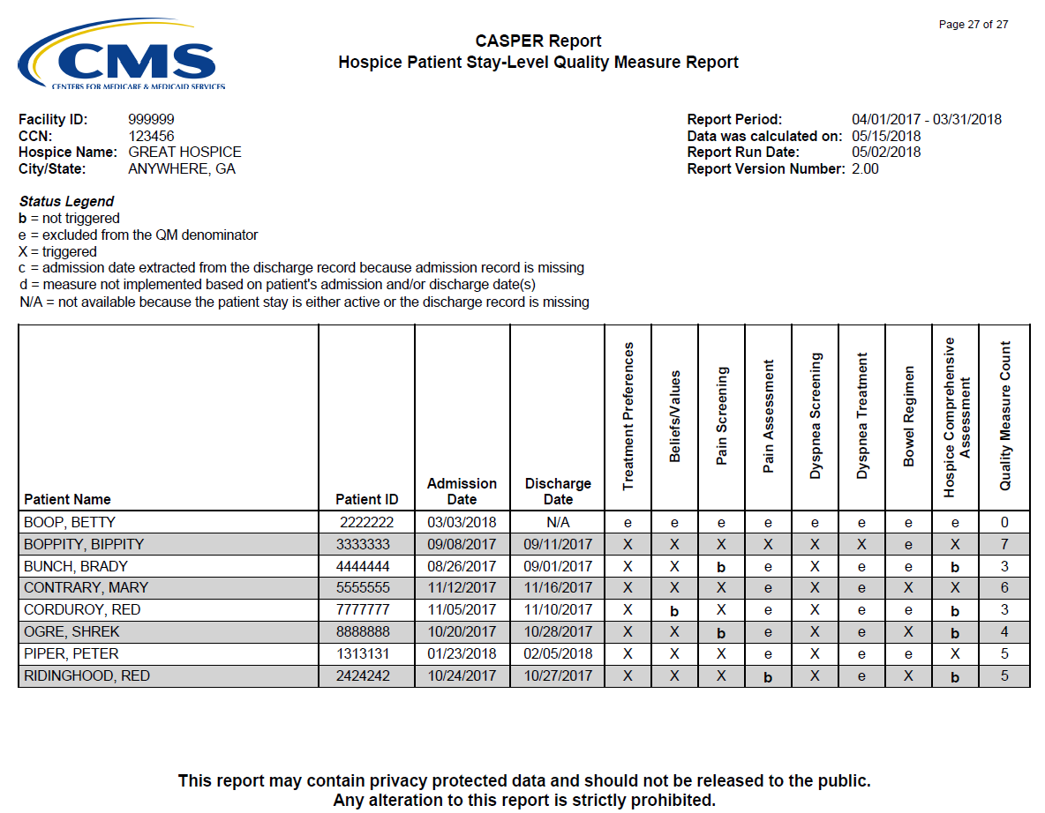
Hospice Patient Stay-Level Quality Measure Report
Notes:
Brenda: Here is a sample Hospice Patient Stay-Level QM report. This report provides a breakdown of the Hospice-level report for the same time period.
This report indicates the measure status, per measure per patient during the requested report period.
I will describe some of the values you can see in each measure column:
A ‘b’ displays when the measure was not triggered (didn’t pass the measure). The ‘b’ displays in bold font for easy identification.
An ‘e’ displays when the patient was excluded from measure
An ‘X’ displays when the measure was triggered (passed the measure)
A ‘c’ displays in the Admission Date column next to the date when the admission date was extracted from the discharge record because the admission record is missing. This will serve as a trigger or flag to you to research why the admission record is missing or hasn’t been submitted.
A ‘d’ displays when the measure was not implemented based on patient’s admission and/or discharge date(s). For example, the Hospice Comprehensive Assessment measure is reported for stays with Admission dates greater than or equal to 04/01/2017. For stays with admission dates prior to 04/01/2017, the result for this measure will be shown as ‘d’.
‘N/A’ displays in the Discharge Date column when the discharge date is not available because either the patient stay is still active, or the discharge record is missing. This is a trigger for you to verify if all discharge records have been submitted.
The Quality Measure Count is the last column on the report, and provides a quick view of how many measures were triggered (passed) during each patient stay.

Slide 80
Hospice Provider Preview Reports
These are two separate reports are located in your CASPER folder.
  Hospice Provider Preview report.
  CAHPS® Hospice Survey Provider Preview report .
Hospice providers are encouraged to use these to review their HIS quality measure results and their facility-level CAHPS® survey results.
Providers have 30 days to review their HIS and CAHPS® results.
The Provider Preview Reports are available for a period of 60 days from the report release date.
Notes:
Brenda: These last few are called Hospice Provider Preview Reports and they can also be found in CASPER. The purpose of these reports is to give providers the opportunity to preview their HIS quality measure results and Hospice CAHPS® survey results prior to public display on Hospice Compare.
These are two separate reports are located in your CASPER folder
Hospice Provider Preview report
CAHPS® Hospice Survey Provider Preview report
Hospice providers are encouraged to use these to review their HIS quality measure results and their facility-level CAHPS® survey results
Providers have 30-days to review their HIS and CAHPS® results
Should a provider believe the denominator or other HIS quality metric to be inaccurate or if there are errors within the results from the CAHPS® Survey data, a provider may request CMS review.
These Reports are available for a period of 60 days from the report release date. Hospices are encouraged to download and save their reports for future reference, as they will no longer be available in CASPER after the 60-day period.
Prior to each quarterly release of data on Hospice Compare, hospice providers are given an opportunity to review their results during the 30-day preview period. These reports are provided after the “freeze date” after which providers cannot make changes to their HIS records. Because of this, hospices are not able to make changes to the underlying data. Providers need to take action to ensure all data is accurate prior to the “freeze date.” If hospices fail to make necessary corrections to their HIS data before a specific “freeze date,” then CMS will base the measure on the data that was in the CMS system at the time that the QMs are calculated.

Slide 81
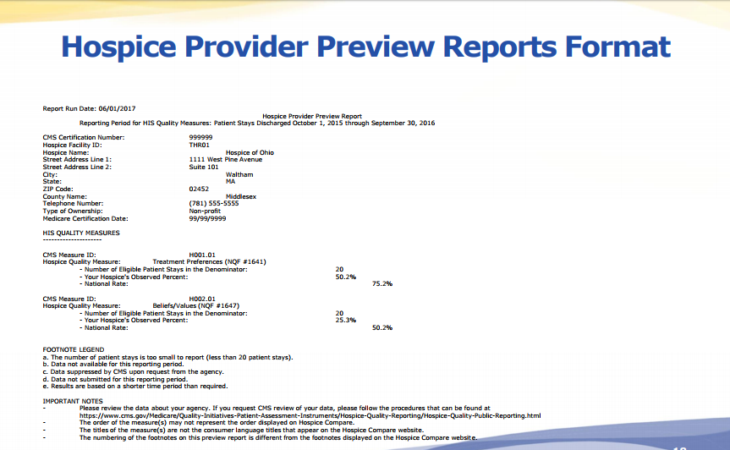
Hospice Provider Preview Reports (cont. 1)
Notes:
Brenda: Here’s a sample Hospice Provider Preview Report. You can see the hospice-identifying information at the top of the report, followed by the results for each measure. Beneath the measure results are the footnote definitions and the important notes.

Slide 82
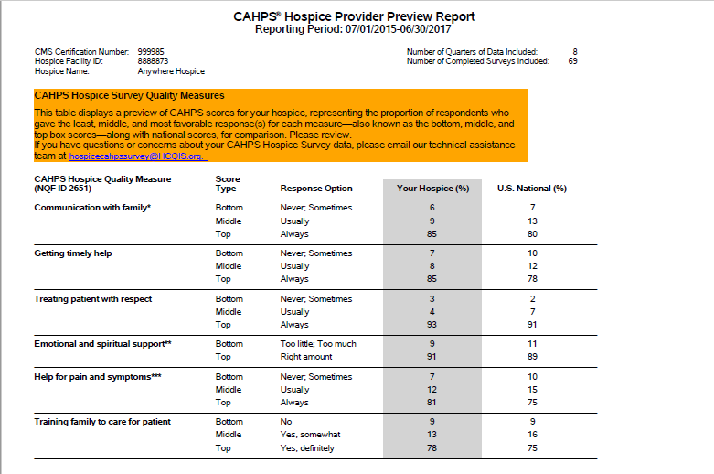
Hospice Provider Preview Reports (cont. 2)
Notes:
Brenda: Here’s a sample CAHPS Hospice Provider Preview Report.

Slide 83
Which report provides detailed information about the status of select submission files?
5
Hospice Item Set Submission Statistics by Provider.
Hospice Final Validation Report.
Hospice Item Sets Submitted.
HIS Record Error Detail by Provider.
Notes:
Brenda: Which report provides detailed information about the status of select submission files?
Hospice Item Set Submission Statistics by Provider.
Hospice Final Validation Report.
Hospice Item Sets Submitted.
HIS Record Error Detail by Provider.

Slide 84
Which report provides detailed information about the status of select submission files? (cont.)
5
Hospice Item Set Submission Statistics by Provider.
Hospice Final Validation Report.
Hospice Item Sets Submitted.
HIS Record Error Detail by Provider.
Notes:
Brenda: The answer is B- Hospice Final Validation Report.

Slide 85
Which report provides the percent of HIS records submitted and accepted within the 30-day submission deadline per fiscal year?
6
Hospice Item Set Submission Statistics by Provider.
HIS Records With Error Number XXXXX Report.
Hospice Timeliness Compliance Threshold Report.
Hospice-Level Quality Measure Report.
Notes:
Brenda: Which report provides the percent of HIS records submitted and accepted within the 30-day submission deadline per fiscal year?

Slide 86
Which report provides the percent of HIS records submitted and accepted within the 30-day submission deadline per fiscal year? (cont.)
6
Hospice Item Set Submission Statistics by Provider.
HIS Records With Error Number XXXXX Report.
Hospice Timeliness Compliance Threshold Report.
Hospice-Level Quality Measure Report.
Notes:
Brenda: The answer is C - Hospice Timeliness Compliance Threshold Report

Slide 87
Reconsideration Process
Notes:
Brenda: Now lets get into more detail regarding the requesting of reconsiderations, should your hospice receive a letter of noncompliance.

Slide 88
What is Reconsideration?
Reconsideration is a request for a review of the non-compliance decision prior to the 2-percentage point reduction in the hospice’s APU that takes effect on October 1.
Notes:
Brenda: If your hospice has applied for a reconsideration, you will be notified about the results by CMS. This notification will fall between August and September.

Slide 89
What is Reconsideration? (cont.)
Any hospice found non-compliant with the HQRP requirements will receive a letter of notification, which will include instructions for requesting reconsideration of the decision.
If you believe your hospice has been identified for this payment reduction in error, you have the right to request a reconsideration of the non-compliant decision.
The HQRP Reconsideration webpage for more information is: https://www.cms.gov/Medicare/Quality-Initiatives-Patient-Assessment-Instruments/Hospice-Quality-Reporting/Reconsideration-Requests.html
Notes:
Brenda: A Reconsideration is a request for a review of the noncompliance decision prior to the two (2) percentage point reduction in the hospice’s annual payment update (APU) taking effect on October 1.
We talked about the APU and that any hospice determined to be non-compliant with the HQRP requirements may be subject to the two (2) percentage point reduction in their APU. This can occur if there is noncompliance with Either HIS or CAHPS® Hospice Survey OR Both HIS and CAHPS® Hospice Survey.
Non-compliant providers will be notified of their APU decision through a letter of notification by US mail and also through the CASPER system. This letter will include instructions for requesting a reconsideration of the decision.
So, If you believe your hospice has been identified for this payment reduction in error, you have the right to request a reconsideration of the non-compliant decision.

Slide 90
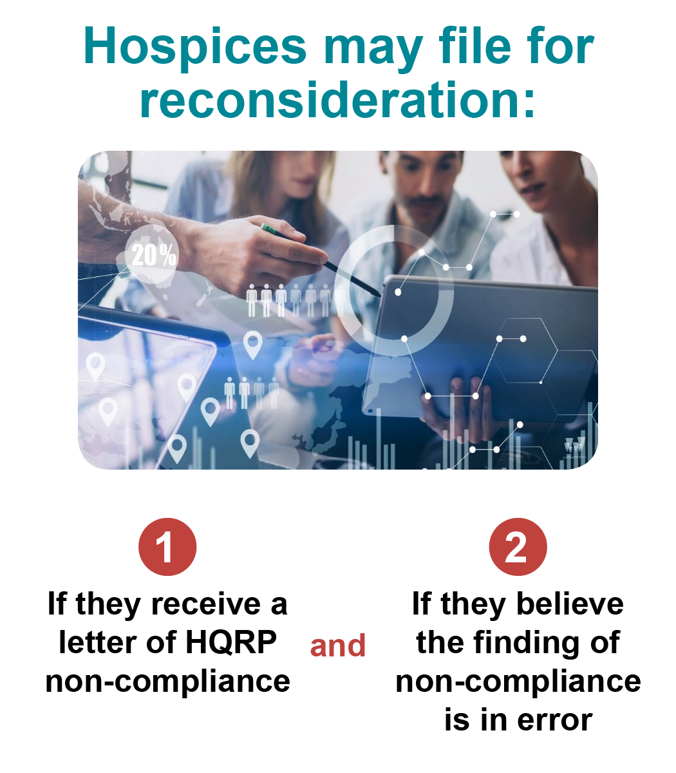
When Would a Hospice Submit a Reconsideration Request?
Hospices may file for reconsideration:
  If they receive a letter of HQRP non-compliance and,
  Believe the finding of non-compliance is in error.
Requests must be submitted within 30 days after the date documented on the non-compliance notification letter.
No requests will be accepted after the 30 day deadline.
Failure to submit a timely HQRP reconsideration automatically subjects any non-compliant hospice to the two percent APU reduction for that fiscal year.
Notes:
Brenda: Hospices can file for reconsideration if they receive a letter of HQRP noncompliance and they believe that the finding is in error. Hospices that want to have their circumstances reviewed by CMS must file a reconsideration request.
Hospices have 30 days to submit the request for reconsideration to CMS! This is 30 days after the date documented on the noncompliance notification letter. CMS will not accept any requests submitted after the thirty (30) day deadline.
If a hospice is found non-compliant with HQRP, it is up to the hospice to prove otherwise during the reconsideration process. So, in other words, if the hospice thinks it meets an exception such as newness or related to some type of a disaster, they need to provide the appropriate documentation to support their position within the 30 day deadline.
Hospices that are deemed to be non-compliant and fail to submit a timely HQRP reconsideration will automatically be subjected to the 2% APU reduction for that fiscal year.

Slide 91

The Reconsideration Request Process
CMS will notify hospices that are non-compliant with HQRP two ways:
  Via the MAC through the USPS.
  An electronic letter via the CASPER system.
Hospices should look for the letter and be sure to access the CASPER system since either letter serves as notice of HQRP non-compliance.
Notes:
Brenda: So, let’s review the process for requesting this Reconsideration!
First, CMS will notify the hospices that are non-compliant. And they are notified by CMS two different ways;
Via the Medicare Administrative Contractors (MACs) through the US postal service…. and also….
Electronically, via the CASPER system.
Hospices should look for the letter and be sure to access their CASPER system since either letter serves as notice of HQRP non-compliance. Hospices that receive a letter of non-compliance must submit a request for reconsideration to CMS within thirty (30) days after the date documented on the non-compliance notification letter if they want to seek reconsideration. CMS will not accept any requests submitted after the thirty (30) day deadline.

Slide 92
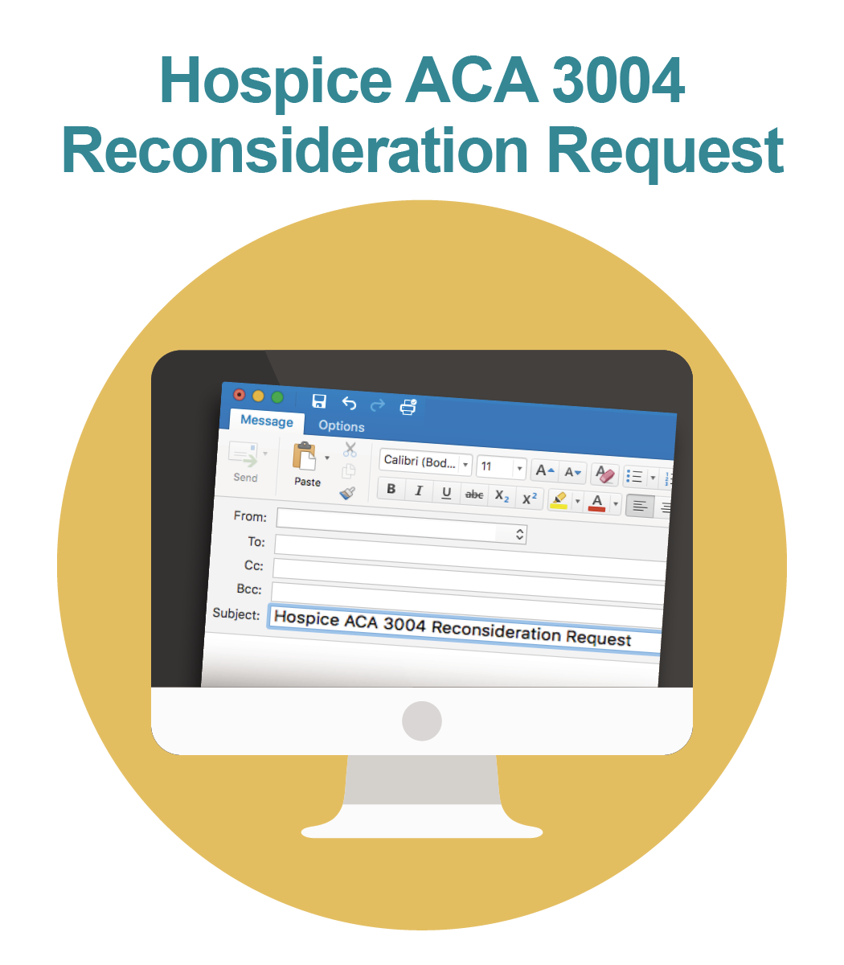
Creating a Reconsideration Request
The only method for submitting reconsideration requests is via email to CMS.
The request must be sent to the following email address:
HospiceQRPReconsiderations@cms.hhs.gov
Notes:
Brenda: Now let us walk through what you will need to create a Reconsideration Request
Most important is to submit by the 30 day deadline and the only method to use to submit is by email. Late requests and those submitted by any other means will not be reviewed for reconsideration.
The request must be sent to the following email address: HospiceQRPReconsiderations@cms.hhs.gov.

Slide 93
Creating a Reconsideration Request (cont.)
The subject line should include: “Hospice ACA 3004 Reconsideration Request” and the hospice’s CMS Certification Number (CCN).
Include the following in the request:
  The hospice CCN, business name, and address.
  The CEO or designated contact information.
  The CMS-identified reason(s) for non-compliance (from the notification letter).
  Information supporting the hospice’s belief that non-compliance is in error, or the evidence which prevented timely submission of data.
Notes:
Brenda: Now let us walk through what you will need to create a Reconsideration Request
Most important is to submit by the 30 day deadline and the only method to use to submit is by email. Late requests and those submitted by any other means will not be reviewed for reconsideration.
Please include the following in the subject line: “Hospice ACA 3004 Reconsideration Request” and the hospice’s CMS Certification Number (CCN) (e.g., Hospice ACA 3004 Reconsideration Request, XXXXXX).
The email request must include the following information:
•The Hospice CMS Certification Number (CCN)
•The Hospice Business Name
•The Hospice Business Address
•CEO or CEO-designated representative contact information, including name, email address, telephone number, and physical mailing address
•CMS identified reason(s) for noncompliance from the noncompliance notification letter
•Information supporting the hospice belief that noncompliance is in error, or evidence of the impact of extraordinary circumstances which prevented timely submission of data
•The request for reconsideration must be accompanied by supporting documentation demonstrating compliance. CMS will be unable to review any request without the necessary documentation. Supporting documentation may include any or all of the following provided as examples:
•Email communications
•For HIS reporting, evidence of HIS transmissions during the reporting period (e.g. an HIS Final Validation Report from the CASPER system showing a timely submission date).
•For HIS reporting, proof of previous exemption/extension approval for the prescribed reporting period.
•For HIS reporting, notification of the CCN activation letter to prove that the CCN was not activated by November 1st.
•For CAHPS® reporting, the hospice must have served fewer than 50 survey-eligible decedents/caregivers during the reporting period, evidence that the hospice filed the Participation Exemption Request Form by the deadline date.
•For CAHPS® reporting, evidence that the hospice continuously collected data and submitted data to the CAHPS® Hospice Survey Data Warehouse during the required timeframe.
Please note: Never include patient information (i.e. protected health information (PHI), patient identified information (PII), or other Health Insurance Portability and Accountability Act (HIPAA) violations) in the documentation being submitted to CMS for review. This includes attaching HIS-Admission or HIS-Discharge records and sending to CMS via email. Email is NOT a secure transmission product and any PHI/PII sent via email will enact security violation protocol prompting involvement by the CMS security offices.
In its review of the hospice’s documentation, CMS will determine whether evidence to support a finding of noncompliance has been provided by the hospice. The determination will be made based solely on the documentation provided. CMS will not contact the hospice to request additional information or to clarify incomplete or inconclusive information. If clear evidence to support a finding of compliance is not present, the 2 percentage point reduction will be upheld. If clear evidence of compliance is present, the reduction will be reversed.

Slide 94
Creating a Reconsideration Request Email
Include supporting documentation demonstrating compliance, such as:
  Email communications, evidence of HIS transmissions during the reporting period, or proof of a previous extension for HIS reporting.
  For CAHPS® reporting, evidence that the hospice served fewer than 50 survey-eligible decedents, or evidence that there was continuous data collection and submission during the required timeframe.
Never include patient information (i.e., protected health information (PHI), patient identified information (PII)), in the documentation being submitted to CMS for review.
Determination will be made based solely on the documentation provided.
Notes:
Brenda:
Include supporting documentation demonstrating compliance, such as:
Email communications, evidence of HIS transmissions during the reporting period, or proof of previous exemption/extension for HIS reporting.
For CAHPS® reporting, evidence that the hospice must served fewer than 50 survey-eligible decedents/caregivers during the reporting period, or evidence that the hospice continuously collected data and submitted data to the CAHPS® Hospice Survey Data Warehouse during the required timeframe.
Please note: Never include patient information (i.e. protected health information (PHI), patient identified information (PII), in the documentation being submitted to CMS for review. Email is NOT a secure transmission and any PHI/PII sent via email will enact security violation protocol prompting involvement by the CMS security offices.
In its review of the hospice’s documentation, CMS will determine whether evidence to support a finding of noncompliance has been provided by the hospice. The determination will be made based solely on the documentation provided. CMS will not contact the hospice to request additional information or to clarify incomplete or inconclusive information. If clear evidence to support a finding of compliance is not present, the 2 percentage point reduction will be upheld. If clear evidence of compliance is present, the reduction will be reversed.
Include supporting documentation demonstrating compliance, such as:
Email communications, evidence of HIS transmissions during the reporting period, or proof of previous exemption/extension for HIS reporting.
For CAHPS® reporting, evidence that the hospice must served fewer than 50 survey-eligible decedents/caregivers during the reporting period, or evidence that the hospice continuously collected data and submitted data to the CAHPS® Hospice Survey Data Warehouse during the required timeframe.
Please note: Never include patient information (i.e. protected health information (PHI), patient identified information (PII), in the documentation being submitted to CMS for review. Email is NOT a secure transmission product and any PHI/PII sent via email will enact security violation protocol prompting involvement by the CMS security offices.
he request for reconsideration must be accompanied by supporting documentation demonstrating compliance. CMS will be unable to review any request without the necessary documentation. Supporting documentation may include any or all of the following provided as examples:
•Email communications
•For HIS reporting, evidence of HIS transmissions during the reporting period (e.g. an HIS Final Validation Report from the CASPER system showing a timely submission date).
•For HIS reporting, proof of previous exemption/extension approval for the prescribed reporting period.
•For HIS reporting, notification of the CCN activation letter to prove that the CCN was not activated by November 1st.
•For CAHPS® reporting, the hospice must have served fewer than 50 survey-eligible decedents/caregivers during the reporting period, evidence that the hospice filed the Participation Exemption Request Form by the deadline date.
•For CAHPS® reporting, evidence that the hospice continuously collected data and submitted data to the CAHPS® Hospice Survey Data Warehouse during the required timeframe.
Please note: Never include patient information (i.e. protected health information (PHI), patient identified information (PII), or other Health Insurance Portability and Accountability Act (HIPAA) violations) in the documentation being submitted to CMS for review. This includes attaching HIS-Admission or HIS-Discharge records and sending to CMS via email. Email is NOT a secure transmission product and any PHI/PII sent via email will enact security violation protocol prompting involvement by the CMS security offices.
In its review of the hospice’s documentation, CMS will determine whether evidence to support a finding of noncompliance has been provided by the hospice. The determination will be made based solely on the documentation provided. CMS will not contact the hospice to request additional information or to clarify incomplete or inconclusive information. If clear evidence to support a finding of compliance is not present, the 2 percentage point reduction will be upheld. If clear evidence of compliance is present, the reduction will be reversed.

Slide 95

The Reconsideration Response
CMS should acknowledge receipt of the reconsideration request within 5 business days through an email.
Following its review of the request and supporting documentation, CMS will issue its decision by regular mail through the MACs and an electronic letter through the CASPER system.
If the decision upholds the finding of non-compliance, a provider may file an appeal with the Provider Reimbursement Review Board.
Notes:
Brenda: CMS should acknowledge receipt of the reconsideration request within five (5) business days through an email. Following its review of the request and supporting documentation, CMS will issue its decision by regular mail through the Medicare Administrative Contractor (the MACs) and an electronic letter through the CASPER system. If the decision upholds the finding of noncompliance, a provider may file an appeal with the Provider Reimbursement Review Board. More information about this can be found on the CMS website. We will review all of those resources at the end of this presentation.

Slide 96

Reconsideration Process: Estimated Timeline
July: Non-compliant hospices that failed to meet the hospice quality reporting requirements are notified.
July – August: Reconsideration requests are due to CMS 30 days from the date on the notification of non-compliance.
CMS provides an email acknowledgement within 5 business days upon receipt of the reconsideration request.
August – September: CMS notifies hospices of the agency’s decision on the reconsideration requests.
October 1: Any hospice determined to be non-compliant is subject to the 2-percent reduction in their APU for that fiscal year.
Notes:
Brenda: so lets review the whole timeline for reconsiderations once more in detail;
July: Non-compliant hospices that failed to meet the hospice quality reporting requirements are notified. CMS will prepare letters for CASPER and also sent to the MACs sometime in June.
July – August: Reconsideration requests are due to CMS 30 days from the date on the notification of non-compliance.
When CMS receives reconsideration requests, they will provide an email acknowledgement within five (5) business days.
August–September: CMS notifies hospices of the agency’s decision on the reconsideration requests.
October 1: Any hospice determined to be non-compliant is subject to the two percent reduction in their APU for that fiscal year.
So that wraps up the reconsideration process. Now lets do another Knowledge check before we move to the resources.

Slide 97
Which of the following statements is not true in regard to reconsiderations?
7
A hospice has 30 days to submit a request.
CMS will contact the hospice if they have further questions.
Requests can be sent only by email.
CMS will issue its decision by regular mail and through the CASPER system.
Notes:
Brenda:

Slide 98
Which of the following statements is not true in regard to reconsiderations? (cont.)
7
A hospice has 30 days to submit a request.
CMS will contact the hospice if they have further questions.
Requests can be sent only by email.
CMS will issue its decision by regular mail and through the CASPER system.
Notes:
Brenda: The answer is B- It is NOT true that CMS will contact the hospice if they have further questions. Therefore it is very important for you to submit all of your supporting documentation with the e-mail that you send for any reconsideration.

Slide 99
Resources
Notes:
Brenda: Now lets review the resources that are available to you for future reference!

Slide 100
Resources
  The Hospice Quality Reporting (HQRP) web page:
  https://www.cms.gov/Medicare/Quality-Initiatives-Patient-Assessment-instruments/Hospice-Quality-Reporting/
HIS web page:
  https://www.cms.gov/Medicare/Quality-Initiatives-Patient-Assessment-Instruments/Hospice-Quality-Reporting/Hospice-Item-Set-HIS.html
CMS Hospice CAHPS® Survey web page:
  https://www.cms.gov/Medicare/Quality-Initiatives-Patient-Assessment-Instruments/Hospice-Quality-Reporting/Hospice-CAHPS%C2%AE.html
The official Hospice CAHPS® Survey website:
  http://www.hospicecahpssurvey.org

Slide 101
Resources (cont.)
Provider Preview Reports:
  https://www.cms.gov/Medicare/Quality-Initiatives-Patient-Assessment-Instruments/Hospice-Quality-Reporting/Public-Reporting-Background-and-Announcements.html
Reconsiderations Request web page:
  https://www.cms.gov/Medicare/Quality-Initiatives-Patient-Assessment-Instruments/Hospice-Quality-Reporting/Reconsideration-Requests.html

Slide 102
HQRP Resources on the QIES Technical Support Office (QTSO) Website
Hospice Submission User's Guide & CASPER Reporting User's Guide:
  Available on the Hospice User Guides & Training web page of the QTSO website: https://qtso.cms.gov/hospicetrain.html
QTSO website:
  - https://www.qtso.com/hospicetrain.html

Slide 103
Previous Trainings
Hospice Quality Reporting Training – Training and Education Library web page:
  https://www.cms.gov/Medicare/Quality-Initiatives-Patient-Assessment-Instruments/Hospice-Quality-Reporting/Hospice-Quality-Reporting-Training-Training-and-Education-Library.html
Requesting Hospice reports via CASPER recorded training modules on the QTSO site:
  https://qtso.cms.gov/webex/qiescat.php

Slide 104
Help Desk Assistance
  Quality Help Desk:
  HospiceQualityQuestions@cms.hhs.gov
  For questions about quality reporting requirements, quality measures, and reporting deadlines.
CAHPS® Hospice Survey Help Desk:
  HospiceCAHPSSurvey@hcqis.org or (844) 472-4621.
  For information about the CAHPS® Hospice Survey, technical assistance, and requests for review of CAHPS® Hospice Survey data.

Slide 105
Help Desk Assistance (cont.)
CAHPS® Hospice Survey Data Warehouse support:
  CAHPSHospiceTechSupport@rand.org
  For questions about data submission, data submission reports, and access to the CAHPS® Hospice Survey Data Warehouse.
QIES Help Desk:
  Help@qtso.com or 1 (877) 201-4721.
  For questions about HIS submission reports and CASPER reports.
APU/Reconsiderations Help Desk:
  HospiceQRPReconsiderations@cms.hhs.gov
  For requesting reconsideration for a determination of noncompliance with hospice quality reporting.

Slide 106


Slide 107
Thank You.
The webinar has now concluded.
Notes:
Brenda

