Slide 1
Getting Involved in Quality Measure Development
A Practical Guide for Patients, Providers, and Advocates
Presenters:
Brenna Rabel, MPH
Nicole Brennan, DrPH

Slide 2
Vision and Goals: MMS Info Sessions
An ongoing process to engage the public in quality measure development.
Elicit feedback that will help CMS design resources that can help all of those interested in healthcare quality improvement better understand the goals of quality measurement.
Education
Outreach
Dedicated Websites
Measure Development Roadmaps
Listserv opportunities
Notes:
CMS is committed to providing Education and Outreach opportunities about the quality measure development process to interested stakeholders to improve understanding of the process. CMS also seeks continual feedback to improve and/or expand its offerings to the healthcare quality measure development community and interested stakeholders.
To date, CMS has implemented an Education and Outreach webinar series and has created resource materials that break down and explain various components and challenges in the measure development process. There are dedicated websites, listservs, and roadmap documents that are available to support those that are working in quality measure development, or are just curious and want to learn more about how it is done.

Slide 3
Agenda
Ways to get involved
Step-by-step guidance
Technical Expert Panel (TEP)
Public Comment
Discussion

Slide 4
Ways to be Involved
Technical Expert Panels (TEPs) / patient panels
Convened by measure developers to support measure development
Public comment
Provide opportunities for the public to provide feedback on measures under development or maintenance
Testing
Measure developers may recruit patients or clinicians to participate in measure testing
Frequently advertised via the MMS Newsletter (sign up here: https://www.cms.gov/Medicare/Quality-Initiatives-Patient-Assessment-Instruments/MMS/MMS-Listserv.html)
Notes:
TEPs, public comment, and testing are 3 types of activities that a patient or clinician might do to be involved. Each of these requires different levels of involvement.
This presentation focuses on TEPs and public comment. Testing will be discussed in-depth another time.

Slide 5
Technical Expert Panels

Slide 6
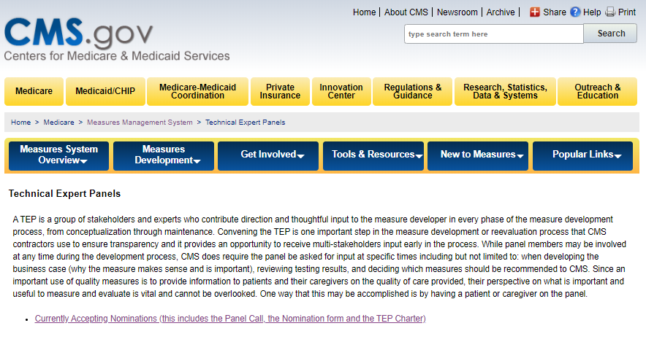
Finding Opportunities
Link: https://www.cms.gov/Medicare/Quality-Initiatives-Patient-Assessment-Instruments/MMS/TEP-Currently-Accepting-Nominations.html
OR
MMS > Get Involved > Technical Expert Panels
Click on ‘Currently Accepting Nominations’
Notes:
All CMS measure developers post calls for TEP nominations on the MMS website. Opportunities are also advertised in the MMS newsletter.

Slide 7
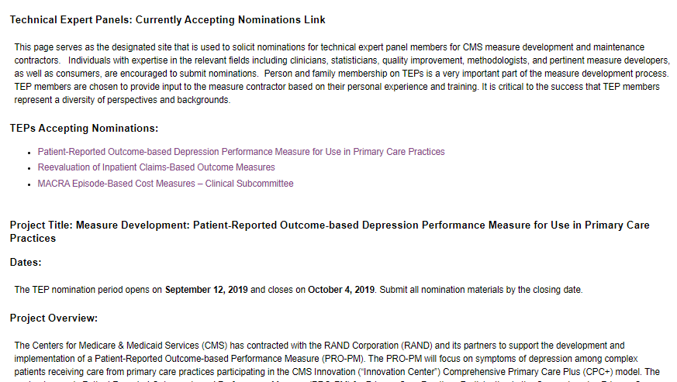
Navigating TEP Opportunities
Information included in TEP postings
Dates (TEP nomination period)
Project overview
Project objectives
TEP requirements
Expected time commitment
Required information
Contact information
Downloads
TEP Charter
TEP Nomination Form
Notes:
Downloads note: Scroll all the way down the page for downloads.

Slide 8
Nomination Requirements
Signed nomination form
Found in “Downloads” section of the TEP page
Conflict of interest disclosure
List any activities, past or present, that may indicate a conflict of interest
Statement of interest
Summarize relevant experience or expertise, typically ~2 pages
Resume/CV (typically N/A for patient representatives)
Notes:
Conflict of interest: Conflicts of interest do not necessarily preclude a person from participating, but it is crucial that this information is disclosed;
e.g. individual is participating in another TEP or measure development project on a related topic.
Statement of interest: Information provided in the statement of interest should not overlap with resume/CV. For patients or patient advocates this can include personal experiences relating to the work being done and explaining any other experience working on patient panels. Physicians and other technical experts should highlight previous TEP or NQF experience, quality improvement or clinical specialty areas that would make them a good fit.
Resume/CV: Patients don’t usually need to submit a resume or CV but are welcome to include one.

Slide 9
Resources for Patients and Families
Link
Step-by-step guidance
Background on quality measurement and TEPs
Tips for self-nominating
Support for how to contribute once selected
Resources for more information
Notes:
Full link: https://www.cms.gov/Medicare/Quality-Initiatives-Patient-Assessment-Instruments/MMS/Downloads/Becoming-a-TEP-Member_Mar2019.pdf

Slide 10
Guidance for Measure Developers
Link
Complementary to the Blueprint for the CMS Measures Management System (“the Blueprint”)
Includes guidance on:
Recruiting and establishing a TEP
Engaging members
Organizing logistics
Concluding a TEP
Notes:
https://www.cms.gov/Medicare/Quality-Initiatives-Patient-Assessment-Instruments/MMS/Downloads/Running-a-TEP-Your-Guide-to-TEPs-for-Clinical-Quality-Measure-Development-FINAL-508.pdf
https://www.cms.gov/Medicare/Quality-Initiatives-Patient-Assessment-Instruments/MMS/MMS-Blueprint.html

Slide 11
Guidance for Measure Developers
Link
Best practices for engaging patients and families in measure development
Includes information about recruitment, facilitating engagement, strategic planning, and other resources
Notes:
Full link: https://www.cms.gov/Medicare/Quality-Initiatives-Patient-Assessment-Instruments/MMS/Downloads/Person-and-Family-Engagemen.pdf

Slide 12
Resources to share
TEP Fact Sheet (pictured)
Link
Relevant Measures Management System (MMS) newsletter articles
TEPs
Link
Person and Family Engagement
August 2018 Info Session on TEPs
Link
Notes:
Fact sheet full link: https://www.cms.gov/Medicare/Quality-Initiatives-Patient-Assessment-Instruments/MMS/Downloads/TEP_Topic_Overview.pdf
TEP newsletter article full link: https://www.cms.gov/Medicare/Quality-Initiatives-Patient-Assessment-Instruments/MMS/Downloads/Technical-Expert-Panels.pdf
Person and Family Engagement full link: https://www.cms.gov/Medicare/Quality-Initiatives-Patient-Assessment-Instruments/MMS/Downloads/Person_and_Family_Engagement_MMS_Newsletter_April_2018.pdf
MACRA webinar link: https://www.cms.gov/Medicare/Quality-Initiatives-Patient-Assessment-Instruments/MMS/Downloads/CMS-MMS-Webinar-BP101-%E2%80%93-Best-Practices-for-Technical-Expert-Panels.pptx

Slide 13
Using Social Media to Recruit a TEP
Benefits: low cost, potentially high impact
Challenges: relatively new outreach channel, highly depending on social media footprint
Sites to consider:
Twitter
Facebook
LinkedIn
Notes:
Social media to advertise TEPs is relatively new, so there is not a lot of data to report on its success in this context.
Social media outreach during public webinar recruitment; only about 1% of registrants heard about the opportunity through Twitter, however that doesn’t account for intangibles (ex., the number of organizations that saw the opportunity on social media and shared the announcement through their networks).
If planning to use social media, efforts should be made to cultivate a following on social media so that the audience seeing the announcements is more robust.

Slide 14
Public Comment
10/21/2019
Notes:
Public comment ensures that quality measures are developed with transparency, allows for collection of balanced input from stakeholders on measures being developed, and provides opportunity to give critical feedback.
There are 2 channels for submitting comments.
Measures being developed and still undergoing testing and programs not using the rulemaking process, e.g. the hospital star rating system
Developers are required to seek public comment as measures are being developed to be iterative and get stakeholder input before it goes in the rulemaking system.
Comment opportunities are posted on the MMS website, announcements, newsletter.
More formal public comment comes through CMS rulemaking.
Stakeholders invited to share comments about any measures being put out in a proposed rule.
Responses are reviewed and responded to by CMS.

Slide 15
Types of Public Comment Opportunities
Comment on measures under development
Comment on a proposed rule
Posted to MMS website
Comments submitted directly to measure developers
Opportunity to provide feedback on a measure before it is submitted for use in a program
Proposed rules are published on the Federal Register: https://www.federalregister.gov/
Comments are posted publicly
Opportunity to provide feedback on measures or policies specific to a given CMS program
Notes:
There are 2 channels for submitting comments.
1. Measures being developed and still undergoing testing and programs not using the rulemaking process, e.g. the hospital star rating system
Developers are required to seek public comment as measures are being developed to be iterative and get stakeholder input before it goes in the rulemaking system.
Comment opportunities are posted on the MMS website, announcements, newsletter.
2. More formal public comment comes through CMS rulemaking.
Stakeholders invited to share comments about any measures being put out in a proposed rule.
Responses are reviewed and responded to by CMS.

Slide 16
Submitting a Comment on a Measure Under Development
Link: https://www.cms.gov/Medicare/Quality-Initiatives-Patient-Assessment-Instruments/MMS/Public-Comments.html
OR
MMS > Get Involved > Public Comments
Click on ‘Currently Accepting Comments’
Notes:
From this page, either “Currently Accepting Comments” or “Updates to Closed Comment Periods” can be selected.
Updates to Closed Comment Periods: The bottom of this page includes comments on the hospital star rating system. From here, you could see the submitted comments, summaries, and CMS’ analysis of comments as well as next steps for the system.

Slide 17
Navigating Public Comment Opportunities on MMS
Information included in Public Comment posting
Project overview
Project objectives
Documents and measures for comment
Project-specific instructions
Downloads
Measure information form (MIF)
Measure justification form (MJF)
Other documents or background information
Notes:
This is a screen capture of “Currently Accepting Comments.”
Please always provide contact information when filling out forms.

Slide 18
Finding a Proposed Rule
Two options:
Go to https://www.federalregister.gov/ and create an account (it’s free!)
Set up a subscription for documents from Centers for Medicare & Medicaid Services
You’ll receive email notifications when new proposed rules are posted for comment
Go to https://www.federalregister.gov/ and do a keyword search
No need for an account, but it can be difficult to find what you are looking for because of the volume of documents housed there

Slide 19
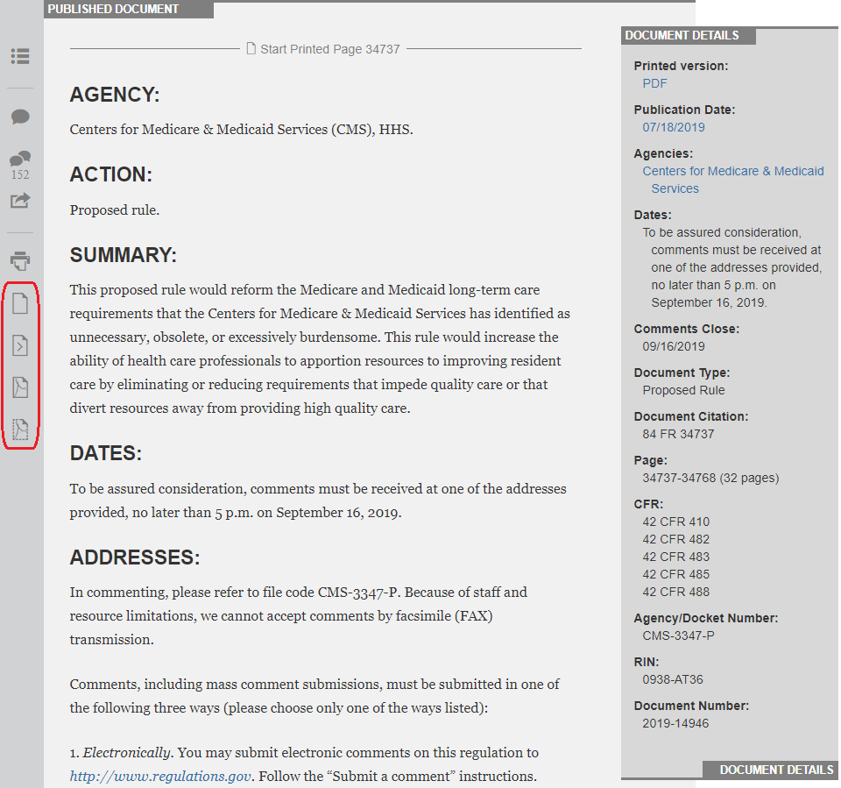
Submitting a Comment on a Proposed Rule

Slide 20
Comment Submission Form
Clicking on “Submit a Formal Comment” opens a form
Complete all required fields
Tip: Draft your comment in a separate document and paste into the comment box when final
Notes:
The image on the right represents page that appears once clicking the green “submit a formal comment” icon as shown in previous slide.
Conciseness and specificity of comments is important when submitting. Pages and paragraph numbers should be listed when applicable.

Slide 21
Tips for Writing a Comment
Be aware that comments are public
Do not include any personal health information in your comments
If you are providing comments on behalf of an organization, include that organization’s name and your contact information
Be specific about your support or concerns for a measure
Cite examples from the literature or from your lived experiences
Notes:
It is helpful to be concise and constructive with comments.
Present alternatives when possible, e.g. alternatives to wording or suggesting an alternate timeline.

Slide 22
Resource to Share
Public comment fact sheet
One-pager to share with interested stakeholders
What is the public comment process?
What does a public comment entail?
When do I make public comments?
Link
Notes:
Full link: https://www.cms.gov/Medicare/Quality-Initiatives-Patient-Assessment-Instruments/MMS/Downloads/Public-Comment_Topic_Overview.pdf

Slide 23
Staying up-to-date on public comment opportunities
Sign up for the MMS Newsletter for monthly announcements
Subscribe to the Federal Register
Visit the MMS website
https://public.govdelivery.com/accounts/USCMS/subscriber/new
https://www.federalregister.gov/
https://www.cms.gov/Medicare/Quality-Initiatives-Patient-Assessment-Instruments/MMS/Index.html

Slide 24
Discussion Questions

Slide 25
CLOSING Slide
Battelle
Contact: MMSsupport@battelle.org
CMS
Kimberly Rawlings (CMS COR)
Contact: Kimberly.Rawlings@cms.hhs.gov

