Slide 1
CMS Measures Management System (MMS) Electronic Clinical Quality Measure (eCQM) Updates. What you need to know.
Kathy Lesh, PhD, RN-BC, CPHQ - Battelle
Floyd Eisenberg, MD, MPH, FACP - iParsimony
December 7, 2017
Notes:
Good afternoon. Today’s presentation is titled Electronic Clinical Quality Measure (eCQM) Updates, What you Need to Know and will be presented by Kathy Lesh and Floyd Eisenberg.

Slide 2
Overview
Review of electronic clinical quality measures (eCQMs)
What’s happened this past year
Addenda
Clinical Quality Language
What it means for you
Questions
Notes:
We are going to review updates to eCQMs (electronic clinical quality measures); the addenda; and the Clinical Quality Language (CQL), and what it means for you.

Slide 3
eCQM Updates
Learning Objectives:
At the end of this webinar, participants will be able to:
Explain, at a high level, what is an eCQM
Describe the eCQM Addenda
Discuss the impact of the Addenda
Understand where Clinical Quality Language (CQL) fits into eCQMs
Discuss the benefits of CQL
Notes:
The goal is for you to be able to give a high-level explanation of what an eCQM is; describe what the addenda is with respect to eCQMs, and the impact of the addenda; understand where CQL fits into the eCQM process as a whole; and discuss the benefits of CQL.

Slide 4
What is an eCQM?
An eCQM is a clinical quality measure specified in the Health Quality Measure Format (HQMF), plus other components
HQMF is a Health Level Seven International (HL7) standard for representing a clinical quality measure as an electronic document (Extensible Markup Language [XML] format)
Ideally, the HQMF provides for measure consistency and unambiguous interpretation
HQMF provides the syntax (document structure), but does not specify where in the EHR the data must be/can be found
Notes:
Initially, an e-measure referred to the Health Quality Measure Format (HQMF). The eCQM is the Health Quality Measure Format (HQMF), which is an XML format plus a human-readable HTML, plus the value sets. The term “e-measure” is still used by some organizations for the whole package.
Health Level Seven International (HL7) is a standards developing organization that provides a framework and standards for the exchange, integration, sharing and retrieval of electronic health information that supports clinical practice and management delivery and evaluation of health services. A goal of the HQMF is to provide consistency and unambiguous interpretation. It provides the document structure but does not specify where in the electronic health record (EHR) the data must be found, so an EHR vendor must map the measure specifications to the data elements in the EHR.

Slide 5
How is an eCQM different from other types of clinical quality measures?
eCQMs require the use of standards and tools
Health information technology, usually an EHR, is the primary source of data for an eCQM
Data in the EHR should be captured as part of regular workflow
Other electronic data may be captured, e.g., from a laboratory information system
The logic must be explicitly stated
eCQMs require additional steps to map measure data elements to corresponding information model components and standard terminologies to assemble the data criteria
Notes:
For chart-abstracted measures, a person can think through the logic and use carefully worded guidance and concept tables from the measure developer about what is acceptable and what is not acceptable. With eCQMs, the data extraction from the EHR will follow the logic statements even if it does not make sense, and it will only look for the data where it is told to look.
For the CMS Blueprint for the Measures Management System (MMS), a resource for measure developers that documents best practices for developing and maintaining measures, logic is the criteria used to define a quality measure and its key components. Until very recently, eCQMs used the Quality Data Model (QDM) to express both the data desired and the logic, or relationships among the data elements, and the mathematical calculations.
There are arguments for only using data collected in a structured field. That means there is a field, such as a laboratory test, with associated standard terminology; for example, LOINC, or the Logical Observation Identifiers Names and Codes, captures the data as opposed to a text field where the data must be extracted using natural language processing or something similar.

Slide 6
Annual Updates
eCQMs have been around for more than five years
Annual updates published every spring beginning with 2014 reporting/performance period
Updates to code systems
Updates to logic
Minor changes
Notes:
The source of truth for the specification for the electronic clinical quality measures (eCQMs) adopted by CMS programs is now the Electronic Clinical Quality Improvement Resource Center, or the eCQI Resource Center. Prior to 2017 the source of truth for specifications was the eCQM Library on CMS.gov. The eCQM Library has been transitioned out. So, if you had bookmarks to the eCQM Library, it is recommended that you change the bookmark to the eCQI Resource Center.

Slide 7
Who uses eCQMs?
Initially, only the EHR Incentive programs used eCQMs
Now eCQMs used by
Hospital Inpatient Quality Reporting Program
Quality Payment Program
Merit-based Incentive Payment System
Alternative Payment Models
Medicare and Medicaid EHR Incentive programs for eligible hospitals and critical access hospitals
Medicaid EHR Incentive Program for eligible professionals

Slide 8
How many eCQMs are there?
Initially 29 eligible hospital measures and 64 eligible professional measures
As of now (2017 reporting):
16 eligible hospital measures
55 eligible clinician/eligible professional measures
Notes:
For the 2017 reporting period, 13 hospital measures were removed. One of the remaining 16 eligible hospital measures is an outpatient quality reporting program measure — ED-3, the median time from ED arrival to ED departure for discharged ED patients. It has not been adopted as an eCQM by the Hospital Outpatient Quality Reporting Program, and so ED-3 cannot be submitted as a hospital inpatient quality reporting (IQR) measure.
For the 2017 performance period for eligible professionals/eligible clinicians eleven (11) measures were removed. For the 2018 performance period for eligible clinicians/eligible professionals two new eCQMs were finalized. These are the first two new eCQMs that were not part of the initial 113. The 2018 Inpatient Perspective Patient System proposed rule asked for comments on 11 eCQMs for possible future adoption.

Slide 9
Standards to Create an eCQM
Quality Data Model (QDM)
Provides the grammar to express eCQMs
Each QDM element is composed of a category of information, a datatype (or context of use), and a value set
The value set defines the specific instance of the category by assigning a set of values (or codes)
Existing value sets are available in the Value Set Authority Center (VSAC)
Clinical Quality Language (CQL)
Value sets are created in the VSAC using standard terminologies
Notes:
A goal of eCQM standards is to be very specific about which standards to use. The first is the Quality Data Model (QDM), now in Version 5.3, which is an information model clearly defining the concepts used in quality measures and clinical care and intended to enable the automation of electronic health record (EHR) use. It provides a way to describe clinical concepts in a standardized format so that individuals — providers, researchers, measure developers — monitoring clinical performance and outcomes can clearly and concisely communicate the necessary information.
The QDM describes information so that the EHR and other clinical electronic system vendors can ideally consistently interpret and easily locate the data required. A QDM element is composed of a category, a data type, a value set, and at least one attribute. Until recently, the measure logic was also included in the QDM. After extensive testing as of October 31, 2017, Clinical Quality Language (CQL), an HL7 standard expression logic language, has been adopted for use with eCQMs. The QDM will continue to be the grammar with the CQL as the logic. The QDM is linked to the Value Set Authority Center (VSAC) via the Measure Authoring Tool (MAT) and the VSAC. The Value Set Authority Center is the authoritative source for value sets.

Slide 10
Standard Terminology
eCQMs rely on standard terminologies to capture data for quality measurement
Systems need to support terminology standards such as LOINC, RxNorm, and SNOMED CT
Terminology and data element requirements may necessitate EHR vendors to redesign and reconfigure workflows and data entry mechanisms to meet the measure collection requirements
Terminology differences, which define the numerators, denominators, exclusions, and exceptions, create differences in the populations of chart-abstracted measures as compared with eCQMs
Notes:
Each value set consists of the numerical values or codes and human-readable names or terms drawn from standard terminologies such as SNOMED CT, RxNorm, and LOINC. ICD codes, now primarily ICD-10-CM, ICD-10-PCS, and common procedural terminology (CPT) have historically been used to define clinical concepts using clinical quality measures (CQMs).
In 2012, the Health Information Technology (HIT) Standards Committee provided terminology recommendations for different data elements. ICD and CPT are HIPAA transactional terminologies, but are considered transitional terminologies in eCQMs. The goal is to move away from ICD and CPT in the future. The Health Information Technology (HIT) Standards Committee and the Health Information Technology (HIT) Policy Committee were convened by the Office of the National Coordinator for Health Information Technology (ONC) as part of the HITECH Act. Both have been replaced in the 21st Century Cures Act by the Health Information Technology (HIT) Advisory Committee. This Advisory Committee is just now getting up and running.
Standard terminologies are associated with each data element; for example, LOINC is used for observations; SNOMED CT for observation values; RxNorm for medications; and the HL7 standard code set CDX for clinical vaccines administered. Although an eCQM may have the same name, denominator, numerator, et cetera, as another measure, the terminology requirements may lead to differences in populations. This has been an industry concern in that the results of eCQMs and their same named non-eCQMs are not comparable.

Slide 11
Tools to Create an eCQM
Measure Authoring Tool (MAT)
A web-based tool for measure developers to author eCQMs
Uses the QDM, links with VSAC, outputs HQMF
https://www.emeasuretool.cms.gov
Value Set Authority Center (VSAC)
https://vsac.nlm.nih.gov
Notes:
The Measure Authoring Tool (MAT) is a free web-based tool that allows measure developers to author eCQMs using the Quality Data Model (QDM) and the Clinical Quality Language (CQL). The tool provides the capability to express complex measure logic and export measures in several formats, including a human-readable document that can be viewed in a web browser and a Health Quality Measure Format or HQMF XML machine-readable document for integration with EHRs.
The data expressed in the MAT by users serves as the input for the transformation process which ultimately supports the defined export files — the HQMF, HTML, and now the CQL. One does not need to know the details of how to create a Health Quality Measure Format (HQMF) document in order to use the MAT. The VSAC with a valid license can be accessed from the MAT. As mentioned previously, the VSAC is the authoritative source for value sets.

Slide 12

Measure Authoring Tool (MAT)
Notes:
This is the homepage of the Measure Authoring Tool (MAT). The arrow at the top is pointing to the Training & Resources tab where you can find the video, user guide, and a link for a new user registration webpage. The arrow on the right is pointing to another link to the new user registration webpage.

Slide 13

Value Set Authority Center (VSAC)
Notes:
This is the homepage of the Value Set Authority Center (VSAC). Measure developers are encouraged to look at existing value sets and repurpose them if at all possible. Adopting existing value sets helps with consistency across measures. Many of the value sets also include information about their purpose, inclusion criteria, and exclusion to help in choosing value sets that already exist.

Slide 14
Quality Reporting Document Architecture (QRDA)
QRDA is a Clinical Document Architecture (CDA)-based HL7 standard for reporting quality measure data
Two types in use
QRDA category I – patient-level
QRDA category III – aggregated patient data calculated from QRDA category I documents
QRDA is the file submitted to and received by the CMS system
For hospital reporting, only QRDA category I is accepted
Eligible professionals and eligible clinicians only submit using QRDA III
Notes:
eCQMs are usually submitted using the Quality Reporting Document Architecture (QRDA) standard. QRDA I is a patient-level data standard and QRDA III is an aggregated patient data standard. Hospitals only use QRDA I.
Initially, eligible professionals could submit eCQMs in either QRDA I or III. Now eligible professionals and eligible clinicians, if using QRDA, can only submit using QRDA III. There are multiple submission options for the new Quality Payment Program (QPP). For more information go to https://qpp.cms.gov/.
Providers — that is hospitals and clinicians — can submit the QRDA themselves or go through a data submission vendor. The data submission vendor may be their EHR vendor. CMS puts additional constraints on the HL7 QRDA such as requiring the CMS certification number for hospital measures and annually publishes implementation guides, schematrons, and sample files. These documents can be found on the eCQI Resource Center at https://ecqi.healthit.gov/qrda.

Slide 15
Tools for Testing eCQMs
Bonnie - https://bonnie.healthit.gov/
Cypress - https://www.healthit.gov/cypress/
National Committee for Quality Assurance eCQM testing resource - http://www.ncqa.org/hedis-quality-measurement/data-reporting-services/emeasure-certification
Pre-submission QRDA Validation Tools
Presubmission Validation Application (PSVA)
CMS Data Receiving System
Submission Engine Validation Tool (SEVT) no longer in use
The Quality Payment Program is developing new tools https://qpp.cms.gov/developers
Notes:
There are several tools available for testing eCQMs. Bonnie is a free tool for testing eCQMs. This tool is designed for use by measure developers as part of their development process and validates that the eCQM logic matches the measure’s intent. Bonnie uses patient scenarios to represent each logic component of the measure specification such as the initial population, denominator, numerator, exclusions, et cetera.
Cypress is an open source certification testing tool for evaluating the accuracy of clinical quality measure (CQM) calculations in electronic health records and modules. Cypress enables testing of an EHR’s ability to accurately calculate eCQMs. Cypress serves as an official eCQM testing tool for the EHR certification program by the Office of the National Coordinator for Health IT (ONC). Recently, the National Committee for Quality Assurance (NCQA), the eCQM testing resource, was approved by ONC as an alternate testing method to Cypress. NCQA is in the process of obtaining ONC approval as an ONC-authorized testing lab as well. Both the PSVA and CMS data receiving systems are accessible from the password-protected portion of the QualityNet portal (https://qualitynet.org).
PSVA is a downloadable tool that operates on a user’s system and allows hospital quality reporting submitters to catch and correct errors prior to data submission to CMS. The application provides validation feedback within the submitter’s system and allows valid files to be separated and submitted while invalid files are identified for error correction. SEVT was used for the Physician Quality Reporting System (PQRS) portal to submit and authenticate a data file that is no longer in use. The Quality Payment Program (QPP) is developing new tools.

Slide 16

Questions, Suggestions, Discussion

Slide 17
What’s happened in the last year?
In January, code system updates to eCQMs for 2017 reporting
In September, code system updates to eCQMs for 2017 4th quarter eligible hospital/critical access hospital reporting
In September, code system updates to eCQMs for 2018 eligible hospital/critical access hospital reporting and eligible clinician/eligible professional reporting
Notes:
Code systems are updated on a different schedule than the eCQMs; for example, the ICD codes are updated each October.

Slide 18
Code system updates to eCQMs for 2017 4th quarter
International Classification of Diseases, 10th Revision – Clinical Modification and Procedure Coding System (ICD-10-CM/PCS)
Logical Observation Identifiers Names and Codes (LOINC)
RxNorm
SNOMED CT
Notes:
These changes affect only eligible hospitals and critical access hospitals.

Slide 19
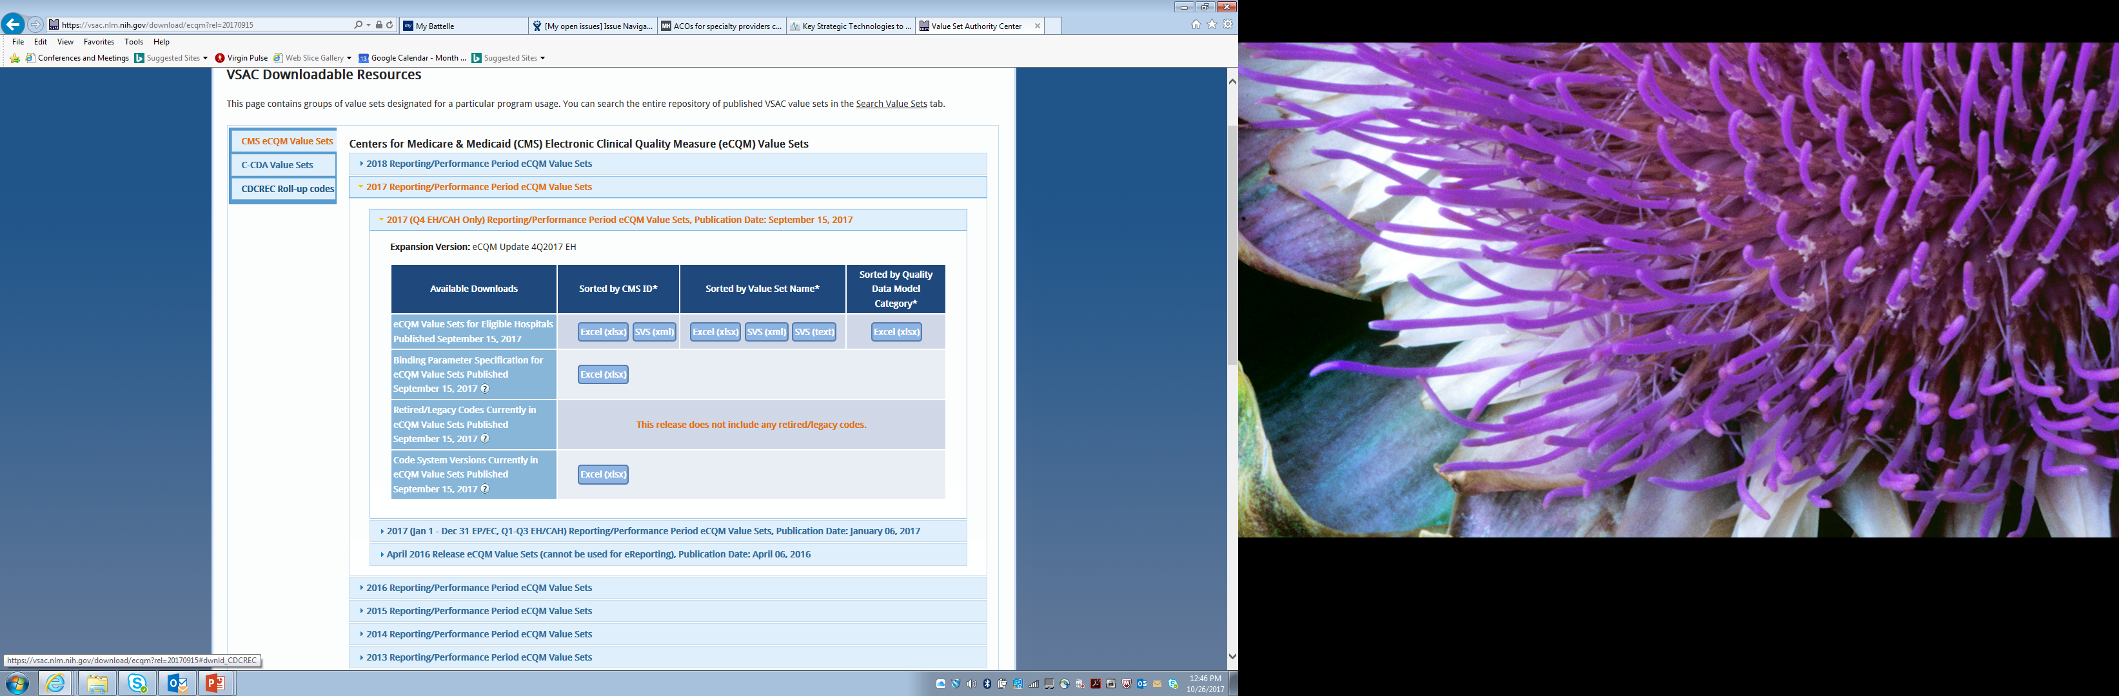
Code system updates to eCQMs for 2017 4th quarter
Notes:
You will find the updates on the Value Set Authority Center (VSAC) website. There is a link to this from the eCQI Resource Center, as well. You need to have a free user account to access the details of the value sets.

Slide 20
Code system updates to eCQMs for 2018 reporting
ICD-10-CM/PCS
LOINC
RxNorm
SNOMED CT
Current Procedural Terminology (CPT)
Vaccine Administered (CVX)
Healthcare Common Procedure Coding System (HCPCS)
Notes:
These code updates were for both hospitals and clinicians.

Slide 21
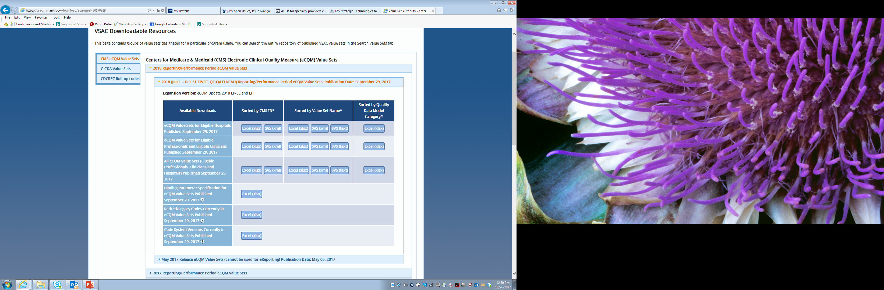
Code system updates to eCQMs for 2018 reporting
Notes:
The Value Set Authority Center (VSAC) is your source for the links to the code system updates. It is found on the eCQI Resource Center under the respective reporting performance period and measure group —eligible hospitals, critical access hospitals, and eligible professional/eligible clinician pages. Remember that you do need an active UMLS user account to access the value sets.

Slide 22
What it means for you
No changes have been made to the measure logic, the Health Quality Measure Format (HQMF) specifications, the value set object identifiers (OIDs), or the measure version numbers for 2017 or 2018 eCQM reporting
Measure implementers should review these changes to ensure their submissions comply with the updated requirements
Notes:
With the terminology updates, measure implementers should review these changes to make sure that their submissions are complying with the updated requirements. There are technical release notes outlining what the changes are on the Resource Center. The technical release notes (TRNs) provide detailed information about those changes.

Slide 23
Clinical Quality Language (CQL)
Clinical Quality Language (CQL) is replacing the logic currently found in the Quality Data Model (QDM)
Measures expressed using CQL logic will continue to use the Quality Data Model (QDM) as the conceptual model to express clinical concepts contained within quality measures
Notes:
After more than a year of testing, CMS has adopted CQL for use in eCQMs. Clinical Quality Language (CQL) is a standard expression logic language. The QDM will continue to be the grammar for use with the CQL as the logic. CQL has been integrated into the Measure Authoring Tool (MAT) and Bonnie. For more information on CQL, see the CQL page on the Resource Center (https://ecqi.healthit.gov/cql).
CQL, a Health Level Seven (HL7) standard for trial use (STU), aims to unify the expression of logic for eCQMs and clinical decision support. CQL provides the ability to better express logic-defining measure populations and improve the accuracy and clarity of eCQM definitions. See QDM Version 5.3 annotated and the current version of the CQL standard to better understand how they work together to provide eCQMs that are human-readable and yet structured for electronic processing.

Slide 24
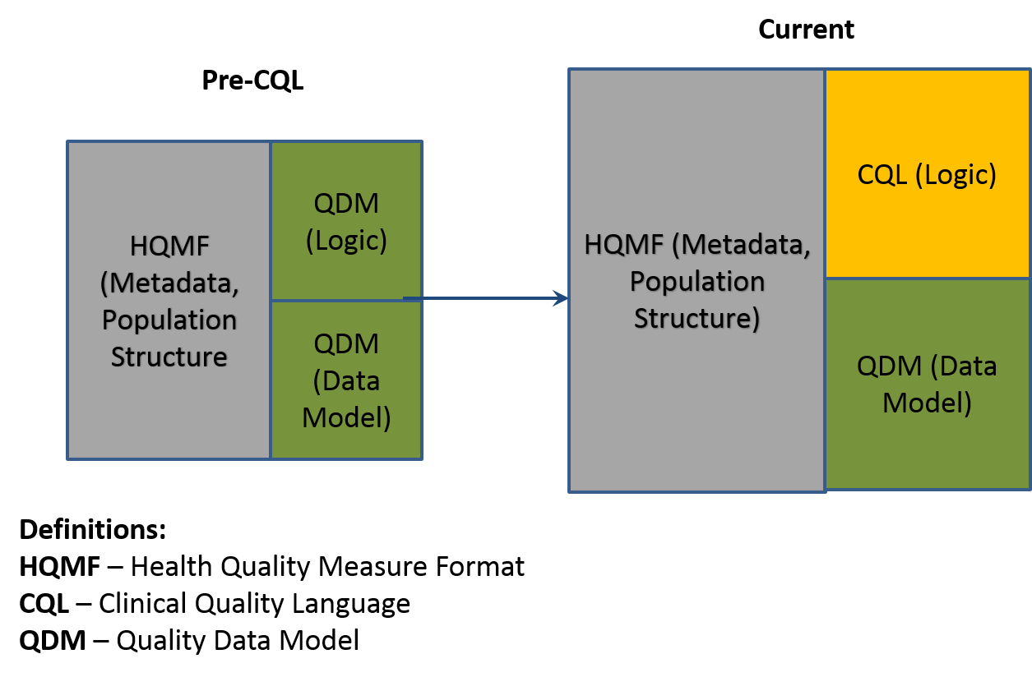
Where does CQL fit?
Notes:
Before CQL, the HQMF represented the structure of the measure and where all the content was included. It included logic from QDM and the QDM data model as well. Our current approach is maintaining the same HQMF for the information about the measure — the metadata and the population and the structure — and replacing QDM logic with CQL while maintaining the data model QDM. The newest version of QDM is specifically designed for use with CQL to make it easier to express the measures.

Slide 25
Why CQL?
Improved expressivity
More precise/unambiguous
Can share logic between measures
Can also share logic with decision support
Can be used with multiple information / data models (e.g., QDM, Fast Healthcare Interoperability Resources [FHIR])
Simplifies calculation engine implementation
Notes:
CQL provides the ability to express things that QDM logic did not. It is more precise with less ambiguity. Logic can be shared between measures in libraries, and the same logic can be used both for a measure and a clinical decision support recommendation so that portions are reusable. It can also be used with multiple information and data models, so CQL could be used moving forward with other data models other than QDM; although, at the moment we are continuing to use it with the QDM model. It simplifies the calculation engine implementation as well.

Slide 26
Why CQL?
QDM logic limits a measure developer’s ability to express the type of comparisons needed to truly evaluate outcomes of care
QDM logic can not request patient results that indicate outcomes and compare if there is improvement over time
For example, Request the change (delta) in depression scale (PHQ-9) results over time for a single patient, or for each patient in a cohort
CQL’s mathematical expression logic allows this type of comparison over time
Notes:
QDM logic limits a measure developer’s ability to express the type of comparisons needed to truly evaluate outcomes of care. QDM logic cannot request patient results that indicate outcomes and compare if there is improvement over time. For example, if you look at the PHQ-9 depression scale and wanted to compare results six months apart — and see how many patients had improvement over time — the QDM logic was not able to calculate that. It made outcome measures especially more difficult to express. CQL’s mathematical expression logic allows for this type of comparison over time.

Slide 27
Why CQL?
QDM logic is unable to express a mathematical expression to derive a desired result
QDM logic cannot provide mathematical calculations based on discrete findings
For example, LDL = Total cholesterol minus HDL + (Triglycerides/5))
Therefore, the respective measure in QDM had to limit results to accept only specific LDL results
CQL’s mathematical expression logic allows the derivation of desired results

Slide 28
What it means for you
The measures published in the 2019 Annual Update will use CQL
These measure specifications must be used for CY 2019 eCQM reporting
Notes:
There will be numerous educational opportunities addressing CQL in the upcoming months. Be on the lookout for announcements through CMS email lists and on the eCQI Resource Center. The 2019 annual update is expected to be published in the spring of 2018 and the CMS Blueprint Version 14.0 is scheduled to be published in the spring of 2018 which includes CQL.

Slide 29
References (1 of 2)
CMS Measures Management System Blueprint
https://www.cms.gov/Medicare/Quality-Initiatives-Patient-Assessment-Instruments/MMS/MMS-Blueprint.html
Comments and questions – MMSSupport@battelle.org
Electronic Clinical Quality Improvement (eCQI) Resource Center
https://ecqi.healthit.gov/
Comment and questions - ecqi-resource-center@hhs.gov
For questions related to eCQM implementation, specifications, logic, data elements, standards, or tools, please go to JIRA (online tracking tool): https://oncprojectracking.healthit.gov
Notes:
Here are some links to different resources to help keep track of all the information covered. To reiterate, the Blueprint is the resource that documents the core set of business processes and decision criteria when developing, implementing and maintaining measures. An updated version is published at least annually in the spring. The CMS Measures Management System (MMS) is where you can go to find out about participating in technical expert panels (TEPs), public comments, and to sign up for the MMS Listserv.
There are resources available for information about eCQMs. The eCQI Resource Center is the one-stop shop for the most current resources to support electronic clinical quality improvement (eCQI). We encourage you to check it out and offer suggestions for improvement. The JIRA tracking tool is a great resource for eCQM implementation information. Anyone can read the tickets, but you have to have an account to enter a ticket. JIRA is also used for the pre-rulemaking process.

Slide 30
References (2 of 2)
CMS Measure Authoring Tool (MAT)
https://www.emeasuretool.cms.gov
Comments and questions- https://www.emeasuretool.cms.gov/web/guest/contact-us;jsessionid=625D8D32B07075C878A12B27C9E02A67ED65CC6DAF6EAA26833896C34B64CABB
National Library of Medicine Value Set Authority Center (VSAC)
https://vsac.nlm.nih.gov
Comments and questions - https://support.nlm.nih.gov/ics/support/default.asp?deptID=28054&category=umls&from=https://www.nlm.nih.gov/research/umls/support.html
National Quality Forum (NQF)
http://www.qualityforum.org/Home.aspx
Comments and questions - info@qualityforum.org
Quality Net
https://www.qualitynet.org
Quality Payment Program
QPP.cms.gov
https://www.cms.gov/Medicare/Quality-Payment-Program/Resource-Library/Resource-library.html
Notes:
The MAT and the VSAC are the tools used to create eCQMs. Both are free to use, but they will require a registration and some information from you before you can have full access. The National Quality Forum (NQF) is planning to give eCQMs a separate designation and most likely an “e” in front of the number. QualityNet is a good resource for a variety of CMS quality programs. The QPP and the reference library are the best source of information about the Quality Payment Program (QPP).

Slide 31
Contact Information
Kathy Lesh
lesh@battelle.org
703-875-2106
Floyd Eisenberg
FEisenberg@iparsimony.com
Notes:
If you have any questions, feel free to contact the presenters of this call.

Slide 32
Questions, Suggestions, Discussion

Slide 33
Upcoming Webinars
Planned Upcoming Webinars:
Jan 25: Adapting/Respecifying Measures
Feb 22: Testing Tools
Mar 19: NQF Measure Submission Criteria
Suggestions for future topics?
Email: MMSsupport@battelle.org
Notes:
If you have any suggested topics, please email us at MMSSupport@battelle.org and we will follow up with you.

