Slide 1
NQF Consensus Development Process (CDP) Redesign
Karen Johnson, Senior Director
May Nacion, Project Manager
September 18, 2017

Slide 2
Agenda
Revisions to NQF Measure Evaluation Criteria
Revisions to NQF Consensus Development Process (CDP)
Questions?
Next Steps

Slide 3
2017 Revisions to NQF Measure Evaluation Criteria

Slide 4
Evidence (subcriterion 1a)
For all outcome measures: Empirical data are required (rationale no longer sufficient)
Current requirements for structure and process measures (i.e., QQC) also apply to patient-reported structure/process measures
For measures derived from patient report: demonstrate that target population values the measured outcome, process, or structure and finds it meaningful
Evidence for specific timeframes or thresholds included in a measure should be presented; if limited, literature regarding standard norms would be considered

Slide 5
Performance Gap (subcriterion 1b)
For maintenance measures
Measure stewards are expected to provide current performance data. If limited data are available (e.g., use is voluntary), data from the literature can be considered.

Slide 6
Validity (subcriterion 2b)
Subcriterion “2b.1” (specs consistent with evidence) removed
Maintenance measures: empirical testing is expected; otherwise, justification for reliance on face validity only is required
Exclusions subcriterion re-worded
Missing data subcriterion now applies to all measures

Slide 7
Usability and Use (criterion 4)
Use: Change to must-pass for maintenance measures
In use in accountability program within 3 years and publicly reported within 6 years
Measure has been vetted by those being measured or others
Usability: not must-pass
Demonstrated improvement
Benefits outweigh evidence of unintended negative consequences to patients

Slide 8
Updated guidance for measures that use ICD-10 coding: Fall 2017 and 2018
Gap can be based on literature and/or data based on ICD-9 or ICD-10 coding
Submit updated ICD-10 reliability testing if available; if not, testing based on ICD-9 coding will suffice
Submit updated validity testing
Submit updated empirical validity testing on the ICD-10 specified measure, if available
OR face validity of the ICD-10 coding scheme plus face validity of the measure score as an indicator of quality
OR face validity of the ICD-10 coding scheme plus score-level empirical validity testing based on ICD-9 coding
OR face validity of the ICD-10 coding scheme plus data element level validity testing based on ICD-9 coding, with face validity of the measure score as an indicator of quality due at annual update

Slide 9
Best practices for ICD-10 coding
Use team of clinical and coding experts to identify specific areas where questions of clinical comparability exist, evaluate consistency of clinical concepts, and ensure appropriate conversion
Determine intent
If desired, use appropriate conversion tool
Not required, but also not sufficient by itself
If using conversion tool, consider both forward and backward mapping
Assess for material change, if possible
Solicit stakeholder comments

Slide 10
eMeasures
“Legacy” eMeasures
Beginning September 30, 2017 all respecified measure submissions for use in federal programs will be required to the same evaluation criteria as respecified measures – the “BONNIE testing only” option will no longer meet endorsement criteria
For all eMeasures: Reliance on data from structured data fields is expected; otherwise, unstructured data must be shown to be both reliable and valid

Slide 11
2017 CDP Redesign

Slide 12
Intent to Submit
Measure stewards/developers notify NQF of their intent to submit a measure at least three months prior to their selected cycle.
Objective:
Allow NQF to adequately plan for measures
Provide developers technical assistance prior to submitting measures
Intent to submit deadline: 3 months prior to the selected cycle

Slide 13
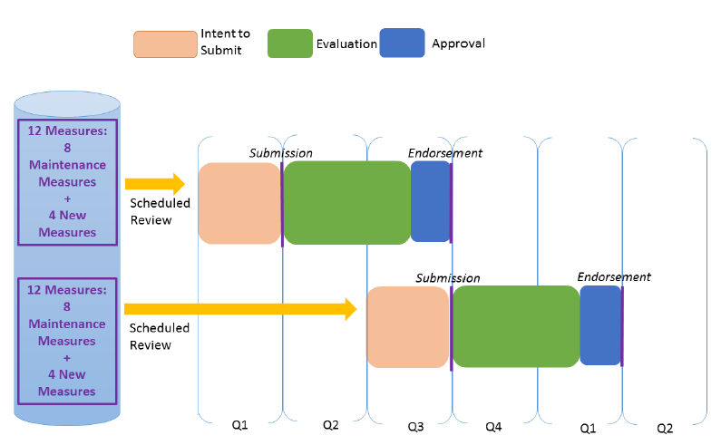
Graphic

Slide 14
Intent to Submit, cont.
Intent to Submit information needed:
Testing information is needed for all new measures and maintenance measures that have indicated updated testing data.
All information must be submitted by the Intent to Submit deadline
Planned submission date (cycle and year) Measure name Measure description Measure title Measure type | Level of analysis Data source Numerator/Denominator statement Testing information

Slide 15
Scientific Methods Panel
Established to allow consumers, patients, purchasers, and other members of NQF standing committees to focus on bringing their expertise to the subject matter under consideration and be more engaged throughout the evaluation process.
Charge
1. Conduct evaluation of complex measures for the criterion of Scientific Acceptability; and
2. Serve in an advisory capacity to NQF on methodologic issues, including those related to measure testing, risk adjustment, and measurement approaches.
Webpage:
https://www.qualityforum.org/Measuring_Performance/
Scientific_Methods_Panel.aspx
Commenting period on proposed roster open until September 20.

Slide 16
Measure Workflow

Slide 17
Questions

Slide 18
Next Steps
List of Measures Sent to Stewards
Questions:
measuremaintenance@qualityforum.org

Slide 19
Thank you!

