Slide 1
CMS Measures Management System (MMS) Respecifying Measures
Kathy Lesh, PhD, RN-BC, CPHQ - Battelle
January 25, 2018
Notes:
Thank you for joining this CMS MMS Information Session. My name is Martin Alvarado and I am with Battelle. Today’s presentation is titled CMS Measures Management System (MMS) Respecifying Measures and will be presented by Dr. Kathy Lesh.

Slide 2
Overview
Definition of respecified measure
Why respecify a measure?
What needs to be done to respecify a measure?
Special considerations
Questions

Slide 3
Respecifying Measures
Learning Objectives:
At the end of this webinar, participants will be able to:
Define respecified measure
Discuss why a measure may be respecified
Outline steps to respecify a measure
Identify any special considerations

Slide 4
Definition of Respecified Measure
An existing measure is changed to fit the current purpose or use. This may mean changing a measure to meet the needs of a different care setting, data source, or population. Or, it may mean changes to the numerator, denominator, or adding specifications to fit the current use.
Notes:
This is the proposed “new “ definition of respecified. In the Blueprint 13.0 we stated a respecified measure was an eCQM and a type of adapted measure. After discussions, it was proposed that the term “adapted measure” be removed and the definition of respecified take on most of the characteristics of the previously used “adapted measure”. We are proposing measures are either de novo or respecified. The draft version 14.0 of the Blueprint will be out soon for comment.

Slide 5
Why respecify?
Use a measure in a different setting
Use a different data source
Use a different population
Measure harmonization
Changes in the recommended practice or environment of use
Notes:
With respect to harmonization, similar measures may be used in different settings with different populations or use different data sources, so can similar measures be respecified to create a measure that can be used in all of these settings, or with all of the populations or with different data sources? There are numerous examples of similar measures developed by different organizations. An example of re-specification for the purposes of harmonization is the Centers for Disease Control and Prevention (CDC) and the American College of Surgeons (ACS) coming together to harmonize the procedure-specific surgical site infection outcome measure, the focus was on colon and abdominal hysterectomy. Previous to this harmonized measure, they each had their own and very similar measure. Please note that specifications may need to be modified slightly to stay current with recommended practice or changes in the environment.

Slide 6
Respecify versus Create De Novo
De novo measure is created from scratch
Respecified measure uses much of the same information provided for “original” evaluation criteria
Respecified measure usually requires less comprehensive testing and evaluation than de novo measure
Notes:
With a respecified measure the intent is the same, therefore much of the information gathering and justification will be the same. Information gathering will need to provide justification for the respecification, such as the incidence in the new population. Because much of the justification remains the same, much of the testing from the original measure will be valid. Testing needs to focus on the differences between the original and the respecified measure.

Slide 7
Questions to Answer Before Respecification
Is the measure applicable to the new setting or population?
Does it meet a quality goal of the new setting or population?
Does it meet the importance need of the new setting or population?
Is use of the new data source feasible?
Notes:
An original measure addressing a highly prevalent condition may not have the same prevalence in a new setting. Evidence that large disparities or suboptimal care based on the original measure may not exist in the new setting or the new population. Changes in the applicability of the original measure should make you ask not only if the new data source is feasible, but are the individual data elements feasible? This is particularly true for the data sources of EHRs and other health information technology (HIT).

Slide 8
Steps to Respecify (1 of 2)
Identify the existing measure(s) for potential respecification
Review the existing measure(s) description
Select the existing measure(s) for respecification
Review existing specifications
Review the existing flowchart, if applicable
Review the existing numerator and denominator terminology codes / value sets
Notes:
There are three places to look for existing measures (with overlap between the three): the CMS Measures Inventory Tool (CMIT), the National Quality Forum’s Quality Position System, and the Agency for Healthcare Research and Quality (AHRQ) National Quality Measure Clearinghouse.
What is the intent of the proposed respecified measure? For example, say your topic is pressure ulcers. There are a few measures related to pressure ulcers in existence now. You will need to get a little more specific than just “pressure ulcers.” What type of measure do you want? Process? Outcome? Efficiency?
CMS went through this exercise and is still going through it as a result of the IMPACT Act of 2014, which required the standardization of measure domains across four settings — long-term care hospitals, SNFs, IRFs and home health agencies.
Many existing measures have flows that help identify the initial populations — denominator, numerator, exceptions and exclusions. If a flow is not available, you may want to create one. Review of the flows will help you think through what is the same and what may be different for your proposed setting, population, data source or change in practice.
What parts of the existing measure can be reused? Review the exist terminology codes and value sets. The terminology codes should all be from standard terminologies such as ICD-10-CM, PSE, CPT, HCPCS, or in the case of eCQMs, SNOMED, LOINC and RxNorm. Are they valid for your setting or population or data source? Consider using the National Library of Medicine (NLM) Value Set Authority Center (VSAC) to create your code lists and value sets. This will be helpful for any type of clinical quality measure (CQM) and not just eCQMs. In order to use the Value Set Authority Center (VSAC) you will need a free Unified Medical Language System (UMLS) license and to register in the Value Set Authority Center (VSAC) as an author.

Slide 9
Steps to Respecify (2 of 2)
Make any needed changes to the existing specifications
Present to your TEP
Revise the specifications based on TEP feedback
Test the revised specifications
Revise all the documentation
Iterate
Notes:
You should be working with your TEP throughout the measure development process and not just after the specifications are created. Respecified measures still require testing to obtain the evidence of reliability and validity. The testing may not be as comprehensive as it is with the de novo measure. The measure testing must be able to detect important changes in the functionality or the properties of the measure. Remember to revise applicable forms to reflect the changes (e.g., Measure Information Form (MIF), Measure Justification Form (MJF)).

Slide 10
Testing the Respecified Measure
Relative frequency of conditions used in the original measure specifications when applied to the new setting/population
Prevalence of the condition in a new setting
Location of data or the likelihood that data are missing
Frequency of codes observed in stratified groups when the measure is applied to a new setting or subpopulation
Risk adjustment model or changes that make the previous risk adjustment model inappropriate in the new setting/population
Notes:
The example provided in the Blueprint is an original measure that uses administrative data for medications in the criteria specification. When applied to Medicare patients in an inpatient setting, the criteria will need to be modified to use medical record abstraction, because Medicare Part A claims do not contain medication information due to bundling.

Slide 11

Questions, Suggestions, Discussion

Slide 12
Discussion Questions
What has been your experience with respecifying measures? Do you have an example of a measure which was successfully respecified?
In your experience with respecifying measures, what is the most valuable lesson learned you have to share?
What is the key difference between respecifying a measure, and developing one de novo, in your experience?

Slide 13
Additional Considerations
If the existing measure is NQF-endorsed, are the changes to the measure significant enough to require resubmission to NQF for endorsement?
Will the measure steward be agreeable to the changes in the measure specifications?
If a measure is copyright protected, are there issues relating to the measure’s copyright that need to be considered?
Notes:
These questions should be explored early in the respecification process, but you may not be able to answer the questions until the measure is respecified.

Slide 14
Electronic Clinical Quality Measure (eCQM) Additional Considerations
Specifications must be in Health Quality Measure Format (HQMF)
eCQMs need to be authored in the Measure Authoring Tool (MAT) using the Quality Data Model (QDM), Clinical Quality Language (CQL), and Value Set Authority Center (VSAC)
Notes:
The authoring of eCQMs in the Measure Authoring Tool (MAT) is going to provide you with output in the Health Quality Measure Format (HQMF). If you have not previously used the Measure Authoring Tool (MAT), you will need to get a free account and learn how to use it first.
The measure data elements must be associated with a Quality Data Model (QDM) data element. After calendar year 2018, all the eCQMs in CMS Programs have their logic expressed in the Clinical Quality Language. In the past, the logic was built into the Quality Data Model (QDM). Both the Quality Data Model (QDM) and CQL are built into the Measure Authoring Tool (MAT) and are connected to the Value Set Authority Center (VSAC).
The steps to respecification outlined earlier are appropriate for eCQMs. You must identify the data elements. The flow is closely related and associated with the logic. For current eCQMs that are in the eligible professional-eligible clinician category, they all have measure flows. Additionally, the standard terminologies are still required; eCQMs use primarily SNOMED CT, LOINC and RxNorm, but they may also include the ICD and CPT codes, HCPCS codes, and a few others.

Slide 15
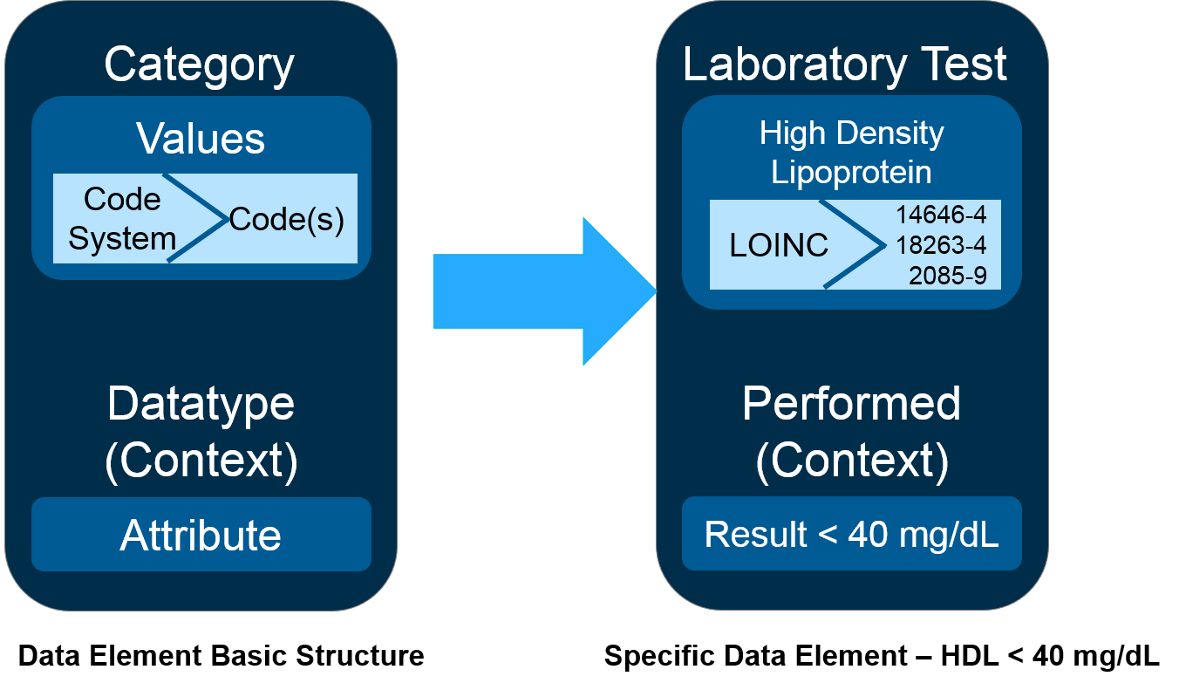
Data Element in the QDM
Notes:
Each data element has a category, which is a particular information group that can be addressed in a quality measure. The QDM data type is the information category and provides the context of expected use for any given data element. The values are codes for a single code used to define a specific data element. For values that require coded data, there are code system recommendations used for data element categories such as SNOMED CT, LOINC, and RxNorm. The attributes are specific details about a data element that further constrains the concept.
If you’re looking left to right, an example is a laboratory test in a category. The value is high density lipoprotein (HDL). The code systems are those listed there for LOINC, and the attribute would be the result which would be less than 40 mg/dL. The code, code systems, and datasets in the chapter in the Blueprint list the QDM data elements, the associated data types, attributes, and the recommended terminologies to use. This list is being updated to align with the most recent version of the Quality Data Model (QDM) which is 5.3, and you will see that in the draft version 14.0 of the Blueprint. If you want to learn more about the QDM and how to use it, there is a user group that meets once a month on Wednesday afternoons.

Slide 16
eCQM Testing
Feasibility
NQF eCQM Feasibility Scorecard
Validity
Measure Logic Validity
Data Element Validity
Reliability
Test a multiple sites and with multiple EHRs
Notes:
eCQMs pose some additional challenges that warrant an enhanced approach to measure testing. The feasibility is more than just a demonstration by an EHR vendor of a system’s ability to capture a data element. Feasibility testing evaluates the reasonableness of collecting the expected data elements during typical clinical workflows in an EHR system. It evaluates the burden on clinicians and determines whether the measure’s data elements are captured by the system in a standardized format.
NQF has several documents that you can refer to for more information and guidance. They have measure evaluation criteria and guidance for evaluating measures for endorsement, and an eCQM feasibility scorecard. Validity testing for the eCQM confirms the intent of the measure and ensures that the eCQM logic is sound. Additionally, the testing confirms that the data elements are aligned with national standards and compares calculated scores from automated extraction to assess the validity at the data element level.
Validity checks may also include a review of value sets and code sets to verify that they correctly identify patient populations, but this last step of looking at value sets and code sets is something you should be looking at with all types of measures. The measure logic validity is an objective evaluation of measure logic and should be performed to confirm whether the measure can correctly identify patients intended to be included or excluded from the numerator, denominator and other populations of the eCQM. The test aims to ensure that the logic and CQL expression of the eCQM is unambiguous, so that the same patients are categorized by the relevant patient population. Testing may identify potential differences in the interpretation of the measure logic that’s encoded in the eCQM.
Bonnie is a free software tool that allows eCQM developers to test and verify the behavior of their logic. Bonnie uses synthetic data. The measure developers create their patients and test their logic against their test patients.
In addition to measure logic validity, data element validity needs to be tested. Data elements from test sites — different EHRs — should be collected through electronic extraction and compared to the gold standard of manual extraction or abstraction to assess the validity of the data element. This comparison is performed to determine whether the eCQM provides the same results for the numerator, inclusions, exclusions, and denominator. Where discrepancies are identified, the visual review of the manually abstracted data will be presumed to be correct and set as the gold standard.
Electronic extraction of EHR data cannot detect values entered as free text as opposed to structured data, but manual abstraction will in the visual review. The visual review will usually capture both the free text and the structured data and would therefore be more complete and accurate. This is one of the big steps when you are moving to an eCQM. Are those data elements that you need in a structured format? Capturing it in free text is not going to work. You cannot depend on everyone having access to natural language processing.
Reliability allows for the comparability of results. You want to make sure that the measure is reproducible and can be implemented consistently within and across organizations. There are three ways of testing the reliability of an eCQM. You want to evaluate the measure for clarity, logic, ambiguity and data element alignment with the standard specifications that support consistent implementation. This testing is in addition to and does not replace statistical reliability testing.
The data element validation against the gold standard of manual abstraction may be conducted in place of data element reliability testing. You need to give consideration to different aspects of reliability that could be considered with the data element validity testing. Complex specifications may make a measure more susceptible to varied data field interpretation by different users. Users may enter information into EHR fields other than those from which the vendor extracts the data for measure reporting.
Testing at multiple sites for feasibility, validity and reliability is important to address potential variability in scoring and reporting based on differences in local workflow processes. Multiple sites using the same EHR vendor product may show different results since the local workflow may vary and data may not consistently be entered into the fields expected by the vendor. Variances in results from such testing at multiple sites should be evaluated to determine if changes are needed in the measure logic or in the definition.

Slide 17
Questions, Suggestions, Discussion

Slide 18
Discussion Questions
What has been your experience in working with measure stewards to respecify a measure?
How has NQF responded to requests to respecify measures?
Can you provide an example of working with the Quality Data Model to respecify a measure?

Slide 19
References (1 of 3)
CMS Measures Management System Blueprint
https://www.cms.gov/Medicare/Quality-Initiatives-Patient-Assessment-Instruments/MMS/MMS-Blueprint.html
CMS Measures Inventory Tool (CMIT)
https://cmit.cms.gov/
NQF Quality Positioning System (QPS)
http://www.qualityforum.org/QPS/QPSTool
AHRQ National Quality Measures Clearinghouse (NQMC)
https://qualitymeasures.ahrq.gov/

Slide 20
References (2 of 3)
QualityNet
https://www.qualitynet.org/dcs/ContentServer?c=Page&pagename=QnetPublic%2FPage%2FQnetHomepage&cid=1120143435383
Quality Payment Program Resource Library
https://www.cms.gov/Medicare/Quality-Payment-Program/Resource-Library/Resource-library.html
Nursing Home Quality Reporting Program
https://www.cms.gov/Medicare/Quality-Initiatives-Patient-Assessment-Instruments/NursingHomeQualityInits/NHQIQualityMeasures.html
Inpatient Rehab Facility Quality Reporting
https://www.cms.gov/Medicare/Quality-Initiatives-Patient-Assessment-Instruments/IRF-Quality-Reporting/IRF-Quality-Reporting-Program-Measures-Information-.html

Slide 21
References (3 of 3)
Electronic Clinical Quality Improvement (eCQI) Resource Center
https://ecqi.healthit.gov/
CMS Measure Authoring Tool (MAT)
https://www.emeasuretool.cms.gov
National Library of Medicine Value Set Authority Center (VSAC)
https://vsac.nlm.nih.gov

Slide 22
Contact Information
Kathy Lesh
lesh@battelle.org
703-875-2106
Notes:
Please feel free to reach out to Kathy Lesh with questions either via email or phone.

Slide 23
Questions, Suggestions, Discussion

Slide 24
Upcoming Webinars
Planned Upcoming Webinars:
Feb 22: Testing Tools
Mar 19: NQF Measure Submission Criteria
Suggestions for future topics?
Email: MMSsupport@battelle.org

