Slide 1
CMS Measure Development Education & Outreach
MACRA Info Session #5
Introducing the Clinical Quality Bundle
& Pre-Rulemaking Updates
Presenters:
Nicole Brennan, Battelle
Jeff Geppert, Battelle
Vince Brown, Battelle
March 6, 2019
2:00-3:00pm EST

Slide 2

Vision and Goals: MACRA Info Sessions
An ongoing process to engage the public in quality measure development.
Elicit feedback that will help CMS design resources that can help all of those interested in healthcare quality improvement better understand the goals of quality measurement.
  Education
  Outreach
  Dedicated Websites
  Measure Development
  Roadmaps
  Listserv opportunities
Notes:
CMS is committed to providing Education and Outreach opportunities about the quality measure development process to interested stakeholders to improve understanding of the process. CMS also seeks continual feedback to improve and/or expand its offerings to the healthcare quality measure development community and interested stakeholders.
To date, CMS has implemented an Education and Outreach webinar series and has created resource materials that break down and explain various components and challenges in the measure development process. There are dedicated websites, listservs, and roadmap documents that are available to support those that are working in quality measure development, or are just curious and want to learn more about how it is done.

Slide 3
Agenda
Introduction to the Clinical Quality Bundle
Updates to the Pre-Rulemaking Process

Slide 4
Introduction to the Clinical Quality Bundle

Slide 5
How do we ensure that meaningful measures are implemented in clinical practice?
Title of Technical Expert Panel (TEP): Quality Measure Development: Supporting Efficiency and Innovation in the Process of Developing CMS Quality Measures
Dates: September 15, 2017 and August 1, 2018
TEP Organizer: Battelle
Purpose: develop recommendations to assist CMS with adding value and efficiency to the measure development process.
Notes:
The TEP reviewed the measure development lifecycle to ensure that as measures are developed, that they are meaningful to CMS, providers, and beneficiaries; that they employ an iterative and efficient process in this lifecycle that ultimately is successful all the way down the line through the implementation phase.

Slide 6
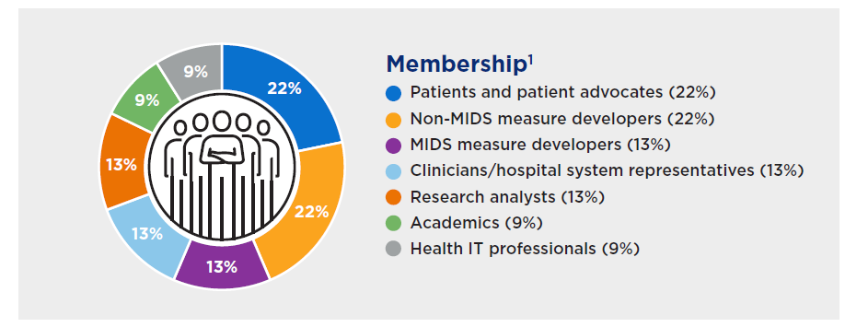
TEP Composition
Notes:
The focus was that we had patient/patient advocate representation. We had over 100 nominations for the TEP and ultimately selected 20 people to participate. We had four alternatives in case somebody were to leave.

Slide 7
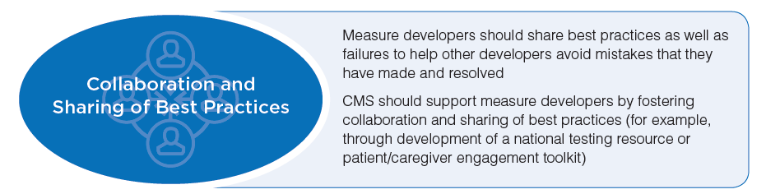
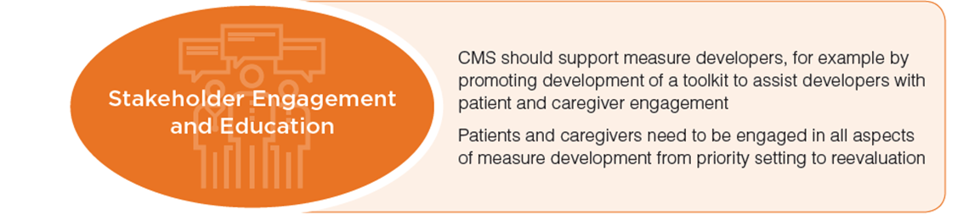
Technical Expert Panel Themes
Notes:
Collaboration and Sharing of Best Practices
How do we engage the technical expert panels (TEPs)?
How do we find patients?
How are we doing testing and what data are we using?
Stakeholder Engagement and Education
How do we get the right people in the room?
If you can’t engage in a TEP, how else might you work with patients or clinicians?
How else can you bring them into the discussion?
What resources are out there?
What should CMS be encouraging contractors to do to ensure they’re getting the right information?
Additional findings
Social media networking sites such as PatientsLikeMe to glean information regarding patient visits, medications and conditions.
Engage healthy patients
How do we get a different demographic than in the past?
How do we get outside of that normal zone of people?
How do we get new groups of people?
Patient stories
Why are they there?
Why is this important to them?
Grounds your group to the mission and vision
They feel invested and that their contributions are valuable
Providing members a toolkit, something that they can reference ahead of time is illustrative to the process of being engaged and aids familiarization of acronyms or topics to be discussed.

Slide 8
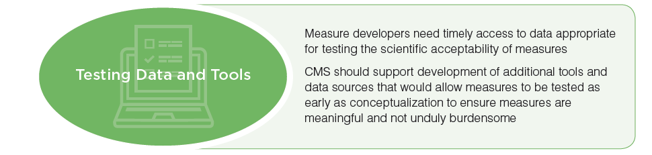
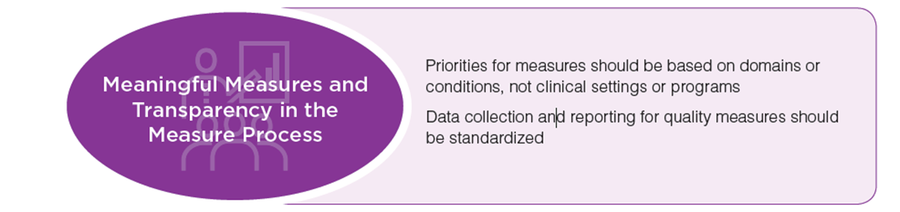
Technical Expert Panel Themes (cont.)
Notes:
Testing data and tools
How can we make testing data more available to our contractors or other measure developers?
Meaningful Measures and Transparency in the Measure Development Process
How do we ensure transparency going through the Measure Development Plan (MDP) or impact assessments?
How do we ensure measures being developed are meaningful to patients and clinicians alike?
How do we ensure that all of the information out there is usable by CMS stakeholders?

Slide 9
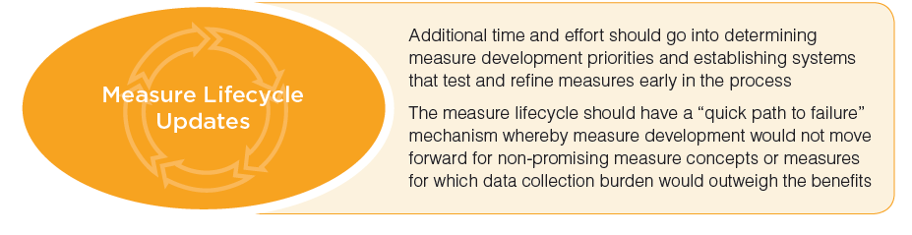
Technical Expert Panel Themes (cont.)
Notes:
Measure Lifecycle
Patients should be engaged as early as the very beginning in setting global priorities as programs are deciding on areas of focus, and areas of gaps.
“Go/no-go” decision points occur after conceptualization and the creation of your business case.
“Yes, this is a good business case, we are going to go forward.”
“No, this really is not aligned with what we were thinking, and this is a no-go for us.”
Revisit the “go/no-go” decision after alpha or beta testing.

Slide 10
Barriers to Implementing
Clinical Quality Measures
Measures are only meaningful if they are being implemented.
What are barriers to implementing clinical quality measures?
How can we support clinicians in clinical quality measurement and quality improvement?
Notes:
How can we strengthen a measure as a whole when it goes out into the community so that clinicians feel like it is something they could reasonably implement within their practice?

Slide 11
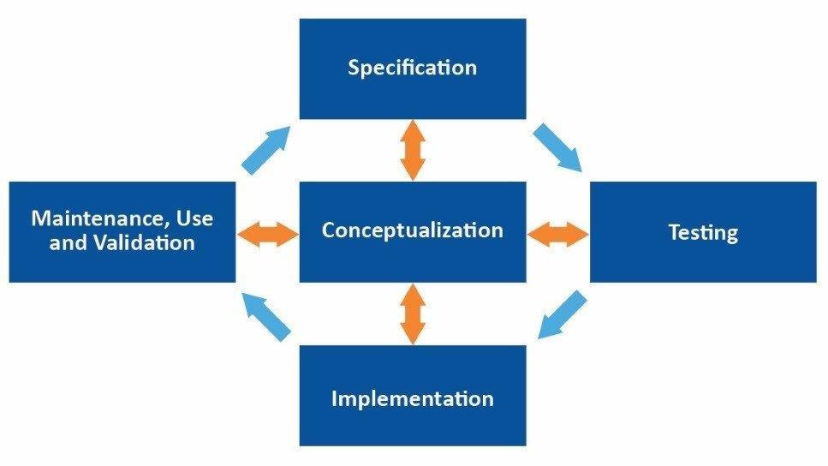
Clinical Quality Measure Bundle
The purpose of a clinical quality measure is to make good decisions, the goal of a CQM is to improve quality through improved performance.
Notes:
Quality Measurement
Operates through mechanisms of selection and choice
Focuses on systematic and persistent factors across the healthcare system
Focused on generating organizational value
Quality Improvement
Operates through mechanisms of standardization and alignment with evidence.
Focuses on individual context in the expertise of clinicians and patients.
Focuses on generating value for users.
They differ in their focus and value.

Slide 12
Supporting Measure Implementation
What tools could we release along with clinical quality measures that would support the implementation process?
The Clinical Quality Measure Support Bundle
Predictive model
Clinical decision support (CDS) artifacts
Clinician engagement guide
Consumer engagement guide
Notes:
How do we better align quality measurement and quality improvement?
With the goal of creating better quality measures?
How do we better support the user of quality measures?
Clinical Quality Bundle
The bundle would accompany the measure and specifications, a risk adjustment model, parameters for the model, benchmarks and thresholds with respect to performance in a population of interest. Included in the bundle are a predictive model, decision support artifacts, clinical decision support (CDS) artifacts, the clinical engagement guide and a consumer engagement guide.

Slide 13
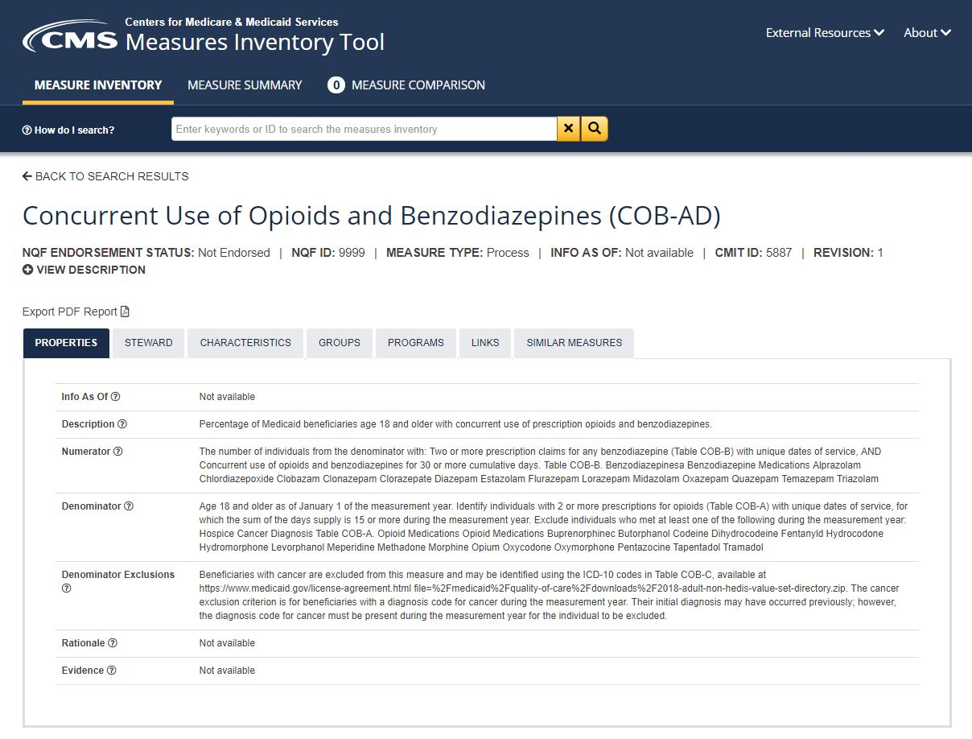
Example: Concurrent Use of Opioids and Benzodiazepines
Notes:
One measure that is part of the Meaningful Measure group is the “concurrent use of opioids and benzodiazepines” (COB-AD). The measure itself is trying to gain an understanding of the percentage of Medicaid beneficiaries who have a concurrent prescription of opioids and benzos. Our goal is to see the percentage be as low as possible.

Slide 14

Predictive Model
Risk Adjustment and Predictive Modeling
Notes:
Process
A process measure is the proportion of time you do the right thing given the opportunity. To better support measures strive to be explicit about the structure or process outcome evidentiary linkage.
Structure
By structure, we refer to the physical structure, the human capital processes that are standardized knowledge through structures. Being explicit about the outcomes associated with our process measure is one way in which we can better support the use and implementation of measures.

Slide 15
Predictive Model (cont.)
Stratify the patient population into subgroups according to the likelihood of the outcome of interest, incorporating both risk factors present at the beginning of the episode and factors that occur during the episode that are in the causal pathway
Used to intervene prospectively, and to analyze retrospectively. The predictive model would also be updated continuously throughout the episode.
“Predictive modeling is a set of tools used to stratify a population according to its risk of nearly any outcome… ideally, patients are risk‐stratified to identify opportunities for intervention before the occurrence of adverse outcomes that result in increased medical costs.”
Cousins MS, Shickle LM, Bander JA. An introduction to predictive modeling for disease management risk stratification. Disease Management 2002;5:157‐167.
Notes:
Risk adjustment model
Intended to account for characteristics of the patients related to the outcome
Independent of quality construct
Disentangles the quality and patient component
Predictive model
Takes into account all the information
Used to make decisions about best next steps
Maximizes the likelihood of a good result for the measure
A tool that is used to drive performance

Slide 16
Opioids and Benzodiazepines
Patients filling both opioid and benzodiazepine prescriptions had a 15-fold increase in the risk of death compared with those filling neither prescription.
More than 30 percent of overdoses involving opioids also involve benzodiazepines
Some of the conditions that warrant treatment with benzodiazepines (e.g., anxiety disorders) are also independent risk factors for opioid overdose.
Notes:
Why is it important to understand the predictive model of patients?
Who might be at risk for having both of these prescriptions?
Fifteenfold increase in the risk of death due to reduced/ceased respiration
More than 30% of overdoses involving opioids, benzodiazepine was present

Slide 17
Opioids and Benzodiazepines
Patients filling both opioid and benzodiazepine prescriptions had a 15-fold increase in the risk of death compared with those filling neither prescription.
More than 30 percent of overdoses involving opioids also involve benzodiazepines
Some of the conditions that warrant treatment with benzodiazepines (e.g., anxiety disorders) are also independent risk factors for opioid overdose.
Predictive Analytics
Patients with:
Chronic Pain
Alcohol Use/Abuse
Veteran
Woman
Anxiety
Depression
Difficulty Sleeping
Notes:
Patient example:
Preexisting condition of difficulty sleeping
Preexisting use of benzodiazepine
Suffered a fall resulting in a broken back
Prescribed opioids in hospital
Predictive analytics can aid a clinician with prescribing practices.

Slide 18
Clinical Decision Support (CDS)
Clinical Decision Support (CDS) provides timely information to help inform decisions about a patient's care and has the ability to significantly impact improvements in quality, safety, efficiency, and effectiveness of health care.
CDS requires computable biomedical information, person-specific data, and a reasoning or inferencing mechanism that combines knowledge and data to generate and present helpful information to clinicians, patients, and care team members as care is being delivered.
This information must be filtered, organized, and presented in a way that supports the current workflow, allowing the user to make an informed decision quickly and to take action on that decision.
Notes:
CDS artifacts are decision trees based principally on guidelines and other systematic evidence. Participation in the development of a CDS artifact is gaining a better sense of the status of the evidence base in support of the measure.
How would participation in the creation of a CDS artifact result in a better CQM?
How explicit is that evidence base?
How mature is that evidence base with respect to the measure being developed?
This is particularly salient moving towards outcome measures. Many measures put forth through NQF and other endorsement processes have a low level of maturity in their evidence base. It is based on consensus evidence, or a general empirical finding about unanticipated variation. Very few measures have strong empirical evidence that is either diagnostic or predictive or prescriptive in nature supporting the use of a quality measure. Participation in CDS development would help bring out the status of the evidence base and identify ways in which the evidence base can be improved.

Slide 19
Clinical Decision Support (cont.)
CDS encompasses, but is not limited to:
Computerized alerts and reminders for providers and patients
Clinical guidelines
Condition-specific order sets
Focused patient data reports and summaries
Documentation templates
Diagnostic support
Qualified Clinical Decision Support Mechanisms as of June 2018
AIM Specialty Health ProviderPortal®*
Applied Pathways CURION™ Platform
Cranberry Peak ezCDS
eviCore healthcare's Clinical Decision Support Mechanism
MedCurrent OrderWise ™
Medicalis Clinical Decision Support Mechanism
National Decision Support Company CareSelect™*
National Imaging Associates RadMD
Sage Health Management Solutions Inc. RadWise®
Stanson Health's Stanson CDS
Test Appropriate CDSM*
Notes:
AHRQ is developing the CDS Connect tool which helps to develop artifacts based on current standards and are interoperable with EHRs. There are currently 2,000 measures in the inventory, but only a handful of artifacts. The reason is that artifacts are based on very strong evidence, while the evidence base that supports measurement is not as strong. Hopefully, by participating in the development of additional CDSs for measures we can drive narrowing that gap.

Slide 20
Clinical Decision Support (cont.)
Studies have shown that well-executed CDS can:
Reduce adverse events from drug-drug interactions^{1,2}
Medication errors³
Decrease unnecessary laboratory testing⁴
Reduce cardiovascular risk in patients with type 2 diabetes⁵
Improve practitioner performance⁶
Increase cardiovascular disease risk assessment in routine primary care practice⁷
¹ Smithburger et al., 2011
² Sonnichsen et al., 2016
³ Fritz et al., 2012
⁴ Felcher et al., 2017
⁵ Cleveringa et al., 2008
⁶ Garg et al., 2005
⁷ Wells et al., 2008
Notes:
Quality measurement differs from quality improvement in its focus on factors structural in nature that are systematic and persistent over time vs. expertise and experience in quality improvement. The development of CDS artifacts can identify those structural characteristics that enable good decision-making and identify good candidates for CQMs, and then use new tools of machine learning and AI to identify those structural characteristics and how to implement them in this CDS context.

Slide 21
User Engagement:
Clinician and Patient Engagement
Human-Centered Design
Using human-centered design (HCD) methods, the clinician and consumer engagement guides would:
Inform stakeholders about why the outcome is meaningful and what might be done to improve performance
Provide feedback to measure developers (e.g., remove unnecessarily burdensome exclusions or risk adjustment factors)
Notes:
Human strengths in problem-solving and improvising are part of what makes it a human system, but also what makes it successful. In the incorporation of HCD think more in terms of a designer than a developer. Measure designers engage users in an interactive way through narrative storytellings to help produce measures aligned with user values.
What are the jobs that clinicians and patients need to accomplish?
What are the roles that are involved?
What are the tasks that are involved?
What resources are necessary?
What kinds of different situations might come up?

Slide 22
User Engagement:
Clinician and Patient Engagement (cont.)
In 2016, the Centers for Disease Control and Prevention (CDC) issued new guidelines for the prescribing of opioids. They recommend that clinicians avoid prescribing benzodiazepines concurrently with opioids whenever possible.
Clinician engagement in clinical quality measure inclusion and exclusion criteria.
Patient engagement on how to recognize the challenges of co-morbidities
Patient engagement on treatment of anxiety and pain; pain and insomnia
Clinician engagement on the importance of avoiding dual prescriptions
Provided alternatives on managing pain, anxiety, insomnia
Notes:
How do comorbidities introduce challenges for patients?
How do patients balance the need for treatment of anxiety, pain and insomnia?
What are alternatives that both the clinician and patient may consider through a shared decision-making process?

Slide 23
User Engagement:
Clinician and Patient Engagement (cont.)
Both prescription opioids and benzodiazepines now carry FDA "black box" warnings on the label highlighting the dangers of using these drugs together.
Prescribers are already required when prescribing an opioid to educate patients. If prescribers must start a benzodiazepine, this should be done with a short course planned (no more than 2–4 weeks). There should be a clear expectation regarding anticipated clinical benefit and a plan for stopping if side effects.
People being prescribed any medications should inform their doctors about all of the other drugs and medications they use, and patients should consult with their doctors about the potential dangers of using various medications and substances together, including the use of alcohol.
Shared Decision Making

Slide 24
Closing Thoughts
We have the tools necessary to improve quality through a systems approach.
Integrating a bundle of tools into the implementation of meaningful measures could result in increased use of a measure and improved health outcomes.
Notes:
ER HIV Rapid Testing
Barriers
Clinicians felt they did not have the tools to do the testing, and/or what to do if one tested positive. They felt this was not the role of the ER. While doing other tests for pregnancy or syphilis and gonorrhea — HIV for some reason felt like one step too far.
Successes
Recommendations stating that everybody should get at least one HIV test and citing statistics from their area on the number of people testing HIV+ within the last year. It was built into the EHR system that anytime a clinician checked the box requesting a syphilis test, the HIV test automatically was selected; otherwise, the clinician manually had to unselect it and enter a reason why — thus making the best choice the easiest choice. Within the first two months some ERs encountered as many as nine HIV+ tests. Clinicians were very much onboard upon realizing these findings.

Slide 25

Discussion & Questions

Slide 26
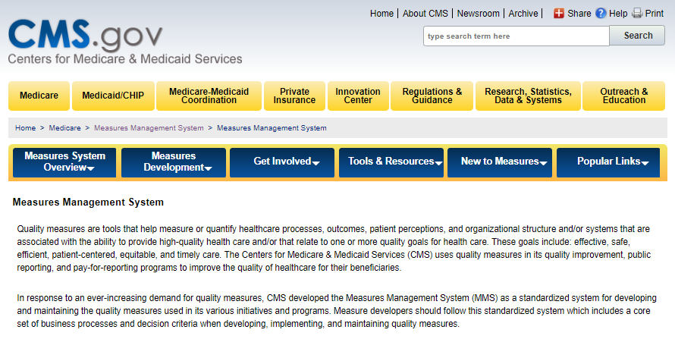
For more information and support:
Go to our Measures Management System website
Contact us at: MMSSupport@Battelle.org

Slide 27
Updates to the
Pre-Rulemaking Process

Slide 28
Pre-Rulemaking
Statutory Reference
Section 3014 of the Patient Protection and
Affordable Care Act
Section 1890 and 1890A of the Social Security Act
Pre-Rulemaking Steps
  CMS publishes the Measures under Consideration (MUC) List annually no later than December 1
  National Quality Forum (NQF) convenes multi-stakeholder groups: Measure Applications Partnership (MAP)
  MAP provides recommendations and feedback to the Secretary annually by February 1
Notes:
The MUC List happens before a new measure is submitted for formal notice of proposed rulemaking and public consideration. ACA required CMS to publish the MUC List for full transparency and a careful vetting of measure ideas and concepts.

Slide 29
Pre-Rulemaking Process:
Medicare Programs
Applies to certain programs and measures
Medicare Programs
Ambulatory Surgical Center Quality Reporting | Inpatient Psychiatric Facility Quality Reporting
End-Stage Renal Disease Quality Incentive | Inpatient Rehabilitation Facility Quality Reporting
Home Health Quality Reporting | Long-Term Care Hospital Quality Reporting
Hospice Quality Reporting | Medicare and Medicaid Promoting Interoperability Program for Eligible Hospitals and Critical Access Hospitals (CAHs)
Hospital-Acquired Condition Reduction | Medicare Shared Savings
Hospital Inpatient Quality Reporting | Merit-based Incentive Payment System
Hospital Outpatient Quality Reporting | Prospective Payment System-Exempt Cancer Hospital Quality Reporting
Hospital Readmissions Reduction | Skilled Nursing Facility Quality Reporting
Hospital Value-Based Purchasing | Skilled Nursing Facility Value-Based Purchasing
Notes:
These pre-rulemaking regulations apply to only certain programs tending to do with hospitals and ambulatory, and also physician type groups. The measures for programs on this slide go through the pre-rulemaking process.

Slide 30
Pre-Rulemaking Process
Measure selection considerations include the following:
Does the measure align with the quality priorities?
Is the candidate measure fulfilling a Meaningful Measure Area gap for this program?
Is the measure evidence-based, fully developed, and tested?
Will the measure be easy to operationalize?
How is respondent burden affected?
Are there any unintended consequences?
What is the measure’s endorsement status?
Notes:
Additional reasons for rejection of a measure:
CMS stating, “This measure has not been sufficiently tested, or not tested in the appropriate setting or population.”
Is this considered a low-bar measure, in that does it offer enough improvement?
Is there room for practitioners, that is will the results be distributed enough?
Is there room for improvement among practitioners as they’re applying this measure in the field?

Slide 31
Measures Development Timeline
Approximation in Months
← 1 | 4 | 8 | 12 | 16 | 20 | 24 | 28 →
Develop & test new measure initial concept (ongoing process) | Submit measures to MUC process | Review and clearance | MUC List published annually | MAP public process and workgroup recomm. | HHS and CMS develop Proposed Rules for measures | Issue Final Rules | Measures adopted in the field
Notes:
January and in the months prior to January measures are being developed and tested and concepts tried out. Around March-April new measures come to CMS and undergo a process of review across CMS and HHS. ACA specifies that CMS must publish the list by December 1st every year. After the MUC List comes out, the MAP workgroup formulates recommendations on every measure stating, “we recommend this, we do not recommend it, or we recommend it with the following suggestions.” CMS then take the measures back and decides whether to put them in the Federal Register in a notice of proposed rulemaking, and then within a year or two the final rules come out.

Slide 32
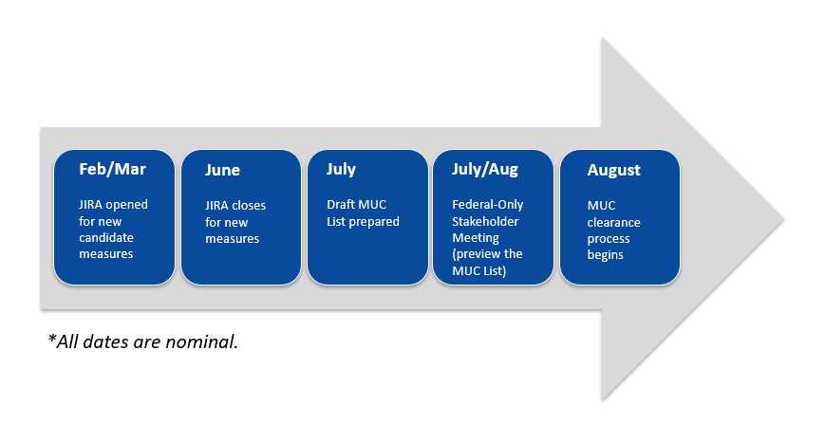
Measures under Consideration
List Workflow
*All dates are nominal.
Notes:
This slide shows the workflow for a typical year. JIRA is currently open for the new 2019 measures. It opens in February-March and is open for several months and will be closing on June 3rd. During July the first draft of the MUC List is prepared. In August it goes through an internal review at CMS. Between August-December it goes through the various layers of the sister organizations at HHS that review and approve each measure. Additionally, they respond to any comments and questions that arise from that clearance process.

Slide 33
Measures under Consideration
List Trends
Year | 2011 | 2012 | 2013 | 2014 | 2015 | 2016 | 2017 | 2018
Number of Measure Records | 366 | 507 | 234 | 202 | 131 | 97 | 32 | 39
CMS publishes the MUC List annually by December 1
The National Quality Forum (NQF) publishes the MAP Final Recommendations report in the first quarter of each subsequent year (example: 2018 MUC List → 2019 MAP Report)
A complete repository of these Lists and Reports is located at: https://www.cms.gov/Medicare/Quality-Initiatives-Patient-Assessment-Instruments/QualityMeasures/Pre-Rule-Making.html
Notes:
There were a large number of measures in the early years of the program with as many as 500 in the year 2012. In recent years that number has been scaled back. The MUC List comes out and NQF publishes their final recommendations report, typically by February 1st of the following year.

Slide 34
Lessons Learned from 2018
Need to make all measure owners, developers, and stewards aware of schedule each year
In general, CMS is promoting development of more outcome measures
Be sure to document changes and history/context when an existing measure is being resubmitted
  For a new program
  Undergoing substantial change
Notes:
The deadline this year is June 3rd. CMS has encouraged developers to move toward more outcome measures and fewer process measures. If promoting or submitting a new measure for the MUC List, please check whether it was on a prior MUC List, or if it’s been through the MAP workgroup review process. Often we get measures marked as new when in fact they were on a prior MUC List, or have been in various stages of development but resubmitted again.

Slide 35
Online System for Gathering New Candidate Measure Information
Jira system hosted by Office of the National Coordinator for Health Information Technology
Available to authorized users
Separate Jira project for each MUC year
Used to manage review, workflow, and approve/reject decisions for each measure
Can attach supporting data files
All measure information in one repository
Notes:
If you visit the pre-rulemaking website, you will see the user guide that describes how to get access if you do not already have access. JIRA puts all of the measure information in one place so that stakeholders can monitor a measure as it proceeds through the workflow and see which various decisions are made about it, and the reasons for those.

Slide 36
New in Jira for 2019
More choices in several drop-downs
Users may now select
  Secondary healthcare priority
  Secondary Meaningful Measure Area
Secondary priorities and MMAs are optional
Different choices for “Data Sources” and “How Measure Will Be Reported”
Notes:
Users were previously asked to specify one healthcare priority and one Meaningful Measure Area per measure. This year we’re calling those the primary priority and primary Meaningful Measure Area, and giving users an option. If it’s useful for your measure, you can also specify a secondary priority and a secondary Meaningful Measure Area.

Slide 37
New for 2019 (cont.)
Can use “Comments” field to define or elaborate on specific sources and reporting methods that are not in drop-down list
“EHR Incentive” program was renamed to reflect “Promoting Interoperability” for hospitals and providers
“Exclusions” field now includes “Exceptions”
Under “Person and Family Engagement,” the MMA “Patient reported functional outcomes” has been renamed “Functional outcomes”

Slide 38
2019 Next Steps
Pre-Rulemaking Meeting Series (April 2019)
  2019 MUC List Kickoff Webinar
  CMS Program Measure-Specific Needs and Priorities Session
  Open Forum Discussions with Jira Demonstrations
  (two webinars)
Visit CMS Pre-Rulemaking site for more info
  https://www.cms.gov/Medicare/Quality-Initiatives-Patient-Assessment-Instruments/QualityMeasures/Pre-Rule-Making.html
Notes:
In Year 2020 CMS is considering moving the schedule earlier in the year for which the cutoff may be earlier than June. This is still in the early discussion stage, with the purpose being to assist the MAP workgroups. If we’re able to publish the MUC List before December 1st, then that gives the MAP workgroups more leeway to accomplish their important work of studying and making recommendations on all of the measures.

Slide 39
Discussion Questions

Slide 40
Upcoming MACRA Info Sessions
Planned Upcoming Webinars:
April 3, 2019 – Why Measures Fail Endorsement, presented by NQF
May 1, 2019 – Environmental Scans
for Measure Development
To suggest topics for upcoming Info Sessions, email: MMSsupport@battelle.org

Slide 41
Contact Information
Battelle
Measures Management System Contract Holder
Contact: MMSsupport@Battelle.org
CMS
Kimberly Rawlings: Kimberly.Rawlings@cms.hhs.gov
Brendan Loughran: Brendan.Loughran@cms.hhs.gov
Helen Dollar-Maples: Helen.Dollar-Maples@cms.hhs.gov

