Slide 1
CMS Measure Development Education & Outreach
MACRA Info Session #5
Where do measure submissions fall short?
Pointers for Navigating NQF’s Consensus Development Process
Presenter:
Karen Johnson, MS, Senior Director, Quality Measurement National Quality Forum
April 3, 2019
2:00-3:00pm EST

Slide 2
Vision and Goals: MACRA Info Sessions
An ongoing process to engage measure developers through education and outreach in quality measure topics.
Elicit feedback that will help CMS design resources that can help all of those interested in healthcare quality improvement better understand the goals of quality measurement.
Education
Outreach
Dedicated Websites
Measure Development Roadmaps
Listserv opportunities
Notes:
CMS is committed to providing Education and Outreach opportunities about the quality measure development process to interested stakeholders to improve understanding of the process. CMS also seeks continual feedback to improve and/or expand its offerings to the healthcare quality measure development community and interested stakeholders.
To date, CMS has implemented an Education and Outreach webinar series and has created resource materials that break down and explain various components and challenges in the measure development process. There are dedicated websites, listservs, and roadmap documents that are available to support those that are working in quality measure development, or are just curious and want to learn more about how it is done.

Slide 3
Where do measure submissions fall short? Pointers for Navigating NQF’s Consensus Development Process

Slide 4
Objectives
Brief background
Limitations specific to the measure itself
Problems with the “defense” of the measure
Contact info
kjohnson@qualityforum.org 202-559-9506
measuremaintenance@qualityforum.org
www.qualityforum.org 202-783-1300
Notes:
4

Slide 5
Background

Slide 6
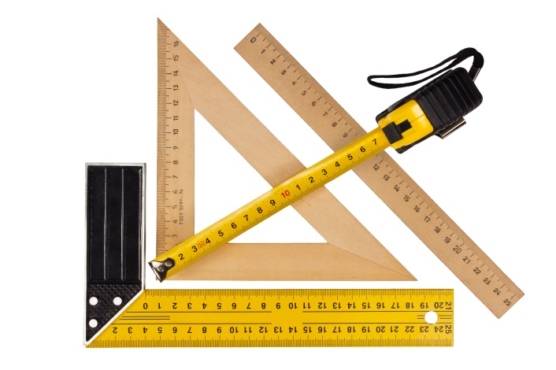
Why Do We Measure?
The primary goal of healthcare performance measurement is to improve the quality (and access and cost) of healthcare
received by patients
(and ultimately, to improve health)
Measurement is a quality improvement tool,
not an end in and of itself
Notes:
At NQF, we are passionate about trying to improve our healthcare delivery system. We see endorsement as a way to drive improvement; therefore, we endorse measures that we think are most likely to drive those improvements.

Slide 7
NQF Consensus Development Process (CDP) 6 Steps for Measure Endorsement
Intent to Submit
Call for Nominations
Measure Evaluation
Public Commenting Period with Member Support
Measure Endorsement
Measure Appeals
Notes:
NQF is a nonprofit, nonpartisan, independent, membership-based organization trying to reach consensus on various issues related to healthcare measurement and quality improvement. Measure developers play a critical role in at least five and possibly even the sixth step, with the one step developers not as involved in being the “call for nominations.”

Slide 8
CDP Timelines
Two evaluation cycles per year
Intent to Submit Deadline (August 1 and Jan 1)
Full Measure Specifications
Measure Testing Attachment
Full Submission Deadline (early April, early November)
Evidence, Gap, Feasibility, Usability and Use, Related/Competing
Measure evaluation meetings (~ February, June)
Draft reports out for comment (~ March/April, July/August)
CSAC meetings (June, October)

Slide 9
NQF Standing Committees: 15 Topic Areas
All-Cause Admissions/ Readmissions
Behavioral Health & Substance Use
Cancer
Cardiovascular
Cost and Efficiency
Geriatrics & Palliative Care
Neurology
Patient Experience & Function
Patient Safety
Pediatrics
Perinatal & Women’s Health
Prevention & Population Health
Primary Care & Chronic Illness
Renal
Surgery
Notes:
Standing Committee Composition
The NQF standing committees are multi-stakeholder groups who evaluate measures to determine their suitability for NQF endorsement. The standing committees are familiar with the submission materials and our measure portfolios.
Topic areas
Measures occasionally do not fit into these 15 topic areas; hence, where the measure gets slotted depends on the measure itself, those areas of expertise on the committees, the capacity of the committees, or whether related/competing measures are being considered by a committee. We strive to maintain consistency across committees, and in cases where we don’t have the right expertise we may borrow from committees and bring them aboard.

Slide 10
NQF Standing Committees
Multi-stakeholder perspectives
Healthcare providers
Different voices (e.g., physicians, nurses, etc.)
Various settings of care (e.g., hospitals, clinics, PAC/LTC, rural)
Health plans and other purchasers
Quality measurement experts/methodologists
Consumers
Patients
When seating Committee members, we look for needed perspectives and expertise (e.g., “many hats”)
Notes:
This is not an exhaustive list as we do at times include measure developers on our committees. Later in the slide deck, we will be addressing making your case to the standing committee, and so it’s helpful to think about who is sitting around the table and what their perspectives are as you’re putting together information on your measure.

Slide 11
NQF’s Measure Evaluation Criteria
Importance to Measure and Report (must-pass)
Evidence
Opportunity for Improvement (gap)
Scientific Acceptability of Measure Properties (must-pass)
Reliability
Validity
Feasibility
Usability and Use
Use is must-pass for previously-endorsed measures
Comparison to Related/Competing Measures
Notes:
Importance to measure and report:
Is it important enough to be endorsed by NQF?
Is there a strong evidence base for the measure?
Is there really a quality problem or room for improvement?
Scientific acceptability of measure properties:
In terms of reliability, how is this behaving out in the world?
Feasibility:
How easy is it to collect the data and to implement the measure?
Usability and use:
Is it being used in accountability programs?
Is it being publicly reported?
Can you show that use of this measure has resulted in improvement?
Are there unintended consequences of measurement?

Slide 12
Two Principal Reasons Measures Do Not Obtain NQF Endorsement
Limitations specific to the measure itself
Measure concept
Measure construct
Problems with the “defense” of the measure
Non-adherence to NQF’s evaluation criteria
Deficiencies with written submission materials
Sub-optimal approach in oral presentations to Standing Committees

Slide 13
Limitations of the Measure

Slide 14
The Measure: Concept and Construct
NQF endorses measures for use in accountability programs (not just for quality improvement)
Demonstrate strong, direct relationship between process measures and patient outcomes
Address a known healthcare quality problem, with evidence of a performance gap
Be precisely and unambiguously specified
Differentiate good quality/performance from poor quality/performance
Be meaningful and actionable
Notes:
NQF endorses measures for use in quality improvement applications and accountability programs:
Use in certification
Accreditation programs
Public reporting
Payment programs
For the concept, what are you trying to assess? For the construct, how have you chosen to operationalize what you are trying to assess with your measure?

Slide 15
Things to Consider: Concept & Construct
Avoid “check box” measures
Avoid precursor or “stepping stone” measures
Think about whether an outcome measure is possible
Use the patient as a data source whenever appropriate
Can already existing measures be expanded?
Target population, setting, level of analysis
Carefully consider need for competing measures
Be able to clearly articulate the quality problem
Address deficiencies uncovered in measure testing
Harmonize measure specifications to the extent possible
Notes:
NQF seeks a strong evidence base
NQF has a preference for outcome measures followed in reverse order by intermediate outcome measures, and then structure/process measures tightly linked to outcome measures.
Consider the possibility of constructing an outcome measure using patients themselves as a data source.
Consider whether an existing measure can be expanded either by target population, or including additional care settings or levels of analysis.
In addressing efficiencies in testing, retest and demonstrate the ability to fix problems.
Harmonize measure specifications to minimize data collection burden.
Competing measures:
In this case we would endorse the superior measure. Clearly articulate the quality problems, i.e., your rationale and show that there is a problem. If there is a good justification for having competing measures, NQF may endorse two measures doing pretty much the same thing.

Slide 16
Problems with the “Defense”
Notes:
We strive to drive improvement in health and healthcare, but realize that your task is to convince the people around the table that what you’ve done meets our requirements for endorsement. NQF desires to help you put your best foot forward, because nobody likes when a measure does not get through the process of endorsement.

Slide 17
Non-Adherence to NQF’s Evaluation Criteria
Unfamiliarity with the NQF evaluation criteria/guidance
Not understanding NQF’s evaluation criteria /guidance
Using outdated evaluation criteria /guidance
Not following NQF’s evaluation criteria requirements
Some solutions
Use the NQF Measure Evaluation Criteria and Guidance document – updated August 2018 (new version expected May 2019)
Attend NQF developer webinars
Contact staff for help/technical assistance
Notes:
Non-adherence example 1:
Measures specified as ICD-10 require testing with ICD-10 coding; no longer accept ICD-9.
Non-adherence example 2:
The reliance on face validity for maintenance measures will require that you provide justification.
Measures presenting for maintenance without justification constitute non-adherence. The standing committee will provide final determination as to the proposed justification’s validity.
It may prove beneficial to participate in our NQF webinars. Also, please join us at the upcoming NQF workshop being held in DC on June 10, 2019.

Slide 18
Addressing General Deficiencies with Written Submission Materials
The NQF submission is like a grant proposal, not a research report
Requires concise, specific responses to the questions being asked
Long lists of citations usually are not helpful
NQF Committees are not required to look at references or appendices—all information that you want them to consider must be in the submission
Do not delegate to the least experienced member of your team
Provide data or other quantitative information whenever asked
Answer ALL questions
If a particular question does not apply, write “N/A”
NOTE that there are relatively few questions that should be “N/A”
Notes:
Our committees are all volunteers and their task is labor-intensive. When attaching an article or a citation to an article that helps to explain your measure, realize the committee is under no obligation to review those materials. Please be concise and synthesize that information.
It is a bit of an art to filling out the submission forms; therefore, do not delegate this task to less experienced team members. If unavoidable, then certainly with appropriate guidance and thorough review afterwards. Lastly, when something is not applicable to your measure write “N/A,” thus minimizing the possibility of being viewed as overlooked or intentionally omitted.

Slide 19
Issues with the Evidence Subcriterion
Good logic diagram
This spells out what evidence the Standing Committee would expect to see
Provide a concise description of the evidence – don’t make the Committee hunt for it
We ask you to summarize the quality and consistency of the evidence
Measure should be evidence-based – do not count on an exception (these are possible, but should be rare)
Notes:
The example on this slide depicts the pathway between the process and the improved health outcomes being targeted in a proposed measure. We expect to see evidence showing that pelvic floor muscle training increases strength, endurance, and coordination, and that with these increases would result in decreased leakage.
Summarize the quality of the data, the quality of the evidence behind your measure, and the consistency of that evidence. NQF may encounter an exception to the evidence criterion; however, not all measures we endorse are completely evidence-based. Remember this is meant to be used rarely and do not count on getting an exception to the evidence.

Slide 20
Issues with the Gap Criterion
Data might not match the measure as specified
May be okay for a new measure, but not for a previously-endorsed measure
Performance data are not current
“Current” may mean different things, depending on the data source
Measures that are “topped out” may not be endorsed
Notes:
For brand new measures perhaps you’re pulling from the literature; however, when returning for maintenance NQF is hopeful that this measure is being used and that you can provide data which supports its current performance.

Slide 21
Issues with the Reliability/Validity Subcriteria
Testing
Testing doesn’t use specified data source/level of analysis
Testing doesn’t match other specifications
If no minimum threshold specified, then don’t use a minimum threshold when testing
A sufficiently large, “representative” sample isn’t used in testing
Not enough detail when describing the methods used in testing
Methods don’t adhere to NQF requirements/guidance
Lack of interpretation of the testing results
Testing identifies a problem, but there is no re-testing
Threats to validity not described/explored
Not taking advantage of labels/headers/descriptive titles
Use for clarity and to make things easy to find
Don’t make us try to guess or assume
Notes:
Testing specification example:
When not specifying a minimum threshold in terms of how many patients are included in the measure, do not use the minimum threshold when testing and so ensure that everything matches. Sampling is allowed, but NQF has guidance in terms of how big/how representative is good enough/big enough.
Complex measure example:
For complex measures being evaluated by our methods panel, provide enough detail when describing methods used, particularly when describing the methodology for testing, and when doing data element testing be specific about what you consider to be the gold standard.
Non-adherence example:
When performing inter-rater reliability or some validation phase showing only percent agreement, NQF has stated specifically that it is insufficient and that we require a bit more sophisticated statistics than simply percent agreement.
For reliability of data elements, NQF requires an analysis for all critical data elements. We also require that you do your own interpretation. In the case of threats to validity such as exclusions and missing data, NQF wishes to understand your thinking and how those issues were addressed. Lastly, NQF provides a testing attachment in Word format which allows you to do formatting with accompanying tables and figures.

Slide 22
Issues with Usability and Use Criterion
Use is now must-pass for maintenance measures
Legwork may be required to know if your measure is being used
Notes:
If you are not the actual implementer of a measure, you may not, in fact, know who’s using your measure. Since it’s now a must-pass criterion, it is highly encouraged that you take this additional step to secure this important information.

Slide 23
How Can NQF Help?
NQF staff will provide technical assistance before and during the submission process – just ask!
Staff will provide feedback on a draft submission before the submission deadline
Completeness/Responsiveness Checks after submission
Provided by NQF to help you “put your best foot forward”
If not clear what you need to do, get in touch quickly
Seriously consider whether to wait for the next evaluation cycle, to give you time to improve your submission
Take advantage of our written guidance
Notes:
Completeness/responsiveness checks:
NQF has a limited amount of time get things ready for their committees to review so you might hear, “Here’s a list of things that we think you ought to address, and you have 48 hours.” Let us know if there’s a list of ten things and you’re not quite sure - “I only have time to do three of them and so which are the three important ones?”
Deferring your measure:
If it’s too much, then just say, “Look, I don't think that we can do this and get it in the shape that we need in time, and so let’s just drop to the next cycle and see if we can make that happen.” By having multiple evaluation cycles in a year, seriously reconsider whether you should just defer to a subsequent cycle.

Slide 24
Become Familiar with our Submitting Standards Page
Notes:
To access the Submitting Standards page please visit our main webpage and navigate to the bottom. There you will find hyperlinks, one of which will take you to our Submitting Standards page. There is a lot of information on this page, including things like blank submission forms.

Slide 25
Submitting Standards Web Page Resources
Criteria and Guidance Document
Measure Developer Guidebook – updated annually
Explains the NQF process and expectations for developers
Evaluation algorithms for evidence, reliability and validity
Lays out the logic that committees will use for rating Evidence, Reliability, and Validity subcriteria
What Good Looks Like: examples of good submissions
Blank copies of submission forms
Resource libraries
Recordings of Methods Panel and Developer Webinar meetings
On-demand educational recordings

Slide 26
Suggestions for the Oral Presentation to Standing Committees
Choose a knowledgeable representative(s) to speak about your measure
Must be familiar with the measure submission information
Must be able to respond to technical questions about the specifications, data, and testing
Uncertainty or equivocating can undermine your measure
Know the criteria and how your measure meets that criteria
Use NQF preliminary analysis and ratings to your advantage
Know the audience (the Committee perspectives)
Don’t take questions or criticisms of the measure personally
Notes:
Choose a knowledgeable representative:
The bulk of your presentation is through the submission forms, but you do have a chance to enter into a dialogue with the standing committee when evaluating your measure. Choose someone very knowledgeable and familiar with your measure being submitted, someone technically savvy in terms of how the measure was calculated, the methods, the results of testing — especially for outcome measures in terms of their ability to discuss their risk adjustment approach.
Preliminary analysis:
NQF provides preliminary ratings for measures whereby you can see from our perspective what we think are some problems your measure might have in the endorsement process. It is advisable to take advantage of that intel and be able to speak to the things we’ve pointed out.
Know the audience:
Consider who is sitting around the table so that you understand where they’re coming from and maybe that might help you craft your answers. Developers spend a lot of time pressing for their discussion with our standing committees, and some folks clearly display being on top of things which in turn makes an impact during these discussions.
Don’t take criticisms personally:
People are human, but try not to take things personally. Remember that you, everybody around the table and we at NQF all have a common end goal of trying to improve healthcare quality.

Slide 27
Thank you

Slide 28
Discussion Questions

Slide 29
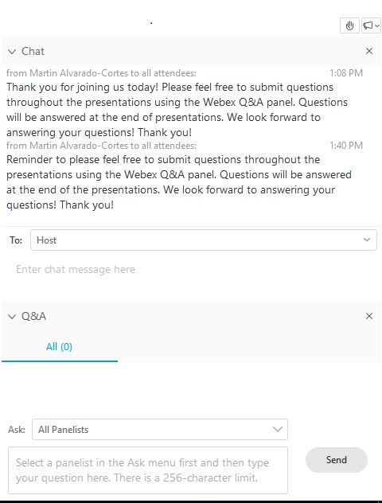
Want to Ask a Question?
The presenters will answer questions at the end of the Info Session.
To ask a question, use one of the Q&A features (note: select the participant panel icon if the Chat/Q&A panel isn’t in view):
Raise your hand. We will call on you at the end.
Type your question into the “Chat” or “Q&A” features.
Hit “Send” to submit your question.
Or you can ask a question at the end when we un-mute the lines.

Slide 30
Upcoming MACRA Info Sessions
Planned Upcoming Webinars:
May 1, 2019 – Best Practices in Environmental Scanning and Introduction to the ESST
May 22, 2019 – eCQI Resource Center: Resources and Updates
June 5, 2019 – eCQM Testing: Making the Most of Limited Testing Data
To suggest topics for upcoming Info Sessions, email: MMSsupport@battelle.org

Slide 31
Contact Information
Battelle
Measures Management System Contract Holder Contact: MMSsupport@Battelle.org
CMS
Kimberly Rawlings: Kimberly.Rawlings@cms.hhs.gov

