Slide 1
MACRA Education and Outreach Series
Meaningful Measures
Presenter: Kimberly Rawlings, CMS
Notes:
Welcome to our May MACRA Education and Outreach session. For those of you who are joining us for the first time today, my name is Mary Sheehan with Battelle, the Measures Management System Contractor to CMS, and I will be facilitating today’s session. Today’s topic is on the Meaningful Measures Initiative and is being presented by Kim Rawlings of CMS.

Slide 2
Vision and Goals: MACRA Webinar Series
An ongoing process to engage clinical specialty societies and patient advocacy groups in quality measure development.
Elicit feedback that will help CMS design toolkits and enduring materials designed specifically for specialty societies and patient advocacy groups interested in measure development.
Education
Outreach
Frequent Communication
Enduring Materials
Dedicated Websites
Measure Development Roadmaps
Targeted Newsletters and Communication
Showcase Opportunities
Notes:
As many of you who have been attending these webinars know, we have been working with CMS to engage you in communications through a variety of outlets, including this webinar series, newsletters, websites and emails, as well as developing materials that will benefit agencies interested in developing quality measures. This webinar series occurs at least monthly, but we do have several months where we provide multiple topics and share information that is related to a wide range of issues, challenges, and processes related to quality measure development.

Slide 3
MACRA Education and Outreach Series Agenda
Agenda Webinar # 11:
Introduction to the Meaningful Approach and Objectives
Review of the Meaningful Measures Framework
Meaningful Measures Next Steps
Meaningful Measure Resources
Discussion and Feedback
Questions and Answers

Slide 4
Meaningful Measures
Notes:
My name is Kim Rawlings and I am the lead for the Measures Management System (MMS) and a part of the team that works on the Meaningful Measures Initiative. Over the past two years there has been continued work and updates to MACRA. We had a renewed emphasis on burden reduction as well as a renewed commitment to having the patients at the center of everything that we do. It has been really exciting listening to these weekly calls as well as attending many of the Spotlight Sessions that some of you have done. Two of the issues that I hear time and time again as I have been listening to feedback from a variety of stakeholders — not just through these webinars and Spotlight Sessions but from a broad range of arenas — is the need for CMS to minimize burden around quality measurement and to be more clear in the story that we are telling and the priorities that we are setting with our measure sets. This is not just at the individual program level, but across all of the programs at CMS. I am really excited to talk with you for the next hour or so and give this presentation on an initiative that I feel really gets to addressing some of the challenges and feedback that I have been hearing from stakeholders.
But before I start talking about Meaningful Measures, I do want to take a quick step back and briefly discuss how we got here, because I think that we all share a common goal — to have a healthy population. With CMS covering people from birth to the end of life, we want to make sure that that journey of the population in getting to be healthier is also a good experience for everyone involved. A primary goal of this administration is to remove obstacles that get in the way of that good experience. One of those obstacles is that increased burden decreases the amount of time that clinicians can spend with their patients.
In October of 2017 CMS introduced the Patients Over Paperwork Initiative to stress the agency’s commitment towards patient-centered care and improving outcomes while concurrently reducing burden for clinicians and providers. The Patients Over Paperwork Initiative includes several major tasks aimed at reducing obstacles that get in the way of this critical patient time — one of which is reducing regulatory burden.
As many of you know, we are an agency that writes a lot of regulations. Now, some of these regulations are good and obviously very necessary as our shared common goal is to keep our population safe and make them healthier; however, given the volume that we produce on any given year, we recognize that this is a good opportunity for us to do some work to improve and do a PDSA (Plan, Do, Study, Act) cycle to check and study what kind of improvements we can make. We want to set up agency-wide processes where we have evaluated, streamlined, et cetera, our regulations and start to address burden in areas where we have heard burden can be, for lack of better words, most burdensome. Two of those areas are payment policy and quality measures.
I know that you will hear more about these efforts in the near future around Patients Over Paperwork, but what we are really going to focus on here today is Meaningful Measures and the reduction of burden in quality measurement.

Slide 5
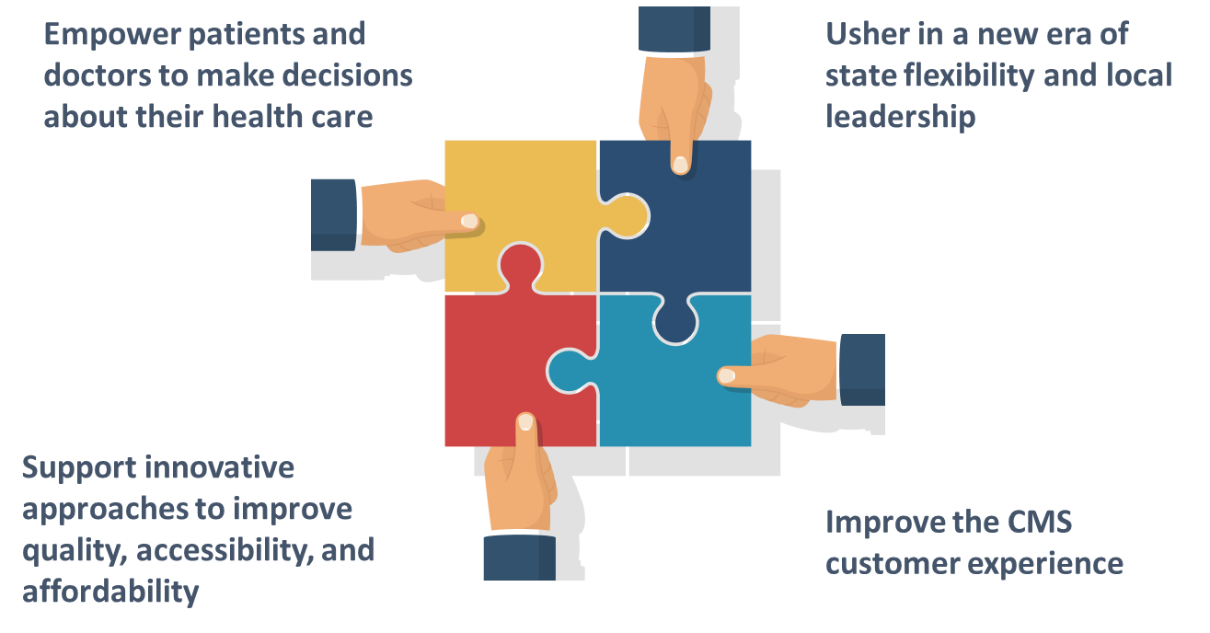
A New Approach to Meaningful Outcomes
Notes:
The Meaningful Measures Initiative is guided by CMS’ four strategic goals of improving the customer experience, ushering in a state of flexibility in local leadership, supporting innovative approaches to improve quality accessibility and affordability, as well as empowering patients and physicians to make decisions about their healthcare. Each one of these goals informs Meaningful Measures and address some common themes that I have heard in the last several years.
One, that there are too many measures. Second, that there are too many disparate measures and people do not understand how the measures fit together or what kind of story the measures tell and how those measures are serving patients. Third, that there is the administrative burden of reporting, and the lack of simplified ways to really focus on those critical, high-priority areas that matter most to clinicians and patients. This is what we are trying to fix with the Meaningful Measures work. We are taking a new approach to evaluating what we do and looking at how we improve the customer experience so that we can give the kind of care we want our patients to have, rather than just having everyone meet our requirements.

Slide 6
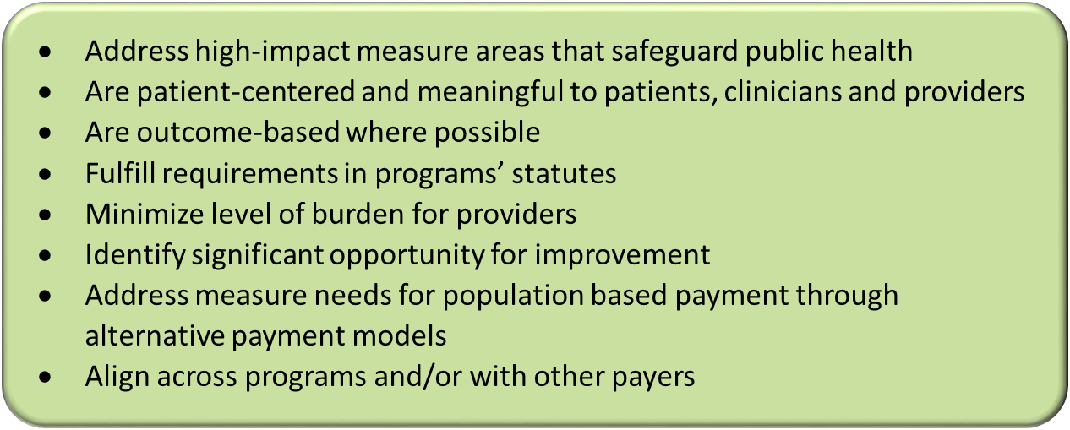
Meaningful Measures Objectives
Meaningful Measures focus everyone’s efforts on the same quality areas and lend specificity, which can help identify measures that:
Notes:
As we begin to look at our measures approach, we talked about a number of objectives. CMS has a unique opportunity to continue to guide real measurable improvements across the nation while still encouraging the use of more parsimonious measure sets and working to reduce the burden of measurement.

Slide 7
Meaningful Measures Framework
Notes:
With the help of our partners we identified some key common quality issues to focus on. CMS introduced a comprehensive approach using the Meaningful Measures Framework to identify the highest priorities for quality measurement and improvement and to assess these core issues that are most critical to providing high quality care and improving individual outcomes. How does this connect with empowering patients to work with their doctors, as well as burden reduction which are both key tenets of the Patients Over Paperwork?
We believe that by reducing the regulatory burdens placed on physicians, we can enable physicians to spend more time focusing on the care of their patients and spending more time having those key conversations that we know are so important with their patients. This will provide patients with more time to talk with their physician, and to really focus on their care and communicating their goals and desired health outcomes. The picture in this slide shows just that in the sense that what Meaningful Measure Areas aims to achieve is high quality healthcare and meaningful outcomes to patients.
Here at CMS we often talk about what CMS can direct and the things that CMS can enable; how we can promote best practices, et cetera, across the entire industry. While we are here today to discuss CMS, we do understand that the reach is much broader. We have spent hours talking to stakeholders, including other payers, to make sure that that alignment continues to occur. Because of the scope and transformative nature of this initiative, these are not outcomes that CMS can achieve alone. The Meaningful Measures Framework draws on work done by the Learning & Action Network (LAN), by the National Quality Forum (NQF), the National Academy of Medicine (NAM), and includes a lot of different perspectives from patients, external stakeholders, et cetera. All of this work and all of this feedback provides the basis for developing criteria around measures being meaningful to the patients as well as actionable for providers.

Slide 8
Meaningful Measures
Notes:
This diagram summarizes the Meaningful Measures approach. As you can see, the patient is at the center along with the four strategic goals. These goals as well as the patient serve as the foundational principles for everything that we do. These strategic goals also connect with the six crosscutting criteria that are around the circle — reducing burden, eliminating disparities, tracking to measurable outcomes and impact, safeguarding public health, achieving cost savings and improving access to rural communities.
These crosscutting criteria serve as desired outcomes at CMS, and our partners as well, believe are most important for improving our nations health system. These are, in other words, the most critical and important concepts that we want with every priority — every Meaningful Measure Area — and every measure should be filtered through these concepts and be applicable and relevant and important to each Meaningful Measure Area.
We also have the six quality priority domains — that is in the bold list. The 19 Meaningful Measure Areas also track to the crosscutting criteria by working to support those desired outcomes.
For example, at a high level we have a crosscutting criteria of achieving cost savings. How would we go about doing that? We can look to the quality priority domain on the outside of the circle of making care affordable. This priority domain has three Meaningful Measures. So then by focusing on these Meaningful Measure Areas such as the appropriate use of healthcare, we can work towards the crosscutting goal of achieving cost savings and ultimately meet our four strategic goals. Each quality priority domain and their respective Meaningful Measures will guide the reduction of reporting burden on providers — while focusing quality improvement efforts on only the most critical areas through the adoption of the most meaningful quality measures, all with the ultimate goal of driving better patient outcomes and hopefully at a lower cost.

Slide 9
Strengthen Person & Family Engagement as Partners in their Care (1 of 2)
Notes:
This slides shows some of the rationale that was discussed in selecting the Meaningful Measure Areas. As an example, we have the quality priority of “strengthen person and family engagement as partners in their care.” Underneath that quality priority, we have four Meaningful Measure Areas. First, care is personalized and aligned with patient goals. Second, end-of-life care according to preferences. Third, patient’s experience of care; and fourth, patient-reported functional outcomes. Here are some of the descriptions, examples and data. If we take end-of-life care according to preferences, fewer than fifty of severely or terminally ill patients have advanced directives in their medical records and so we want to make sure that there are measures in our programs that ensure that the care that is delivered at the end of life is harmonious and what the patient and their family wants. That includes knowing those desires and providing aligned services and aligned care as well.

Slide 10
Strengthen Person & Family Engagement as Partners in their Care (2 of 2)
Notes:
This slide shows a couple of examples of measures that fit that Meaningful Measure Area. Staying with the example of end-of-life care from the previous slide, two of the measures that we have are hospice visits when death is imminent, and the CAHPS hospice survey, getting emotional and religious support, both under the Hospice Quality Reporting Program (HQRP). That works to try and tell that story of how these two measures in this program feed to not only the end-of-life care according to the Meaningful Measure Area, but how it begins to strengthen person and family engagement and gets to our six crosscutting areas that we outlined, and, ultimately at a very high level, get to our strategic goals and improving the customer experience.

Slide 11
Promote Effective Communication & Coordination of Care (1 of 2)
Notes:
On the next few slides are some of the other quality priorities and examples of how their Meaningful Measure Areas tie to individual measures in programs.

Slide 12
Promote Effective Communication & Coordination of Care (2 of 2)

Slide 13
Promote Effective Prevention & Treatment of Chronic Disease (1 of 2)

Slide 14
Promote Effective Prevention & Treatment of Chronic Disease (2 of 2)

Slide 15
Promote Effective Prevention & Treatment of Chronic Disease – Example
Notes:
On this slide we have a Meaningful Measure Area called “prevention and treatment of opioid and substance use disorders” which falls under the quality priority of “promoting effective prevention and treatment of chronic disease.”
As I am sure many of you have heard, this is a key priority and not just for the CMS administration, but for the HHS administration as well as Congress and the White House. For illustrative purposes, two measures among the quality measures that address the Meaningful Measure Area of “prevention and treatment of opioid and substance use disorders” in CMS’ programs are shown in this graphic. We have the “alcohol use screening” as well as the “use of opioids at high dosage.” By focusing on this Meaningful Measure Area, CMS can work to eliminate any measures that do not add value to this area. They will also work to identify gaps in measurement and quality improvement efforts, work to retain quality measurements that really target the opioid and substance use disorders, and to make sure we are targeting our efforts in partnership with states and communities on combatting the opioid crisis.
CMS is committed to working with clinicians, providers, registries, EHR vendors and other federal stakeholders such as the Office of the National Coordinator for Health Information Technology (ONC) in order to advance measurement systems to lower burden by identifying electronic data sources and aligning datasets where possible so that opioid data can be seamlessly captured.

Slide 16
Getting to Measures that Matter
How do Meaningful Measure Areas relate to existing CMS programs?
How will this initiative reduce burden for clinicians and providers?
What does this initiative mean for clinicians, including specialists?
How are current programs/documents going to incorporate this information?
Notes:
Here are some frequently asked questions (FAQs) that we get about Meaningful Measures:
How do Meaningful Measure Areas relate to existing CMS programs? It is really important to stress here that Meaningful Measure Areas, the Meaningful Measures Initiative, and everything that I just talked about is not intended to replace any existing programs. It is not meant to create any new requirements, mandate any new measures, et cetera. It is really about helping programs identify and select individual measures. It is intended to increase alignment of measures across CMS programs, and to the extent possible, across public and private initiatives by pointing to high-priority areas where there may be gaps in available quality measures to help guide our effort to develop and implement quality measures to fill those gaps.
How will this initiative reduce burden for clinicians and providers? It is really important that we allow clinicians and providers the time to focus on their patients and improve quality of care that is meaningful to them instead of just reporting or doing paperwork. So again, by prioritizing the use of outcome measures through high-priority process measures, we will continue to seek outcomes and get to those core outcomes and priority outcomes. Of course, there are some cases where priority process measures are still needed. They will continue to be considered on a case-by-case basis where outcome measures might not be possible, but the idea is to get to smaller and more Meaningful Measure sets whenever possible.
What does this initiative mean for clinicians, including specialists? Again, this is intended to capture the most impactful and highest priority quality improvement areas for all clinicians including specialists. A lot of these are applicable across the lifespan of the patient and across all care settings. Taking orthopedic surgeons as an example, we have heard from patients and surgeons that measuring patient-reported function outcomes (PROs) after surgery is really important to determine if the surgery has been effective in improving or maintaining a patient’s quality of life.
How are current programs or documents going to incorporate this information? Considering the Meaningful Measure Areas, last year for our pre-rulemaking cycle, CMS narrowed the initial 184 measures submitted by stakeholders for consideration in Medicare quality reporting and value-based purchases program down to only 32 measures. That’s 17% of the original submissions. It is allowing CMS to focus its efforts to achieve goals of high quality healthcare and meaningful outcomes for patients while still minimizing burden.
The other question that I get a lot is that the Meaningful Measures Initiative identifies objectives and goals for the measures to ensure that they are most meaningful. It creates a framework to better distinguish quality priorities; however, it does not in and of itself create any new measures or new Meaningful Measure sets. The idea is that we will use these goals and objectives and framework to apply to all of our measures and programs to ensure all of the measures in our programs are most meaningful.

Slide 17
Meaningful Measures Next Steps
Three dimensions of implementation
Ongoing stakeholder input to further improve the Meaningful Measures framework
Give us your feedback!
MeaningfulMeasuresQA@cms.hhs.gov
Notes:
Clinicians, specialty societies, patients, patient advocates and others in the healthcare industry have substantial engagement with CMS to inform the identification of these 19 Meaningful Measure Areas. These collaborative efforts and robust feedback will help to provide clarity and transparency around the priorities for quality measurement. It will work towards reducing the reporting burden.
With this framework CMS is simultaneously addressing three other dimensions to the implementation of Meaningful Measures.
First, it is conducting a thorough review of all the existing measures and removing the ones that do not meet the criteria. We believe that with everyone’s efforts focusing on the same high impact quality areas along with the reduced number of overall measures, there will be a decreased reporting burden for clinicians and providers, and in turn an even better ability to focus on patients and providing appropriate care that is meaningful to them.
Second it is analyzing measure sets to identify gaps based on the Meaningful Measures Framework and focusing any new measures on filling those gaps and moving from lower-value process measures towards higher-value measures such as outcome measures. CMS is focusing our contract dollars to identify performance and measurement gaps so that the focus of any new measure development will be to fill those priority gaps, as well as replace process measures with outcome measures and also patient-reported outcome (PRO) measures which are very high value as well.
Third, it is working with clinicians, providers, registries, EHR (electronic health records) vendors, et cetera to advance measurement systems to be lower burden, particularly around the area of reporting. CMS has been incorporating user-centered design approaches, meeting with frontline clinicians, hospitals, developers, and EHR vendors to address the challenges and high burden of developing, implementing, and reporting electronic clinical quality measures (eCQM)s.
CMS has adopted an API (application programming interface) First Strategy and has been testing new APIs with vendors and registries with the goal being to dramatically simplify the way in which quality measure data is submitted to CMS. We have also been collaborating closely with ONC, the Office of the National Coordinator, to address the burden of quality reporting with respect to EHRs. We and ONC have partnered to implement one of the major and most impactful provisions of the 21st Century Cures Act which requires that HHS establish a goal with respect to the reduction of regulatory and administrative burdens relating to the use of EHRs and develop a strategy and recommendations for meeting that goal.
So then with continued engagement with frontline clinicians — patients, families, and caregivers — we are really hoping to drive efforts to move payment towards value and continue our efforts in that arena. We will apply the Meaningful Measures Framework across our programs by focusing everyone’s efforts on the same quality areas with the common principles for quality measures to achieve our common goal which is to provide high quality healthcare to all Americans.
At the bottom of the screen is MeaningfulMeasuresQA@cms.hhs.gov,, an email where you can send your feedback and send your questions around Meaningful Measures.

Slide 18
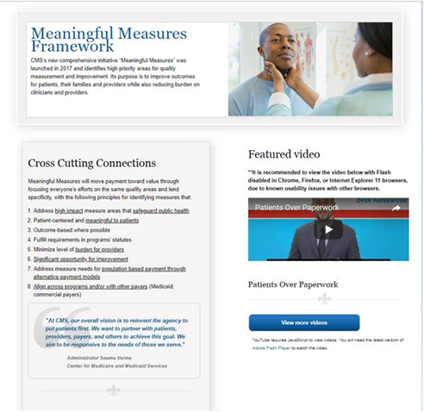
Meaningful Measures Website
Go to:
https://www.cms.gov/Medicare/Quality-Initiatives-Patient-Assessment-Instruments/QualityInitiativesGenInfo/CMS-Quality-Strategy.html
Notes:
Here is the Meaningful Measures website where you can go for more information.

Slide 19
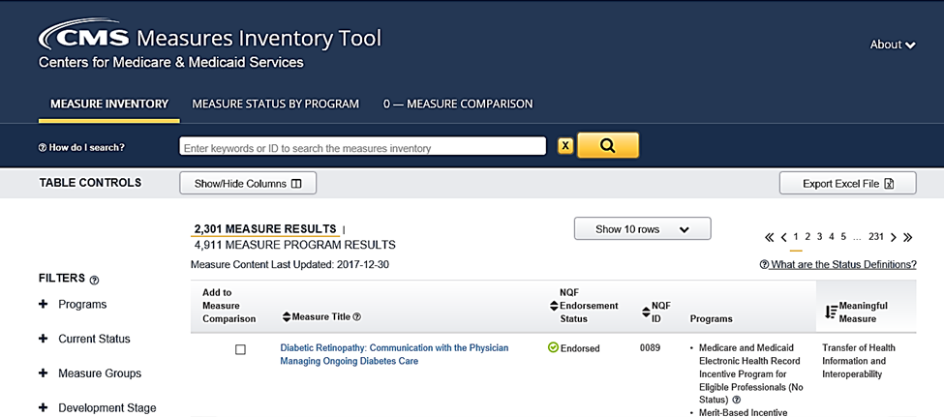
Where to Find Meaningful Measures
CMS Measures Inventory Tool: https://www.cms.cmit.gov
Notes:
We are also actively in the process of updating CMIT, the CMS Measures Inventory Tool with information on our Meaningful Measures so that you can look them up. There are a lot of measures in there, but with our MUC (measures under consideration) List and going forward with the measures to implement, they are actively in the process of showing which Meaningful Measure Area a particular measure has been classified in and putting that in CMIT so that it is accessible for everyone.

Slide 20
Questions for the Audience

Slide 21
Question 1: Which of the Areas are most critical to you, and why?

Slide 22
Question 2 : Prioritizing Patient Input
Collaborating with patients and families is so important when developing, reporting and improving quality measures; however, developers and policy makers are often challenged to find the best way to make sure that the patient voice is included in every aspect of measure development and implementation. What are some special considerations CMS should be aware of when building these key partnerships with patients and families around quality measurement?

Slide 23
Question 3: Stakeholder engagement?
Recognizing that measure, alignment, reporting burden, etc. is part of a complete system, how can the Meaningful Measures framework be used to articulate a different daily life for you?

Slide 24
Additional Questions?

Slide 25
References
Centers for Disease Control and Prevention. “Healthcare-associated Infections,” Available: https://www.cdc.gov/hai/surveillance/
Centers for Disease Control and Prevention. “Home and Recreational Safety,” Available: https://www.cdc.gov/homeandrecreationalsafety/falls/adultfalls.html
Reuben, D.B. & Tinetti, M.E. (2012). “Goal-Oriented Patient Care—An Alternative Health Outcomes Paradigm,” Available: http://www.nejm.org/doi/citedby/10.1056/NEJMp1113631#t=citedby
Centers for Disease Control and Prevention. “Advance Care Planning: Ensuring Your Wishes are Known and Honored If you are Unable to Speak for Yourself,” Available: https://www.cdc.gov/aging/pdf/advanced-care-planning-critical-issue-brief.pdf
Centers for Disease Control and Prevention. “Hospitalization for Total Knee Replacement Among Inpatients Aged 45 and Over: United States, 2000–2010,” Available: https://www.cdc.gov/nchs/products/databriefs/db210.htm
Centers for Disease Control and Prevention. “Cancer Screenings in the United States,” Available: https://www.cdc.gov/cancer/dcpc/research/articles/screening_us.htm
Centers for Medicare & Medicaid Services (2016, July). “Measure Specifications for Measures Adopted in the FY 2017 IRF QRP Final Rule,” Available: https://www.cms.gov/Medicare/Quality-Initiatives-Patient-Assessment-Instruments/IRF-Quality-Reporting/Downloads/Measure-Specifications-for-FY17-IRF-QRP-Final-Rule.pdf
Y. Gorina, L. A. Pratt, E. A. Kramarow, and N. Elgaddal, “Hospitalization, Readmission, and Death Experience of Noninstitutionalized Medicare Fee-for-service Beneficiaries Aged 65 and Over,” National Health Statistics Report, CDC, Available: https://www.cdc.gov/nchs/data/nhsr/nhsr084.pdf
R. B. Zuckerman, S. H. Sheingold, E. J. Orav, J. Ruhter, and A. M. Epstein, “Readmissions, Observation, and the Hospital Readmissions Reduction Program,” The New England Journal of Medicine, April 21, 2016. Available: http://www.nejm.org/doi/full/10.1056/NEJMsa1513024?source=acsh.org&#t=article
Centers for Disease Control and Prevention. “50 National Center for Health Statistics 1960-2010 Celebrating 50 Years,” Available: https://www.cdc.gov/nchs/data/about/nchs_50th_brochure.pdf
Centers for Disease Control and Prevention. “Cancer Screening in the United States,” Available: https://www.cdc.gov/cancer/dcpc/research/articles/screening_us.htm
Centers for Disease Control and Prevention. “Multiple Chronic Conditions,” Available: https://www.cdc.gov/chronicdisease/about/multiple-chronic.htm
National Alliance on Mental Illness. “Mental Health by the Numbers,” Available: https://www.nami.org/Learn-More/Mental-Health-By-the-Numbers
Centers for Disease Control and Prevention. “Opioid Overdose,” Available: https://www.cdc.gov/drugoverdose/data/index.html
Centers for Disease Control and Prevention. “Addressing Prescription Drug Abuse in the United States, Current Actions and Future Opportunities,” Available: https://www.cdc.gov/drugoverdose/pdf/hhs_prescription_drug_abuse_report_09.2013.pdf
Centers for Disease Control and Prevention. “Deaths and Mortality,” Available: https://www.cdc.gov/nchs/fastats/deaths.htm
Centers for Disease Control and Preventions. “Adults with One or More Functional Disabilities—United States, 2011-2014,” Available: https://www.cdc.gov/mmwr/volumes/65/wr/mm6538a1.htm
Centers for Disease Control and Prevention. “The Power of Prevention,” Available: https://www.cdc.gov/chronicdisease/pdf/2009-power-of-prevention.pdf .
S. Brownlee, V. Saini, and C. Cassel, “When Less Is More: Issues Of Overuse In Health Care,” Health Affairs Blog. Available: http://healthaffairs.org/blog/2014/04/25/when-less-is-more-issues-of-overuse-in-health-care/
National Quality Forum. (2009). Patient-Focused Episodes of Care. “Measurement Framework: Evaluating Efficiency Across Patient-Focused Episodes of Care.”
Centers for Medicare and Medicaid Services. “NHE Fact Sheet,” Available: https://www.cms.gov/research-statistics-data-and-systems/statistics-trends-and-reports/nationalhealthexpenddata/nhe-fact-sheet.html

Slide 26
CMS Spotlight Opportunities
Reminder:
If you are currently developing quality measures that you would like to present to CMS contact the MMS Support Desk at MMSsupport@battelle.org
Notes:
In addition to the newsletter and this webinar series, CMS is also hosting a Spotlight series which is intended for specialty societies, patient-advocacy groups, and other stakeholders who are developing measures aligned with the Merit-based incentive payment system (MIPS) program. Presenters can expect to give a 30-40 minute presentation with the remaining 20-30 minutes meant to be an opportunity to receive feedback on your measures from CMS. It is meant to provide developers a greater understanding on the MIPS program priorities and discuss challenges and successes in the measure development process. Meetings can be help in-person at CMS or virtually via WebEx. If you would like to present, please email MMSSupport@battelle.org, and mention the Spotlight Session in the subject line, and someone will be in touch with you about scheduling your session.

Slide 27
MACRA Education and Outreach Newsletter
Notes:
You can expect to see updates on what is new for the Measure Development Education and Outreach Series including resources that will be helpful to any upcoming webinars. You will get brief descriptions of upcoming webinar topics and the opportunity to register for the upcoming webinars. And lastly, you will see a section on opportunities to engage in the measure development process including public comments, TEPs, and when those opportunities are set to expire. We will provide links to those opportunities for easy access to participation. If you have not received this newsletter and are interested in getting this monthly communication, please email MMSSupport@battelle.org, and identify that you would like to receive the MACRA Education and Outreach Series newsletter.

Slide 28
MACRA Education and Outreach Series
Planned Upcoming Webinars:
May 30, 2018; 12:00-1:00pm ET: Overview of the eCQM Annual Update and the eCQI Resource Center
June 6, 2018; 2:00-3:00pm ET: Risk-Adjustment for Quality Measures
June 27, 2018; 2:00-3:00pm ET: Updates to CQL for eCQMs

Slide 29
MACRA Contact Information
Battelle
Measures Management System Contract Holder: Battelle
Contact: MMSsupport@battelle.org
CMS
Golden Horton: Golden.Horton@cms.hhs.gov
Kimberly Rawlings: Kimberly.Rawlings@cms.hhs.gov
Notes:
Thank you for joining us today. That concludes our webinar. Again, these slides will be made available to you on the MMS website, and they will include several reference slides that provide some details specific to a couple of the additional healthcare priority areas.

Slide 30
Additional Reference Slides

Slide 31
Work with Communities to Promote Best Practices of Healthy Living (1 of 2)

Slide 32
Work with Communities to Promote Best Practices of Healthy Living (2 of 2)

Slide 33
Make Care Safer by Reducing Harm Caused in the Delivery of Care (1 of 2)

Slide 34
Make Care Safer by Reducing Harm Caused in the Delivery of Care (2 of 2)

Slide 35
Make Care Affordable (1 of 2)

Slide 36
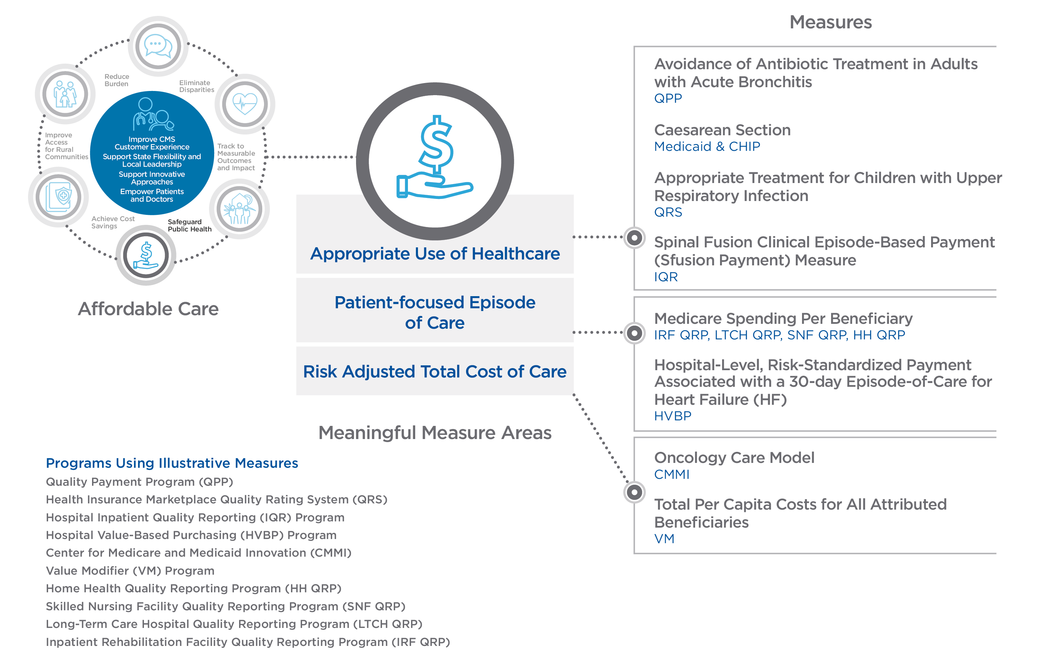
Make Care Affordable (2 of 2)

