Slide 1

National Quality Forum: Measure Evaluation Criteria

Slide 2

Vision and Goals

Slide 3
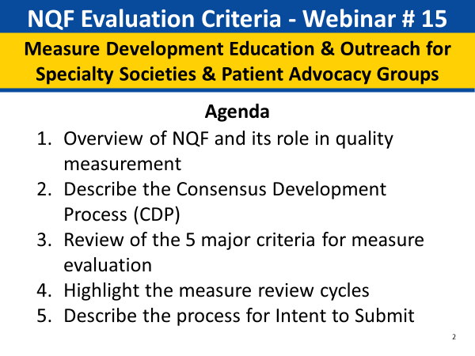
NQF Evaluation Criteria

Slide 4
National Quality Forum’s Measure Evaluation Criteria
August 8, 2018

Slide 5



Presenters with photos
Kyle Cobb, MS
Senior Director
Jean-Luc Tilly, Senior Manager, Data Analytics
Katie Goodwin, Senior Project Manager

Slide 6

About NQF
Our mission is to lead national collaboration to improve health and healthcare quality through measurement.
NQF is a non-profit, nonpartisan, membership-based organization that works to catalyze improvement in healthcare.
Notes:
The National Quality Forum (NQF) was established in 1999 as a nonprofit, nonpartisan membership-based organization. NQF is recognized and funded in part by Congress and entrusted with the important responsibility of bringing together various public and private sector organizations to reach consensus on how to measure quality in healthcare.

Slide 7
What We Do
NQF achieves its mission through projects that:
Set standards by endorsing measures through the Consensus Development Process (CDP).
Recommend measures for use in payment and public reporting programs, such as Medicaid and Medicare programs.
Accelerate quality improvement priorities.
Advance electronic measurement.
Provide information and tools to help healthcare decision-makers.
Notes:
The role of NQF is to convene groups of experts from different perspectives to make decisions as a group with multi-stakeholder representation and perspectives. Convening is at the heart of all of NQF’s work. This presentation is focusing on the evaluation criteria used to determine endorsement of measures that go through the consensus development process (CDP).

Slide 8
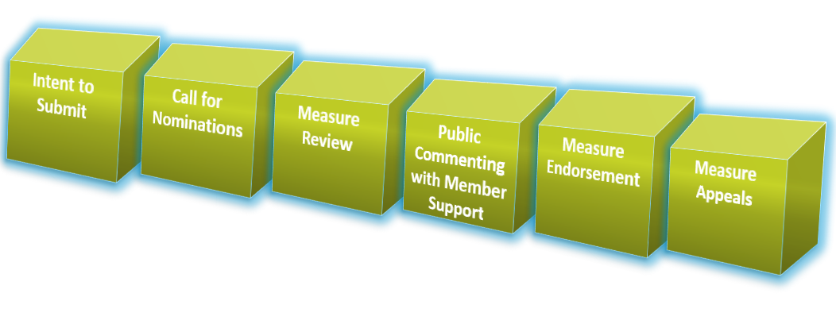
NQF Consensus Development Process
More info about NQF’s CDP Process
Notes:
A high-level overview of steps within the CDP:
A six-step process, including Intent to Submit and a Call for Nominations. There are 15 standing committees working on CDP projects organized by topic area which oversee over 600 NQF-endorsed measures across these clinical areas — as well as evaluate new measures. The third step is a measure review where standing committees will evaluate measures against the evaluation criteria and make recommendations for endorsement. All recommendations go through a public commenting period, and NQF members can express their support/non-support of the measures under review.
The fifth step is measure endorsement where the Consensus Standards Approval Committee (CSAC) finalizes the endorsement decision of a measure. Finally, all endorsed measures go through a 30-day appeals period where members of the public can file an appeal.

Slide 9
NQF Measure Evaluation Criteria for Endorsement
NQF endorses measures for accountability applications (public reporting, payment programs, accreditation, etc.) as well as quality improvement.
Standardized evaluation criteria
Criteria have evolved over time in response to stakeholder feedback
The quality measurement enterprise is constantly growing and evolving – greater experience, lessons learned, expanding demands for measures – the criteria evolve to reflect the ongoing needs of stakeholders
Notes:
NQF endorsement is intended to identify measures most likely to facilitate achievement of efficient, high-quality healthcare for patients.
To determine whether a measure should be endorsed by NQF, a standing committee evaluates the measure against NQF’s standard measure evaluation criteria. These criteria have evolved over time to reflect the input of a wide variety of stakeholders and the needs indicated by those stakeholders for the measures that will hold people accountable for the care that they deliver. The standard criteria foster consistency and predictability for measure developers and for those using NQF-endorsed measures.

Slide 10
Major Endorsement Criteria
Importance to Measure and Report: Goal is to measure those aspects with greatest potential of driving improvements; if not important, the other criteria are less meaningful (must-pass)
Reliability and Validity-scientific Acceptability of Measure properties : Goal is to make valid conclusions about quality; if not reliable and valid, there is risk of improper interpretation (must-pass)
Feasibility: Goal is to, ideally, cause as little burden as possible; if not feasible, consider alternative approaches
Usability and Use: Goal is to use for decisions related to accountability and improvement; if not useful, probably do not care if feasible
Comparison to Related or Competing Measures
Notes:
NQF’s criteria are organized around five major concepts, with subcriteria that further describe how the main criteria are demonstrated. The criteria are arranged in a hierarchy for review and evaluation.
For each of the standard criteria, several subcriteria delineate how to demonstrate that the major criteria are met. NQF’s criteria parallel best practices for measure development; for example, begin with identifying what is important to measure, and later what is feasible. Most criteria and subcriteria involve a matter of degree rather than an all-or-nothing determination as this requires both evidence and expert judgment.
The major endorsement criteria will be discussed in more detail throughout this presentation.

Slide 11
Criterion #1: Importance to Measure and Report
1. Importance to measure and report - Extent to which the specific measure focus is evidence-based and important to making significant gains in healthcare quality where there is variation in or overall less-than-optimal performance.
1a. Evidence: the measure focus is evidence-based
1b. Opportunity for Improvement: demonstration of quality problems and opportunity for improvement, i.e., data demonstrating considerable variation, or overall less-than-optimal performance, in the quality of care across providers; and/or disparities in care across population groups
1c. Quality construct and rationale (composite measures only)
Notes:
The first criterion reflects the goal of measuring those aspects with the greatest potential of driving improvements. These measures are evidence-based and reflect variation in performance, overall less-than-optimal performance, or disparities. This criterion allows for distinction between that which is important to do in clinical practice versus those that rise to the level of importance required for a national performance measure. NQF considers criterion number one and its associated subcriteria as paramount. This criterion and both of its subcriteria are must-pass criteria.

Slide 12
Subcriterion 1a: Evidence
Outcome Measures
Empirical data demonstrate a relationship between the outcome and at least one healthcare structure, process, intervention, or service. If not available, wide variation in performance can be used as evidence, assuming the data are from a robust number of providers and results are not subject to systematic bias.
Structure, Process, Intermediate Outcome Measures
The quantity, quality, and consistency of the body of evidence underlying the measure should demonstrate that the measure focuses on those aspects of care known to influence desired patient outcomes
Empirical studies (expert opinion is not evidence)
Systematic review and grading of evidence
Clinical Practice Guidelines – variable in approach to evidence review
For measures derived from patient (or family/parent/etc.) report:
Evidence should demonstrate that the target population values the measured outcome, process, or structure and finds it meaningful.
Current requirements for structure and process measures also apply to patient-reported structure/process measures.
Notes:
Subcriterion 1a is evidence. This subcriterion addresses the question of whether there is adequate empirical evidence to support a measure for use as a national consensus standard. The assumption underlying this subcriterion is that use of limited resources for measuring and reporting a measure are justified only if there is unambiguous evidence that it can facilitate gains in quality and health. For many healthcare quality measures, the evidence will be that of clinical effectiveness and a link to desired health outcomes. The strength of such evidence is related to its quantity, quality, and consistency from the relevant body of evidence.

Slide 13
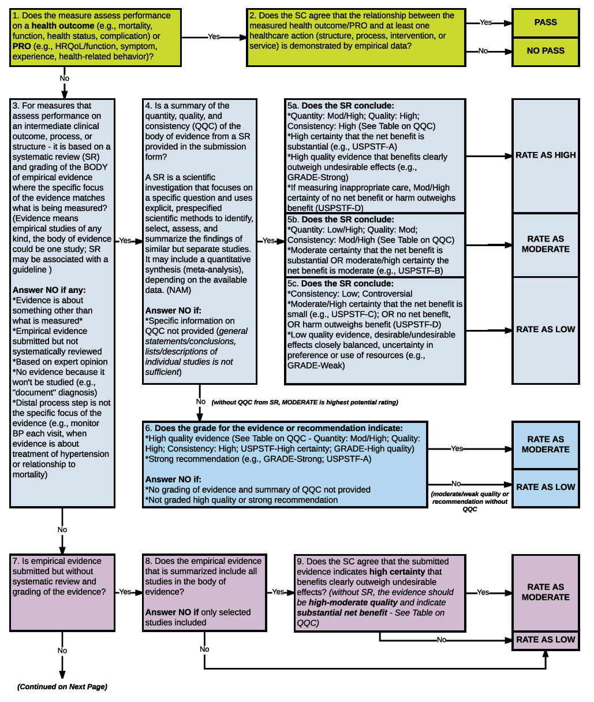
Rating Evidence: Algorithm #1 – Page 34
Notes:
NQF has created guidance for evaluating the clinical evidence. The algorithm was designed to assist committee members in determining the appropriate rating for meeting this subcriterion. Several key points for evaluating evidence:
• Evaluation of the evidence subcriterion depends on the type of measure under consideration.
• Evidence should be presented about the relevant body of evidence, not selected individual studies.
• Measure developers will summarize a systematic review of the evidence assembled, reviewed, and graded by others.
• Expert opinion is not considered empirical evidence, but evidence is not limited to Randomized Control Trials (RCTs).
• Measures with inconsistent/conflicting evidence should not pass the evidence subcriterion.
• When evaluating the quality of the evidence, consider the following:
o The study design itself (e.g., RCT, non-RCT) or flaws in the design or conduct of the study (e.g., lack of allocation concealment or blinding; large losses to follow-up; failure to adhere to intention to treat analysis; stopping early for benefit; failure to report important outcomes)
o The directness/indirectness of evidence to measure as specified (e.g., regarding the population, intervention, comparators, and/or outcomes)
o Imprecision in study results (i.e., wide confidence intervals due to few patients or events)
Under limited circumstances, an exception to the evidence subcriterion may be invoked and evaluated according to the evidence algorithm.

Slide 14
Subcriterion 1b: Performance Gap
1b. Opportunity for Improvement: demonstration of quality problems and opportunity for improvement, i.e., data demonstrating considerable variation, or overall less-than-optimal performance, in the quality of care across providers; and/or
disparities in care across population groups
Notes:
Because the measurement enterprise is resource intensive, NQF’s position is to endorse measures that address areas of known gaps in performance. Opportunity for improvement can be demonstrated by data that indicate overall poor performance in the activity or outcome targeted by the measure, substantial variation in performance across providers, or variation in performance for certain subpopulations such as disparities in care.
Occasionally, measures being evaluated for continued endorsement may reflect a high level of performance across all providers and for all population subgroups — topped out. Such measures previously would not be considered as meeting the performance gap subcriterion and thus might not be granted continued endorsement. The standing committee may, in certain circumstances, recommend those measures for inactive endorsement with reserve status. Use of the reserve status should be applied only to highly credible, reliable, and valid measures that have high levels of performance due to quality improvement actions.

Slide 15
Subcriterion 1c: Composite Quality Construct and Rationale
1c. Composite Quality Construct and Rationale: The quality construct and rationale should be explicitly articulated and logical; a description of how the aggregation and weighting of the components is consistent with the quality construct and rationale also should be explicitly articulated and logical.
Notes:
A composite performance measure is a combination of two or more component measures, each of which individually reflects quality of care, into a single performance measure with a single score. The types of measures that will/will not be considered composite performance measures for purposes of NQF measure submission, evaluation, and endorsement are listed in the section on composites measures in the Measure Evaluation Criteria and Guidance document.
The first step in developing a composite performance measure should be to articulate a coherent quality construct and rationale to guide construction of the composite. Once this is determined, the developer should select which component measures will be included in the composite measure and determine how those components will be combined. This subcriterion allows measure developers to "tell the story" behind their composite performance measure. Developers are asked to describe the quality construct, which should include the following:
overall area of quality
component measures that are included in the composite performance measure
conceptual relationships between each component and the overall composite
relationships among the component measures (e.g., whether they are correlated or not, processes that are expected to lead to better outcomes)
Developers also should describe the rationale underlying the composite performance measure, including a discussion of how the composite performance measure provides added value over and above what is provided by the component measures individually. Finally, they should describe how the method for combining the component measures fits with the quality construct and rationale that they have articulated.

Slide 16
Criterion #1: Importance to Measure and Report Criteria emphasis is different for new vs. maintenance measures
New measures | Maintenance measures
Evidence – Quantity, quality, consistency (QQC) Established link for process measures with outcomes | DECREASED EMPHASIS: Require measure developer to attest evidence is unchanged evidence from last evaluation; Standing Committee to affirm no change in evidence IF changes in evidence, the Committee will evaluate as for new measures
Gap – opportunity for improvement, variation, quality of care across providers | INCREASED EMPHASIS: data on current performance, gap in care and variation
Notes:
NQF’s measure evaluation criteria applies to both maintenance and new measures; however, this slide highlights how the the criteria emphasis differs between the two.
There are some differences between new measures and maintenance measures. We have more emphasis on looking at evidence for new measures and links between the process and outcomes for outcome measures. For maintenance measures it is decreased, but this is touched upon around performance gaps, in that with maintenance measures we want to continue to see some type of performance gap or variation.

Slide 17
Criterion #2: Reliability and Validity–Scientific Acceptability of Measure Properties
Extent to which the measure, as specified, produces consistent (reliable) and credible (valid) results about the quality of health care delivery
2a. Reliability (must-pass)
2b. Validity (must-pass)
Notes:
17
17
Once the standing committee agrees that a measure is “important to measure and report,” it will then consider the scientific properties of the measure. The second evaluation criterion, “scientific acceptability of measure properties” reflects NQF's view that performance measures must demonstrate sound measurement science. They must be both reliable and valid. Both the reliability and validity subcriteria under the scientific acceptability criterion are must-pass subcriteria; if both of these are not met, then the measure cannot be endorsed.
The criterion is meant to reflect the extent to which the measure, as specified, produces consistent and credible results about the quality of care. The focus of this criterion is measurement science, not clinical science. Specifically, this criterion addresses the basic measurement principles of reliability and validity. This can help to address the following questions:
• Are the specifications clear so that everyone will calculate the measure in the same way?
• Is the variation between providers primarily due to real differences? Is it because there is a lot of noise in the measurement?
• Is the measure actually measuring what it is intended to measure (i.e., quality of care)?
• Do the results of the measurement allow for correct conclusions about quality of care?
Use of measures that are unreliable or invalid could result in inconsistent measurement, inaccurate measurement, and measurement that cannot differentiate providers, and/or measurement that lead to wrong conclusions about the quality of care provided. The consequences of using unreliable/invalid measures can be considerable — waste of resources used in data collection, reporting/reacting to results; misinformation, misdirection, or even unintended harmful consequences for patients. The use of unreliable or invalid measures will undermine confidence in measures among providers and consumers of healthcare.
Reliability and validity are not all-or-none properties; they are a matter of degree. Reliability and validity are not static and can vary with different conditions of using the measure. In order to be valid, a measure must be reliable, but reliability does not guarantee validity.

Slide 18
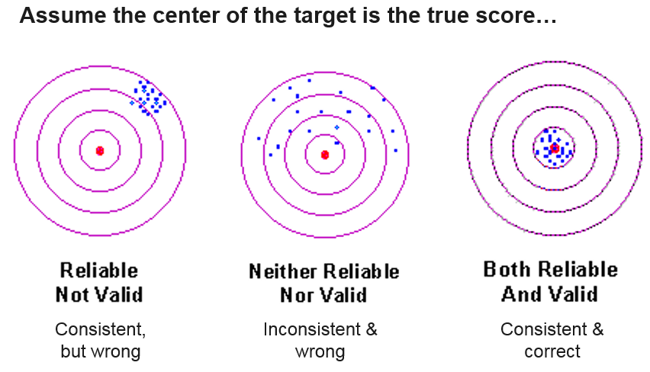
Reliability and Validity
Notes:
18
This bullseye graphic illustrates the concepts of reliability and validity of measurement.
The center of the target is the concept being measured (e.g., percentage of facilities that provide aspirin to heart attack patients within 24 hours of arrival). Each dot on the target represents a measurement. In the first target, all of the measurements are quite similar and consistent, but do not do a very good job of hitting the target. This portrays a measure that is reliable, but not valid. In the second target, the measurements are not very close to each other or to the center of the target. This portrays a measure that is neither reliable nor valid. In the third target, all of the measurements are close to each other and to the center of the target. This portrays a measure that is both valid and reliable. In order to be valid a measure must be reliable; however, reliability does not guarantee validity.

Slide 19
Criterion #2a: Reliability
Extent to which the measure, as specified, produces consistent (reliable) results about the quality of health care delivery.
2a. Reliability (must-pass)
2a1. Precise specifications including exclusions
2a2. Reliability testing—data elements or measure score
Notes:
19
19
Empirical evidence of reliability and validity is expected. Reliability and validity are demonstrated for the measure as specified, and not the measure concept.
NQF is flexible on the types of testing we accept, rather than prescriptive. There are not specific thresholds that must be met, but we do ask that results be within acceptable norms. Testing is required, because insufficient evidence and lack of testing cannot be evaluated or considered for endorsement.
Reliability and validity can be tested for the data elements and/or the measure score
Data elements include things like:
Numerator (e.g., is number of laboratory tests)
Denominator (e.g., patients with diabetes)
Generally not focused on the reliability of the physiologic test
Measure score is something like:
Observed/Expect total cost per AMI episode
Testing can be done on samples, and it doesn’t need to be done on every single patient in a hospital in an entire year.
Note for reliability testing in that if a measure has empirical evidence of data element validity, separate reliability of data elements is not required, because the data element validity is sufficient to also demonstrate reliability. For results of their reliability tests, NQF asks for both the actual statistical results of the tests, as well as some commentary about what the statistics mean. We look for both data and narrative to explain the data.

Slide 20
Reliability Testing - Key Points
Reliability of the measure score refers to the proportion of variation in the performance scores due to systematic differences across the measured entities in relation to random variation or noise (i.e., the precision of the measure).
Example - Statistical analysis of sources of variation in performance measure scores (signal-to-noise analysis)
Reliability of the data elements refers to the repeatability/reproducibility of the data and uses patient-level data
Example –inter-rater reliability
Consider whether testing used an appropriate method and included adequate representation of providers and patients and whether results are within acceptable norms
Notes:
20
Precise specifications provide the foundation for achieving consistency, but not empirical evidence of reliability. Has it been demonstrated that variability across entities is due to true difference (signal) vs. error (noise)? In Section 2a-1, you will see precise specifications of the measure. On the first page of the form we show the general numerator and denominator statements, but in this section the developer gives all the details under those general statements.
Exclusions to the denominator. As measures are evaluated, NQF asks committees to consider these exclusions of people who are not in the measure and determine whether or not they ring true. How the measure is stratified or risk adjusted — note that stratification/risk adjustment is typically seen with outcome measures. Note also under that section the developer is telling you that the measure score is a rate or proportion, and that higher scores reflect better quality. By sources of data, we mean what kind of data they have specified the measure as relying upon. Here the data can come from electronic clinical data, EHRs, or paper records.

Slide 21
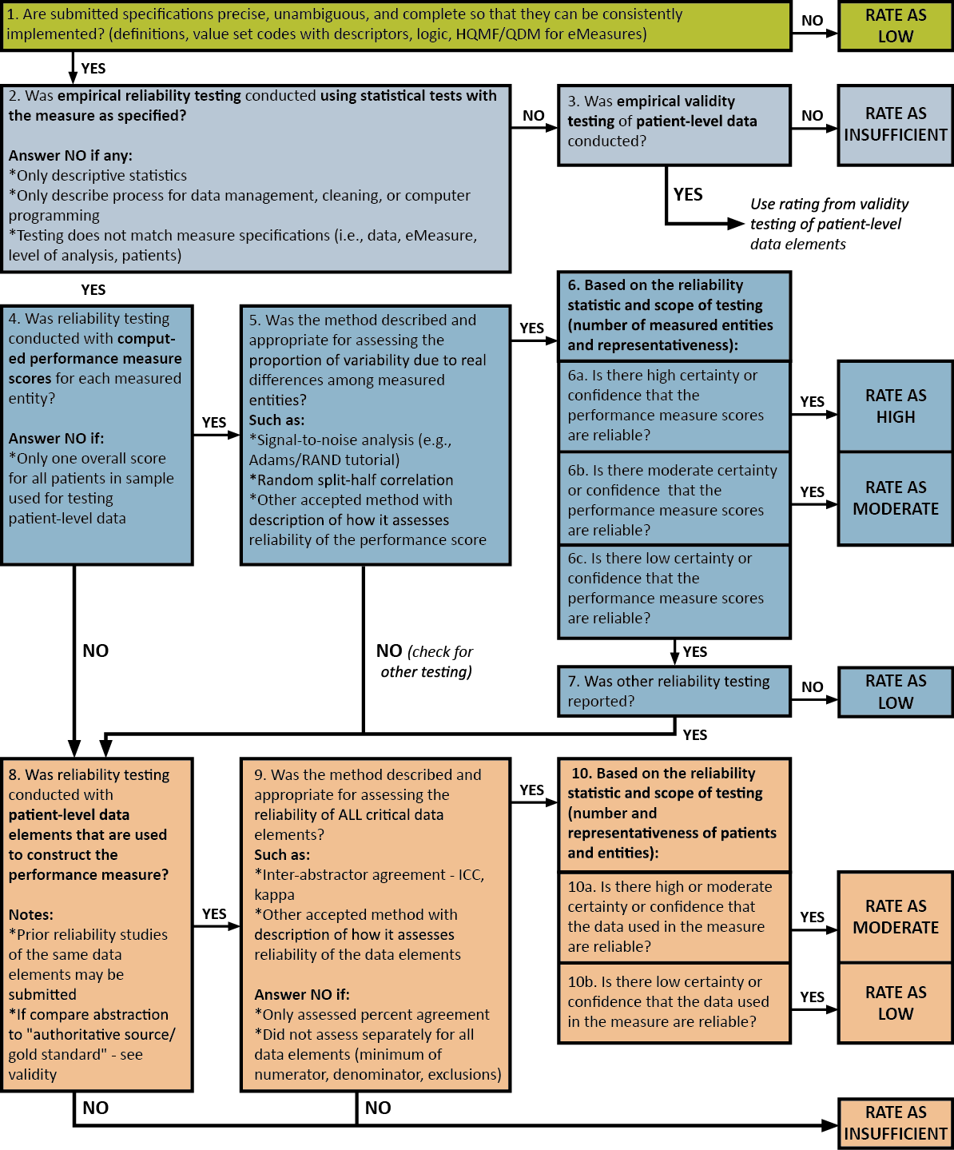
Rating Reliability: Algorithm #2
Notes:
This is the reliability algorithm that we ask committees to walk through. It tells us if a measure is high, moderate, low, or insufficient on reliability. Measures must achieve either a high or a moderate to continue to move forward through the evaluation process. If a measure is rated low or insufficient, it does not pass reliability.

Slide 22
Criterion #2b: Validity
Extent to which the measure, as specified, produces credible (valid) results about the quality of health care delivery.
2b. Validity (must-pass)
2b1. Validity testing—data elements or measure score
2b2. Justification of exclusions—relates to evidence
2b3. Risk adjustment—typically for outcome/cost/resource use
2b4. Identification of differences in performance
2b5. Comparability of data sources/methods
2b6. Missing data
Notes:
22
22
Reliability and validity are not all-or-none properties. They are a matter of degree and reliability and validity are not static. They can vary with different conditions of using the measure. In order to be valid, a measure must be reliable; however, reliability does not guarantee validity and so we also look to empirical testing for the validity of a measure.
As with reliability, NQF is flexible in the types of testing considered acceptable. We do not set thresholds, but we look for results within acceptable norms. We cannot consider measures that do not have validity testing.

Slide 23
Validity testing - Key Points
Empirical Testing
Measure score – Assesses a hypothesized relationship of the measure results to some other concept; assesses the correctness of conclusions about quality.
Data element – Assesses the correctness of the data elements compared to a “gold standard.”
Face Validity
Subjective determination by experts that the measure appears to reflect quality of care.
Empirical validity testing is expected at time of maintenance review; if not possible, justification is required.
Requires systematic and transparent process, by identified experts, that explicitly addresses whether performance scores resulting from the measure as specified can be used to distinguish good from poor quality. The degree of consensus and any areas of disagreement must be provided/discussed.
Notes:
NQF prefers statistical validity testing, but for new measures will accept face validity. For empirical validity testing, we either assess the measure score — relationship of the results to another concept — or data elements and how correct the data elements are compared to a gold standard. Face validity is a subjective decision by a group of experts that the measure tells you something about the quality of the care.

Slide 24
Evaluating Scientific Acceptability – Key Points
Empirical analysis to demonstrate the reliability and validity of the measure as specified, including analysis of issues that pose threats to the validity of conclusions about quality of care such as exclusions, risk adjustment/stratification for outcome and resource use measures, methods to identify differences in performance, and comparability of data sources/methods.
Notes:
This is a summary of what NQF looks for when assessing scientific acceptability.

Slide 25
Threats to Validity
Conceptual
Measure focus is not a relevant outcome of healthcare or not strongly linked to a relevant outcome
Unreliability
Generally, an unreliable measure cannot be valid
Patients inappropriately excluded from measurement
Differences in patient mix for outcome and resource use measures
Measure scores that are generated with multiple data sources/methods
Systematic missing or “incorrect” data (unintentional or intentional)
Notes:
25
Threats to validity are ways that measures could be negatively impacted and therefore invalid. For example, if you excluded the wrong patients, or if you did not manage missing data, you would not accurately assess the quality of care given. If a measure can be collected using multiple data sources, you need to ensure the same result regardless of which data source.
Developers are asked to respond to questions on how they thought about potential threats to validity and assess the impact of these threats on their measure. The committees are asked whether developers addressed them adequately.

Slide 26
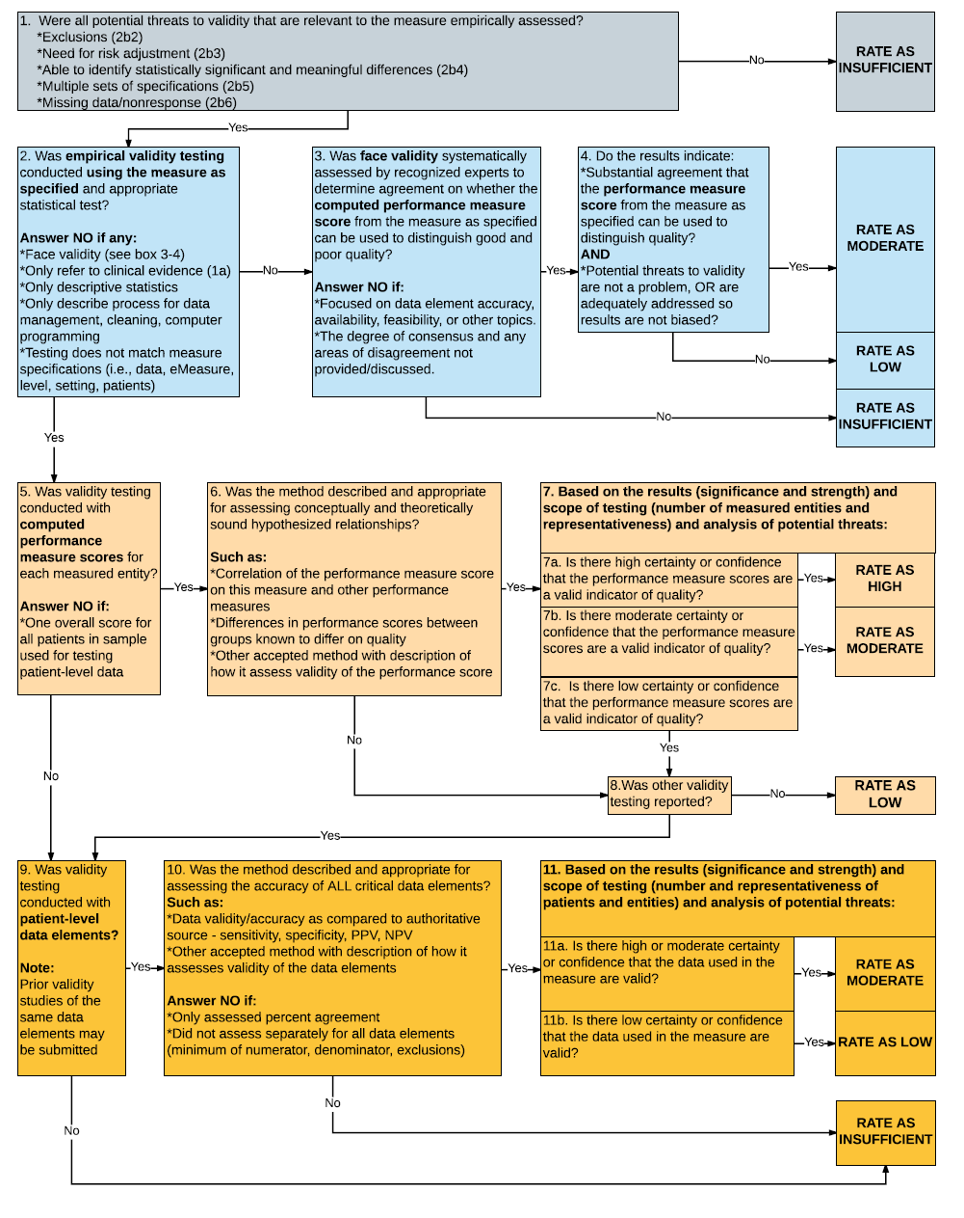
Rating Validity: Algorithm #3
Notes:
This is the validity algorithm we ask committees to walk through. It tells you whether a measure is high, moderate, low, or insufficient on validity.

Slide 27
Composite Measures: Empirical Analysis to Support Composite Construction Approach
2c. For composite performance measures, empirical analyses support the composite construction approach and demonstrate that:
2c1. the component measures fit the quality construct and add value to the overall composite while achieving the related objective of parsimony to the extent possible; and
2c2.the aggregation and weighting rules are consistent with the quality construct and rationale while achieving the related objective of simplicity to the extent possible.
If empirical testing was not conducted or results not adequate, justification must be submitted and accepted.
Notes:
Composite measures combine two or more component measures, each of which individually reflects quality of care, into a single performance measure with a single score. They must demonstrate reliability and validity of the composite measure score, not just the component measures.

Slide 28
Criterion #2: Scientific Acceptability
New measures | Maintenance measures
Measure specifications are precise with all information needed to implement the measure | NO DIFFERENCE: Require updated specifications
Reliability Validity (including risk-adjustment) | DECREASED EMPHASIS: If prior testing adequate, no need for additional testing at maintenance with certain exceptions (e.g., change in data source, level of analysis, or setting) Must address the questions regarding use of social risk factors in risk-adjustment approach
Notes:
This is an overview of what we look for in the differences between new and maintenance measures for the scientific acceptability criteria. For maintenance measures, we are looking for updated validity testing if there was no empirical testing reviewed in the past. If prior testing was adequate, we do not reassess. If there is updated testing, the committee will review it again.

Slide 29
Criterion #3: Feasibility - Key Points
Extent to which the required data are readily available, retrievable without undue burden, and can be implemented for performance measurement.
3a: Clinical data generated during care process
3b: Electronic sources
3c: Data collection strategy can be implemented
Notes:
29
29
The feasibility criterion is not a must-pass. Assuming that a measure meets all the subcriteria for importance and scientific acceptability, feasibility generally should not be the only reason that a measure would not be endorsed. In fact, feasibility may improve with broader implementation, and ways to improve feasibility should be sought out for important and scientifically sound performance measures.
3a. For clinical measures, the required data elements are routinely generated and used during care delivery — blood pressure, lab test, diagnosis, medication order.
3b. The required data elements are available in electronic health records (EHRs) or other electronic sources. If the required data are not in electronic health records or existing electronic sources, a credible near-term path to electronic collection is specified.
3c. Demonstration that the data collection strategy — source, timing, frequency, sampling, patient confidentiality, costs associated with fees/licensing of proprietary measures — can be implemented, e.g., already in operational use, or testing demonstrates that it is ready to put into operational use. Well-known and more seasoned measures tend to have feasible established data collection strategies. With newer measures, committee members must ask:
What is the developer’s plan?
How does the developer expect to collect this data?
Does that plan seem feasible?
Is there undue burden?

Slide 30
Criterion #4: Usability and Use - Key Points
Extent to which potential audiences (e.g., consumers, purchasers, providers, policymakers) are using or could use performance results for both accountability and performance improvement to achieve the goal of high-quality, efficient healthcare for individuals or populations.
Use (4a) Now must-pass for maintenance measures
4a1: Accountability and Transparency: Performance results are used in at least one accountability application within three years after initial endorsement and are publicly reported within six years after initial endorsement.
4a2: Feedback by those being measured or others: Those being measured have been given results and assistance in interpreting results; those being measured and others have been given opportunity for feedback; the feedback has been considered by developers.
Usability (4b)
4b1: Improvement: Progress toward achieving the goal of high-quality, efficient healthcare for individuals or populations is demonstrated.
4b2: Benefits outweigh the harms: The benefits of the performance measure in facilitating progress toward achieving high-quality, efficient healthcare for individuals or populations outweigh evidence of unintended negative consequences to individuals or populations (if such evidence exists).
Notes:
The usability and use criterion is not designated as must-pass for initial endorsement, however the subcriteria (4a and 4b) is must-pass when evaluating measures for continued endorsement. The expectation is that endorsed measures will not only be used, but eventually lead to an improvement in patient outcomes.

Slide 31
Criteria #3-4: Feasibility and Usability and Use
New measures | Maintenance measures
Feasibility
Measure feasible, including eMeasure feasibility assessment | NO DIFFERENCE: Implementation issues may be more prominent
Usability and Use
Use: used in accountability applications and public reporting Usability: impact and unintended consequences | INCREASED EMPHASIS: Much greater focus on measure use and usefulness, including both impact and unintended consequences
Notes:
The biggest difference in evaluation criteria for new and maintenance measures is that for maintenance measures there is an increased emphasis on use.

Slide 32
Criterion #5: Related or Competing Measures
5a. The measure specifications are harmonized with related measures OR the differences in specifications are justified.
5b. The measure is superior to competing measures (e.g., is a more valid or efficient way to measure) OR multiple measures are justified.
If a measure meets the four criteria and there are endorsed/new related measures (same measure focus or same target population) or competing measures (both the same measure focus and same target population), the measures are compared to address harmonization and/or selection of the best measure.
Notes:
If the committee agrees that a measure has met the first four NQF evaluation criteria, the committee will also evaluate that measure in relation to similar measures – recognizing that the current measure landscape contains an abundance of measures, including some that could be considered duplicative. Such duplicative measures may increase data collection burden and/or create confusion or inaccuracy in interpreting performance results. The “comparison to related or competing measures” criterion requires careful consideration of such similar measures, with the goal of endorsing only the best-in-class measures.

Slide 33
NQF Scientific Methods Panel
The Scientific Methods Panel consists of over 20 individuals with expertise in statistics, risk adjustment, measure testing, psychometrics, economics, composite measures and eMeasures
Purpose:
Promote more consistent evaluations of Scientific Acceptability criterion
Reduce standing committee burden
Promote greater participation of consumers, patients, and purchasers on NQF standing committees
Notes:
The NQF scientific methods panel is co-led by NQF staff and two co-chairs. Each panel member serves an initial term of either two or three years, with an optional three-year term to follow. The Consensus Standards Approval Committee (CSAC) oversees the work of the scientific methods panel.

Slide 34
Methods Panel Charge
Conduct evaluation of complex measures only for the Scientific Acceptability criterion, with a focus on a measure’s reliability and validity analyses and results
Serve in an advisory capacity to NQF on methodologic issues, including those related to measure testing, risk adjustment, and measurement approaches.
Notes:
NQF is working with the Scientific Methods Panel to possibly come up with thresholds or different cut points to help systematize the reliability evaluations, or other publish more explicit guidance on the kind of risk adjustment approaches we will accept.

Slide 35
Evaluation of the Scientific Acceptability Criterion
Provide evaluation and ratings for reliability and validity subcriteria
This information will help to inform the standing committee’s endorsement decision
The Scientific Methods Panel will not render endorsement recommendations
Standing committees may raise concerns with the specifications of the measure or with potential threats to validity (e.g., selection of variables for risk adjustment model) and can overturn the Scientific Methods Panel ratings

Slide 36
Complex vs. Non-Complex Measures
Complex Measures
Outcome measures, including intermediate clinical outcomes
Instrument-based measures (e.g., PRO-PMs)
Cost/resource use measures
Efficiency measures (those combining concepts of resource use and quality)
Composite measures
Non-Complex Measures
Process measures
Structural measures
Previously endorsed complex measures with no changes/updates to the specifications or testing
Notes:
If a measure is defined as complex, it will be reviewed by the methods panel. If it is non-complex, the evaluation is conducted by staff.

Slide 37
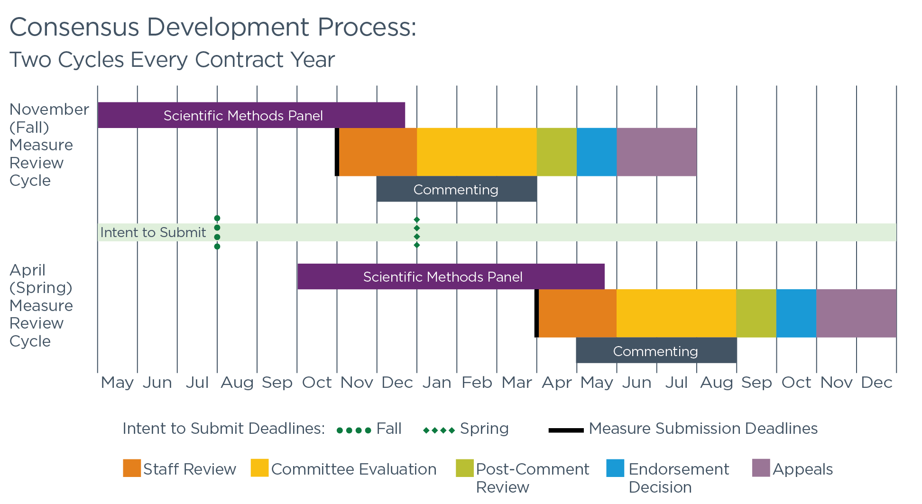
Measure Review: Two Cycles Per Year
Notes:
This new system runs two cycles every year across all 15 topic areas.
If a deadline is missed, one will never have to wait more than six months. Generally, cycles are able to accommodate up to 50 measures. The first is the Intent to Submit deadline. You indicate that you are going to submit your measure and submit both the specifications of your measure and the testing information. The scientific methods panel then begins their work of evaluating the scientific acceptability of the measure. Other components of the measure submission — evidence, feasibility information, usability and use — are all submitted by a deadline that comes a little bit later.

Slide 38
Intent to Submit – Spring Cycle 2019
Measure stewards/developers notify NQF of their intent to submit a measure via an adapted Measure Submission Form
Objective:
Full implementation of new process
Track submission planning
Intent to Submit Deadline: January 2, 2019
Full Measure Submission Deadline: April 2019
Notes:
For the Spring 2019 cycle, the next Intent to Submit deadline is January 2, 2019. That is when you would submit your specifications and testing. The rest of the measure information would be submitted sometime in early April. Projects are sorted to three different cohorts, depending on the topic area, you would submit as of by April 1st, April 7th or April 15th.

Slide 39
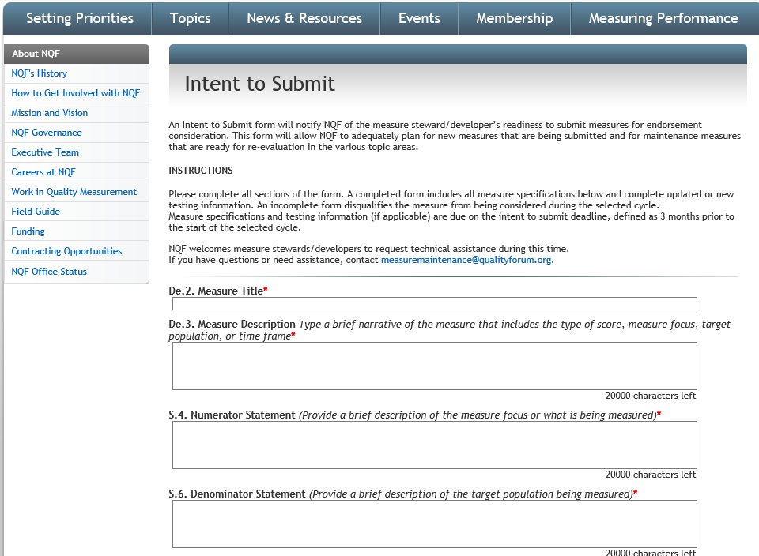
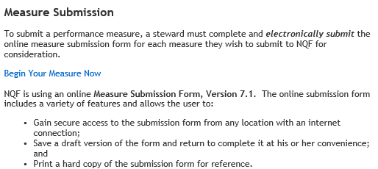
Intent to Submit, New Measures
New Measures:
Complete a measure submission form the NQF website: http://www.qualityforum.org/Measuring_Performance/Submitting_Standards.aspx
Populate information needed on the Intent to Submit page
Notes:
For new measures you will complete a new measure submission form. Once you have indicated the type of measure — single/paired, grouped, composite — you will immediately be taken to the Intent to Submit screen. Here you will complete the required information and press submit. Anytime after you hit submit, you may go back into your measure submission form and add in all of the other required information such as evidence, feasibility, use and usability, up to the measure submission deadline.

Slide 40
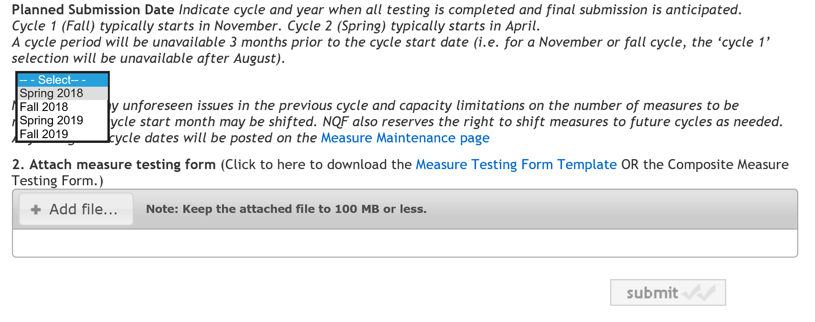
Intent to Submit – Spring 2019
Notes:
Here you may select the cycles. If for some reason you happen to have your materials prepared six months in advance, certainly you deserve some kind of commendation, but you can indicate that in the webform as well.

Slide 41

Intent to Submit – New Measures
Notes:
Here is a screenshot of where you would go on the website to submit a measure.

Slide 42
Intent to Submit, New Measures
Intent to Submit information needed:
Testing information is needed for all new measures and maintenance measures that have indicated updated testing data.
All information must be submitted by the Intent to Submit deadline
Planned submission date (cycle and year) Measure name Measure description Measure title Measure type Level of analysis Data source | Numerator/Denominator statement, details Stratification/risk adjustment Type and interpretation of score Calculation algorithm/measure logic Sampling Survey instrument/Data Dictionary Testing information
Notes:
This comprehensive list details all of the testing information that we ask for at the Intent to Submit deadline. It is all of the specification and testing information that you would be expected to provide. It ranges from everything from the numerator and denominator, but then also your sampling strategy, your risk adjustment, the calculation algorithms, et cetera.

Slide 43
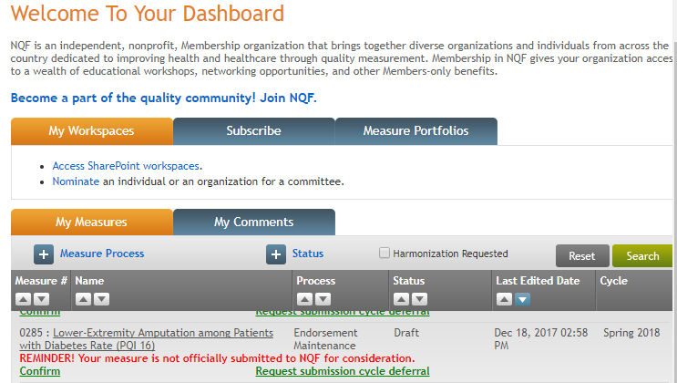
Intent to Submit (Continued)
Maintenance Measures:
Log in to your dashboard
Verify the specifications your measure is still accurate.
Upload your testing information using the latest NQF testing form (currently version 7.1)
Click “Save Draft” to Finalize the Intent to Submit
Notes:
For maintenance measures you simply log into your dashboard.
You would ensure that all of the basic specifications are still correct; upload your testing information with the latest testing attachment document and select submit. Anytime after you hit submit, you are able to go back into your measure submission form and add in all of the other required information such as evidence, feasibility, use and usability, up to the measure submission deadline.

Slide 44
Resources for Measure Developers
Refer to the NQF Submitting Standards web page for numerous resources specifically for developers:
Measure Developer Guidebook: general process guidance
Measure Evaluation Criteria: detailed overview of NQF’s measure requirements
Submission deadlines: key dates for project/topic area measure submissions
Measure Developer Resource Library: includes recordings of past developer webinars
“What Good Looks Like”: sample measure submissions
Submitting Standards: includes guidance and reports on all of the major criteria
Notes:
Here are a variety of resources for measure developers. The submitting standards page contains all of the links that you see here, but more specifically we have a developer guidebook that answers a lot of FAQs. Should you require more detail on the criteria offered today, you are welcome to review our measure evaluation criteria document which runs several hundred pages and has a lot of specific examples.

Slide 45
General Reminders
Measure developer webinars offered monthly
Contact measuremaintenance@qualityforum.org for general inquiries or questions related to the CDP, measure evaluation criteria, or technical assistance
Check your dashboard regularly and verify the correct measure developer/steward contacts are listed
Seek technical assistance from NQF staff early and often
Notes:
You may attend our monthly webinars to ensure you are up-to-date with NQF timelines and process changes. If the dashboard contact information changes, please notify NQF immediately via the appropriate project mailbox. NQF uses the contacts listed in the dashboard to send updates and reminders about deadlines related to your measure.
Seek technical assistance (TA) from NQF staff early and often. Measure submission deadlines are firm and extensions will not be granted. If you would like NQF staff to provide input on your draft submission, please contact the NQF project team and request technical assistance well in advance of the deadline.

Slide 46

Thank you

Slide 47

CMS Spotlight Opportunities

Slide 48
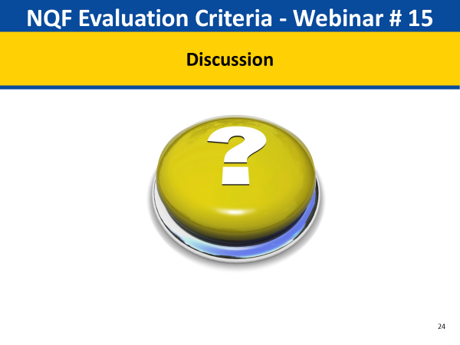
Discussion

Slide 49

Upcoming Webinar announcement and call for future topics

Slide 50
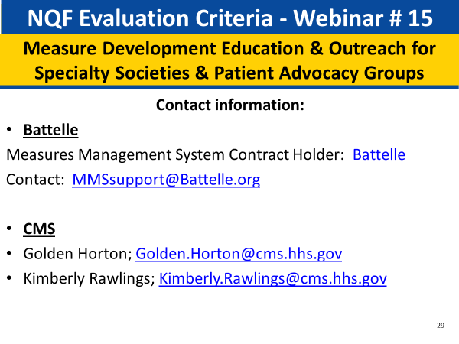
Contact Information

