Slide 1
Measure Development Education & Outreach for Specialty Societies & Patient Advocacy Groups
Webinar #12
Electronic Clinical Quality Improvement (eCQI) Resource Center Demonstration
Presenter:
Jessica Sanford, Ph.D.
May 30, 2018
12:00-1:00 PM ET

Slide 2
Vision and Goals: Webinar Series
Measure Development Education & Outreach for Specialty Societies & Patient Advocacy Groups
An ongoing process to engage clinical specialty societies and patient advocacy groups in quality measure development.
Elicit feedback that will help CMS design toolkits and enduring materials designed specifically for specialty societies and patient advocacy groups interested in measure development.
Education
Outreach
Frequent Communication
Enduring Materials
Dedicated Websites
Measure Development Roadmaps
Targeted Newsletters and Communication
Showcase Opportunities

Slide 3
eCQI Resource Center Webinar # 12
Measure Development Education & Outreach for Specialty Societies & Patient Advocacy Groups
Agenda Webinar # 12:
eCQI Resource Center Background
eCQMs for 2019 Reporting/Performance Overview
eCQI Resource Center Demonstration
eCQI Resource Center Contact Information
Questions and Suggestions
Upcoming Webinar Sessions

Slide 4
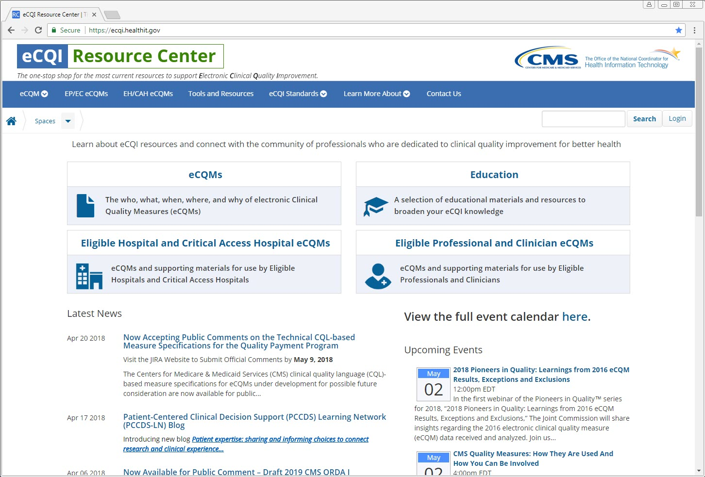
eCQI Resource Center Webinar # 12
One-stop shop for the most current resources to support electronic clinical quality improvement
Notes:
The Electronic Clinical Quality Improvement (eCQI)) Resource Center is the product of strategic planning and collaboration across CMS divisions, the Office of the National Coordinator for Health Information Technology (ONC), and input from other federal agencies. This Resource Center support federal quality improvement initiatives in hospitals and healthcare facilities across the country. It aims to provide users with information and tools to support implementing electronic clinical quality measures (eCQMs) that facilitate effective, safe, efficient, patient-centered, equitable and timely care. The eCQI Resource Center landing page was designed to serve as a one-stop shop for the most current resources supporting electronic clinical quality improvement efforts.
CMS is excited to offer this resource to better meet the needs of all involved in electronic clinical quality improvement efforts, including providers, measure developers, measure stewards, and health IT developers engaged in health IT-enabled quality improvement. The Resource Center website contains information about electronic clinical quality measures (eCQMs), the Quality Data Model (QDM), clinical decision support (CDS) and external resources related to eCQMs such as the ONC JIRA issue tracker, the Measure Authoring Tool (MAT) and the National Quality Strategy (NQS).

Slide 5
eCQI Resource Center Webinar # 12
eCQI Resource Center Background
The Resource Center serves as a one-stop-shop for the most current information to support electronic clinical quality improvement (eCQI).
This website has the most current news, events and resources related to electronic Clinical Quality Measure (eCQM) tools and standards.
A place to coordinate people and the activities around eCQI.
Notes:
The eCQI Resource Center is regularly updated and improved with additional functionality and resources as they become available. Recently, the site underwent a redesign to make information easier to find. Check back often as the site evolves to better meet your needs.

Slide 6
eCQI Resource Center Webinar # 12
eCQI Resource Center Background
Contains provides the most current resources for electronic clinical quality improvement, such as:
eCQMs
eCQI Standards
Clinical Quality Language (CQL)
Quality Data Model (QDM)
Quality Reporting Document Architecture (QRDA)
Tools and Resources
Education
Implementation Resources
Checklists
eCQM Measure Logic and Implementation Guidance
Technical Release Notes
Tools Library
Notes:
The eCQI Resource Center offers information about eCQM and eCQI standards, tools. and resources, as well as education and implementation resources. The updated eCQM specifications for the 2019 reporting period can be found on the eCQI Resource Center.

Slide 7
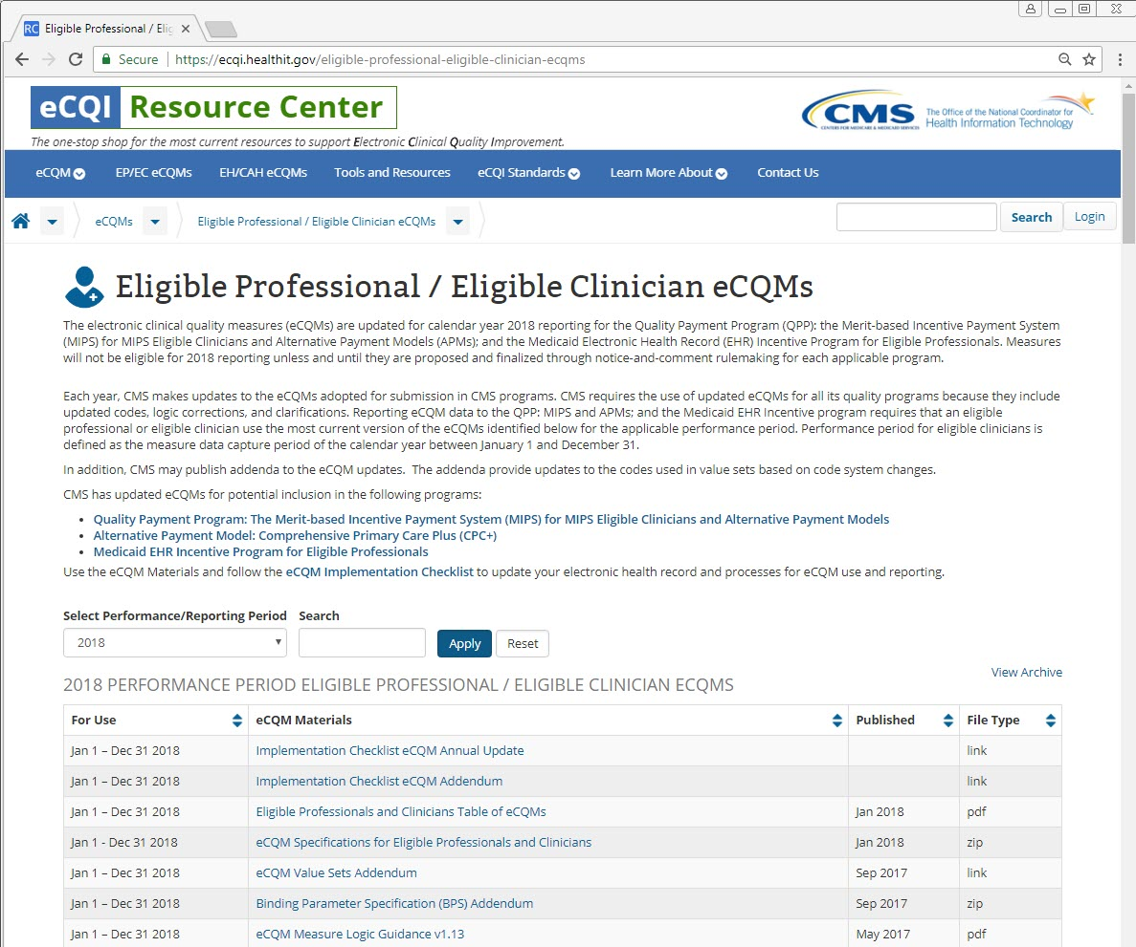
eCQI Resource Center Webinar # 12
Eligible Professional / Eligible Clinician eCQMs
https://ecqi.healthit.gov/ep
Notes:
A webpage is dedicated to eligible professional (EP) and eligible clinician (EC) eCQMs.

Slide 8
eCQI Resource Center Webinar # 12
Eligible Professional / Eligible Clinician eCQMs
Select 2019
https://ecqi.healthit.gov/ep
Notes:
The eCQMs for use in the 2019 reporting period can be found by selecting 2019 in the reporting period and clicking apply. The page will update with the corresponding eCQMs and materials available for 2019 reporting.

Slide 9
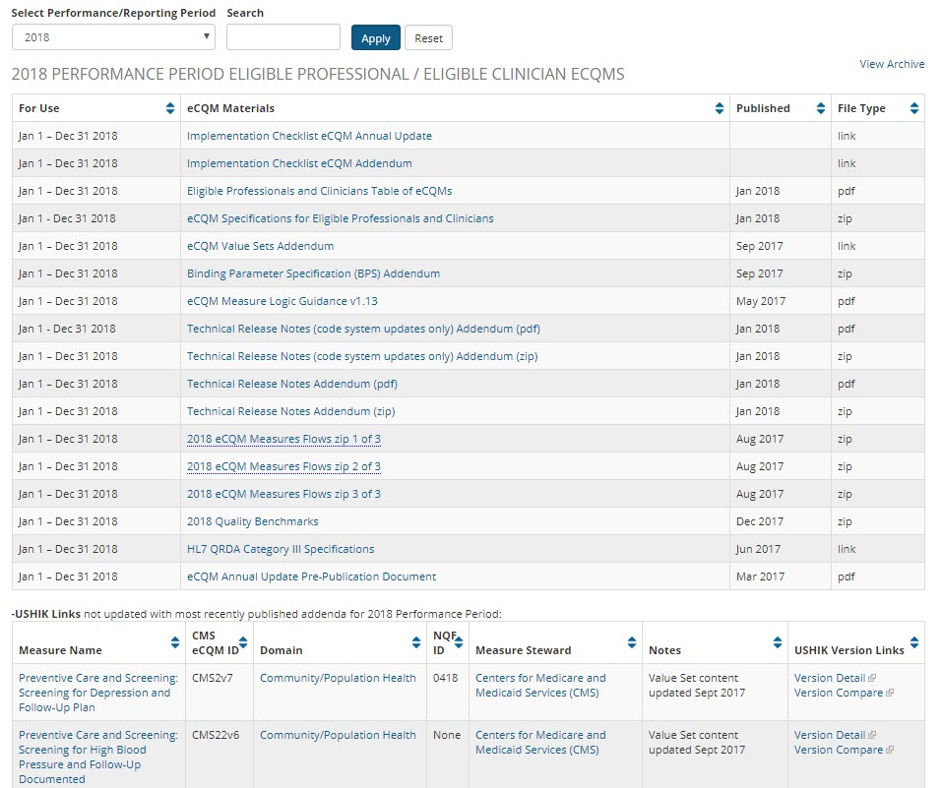
eCQI Resource Center Webinar # 12
Eligible Professional / Eligible Clinician eCQMs
eCQM Materials
eCQM Specifications
Technical Release Notes
Implementation Guides
QRDA Links
eCQM Table
Notes:
The eCQM materials include the implementation checklist, the eCQM specifications, eCQM measure logic and guidance document, technical release notes (TRNs), links to the Quality Reporting Document Architecture (QRDA) implementation guide and more. The eCQM table on this webpage is dynamic and can be sorted by various column headers by selecting the up and down arrows at the top of each column.

Slide 10
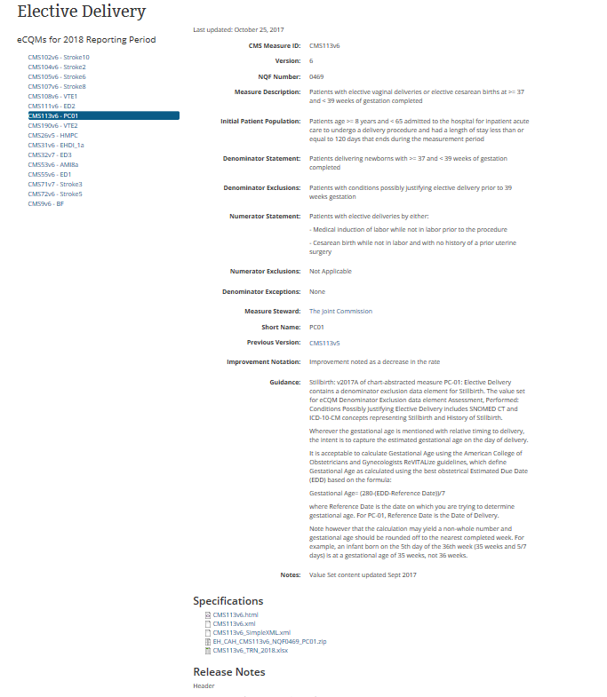
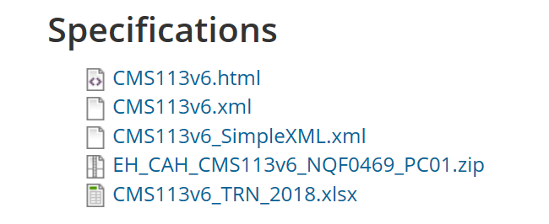
eCQI Resource Center Webinar # 12
Eligible Professional / Eligible Clinician eCQMs - Measure Detail
Downloadable specifications
https://ecqi.healthit.gov/ecqm/measures/cms113v6
Notes:
Each eCQM has a details page. Please note, individual specifications are available for download from these pages.

Slide 11
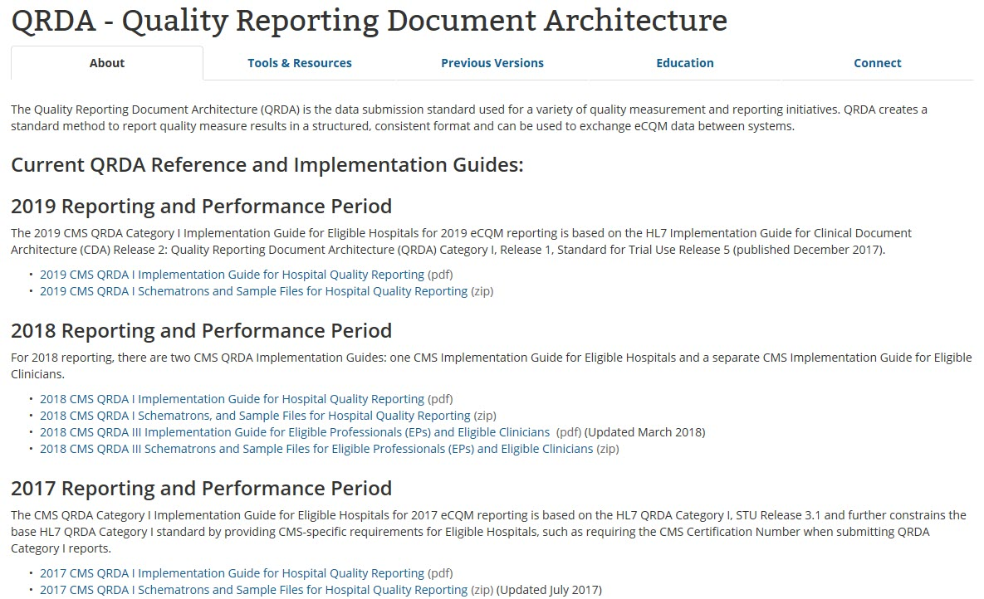
eCQI Resource Center Webinar # 12
Eligible Professional / Eligible Clinician eCQMs - QRDA
Find 2019 QRDA here and in eCQM Materials
https://ecqi.healthit.gov/qrda
Notes:
QRDA implementation guides and schematrons (rule-based validation language for making assertions about the presence or absence of patterns in XML trees) are available on the QRDA webpage on the eCQI Resource Center. You can also find these resources within the eCQM materials list located on the measures webpage.

Slide 12
eCQI Resource Center Webinar # 12
eCQI Resource Center Webinar # 12
Overview
This webinar will provide a demonstration of the electronic clinical quality improvement (eCQI) Resource Center. We will provide a high level overview:
The Home page
The electronic clinical quality measures (eCQM) page
Educational Resources
The Eligible Professionals and Eligible Clinicians page
The Eligible Hospital and Critical Access Hospitals page
Tools and Resources
eCQI Standards
Learn More About: focusing on CDS, FAQs, Engage, and Implementers
Advanced Search and the Contact Us page
Requesting a User Account and Subscribing to a topic area on the eCQI Resource Center
Notes:
The following is an overview of the eCQI Resource Center. Earlier this month, CMS published the eCQM Annual Update for 2019 Reporting and Performance Periods on the eCQI Resource Center. Recently, the website was updated to a tab format to improve its usability. Today we will review key sections and features of the website.

Slide 13
eCQI Resource Center Webinar # 12
https://ecqi.healthit.gov
Demonstration
Notes:
Live demonstration of the eCQI Resource Center website took place.

Slide 14
eCQI Resource Center Webinar # 12
Engage with eCQI
Provide feedback and suggestions to ecqi-resource-center@hhs.gov
Submit key eCQI news and events for highlighting on the eCQI Resource Center
Share the eCQI Resource Center with your peers and stakeholders
Add a link to the eCQI Resource Center from your website and include in your newsletters
Notes:
The hope is that the eCQI Resource Center will help to unify the eCQI community by connecting related activities. Your feedback is essential to our success. Users are encouraged to use the eCQI Resource Center and to provide feedback on electronic clinical quality improvement and program implementation resources to help ensure program success.

Slide 15
eCQI Resource Center Webinar # 12
Questions?

Slide 16
CMS Showcase Opportunities
Measure Development Education & Outreach for Specialty Societies & Patient Advocacy Groups
Reminder:
If you are currently developing quality measures that you would like to present to CMS contact the MMS Support Desk at MMSsupport@Battelle.org
Notes:
CMS also offers Spotlight Sessions to stakeholders who are developing measures for MIPS. If interested, selected stakeholders are given the opportunity to give a 30-40 minute presentation to CMS about their measure then receive feedback. It is meant to provide developers with a better understanding of the MIPS (merit based incentive payment system) program priorities and to discuss challenges and successes they have experienced going through the measure development process. Meetings can be held in-person at CMS, or virtually via WebEx. If this is of interest to you and you would like to present, please let us know via the email address listed on the slide. Please include Spotlight Session in the subject line. Someone will be in touch with you about getting a session scheduled.

Slide 17
CMS Measures under Consideration
Measure Development Education & Outreach for Specialty Societies & Patient Advocacy Groups
Reminder:
The opportunity to submit measures to CMS for consideration in a program ends in June.
June 1, 2018: MIPS-Quality measures are due
June 15, 2018: JIRA closes, no more submissions accepted

Slide 18
MACRA Newsletter
Measure Development Education & Outreach for Specialty Societies & Patient Advocacy Groups
Notes:
If you would like to be more connected, please consider subscribing to the monthly MACRA newsletter. To subscribe, please email us at MMSSupport@battelle.org and include MACRA newsletter in the subject line.

Slide 19
eCQI Resource Center Webinar # 12
Measure Development Education & Outreach for Specialty Societies & Patient Advocacy Groups
Planned Upcoming Webinars:
June 6, 2018; 2:00-3:00pm ET: Risk-Adjustment for Quality Measures
June 27, 2018; 2:00-3:00pm ET: Updates to CQL for eCQMs
Suggestions for future topics?
Email: MMSsupport@battelle.org

Slide 20
eCQI Resource Center Webinar # 12
Measure Development Education & Outreach for Specialty Societies & Patient Advocacy Groups
Contact information:
Battelle
Measures Management System Contract Holder: Battelle
Contact: MMSsupport@Battelle.org
CMS
Golden Horton: Golden.Horton@cms.hhs.gov
Kimberly Rawlings: Kimberly.Rawlings@cms.hhs.gov

