Slide 1
CMS Measure Development Education & Outreach
Webinar #13
CQL for Clinicians and Quality Professionals: What it Means for You
Presenter:
Floyd Eisenberg, ESAC
June 27, 2018
2:00 pm EST

Slide 2
CMS MACRA Education and Outreach
Vision and Goals: MACRA Webinar Series
An ongoing process to engage clinical specialty societies and patient advocacy groups in quality measure development.
Elicit feedback that will help CMS design toolkits and enduring materials designed specifically for specialty societies and patient advocacy groups interested in measure development.
  Education
  Outreach
  Frequent Communication
  Enduring Materials
  Dedicated Websites
  Measure Development Roadmaps
  Targeted Newsletters and Communication
  Showcase Opportunities
Notes:
CMS is committed to providing education and outreach opportunities about the quality measure development process to interested stakeholders to improve understanding of the process. CMS also seeks continual feedback to improve and or expand its offerings to the healthcare quality measure development community and interested stakeholders. To date, CMS has implemented an Education and Outreach webinar series and has created resource materials that break down and explain various components and challenges in the measure development process. There are dedicated websites, listservs, and roadmap documents that are available to support those that are working in quality measure development, or are just curious and want to learn more about how it is done.

Slide 3
CQL for Clinicians and Professionals
Topics
What is an electronic clinical quality measure (eCQM)?
Why are standards needed to express eCQMs?
What is Clinical Quality Language (CQL)?
How does CQL help explain eCQM math?
CQL and eCQMs – What does the change mean for you?
Available tools and resources
Questions

Slide 4
CQL for Clinicians and Professionals
Acronyms
CAH - Critical Access Hospital
CDS - Clinical Decision Support
CQL - Clinical Quality Language
eCQM - Electronic Clinical Quality Measure
EP - Eligible Professional
ELM - Expression Logical Model
HQMF - Health Quality Measure Format
HL7 - Health Level Seven International
MIPS - Merit-based Incentive Payment System
QDM - Quality Data Model
SQL - Structured Query Language

Slide 5
What is an Electronic Quality Measure (eCQM)?

Slide 6
CQL for Clinicians and Professionals
What is a Quality Measure?
What is a quality measure?
  Quantitative tool to assess performance related to a specific clinical process or outcome
What is an eCQM?
  Electronic representation of a quality measure with the goal of enabling the measure to be evaluated as automatically as possible

Slide 7


CQL for Clinicians and Professionals
Measuring Performance Based
on a Clinical Guideline
General Information:
Children who have evidence of receiving recommended vaccines, having a documented clinical history of serologic evidence of the illness the vaccine is intended to prevent
  Evidence: Recommended vaccines by age: https://www.cdc.gov/vaccines/vpd/vaccines-age.html
  Identifier: CMS #
  Measurement Period: January 1, 20xx to December 31, 20xx
  Measure Steward:
  Description:
  Etc.
Value Sets
DTaP vaccines
MMR vaccines
Varicella vaccines
MMRV vaccines
Varicella diagnoses
Laboratory tests for varicella immunity and relevant results to indicate immunity
Etc.
Data Elements (Examples):
  Age – 2 years of age during the measurement year
  DTaP vaccine (# doses)
  MMRV Vaccine (# doses)
  Varicella diagnosis
  Laboratory immunity to Varicella
  Etc.
  DTaP (Diphtheria, Tetanus, acellular Pertussis Combination Vaccine
  MMRV – Measles Mumps Rubella Varicella Combination Vaccine
Notes:
The above is an example of a measure of immunizations for children. Here, general information is provided including identifiers — a CMS number, Medicare number, references to who is the steward, what evidence is used to create the content of the measure, and what period of time is used to report the measure.
There are many data elements that are used to define the measure. For example, what age of child? It’s two years of age and those reaching two years of age during the measurement year.
For many data elements there is also a value set. For vaccines, it’s generally using CVX which is the code set that’s used for identifying vaccines (DTaP, measles, mumps, rubella (MMR), varicella, et cetera).

Slide 8

CQL for Clinicians and Professionals
Measure Logic Expression – Childhood Vaccination
Instructions:
Assure No Missing Information
1. Required:
  a. DTaP Vaccination
  b. MMR Vaccination
  c. Varicella Vaccination
  Or, Varicella clinical diagnosis
  Or, Varicella serologic evidence of immunity
  d. Etc.
  Before the 2nd birthday
Define serologic result values that indicate positive immunity
Or, expect local mapping of serology results to codes indicating serologic evidence consistent with history of varicella disease
  a. Allows local variation in interpretation
  b. Allows local variation in which lab tests are acceptable
Optional Variation(s)
Measures use CQL to express the logic and relationships among the data elements
3. Vaccine administered (immunization records)
4. Billing code for administering the vaccine
5. Family attestation that the vaccine was administered
Notes:
Once data elements are identified, we determine what happens when and what should be included in the measure. The logic expression (left-hand side of the slide) for this childhood vaccination example would include specific vaccines or evidence of diagnosis and when they are required. Next, ensure that there is no missing information, and define the serologic result values that indicate positive immunity. You don’t want to know just that the test was done, but that it’s positive in order to fit the requirements for the numerator that this patient has had the vaccine.
There are also some options for the measure. For example, immunization records might come from an electronic health record (EHR), attestation from the family, or a billing code. Therefore there are differences depending on the rigor of required evidence. The measure developer will determine which of those are included in the measure.

Slide 9
Why are Standards Needed to Express eCQMs?

Slide 10
CQL for Clinicians and Professionals
Using Standards to Express eCQMs
Instructions: Expression Logic
HQMF (Metadata, Population Structure)
CQL (Logic)
General Information
General Information
Instructions: Expression Logic
HQMF (Metadata, Population Structure
QDM (Logic)
QDM (Data Model) with Value Sets
Data Elements
Data Elements
QDM (Data Model) with Value Sets
Definitions:
HQMF – Health Quality Measure Format
CQL – Clinical Quality Language
QDM – Quality Data Model
Notes:
eCQMs historically started with a HL7 standard called the Health Quality Measure Format (HQMF). Though it started as a draft standard for trial use (STU) it now has a normative standard meaning. It represents the wrapper that contains the measure — It contains the information about the measure, identifies the components of the measure (the population, the denominator, denominator exclusions, the numerator), and what the people in the population are supposed to have happen to them to meet the requirements.
Within that HQMF, the data elements use a Quality Data Model (QDM) which identifies an immunization administered, and then uses the value set for the immunization — the list of codes that represent that immunization that we call a value set.
In order to indicate when that should have happened we need to use expression logic.
The right-hand side shows what we use now. As shown, we still use the same wrapper. The content of the measure is included and represented within the Health Quality Measure Format (HQMF). The data model is basically the same quality data model although modified slightly in order to make it more amenable for use with the new expression language called Clinical Quality Language (CQL).

Slide 11
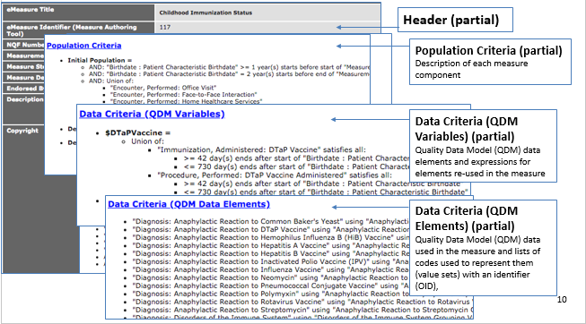
CQL for Clinicians and Professionals
eCQM Structure with QDM Logic through
2018 Reporting Year
Notes:
This is what earlier versions of eCQM actually looked like.

Slide 12
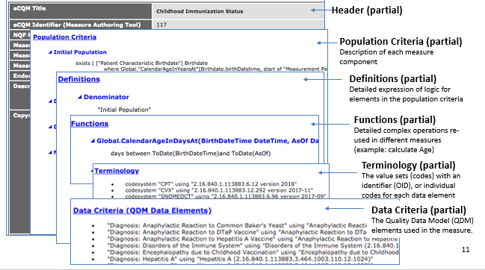
CQL for Clinicians and Professionals
eCQM Structure Using CQL Beginning
2019 Reporting Year
Notes:
The new measures still use the HQMF, so they will still have the title, identifier and information about the measure. It still has population criteria, but within that there are more simple descriptions. For instance, it will say the denominator is made up of the initial population which includes these elements, and rather than define the elements there, it advises you to scroll below and look at a definition for that element.
There is also terminology defining certain procedures we provide the OID which is an identifier for the value set or list of codes. We provide the name of the value set and the data criteria indicating that we have QDM data elements.

Slide 13
What is CQL?

Slide 14
CQL for Clinicians and Professionals
What is CQL?
CQL is a Health Level Seven (HL7) International standard that aims to unify the expression of logic for eCQMs and CDS
Provides the ability to better express logic defining measure populations to improve the accuracy and clarity of eCQMs
A standard language for expressing clinical knowledge that is readable, shareable, and computable

Slide 15
CQL for Clinicians and Professionals
What is CQL?
eCQMs use the CQL standard for logic expression beginning with the CY 2019 reporting period
Measure developers successfully tested CQL for expressing eCQMs from 2016 through 2017
CMS published CQL-based eCQMs in May 2018
Applicable to Eligible Hospitals and Critical Access Hospitals (CAHs), Eligible Professionals (EPs) and Eligible Clinicians participating in the following programs:
  Hospital Inpatient Quality Reporting Program
  Promoting Interoperability Programs (formerly Medicare and Medicaid EHR Incentive Programs)
  Quality Payment Program: Merit-based Incentive Payment System (MIPS) and Alternative Payment Models

Slide 16
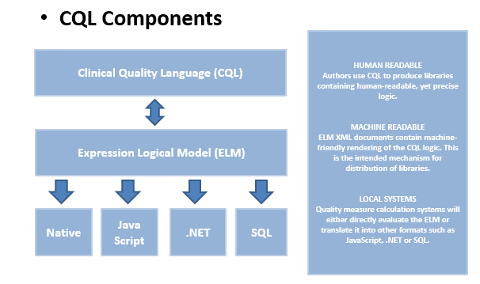
CQL for Clinicians and Professionals
What is CQL?
Notes:
CQL is a standard, and it has an expression which is very much like a mathematical expression. It tells you what needs to exist to pull from the record, and it’s what we consider the human-readable portion of the expression language. It also has a companion expression called Expression Logical Model (ELM) that is more of the machine-readable version of CQL that can be identified and read by a computer. The intent is that it needs to be human-readable and expressed, and then automatically converted into something that a computer can read and use with no change of fidelity.
The ELM is also easily converted into local computer code in order to identify what’s necessary to extract directly from a record so that the ELM can help generate what’s needed locally without having to provide each possible local type of expression to ultimately make it more versatile.

Slide 17
How Does CQL Help Explain eCQM Math?

Slide 18
CQL for Clinicians and Professionals
How Does CQL Help Explain eCQM Math?
CQL allows:
  Definition of exact time relationships needed (e.g., are the data elements separated by seconds, minutes, hours, or days)
  Clearer data element start and stop times that were often vague or ambiguous in QDM logic
  Calculation in a format more suitable for computer processing
Notes:
One thing that was complex in trying to identify the QDM logic was timing. Now, CQL provides that kind of exact time relationship and will separate by seconds, minutes, hours, or days, and lets you indicate which you want based on how the CQL is written.

Slide 19
CQL for Clinicians and Professionals
How Does CQL Help Explain eCQM Math?
CQL allows simple calculations, e.g., stating basic addition, subtraction, or multiplication not possible with QDM logic:
  Positive change in PHQ-9 depression scale after six months of treatment
  LDL calculated as (TC - HDL)
  Cumulative medication duration – Medication prescriptions covering at least 180 days of treatment
  PHQ - Personal Health Questionnaire
  LDL - Low-density lipoprotein
  HDL – High-density lipoprotein
  TC – Total Cholesterol
Notes:
With the QDM logic, basic math like subtracting A from B to get C was not possible, but it is now with CQL. CQL can calculate simple and more complex calculations.

Slide 20
CQL and eCQMs – What Does the Change Mean for You?

Slide 21
CQL for Clinicians and Professionals
What Does the Change Mean for You?
Initial learning curve, but CQL measures will be more readable and more clearly detail the intent of the measures
Better explain how measure outcomes are to be interpreted

Slide 22
CQL for Clinicians and Professionals
What Does the Change Mean for You?
Cumulative Medication Duration Example
  Dispensing: Calculated from the number of doses dispensed divided by the number of doses per day – and then add all dispensing events to come up with the total number of days covered by multiple dispensing events over a defined time period
  Administering: Calculated from the number of administration events from the beginning of the first to the end of the last over the defined period of time

Slide 23
CQL for Clinicians and Professionals
What Does the Change Mean for You?
The intent of CQL is to more accurately represent clinical performance by allowing the use of more precise methods to define activities
  Improves the ability to read, interpret, and understand measure logic
  Enables more automation to retrieve data with less data entry on the front end
  Allows for prospective evaluation of a patient’s record to recommend actions as Clinical Decision Support (CDS)

Slide 24
CQL for Clinicians and Professionals
What Does the Change Mean for You?
Data may be impacted by the change in the interpretation of measures
Work with your IT staff to:
  Help prospectively improve chances of doing well on the measures - reuse logic for CDS to improve performance
  Assess whether unexpected results of measure scores can be improved by evaluating if recommended interventions have occurred and if the clinical outcome has been achieved
Notes:
Data could be impacted by the change in interpreting measures. If your organization or your vendor interpreted the QDM version of the measure differently than might have been originally intended, the result you get from a measure run using CQL, where there is less ambiguity, may be different than the result you had using the QDM logic.

Slide 25
CQL for Clinicians and Professionals
What Does the Change Mean for You?
CMS released CQL-based eCQMs for CY 2019 CMS quality reporting programs in May 2018
CMS has released guidance on “How to read an eCQM” with incorporation of CQL for logic
Both are found on the eCQI Resource Center

Slide 26
What are the Available Tools and Resources?

Slide 27
CQL for Clinicians and Professionals
Tool and Resources
CQL Specification - CQL Release 1, Standard for Trial Use (STU) 2
  http://www.hl7.org/implement/standards/product_brief.cfm?product_id=400
CQL-Based HQMF Implementation Guide – Release 1, STU 2.1
  http://www.hl7.org/implement/standards/product_brief.cfm?product_id=405
eCQI Resource Center
  CQL Space, including the QDM v5.3 and v5.3 Annotated
    https://ecqi.healthit.gov/cql
  Check the eCQI Resource Center Events page and CQL Educational Resources page for more information
    https://ecqi.healthit.gov/ecqi/ecqi-events
    https://ecqi.healthit.gov/cql/cql-educational-resources
To submit an issues ticket for CQL, please visit the ONC JIRA site
  https://oncprojectracking.healthit.gov/support/projects/CQLIT
To view draft 2019 eCQMs
  https://oncprojectracking.healthit.gov/support/projects/CQM

Slide 28

CQL for Clinicians and Professionals
Discussion Questions

Slide 29
CMS MACRA Education and Outreach
CMS Spotlight Opportunities
Reminder:
If you are currently developing quality measures that you would like to present to CMS contact the MMS Support Desk at MMSsupport@battelle.org
Email: MMSsupport@battelle.org

Slide 30
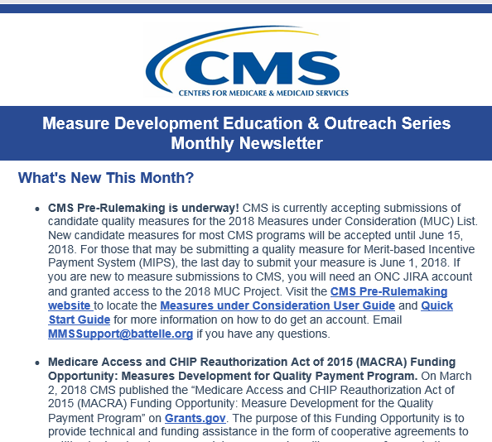
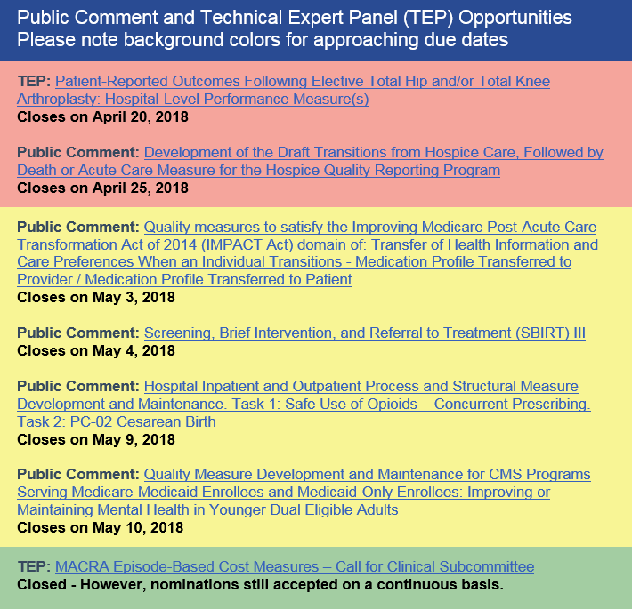
CMS MACRA Education and Outreach
MACRA Monthly Newsletter

Slide 31
CMS MACRA Education and Outreach
CMS MACRA Education and Outreach Webinars
Planned Upcoming Webinars:
July 25, 2018; 2:00-3:00pm ET: Developing and Implementing a Technical Expert Panel (TEP)
Email: MMSsupport@battelle.org

Slide 32
CMS MACRA Education and Outreach
CMS Measure Development Education & Outreach
Contact information:
Battelle
Measures Management System Contract Holder: Battelle
Contact: MMSsupport@Battelle.org
CMS
Golden Horton: Golden.Horton@cms.hhs.gov
Kimberly Rawlings: Kimberly.Rawlings@cms.hhs.gov

