Slide 1
Measure Development Education & Outreach for Specialty Societies & Patient Advocacy Groups
Webinar #10
Risk-Adjustment for Outcome Measures
Presenter:
Patrick S. Romano, MD MPH Professor of Medicine and Pediatrics, UC Davis
Notes:
This presentation is titled Risk-Adjustment for Outcome Measures and will be given by Dr. Patrick Romano.

Slide 2
CMS MACRA Education and Outreach
Vision and Goals: MACRA Webinar Series
An ongoing process to engage clinical specialty societies and patient advocacy groups in quality measure development.
Elicit feedback that will help CMS design toolkits and enduring materials designed specifically for specialty societies and patient advocacy groups interested in measure development.
  Education
  Outreach
  Frequent Communication
  Enduring Materials
  Dedicated Websites
  Measure Development Roadmaps
  Targeted Newsletters and Communication
  Showcase Opportunities
Notes:
CMS developed this webinar series to offer interested stakeholders educational information about the measure development process and as a means to communicate with CMS about the topic. Other resources available to learn about the topic include a newsletter, dedicated website, and Spotlight sessions.

Slide 3
Risk-Adjustment for Measures
CMS Perspective on Risk-Adjustment
CMS understands the importance of risk-adjustment and highlights strategies for risk-adjusting measures in the CMS MMS Blueprint
The Blueprint provides evidenced-based risk-adjustment strategies that include statistical risk models and stratification.
CMS is aware of the challenge when developing outcome measures, because performance of those measures holds the provider accountable for the outcome.
  When measuring outcomes, there is a need to control for outside factors that influence health
Notes:
The Centers for Medicare & Medicaid Services (CMS) is aware that there are various strategies for applying risk adjustment to your measures; and, therefore, provides some overarching strategies and resources to help measure developers with risk adjustment. You can find those strategies outlined in the CMS Blueprint. They are evidence-based and include some statistical risk modeling examples, as well as risk stratification options.
Applying risk adjustment is important, because when using outcome measures to score provider performance, CMS acknowledges that those measures hold the provider accountable for those outcomes when, in fact, there may be some other factors that influence a patient’s health status that are not otherwise controlled for in the measure development process.
There are multiple provisions in the Affordable Care Act (ACA) that support the development of quality measures, and specifically call out the development of outcome measures. Outcomes capture what patients in society care about the most in terms of the results of care provided. Applying these risk adjustment strategies helps control for some of those outside factors and make performance scoring for those measures more directly related to the care provided enabling accurate comparison of clinician or facility performance.

Slide 4

Risk-Adjustment for Measures
CMS Perspective on Risk-Adjustment
Multiple terms that describe the concept:
  Severity adjustment
  Case-mix adjustment
Accounting for social risk factors should be considered when and where appropriate
Ultimately, the measure developer must determine if risk adjustment is necessary or if including risk adjustment may obscure disparities in care for patients with social risk factors
Notes:
There are a few different terms that are used in relation to risk adjustment. Sometimes you will see severity adjustment or case-mix adjustment. You will even see things in measure titles, for example, something related to risk standardized mortality rates or risk standardized readmission rates. This just means that a risk adjustment has been applied to the specifications within that measure.
Outcome measures adjust for patient characteristics that exist prior to the episode of care that may make the outcome more likely.
The challenge when developing an outcome measure that can be used for accountability is to ensure that the outcomes are an actual influence of the provider and not caused by those other characteristics that influence patient outcomes. For that reason, outcome measures are generally risk-adjusted. If you ’ra submitting an outcome measure that does not use risk adjustment, you will want to make sure there is a rationale and strong evidence to be provided for why you would not have used a risk adjustment/stratification model.

Slide 5
Risk-Adjustment for Measures
CMS Perspective on Risk-Adjustment
CMS uses quality measures as tools to help measure or quantify processes, outcomes, patient perceptions, and organizational structures and systems.
The goal for using these tools is to provide patients with effective, safe, patient-centered, equitable, and timely care.
CMS has worked to provide multiple resources to assist with risk-adjustment: https://www.cms.gov/Medicare/Quality-Initiatives-Patient-Assessment-Instruments/MMS/Index.html
Notes:
CMS uses quality measures as a tool to measure and quantify the spectrum of care with the underlying goal of ensuring equitable care is being provided to the American Public. CMS provides multiple resources to assist with risk adjustment in terms of strategies.

Slide 6
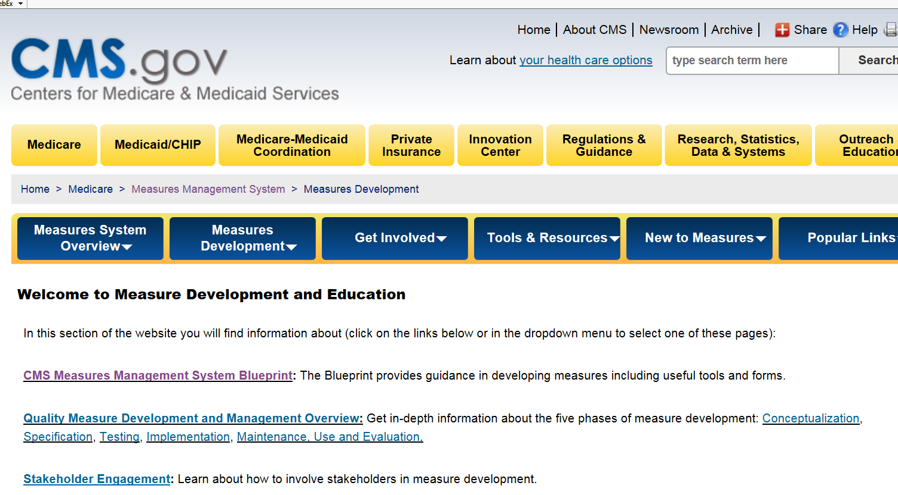
Risk-Adjustment for Measures
CMS Perspective on Risk-Adjustment
Notes:
The CMS Measures Management (MMS) website houses the MMS Blueprint.

Slide 7
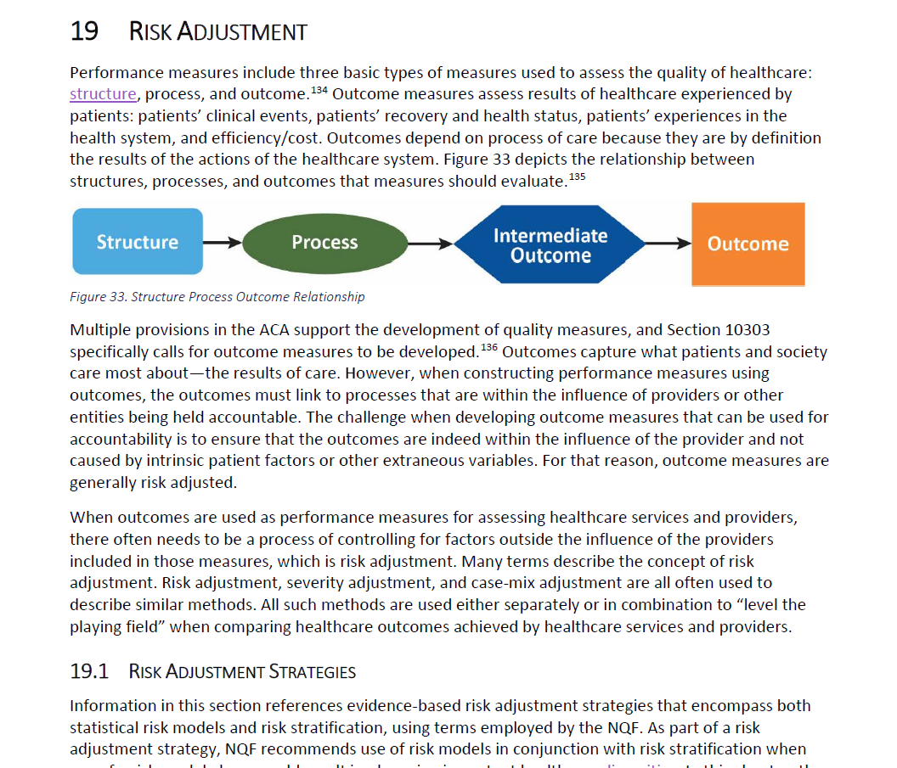
Risk-Adjustment for Measures
CMS Perspective on Risk-Adjustment
Section 3, Chapter 19 of the Blueprint
Notes:
Section 3 of Chapter 19 of the MMS Blueprint outlines risk adjustment in detail.

Slide 8
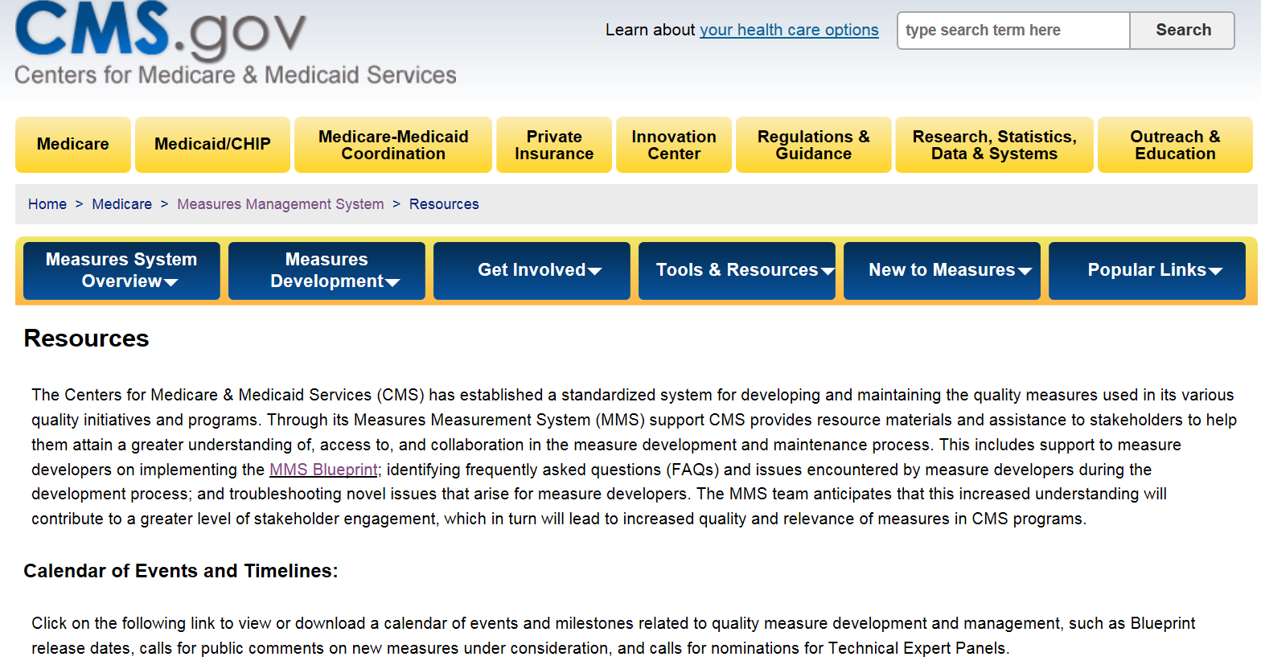
Risk-Adjustment for Measures
CMS Perspective on Risk-Adjustment
CMS MMS Website Resources
Notes:
The CMS MMS website has a Tools and Resources tab that provides resources specific to the measure development process.

Slide 9
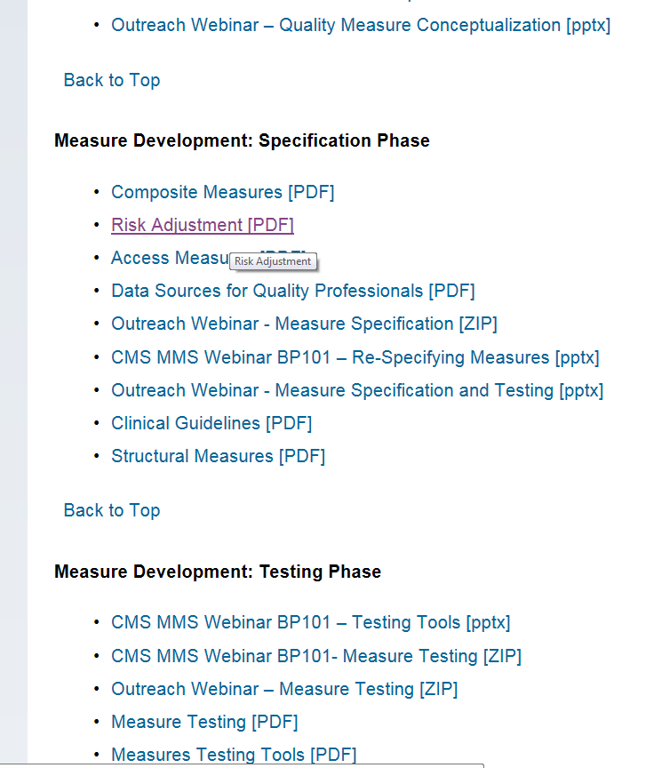
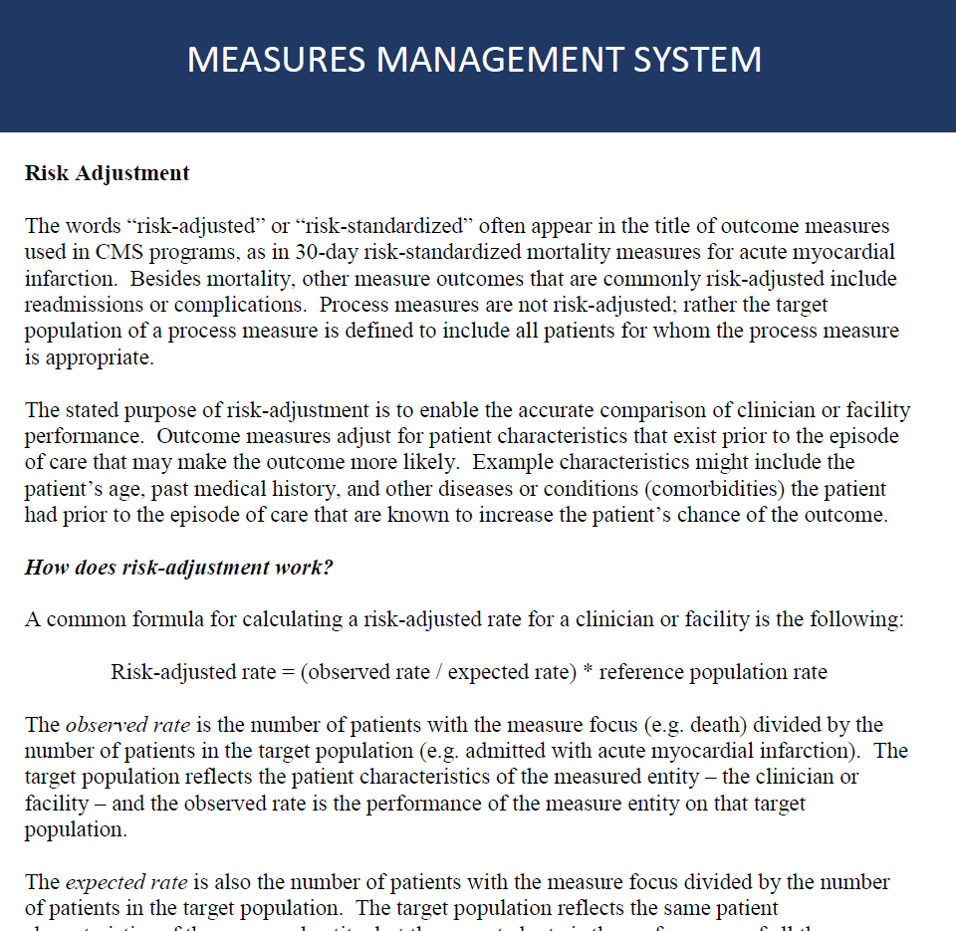
Risk-Adjustment for Measures
CMS Perspective on Risk-Adjustment
CMS MMS Website Resources
Notes:
Risk adjustment happens during the specification phase. The website offers references about risk adjustment and how you might apply risk adjustment to your measures.

Slide 10
Risk-Adjustment for Measures
Measure Development Education & Outreach for Specialty Societies & Patient Advocacy Groups
Agenda Webinar # 10:
What is risk-adjustment?
When is risk-adjustment NOT necessary?
Iezzoni’s 4 questions for risk-adjustment
Types of risk factors
Considerations in selecting risk factors
Social risk factors
Evaluating risk-adjustment

Slide 11
Risk-Adjustment for Measures
What is Risk Adjustment?
IOM’s 2006 Performance Measurement report:
“a process that modifies the analysis of performance measurement results by those elements of the patient population that affect results, are out of the control of providers, and are likely to be common and not randomly distributed.”
National Quality Forum’s 2014 Risk Adjustment for SES report:
“statistical methods to control or account for patient-related factors when computing performance measure scores”
Iezzoni’s 2013 Risk Adjustment for Measuring HealthCare Outcomes:
“aims to account for differences in intrinsic health risks that patients or populations bring to their health care encounters”
Notes:
The Institute of Medicine (IOM) describes risk adjustment as a “process that modifies the analysis of performance measurement results by those elements of the patient population that affect the results and are out of the control of providers, and are likely to be common and not randomly distributed.”
The National Quality Forum (NQF) describes risk adjustment as a “set of statistical methods to control or account for patient-related factors when computing performance measure scores.”
The book Risk Adjustment for Measuring Healthcare Outcomes by Lisa Iezzoni defines risk adjustment as “based on its aim to account for differences in intrinsic health risks that patients or populations bring to their healthcare encounters.”

Slide 12
Risk-Adjustment for Measures
Implications of Definitions of Risk-Adjustment
Risk-adjustment is about performance measurement results that are assessed and/or reported at the level of “accountable entities”
  Most people don’t care about risk-adjustment outside a decision-making context in which the information is used
Risk-adjustment requires data on risk factors and statistical methods
Risk-adjustment is about minimizing confounding
  Confounders are factors that are associated with both the exposure of interest (e.g., provider organization) and the risk of an adverse outcome, but are not caused by the exposure of interest
Notes:
Risk adjustment is about performance measurement results that are assessed and/or reported for accountable entities. In other words, the purpose is not to assess or report the performance of accountable entities, but to create the infrastructure for ongoing monitoring within the organization.
Risk adjustment is not always necessary for all outcome measures; it is typically necessary for outcome measures that are used for performance comparisons and for accountability applications. Implications to consider regarding risk adjustment are data requirements and the need to use statistical methods.
From an epidemiologic perspective, risk adjustment is about minimizing confounding. We define confounders as factors that are associated with both the exposure of interest — in our case the provider organization — and the risk of an adverse outcome that is not actually caused by the exposure of interest, and in this case, the provider or health plan.

Slide 13
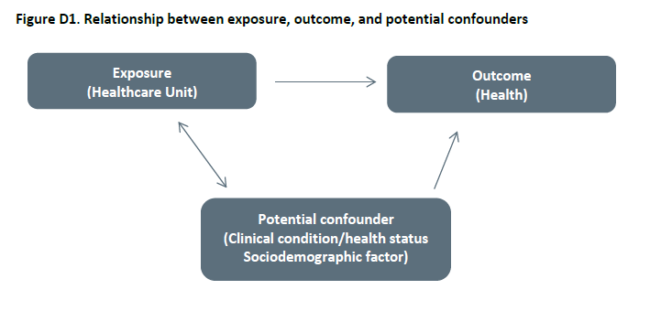
Risk-Adjustment for Measures
Confounding
Risk Adjustment for Socioeconomic Status or Other Sociodemographic Factors
NQF TECHNICAL REPORT; August 15, 2014
Notes:
This is a graphic representation of the confounding relationship from NQF. The goal of outcome measures is to evaluate healthcare units and their impact on health outcomes, but there are potential confounders — clinical conditions, health status, social factors, etc. — that are related and that are non-randomly distributed across healthcare units that have a causal arrow pointing towards health outcomes. These are the factors that we want to adjust for through risk adjustment.
If a potential confounder is in fact randomly distributed across healthcare units, then it is not a confounder by definition. It has to be something that is more common in some healthcare units than in others and it has to be something is causally related to the outcomes we are interested in. It cannot be under the direct control of the healthcare unit.

Slide 14
Risk-Adjustment for Measures
When Is Risk-Adjustment NOT Necessary?
When performance measurement results are not being used for public or private decision-making
When there are no important risk factors “out of the control of providers”:
  “Never events” that are unambiguous, serious, and virtually always preventable (e.g., operation on the wrong person or wrong site)
When confounding can be eliminated through random allocation to different providers or settings:
  Very rare but not impossible in health care
When confounding can be eliminated in simpler ways:
  Restriction/stratification
  Matching (typically each person serves as own control)
Notes:
There are some particular situations where risk adjustment may not be necessary.
Risk adjustment is not necessary when performance measurement results are not being used for decision-making, when they are only being used to identify cases oras a screening tool, or when there are no important risk factors that are out of the control of providers.
Never events are unambiguous, serious events. There may be risk factors you can identify related to patient characteristics that are associated with a higher or lower risk of never events, but there is a final common pathway that always has to do with some kind of slipup within the healthcare organization. So, because of that, the final common pathway, we say that these never events are under the control of providers, and they are not subject to risk adjustment.
Also, there are some cases where confounding can be eliminated through random allocation. This is pretty unusual in healthcare settings. For example, ambulance companies may randomly bring patients to different hospitals within their service area according to some kind of a predetermined rotation system. If you have this kind of random allocation in place, then it turns out that you do not have confounding, because the patient characteristics are going to be similar across the healthcare units. That is quite an uncommon situation, of course, particularly in the realm of CMS measures.
In some cases, you can restrict the definition of the outcome measure — both the denominator and the numerator —to make the patients within the restricted definition very homogeneous, eliminating sufficient variation in patient characteristics within that subgroup making risk adjustment unnecessary. This is quite unusual, but it may apply to some very low-risk, benign, elective procedures where essentially everybody has been prescreened and proven to be healthy when they come in for this procedure. In this kind of situation everyone is equally low-risk and we do not have to worry about variation in risk.
Matching is an interesting case and happens when each person serves as their own control. For example, there may be a measure or some patient-centered outcome before an intervention, and then again after the intervention. In this situation, each person’s health outcome after the intervention is matched with their health state before the intervention. This kind of situation may avoid the need for risk adjustment because you are automatically accounting for all of the unchanging characteristics of that individual patient when they serve as their own control. There are, of course, differences in how people respond to treatment based on their baseline characteristics and we call this effect modification, or interaction effects, and this may provide a separate reason for risk adjustment.

Slide 15
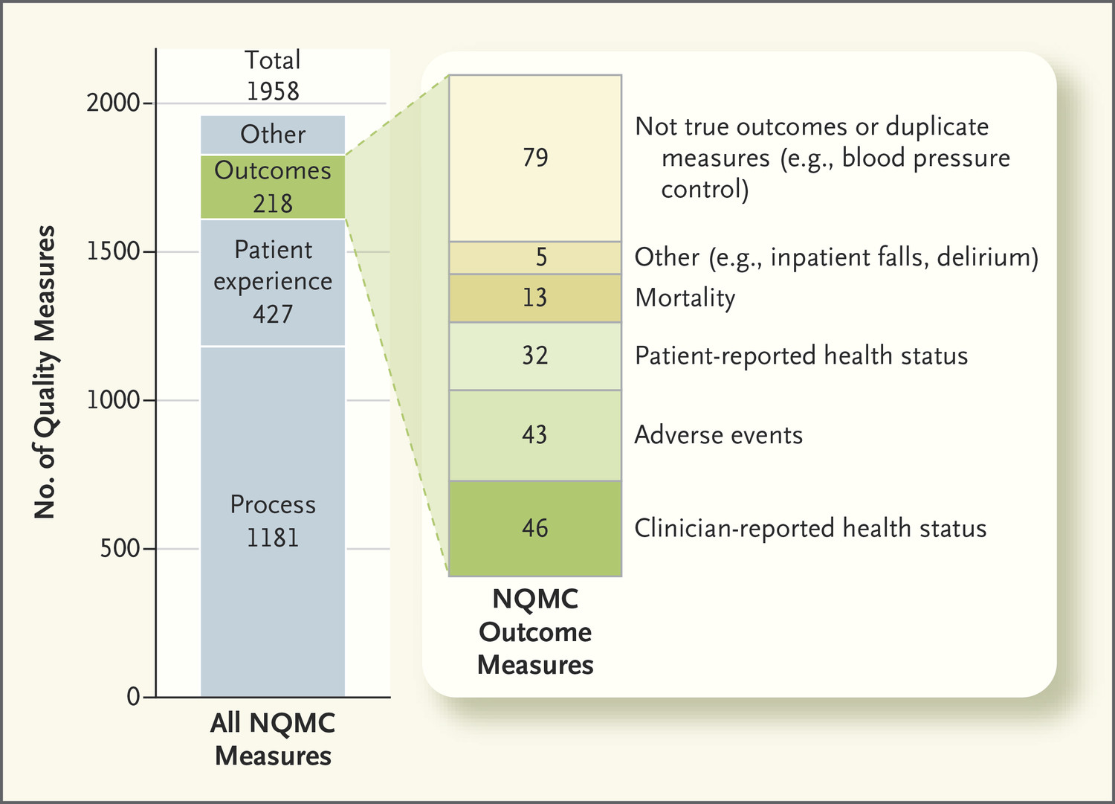
Risk-Adjustment for Measures
Risk-Adjustment is Not Easy
Porter ME et al. N Engl J Med 2016; 374:504-506.
Notes:
Risk adjustment will be necessary for the majority of CMS measures and it is difficult to do well. Additionally, it is expensive and that is why it has not been done as much as process measurement in the past.

Slide 16
Risk-Adjustment for Measures
Iezzoni’s 4 Questions for Risk-adjustment
Risk of what outcome?
Over what time frame?
For what population?
For what purpose?
Notes:
There are four basic questions that you have to answer in figuring out how to approach risk adjustment. You have to decide the risk of what? Or restated, what is the outcome that I am looking at in this risk-adjusted analysis? What is the timeframe over which this outcome will be ascertained or measured? What is the population at risk for this outcome that is going to be included in the measure and in the risk adjustment? Finally, what is the purpose of this risk adjustment exercise? All four of these questions have to be answered before you can make decisions about how to do risk adjustment.

Slide 17
Risk-Adjustment for Measures
Risk of What?
Clinical outcomes of care
  Death
  Complications
Resources used
  Hospital days, readmissions, emergency visits
  Costs
Patient-reported outcome measures
  Functional status/quality of life
  Symptom control
  Experiences with care

Slide 18
Risk-Adjustment for Measures
Over What Time Frame?
Short (in-hospital) versus medium (30-90 days) versus long-term (180 days to 10 years or more)
Shorter time frame may have greater attributional validity
Longer time frame may be more patient-centered
Social risk factors may become more important over longer time frame
Notes:
Over what time frame? The first thing to do is to define the timeframe. As you go from shorter timeframes to longer timeframes, there are some interesting considerations. For a shorter timeframe, we generally have greater attributional validity. In other words, it is easier to attribute the outcome to the healthcare provider or the healthcare unit that provided that service, and it is easier, therefore, to link those outcomes to processes of care within that healthcare unit. On the other hand, longer timeframes may be more patient-centered. They really better reflect what the goals of treatment are.

Slide 19
Risk-Adjustment for Measures
For What Population?
What is the “population at risk”?
Consider restricting restrict to patients/enrollees at non-zero, non-certain risk (e.g., between 0.1% and 99%)
Consider restricting to patients/enrollees for whom the outcome is clinically relevant (e.g., symptom relief for terminally ill patients receiving palliative care)
Consider restricting to patients/enrollees who could plausibly benefit from measurement (e.g., through better processes that have been shown to lead to better outcomes)
Notes:
For what population at risk? We generally consider a population at risk to be people who are at some risk that is not zero and not 100% and where there is some variation in their risk level. You may want to restrict your population definition and exclude people who are at zero risk or exclude people who are at virtually 100% risk.
You also may want to restrict to patients or enrollees for whom the outcome is clinically relevant. For example, for a terminally ill patient receiving palliative care, we typically do not want to look at measures of 30-day/90-day mortality, instead you would want to focus on symptom relief and quality of life.
Also, you may want to restrict to enrollees or patients who could plausibly benefit from being part of this measurement program, and so there is some concern that we like to have as much linkage as possible between our process measures and outcome measures. If a certain process of care has been shown to be dangerous in a certain subpopulation of patients, then you may want to exclude that subpopulation. For example, if we are looking at postoperative venous thrombosis after hospital surgery, then patients who have spinal trauma or central nervous system trauma cannot receive antithrombotic medication. So if those patients cannot receive antithrombotic medication, they cannot benefit from the process that has been shown to improve outcomes. This is a situation where we may want to focus the population definition on those for whom we think the process outcome relationship is relevant.
Finally, because risk adjustment measures are typically designed on a referenced population, the population on which you design the risk adjustment on, then you must be careful not to apply the measure to a completely different type of population, with different characteristics.

Slide 20
Risk-Adjustment for Measures
For What Purpose?
Prospective or predictive:
  Set payment or premium levels (prospective or predictive)
  Incentivize enrollment or treatment of high-risk enrollees and patients (to reduce adverse selection)
  Patient/clinician decision-making tool
Retrospective or explanatory:
  Track outcomes over time (within provider organizations)
  Compare outcomes across provider organizations for public accountability
  Financially reward performance attainment or improvement
Notes:
For what purpose? Purposes can be broadly categorized as prospective or retrospective. Prospective purposes are basically to advise regarding some future decision. A retrospective purpose is basically using data from the past to provide some information in the present. For example, a prospective purpose would be to use this year’s data to set next year’s payment levels or premium levels for health plans in the Medicare Advantage programs.

Slide 21
Risk-Adjustment for Measures
Why Else is Purpose (Intended Use) Important?
Consider the conceptual framework
Track outcomes over time:
  Focus on risk factors that are likely to change over time
Compare outcomes across provider organizations for public accountability:
  Focus on risk factors that are likely to differ across providers
Financially reward performance attainment or improvement:
  Consider social factors to avoid systematically penalizing the most vulnerable providers
Notes:
The purpose or intended use links to a number of other sort of intended aims of the measurement. All of the reference materials on the topic of risk adjustment — including the CMS MMS Blueprint — talk about the importance of a conceptual framework to help guide what the objectives of measurement are, and, therefore, what factors should be included in the risk adjustment. For example, if your purpose is to track patient outcomes over time, then you may focus particularly on selecting risk factors likely to change over time. If your focus is on comparing outcomes across provider organizations for public accountability in a single timeframe, then you may want to focus on risk factors likely to differ across providers. If you are designing a program to financially reward performance attainment or improvement, then you may want to consider social factors in stratification — if not in adjustment to avoid systematically penalizing providers who may be the most vulnerable and may need extra resources in order to improve the care they are providing to a vulnerable population.

Slide 22
Risk-Adjustment for Measures
Types of Risk Factors
Genetics (e.g., predisposition to health conditions)
Demographic characteristics (e.g., age, sex, country of origin)
Chronic clinical factors (comorbid conditions and severity; physical, mental, cognitive function)
Acute clinical factors (principal diagnosis, physiologic stability)
Psychosocial, socioeconomic, and environmental factors (e.g., family, education, occupation, economic resources, health insurance, neighborhood)
Health-related behaviors and activities (tobacco, diet, physical activity)
Quality of life, attitudes, and perceptions (health-related quality of life and overall health status; preferences; cultural, religious beliefs, and behavior)

Slide 23
Risk-Adjustment for Measures
Considerations in Selecting Risk Factors
Consideration | Rationale
Clinical/conceptual relationship with the outcome of interest | Begin with conceptual model informed by research and experience
Empirical association with the outcome | To confirm conceptual relationship
Variation in prevalence of the factor across the measured entities | No variation – no confounding bias
Present at the start of care | Ensures not a result of care provided
Not an indicator or characteristic of the care provided (e.g., treatments, expertise of staff) | Goal is to isolate differences in performance due to differences in the care provided
Resistant to manipulation or gaming | Mitigate unintended consequences
Accurate data that can be reliably and feasibly captured | Minimize burden, maximize value
Contributes unique variation in the outcome | Not redundant with other risk factors
Improve metrics of discrimination and/or calibration | Tested with cross-validation to assess robustness, weigh against face validity
Notes:
In general, the clinical or conceptual relationship is foundational and so you have to start with a clear conceptual model that is informed by previous research and clinical experience with expert input. And then you want to look for empirical associations with the outcome. Again, it may be from prior research. It may be from your own data. You are looking for variation in the prevalence, the factor across the healthcare units or measured entities — no variation, no bias.
It has to be something present at the start of care so that it is under the control of the providers. A commonly used definition is within 24 hours of presentation to the hospital for inpatient measures--some have argued even for tighter windows of six hours or 12 hours, but the point is that it needs to be something that is present basically at the start of care. It has to be something that is not actually an indicator or a characteristic of the care provided, and so we can isolate confounding from true differences in performance.
Ideally, it should be resistant to manipulation or gaming to mitigate unintended consequences as the accountable entities attempt to improve their performance on the measure. We want accurate data that can be reliably and feasibly captured. The risk adjusters should be not redundant with other risk factors. We want parsimonious models that have as few risk factors as are necessary to account for the significant sources of confounding.

Slide 24
Risk-Adjustment for Measures
Proxy Risk Factors
When the actual (conceptual) risk factor of interest cannot be ascertained, we may use “proxy” risk factors instead – while recognizing their limitations.
Actual Risk Factor of Interest | Proxy
Functional status | Prior residence in a residential care or skilled nursing facility
Chronic disease burden | Prior utilization of health services (e.g., number of hospital admissions or days)
Educational attainment, home ownership, household income, or unemployment | Mean/median educational attainment, home ownership, household income, or employment in census tract of residence
Household income/family structure | Medicaid enrollment status
Acute physiologic instability | Admission by transfer from another hospital or through emergency department
Notes:
For some cases you must rely on proxy risk factors, sometimes referred to as surrogate risk factors. For example, say you would like to adjust for functional status, but you do not have a measure of functional status. However, you have administrative data on whether the patient previously resided in a skilled nursing facility (SNF) or residential care facility (RCF) which could serve as a proxy indicating that this is a patient who is likely to have lower functional status.

Slide 25
Risk-Adjustment for Measures
Key Concerns about Social Risk Factors
Disadvantaged patient groups might receive worse quality of care, on average:
  Bias in care by providers based on the sociodemographic characteristics of the patients (e.g., poverty, race, language).
  Reduced resources and funding in places where patients receive care.
  Attempts by the clinician to tailor care to perceived constraints of the patient (which may or may not be appropriate).
Adjustment may mask meaningful differences in quality or performance, perhaps resulting from implementation of interventions to mitigate the effects of social risk factors.
Adjustment implies that worse outcomes are “expected” for certain patient groups, creating a double standard, and no expectation that healthcare units try to mitigate these effects.
Notes:
There is concern that disadvantaged patient groups may receive worse quality of care on average, perhaps because of bias, perhaps simply because of reduced resources and funding in places where disadvantaged patients are more likely to receive care, and perhaps because of quite careful and conscientious attempts by the clinician to tailor care based on the perceived constraints of the patient such as inability to afford a copay on a newer prescription drug.
This means that in some cases social risk factors may capture aspects of both the preexisting characteristics of the patient that affect their risk, but also characteristics of care that they receive. Adjustment may mask meaningful differences in quality or performance. Adjustment implies that worse outcomes are expected for patients in certain groups, thereby creating a double standard and perhaps removing some of the motivation or expectation that healthcare units would try to mitigate those disparities.

Slide 26
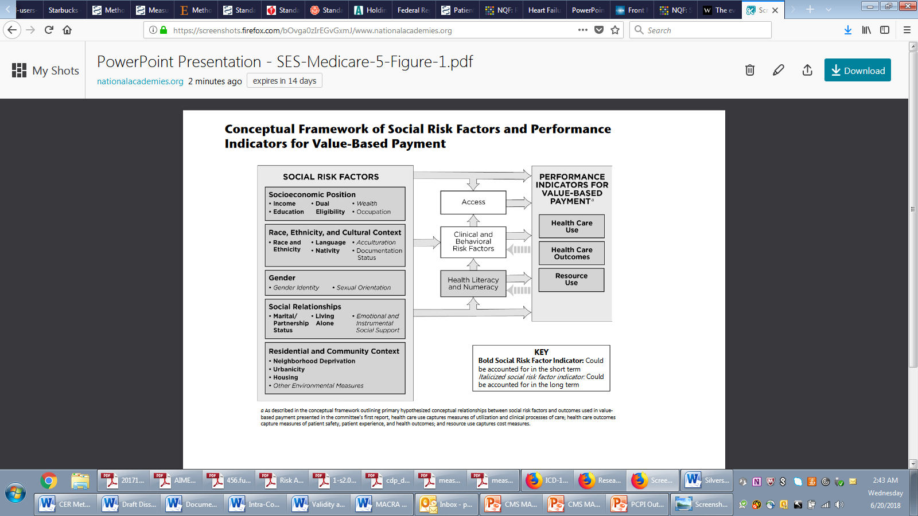
Risk-Adjustment for Measures
Social Risk Factors
National Academies of Sciences, Engineering, and Medicine. 2017. Accounting for social risk factors in Medicare payment. Washington, DC: National Academies Press.
Notes:
It is known that social risk factors have a variety of relationships with outcomes. This graphic from the National Academy of Medicine (NAM) displays a summary of a variety of different social risk factors.

Slide 27
Risk-Adjustment for Measures
Analytic Approaches
Multivariable regression
  Account for clustering of patients within units
  Hierarchical/mixed models
  Random effects
  Shrinkage estimators
Classification trees
Machine learning
Propensity scores
Notes:
Currently, the NQF and CMS are encouraging measure developers to think about these social risk factors very carefully and to articulate an appropriate conceptual model regarding when and where they would be important, and then to empirically test that model using the available data. These are some of the analytic approaches that are often used in risk adjustment.
This is not a presentation on statistics, and so obviously you will need to consult with a statistician. The primary approach typically that has been used has been a multivariable regression approach in which there is some effort to account for clustering of patients within units, and so we come to understand that the patients who receive care within a healthcare unit are not truly independent of each other as traditional statistical modeling requires.
We have moved towards so-called multilevel or hierarchical models or mixed models that account for this kind of clustering in different ways, and a commonly used way that that si done is by treating the provider effects as so-called random effects. In other words, treating the healthcare units or providers as clusters that could be randomly drawn from some larger hypothetical population of healthcare units. In some cases, shrinkage estimators are used to make the results more robust and to reduce predictive error in the results — especially for small units.
There are other approaches that are sometimes useful. Classification trees have a number of advantages, particularly for clinical decision models. Machine learning has become a popular approach when you have a very large number of variables. Propensity scores are another approach that we are seeing used more widely. Again, it is more commonly used in the context of comparative effectiveness research (CER) or policy research, as opposed to a measurement program.

Slide 28
Risk-Adjustment for Measures
Evaluating Risk-Adjustment
National Quality Forum Measure Evaluation Criteria and Guidance for Evaluating Measures for Endorsement, August 2017
“an evidence-based risk-adjustment strategy is specified; is based on patient factors (including clinical and social risk factors) that influence the measured outcome and are present at start of care, and has demonstrated adequate discrimination and calibration”
OR
“rationale/data support no risk adjustment.”
“Risk factors that influence outcomes should not be specified as exclusions.”
Notes:
NQF is looking for clear specification of an evidence-based risk adjustment strategy, evidence-based meaning that it uses risk factors that have been identified through previous evidence. Alternatively, of course, you can provide a rationale for no risk adjustment. Risk factors that influence outcomes should not be specified as exclusions. NQF is really looking carefully at exclusions to make sure that you are not excluding people with high-risk characteristics for whom the measure is quite relevant, but the factor should be included in the adjustment model.

Slide 29
Risk-Adjustment for Measures
Evaluating Risk-Adjustment
Face/content validity: Does the method adjust for all of the key content domains identified by prior research or expert knowledge?
Criterion validity: Does the method perform as well as a “gold standard” method based on detailed clinical factors?
Predictive validity: Does the method have adequate discrimination and calibration in predicting outcomes?
Construct validity: Does the method behave as expected, based on a previously articulated construct or conceptual framework?
Attributional validity: Can the method be used to attribute differences in outcomes to differences in processes of care?
Notes:
The following are broadly constructed domains of validity for evaluating risk adjustment.
Face or content validity is basically driven by expert input and review of prior research.
Criterion validity is based on the availability of some sort of gold standard where you are trying to demonstrate that perhaps a risk adjustment method based on administrative data or claims data works as well as a method that is based on registry data, or more complex clinical data. This kind of comparison would establish criterion validity.
Predictive validity is about discrimination and calibration and predicting outcomes.
Construct validity is based on seeing whether the method behaves as you would expect it to behave based on some construct or conceptual framework. If you set forth your conceptual model in advance, you gain the ability to assess construct validity to see whether the measure actually behaves as you would expect — whether the patients whom you thought would be higher risk are in fact higher risk, and whether the hospitals that you thought would be treating higher-risk patients are in fact treating higher-risk patients according to your model.
Attributional validity is a method that can be used to attribute differences in outcomes to differences in processes of care.

Slide 30
Risk-Adjustment for Measures
Discrimination and Calibration
Discrimination: extent to which the model predicts higher probabilities of the outcome for patients who experienced the outcome than for those who did not
  C statistic = area under ROC curve (among randomly selected pairs of observations with and without the adverse outcome, how often does the risk-adjustment model predict a higher likelihood?)
Calibration: match between predicted and actual outcome rates within subgroups of the data such as risk deciles
  Does the model overpredict or underpredict risk, on average, either overall or in meaningful subgroups?
Overall measures: R squared, Brier score, Mean squared prediction error
Notes:
Discrimination and calibration are the standard approaches to predictive validity as described in the MMS Blueprint.
Discrimination means the extent to which the models predict higher probabilities of the outcome for patients who experienced the outcome than for those who did not. This essentially means, “Can the model discriminate between people who are higher risk and people who are lower risk?” Note that this is always based on a relative ranking of risk. It is about discriminating higher risk from lower risk. In this context, it is about discriminating patients, not discriminating healthcare units. That is a completely separate question that has to do with the characteristics of the performance measure. Here we are talking about the risk adjustment model, and we are talking strictly about the ability to discriminate higher-risk patients or enrollees from lower-risk.
The way this is typically done for a dichotomous outcome is through a C-statistic, which is also known as the area under the receiver operating characteristic or ROC curve. One way to think about this is by asking yourself how often does the risk adjustment model predict the higher likelihood for the patient who had the bad outcome over the one with the good outcome? You could do this repeatedly across all of the possible randomly selected pairings of observations, and you could express that as a proportion. That would be the C-statistic.
The other commonly used approach is calibration, which is focusing on the match between predicted and actual outcome rates within subgroups of the data. Discrimination is about the relative ranking, whereas calibration is about am I on the mark? Am I predicting a 15% probability of death for the patients who actually do have a 15% probability of death? Am I overpredicting/underpredicting the outcome for certain important subgroups?

Slide 31
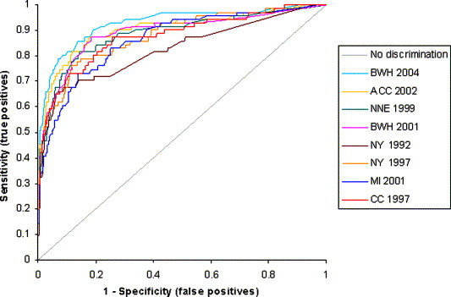
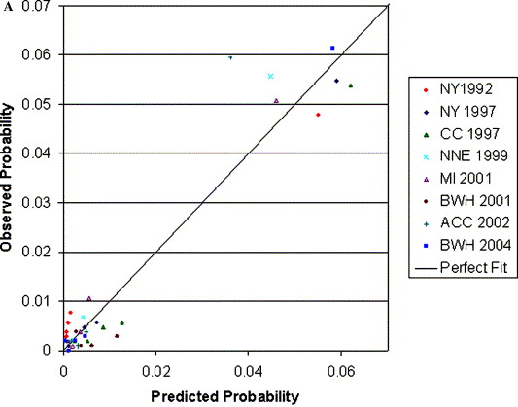
Risk-Adjustment for Measures
Discrimination and Calibration
Matheny ME, Ohno-Machado L, Resnic FS. Discrimination and calibration of
mortality risk prediction models in interventional cardiology. J Biomed Inform.
2005; 38(5):367-75.
Notes:
The graphic displays the ROC curve with the area under that ROC curve being the C-statistic. You see that the total area of the graph is “1” and so a random model, a worthless model, would follow the diagonal line with the C-statistic of “0.5.” This is a comparison of different risk prediction models that had been used in interventional cardiology for percutaneous coronary intervention (PCI) outcomes from different states and programs in this performance measurement arena. You can see how the different measures vary a bit in terms of the area under the ROC curve where there is discrimination, generally you would prefer models with higher discrimination.
On the lower right corner is an example of a calibration plot where we divide the different models according to quintiles of risk. And then we show the predicted probability based on the risk adjustment model compared with the observed probability in that quintile. In this example, each of these risk adjustment models is represented by five points, five quintiles of risk. You can see that in general you can put a line through them which means that if the predicted probability is higher, then the observed probability is also higher on average, but you will note some points that are well off that line — some points that suggest a calibration problem.
For example, there is a point where the observed probability is 6% or .06, but the predicted probability is less than 4%, and so for this particular cohort of patients the model is underpredicting the risk of death and therefore hospitals that had more of those patients would be disadvantaged by that model, because the model is underpredicting the actual risk of death. This is a calibration plot.

Slide 32
Risk-Adjustment for Measures
References
CMS MAT
  https://www.emeasuretool.cms.gov
National Quality Forum
  http://www.qualityforum.org/Home.aspx
  http://www.qualityforum.org/Publications/2014/08/Risk_Adjustment_for_Socioeconomic_Status_or_Other_Sociodemographic_Factors.aspx
National Academy of Medicine
  https://www.nap.edu/read/23635/chapter/1
AHA/ACC
  http://circ.ahajournals.org/content/113/3/456.long
Iezzoni LI, et al. Risk Adjustment for Measuring Health Care Outcomes, 4th edition. Health Administration Press: Chicago, 2013.

Slide 33

Risk-Adjustment for Measures
Discussion Questions

Slide 34
CMS Showcase Opportunities
Measure Development Education & Outreach for Specialty Societies & Patient Advocacy Groups
  Reminder:
  If you are currently developing quality measures that you would like to present to CMS contact the MMS Support Desk at MMSsupport@Battelle.org

Slide 35

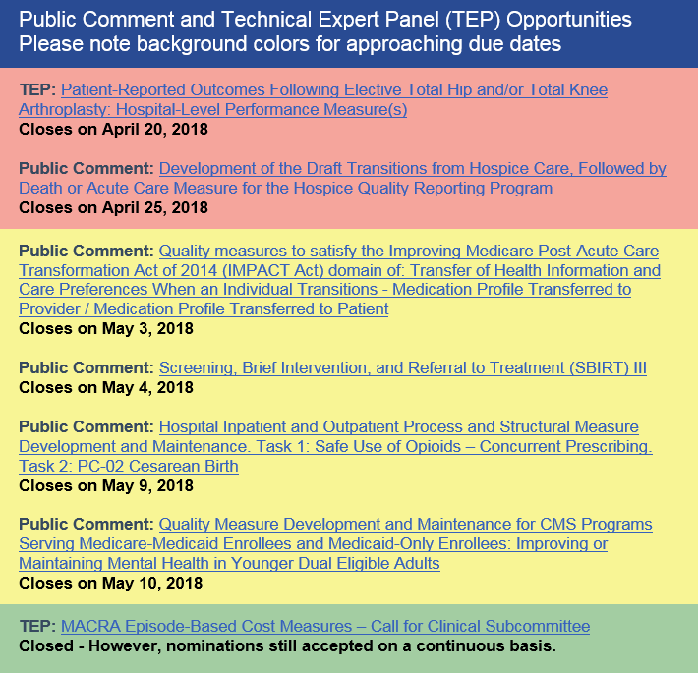
CMS MACRA Education and Outreach
MACRA Monthly Newsletter
Notes:
Email MMSSupport@battelle.org to request to be added to the newsletter listserv.

Slide 36
CMS MACRA Education and Outreach
Measure Development Education & Outreach for Specialty Societies & Patient Advocacy Groups
Planned Upcoming Webinars:
  June 27, 2018; 2:00-3:00pm ET: CQL for Clinicians and What It Means for You
  July 25, 2018; 2:00-3:00pm ET: Developing and Implementing a Technical Expert Panel (TEP)
Suggestions for future topics?
Email: MMSsupport@battelle.org

Slide 37
Risk-Adjustment for Measures
Measure Development Education & Outreach for Specialty Societies & Patient Advocacy Groups
Contact information:
Battelle
Measures Management System Contract Holder: Battelle
Contact: MMSsupport@Battelle.org
CMS
Golden Horton: Golden.Horton@cms.hhs.gov
Kimberly Rawlings: Kimberly.Rawlings@cms.hhs.gov

