Slide 1
CMS Measure Development Education & Outreach
Public Webinar
CMS Quality Measures: How they are used and how you can be involved
Presenter:
Golden Horton, CMS
Kimberly Rawlings, CMS
Nicole Brennan, DrPH, Battelle
April 26, 2018
1:00-2:00pm EST
Notes:
CMS is committed to engaging with healthcare stakeholders to help in the understanding of the quality measure development process. They look for feedback that can provide guidance on the creation and implementation of resources that will help those who are interested in measure development to better understand what is happening as measures are developed. To date, CMS has implemented an Education & Outreach webinar series and resource materials to break down and explain various components and challenges in the measure development process. They have also dedicated websites, listservs and roadmap documents to support those interested in developing measures, or wanting to learn more about how it is done.

Slide 2

Vision and Goals: Public Webinars
CMS Measure Development Education & Outreach
An ongoing process to engage the public in quality measure development.
Elicit feedback that will help CMS design resources that can help all of those interested in healthcare quality improvement better understand the goals of quality measurement.
  Education
  Outreach
  Dedicated Websites
  Measure Development Roadmaps
  Listserv opportunities

Slide 3
CMS Quality Measurement
CMS Measure Development Education & Outreach
Agenda Webinar:
Introduction to CMS and quality goals
Overview of the Measures Management System (MMS)
How quality measures are used and how they are developed
Lifecycle of a quality measure
Regulatory processes mandated for inclusion of quality measures
How to get involved
Meaningful Measures
Notes:
I am pleased to welcome our three presenters today — Ms. Golden Horton and Ms. Kimberly Rawlings of CMS, and Dr. Nicole Brennan of Battelle.

Slide 4

CMS Quality Measurement
Introduction to CMS and Quality Goals:
Golden Horton
Welcome! This is our first of a two part series to engage the public in the work CMS is doing around quality measurement
Aim to shed light on the processes and function of quality measurement in CMS programs and initiatives
If you are new to quality measurement, stay tuned for available resources that can help navigate development and use

Slide 5
CMS Quality Measurement
Measures Management System:
Dr. Nicole Brennan
CMS developed the Measures Management System (MMS) as a standardized system for developing and maintaining quality measures
The MMS oversees the CMS MMS Blueprint, which is the publicly available documented processes to ensure coherent, transparent, and effective quality measure development
The MMS website provides a link to the Blueprint, measure development tools and resources, and is easily navigated for all measure development needs
https://www.cms.gov/Medicare/Quality-Initiatives-Patient-Assessment-Instruments/MMS/Index.html
Notes:
We are going to start at the very beginning and just define really what is the Measures Management System (MMS). CMS established the Measures Management System (MMS) as a way to help standardize a process for developing, implementing and maintaining quality measures. I want to note here that there is a difference between quality measures, quality improvement and quality assurance. Today we are going to be focusing on the clinical quality measures (CQMs) aspect.
There are a couple of key components to the Measures Management System (MMS). The first is creating tools to assist in the development of clinical quality measures (CQMs). The second is to engage stakeholders such as patients, clinicians, clinical specialty societies and patient advocacy groups on how to get involved in the quality measure process. Tools that have been developed include the Measures Management System (MMS) Blueprint, the CMS Measures Inventory Tool (CMIT), and our newly redesigned MMS website.

Slide 6
CMS Quality Measurement
CMS MMS Blueprint
Six sections to guide measure development
Measure lifecycle
In-depth look on each step of the process
Forms and templates
https://www.cms.gov/Medicare/Quality-Initiatives-Patient-Assessment-Instruments/MMS/Downloads/Blueprint-130.pdf
Notes:
While you are on the MMS website, you can locate the MMS Blueprint. When you first open up the 376 page document, it can seem very daunting. However, it is not designed for you to read from front to back, but it is to be used as a guide to measure development throughout the entire process. It is broken into six sections. Section one and two combined are only 30 pages long, and really are there to provide you with a high level overview of MMS and the Measures Management lifecycle. Section three, is quite long, but that is a deep dive into a number of different topics, including person and family engagement and how measure developers can better engage family members or patients into the development process. It talks more about measure testing and gets into nuances such as risk adjustment and how we evaluate a measure and make sure it is still usable and meaningful to the public. Section four provides tools and forms to help people develop measures. Section five is a glossary of terms and section six is the appendices.

Slide 7
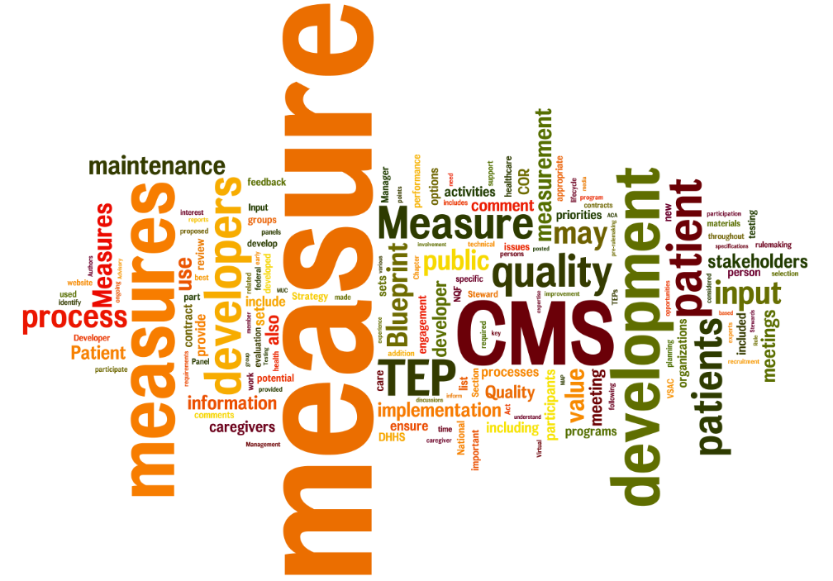
CMS Quality Measurement
What is a Quality Measure?
  Quantifies healthcare processes, outcomes, patient perceptions, and organizational structure and/or systems
  Associated with the ability to provide high-quality health care and/or that relate to one or more quality goals for health care
  Supported by evidence
Notes:
Measures are quantifiers of processes and outcomes, patient perceptions and organizational structures. An example of an organizational structure would be, “How many healthcare organizations are using electronic health records (EHRs)?” Quality measures overall are associated with our ability to provide high quality care. They are supported by both empirical and practical evidence. We also engage our stakeholders to make sure it is practical in practice.

Slide 8
CMS Quality Measurement
CMS Programs that Develop Quality Measures
CMS has many programs and initiatives that use quality measures to either determine payment or reimbursement amounts or to improve performance.
There are many divisions within CMS that use quality measures including, but not limited to:
  Merit-Based Incentive Payment System (Center for Clinical Standards and Quality - CCSQ)
  Hospital Inpatient Quality Reporting Program (CCSQ)
  Medicare Shared Savings Program (Center for Medicare)
  Medicaid (Center for Medicaid)
Notes:
The takeaway message here is that measures are used across the entire healthcare spectrum — primary care, post-acute care, and hospitals. We try to develop measures so that we evaluate the system as a whole.

Slide 9
CMS Quality Measurement
Purpose of a Clinical Quality Measure (CQM)
A Clinical Quality Measure is a tool for making “good decisions”
  One that makes it more likely that the user will experience a good result and
  Makes it less likely that the user will experience an adverse result
    That was not foreseen or was not understood
Why are Clinical Quality Measures relevant to clinical practice?
Notes:
I want to highlight here that there are definitions of probably and likelihood here, which means a measure does not guarantee the experience of a good result, but is meant to get us closer and standardize the process to getting to that.

Slide 10
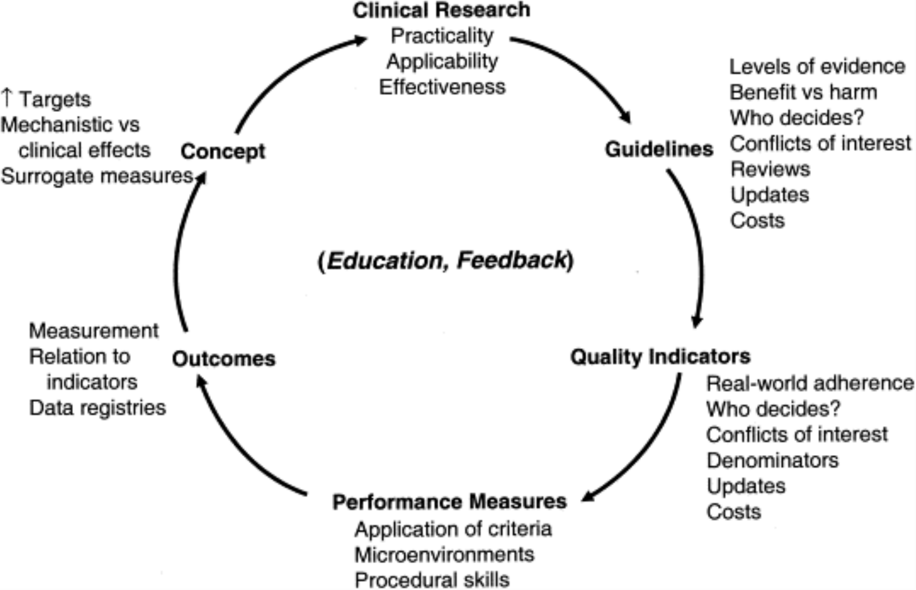
CMS Quality Measurement
How CQMs are Used
From: Integrating quality into the cycle of therapeutic development
J Am Coll Cardiol. 2002;40(11):1895-1901. doi:10.1016/S0735-1097(02)02537-8
Model for the integration of quality into the therapeutic development cycle.
Notes:
How does the measure affect decision-making and how is it relevant in clinical practice? There are a lot of steps that we go through before we ever develop a measure. We should not just see a problem and immediately think that if we develop a measure, that will fix it. We have a systemic process of getting to the point where we are ready to develop the right measure.
We will use the example of concussions as we go through this cycle.
First, the clinician might see room for improvement in health outcomes, like needing more medical attention to concussions. Previously, concussions were thought of as a right of passage to playing sports, or that someone could recover very quickly. We did not recognize the adverse and negative health outcomes that could result from concussions.
We did a lot to develop guidelines around “treatment of mild head trauma,” but now we think more people than necessary are getting medical treatment such as CT scans or MRIs for mild head trauma. Now we have our concept, which is some insight into the system we are working in. This is also combined with what we know about patients, what we know about that specific condition, and how we conduct research in order to validate our ideas. The next step would be to look at or conduct clinical research to look at concussions and what treatments are currently being offered, and how often they should be offered.
In the third step we take all of that research and we analyze and synthesize it, and then we develop a guideline based on it. For example, a guideline was developed related on when we should and should not conduct a CT following mild head trauma in children. We then incorporate those guidelines into what is called a clinical decision-support tool so that we have the pediatric head trauma tool, and those guidelines are used to inform our clinical decision-making in actual practice.
Now we want some way of evaluating whether or not we are using these recommendations. We have developed quality indicators, and this might be where quality improvement and quality assurance happens within your practice. In an ideal world, for every clinical decision there would be an indicator based on that guideline that would tell us if we are using the guideline. We know in practice that you cannot always implement the guidelines step-by-step, but this is meant to really help standardize those steps and improve health outcomes.
Once we have these indicators and metrics, we are interested in looking across the entire nation or entire spectrum of the healthcare system, and we might develop a performance measure. So here we have the CMS measure on “emergency department (ER) utilization for CT scans in minors with head trauma between the ages of 2-17 years old.” We have gotten pretty specific there. We are looking at a very specific population and a very specific setting.
A performance measure is all about standardization, benchmarks and thresholds. Ultimately, what we care about are those outcomes. We want children who need CT scans to get them and prevent further injury, and we want children who do not need them to not get unnecessary procedures. So how does quality actually improve through the use of these measures? There are really two ways we can get to that. They are called selection and change. Selection involves moving populations of patients from low-performing clinicians to high-performing clinicians. We report on how the clinicians are doing and the patients make a choice on where they want to receive care. If you do that, the average outcomes should improve. And then we have change, which would involve individual clinicians moving from being a low-performer in a specific area to being a high-performer. Again, to the degree that that can happen our overall health outcomes will improve.

Slide 11
CMS Quality Measurement
Attributes of a CQM
Components of a Clinical Quality Measure
Measure name/title Measure description Initial population Denominator (i.e. target population) Numerator (i.e. measure focus) Exclusion and exception Data sources | Key terms, data elements, codes Unit of measurement or analysis Sampling Risk adjustment Time windows Measure results Calculation algorithm
Notes:
This slide shows all the components of the measure, and it is really here to help answer questions like what is the decision we are trying to make? Even really down to something as basic as does the title of the measure provide good information on what the measure is actually supposed to do? Here we would start developing our numerator and denominator. What populations of patients are we looking at, and really who might be excluded from that population and why?

Slide 12
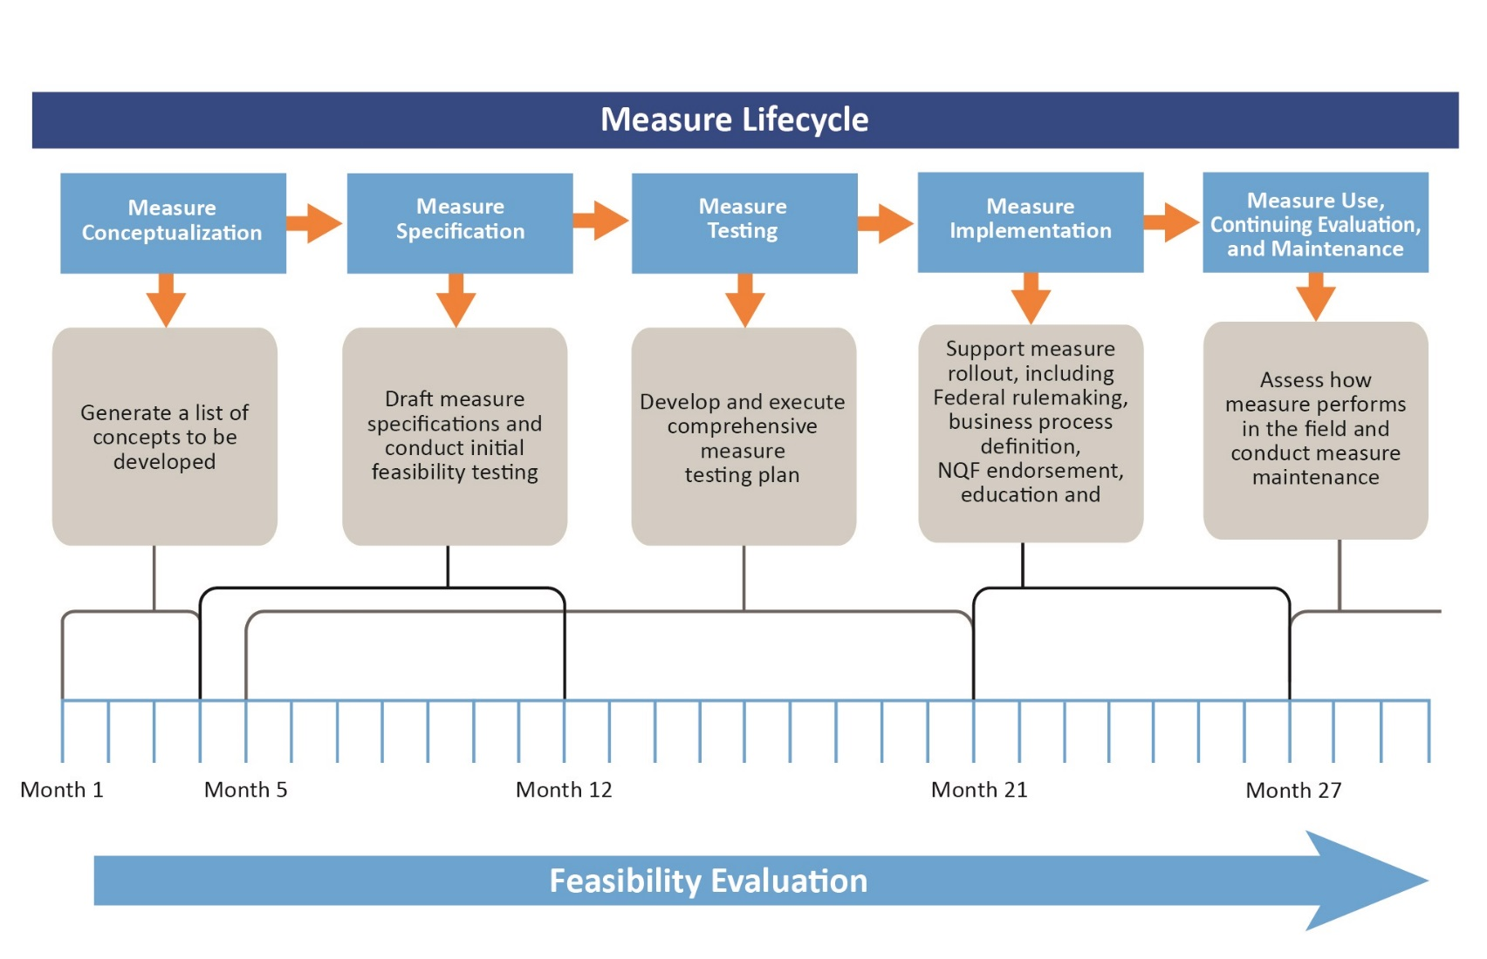
Measure Lifecycle
Notes:
If the measure lifecycle was a linear process, this is what it would look like. The lifecycle starts with us developing our concept around a measure and developing those specifications, testing it, implementing the measure, and then going through evaluation and maintenance.
It is important to note, though, that the measure cycle is not actually linear. If we are doing it right, we are testing during the conceptualization, testing during specification; trying to make sure that we are being very iterative in the process so that if a measure is going to fail, it would fail very early. If it was going to succeed, we would also begin to see how it was going to succeed very early as well. Most importantly through each and every one of the steps we want to be engaging our stakeholders. We want patients’ input on what measures are meaningful to them, and for clinicians we want to know what measures are usable for them.

Slide 13

CMS Quality Measurement
Measure Conceptualization
Building the evidence base for the measure concept and basic elements of the measure
Steps to be completed in this phase:
  Information Gathering
  Gap Analysis
  Initial Business Case
  Stakeholder Input
  Public Comment
Notes:
Measure conceptualization is where we really start to develop the case for why a measure should be developed. What is the science behind the condition? We review all the other measures that are already out there. We review recommendations that have been made on what measures should be developed, and we try and gather as much stakeholder input as we possibly can. This is a great stage for you to get involved in the measure development process. By informing a measure during measure conceptualization, you can really help make sure that in the end that measure is as meaningful as possible.

Slide 14
CMS Quality Measurement
Measure Specification
Specifications provide the comprehensive details that allow the measure to be collected and implemented consistently, reliably, and effectively
Steps to be completed in this phase:
  Develop candidate measure list
  Develop precise technical specifications and update the Measure Information Form (MIF)
  Define the data source
  Specify code systems and construct data protocol
  Continued stakeholder engagement

Slide 15
CMS Quality Measurement
Measure Testing
Testing quality measures, including the components of the measure such as the data elements, the scale, and the performance score
Steps to be completed in this phase:
  Develop testing work plan
  Implement Alpha and Beta testing
  Analyze testing results and refine measure specs
  Report on measure testing results
  Continued stakeholder engagement
Notes:
Measure testing can be split this into two phases, alpha testing and beta testing. Alpha testing can occur as early as the information-gathering process and is repeated over and over, and so here that includes methods to determine if individual data elements are available and if the form in which they exist is consistent with the measure. It is very hard to implement a measure if you cannot actually collect the data for it. Beta testing which we also call field testing, generally occurs after we have gotten through the specifications, and it happens on a larger scope than the alpha testing. In addition to gathering further information about feasibility, the beta tests serve as a primary means for assessing if the measure is scientifically sound and if it is usable in practice.

Slide 16

CMS Quality Measurement
Measure Implementation
Refers to the transparent process by which a measure is submitted for use by CMS, and is subject to stakeholder and public review
Steps to be completed in this phase:
  Submit measure specifications to CMS Pre-Rulemaking Process
  MAP Workgroup recommendations
  CMS rulemaking processes
  Continued stakeholder engagement

Slide 17
CMS Quality Measurement
Measure Use, Continuing Evaluation, and Maintenance
The processes and data collection used to ensure the continued soundness of the measure
Steps to be completed in this phase:
  Data collection and literature reviews
  Evaluate Business Case
  Measure Updates
  Comprehensive Reevaluation
  Ad Hoc Review
Notes:
Measure use, continued evaluation and maintenance should not be seen as the final stage of the measure lifecycle, but as the stage where the measure is routinely being reviewed for usability, burden, feasibility and value to patients.

Slide 18
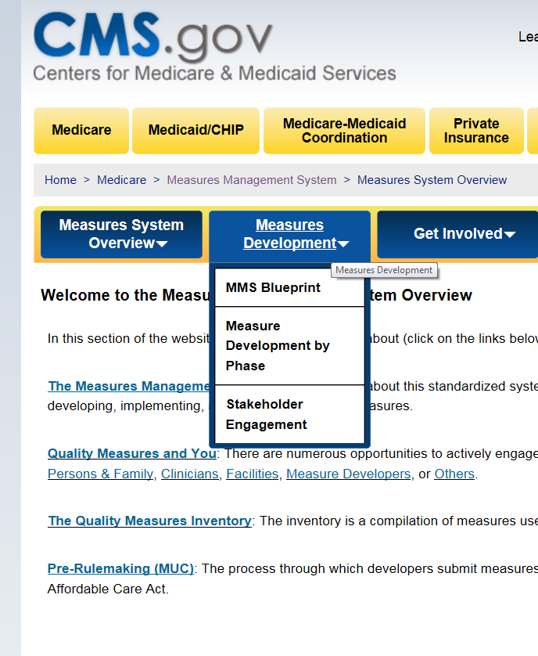
CMS Quality Measurement
Want to Learn More?
Quality Measure Resources:
  CMS MMS Website
  CMS MMS Blueprint

Slide 19
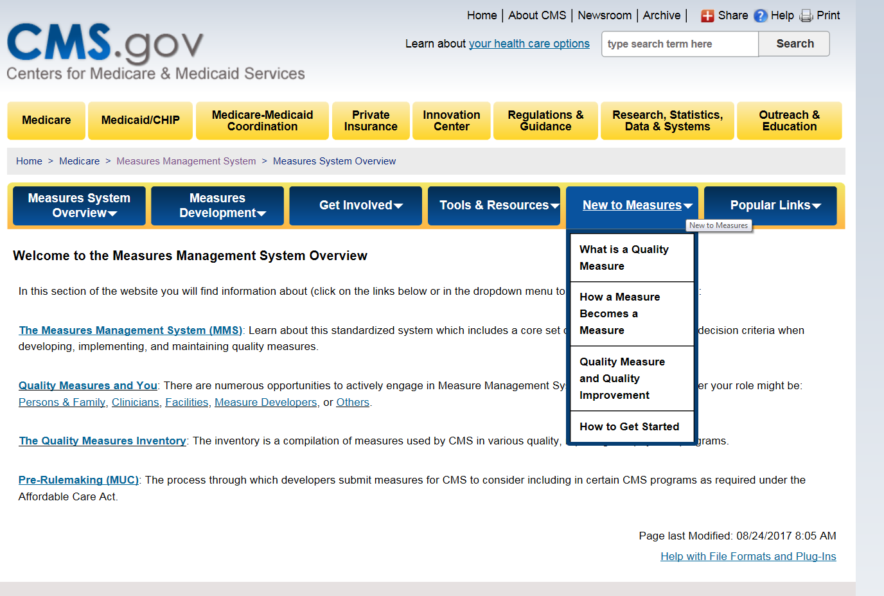
CMS Quality Measurement
Want to Learn More?
Notes:
On the CMS MMS website, you are going to see six tabs in blue across the top. We give a basic overview of what MMS is and more information on how to develop a measure and a lot more specifics on how to get involved. We provide tools and resources for both the general public and measure developers, and we also have a link just for new measure developers, and then our series of popular links where you can get back to that inventory or to the other CMS programs that you might be interested in seeing.
The measure development process really has a role for everyone. We want to help patients understand that they can be part of technical expert panels (TEPs). While it has been named a technical expert panel (TEP), nobody is more of an expert in healthcare than the patients. We also really welcome public comments to the Measure Development Plan (MDP) and to measures as they are going through rulemaking. Here you can also find a link to the MMS Listserv which will send you a monthly newsletter. In that newsletter you will see articles that explain more about measure development but also let you know of additional ways you can get involved.

Slide 20
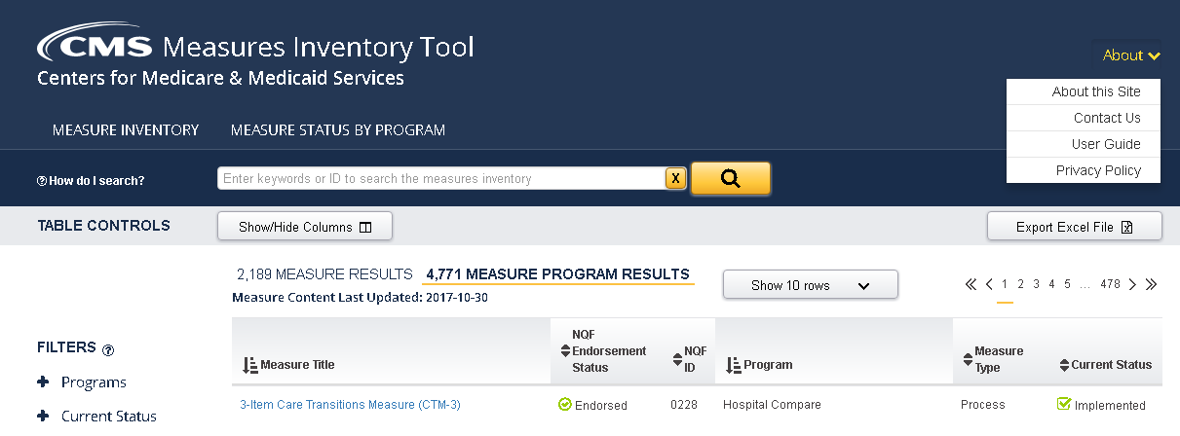
CMS Quality Measurement
Want to Learn More?
Quality Measure Resources:
  The CMS Measures Inventory Tool (CMIT)
Notes:
Over the past three years CMS has transformed the Measures Inventory from a spreadsheet that contained over 10,000 cells of data to an interactive web-based tool. The CMS Inventory Tool (CMIT) was really developed to increase the usability and transparency of the inventory.

Slide 21
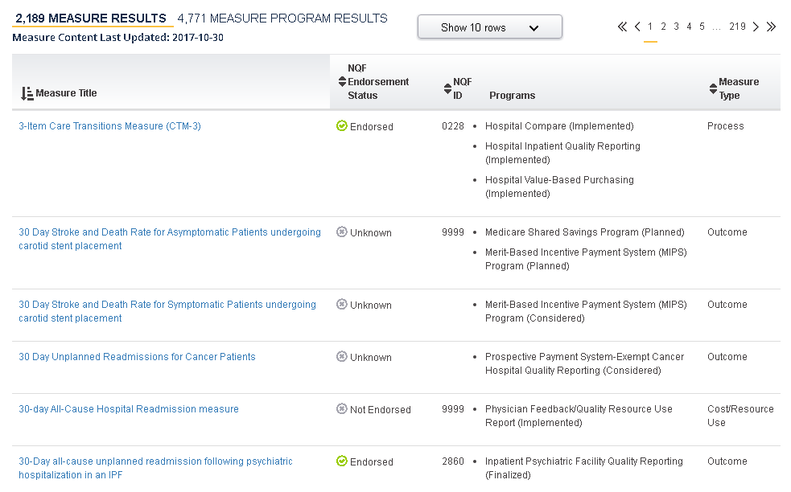
CMS Quality Measurement
Want to Learn More?
Notes:
On the website, you will see a list of every measure that is currently being implemented in CMS programs. You will also see measures that are being proposed to be used within the next couple of years. You will also see measures that have been retired, or measures that are still under development.

Slide 22
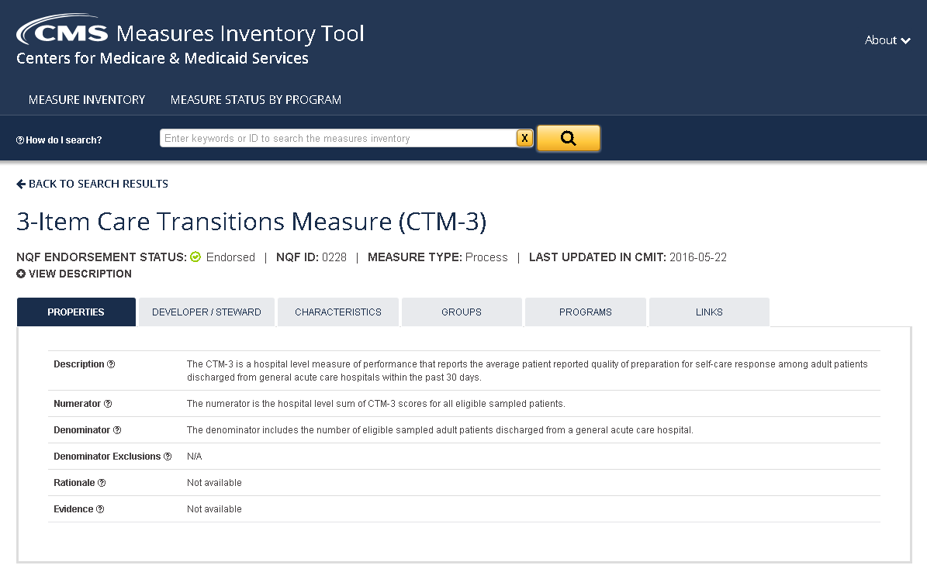
CMS Quality Measurement
Want to Learn More?
Notes:
Measures can be sorted by their condition or keywords within the measure. You can also look at measures based on their NQF endorsement status or what type of measure they are. Once you find the measure you are looking for, on the first page you will see all of those specifications that stay with that measure no matter what program is implementing it. If more than one program is implementing this measure, it should have the same numerator and denominator within those programs.
Once you go down that line, you will see the tab for programs. That is where you will see specifically how the program has categorized this measure and what stage it is in within the program. There are links to all of the rules that established the measure and oftentimes, the specification documents related to the measure. CMIT tries to put everything in one place and be as usable as possible for you to find more information about clinical quality measures (CQMs).

Slide 23
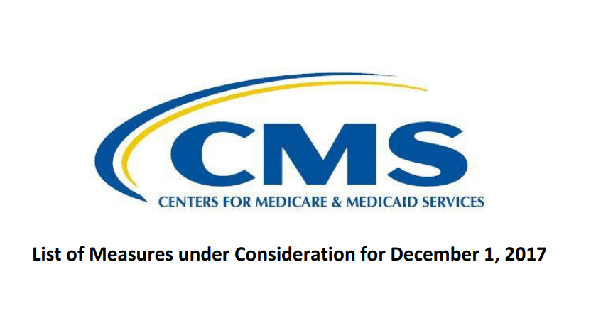
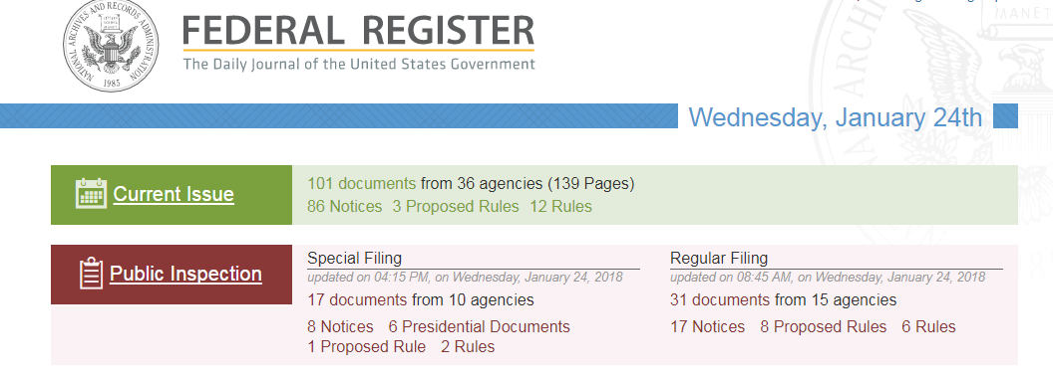
CMS Measure Processes for Inclusion in a Program
Pre-Rulemaking Process
Rulemaking Process
Notes:
Not all measures are part of rulemaking, but there are a number of programs that require a measure to be published within the Federal Rule before they can be implemented within the program. The first step of that process is called pre-rulemaking.

Slide 24
CMS Quality Measurement
CMS Pre-Rulemaking Process
Opportunity for measure developers to submit quality measures for consideration by 18 quality reporting and payment programs
Reviewed by CMS Program Leads and final list published by Dec. 1 each year
Measures are then submitted to the Measure Application Partnership (MAP) workgroups to undergo expert review and recommendations

Slide 25

CMS Quality Measurement
CMS Rulemaking Process
Method by which CMS includes measures for use in their programs and initiatives
The public can give feedback on the measures through public comment
Can be published in an annual Federal Rule or in a program-specific Call Letter
Notes:
CMS may seek additional public feedback by publishing a measure in a proposed rule. Each program releases twice a year what is called a proposed rule and then a final rule. In the proposed rule they will list out measures that they are considering adding to the programs, or measures they are considering to remove from the programs.
This is another great opportunity to get involved. You can go onto the Federal Rule website and add comments related to measures, and before the measure goes to final rule CMS reviews all of the public comments. And then when you read the final rule, you will see that they answer many, if not all, of the comments that are made, and then come to a final decision on whether the measure should move forward or not. Many times comments will influence a measure to not be put into the program. Other times such accolades are made or a need is met that measures go into the programs.

Slide 26
CMS Quality Measurement
How Can You Participate?
Technical Expert Panels
  CMS requires TEPs for business cases, reviews of testing results, and determining which measures should be submitted
  Should include persons/family members, providers, and recognized experts in the field
Public Comment
  Provides an opportunity for a wide array of interested parties to provide input on measures
Creating measures for use in a CMS Program

Slide 27

CMS Quality Measurement
How are the Measure Attributes Assessed?
Importance to measure and report
Scientific acceptability
  Reliability
  Validity
Usability and Use
Feasibility
Harmonization (Related and Competing Measures)

Slide 28
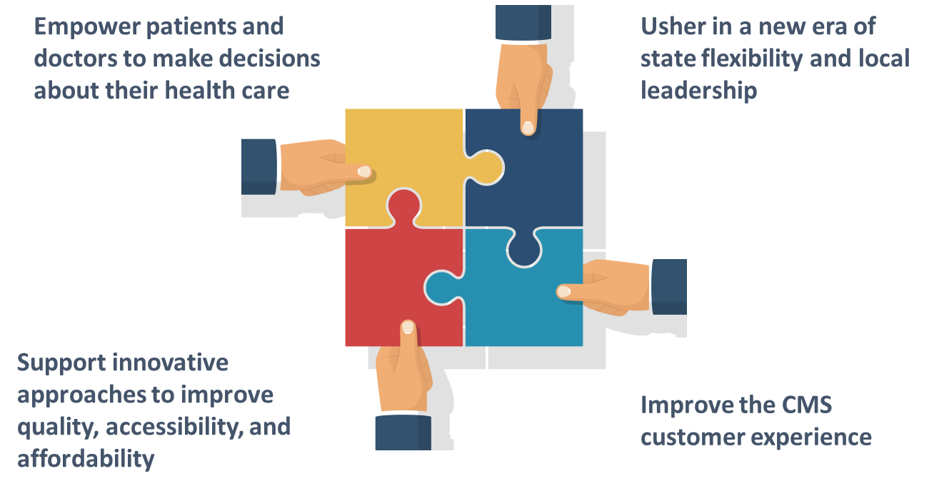
CMS Quality Measurement
A New Approach to Meaningful Outcomes
Notes:
My name is Kim Rawlings and I am from CMS. I am going to provide you an overview of the Meaningful Measures Initiative. A primary goal of the CMS administration is to remove obstacles that get in the way of the time that clinicians spend with their patients. We realize that this is incredibly important and precious time. It is often not long enough and so we want to try and optimize that. One method is to reduce regulatory burden. Of course, we know that some regulations are good and very necessary and really promote the health of the population, but at the same time we realize that there might be areas for improvement.
This has led us to develop our Meaningful Measures Initiative which is guided by CMS’ four strategic goals that you see here — empowering patients and doctors to make decisions about their healthcare; ushering in an era of state flexibility and local leadership; supporting innovative approaches to improve quality, and accessibility and affordability. And last but not least, improving the CMS customer experience. We recognize that there are too many measures. It can be difficult to understand how these measures fit together, which can lead to a lack of focus and there is an administrative burden of reporting. Through the Meaningful Measures Initiative, we are taking a new approach at evaluating what we do.

Slide 29
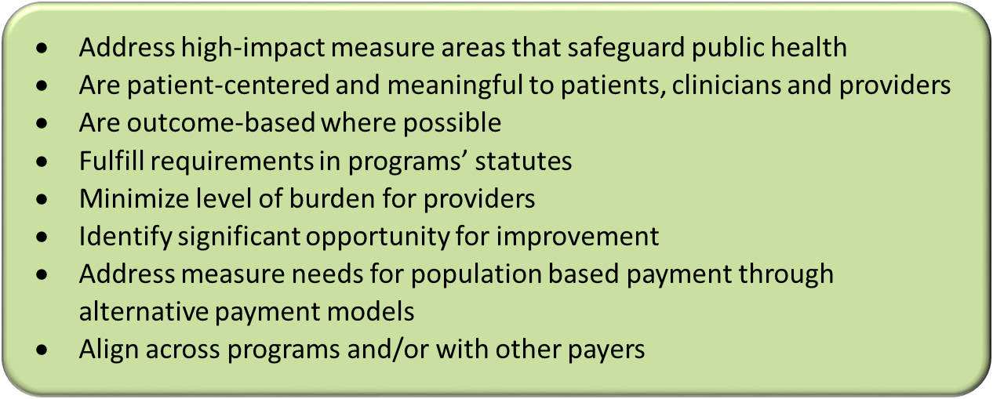
CMS Quality Measurement
Meaningful Measures Objectives
Meaningful Measures focus everyone’s efforts on the same quality areas and lend specificity, which can help identify measures that:
Notes:
At CMS we view ourselves as having unique opportunities to continue to guide real measurable improvements for the entire nation, while also encouraging the use of a more parsimonious measure sets, while still working to reduce the burden of measurement.

Slide 30

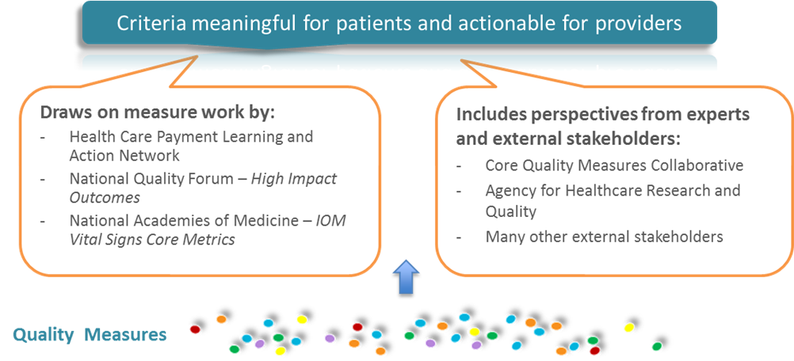
CMS Quality Measurement
Meaningful Measures
Notes:
With the help of our partners, we have identified key common quality issues to focus on. CMS introduced a comprehensive approach using the Meaningful Measures Framework to identify the highest priorities for quality measurement and improvement, and to assess the core issues that are most critical to providing high quality care and improving individual outcomes for our patients. Of course, because of the scope of this work the transformative nature of this initiative, we cannot do this alone at CMS. We cannot achieve this in isolation or in a silo, and so the Meaningful Measures Framework really draws on measures work and various perspectives from experts and external stakeholders that you see here. These bodies of work and stakeholders really provided us the basis for developing criteria around measures being meaningful to patients and having these be actionable for providers.

Slide 31
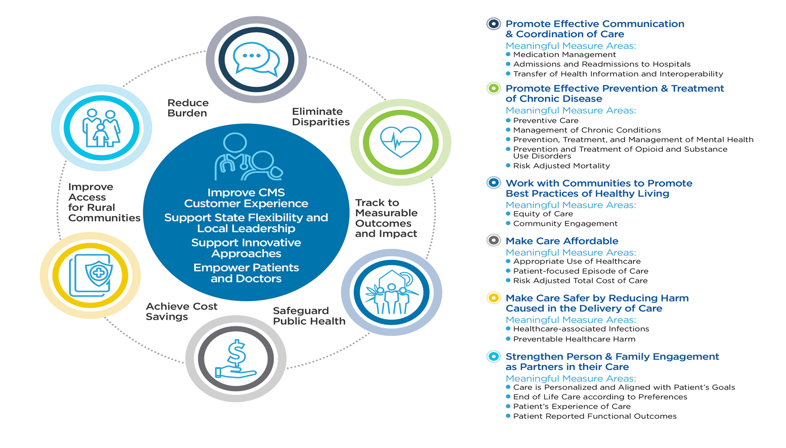
CMS Quality Measurement
Meaningful Measures
Notes:
This is the Meaningful Measures Framework. At the center you can see the patient is right there where he or she belongs along with our four strategic goals. These strategic goals connect to the six crosscutting criteria, which you can see around the circle: “eliminate disparities, track to measurable outcomes, safeguard public health, achieve cost savings, improve access to rural communities,” and last but not least “reduce burden.”
These crosscutting criteria serve as desired outcomes that CMS and our partners believe are critical for improving the healthcare system. Shown pictorially in the circles and then in bold on the right, there are six quality priorities. Hopefully, these are fairly familiar to you and you will be able to recognize them, but six quality priorities along with their 19 Meaningful Measure Areas that also track to the crosscutting criteria by working to support those desired outcomes.
For example, we have crosscutting criteria of achieving cost savings. How would we do that? We can look to the quality priority on the outside of the circle “making care affordable.” This quality priority has three Meaningful Measure Areas — appropriate use of healthcare, patient-focused episode of care and risk-adjusted total cost of care. By focusing on these Meaningful Measure Areas such as appropriate use of healthcare, we can work towards the crosscutting goal of achieving cost savings and ultimately meet our CMS strategic goals, and again all of this with the patient and provider in mind.

Slide 32
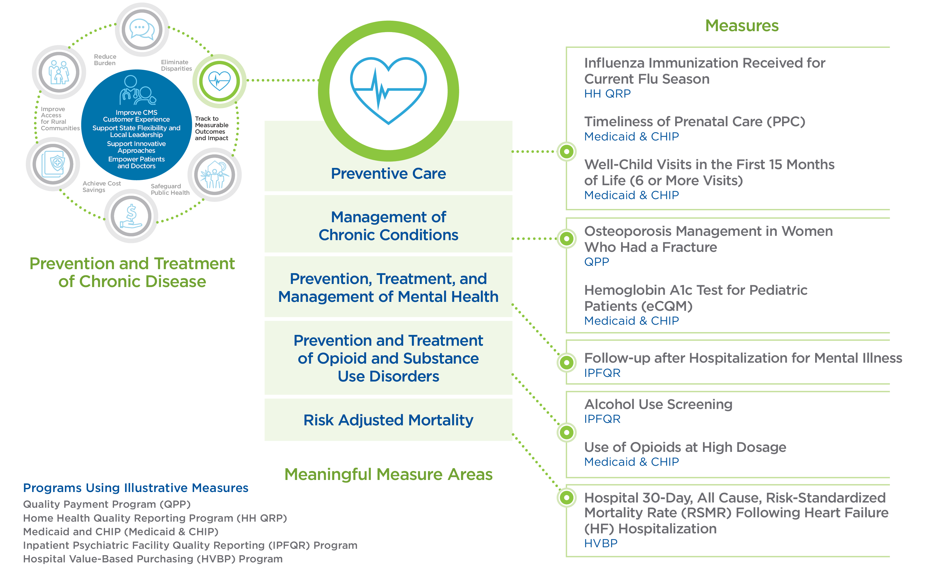
CMS Quality Measurement
Prevention and Treatment of Chronic Disease
Notes:
As an example, one of the six quality priorities is the prevention and treatment of chronic disease. It has five Meaningful Measure Areas: preventative care, management of chronic conditions, prevention, treatment and management of mental health, prevention and treatment of opioid and substance use disorders, and finally risk-adjusted mortality.
And then just to the right under measures we have examples of measures actively in our programs that would fit into each of these Meaningful Measure Areas. Each quality priority and their respective Meaningful Measures will guide the reduction of reporting burden on providers while focusing quality improvement efforts on only the most critical areas, and we are doing this by the adoption and evaluation of the most meaningful quality measures to drive better patient outcomes at lower costs.
One of the questions that we have received several times since this has rolled out in October of last year is how do Meaningful Measure Areas relate to existing CMS programs? The Meaningful Measures Initiative is not intended to replace any existing programs, create any new requirements or mandate new measures.
Again, this is about burden reduction and getting to the most Meaningful Measures possible. It is not creating additional requirements or work, and so the purpose is to use this framework to really help programs identify and select individual measures and increase measure alignment across programs. Of course, we are working with other public and private initiatives as well to hopefully align even across payers. We want to make sure that the agency is pointing to high-priority areas where there may be gaps in available quality measures and that will help guide CMS’ efforts to develop and implement quality measures to fill those gaps.

Slide 33
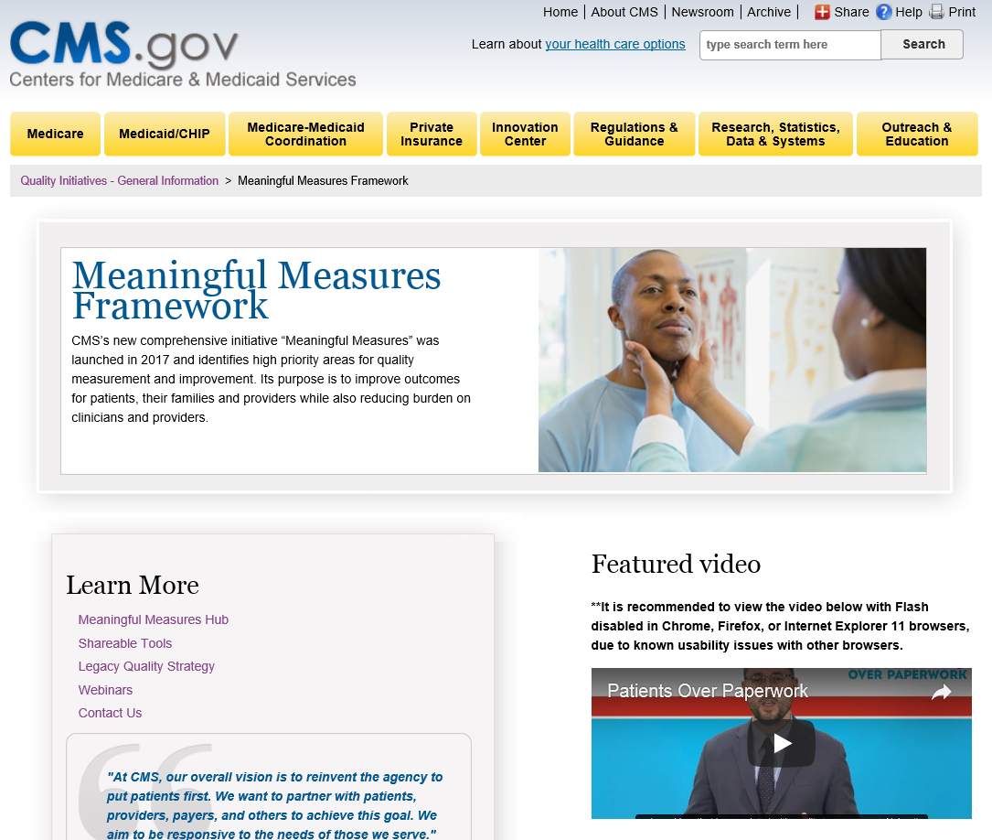
CMS Quality Measurement
Meaningful Measures Website
https://www.cms.gov/Medicare/Quality-Initiatives-Patient-Assessment-Instruments/QualityInitiativesGenInfo/CMS-Quality-Strategy.html
Notes:
We recently launched a Meaningful Measures website that serves as a hub for all of this information. It includes information on what this initiative is about. There are several videos that you can watch and lots of fact sheets, Q&As, and more detail on the 19 Meaningful Measure Areas.
As I stated before, we definitely cannot do this in isolation or in a vacuum, and so we welcome your feedback and thoughts and perspectives on this and the email where you can provide us that feedback is on the website as well. As someone who answers those emails, I can guarantee you that we respond to everyone and that we do read all of those emails and comments. I really encourage you to check out the website to learn more about it.
The CMS Measures Inventory Tool (CMIT) that Nicole mentioned earlier contains the Meaningful Measure Areas for some of our measures. We are working to incorporate that field so you can find more information there as well.

Slide 34
CMS Quality Measurement
References
CMS MMS Blueprint
  https://www.cms.gov/Medicare/Quality-Initiatives-Patient-Assessment-Instruments/MMS/Downloads/Blueprint-130.pdf
CMS Measures Inventory Tool (CMIT)
  https://cmit.cms.gov
CMS Pre-rulemaking
  https://www.cms.gov/Medicare/Quality-Initiatives-Patient-Assessment-Instruments/QualityMeasures/Pre-Rule-Making.html
MMS Website
  https://www.cms.gov/Medicare/Quality-Initiatives-Patient-Assessment-Instruments/MMS/Index.html

Slide 35

CMS Quality Measurement
Discussion Questions

Slide 36
CMS Quality Measurement
CMS Public Engagement Webinars
Planned Upcoming Webinars:
Today’s session will be held again next week for those that were not able to join today.
  Session #2: May 2, from 4:00-5:00pm EST
The next series of webinars will take a deeper look into ways for the public to participate in measure development and how you can get started in measure development.
  Session #3: May 17th from 4:00-5:00pm EST
  Session #4: May 23rd from 12:00-1:00pm EST
Email: MMSsupport@battelle.org

Slide 37
CMS Quality Measurement
CMS Measure Development Education & Outreach
Contact information:
Battelle
Measures Management System Contract Holder: Battelle
Contact: MMSsupport@Battelle.org
CMS
Golden Horton: Golden.Horton@cms.hhs.gov
Kimberly Rawlings: Kimberly.Rawlings@cms.hhs.gov

