Slide 1
Unpacking the CMS Meaningful Measurement and Improvement Strategy
January 31, 2019

Slide 2
Discussion Topics
Introduction
Meaningful Measures Overview
New Approach to Meaningful Outcomes
Four Strategic Goals
Objectives
Framework
Progress to Date
Next Steps
Resources
Panel of Speakers
Question & Answer Session

Slide 3
Learning Objectives
By the end of this presentation, participants should be able to:
Identify an objective of the Meaningful Measures initiative
Recognize the challenges with quality measures and quality measure development that have led to the need for the Meaningful Measures initiative
Recognize an example of how CMS has used the Meaningful Measures Framework to improve quality reporting.

Slide 4

Introduction
Primary goal of the Administration: Remove obstacles that get in the way of the time clinicians spend with their patients
Patients Over Paperwork
Shows CMS’s commitment to patient-centered care and improving beneficiary outcomes
Includes several major tasks aimed at reducing burden for clinicians
Motivates CMS to evaluate its regulations to see what could be improved

Slide 5
Speakers
Reena Duseja ,MD, MS
Tamyra Garcia, MPH
Kyle Campbell, PharmD
Dale Bratzler, DO, MPH

Slide 6
Meaningful Measures Overview
Reena Duseja, MD, MS
Chief Medical Officer
Quality Measurement and Value-Based Incentives Group
Centers for Medicare and Medicaid

Slide 7
A New Approach to Meaningful Outcomes
What is Meaningful Measures Initiative?
Launched in 2017, the purpose of the Meaningful Measures initiative is to:
Improve outcomes for patients
Reduce data reporting burden and costs on clinicians and other health care providers
Focus CMS’s quality measurement and improvement efforts to better align with what is most meaningful to patients

Slide 8
A New Approach to Meaningful Outcomes (Cont.)
Why Implement the Meaningful Measures Initiative?
There are too many measures and disparate measures
Administrative burden of reporting
Lack of simplified ways to focus on critical areas that matter most for clinicians and patients

Slide 9

CMS Strategic Goals
Empower patients and doctors to make decisions about their health care
Usher in a new era of state flexibility and local leadership
Meaningful Measures: Guided by Four Strategic Goals
Support innovative approaches to improve quality, accessibility, and affordability
Improve the CMS customer experience

Slide 10
Meaningful Measures Objectives
Meaningful Measures focus everyone’s efforts on the same quality areas and lend specificity, which can help identify measures that:
Address high-impact measure areas that safeguard public health
Are patient-centered and meaningful to patients, clinicians and providers
Are outcome-based where possible
Fulfill requirements in programs’ statutes
Minimize level of burden for providers
Identify significant opportunity for improvement
Address measure needs for population based payment through alternative payment models
Align across programs and/or with other payers

Slide 11
Meaningful Measures Framework
Meaningful Measure Areas Achieve
High quality healthcare
Meaningful outcomes for patients
Quality Measures
Criteria meaningful for patients and actionable for providers
Draws on measure work by:
Health Care Payment Learning and Action Network
National Quality Forum- High Impact Outcomes
National Academy of Medicine – IOM Vital signs Core Metrics
Includes perspectives from experts and external stakeholders:
Core Quality Measures Collaborative
Agency for Healthcare Research and Quality
Many other external stakeholders

Slide 12
Visions for Quality Reporting
KEY LEVERS
Engage Patients and Providers
Strengthen/Facilitate Interoperability
Optimize Public Reporting
Aligned Measure Portfolio
Aligned Quality Reporting and Value-based Purchasing
Measures development begins from a person-centered perspective
Involve patients and caregivers in measure development and public reporting efforts
Involve first-line health care professionals on the front line are involved in measure development, implementation, and data feedback processes
Ongoing, timely information is provided to health care professionals
Data collection and exchange is low burden
Quality measure data is fed into planning and implementation of quality improvement initiatives
Relevant, actionable data is accessible to a variety of audiences
Patients and caregivers have access to data
An enterprise-wide strategy for measure selection focuses on patient-centered, outcome, and longitudinal measures
Infrastructure supports development of health IT enabled measures
Aligned and streamlined policies and processes for quality reporting and value based purchasing programs
CMS demonstration programs have flexibility to test innovative models, while maintaining a desired end state of alignment with legacy CMS programs

Slide 13






Meaningful Measures
Promote Effective Prevention & Treatment of Chronic Disease
REDUCE BURDEN
Strengthen Person & Family Engagement as Partners in their Care
EMLIMINATE DISPARITIES
Promote Effective Communication & Coordination of Care
Make Care Affordable
REDUCE BURDEN
EMLIMINATE DISPARITIES
REDUCE BURDEN
REDUCE BURDEN
EMLIMINATE DISPARITIES
REDUCE BURDEN
EMLIMINATE DISPARITIES
REDUCE BURDEN
EMLIMINATE DISPARITIES
REDUCE BURDEN
EMLIMINATE DISPARITIES
EMLIMINATE DISPARITIES
Make Care Safer by Reducing Harm
Caused in the Delivery of Care
Meaningful Measure Areas:
Meaningful Measure Areas:
Meaningful Measure Areas:
Work With Communities to Promote Best Practices of Healthy Living
Preventive Care
Management of Chronic Conditions
Prevention, Treatment, and Management of Mental Health
Prevention and Treatment of Opioid and Substance Use Disorders
Risk Adjusted Mortality
Meaningful Measure Areas:
Appropriate Use of Healthcare
Patient-focused Episode of Care
Risk Adjusted Total Cost of Care
Care is Personalized and Aligned with Patient’s Goals
End of Life Care according to Preferences
Patient’s Experience of Care
Patient Reported Functional Outcomes
IMPROVE ACCESS FOR RURAL COMMUNITIES
Improve CMS Customer Experience Support State Flexibility and Local Leadership Support Innovative Approaches
Empower Patients and Doctors
TRACK TO MEASURABLE OUTCOMES & IMPACT
Meaningful Measure Areas:
Medication Management
Admissions and Readmissions to Hospitals
Transfer of Health Information and Interoperability
IMPROVE ACCESS FOR RURAL COMMUNITIES
Improve CMS Customer Experience Support State Flexibility and Local Leadership Support Innovative Approaches
Empower Patients and Doctors
TRACK TO MEASURABLE OUTCOMES & IMPACT
Meaningful Measure Areas:
IMPROVE ACCESS FOR RURAL COMMUNITIES
TRACK TO MEASURABLE OUTCOMES & IMPACT
Healthcare-Associated Infections
Preventable Healthcare Harm
IMPROVE ACCESS FOR RURAL COMMUNITIES
Improve CMS Customer Experience Support State Flexibility and Local Leadership Support Innovative Approaches
Empower Patients and Doctors
TRACK TO MEASURABLE OUTCOMES & IMPACT
IMPROVE ACCESS FOR RURAL COMMUNITIES
Improve CMS Customer Experience Support State Flexibility and Local Leadership Support Innovative Approaches
Empower Patients and Doctors
TRACK TO MEASURABLE OUTCOMES & IMPACT
IMPROVE ACCESS FOR RURAL COMMUNITIES
Improve CMS Customer Experience Support State Flexibility and Local Leadership Support Innovative Approaches
Empower Patients and Doctors
TRACK TO MEASURABLE OUTCOMES & IMPACT
IMPROVE ACCESS FOR RURAL COMMUNITIES
Improve CMS Customer Experience Support State Flexibility and Local Leadership Support Innovative Approaches
Empower Patients and Doctors
TRACK TO MEASURABLE OUTCOMES & IMPACT
Improve CMS Customer Experience Support State Flexibility and Local Leadership Support Innovative Approaches
Empower Patients and Doctors
Equity of Care
Community Engagement
ACHIEVE COST SAVINGS
SAFEGUARD PUBLIC HEALTH
ACHIEVE COST SAVINGS
SAFEGUARD PUBLIC HEALTH
ACHIEVE COST SAVINGS
SAFEGUARD PUBLIC HEALTH
ACHIEVE COST SAVINGS
SAFEGUARD PUBLIC HEALTH
ACHIEVE COST SAVINGS
SAFEGUARD PUBLIC HEALTH
ACHIEVE COST SAVINGS
SAFEGUARD PUBLIC HEALTH
ACHIEVE COST SAVINGS
SAFEGUARD PUBLIC HEALTH

Slide 14
Promote Effective Communication & Coordination of Care
MEANINGFUL MEASURE AREAS:
MEDICATION MANAGEMENT
ADMISSIONS AND READMISSIONS TO HOSPITALS
TRANSFER OF HEALTH INFORMATION AND INTEROPERABILITY
Measures
Use of High Risk Medications in the Elderly - QPP
Medication Reconciliation Post-Discharge - MSSP
Annual Monitoring for Patients on Persistent Medications (MPM) - QRS
Drug Regimen Review Conducted with Follow-Up for Identified Issues - IRF QRP, LTCH QRP, SNF QRP, HH QRP
Measures
Standardized Readmission Ratio (SRR) - ESRD QIP
Plan All-Cause Readmissions - Medicaid & CHIP
Measures
Use of an Electronic Health Record - IPFQR, QIO
Programs Using Illustrative Measures
Long-Term Care Hospital Quality Reporting Program (LTCH QRP)
Home Health Quality Reporting Program (HH QRP)
End-Stage Renal Disease Quality Incentive Program (ESRD QIP)
Medicaid and CHIP (Medicaid & CHIP)
Inpatient Psychiatric Facility Quality Reporting (IPFQR) Program
Quality Improvement Organization (QIO)
Quality Payment Program (QPP)
Medicare Shared Savings Program (MSSP)
Health Insurance Marketplace Quality Rating System (QRS)
Inpatient Rehabilitation Facility Quality Reporting Program (IRF QRP)
Skilled Nursing Facility Quality Reporting Program (SNF QRP)

Slide 15
Promote Effective Prevention & Treatment of Chronic Disease
MEANINGFUL MEASURE AREAS:
PREVENTIVE CARE
MANAGEMENT OF CHRONIC CONDITIONS
PREVENTION, TREATMENT, AND MANAGEMENT OF MENTAL HEALTH
PREVENTION AND TREATMENT OF OPIOID AND SUBSTANCE USE DISORDERS
RISK ADJUSTED MORTALITY
Measures
Measures
Influenza Immunization Received for Current Flu Season - HH QRP
Timeliness of Prenatal Care (PPC) - Medicaid & CHIP
Well-Child Visits in the First 15 Months of Life (6 or More Visits) - Medicaid & CHIP
Measures
Hospital 30-Day, All Cause, Risk-Standardized Mortality Rate (RSMR) Following Heart Failure (HF) Hospitalization - HVBP
Osteoporosis Management in Women Who Had a Fracture - QPP
Hemoglobin A1c Test for Pediatric Patients (eCQM) - Medicaid & CHIP
Measures
Measures
Follow-up after Hospitalization for Mental Illness - IPFQR
Alcohol Use Screening - IPFQR
Use of Opioids at High Dosage - Medicaid & CHIP
Programs Using Illustrative Measures
Quality Payment Program (QPP)
Home Health Quality Reporting Program (HH QRP)
Medicaid and CHIP (Medicaid & CHIP)
Inpatient Psychiatric Facility Quality Reporting (IPFQR) Program
Hospital Value-Based Purchasing (HVBP) Program

Slide 16
Getting to Measures that Matter
The Meaningful Measures Initiative:
Aligns with existing quality reporting programs and helps programs to identify and select individual measures
Allows clinicians and other health care providers to focus on patients and improve quality of care in ways that are meaningful to them
Intends to capture the most impactful and highest priority quality improvement areas for all clinicians including specialists
Is used to guide rulemaking, measures under construction lists, and impact assessments

Slide 17



From Vision to Reality: Progress to Date

Slide 18
Meaningful Measures: Progress to Date
MUC Lists
In 2017, narrowed the initial 184 measures submitted during the open call for measures to 32 measures (83% reduction); this reduced stakeholder review efforts
The 32 measures:
Focus on achieving high quality health care and meaningful outcomes for patients, while minimizing burden
Have the potential to drive improvement in quality across numerous settings of care, including clinician practices, hospitals, and dialysis facilities
In 2018, experienced lower measure submissions because CMS was able to articulate the specific types of measures we were looking for; this reduced CMS and stakeholder review efforts

Slide 19
Meaningful Measures: Progress to Date
In the FY 19 Medicare Hospital IPPS and LTCH Prospective Payment System Proposed Rule, CMS proposed:
Eliminating a total of 19 measures (and decreasing duplication for an additional 21 measures) that acute care hospitals are currently required to report across the 5 hospital quality and value-based purchasing programs
Removing 8 of the 16 CQMs to produce a smaller set of more meaningful measures and in alignment with the Hospital IQR Program beginning with the 2020 reporting period
Removing certain measures that do not emphasize interoperability and the electronic exchange of health information
Adding new measures, such as Query of the PDMP and Verify Opioid Treatment Agreement, related to e-prescribing of opioids
Notes:
Source: https://www.cms.gov/Newsroom/MediaReleaseDatabase/Fact-sheets/2018-Fact-sheets-items/2018-04-24.html

Slide 20
Meaningful Measures: Progress to Date
In the Quality Payment Program Year 3 NPRM, CMS proposed:
Removing low-value and low-priority process measures
Focusing on meaningful quality outcomes for patients
Moving clinicians to a smaller set of Objectives and Measures with scoring based on performance for the Promoting Interoperability performance category
Using the “ABC™ methodology” for public reporting on Physician Compare, to determine benchmarks on historical data to provide clinicians and groups with valuable information about the benchmark before data collection starts for the performance period; the goal is to help make measures more meaningful to patients and caregivers
Notes:
Source: Draft QPP Year 3 NPRM Fact Sheet

Slide 21

Meaningful Measures Future Direction
Use the foundation of the Meaningful Measures framework to:
Engage with key stakeholders to help move towards achieving high value outcomes in our CMS programs.
Better support providers who invest in practice innovation, care re-design and coordination through new and revised alternative payment models.
Advance options for feedback and data analysis, improving data collection and submission systems through technology, and enhancing population health management initiatives.
GIVE US YOUR FEEDBACK!
MeaningfulMeasuresQA@cms.hhs.gov

Slide 22

Meaningful Measures Website
Go to:
https://www.cms.gov/Medicare/Quality-Initiatives-Patient-Assessment-Instruments/QualityInitiativesGenInfo/CMS-Quality-Strategy.html

Slide 23
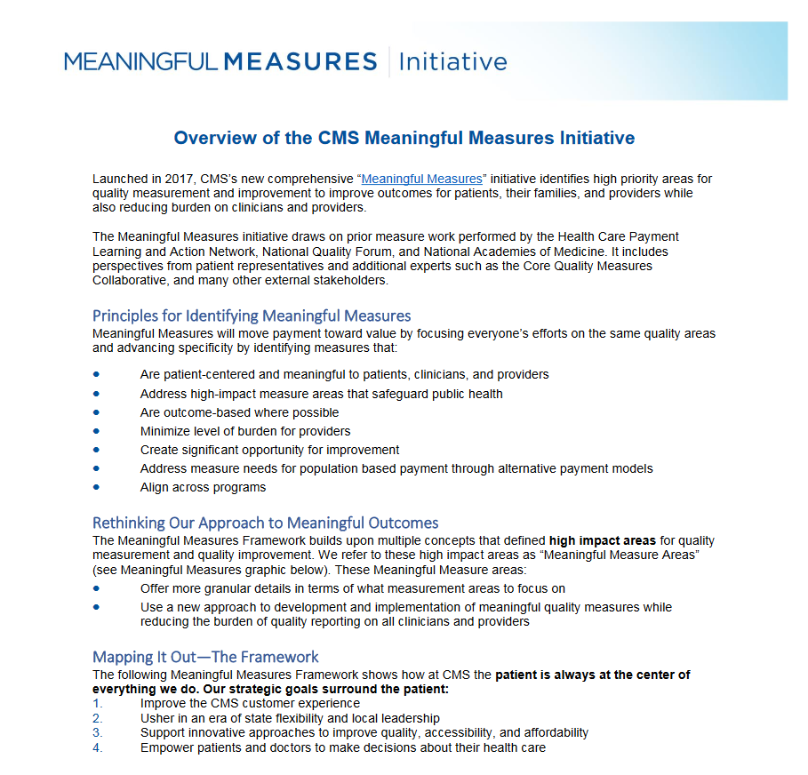
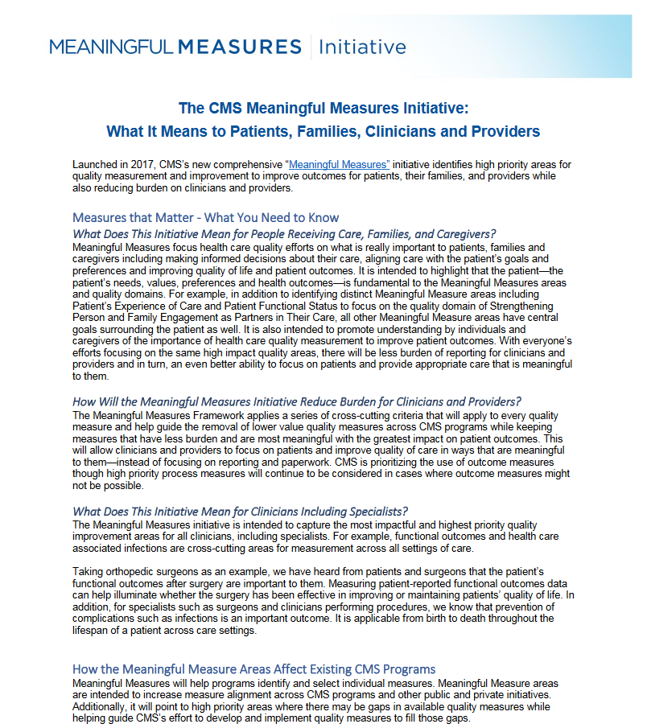

Meaningful Measures Fact Sheets
https://www.cms.gov/Medicare/Quality-Initiatives-Patient-Assessment-Instruments/QualityInitiativesGenInfo/MMF/Shareable-Tools.html

Slide 24
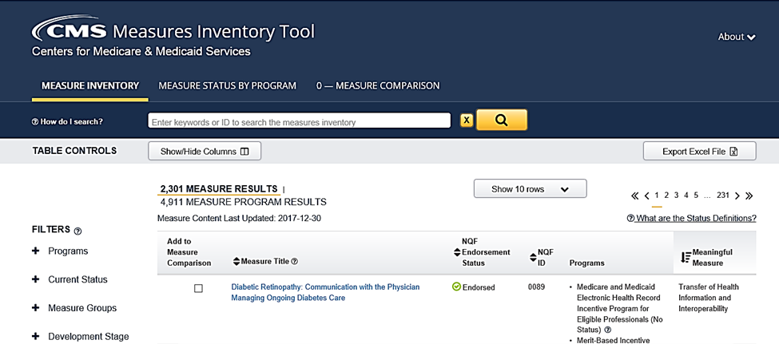
Where to Find Meaningful Measures
CMS Measures Inventory Tool: cmit.cms.gov

Slide 25
Tamyra Garcia, MPH Acting Deputy Group Director Quality Measurement and Value-Based Incentives Group Centers for Medicare and Medicaid

Slide 26

Applying the Meaningful Measures Framework to CMS Program
Goal: To create the most clinically meaningful, parsimonious measures set for each program.
Applied the clinical priorities set forth in the Meaningful Measures Initiative
Leveraged Guiding Principals to inform decisions
(3) Engaged CMS Leadership using red-yellow-green approach
(4) Solicited public comment
(5) Finalized measures based on public comment
Current State: Identifying gaps for further measure development.

Slide 27
Meaningful Measurement takes may concepts into account to determine the future of a measure
Meaningful Measures Framework Guiding Principals to inform measure by measure decisions:
How do external stakeholders (ex. Beneficiaries, clinicians, specialty societies, quality improvement organizations, providers) use this measure?
Does this measure fulfill a statutory requirement? Is there another measure that can meet the statutory requirement?
Consider alignment with other programs. Do other programs/payers use of the measure?
Is this measure used in conjunction with another measure to ascertain performance? What is the measure’s relationship with other measures in the program? Is the measure a part of a core set?
What is the level of reporting burden for providers?
What does the performance and trend data tell? Do we see improvement over time?
Notes:
Emphasize— same process, new tool to use— MM is one component to factor in when considering measure selection/removal

Slide 28
Inpatient Quality Reporting Program EXAMPLE
Measure proposed for Removal
Influenza Immunization | Chart Prevention / Pop. Health | IQR: Used in IPFQR; Used by The Joint Commission; Part of HRSA MBQIP's core measure set. Trends: IQR - Topped out; Measure rate was 86 in Q1 2012, now 93.6 in Q4 2016. | Remove
Measure “to be retained” in HVBP and proposed for removal in IQR
Hospital-Level Risk-Standardized Complication Rate Following Elective Primary Total Hip Arthroplasty and/or Total Knee Arthroplasty | Claims Outcome – Clinical Care | IQR: Used in CMMI's Comprehensive Joint Replacement Model. HVBP: HVBP will begin using for FY 2019 payment adjustments. Data collected through IQR. Trends: IQR & HVBP - Not topped-out; median rate 3.26 in Q3 2010-Q2 2013, now 2.74 in Q2 2013-Q1 2016. | Under Discussion | Retain

Slide 29
What have we learned?
What is next?
Identifying gaps for further measure development

Slide 30
Kyle Campbell, PharmD
Vice President, Pharmacy and Quality Measurement, HSAG

Slide 31
Applying Meaningful Measures to Our Work
Used Meaningful Measures to support:
Measure Development
Measure Evaluation
CMS Measure Development Plan (MDP) and Annual Report
Key Benefits:
Provides a focused conceptual framework to address national healthcare priorities
Establishes clear objectives for quality measures (e.g., minimize burden)
Supports consistency between measure development and evaluation activities

Slide 32
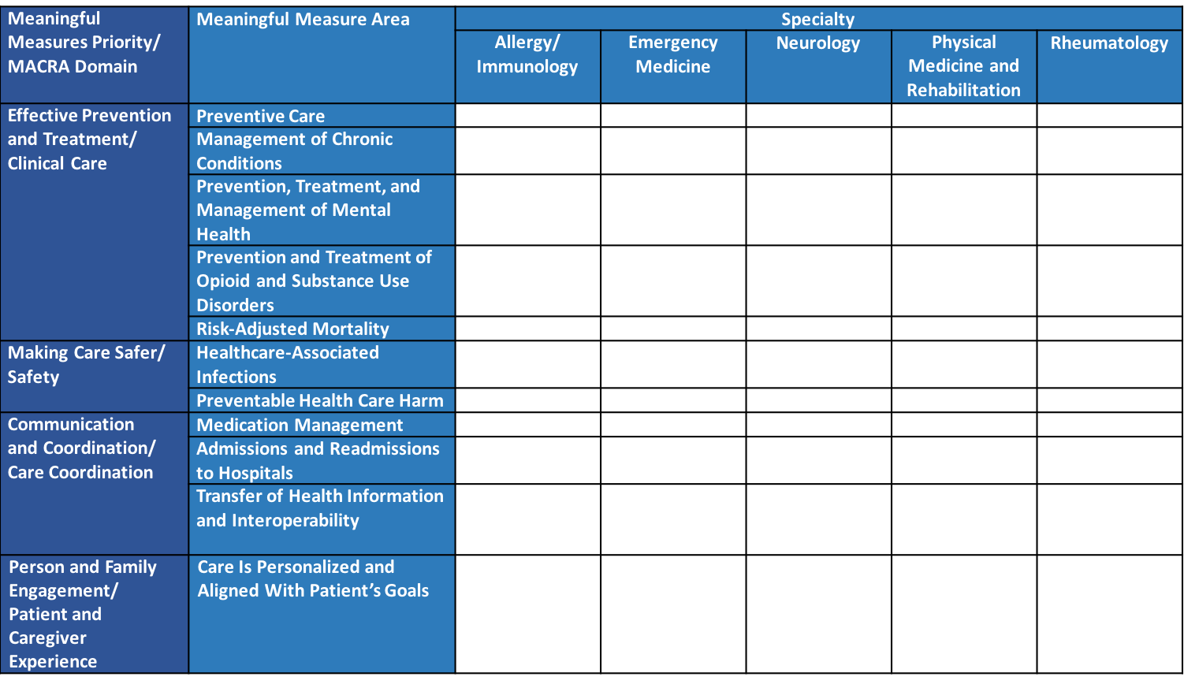
Conceptual Framework Supporting Clinician Specialty Measure Development

Slide 33
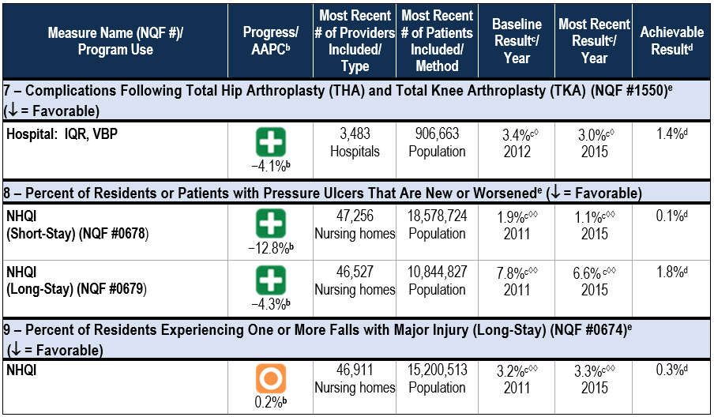
Preventable Harm Dashboard from the 2018 Impact Assessment Report

Slide 34
Dale Bratzler, DO, MPH
Enterprise Chief Quality Officer, Oklahoma University Health Sciences Center

Slide 35
Q and A
&
Q
A

Slide 36
Thank you!

