Slide 1

2017 CMS Measures under Consideration and the Measure Applications Partnership
2019 Pre-Rulemaking Kickoff
Measures Under Consideration and Measure Applications Partnership Overviews
Kimberly Rawlings, CMS
Maria Durham, CMS
Susan Arday, CMS
Christine Holland, Mathematica
Mary Sheehan, Battelle
Helen Dollar-Maples, CMS
Vince Brown, Battelle
April 16, 2019

Slide 2
Housekeeping
The meeting is moderated.
All lines will be muted during the presentation.
The meeting is being recorded and will be uploaded to the CMS website for future viewing. The meeting facilitator will send the link to the recording in a follow-up email.
Questions will be accepted later in the presentation.

Slide 3
Agenda
Meaningful Measures Overview
Interoperability
Pre-rulemaking Overview
CMS Measures Inventory Tool (CMIT)/Environmental Scan Support Tool (ESST) Demo
Measure Applications Partnership (MAP)
Lessons Learned/Updates
Live Demonstration of Jira
Question and Answer Session

Slide 4
What is Meaningful Measures Initiative?
Launched in 2017, the purpose of the Meaningful Measures initiative is to:
Improve outcomes for patients
Reduce data reporting burden and costs on clinicians and other health care providers
Focus CMS’s quality measurement and improvement efforts to better align with what is most meaningful to patients

Slide 5
Why Implement the Meaningful Measures Initiative?
There are too many measures and disparate measures
Administrative burden of reporting
Lack of simplified ways to focus on critical areas that matter most for clinicians and patients
Notes:
As measures go through the pre-rulemaking cycle and get to the MAP, people have expressed difficulty with connecting the measure with the previous CMS quality strategy. Meaningful Measures makes that connection between the quality work of CMS and the measures in our programs.

Slide 6

Meaningful Measures graphic
Empower patients and doctors to make decisions about their health care
Usher in a new era of state flexibility and local leadership
Support innovative approaches to improve quality, accessibility, and affordability
Improve the CMS customer experience
Notes:
As measures go through the pre-rulemaking cycle and get to the MAP, people have expressed difficulty with connecting the measure with the previous CMS quality strategy. Meaningful Measures makes that connection between the quality work of CMS and the measures in our programs.

Slide 7
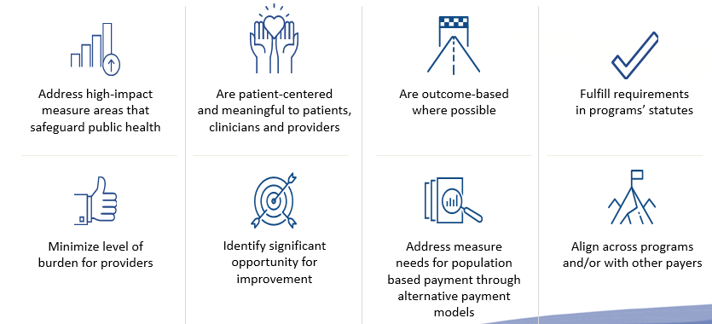
Meaningful Measures Objectives
Meaningful Measures focus everyone’s efforts on the same quality areas and lend specificity, which can help identify measures that:
Notes:
Meaningful Measures objectives:
Ensure that we are developing the best and highest quality measures possible
Ensuring that everyone is going in the same direction
Ensuring that all of our efforts are focused on the same types of measures
What characteristics are we looking at?
What characteristics should those measures have?
We have some program statutes that need to be fulfilled, i.e., aligning measures across programs with other payers as with the clinical quality measure collaborative and ensuring our measures are addressing high impact areas and are outcome-based where possible.

Slide 8
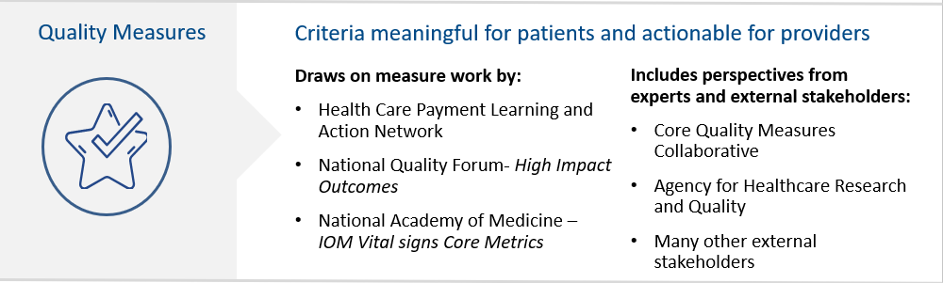
Meaningful Measures Framework
Meaningful Measure Areas Achieve
High quality healthcare
Meaningful outcomes for patients
Notes:
Within this framework, our two goals are to ensure that we are providing high quality healthcare for patients and having meaningful outcomes for patients. We drew on lots of work from others, including the launch at LAN. There were several tie-ins with NQF, and NAM also played a critical part in this process. We included perspectives from several others, both internal and external to government.

Slide 9
Visions for Quality Reporting
KEY LEVERS
Engage Patients and Providers
Strengthen/Facilitate Interoperability
Optimize Public Reporting
Align Measure Portfolio
Align Quality Reporting and Value-based Purchasing
Measures development begins from a person-centered perspective
Involve patients and caregivers in measure development and public reporting efforts
Involve first-line health care professionals on the front line who are involved in measure development, implementation, and data feedback processes
Ongoing, timely information is provided to health care professionals
Data collection and exchange is low burden
Quality measure data is fed into planning and implementation of quality improvement initiatives
Relevant, actionable data is accessible to a variety of audiences
Patients and caregivers have access to data
An enterprise-wide strategy for measure selection focuses on patient-centered, outcome, and longitudinal measures
Infrastructure supports development of health IT enabled measures
Aligned and streamlined policies and processes for quality reporting and value based purchasing programs
CMS demonstration programs have flexibility to test innovative models, while maintaining a desired end state of alignment with legacy CMS programs
Notes:
Here we articulate several key levers that helps us achieve this work more globally. Things that not only we can align with throughout the agency, but also other things that we think non-CMS developers can really support.

Slide 10
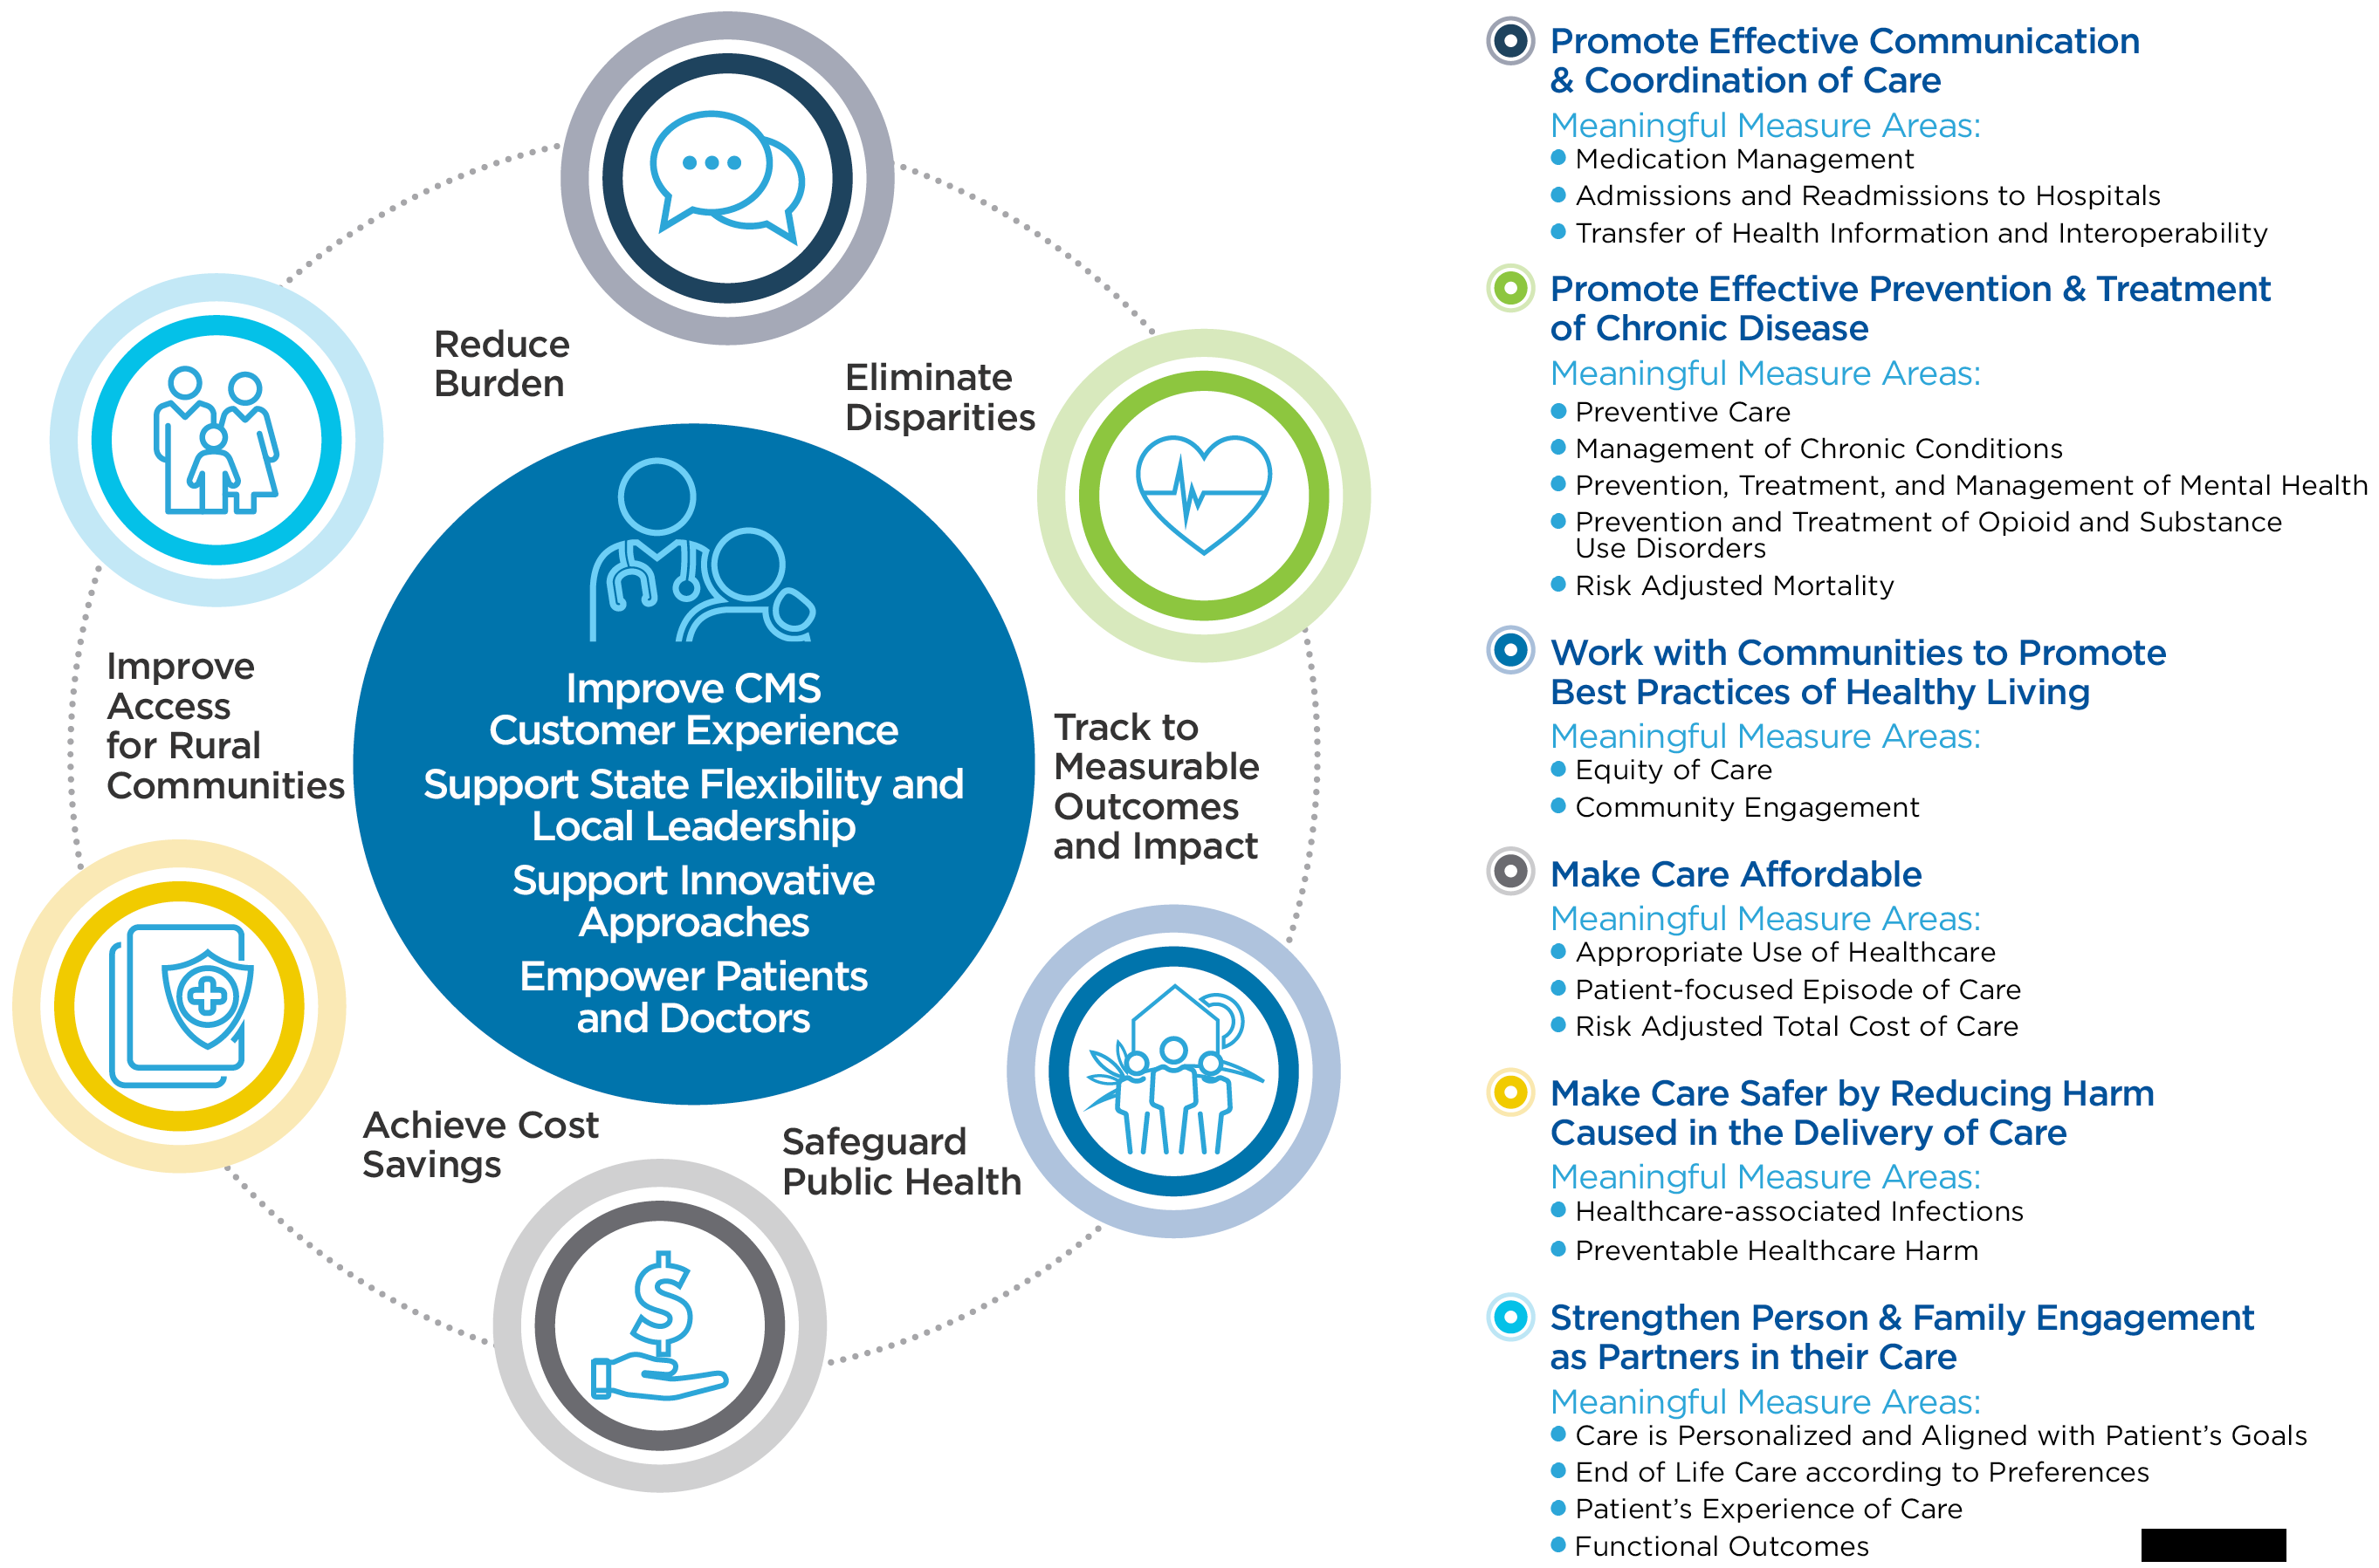
Meaningful Measures Framework
Notes:
At the center of this Meaningful Measures Framework are our four CMS strategic goals along with a pictorial depiction of the provider and patients, which again emphasizes that that relationship is at the core of this strategy.
The six crosscutting criteria are to eliminate disparities, track to measurable outcomes and impact, safeguard public health, achieve cost savings, improve access for rural communities and reduce burden. By crosscutting criteria we infer that these are criteria that all measures should touch upon when implemented into our programs.
In the bolded list are our six healthcare priorities — promote effective communication and coordination, promote effective prevention and treatment of chronic disease, work with communities to promote best practices of healthy living, make care affordable, make care safer by reducing harm caused in the delivery of care, and strengthen person and family engagement as partners in their care.
Underneath those are 19 Meaningful Measure Areas (MMAs). The MMAs make this link between this very broad quality priority such as “make care affordable” and the actual measure. Think of it as a couple of categories underneath “make care affordable” that are a bit more specific to help make the connection.

Slide 11
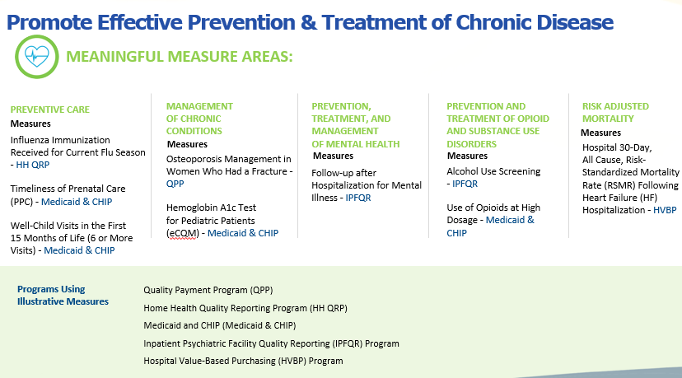
Promote Effective Prevention & Treatment of Chronic Disease
Notes:
Here is the healthcare priority of “promote effective prevention and treatment of chronic disease,” and underneath that the five MMAs. The Meaningful Measure Areas (MMAs) guide our work, not only in us trying to articulate to you the areas that we’re most interested in, but also working to categorize our measures by these areas so we can more clearly see gaps.
Example:
“Here’s where we see a gap in management of chronic conditions. We would like more measures in this area.”
Communication is key as it helps us better focus and articulate our needs and priorities. Obviously, with the pre-rulemaking and creation of the MUC List this helps us articulate those priorities for us. When entering a measure into JIRA you’ll be asked to assign a Meaningful Measure Area (MMA) to the measure.

Slide 12

CMS Interoperability Roadmap
Notes:
We will address CMS’ strategic priorities for 2019. Seema Verma, our administrator, addressed this at the quality conference. She spoke about focusing on results, empowering patients and unleashing innovation. She further spoke about transparency and innovative payment mechanisms to help assist us towards achieving these three goals which all rely on interoperability. Interoperability refers to technology and the ability to share data seamlessly which clearly is very important in healthcare.

Slide 13

A lack of seamless data exchange in healthcare
A lack of seamless data exchange in healthcare…
leads to disconnected care, worse health outcomes, and higher costs.
Notes:
There are many players when requiring healthcare services. Insurance coverage may be provided by Medicare, either Parts A, B, C, D. There are 50 different state Medicaid programs, Medi-Cal in California, Medicare Advantage, Medigap plans, CHIP, the Veteran’s Administration (VA), the military and hundreds of thousands of private employer-provided plans, as well as the individual insurance markets. Each plans has its own web of providers, suppliers, facilities and other partners that overlap and intersect and all participate in the health of Americans. Advancing interoperability is very important, since we require data to track patient progress and to understand quality. Insurance companies such as CMS cannot tie payment to outcomes, which is the very underpinning of all CMS quality programs.
Interoperability example:
While running a jogger trips which results in a broken elbow. The jogger later hand-delivers the CD containing the elbow X-ray from the initial doctor’s office visit to the specialist who will provide a proper plan of care. This lack of interoperability may lead to disconnected care, worse health outcomes and higher costs, since it is likely that the specialist will have retaken the X-rays.

Slide 14

Interoperable healthcare data exchange…
enables coordinated care, improved health outcomes, and reduced cost.
Notes:
Patients should be able to take ownership of their own health data. With greater technical efficiency we will not need to repeat expensive tests. We will also decrease the risk of adverse drug interactions, and so having an interoperable healthcare data exchange is a way of putting the patients first.

Slide 15
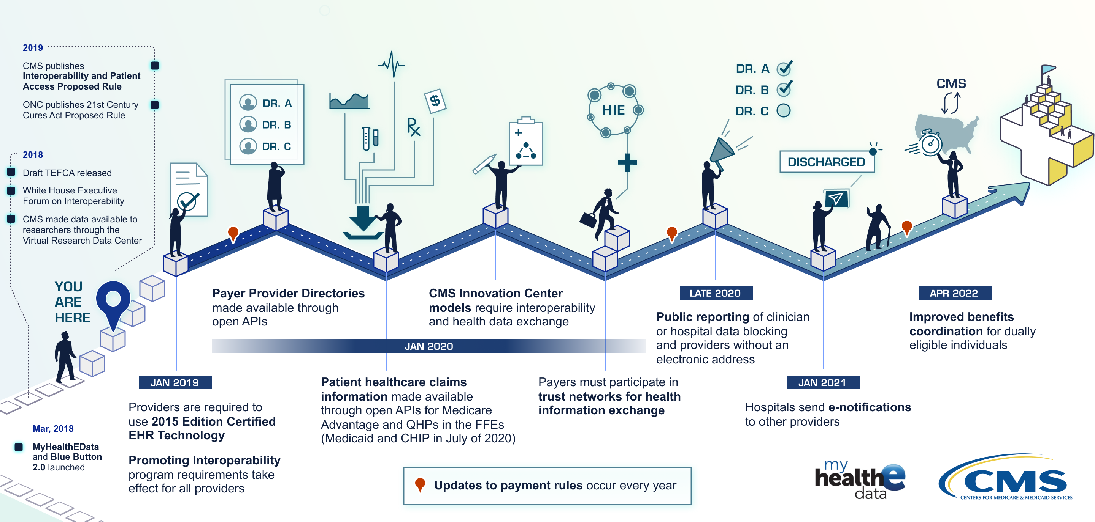
How might we get there?
The proposed rule would lay the foundation for healthcare interoperability.
Notes:
In the beginning stages with the Meaningful Measures work, CMS was looking at measure sets and reducing measures that weren't meaningful and identified gaps. We are changing the way measures are reported and the way the data is transported.
We are creating policies that drive a system whereby doctors and their patients are incentivized to make sound decisions based on patient information in a safe and secure environment. Interoperability will support our quality work by helping to ensure that low burden of data collection and exchange, and make sure that quality measure data feeds into the planning and implementation of quality improvement activities. EHR-based eCQMs are considered a very high priority for CMS and for most of our programs, and additionally we’re considering FHIR standards to help make them even better.
Although EHRs are only a component of interoperability, they’re essential to the overall solution. Our ability to standardize on structures, semantics, on common meanings of medical terms, is quintessential to the success of data sharing. By proposing FHIR standards we are promoting scalable data sharing, not just for an individual patient record from hospital-to-hospital, but as a model that supports the flow of information across the entire healthcare system. In a sense, interoperability is baked into Meaningful Measures at a variety of levels.

Slide 16
HOW DOES THIS RELATE TO OUR QUALITY MEASURES?
HOW DOES THIS RELATE TO OUR QUALITY MEASURES?
Notes:
In addition to the MMA titled “transfer of health information and interoperability” we have crosscutting criteria to track to measurable outcomes and impact, achieve cost savings and reduce burden. We also have quality priorities such as “promote effective communication and coordination of care.” Advancing interoperability not only supports these but also advances these areas; therefore, interoperability is part of that solution.

Slide 17
Overview of Pre-Rulemaking

Slide 18
Pre-Rulemaking
Statutory Reference
Section 3014 of the Patient Protection and Affordable Care Act
Section 1890 and 1890A of the Social Security Act
Pre-rulemaking Steps
CMS annually publishes the Measures under Consideration (MUC) List by December 1
National Quality Forum (NQF) convenes Multi-Stakeholder Groups Measure Applications Partnership (MAP)
MAP provides recommendations and feedback to the Secretary annually by February 1

Slide 19
Caveats
Measures in current use do not need to go on the Measures under Consideration List again
Exceptions are measure being expanded into other CMS program(s) or measure undergoing substantial changes
Submissions will be accepted this year if the measure was submitted to be on a prior year's MUC List, but was not accepted by any CMS program(s).
Measure specifications may change over time. If a measure has significantly changed, you may submit it again for consideration

Slide 20
Pre-Rulemaking Process - Medicare Programs
The pre-rulemaking process applies to certain programs and measures.
Medicare Programs
Ambulatory Surgical Center Quality Reporting | Inpatient Psychiatric Facility Quality Reporting
End-Stage Renal Disease Quality Incentive | Inpatient Rehabilitation Facility Quality Reporting
Home Health Quality Reporting | Long-Term Care Hospital Quality Reporting
Hospice Quality Reporting | Medicare and Medicaid Promoting Interoperability Program for Eligible Hospitals and Critical Access Hospitals (CAHs)
Hospital-Acquired Condition Reduction | Medicare Shared Savings
Hospital Inpatient Quality Reporting | Merit-based Incentive Payment System
Hospital Outpatient Quality Reporting | Prospective Payment System-Exempt Cancer Hospital Quality Reporting
Hospital Readmissions Reduction | Skilled Nursing Facility Quality Reporting
Hospital Value-Based Purchasing | Skilled Nursing Facility Value-Based Purchasing
Notes:
Not every single program goes through the pre-rulemaking cycle; only these 18 listed here which are all Medicare quality programs.

Slide 21
Pre-Rulemaking Process
Measure selection considerations include the following:
Does the submission align with the quality priorities?
Is the candidate measure fulfilling a Meaningful Measure area gap for this program?
Take a cascading look across programs to identify potential duplication of measures from both the private and public sectors; if so, maybe the newer version is enhanced in some way? In this scenario, could the original measure be removed?
Is the measure evidence-based, fully developed and tested; would the measure be burdensome to operationalize?
Endorsement status?
Notes:
We use Meaningful Measures both to evaluate measures in our programs, but also to categorize measures and note gaps where we need new measures. We will be speaking more on this on April 25th. Each program will walk through the needs and priorities of their particular program. Regarding “measure is evidence-based, fully developed and tested,” this is where a majority of measures or is likely our number one reason for measures not being accepted onto the MUC List.

Slide 22
Measures Implementation Timeline
Approximation in Months
← 1 | 4 | 8 | 12 | 16 | 20 | 24 | 28 →
Develop & test new measure initial concept (ongoing process) | Submit measures to MUC process | Review and clearance | MUC List published annually | MAP public process and workgroup recomm. | HHS and CMS develop Proposed Rules for measures | Issue Final Rules | Measures adopted in the field
Notes:
Once a measure is completely developed and tested, then it starts the measure implementation timeline. You submit it to the MUC List through JIRA which is what’s happening right now. It closes shortly in early June. We then review all measure submissions, make recommendations, put that list through clearance and publish the MUC List annually — by December 1st.
The MAP workgroup then weighs in and makes recommendations by February. CMS and HHS will take those recommendations of the measures and the MUC List and put some of those measures into the proposed rule for that program. The final rule is issued, and then finally as a last step in the implementation timeline the measures are adopted in the field.

Slide 23
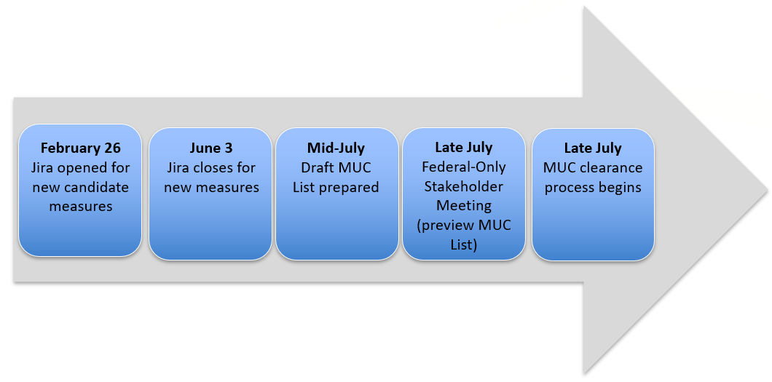
Measures under Consideration List Publishing
Notes:
This timeline is earlier this year to enable our rule writers a bit more time to digest the MAP’s recommendations and allow people more time to have public comment on the NPRMs and rules.

Slide 24
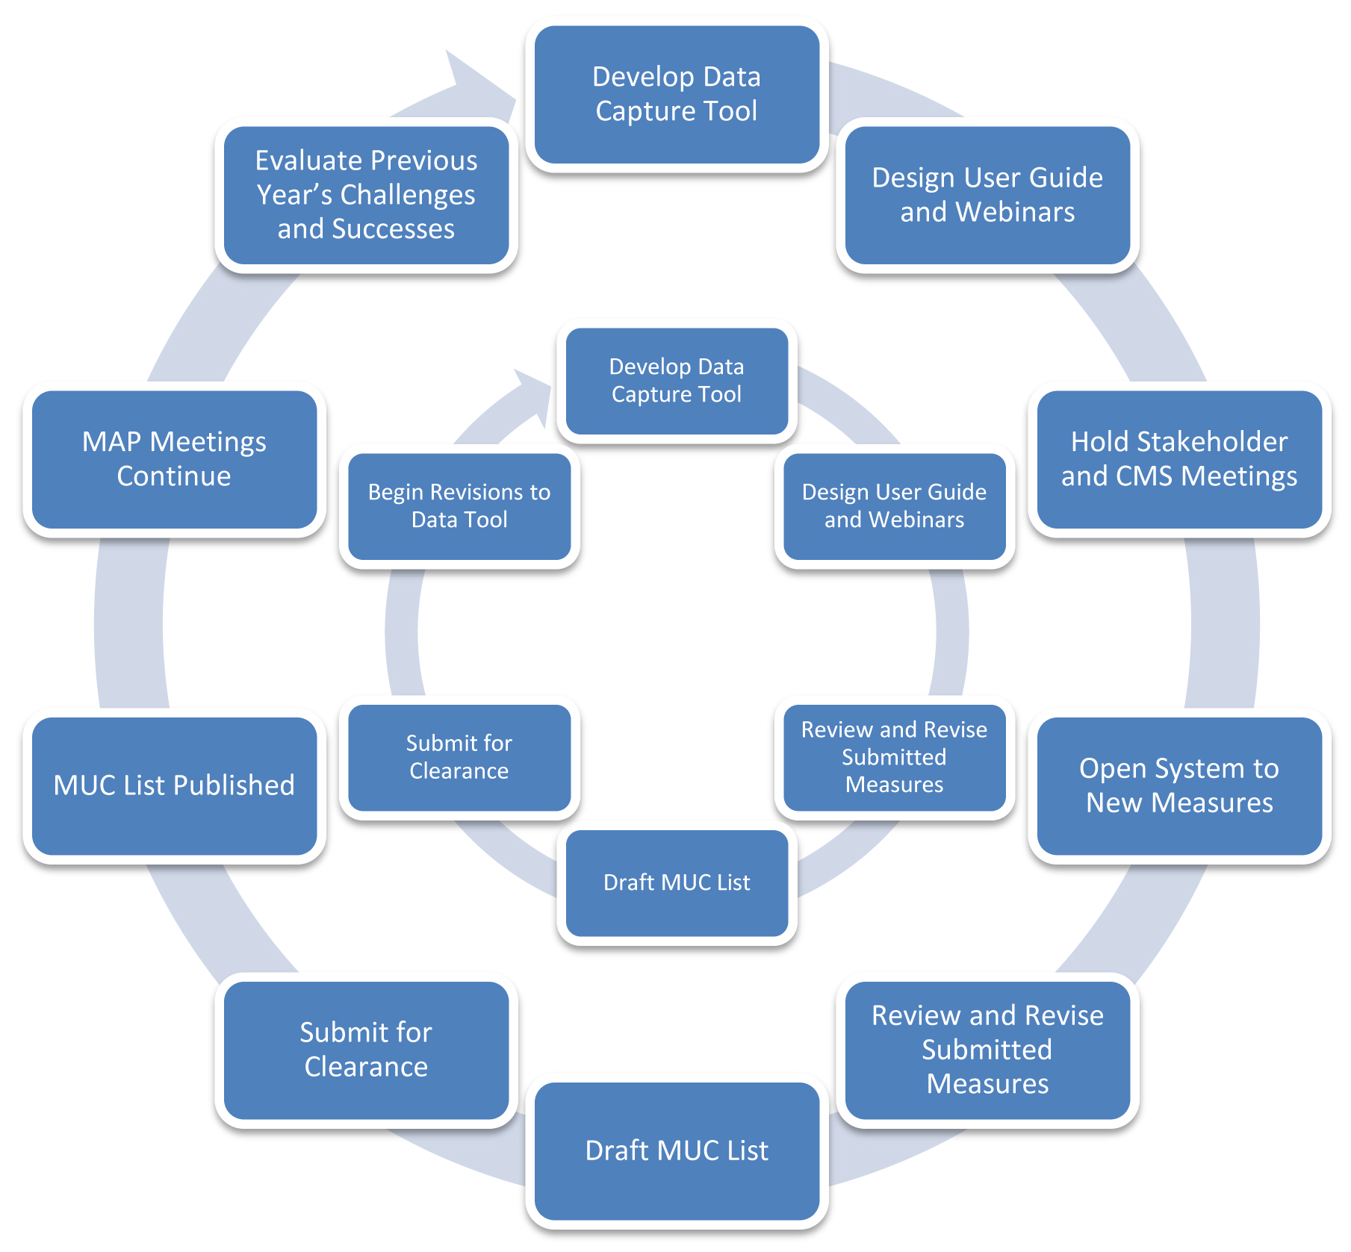
Recursive Process of Measure Implementation
Notes:
This diagram is meant to depict, as you can see from the timeline, that we are constantly somewhere in the process. The recommendations to HHS and the HHS Secretary are made by the MAP February 1st and in February we are opening JIRA. It is therefore an overlapping process whereby we are constantly in at least two MUC cycles in any part of the year.

Slide 25
Measures under Consideration List Trends
Year | 2011 | 2012 | 2013 | 2014 | 2015 | 2016 | 2017 | 2018
Number of Measure Records | 366 | 507 | 234 | 202 | 131 | 97 | 32 | 39
CMS publishes the MUC List annually by December 1
The National Quality Forum (NQF) publishes the MAP Final Recommendations report in the first quarter of each subsequent year
A complete repository of these Lists and Reports is located at: https://www.cms.gov/Medicare/Quality-Initiatives-Patient-Assessment-Instruments/QualityMeasures/Pre-Rule-Making.html
Notes:
There have been trends of a decreasing number of measures on the MUC List, reason being we are communicating better our needs and priorities, not only with the areas that the measures are in, i.e., a substance use measure or a preventive care measure. Secondly, we are focusing on outcome measures ensuring the measures are patient-centered and patient-reported if possible. All previous MUC Lists may be found on our pre-rulemaking website from past years.

Slide 26
Lessons Learned from 2018
Relatively fewer candidate measures accepted for MUC List; evolving criteria for acceptance
Emphasis on test data
Separation of MIPS Cost and Quality measures
Measure owners can gather measure information in advance offline
Future years: watch for earlier data collection, to allow MAP Workgroups sufficient time for review
Notes:
Later in the slide deck we will address eCQM readiness that will speak a great deal to testing. Last year with the exception of the MIPS-Quality measure JIRA closed on June 15th. Around that date this year all of the measures across the board are closing June 3rd. Next year we are looking at possibly closing mid-May, thus again moving up the entire timeline.

Slide 27
2019 Next Steps
Pre rulemaking Meeting Series
Open Forum Discussions – Thursday, April 18 and Tuesday, April 23 from 1 to 2 PM ET
CMS Program Measure-Specific Needs and Priorities Session on Thursday, April 25, from 1 to 3 PM ET
CMS Pre-Rulemaking Resources
https://www.cms.gov/Medicare/Quality-Initiatives-Patient-Assessment-Instruments/QualityMeasures/Pre-Rule-Making.html
Notes:
The Open Forum provides a longer live demonstration and instruction of JIRA where you can ask questions about data fields, its functionality and the basic process. During the Needs & Priorities webinar each program will emphasize their individual needs and priorities for their given program by Meaningful Measure Area (MMA). There are lots of resources on our pre-rulemaking website.

Slide 28
MIPS Peer Review Journal Requirement

Slide 29
MIPS Peer Review Journal Requirement
Section 1848(q)(2)(D)(iv) of the Act, as added by Section 101(c)(1) of the Medicare Access and CHIP Reauthorization Act (MACRA)
Submit to applicable specialty-appropriate, peer-reviewed journals potential new measures before including such measures in the final list of annual CQM under MIPS.
Information shall include the method for developing and selecting such measures, including clinical and other data supporting such measure
Notes:
CMS is required to submit the proposed MIPS-Quality measure and the method for developing that measure for publication in applicable specialty-appropriate peer-reviewed journal in order to add a new measure into MIPS. This is under Section 1848(q)(2)(D)(iv) of the Act. It’s added in Section 101(c)(1) of the Medicare Access and CHIP Reauthorization Act (MACRA). Measure owners submitting measures into JIRA have to complete the required information by the Call for Measures deadline on June 3rd.
Some of the information requested in the peer-reviewed journal article requirement template may be listed in the specific fields in the JIRA tool. To ensure that CMS has all the necessary information from a measure owner/steward submitting and to avoid delays in the evaluation of MIPS-Quality measures, fully complete the form as an attached Word document. The information in JIRA must be consistent with the information on your form.

Slide 30
MIPS Peer Review Journal Requirement
Benefits of this requirement:
Provide clinicians with information on clinical quality measures, including specialties, who do not have access to or involvement with the MUC and MAP processes.
Eligible professionals will be more aware of the types of quality measures that can be reported to CMS quality programs.

Slide 31
MIPS Peer Review Journal Requirement
Required information
Submit as an attachment using the template
Comprehensive reliability and validity testing information is necessary
It is recommended to copy/paste any duplicative information present in the JIRA submission into the Peer Review Template form to ensure consistency
Blank template and completed examples (non-eCQMs and eCQMs) are available on the CMS Pre-Rulemaking website and on the QPP Resources Library in the Call for Measures and Activities zip file.

Slide 32
MIPS Peer Review Journal Requirement
This will be the standardized process for collecting required information
The template is subject to change each year
Access the latest version of the MIPS Peer Reviewed Template and Examples here:
https://www.cms.gov/Medicare/Quality-Initiatives-Patient-Assessment-Instruments/QualityMeasures/Pre-Rule-Making.html
https://www.cms.gov/Medicare/Quality-Payment-Program/Resource-Library/2018-Resources.html

Slide 33
eCQM Readiness
Notes:
Electronic clinical quality measures (eCQMs) submitted to the Call for Measures have additional considerations and requested information so that CMS can ensure that the submitted measures are ready for implementation in MIPS. We refer to this as our eCQM “readiness check.”

Slide 34
eCQM Readiness, Step 1: Assess and document eCQM characteristics
eCQM characteristic | Testing activity | Documentation for CMS
Is the eCQM feasible? | Feasibility test results | NQF’s feasibility scorecard
Is the eCQM a valid measure and/or are the data elements in the eCQM valid? | Correlation of data element or measure score with ‘gold-standard’, or face validity results | Kappa agreement between EHR extracted data element and chart abstract and/or correlation between measure score and a related external measure of quality; information about data used for testing (e.g., number of practices, number of providers)
Is the eCQM reliable? | Provider level reliability testing for measure score in the setting which the measure is intended to be reported | Reliability coefficient using signal-to-noise or split half inter-rater reliability; information about data used for testing (e.g., number of practices, number of providers).

Slide 35
eCQM Readiness, Step 2: Specification readiness
Requirement | Tool | Documentation for CMS
Specify eCQM according to latest CMS and ONC standards | Measure Authoring Tool (MAT) | MAT output to include, at minimum, HQMF and human readable files
Create value sets that use current, standardized terminologies | The National Library of Medicine’s Value Set Authority Center (VSAC) | Published value sets in the VSAC that have been validated against the most recent terminology expansion with 100% active codes
Test eCQM logic using a set of test cases that cover all branches of logic with 100% pass rate | Bonnie | Excel file of test patients showing testing results (Bonnie export)
Notes:
Step two of the eCQM readiness check relates to the specification readiness of the eCQM for implementation in a national program. The eCQMs must use a MAT to specify the measure. The Call for Measures requests a MAT number and MAT package for all submitted eCQMs. The value sets for eCQMs must be created in the National Library of Medicine (NLM) VSAC. The Call for Measures requests attestation that value sets are published and publicly viewable in the VSAC.
The eCQM logic must be tested using a Bonnie tool which uses test cases to verify the measure’s logic is working as intended. For inclusion in MIPS an eCQM must have test cases that cover all branches of the logic with 100% pass rate in Bonnie. The Call for Measures requests that Bonnie test cases for the measure are showing 100% logic coverage.

Slide 36
eCQM Readiness: Resources
Value Set Authority Center: https://vsac.nlm.nih.gov/
Bonnie: https://bonnie.healthit.gov/
eCQI Resource Center: https://ecqi.healthit.gov/
CMS Measures Management System Blueprint: https://www.cms.gov/Medicare/Quality-Initiatives-Patient-Assessment-Instruments/MMS/MMS-Blueprint.html
National Quality Forum eCQM testing (feasibility): http://www.qualityforum.org/Electronic_Quality_Measures.aspx
Notes:
Included here are resources to support the development and submission of eCQMs ready for implementation in MIPS, including the VSAC, Bonnie, the Blueprint and eCQM testing requirements related to feasibility.

Slide 37
Questions ?
Questions ?

Slide 38

Overview of the CMS Measures Inventory Tool

Slide 39

CMS Measures Inventory Tool
CMIT is an interactive web-based application with intuitive and user-friendly functions for quickly searching through the CMS Measures Inventory
Notes:
We span the scope of measures under development (MUD) through measures under consideration (MUC). Measures actively used in CMS programs or initiatives, and those having been removed from programs — we do retain that historical information. For those still doing development, you get an opportunity to see what has been used in the past. We offer information that links to different resources to elaborate on why a given measure may have been removed from a program, such as a topped out measure.

Slide 40
CMS Measures Inventory Tool
Data includes measures under development, considered, or in use for a CMS Program or Initiative
Data are updated 3 times per year in alignment with the Pre-rulemaking and Rulemaking schedules
Measure information includes specifications like
Title
Description
Numerator
Denominator
Exclusions
NQF status
Healthcare Priority
Meaningful Measure Area
Type
Data Source
Notes:
Currently, there are approximately 37 programs and initiatives in CMIT that cover 2,238 measures. We work with NQF to ensure we have the most up-to-date NQF identifiers and endorsement status. We’ve worked very closely with CMS over the past year to be inclusive of their Meaningful Measure Area (MMA) framework so that you can find measures related to those areas. We provide information on the type of measure, the data source, and then the status of that measure within a given program.
We work to update information three times a year, corresponding with the federal rulemaking process. As proposed rules come out for various programs, we scan that information and collect data. We send that information to CMS program leads to validate and publish it. A corresponding final rule then will come out for that program and we do the same process. That measure information collected through the end of November-early December, those rules are released and the MUC List and all of that information is updated in February.

Slide 41
CMS Measures Inventory Tool
Can be useful for measure submissions in Jira to help identify:
If the measure is used in another program
If there are similar or competing measures already in use by a program
Find measures that have been published on previous MUC Lists with their MUC year and MUC ID
Notes:
Requirements for submission:
Is this measure used in another program?
Has this measure been submitted to the MUC List before? If so, what’s the identifier?
Are there similar or competing measures within a program?

Slide 42
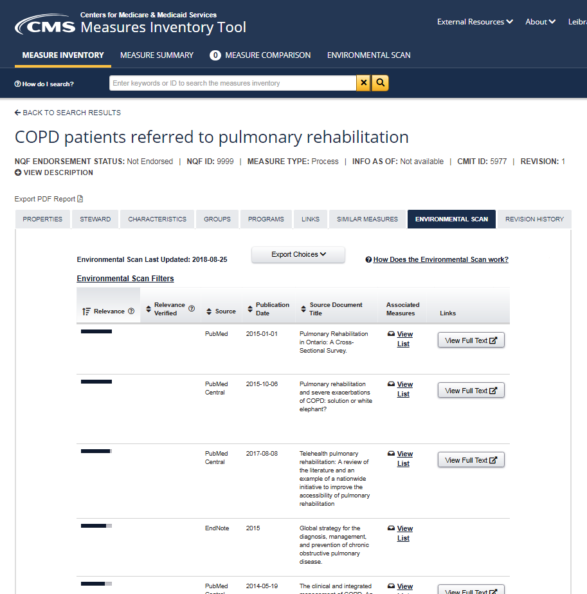
New Feature Coming to CMIT Environmental Scan Support Tool
Automates environmental scan search and prioritization of biomedical literature
Monthly updates for all Process and Outcome measures in CMIT
Notes:
One of our new functionalities is the Environmental Scan Support Tool (ESST) and will be released into CMIT in the next couple of weeks. We’ve been working to automate an environmental scan search process to help prioritize and locate some of this biomedical literature. This for applicable for both process and outcome measures in CMIT.

Slide 43
Environmental Scan Support Tool (ESST)
How does it work?
Artificial Intelligence identifies the most relevant PubMed content from the Measure Information Form
Clinical Quality Measures Ontology (CQM) “describes” a measure, identifying the population, health status or process, the change concept, and the expected output to categorize
Notes:
Clinical quality measures (CQMs) are used to create an ontology that describes the concept of a measure by identifying the population, the health status, or the processes that are part of that measure concept, and the expected goal change. We worked to build that ontology to provide an AI tool to conduct searches to identify the most relevant PubMed content. Manual extraction was also done based on sources identified in the MIF form; thus, building a comprehensive library that is updated once a month.

Slide 44
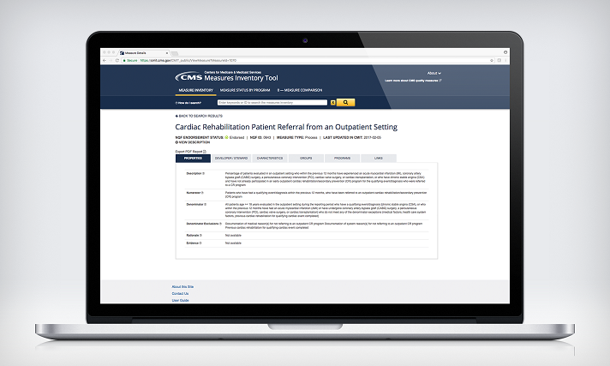
CMS Measures Inventory Tool
CMIT Demo - cmit.cms.gov
Notes:
To get to the actual specification information, click on the measure and come to the tab with various high-level specifications in terms of description, numerator, etc. More information is available related to the developer/steward. There are characteristics here in terms of the measure type and any NQF information and program-specific information with the status of each measure within that program. Additionally, then click to find information about the data sources and the date of implementation.
Search by program level by MUC ID/MUC year
Search by considered measures
Search by measure comparison
Search by associated measure

Slide 45
Measure Applications Partnership and the National Quality Forum (NQF)
Overview of the Measure Applications Partnership (MAP)

Slide 46
The Role of MAP
To promote healthcare improvement priorities, MAP:
Informs the selection of performance measures to achieve the goal of improvement, transparency, and value for all
Provides input to HHS during pre-rulemaking on the selection of performance measures for use in public reporting, performance-based payment, and other federal programs
Identifies gaps for measure development, testing, and endorsement
Encourages measurement alignment across public and private programs, settings, levels of analysis, and populations to:
Promote coordination of care delivery
Reduce data collection burden

Slide 47
What is the value of pre-rulemaking input?
Facilitates multi-stakeholder dialogue that includes HHS representatives
Allows for a consensus-building process among stakeholders in a transparent open forum
Proposed rules are “closer to the mark” because the main provisions related to performance measurement have already been vetted by the affected stakeholders
Reduces the effort required by individual stakeholder groups to submit official comments on proposed rules
Notes:
The MAP is made up of a multi-stakeholder group that encompasses a variety of different perspectives which allows for a very transparent process. The input provided during this comment period provides valuable input to CMS.

Slide 48
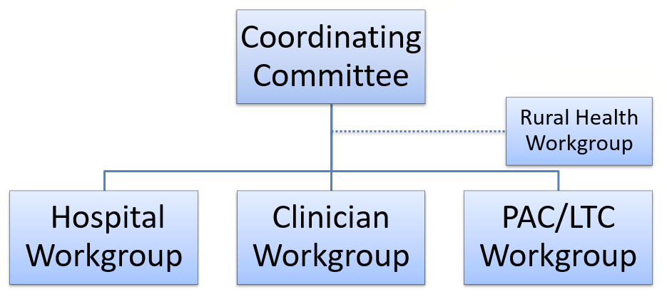
MAP Structure
Notes:
Depicted on this slide is the MAP structure. The coordinating committee adjudicates the recommendations from the various MAP workgroups — hospital workgroup, clinician workgroup, post-acute care workgroup. We recently added the rural health workgroup, which will be tasked to review every measure on the MUC List and how they believe it fulfills a need for the rural population and their particular patients and beneficiaries.

Slide 49
MAP Members
Three types of members:
Organizational Representatives
Constitutes the majority of MAP members
Include those that are interested in or affected by the use of measures
Organizations designate their own representatives
Subject Matter Experts
Serve as individual representatives bringing topic specific knowledge to MAP deliberations
Chairs and co-chairs of MAP’s Coordinating Committee, workgroups, and task forces are considered subject matter experts
Federal Government Liaisons
Serve as ex-officio, non-voting members representing a Federal agency
Notes:
Here we have the various types of members. The MAP members include organizational representatives of subject matter experts (SMEs) and federal government liaisons, LNOs. Bringing this group together to discuss measures lends to an open and transparent process which allows a variety of voices to be heard regarding each measure on the MUC List.

Slide 50
MAP Measure Selection Criteria
NQF-endorsed measures are recommended for program measure sets, unless no relevant endorsed measures are available to achieve a critical program objective
Program measure set adequately addresses the CMS Healthcare Priorities
Program measure set is responsive to specific program goals and requirements
Program measure set includes an appropriate mix of measure types
Program measure set enables measurement of person- and family-centered care and services
Program measure set includes considerations for healthcare disparities and cultural competency
Program measure set promotes parsimony and alignment
Program measure set considers burden/operational criteria
Notes:
MAP measure selection criteria:
Are endorsement ready
Address CMS healthcare priorities
Fill gaps within programs
Ideally, outcome measures
We understand that a process measure needs to get to that point where an outcome measure is developed and ready for use. We welcome more person and family-centered care in service measures. We also seek to promote alignment across our programs and within the program itself, and look at the burden of a measure and how it may impact providers and those reporting on measures.

Slide 51
Evaluate Measures Under Consideration
MAP Workgroups must reach a decision about every measure under consideration
Decision categories are standardized for consistency
Each decision should be accompanied by one or more statements of rationale that explains why each decision was reached

Slide 52
MAP Decision Categories
Support for Rulemaking
Conditional Support for Rulemaking
Do not Support for Rulemaking with Potential for Mitigation
Do Not Support for Rulemaking
Notes:
MAP may support a measure for rulemaking that addresses a previously identified gap in a program or promotes alignment.
MAP may conditionally support a measure if the group thinks it is ready for rulemaking, but needs NQF endorsement.
The “refine and resubmit” category is new this year and implemented by the MAP to express support for the concept of a measure with the stipulation that it requires modifications such as testing before implementation.
MAP does not support a measure for rulemaking, if it overlaps with existing measures or if a different measure better addresses the needs of the program.

Slide 53
Preliminary Analysis of Measures Under Consideration
To facilitate MAP’s voting process, NQF staff will conduct a preliminary analysis of each measure under consideration.
The preliminary analysis is an algorithm that asks a series of questions about each measure under consideration. This algorithm was:
Developed from the MAP Measure Selection Criteria, and approved by the MAP Coordinating Committee, to evaluate each measure
Intended to provide MAP members with a succinct profile of each measure and to serve as a starting point for MAP discussions

Slide 54
MAP Preliminary Analysis Algorithm
The measure addresses a critical quality objective not currently, adequately addressed by the measures in the program set.
The measure is an outcome measure or is evidence-based.
The measure addresses a quality challenge.
The measure contributes to efficient use of resources and/or supports alignment of measurement across programs.
The measure can be feasibly reported.
The measure is NQF-endorsed or has been submitted for NQF-endorsement for the program’s setting and level of analysis.
If a measure is in current use, no implementation issues have been identified.
Notes:
An algorithm ensures the following:
Is it an outcome measure?
Is it addressing gaps?
Is it addressing any kind of quality challenges?
Can it be feasibly reported?
Is it actually in current use?
Have any issues been identified?

Slide 55
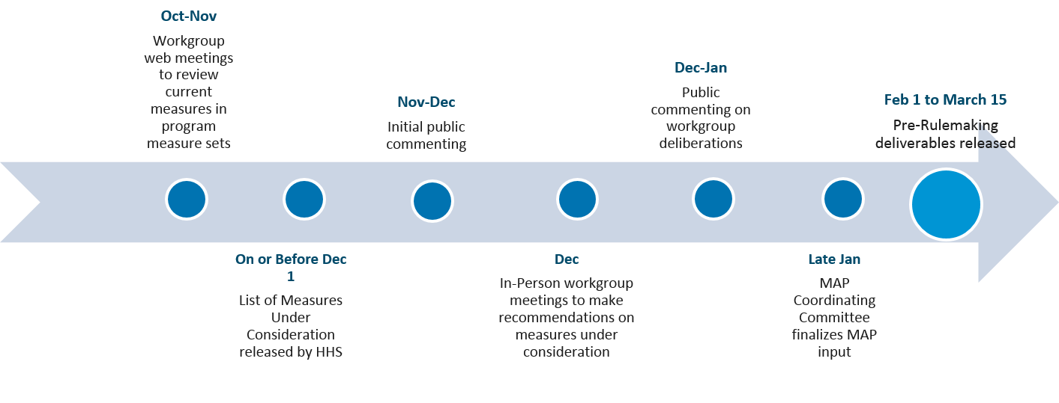
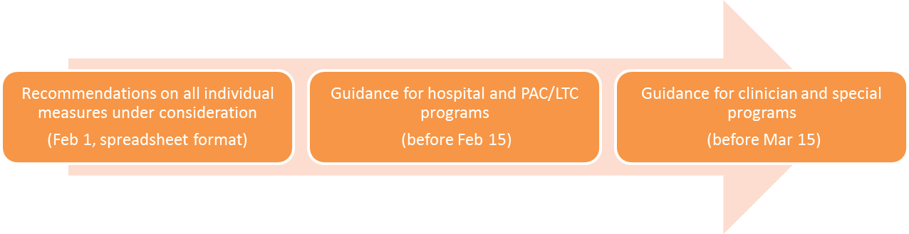
MAP Approach to Pre-Rulemaking
Sept
MAP Coordinating Committee to discuss strategic guidance for the workgroups to use during pre-rulemaking
Notes:
In September, the coordinating committee will discuss strategic guidance for the workgroups to use during their pre-rulemaking. In October and November we will have web meetings with workgroup members to ensure that they understand the process and their role within the pre-rulemaking cycle. On or before December 1st the statute dictates the MUC List will be published, and in between November and December NQF will put out the MUC List for public comment. When the in-person workgroup meetings begin, they will turn off the public commenting tool. The workgroups will come together and discuss each measure on the MUC List. Between December and January — January being when they have the coordinating committee meeting — they will hold another public commenting period for comment on where the MAP workgroups came to consensus regarding each measure. The coordinating committee then adjudicates the MAP workgroup’s recommendations, and no later than February 1st NQF will deliver to CMS the list of measures and their final recommendations.

Slide 56
Nominations to Serve on the MAP
One-third of the seats on MAP are eligible for reappointment each year
The formal call for nominations occurs in the early Spring but NQF accepts nominations year round
For more information and to apply, please visit the NQF Committee Nominations webpage at http://www.qualityforum.org/nominations/
Nominations are sought from organizations and individual subject matter experts
Notes:
We have just closed out the nominations for folks to serve on the MAP for which the seats are eligible for appointment each year. The formal Call for Nominations occurs early spring but accepted year-round. Use the link provided if you are interested in serving on a MAP. There you may submit your name or nominate a colleague. We are always looking for a voice on a variety of different perspectives.

Slide 57
Jira 2019
Notes:
Vince Brown of Battelle, the Measures Management System (MMS) contractor for CMS, will present the overview of JIRA for 2019.

Slide 58
New for 2019
Renamed one program; more choices in several drop-downs
May now select a secondary healthcare priority
May now select a secondary Meaningful Measure
Different choices for Data Sources and How Reported
Users are invited to use “Comments” if needed to define or elaborate on specific sources and reporting methods that are not in drop-down list
Notes:
On the pre-rulemaking website you can access a downloadable User Guide that walks you through questions and screen guidance for purposes of familiarization. This particular presentation is more directed toward those familiar with JIRA. The Open Forums occurring this Thursday and next Tuesday will provide a more in-depth introduction and are more suited for people new to JIRA.
In 2018 users were required to select one and only one priority and one and only one Meaningful Measure. For 2019 at your option, you can add a secondary priority and a secondary Meaningful Measure. The feedback we received indicated confusion amongst people regarding which priority fit their given measure best and for that reason this change was incorporated.

Slide 59
New for 2019 (continued)
“EHR Incentive” renamed to reflect “Promoting Interoperability” for hospitals and providers
“Exclusions” field also has “Exceptions”
Under the priority “Person and Family Engagement,” the MMA “Patient reported functional outcomes” has changed to read “Functional outcomes”
Secondary priorities and MMAs are optional
Notes:
The program formerly known as EHR Incentive for eligible hospitals (EHs) and critical access hospitals (CAHs) has been editorially renamed to be called “promoting interoperability.” We would receive frequent questions regarding the difference between an exclusion vs. an exception. For this reason, we have modified that one field to encompass both of those ideas.
Last year there was a Meaningful Measure Area (MMA) called “patient reported functional outcomes.” That MMA has been simplified to be functional outcomes only. An additional change not indicated on this slide is for your NQF ID number. If the measure is in the NQF system, that identifying number had previously been a numeric value up to four digits. NQF has added a letter at the end to designate certain measures. We have expanded that field and updated JIRA to accommodate that change; therefore, some measures will have an “e” at the end that has special significance in the NQF world. Lastly, for the MIPS program when entering a measure you are required to make the distinction in JIRA between MIPS-Quality vs. MIPS-Cost.

Slide 60
Live Demonstration of JIRA
Illustrate new fields
Changes to requirements and screen guidance
Adding new users
Complete blank template offline
Complete each record in one session
Change requests/questions/feedback
Notes:
You will require an account with the Office of the National Coordinator for Health IT (ONC), but are required to initially have a JIRA account with them to begin. The User Guide describes how to gain access to the MUC List for each year and is a controlled access environment. After login locate “projects” and click and go to “2019.” In the 2019 project, select the yellow button at the top that says “create” making sure this issue type states “measure submission.” That is where you begin to add a new measure. There are red asterisks beside the “required fields” indicating you must complete that field or it will not allow you create the measure record.
Here is the field called “exclusions/exceptions” and so that’s a bit clearer. Scrolling down to “healthcare priority,” you’ll see this field is now called “what one primary healthcare priority applies,” and it has an asterisk. Notice that the primary Meaningful Measure doesn't have any drop-downs, and that’s because you have not selected a priority. The system is context-sensitive. Once you choose a priority, then your Meaningful Measure drop-down populates with the appropriate MMAs subsidiary to that priority.
The new fields this year are “what secondary priority applies, and what secondary Meaningful Measure?” You’re asked to add these to your measure only if applicable with the secondary ones being optional. Here is your peer-reviewed evidence that has come up on the call and here is NQF status and NQF ID. At the bottom the “comments” field is suitable for any information in your measure not included in the drop-down. When adding a comment reference the appropriate field and provide your information in this open-ended text field.
The MIPS peer-reviewed journal article attachment is a separate Word file accessed via the link provided on Slide 31. Once completed, you would drag it or browse to attach the peer-reviewed journal article attachment to your candidate measure record — for MIPS only. Other measure types, eCQMs and other measure types have required attachments. There is a limit of 10MB.
For an eCQM, you must attach Bonnie test cases and attestation about the VSAC and the NQF feasibility scorecard. Depending on the type of measure, if you follow the screen guidance, it will tell you what kinds of attachments are required. When finished, click create.
An important feature of JIRA is each measure must be entered in one session. There is an offline template on the pre-rulemaking website, a Word file suitable for gathering your information in one place. When in JIRA, simply drop all the measure data into that JIRA interface in one session. That template has been very well-received with many users indicating it was helpful. In JIRA once you have entered a measure, then you cannot go back in and change that record. Instead we have a mechanism called a “change request” or “modify candidate measure.” That method would facilitate your change request.

Slide 61
Questions ?
Questions ?

Slide 62
Contacts for Pre-rulemaking
CMS MUC Coordinators:
Helen Dollar-Maples — Helen.Dollar-Maples@cms.hhs.gov
Kimberly Rawlings — Kimberly.Rawlings@cms.hhs.gov
Measures Manager— Pre-Rulemaking:
Vince Brown — brownv@battelle.org
614.424.5928

