Slide 1

2019 CMS Program-Specific Measure Needs and Priorities
Pre-Rulemaking
Kim Rawlings, CMS
CMS Program/Measures Leads
April 25, 2019

Slide 2
Welcome
The meeting is moderated.
All lines will be muted during the presentation.
The meeting is being recorded and will be uploaded to the CMS website for future viewing. The meeting facilitator will send the link to the recording in a follow-up email.
Questions will be accepted later in the presentation.

Slide 3
Agenda
Welcome
Brief Meaningful Measures Initiative Overview
Brief Overview of Pre-rulemaking
Program Needs and Priorities
  Segment 1: Chronic and Post-Acute Care Measures
  Segment 2: Clinician Measures
  Segment 3: Hospital Measures

Slide 4
A New Approach to Meaningful Outcomes
What is Meaningful Measures Initiative?
Launched in 2017, the purpose of the Meaningful Measures initiative is to:
  Improve outcomes for patients
  Reduce data reporting burden and costs on clinicians and other health care providers
  Focus CMS’s quality measurement and improvement efforts to better align with what is most meaningful to patients
Notes:
All of the programs referenced in this slide deck will address Meaningful Measures as a way to identify gaps in our programs and communicate those most efficiently, thereby providing very clear guidance and communications around where we’re focusing our quality measure efforts.

Slide 5

Meaningful Measures graphic
Empower patients
and doctors to make decisions about their health care
Usher in a new era
of state flexibility and local leadership
Support innovative approaches to improve quality, accessibility, and affordability
Improve the CMS customer experience
Notes:
Depicted on this slide are CMS’ four strategic goals.

Slide 6
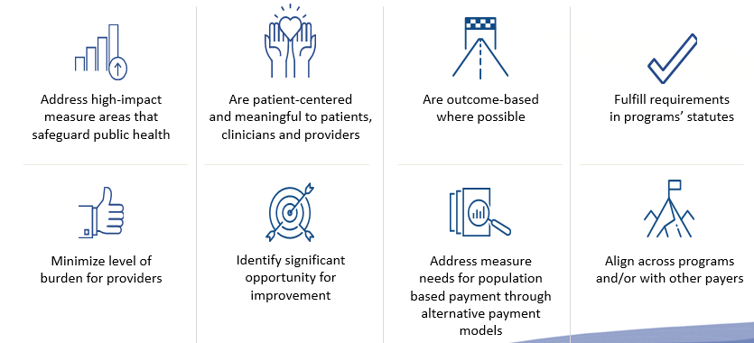
Meaningful Measures Objectives
Meaningful Measures focus everyone’s efforts on the same quality
areas and lend specificity, which can help identify measures that:
Notes:
Meaningful Measures objectives:
Ensure that we are developing the best and highest quality measures possible
Ensuring that everyone is going in the same direction
Ensuring that all of our efforts are focused on the same types of measures
What characteristics are we looking at?
What characteristics should those measures have?
We have some program statutes that need to be fulfilled, i.e., aligning measures across programs with other payers as with the clinical quality measure collaborative and ensuring our measures are addressing high impact areas and are outcome-based where possible.

Slide 7
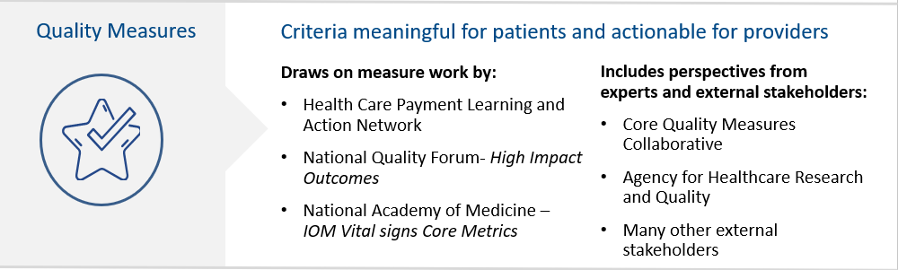
Meaningful Measure Areas Achieve
  High quality healthcare
  Meaningful outcomes for patients
Notes:
Within this framework, our two goals are to ensure that we are providing high quality healthcare for patients and having meaningful outcomes for patients. We drew on lots of work from others, including the launch at LAN. There were several tie-ins with NQF, and NAM also played a critical part in this process. We included perspectives from several others, both internal and external to government.

Slide 8
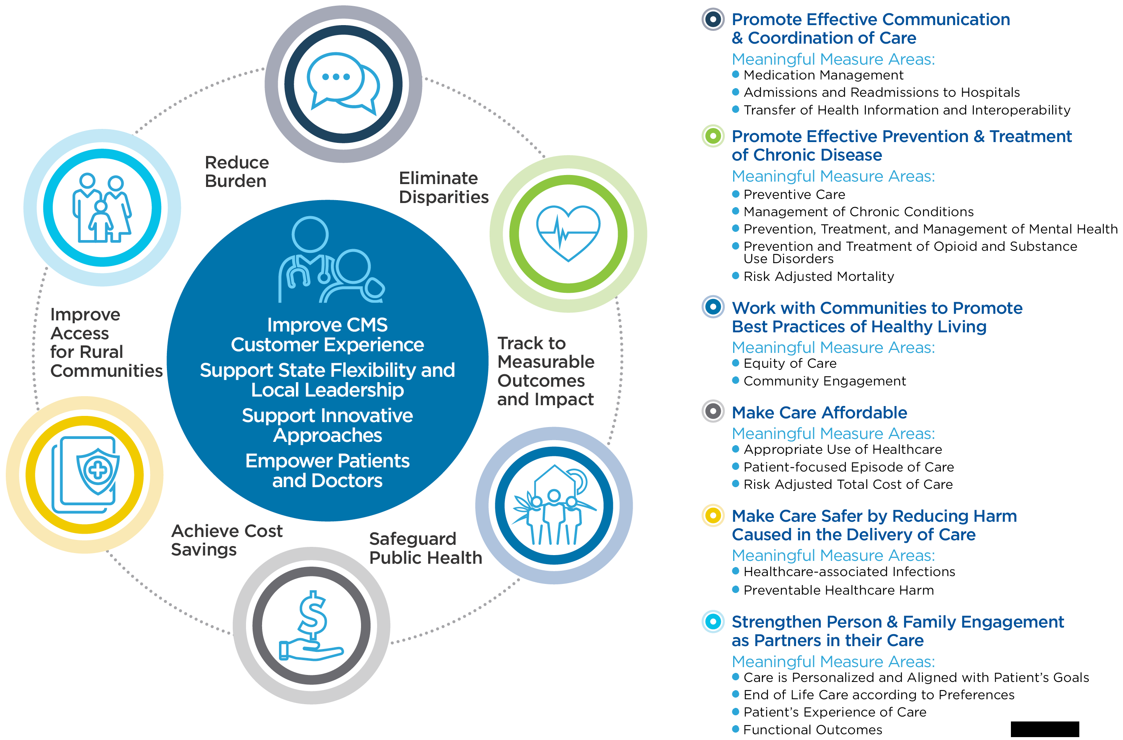
Meaningful Measures Framework
Notes:
At the center of this Meaningful Measures Framework are our four CMS strategic goals along with a pictorial depiction of the provider and patients, which again emphasizes that that relationship is at the core of this strategy.
The six crosscutting criteria are to eliminate disparities, track to measurable outcomes and impact, safeguard public health, achieve cost savings, improve access for rural communities and reduce burden. By crosscutting criteria we infer that these are criteria that all measures should touch upon when implemented into our programs.
In the bolded list are our six healthcare priorities — promote effective communication and coordination, promote effective prevention and treatment of chronic disease, work with communities to promote best practices of healthy living, make care affordable, make care safer by reducing harm caused in the delivery of care, and strengthen person and family engagement as partners in their care.
Underneath those are 19 Meaningful Measure Areas (MMAs). The MMAs make this link between this very broad quality priority such as “make care affordable” and the actual measure. Think of it as a couple of categories underneath “make care affordable” that are a bit more specific to help make the connection.

Slide 9
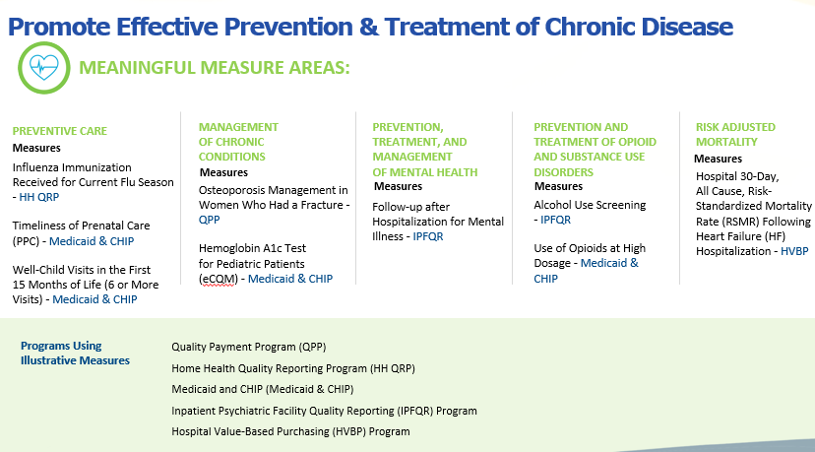
Promote Effective Prevention & Treatment of Chronic Disease
Notes:
Here is the healthcare priority of “promote effective prevention and treatment of chronic disease,” and underneath that the five MMAs. The Meaningful Measure Areas (MMAs) guide our work, not only in us trying to articulate to you the areas that we’re most interested in, but also working to categorize our measures by these areas so we can more clearly see gaps.
Example:
“Here’s where we see a gap in management of chronic conditions. We would like more measures in this area.”
Communication is key as it helps us better focus and articulate our needs and priorities. Obviously, with the pre-rulemaking and creation of the MUC List this helps us articulate those priorities for us. When entering a measure into JIRA you’ll be asked to assign a Meaningful Measure Area (MMA) to the measure.

Slide 10

Meaningful Measures Website
https://www.cms.gov/Medicare/Quality-Initiatives-Patient-Assessment-Instruments/QualityInitiativesGenInfo/CMS-Quality-Strategy.html
Notes:
If you visit our website you can learn more about those categories. The CMS Measures Inventory Tool (CMIT) also provides information about many measures currently active in our programs. You can gauge where they are assigned to the Meaningful Measures Area (MMA). When submitting measures into JIRA you will assign a Meaningful Measure Area (MMA) and a healthcare priority to your measure. The programs presenting in this slide deck will draw attention to these Meaningful Measure Areas (MMAs) and the healthcare priorities.

Slide 11
Pre-Rulemaking
Statutory Reference
  Section 3014 of the Patient Protection and Affordable Care Act
  Section 1890 and 1890A of the Social Security Act
Pre-rulemaking Steps
  Annually Publish Measures under Consideration (MUC) List by December 1
  Multi-Stakeholder Groups, National Quality Forum’s Measures Application Partnership (MAP)
  Annually by February 1 the MAP provides recommendations and feedback to the Secretary
Notes:
Pre-rulemaking is mandated by Section 3014 of the Patient Protection and Affordable Care Act, and there are three main steps and milestones in the process. By December 1st we have to publish the measures under consideration (MUC) List. We then hand that to our multi-stakeholder group, the Measure Applications Partnership (MAP) which is currently held through the National Quality Forum (NQF). And then by February 1st the MAP provides recommendations and feedback on the MUC List to the HHS Secretary, and so in order to meet those timelines and meet those deadlines, we need to have measures submitted by June 3rd. That is the magic date for 2019.

Slide 12
Basic Measure Requirements: All Programs
Measure reporting is feasible to implement and measures have been fully developed and tested for reliability and validity
Sensitive to program goals and statutory requirement
Important condition/topic with a performance gap
Aligns with CMS programs and across HHS as well as private payer programs
Identifies opportunities for improvement
No duplicates
Feasibility testing for eCQMs
Title, numerator, denominator, exclusions, measure steward, link to full specs, established mechanism for data collection
Notes:
The Needs & Priorities document will identify the more program-specific measure requirements.
Ensure that measures are not “topped out”
Ensure that there is room for improvement in the area of focus on quality
Ensure that there are no duplicates of existing/similar measures

Slide 13
Measure Submission
Measures, Change Requests, MUC questions, and Feedback accepted via Jira web-based system
  Set up your Jira user account
  Email MMSsupport@battelle.org to request access for the current Measures under Consideration project in Jira
  Requests are reviewed by respective CMS Program Lead
  See User Guide on CMS Pre-Rulemaking web site: https://www.cms.gov/Medicare/Quality-Initiatives-Patient-Assessment-Instruments/QualityMeasures/Pre-Rule-Making.html
Notes:
Please contact: MMSsupport@battelle.org
Measures are reviewed in real time; therefore, it’s advisable to submit measures earlier in the process. Measures then go through our clearance process and are reviewed by leadership first at CMS, then HHS, et cetera. If you go to the pre-rulemaking website, all of that information is laid out in great detail to help support your submission.

Slide 14
2019 MUC List: program needs and Priorities
Center for Clinical Standards and Quality
Notes:
This slide deck includes the 18 programs presenting their Needs & Priorities for the 2019 pre-rulemaking cycle. The official Needs & Priorities document will be posted online to our pre-rulemaking website within the next three or four weeks.

Slide 15
Chronic and Post-Acute Care
Inpatient Rehabilitation Facilities Quality Reporting Program
Long-Term Care Hospital Quality Reporting Program
Home Health Quality Reporting Program
Hospice Quality Reporting Program
Skilled Nursing Facility Quality Reporting Program

Slide 16
Ask a Question
Moderator will provide instruction.

Slide 17
Clinician
Merit-Based Incentive Payment System (MIPS)
Medicare Shared Savings Program

Slide 18
Ask a Question
Moderator will provide instruction.

Slide 19
Hospital
Hospital-Acquired Condition Reduction Program
Hospital Readmissions Reduction Program
Hospital Inpatient Quality Reporting Program and Medicare and Medicaid Promoting Interoperability Program for Eligible Hospitals and Critical Access Hospitals
Prospective Payment System-Exempt Cancer Hospitals Quality Reporting Program

Slide 20
Hospital cont.
End-Stage Renal Disease Quality Incentive Program
Hospital Value-Based Purchasing Program
Ambulatory Surgical Center Quality Reporting Program
Hospital Outpatient Quality Reporting Program
Inpatient Psychiatric Facility Quality Reporting Program
Skilled Nursing Facility Value-Based Purchasing Program

Slide 21
Ask a Question
Moderator will provide instruction.

Slide 22
Next Steps
July 2019 TBD: Federal-Only Stakeholder Meeting
Resource for everything MUC
  Pre-Rulemaking Web Site

Slide 23
Contact for MUC List
CMS MUC Coordinators:
Helen Dollar-Maples — Helen.Dollar-Maples@cms.hhs.gov
Kimberly Rawlings — Kimberly.Rawlings@cms.hhs.gov
Measures Manager— Pre-Rulemaking:
Vince Brown — brownv@battelle.org
614.424.5928

