Slide 1

2019 Measures Under Consideration
Pre-Rulemaking: Open Forum Discussion #2
Kimberly Rawlings, CMS
Vince Brown, Battelle
April 23, 2019

Slide 2
Welcome
The meeting is moderated.
All lines will be muted during the presentation.
The meeting is being recorded and will be uploaded to the CMS website for future viewing. The meeting facilitator will send the link to the recording in a follow-up email.
Questions will be accepted later in the presentation.

Slide 3
Agenda
Pre-Rulemaking Review
Demonstration of Jira
Question and Answer Session

Slide 4
Pre-Rulemaking Review

Slide 5
Guidelines for Proposing Measures
Measures in current use do not need to go on the Measures under Consideration List again
  Exceptions are measure being expanded into other CMS program(s) or measure undergoing substantial changes
Measures that were submitted to be on a prior year's MUC List, but were not accepted by any CMS program(s), are eligible for resubmission
Measure specifications may change over time. If a measure has significantly changed, you may submit it again for consideration
Notes:
If a measure is actively used in a program, it does not need to go on the MUC List. For measures eligible for resubmission we encourage you to take feedback we’ve given as to why and try and rework the measure. Measure specifications do change over time. We encourage you to reconsider the measure for the MUC List and get broad stakeholder feedback.

Slide 6
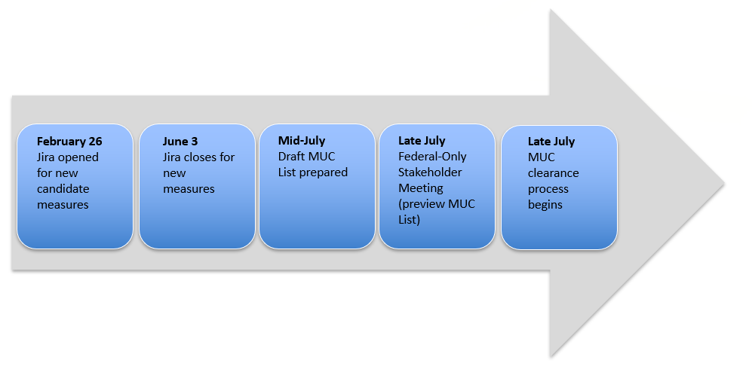
Measures under Consideration List Publishing
Notes:
This timeline is earlier this year to enable our rule writers a bit more time to digest the MAP’s recommendations and allow people more time to have public comment on the NPRMs and rules.

Slide 7
New for 2019
Renamed one program; more choices in several drop-downs
May now select a secondary healthcare priority
May now select a secondary Meaningful Measure
Different choices for Data Sources and How Reported
Users are invited to use “Comments” if needed to define or elaborate on specific sources and reporting methods that are not in drop-down list
Notes:
On the pre-rulemaking website you can access a downloadable User Guide that walks you through questions and screen guidance for purposes of familiarization. In 2018 users were required to select one and only one priority and one and only one Meaningful Measure. For 2019 at your option, you can add a secondary priority and a secondary Meaningful Measure. The feedback we received indicated confusion amongst people regarding which priority fit their given measure best and for that reason this change was incorporated.

Slide 8
Notes on 2019 Interface
Scroll to see all drop-down choices (some lists are long)
If you select “Other,” then navigate to the Comments field at the very bottom of the form. List the data field and specify the intended “other” value
Measure Title field is limited to 255 characters
Enter NA if you cannot complete a required text field
Notes:
Some drop-down lists are lengthy fields such as “specialty and registry.” For the “comments” field, if you select “other” you will be asked to scroll to the “comments” field at the bottom and include other pertinent information which enables the reviewers to have more in-depth familiarity with your measure details.
Please note that the measure title field is truncated at 255 characters. You may wish to edit your title, so as not to cut off any important information beyond the 256 characters. If a certain required question is not relevant to your measure or you don’t have the necessary information right then, we ask that you state “N/A.” If left blank, JIRA will reject the measure.

Slide 9
Jira Filters for Reporting
Users can create and save custom filters with columns/fields of their choosing and criteria such as certain programs or measure types
Can export custom reports into CSV file
Can set up personalized dashboard views with updated info based on frequently needed filters
Notes:
You will require an account with the Office of the National Coordinator for Health IT (ONC), but are required to initially have a JIRA account with them to begin. The User Guide describes how to gain access to the MUC List for each year and is a controlled access environment. After login locate “projects” and click and go to “2019.” In the 2019 project, select the yellow button at the top that says “create” making sure this issue type states “measure submission.” That is where you begin to add a new measure. There are red asterisks beside the “required fields” indicating you must complete that field or it will not allow you create the measure record.
Here is the field called “exclusions/exceptions” which incorporates either selection. Scrolling down to “healthcare priority,” you’ll see this field is now called “what one primary healthcare priority applies,” and it has an asterisk. Notice that the primary Meaningful Measure doesn't have any drop-downs, and that’s because you have not selected a priority. The system is context-sensitive. Once you choose a priority, then your Meaningful Measure drop-down populates with the appropriate MMAs subsidiary to that priority.
The new fields this year are “what secondary priority applies, and what secondary Meaningful Measure?” You’re asked to add these to your measure only if applicable with the secondary ones being optional. Here is your peer-reviewed evidence that has come up on the call and here is NQF status and NQF ID. At the bottom the “comments” field is suitable for any information in your measure not included in the drop-down. When adding a comment reference the appropriate field and provide your information in this open-ended text field.
The MIPS peer-reviewed journal article attachment is a separate Word file. Once completed, you would drag it or browse to attach the peer-reviewed journal article attachment to your candidate measure record — for MIPS only. Other measure types, eCQMs and other measure types have required attachments. There is a limit of 10MB.
For an eCQM, you must attach Bonnie test cases and attestation about the VSAC and the NQF feasibility scorecard. Depending on the type of measure, if you follow the screen guidance, it will tell you what kinds of attachments are required. When finished, click create.
An important feature of JIRA is each measure must be entered in one session. There is an offline template on the pre-rulemaking website, a Word file suitable for gathering your information in one place. When in JIRA, simply drop all the measure data into that JIRA interface in one session. That template has been very well-received with many users indicating it was helpful. In JIRA once you have entered a measure, then you cannot go back in and change that record. Instead we have a mechanism called a “change request” or “modify candidate measure.” That method would facilitate your change request.

Slide 10
Ask a Question
Moderator will provide instruction

Slide 11

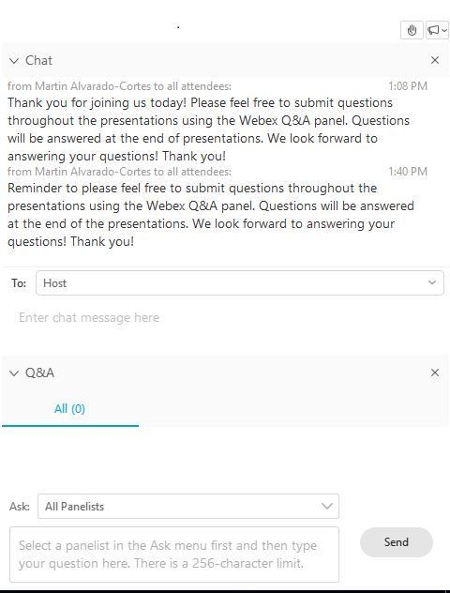
Want to Ask a Question?
The presenters will answer questions at defined points in the presentation.
To ask a question, use one of the Q&A features listed below (note: select the participant panel icon if the Chat/Q&A panel isn’t in view):
Raise your hand. We will
call on you during Q&A.
Type your question into the “Chat”
or “Q&A” features.
  Hit “Send” to submit
  your question.
Or you can ask a question
aloud at the end when we
un-mute the lines.

Slide 12
Next Steps
2018 CMS Pre-Rulemaking Program Measure Needs and Priorities Session – April 25 from 1:00 to
3:00 PM ET
Jira closes for new measures on June 3, 2019
Resource for everything MUC:
  Pre-Rulemaking Web Site
Notes:
During the Needs & Priorities webinar each program will emphasize their individual needs and priorities for their given program by Meaningful Measure Area (MMA). There are lots of resources on our pre-rulemaking website.

Slide 13
Contacts for MUC List
CMS MUC Coordinators:
Helen Dollar-Maples — Helen.Dollar-Maples@cms.hhs.gov
Kimberly Rawlings — Kimberly.Rawlings@cms.hhs.gov
Measures Manager— Pre-Rulemaking:
Vince Brown — brownv@battelle.org
614.424.5928

Slide 14
For More Information
Jira Submission Template Blank
FAQs
Jira User Guide
Pre-Rulemaking Web Site

