Slide 1



Streamlined Access to PECOS, EHR, and NPPES
November 15, 2013

Slide 2
Medicare Learning Network®
This MLN Connects™ National Provider Call (MLN Connects Call) is part of the Medicare Learning Network® (MLN), a registered trademark of the Centers for Medicare & Medicaid Services (CMS), and is the brand name for official information health care professionals can trust.

Slide 3
Disclaimer
This presentation was current at the time it was published or uploaded onto the web. Medicare policy changes frequently so links to the source documents have been provided within the document for your reference.
This presentation was prepared as a service to the public and is not intended to grant rights or impose obligations. This presentation may contain references or links to statutes, regulations, or other policy materials. The information provided is only intended to be a general summary. It is not intended to take the place of either the written law or regulations. We encourage readers to review the specific statutes, regulations, and other interpretive materials for a full and accurate statement of their contents.

Slide 4
Today’s Speakers
Zabeen Chong, Director
Provider Enrollment Operations Group (PEOG),
Center for Program Integrity
Richard Gilbert, Director
Division of Enrollment Systems
Provider Enrollment Operations Group (PEOG),
Center for Program Integrity
Alisha Banks, Health Insurance Specialist
Division of Enrollment Systems
Provider Enrollment Operations Group (PEOG),
Center for Program Integrity

Slide 5
Agenda
Opening remarks
Overview of I&A
Review of Enhancements
Top 10 FAQs
Useful Resources
Question and Answer Session

Slide 6
What is the Identity & Access Management System (I&A)
The I&A System is where users register for usernames and passwords to access:
PECOS
NPPES
Electronic Health Records (EHR) Incentive Program
The I&A System works behind the scenes, and controls what users are able to access in those systems.
Choosing to approve others to work on your behalf in these systems is not required, and has no impact to claims payments.

Slide 7
Challenges
Individual Providers can not assign someone to work on their behalf in PECOS
Sharing of personal account information caused security violations
The process for gaining access to PECOS took weeks, was not clear, and required mailing documents to External User Services (EUS)
Users were required to contact EUS for forgotten Username & Password Reset.

Slide 8
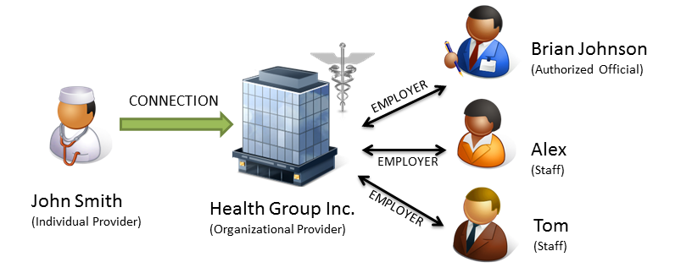
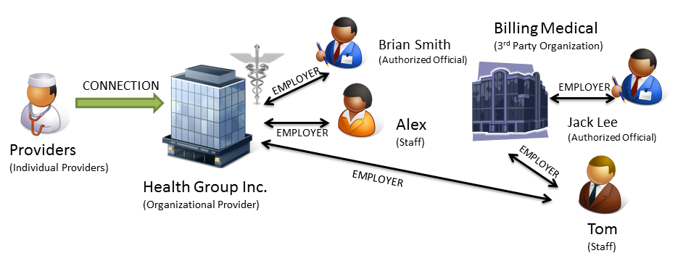
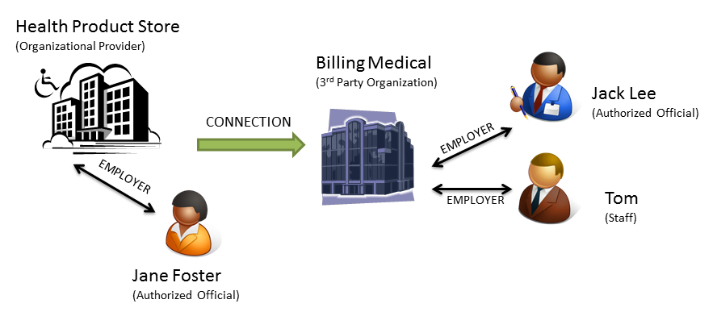
Types of Situations
1. Individual Provider working for an Enrolled Group
3. Enrolled Group (w/Individual Provider)
works with 3rd Party
2. Enrolled Organization works with 3rd Party

Slide 9
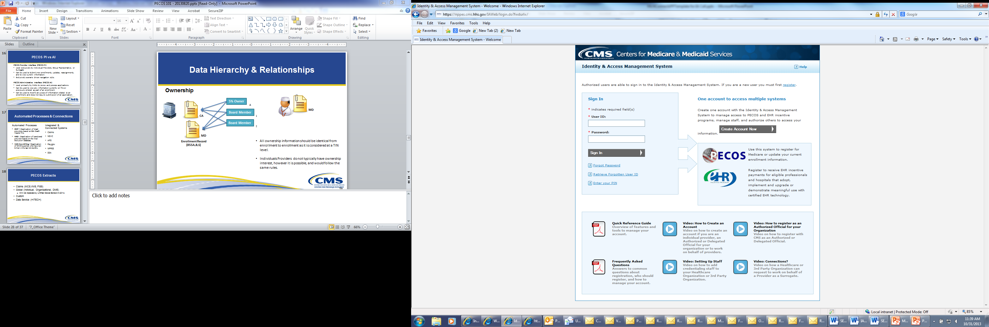
Enhancements to I&A – More Education
Improved user interface to make more intuitive
Reset username and passwords online, without calling EUS
Quick Reference Guides, FAQs and Tutorials available from the I&A homepage

Slide 10
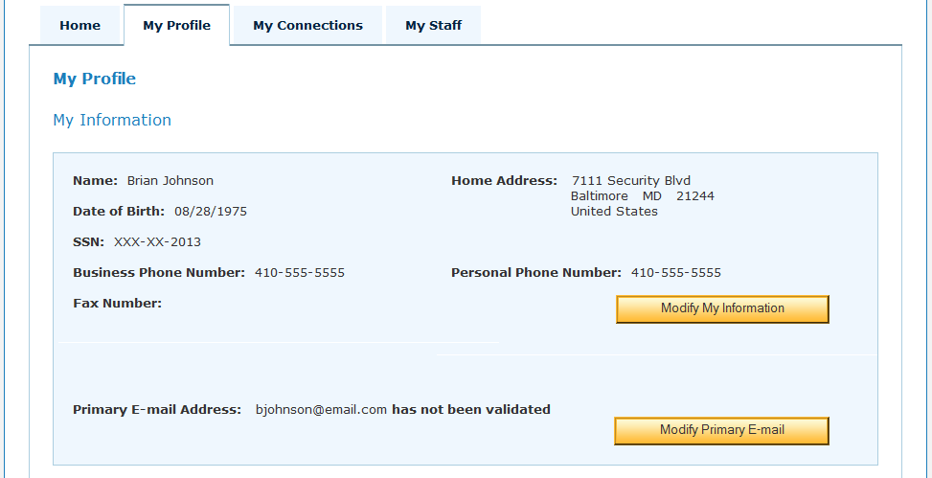
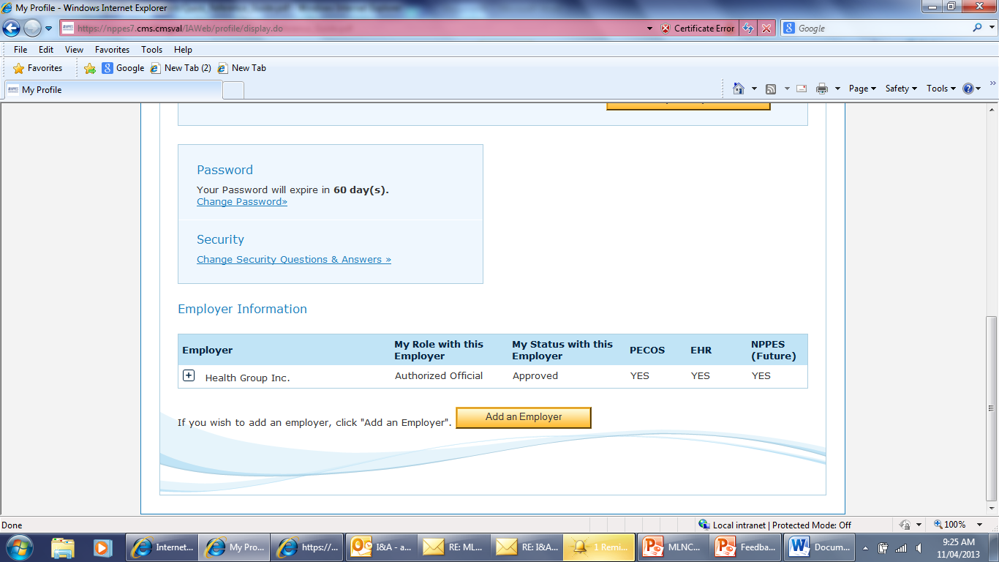
Enhancements to I&A – Simple Registration & Approvals
Streamlined new user registration, process.
Allow Authorized and Delegated Officials of enrolled organizations to be automatically approved without submitting documentation to EUS for verification.
Allow for 3rd Party Organizations (Billing Company, Credentialing Specialists, Office staff) to register and create their own account.

Slide 11
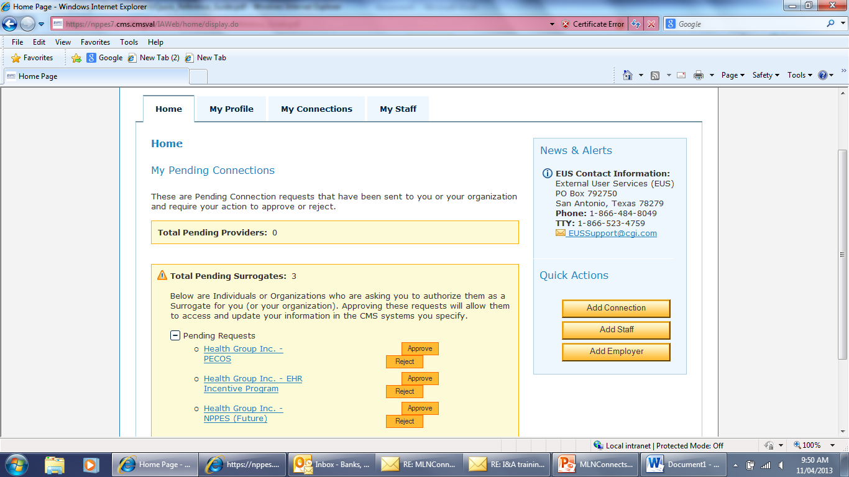
Enhancements to I&A - Connections
Continued Ability for Providers to allow Groups to Attest on behalf of Providers in EHR
New ability for Individual and Organizational Providers to establish connections, allowing others to work on their behalf in PECOS
Email Notifications to all users when new Connections are created.
IMPORTANT NOTE: Approving a Connection (Surrogate) to work on your behalf DOES NOT give that user authority to sign Medicare enrollment applications in PECOS. All enrollment applications are still required to be signed by the Individual Provider or appropriate Official of the Organizational Provider.

Slide 12
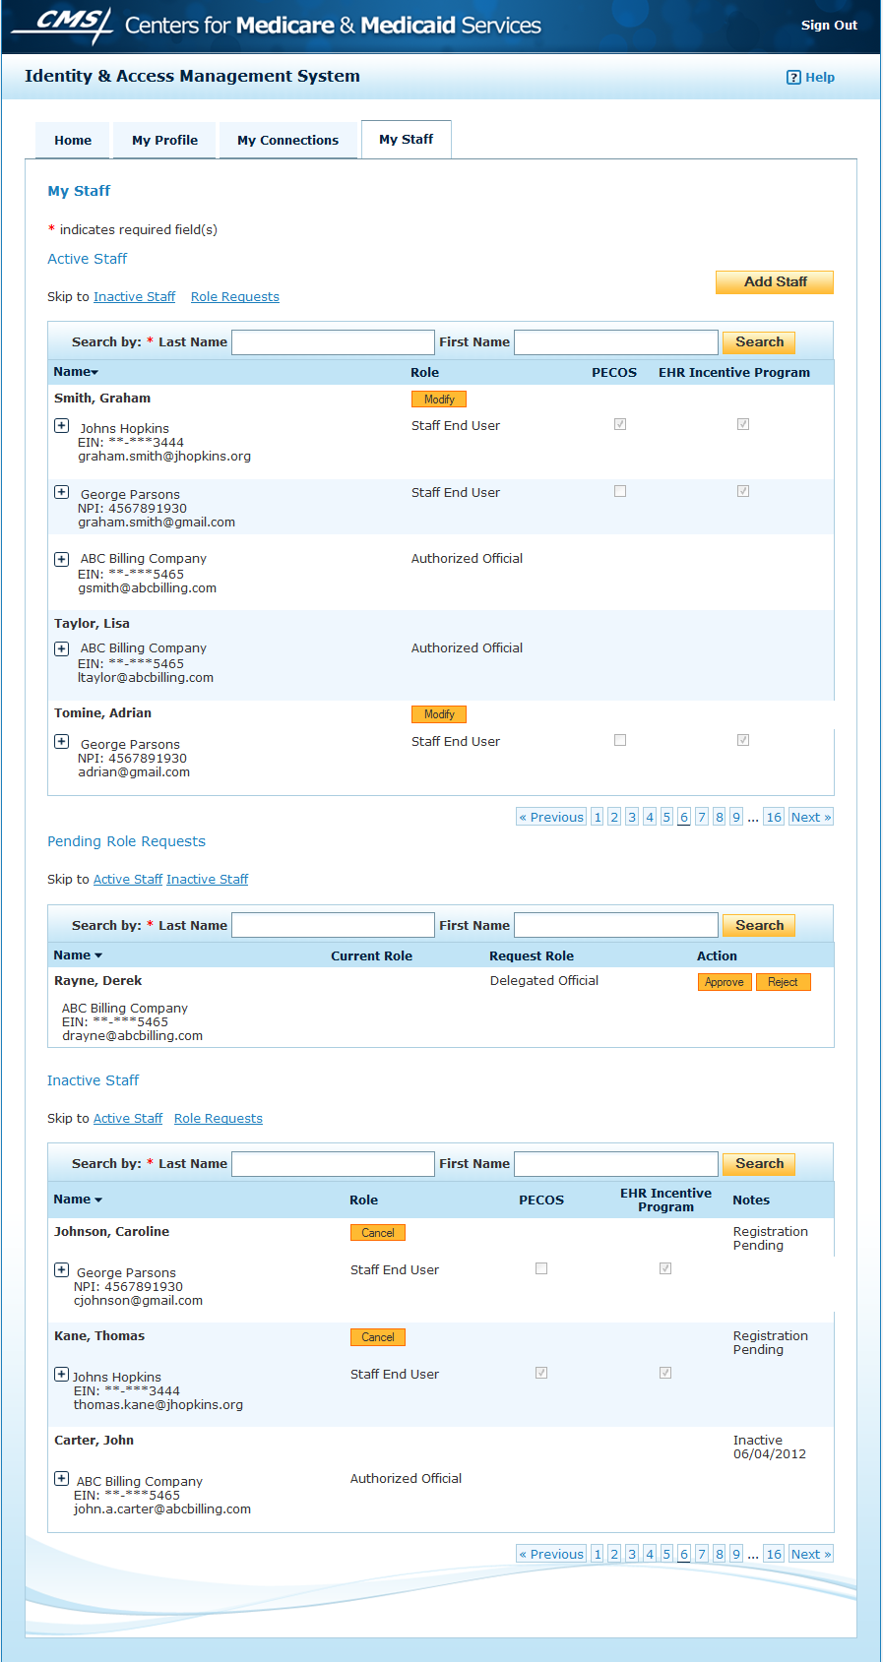
Enhancements to I&A - Staff Management
Create one connection to allow access for all staff.
Authorized and Delegated Officials can invite and manage what staff can access.

Slide 13
Existing Users
Any Authorized Official, Staff End User, or Individual Provider who previously accessed PECOS, NPPES, or EHR already has an account.
Existing usernames and passwords previously used to access PECOS, EHR and NPPES have been converted, and can still be used.
Users have access to the same systems and information that existed prior to the I&A updates

Slide 14
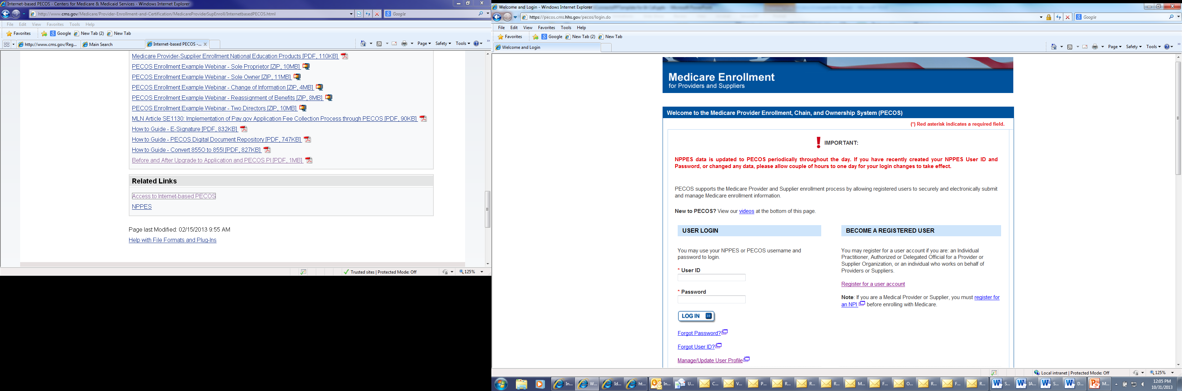
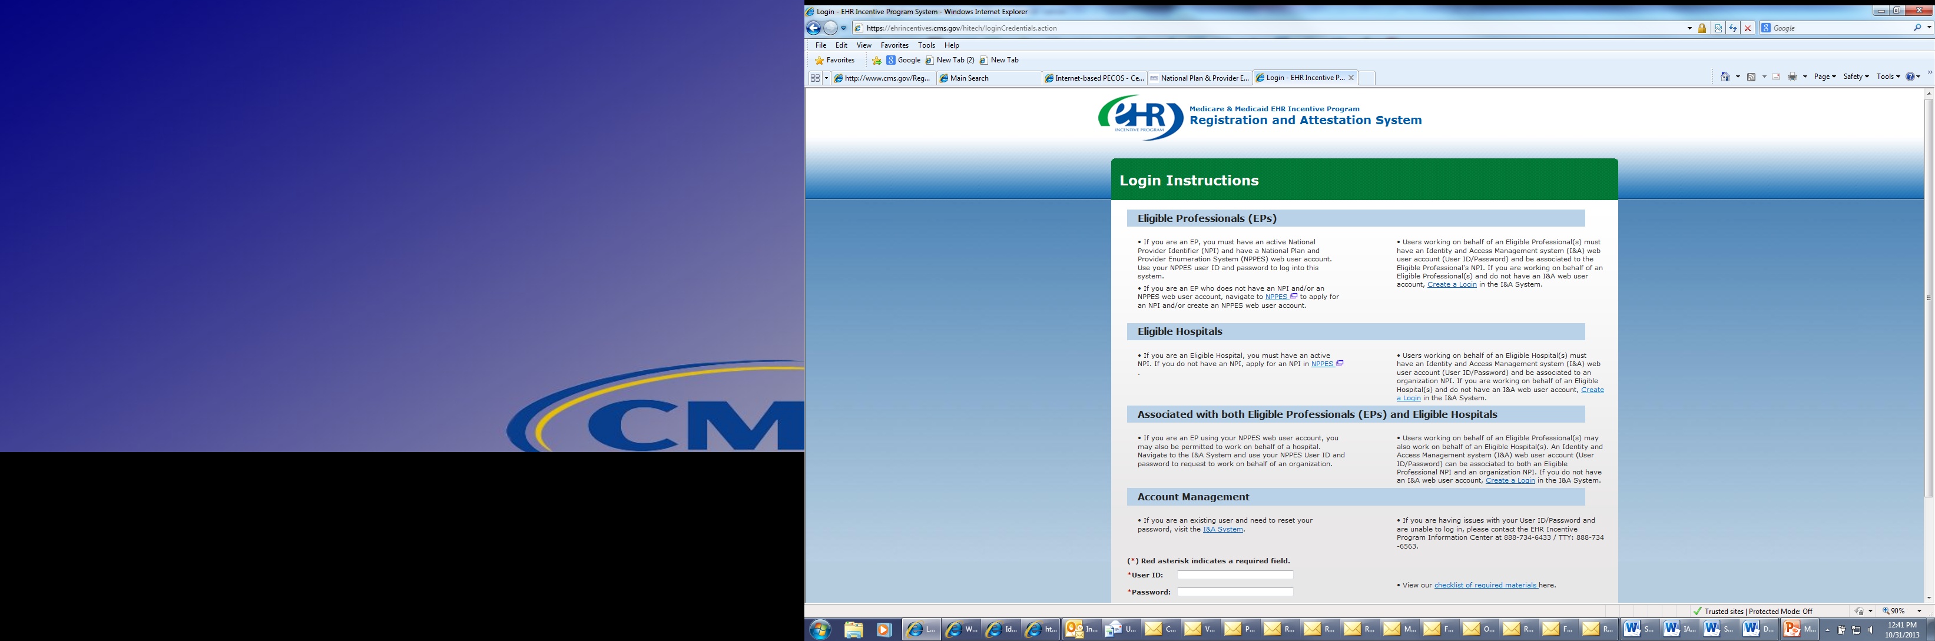
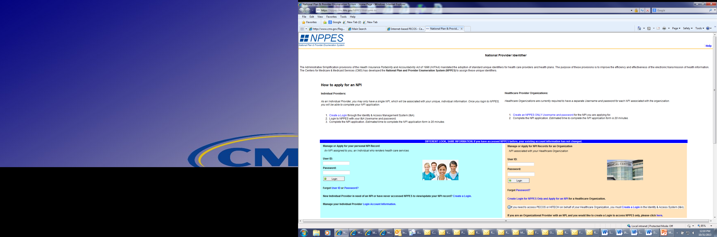
Accessing I&A from PECOS, EHR and NPPES
Create an account.
Manage Your Account Retrieve forgotten User ID or Password
Create an account.
Manage Your Account Retrieve forgotten User ID or Password
Create an account.
Manage Your Account Retrieve forgotten User ID or Password
Notes:
Show & Label Links
Create Account
Forgot U/P
Manage Account

Slide 15
Important Definitions
Organizational Provider
An Organization that provides medical items and/or services to Medicare beneficiaries (e.g. DMEPOS Supplier, Physician Group Practice, Hospital, etc…) Must have or be eligible for a Type 2 NPI in NPPES.
3rd Party Organization
A third-party organization (e.g. billing agency, credentialing consultant, or other staffing company) that has business relationships with Individual Providers or Organizational Providers to work on their behalf.
Surrogate
An employee (eg. Staff, AO or DO ) of an Individual Provider or Organizational Provider or 3rd Party Organization that is authorized to access, view, and modify information within CMS computer systems on behalf of their employer; OR
An Organizational Provider that has a business relationship with an Individual Provider to access, view, and modify information within CMS computer systems on their behalf; OR
A Third-Party Organization that has a business relationship with an Individual Provider or Organizational Provider to access, view, and modify information within CMS computer systems on their behalf.

Slide 16
Top 10 Frequently Asked Questions (FAQs)
With the I&A updates, am I required to create a new account? No, your existing username and password for NPPES, PECOS, and EHR is also used to access the I&A system. If you are not sure if you have an account, you can check by using the forgot User ID or Password link on the I&A, PECOS, or NPPES homepage.
Who can be a Surrogate for a Provider? An Authorized or Delegated Official for an Organization can make a request for their organization to work on behalf of a Provider. Once approved anyone in the Authorized or Delegated Official’s Organization (eg. Staff) may work on behalf of that provider.
Do I need to the be the Authorized (AO) or Delegated Official (DO) on my enrollment to act as such in I&A? No; however, CMS recommends that the AO or DO be the same individuals as the enrollment as they must be able to legally bind the company, are responsible for approving the staff within the system, and most importantly can be approved without sending paperwork to EUS.

Slide 17
Top 10 Frequently Asked Questions (FAQs)
Why can’t I see all the Individual Providers in my Group Practice? Authorized & Delegated Officials are able to see all the Individual Providers who have approved the Group as their Surrogate. Staff need be given access to those records by an AO or DO.
Why can’t I create connections to Providers? Only approved Authorized Officials and Delegated Officials of an Organization are able to create and manage connections. If you have been authorized to perform these functions, you need to perform a role change request on the My Profile page under the employer information section at the bottom of the page, and have your Authorized Official approve you to be a Delegated Official.
How do I change my role in I&A if I am listed as an Staff End User for my organization, and I should be an Authorized Official (AO) or Delegated Official (DO)? You need to perform a role change request on the My Profile page under the employer information section at the bottom of the page, and have your Authorized Official approve you to be a Delegated Official, or submit the appropriate IRS documentation to EUS.

Slide 18
Top 10 Frequently Asked Questions (FAQs)
Do I still need to submit IRS documentation to the External User Services (EUS) Help Desk when establishing a user account? In most cases, no. If you are an Authorized or Delegated Official listed on an approved existing enrollment in PECOS for your Organization, your employment relationship will be automatically approved. If you are a Staff End User you must receive a request from your AO or DO registered in the system. If you are a newly enrolling entity, AO or DO that is not listed on an existing enrollment, or an AO or DO for a 3rd Party that does not have an NPI and does not qualify as an enrolling entity then you will need to submit IRS documentation to EUS for review prior to receiving approval for your role with the organization.
How do I register my 3rd party Organization? An appointed official with the authority to legally bind that organization must register in I&A, and then add the organization as his employer, and then follow directions to send appropriate documents to EUS.
How often will I need to re-establish Connections? Once approved, a connection will not expire. Either party may login and remove the Connection at any time.
How do I access NPPES on behalf of a Provider? Today NPPES does not allow Connections, however we are working to add this functionality in the future.

Slide 19
Day One: Issues & Concerns
Not Receiving Emails - The I&A system is generating and successfully sending e-mails. If you have not received an e-mail, please check your SPAM folder. We are continuing to look for ways to quickly reduce this burden.
Delay in receiving NPIs - Prior to 10/31 some users experienced delays in receiving their NPI’s. This back log has been reduced, and users should see Type I enumeration return to normal processing times.
No longer having access to same Information - Prior to 10/23 users may have experienced issues with access to information they were able to see prior to the update. This has been corrected and should no longer be an issue for users. If it is please verify your role under My Profile, and contact your Authorized or Delegated Official to ensure you have appropriate access to all your providers.
Missing Secret Questions – If your account does not have at least 3 secret questions associated with it, then you will be required to call EUS the first time you reset your password. We are continuing to look for ways to quickly reduce this burden.

Slide 20
Resources
I&A Home Page: https://nppes.cms.hhs.gov/IAWeb/login.do
Login
Quick Reference Guides
FAQs
Video Tutorials
For question related to contact the External User Services (EUS) Help Desk at 1-866-484-8049 or EUSSupport@cgi.com

Slide 21
Question and Answer Session

Slide 22
Evaluate Your Experience
Please help us continue to improve the MLN Connects National Provider Call Program by providing your feedback about today’s call.
To complete the evaluation, visit http://npc.blhtech.com/ and select the title for today’s call.
Evaluations are anonymous, confidential, and voluntary.
All registrants will receive a reminder email about the evaluation for this call. Please disregard the email if you have already completed the evaluation.
We appreciate your feedback.

Slide 23
Thank You
For more information about the MLN Connects National Provider Call Program, please visit http://cms.gov/Outreach-and-Education/Outreach/NPC/index.html
For more information about the Medicare Learning Network (MLN), please visit http://cms.gov/Outreach-and-Education/Medicare-Learning-Network-MLN/MLNGenInfo/index.html

