Slide 1
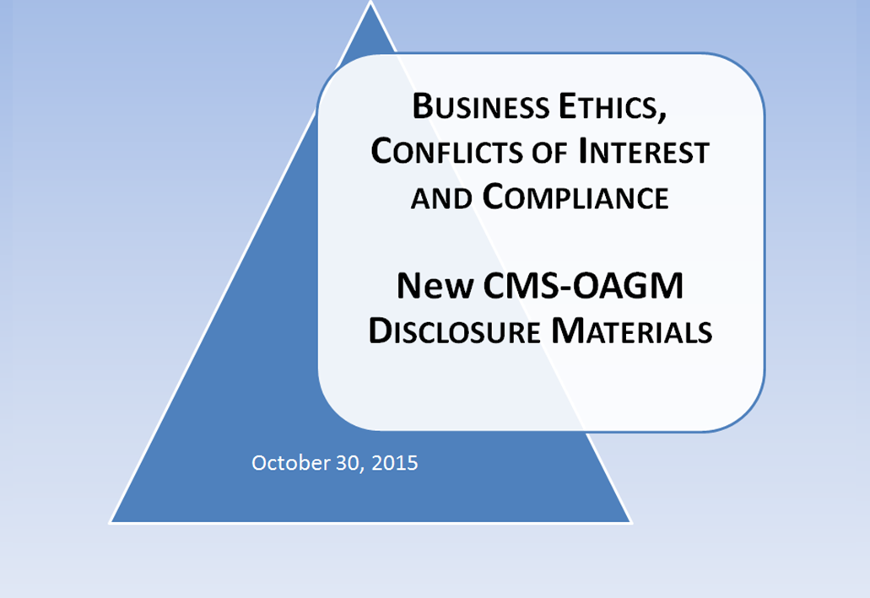
2015 CONTRACTING WITH CMS CONFERENCE
October 30, 2015

Slide 2
Conflict of Interest – What is a Conflict?
Three Forms of Conflicts
Biased Ground Rules (BGR) – An Example is where the contractor helped develop the statement of work (SOW), or technical evaluation criteria, or created source selection material
  Concern – May provide an unfair competitive advantage because may have tilted the procurement material to favor, whether intentionally or not, its or an affiliate’s interests, services or products
  Usually a procurement integrity COI
  Unequal Access to Information (UAI) – An Example is where the contractor obtained government supplied information, to which no other potential contractor has access
  Concern – May provide an unfair competitive advantage because the “secret” information provides insight to the government’s needs.
  Usually a procurement integrity COI
NOTE: Knowledge or experience gained from incumbency alone, is NOT considered “unfair”
Notes:
Good morning, everyone, and welcome to our mid-year All Staff Meeting! I’d like to extend a special welcome to those of you joining us via Webinar and calling in.
Believe it or not, we will be half way through Fiscal Year 2015 at the end of this month. And it certainly has been a busy year thus far. As you can see, we have a lot to cover during this meeting. So, please hold all questions until the very end. We hope to have some time then to address them. And for those of you joining us on the phone, please remember to keep your phones on mute until we open the floor for questions.

Slide 3
New OAGM Employees
Three Forms of Conflicts (continued)
Impaired Objectivity (IO) – An Example is where the contractor’s other interests may effect decisions it makes or services it provides to the Government
  Concern – Risk that performance may not be in best interests of the government, or biased to favor the contractor’s interests
  Usually a performance or business risk COI
  NOTE: If the contractor participated in the SOW, etc. development, has access to government supplied information where no other contractor has access, or has financial interests that could conflict with providing unbiased advice or services to the Government, then CMS must assume the worst case scenario in order to make a reasonable determination on how the COI is to be addressed
Notes:
We are very fortunate to have added 10 new employees to OAGM’s staff since October 2014—some of whom are previous CMS/OAGM employees or are on detail with us for a few months! If you’re here with us today, please stand in place when your name is announced.
AGG (Ed’s Group):
William Houseman
ASG (Brian’s Group):
Avery Bishop
Matthew Norris
Ashlee Stem
MACG (Linda’s Group):
Jaime Galvez (Welcome back!)
Christine Hill
Karla Santiago
Melanie Suris- Rodrigues
ABSG (Leisa’s Group):
Estelle Sarricks (on detail)
BOS (Dan’s Group):
Chris Motsiopoulos (HHS SES Candidate Development Program)
…speaking of details…we also have Lou Anderson on detail to MACG.
Let’s welcome them all with a round of applause!

Slide 4
Conflict of Interest Overview
Purpose –
To determine as early in the acquisition cycle as possible whether a COI exists
Early detection permits broader remedial action and saves time
Two Kinds of COI Risk –
Risk to Procurement Integrity – Focus is Pre-Solicitation/Pre-Award
Business/Performance Risk – Focus is Post-Award
CMS’ Goal – Before Contract Award…
Prevent unfair competitive advantage
Prevent the existence of conflicting roles that might bias a contractor’s performance
Analytical Framework: When CMS Considers COIs –
Before solicitation preparation (both pre-award procurement integrity and post-award business performance risks – forward thinking)
At Pre-award (post-award business/performance risk – discovered during proposal review)
Notes:
We are very fortunate to have added 10 new employees to OAGM’s staff since October 2014—some of whom are previous CMS/OAGM employees or are on detail with us for a few months! If you’re here with us today, please stand in place when your name is announced.
AGG (Ed’s Group):
William Houseman
ASG (Brian’s Group):
Avery Bishop
Matthew Norris
Ashlee Stem
MACG (Linda’s Group):
Jaime Galvez (Welcome back!)
Christine Hill
Karla Santiago
Melanie Suris- Rodrigues
ABSG (Leisa’s Group):
Estelle Sarricks (on detail)
BOS (Dan’s Group):
Chris Motsiopoulos (HHS SES Candidate Development Program)
…speaking of details…we also have Lou Anderson on detail to MACG.
Let’s welcome them all with a round of applause!

Slide 5
Conflict of Interest Process
Required COI Clauses—Inserted info Solicitation Materials and Contracts
Section H.1 shall be in every contract that is above the simplified acquisition threshold (currently $150,000)
Section H.1 (Long) – Business Ethics, COI and Compliance (OCT 2015)
This clause is used when CO identifies significant potential COIs
Format -
Will always be the first numbered provision in Section H
Contains Standardized text and cross references
Contains pre-award Disclosure Requirements; potential post-award Audit Requirement
Alternative Section H.1.c – For High Risk/Profile Programs (ZPIC, MAC, QIC, QIO, etc.) – Alternatives are designed for specific programs; otherwise, default already at H.1.c will be used
  Section H.1 (Short) – Post-Award Business Ethics, COI and Compliance (OCT 2015)
  This clause is used when NO significant potential COIs are identified
  Designed as a contingent clause in the event COIs arise during the POP
  Contractor community required to notify CO of newly discovered COIs
  The text is abbreviated (e.g., fewer defined terms, no Alternative sections, no pre-award disclosure requirements)

Slide 6
Conflict of Interest Process
Required J Attachments – Inserted info Solicitation Materials and Contracts
H.1 Clauses cross-reference the disclosure requirements of the J Attachments (“x” and “y” are place holders only; CMS will conform to numbering sequence)
J.x Template format is not required to be used, but information requested therein is required to be submitted
Attachment J.x – Contractor Business Ethics, COI and Compliance Program Requirements
To be completed by offeror/contractor and all proposed subcontractors
Designed as guide to information categories and depth of disclosures
This information will be submitted to CMS for independent analysis; must provide sufficient detail for CMS independent analysis
Requires corporate organizational chart(s)
Requires full description of identified COIs (actual, potential or apparent; BGR, UAI, OI); financial relationships; proposed mitigation plans
Requires Business Ethics/Integrity disclosures (filed complaint or enforcement action)
Includes Subcontractor flow-down requirements (same information and lead/prime)
Certification Signed by Person with Authority to Bind the Company

Slide 7
Conflict of Interest Process
Required J Attachments (continued)
Attachment J.y – Personal COI Financial Disclosure
Similar to Government’s OGE 450 Financial Disclosure for Federal Employees
Limited to Health Care Related Investments/Interests
Reporting Thresholds Raised
To be completed by offeror’s/contractor’s/subcontractor’s officers, directors, managers and key personnel assigned to the contract
  Designed as guide to information categories and depth of disclosures
  Underlying information NOT to be submitted to CMS due to Personally Identifiable Information (PII) risks
  Offeror’s/contractor’s/subcontractor’s compliance officer will analyze disclosures and certify in writing to CMS whether personal COIs were identified and any mitigation plans implemented
  CO has discretion to inquire further

Slide 8
Conflict of Interest Process
Required L and M Clauses—Inserted into Solicitation Materials
Section L – Proposal Submission Instructions
Describes how the offeror/contractor will present the Ethics and COI materials to CMS
Two Instruction Versions –
When Significant Potential COIs have been Identified
When NO COIs have been Identified
The instruction not used will be deleted by CMS
  Section M – COI Evaluation Factors for Award
  CMS Disclosure on how CMS will analyze Business Ethics, COI and Compliance submissions
  Material is not “scored”; more of a go/no go determination

Slide 9
Conflict of Interest Process
Discussions
CMS will perform an independent analysis on the offeror/contractor materials disclosed in the J.x submissions
CO will determine whether Discussions with the offeror/contractor are required for identified COIs and/or proposed mitigation plans
If Discussions are NOT required, CO may go directly to pre-award process for determining apparent successful awardee
If Discussions ARE required, CO will prepare requests for additional information –
Offer/contractor will submit supplemental J.x with new information
New information will be assessed in same manor as described above
Process will repeat until CO is satisfied with the resolution
Following discussions, CO may request Final Revised Proposals, if necessary

Slide 10
Conflict of Interest Process
Pre-Award Memo for Apparent Successful Awardee
Memo is Prepared by CO; part of the Official Contract File
If the Apparent Successful Awardee has unresolved COIs, a more in-depth COI review must take place
Reliance on previous analytical work-papers is appropriate
Documentation regarding the acceptable COI remediation is critical to a successful defense of the CO’s COI determination
But, the COI determination only needs to be “reasonable”
Exchanges in order to resolve Apparent Successful Awardee COIs are not “discussions”
This rule is ONLY applicable to the Apparent Successful Awardee
Caution – If an acceptable COI resolution plan requires changes to the proposal and/or proposed subcontractors which is material to the proposal’s technical or cost aspects, CMS may be required to reopen discussions

Slide 11
Conflict of Interest Process
Business Ethics, COI and Compliance
Under FAR 9.5, Conflict of Interest Rules Do Not Exclude Small Businesses
Under FAR 3.10 Business Ethics and Compliance Programs also Apply to Small Business
Formal Internal Controls and Training required where the prime contract or subcontract amount exceeds $5 Million in value
Regardless of the threshold, a Small Business must have a Code of Business Ethics and Conduct
US Sentencing Guidelines note that the difference between small and large business for compliance program effectiveness determination is only the degree of formality
CMS’ position is Small Business must Demonstrate an Effective Compliance Program especially regarding Fraud, Waste and Abuse, and COI detection and remediation
Justified because CMS programs are generally high-risk, high-profile and under intense scrutiny
The Degree of Formality can be tailored to the size of the entity, and magnitude of the CMS business

Slide 12
Conflict of Interest Process
HCA Waiver
If the Apparent Successful Awardee has COIs which cannot be adequately resolved to the CO’s satisfaction, then a CO’s request for Waiver may be required
This remedy should not occur often – rare event
Should only be considered an option for post-award performance business risk, not for procurement integrity risk
CMS Request for HCA Waiver Memo Prepared by CO
Justifies the CO’s determination for the needed waiver
Must always be in the Government’s best interest despite COI
No other viable solution – fully explained
Only the HCA or designee can grant the waiver
Waiver Memo Becomes Part of the Official Contract File

Slide 13
Conflict of Interest Process
Post-Award COIs
Both the Long and Short versions of Section H.1 have the same requirements post-award
Primarily used as a contingent against the development of post-award COIs due to changing business environment, mergers/ acquisitions, and new contract opportunities
Attachments J.x and J.y are included in the contract for the same reason regardless of which clause (long or short) was used in the solicitation materials
If a COI arises, Section H.1 Requires Timely Disclosure to the CO
Use Attachment J.x to provide the CO disclosure information on the newly developed COI
A similar analysis will occur as described for the pre-award process
Use Attachment J.y to gather information on director, key personnel and managers as described under the pre-award process
This information NOT provided to CMS; only the compliance officer certification is submitted to CMS

Slide 14
Frequently Asked Questions
General
Q: Will CMS modify existing contracts with this H.1 clause?
A: This new process became effective October 1, 2015. Is intended as a “going forward” requirement for “new awards” (including those currently in the pre-award stage). Generally, for post award/existing contracts it will be at the CO’s discretion. However, in some instances where the contract has a relatively long POP, or the program is high profile/high risk, then a contract mod to include these new Materials may be appropriate.
COI Clause H.1
Q: There is a “potential post-award audit” requirement mentioned in COI Clause H.1. What is meant by this, and how is this audit different than the audit requirements currently included in many CMS contracts?
A: Generally CMS contracts contain an annual compliance/COI audit. Usually, this audit is linked to the annual COI certification also required by the contract.
CMS has determined that routine, annual audits are too resource heavy given CMS’ return experience. CMS’ new approach is to require an audit only where there is a mitigation plan needed to resolve a COI. These will be negotiated prior to award, and both will be incorporated into the contract.
The audit will usually be conducted after the first year of performance to confirm that the agreed upon mitigation plan was implemented and is operating as intended. If there are no findings resulting from this audit, then the CO has discretion to not require additional audits or certifications for the remaining POP. However, if there are findings or other evidence suggesting the need, then the CO may require additional audits.

Slide 15
Conclusion
Any Questions?

Slide 16
Conclusion
Other Questions?

