Slide 1
Exchanges with Industry
CMS Industry Day
October 30, 2015
Brian Hebbel (Director of the Acquisition Support Group, OAGM)

Slide 2
The Importance of Engaging Industry
Brian Hebbel (Director of the Acquisition Support Group, OAGM)

Slide 3
Guidance Available
Federal Acquisition Regulations – 15.201 – Exchanges with Industry before receipt of proposals
Mythbusters – Office of Federal Procurement Policy
HHS Vendor Communication Plan – April 2014

Slide 4
Common Questions
Can Government officials engage Industry?
Do Government officials have to engage Industry?

Slide 5
Why Engage Industry?
New trends in the marketplace
New technologies in the marketplace
Help solve a problem on your program
Help save money on your program
Market research: commercial vs. non-commercial/small vs. large business
Acquisition Strategies: Other Agency Statement of Work (SOW), deliverables, evaluation criteria

Slide 6
Actions Already Taking Place at CMS
OAGM Industry Day events
CMS Chief Technology Officer (CTO) meetings with industry (George Linares)
The Cyber Security Conference was open to CMS employees and contractors and had contractors giving presentations
National Contract Management Association (NCMA) Activities – networking and education events mixed with OAGM and contractor staff
1st Annual CMS IT Conference – CMS Convergence 2015

Slide 7
Actions Already Taking Place at CMS (…continued)
CMS Grand Rounds (Patrick Conway) includes contractors giving roundtable presentations
OAGM Posting the Annual Acquisition Forecast
Regular Meetings throughout the Agency with Contractors
Ongoing Requests for Information (RFIs)
Pre-solicitation/pre-proposal conferences
HHS Access Forums at CMS –which include program managers meeting with capable small businesses
Industry-sponsored Initiatives

Slide 8


Vendors vs. CMS Needs
What Vendors Want
What CMS Wants
Talk to the leadership at CMS
Learn how to engage CMS
Showcase products and services
Structure & organization
Meet and reach out to industry
Learn from industry
Staff education, currency, and viability with technology

Slide 9
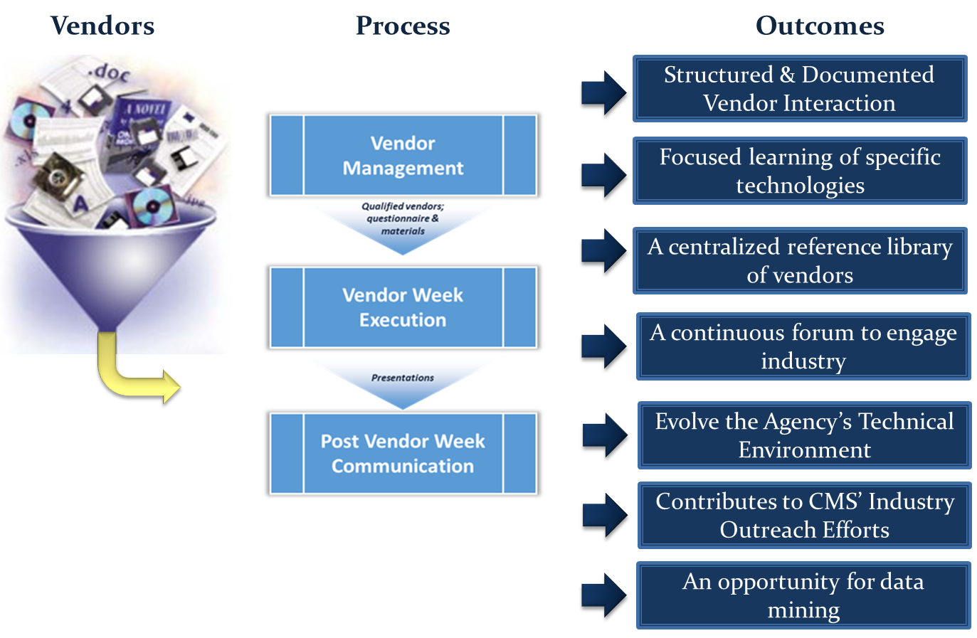
“Vendor Week” Outcomes

Slide 10
Tips for Vendors
Know the rules and educate Government officials about the rules.
Have a value proposition before you contact CMS officials (must have done your homework).
Don’t leave unless they know how to reach you about your contracting vehicles; explain how they work!

Slide 11

Questions

