Slide 1
Information Technology Governance and Services
Janet L. D. Vogel
Director, Office of Technology Solutions,
Deputy CIO
Centers for Medicare & Medicaid Services
Friday, October 30, 2015

Slide 2
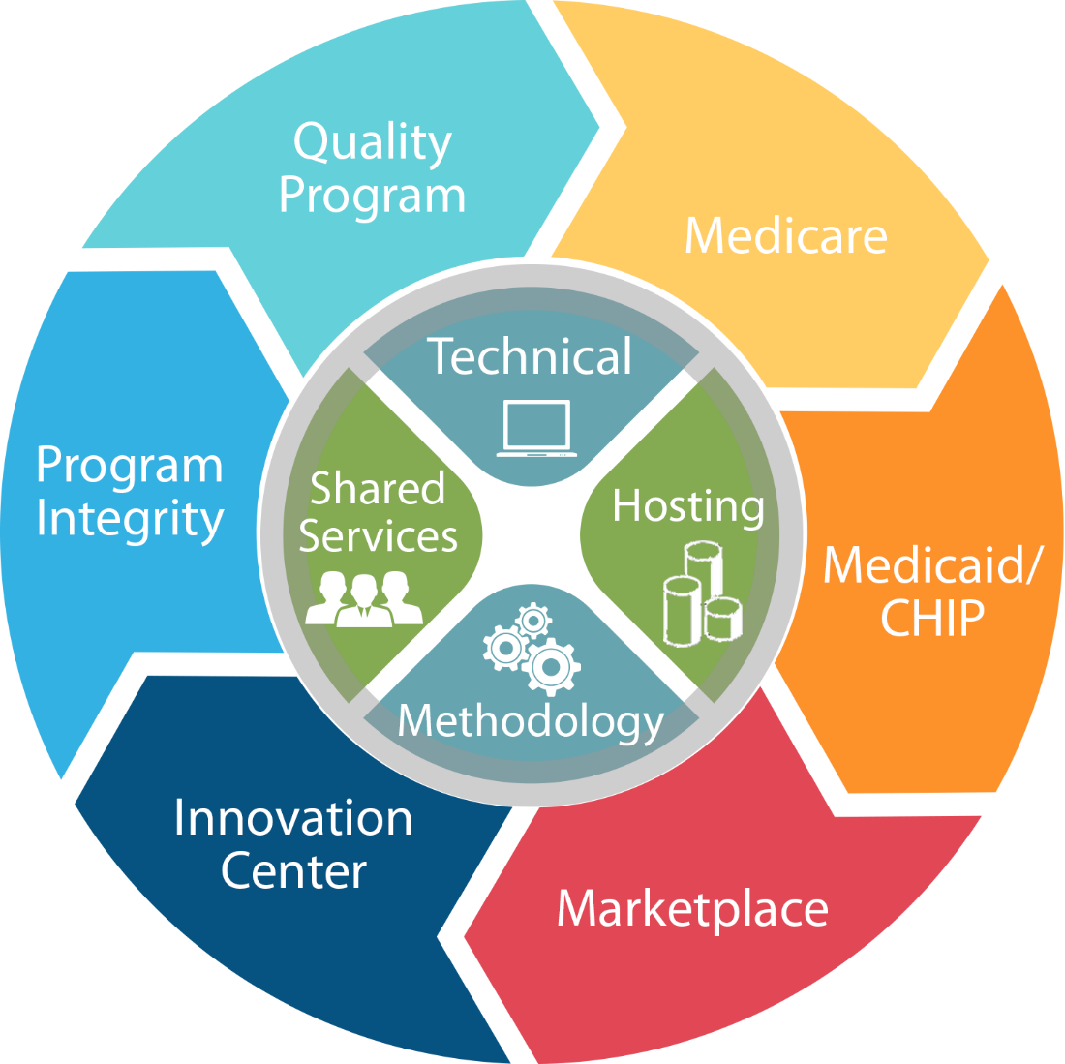
CMS IT Program Support
Foundational IT Support
Technical Delivery
Hosting
Methodology
Shared Services

Slide 3
Agenda Topics
Examples of IT Governance Bodies, Guidance, and Processes
IT Security
Shared Services

Slide 4

IT Governance
Information Technology Investment Review Board (ITIRB)
Business Assessment
Technical Review Board

Slide 5
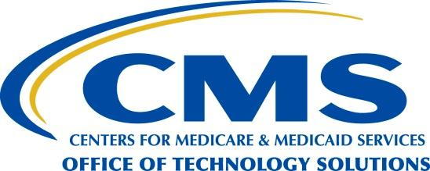
Information Technology Investment Review Board (ITIRB)
The CMS ITIRB is established as the executive review and decision-making body for CMS IT management.
The ITIRB will review and approve IT initiatives and IT expenditures.
The ITIRB will ensure that proposed investments contribute to the Secretary’s strategic vision and mission requirements, meet the business needs of the agency, employ sound IT investment methodologies, comply with Departmental systems architectures, and provide the highest return on the investment or acceptable project risk.
The ITIRB will ensure the agency’s IT investments are positioned for success through guidance provided by the CMS TRB technical architecture standards to help ensure that the agency gets the most value out of its IT investments by maximizing opportunities for reuse and information sharing.
The ITIRB will provide leadership and IT policy direction to ensure that the business drivers guide the agency’s IT budget, operations, and development.
The ITIRB will operate within the framework of the Agency’s enterprise architecture, acquisition management requirements, capital planning requirements, and other administrative regulations.
The ITIRB has the authority to plan, develop, and direct projects within the scope of their responsibility.
The Clinger-Cohen Act requires that each agency undertake capital planning and investment control by establishing a “process for maximizing the value and assessing and managing the risks of information technology acquisitions of the executive agency.”

Slide 6
Information Technology Investment Review Board (ITIRB)
The goal of the ITIRB is to promote integrated planning and collaboration among CMS programs, information technology systems, and business processes.
Integration and collaboration will be facilitated through the ITIRB Executive Steering Committees (ESCs) and interaction with the Technical Review Board (TRB).
The ESCs will review all IT investments from an enterprise perspective, prioritize IT investment requests using scoring criteria approved by the ITIRB, and prepare recommendations for the ITIRB.
The TRB will review all IT projects as they progress through the IT Investment Life Cycle (ILC).
The TRB will serve in an advisory capacity and make recommendations to the ITIRB and/or ESC, as appropriate. All matters brought to the ITIRB will be reviewed and documented through a formal capital planning and investment review process.
The ITIRB will focus on high cost, high risk, and mission critical investments.
An investment may meet any of the three criteria to be a candidate for full ITIRB review.
The ESCs will review all investments and provide recommendations to the ITIRB.
The ITIRB will rely on the recommendations of the ESCs for investments that don’t meet these criteria.
The ITIRB will reserve the right to perform a full review of any investment regardless of size, risk, and strategic value.

Slide 7
Business (BATS)
The Business And Technology Solutions (BATS) Board supports the IT Investment Review Board (ITIRB) in managing the CMS IT portfolio. It is responsible for ensuring that IT budget decisions align with CMS business, financial and technical strategies.
To help achieve this purpose, the BATS Board has the following objectives:
Review IT budget requests as one unified enterprise IT portfolio.
Provide the ITIRB with project-level funding recommendations during the IT budget formulation and execution phases.
Revise for in-year adjustments, as necessary, during the IT budget formulation and execution phases.
Provide project-level funding recommendations for unfunded IT projects based (i.e., Sweeps)
Review performance of major IT investments (i.e., Operational Analysis, TechStat, PortfolioStat, etc.).

Slide 8
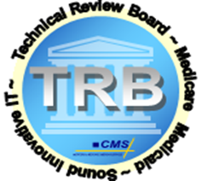
CMS Technical Review Board
The Technical Review Board (TRB) is the CMS technical governance body for information technology (IT) projects that conducts system life cycle governance reviews and consultations. It provides guidance to project teams on adhering to CMS technical standards and leveraging existing technologies (e.g., Shared Services).
In this role, the TRB provides the following benefits to the Agency:
Provides lessons learned and best practices for IT projects and programs
Helps to ensure that IT investments are positioned for success and adhere to the CMS architecture, standards, and guidance
Helps to ensure that the Agency gets the most value out of its IT investments by maximizing opportunities for reuse and information sharing
Contributes to leading edge discussions on business architecture
Advocates for the strategic IT direction
Promotes effective systems integration
Provides consistent technical guidance to teams on how to implement their project/program in an efficient way
Consultation | XLC Review
Consultations (also called consults) are discussions between the TRB and the project team that usually occur prior to formally engaging the Office of Technology Services (OTS); they are not official XLC reviews. The project team can request a consult at any time during the life cycle to discuss issues or seek the TRB’s guidance. | XLC reviews (also called gate reviews) are more structured than consultations. The TRB uses XLC reviews to discuss project implementation with the project team. The TRB is responsible for conducting several reviews identified in the XLC, including the Preliminary Design Review (Level 2 and 3 projects), the Detailed Design Review (Level 3 projects), and the Operational Readiness Review (Level 1, 2 and 3 projects).

Slide 9
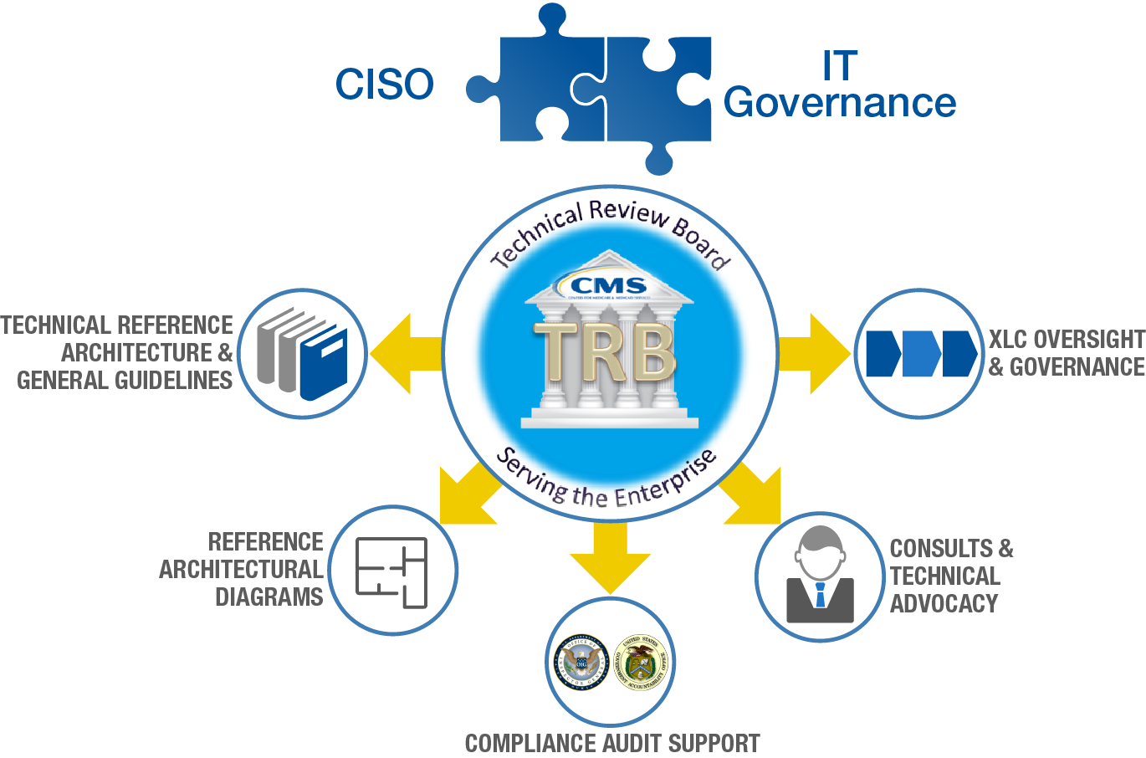
Technical Review Board
All of CMS Directly Benefits

Slide 10

CMS Technical Reference Architecture
Framework for CMS’s Architecture Standards & Best Practice
Standardized Operating Environment
Consistent Security Practices
Interoperability and Reuse of Shared Infrastructure
Required for IT Procurements/Contracts

Slide 11
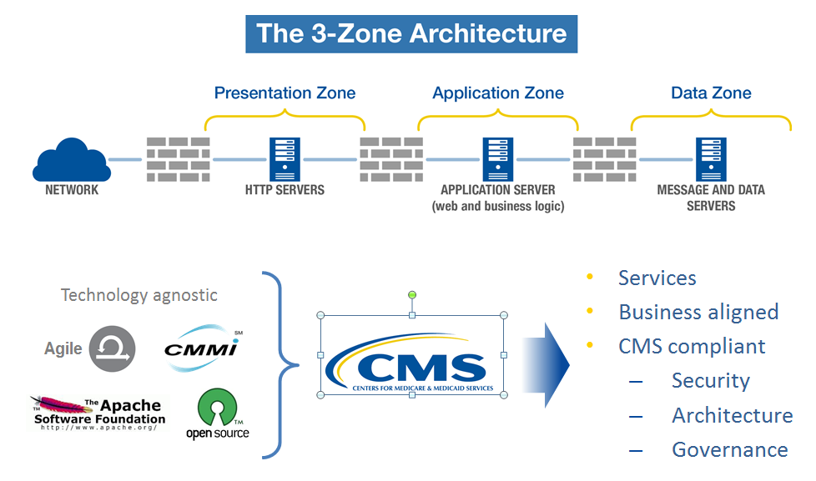
Technical Delivery

Slide 12
TRB Process and “Gateways”
Architecture
TRA
Tech Standards
Guidance
Other
Standards & Guidance Review
New Products &
Technologies
TRB Mission
To help ensure that the agency’s IT investments are positioned for success and adhere to the CMS architecture, standards, and guidance.
To ensure that the agency gets the most value out of its IT investments by maximizing opportunities for reuse and information sharing.
Advisory Services
for
Technical SOWs
Infrastructure
Changes
Ad Hoc Inquiries
In scope reviews for the TRB
Architecture Review(AR)
(BATS Review)
Preliminary
Design
Review
(PDR)
Detailed
Design
Review
(DDR)
Operational
Readiness
Review
(ORR)
Post
Implementation
Review
(PIR)
Arch Significant
Changes
Disposition
Review
(DR)
Ad Hoc Consults
System Development Projects
Initiation
Phase
Concept
Phase
Planning
Phase
Rqmts
Analysis
Phase
Design
Phase
Development
Phase
Test
Phase
Implementation
Phase
O&M
Phase
Disposition
Phase
Out of scope reviews for TRB
OTS Intake
Project
Baseline Review
Investment
Selection
Review
Requirements
Review
Environment
Readiness
Review
Annual
Operational
Analysis
Security
C&A

Slide 13
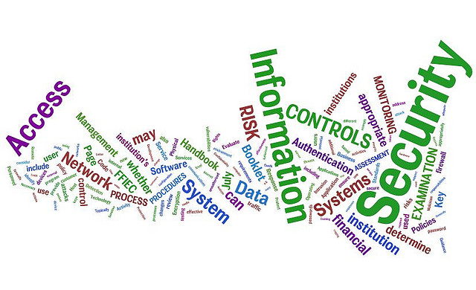
Information Security

Slide 14
IT Security
Key and critical to any IT activity in CMS
Consider, also, the Privacy implications of any activity
Data Guardians Program
CIO Directive 15-01:
Requires CMS systems and applications to utilize strong authentication, also referred to as Multi-Factor Authentication (MFA), mechanisms for privileged user access in accordance with CMS security and privacy guidelines.

Slide 15
SCA/ATO
Security Controls Assessment (SCA) & Authority To Operate (ATO)
XLC (Development)
Operations & Maintenance
Security Controls Assessment (SCA) - All controls supporting the application and/or system are tested every three years by a third party vendor. And at least 1/3 of the controls are tested on a yearly basis. An Authority To Operate (ATO) will NOT be granted unless an SCA is performed, all controls tested and is signed off by the CMS Chief of Information Security Officer (CISO)
Remember - “Security assessments are not about checklists, simple pass-fail results, or generating paperwork to pass inspections or audits—rather, they are the last line of defense in knowing the strengths and weaknesses of an organization’s information system…”
What is an ATO? - The ATO process is an essential part of the CMS enterprise-wide Information Security Program. It is used in making a risk determination decision for the operation of the subject system. When the level of risk to the CMS enterprise is deemed acceptable, the system is granted an ATO for up to three years.
Notes:
The reason we have information security is to protect the confidentiality, integrity, and availability of information. Risk Management is the security governance process that includes building and assuring security as part of the eXpedited life cycle and continuously monitoring security and mitigating risk in the Operations & Maintenance Phase as part of the larger Security Life Cycle.
This point is so important that it has been codified into laws and guidance:
Federal Information Security Management Act (FISMA) … improve the way all agencies secure federal information and information systems
Privacy Act … requires protection of information about individuals
HIPAA … requires protection of health information regarding individuals
OMB A-130, Appendix III … requirements for Security of Federal Automated Information Resources
Federal Information Processing Standards … Provide mandatory standards for agencies regarding all aspects of Information Technology
HHS OCIO Policy for Information Security and Privacy
This graphic on the slide shows the XLC and its relation to Risk Management.
The XLC deals with projects that create or modify systems
The Operations and Maintenance phase deals with running systems and keeping them running
Risk Management deals with managing risks associated with information and systems; from creation, through operations, to eventual disposal.

Slide 16

Enterprise Shared Services
IT shared services also complement other major federal IT initiatives laid out in OMB’s December 2010 25-Point Implementation Plan to Reform Federal IT Management, including federal strategies for cloud computing, digital government, and enterprise architecture.

Slide 17

What are Shared Services ?
Shared services are the consolidation of business operations used by multiple parts of the same organization
Shared services are cost-efficient because they centralize operations that are used by multiple components within the enterprise
The goal of a shared services delivery model is to allow each component to focus limited resources on activities that support their goals
Purpose is to shorten the time to market, reduce cost, improve interoperability, streamline communications, and provide standardization

Slide 18
Summary of Available Shared Services
CMS currently has five shared services, with additional services expected to be implemented.
Master Data Management (MDM) – service that synchronizes and links beneficiary, provider, and organizational data from different databases throughout the agency (Managed by OTS-EDSG)
Business Rules Engine Services (BRES) – service that expands agency-wide use and management of business rules (Managed by OTS-ESSG)
Enterprise Portal – a gateway allowing the public to access a number of systems related to Medicare Advantage, Prescription Drug, and other CMS programs (Managed by OTS-EDSG)
Enterprise Eligibility Services – provides a secure, consistent and re-usable way for applications to access beneficiary eligibility data (Managed by OTS-BAMG)
Enterprise Identity Management (EIDM) – helps to ensure individuals and organizations have secure, authorized access to a variety of CMS business applications (Managed by OTS-ESSG)

Slide 19
What is “Master Data Management” at CMS?
Master Data Management (MDM) is an enterprise infrastructure and associated processes for collecting, aggregating, matching, consolidating, quality-assuring, persisting and distributing Master Data throughout an organization to ensure consistency and control in the ongoing maintenance and use of this information.
At CMS, MDM cross references and stores data obtained from CMS operational Systems of Record.
MDM does not change source data, so MDM data can be considered to be as authoritative as the data is in the source System of Record from which it is obtained.
Its primary areas of focus at CMS are to:
Provide a trusted Identity Resolution capability for CMS’ expanding catalog of Master Data sources.
Provide trusted Integration and Consolidation of Master Data from numerous disparate data sources to create a consolidated, authoritative view of each entity.
Provide flexible and easy Access to Master Data (e.g., near real-time web services, extracts for batch processing, BI reporting, and real time portal access to BI tools through CMS’ Enterprise BI Environment).
Promote the development of Enterprise Data Governance of Master Data
Promote the improvement of data quality, integrity, and understanding (Data Stewardship)

Slide 20
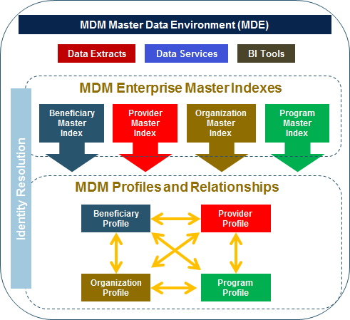
MDM Summary
MDM does not change source system data, and will not replace program-specific SOR applications.
MDM is a standard methodology for accessing a comprehensive unified view of data across data repositories and systems.
MDM provides a “Master Data Environment” (MDE) for 4 Domains of CMS Data:
1. Beneficiaries 2. Providers 3. Organizations/Plans 4. Programs
MDM provides a mechanism for consistently identifying, organizing, synchronizing, and easily accessing authoritative data across CMS.
The MDM MDE contains:
1) MDM Enterprise Master Person Indexes (EMPI) that will provide identity resolution and linking using key data in each domain from multiple data sources 2) MDM Profiles and Relationships that will store domain-specific profiles and relationships between each data domain 3) MDM Data Access methods:
Master Data Services (e.g., web services)
MDM Data Extracts
Business Intelligence (BI) Tools

Slide 21
What is Enterprise Portal?
Enterprise Portal is a Shared Service (Horizontal service) to support multiple business units (Vertical applications/projects)
Provide a single point of access for users
Provide authentication and minimum authorization mechanisms to vertical applications
Integrated with Enterprise Identity Management (EIDM), Enterprise User Access, and Enterprise LDAP for authentication
Users can use EUA, IACS and EIDM accounts
Integrated with Business Intelligence Tools – MicroStrategy, Cognos, SASEBI and Business Objects via OnePI
Support 373,081 users and 33 business applications
Customers include Professionals, providers, hospitals, issuers, Agent/Brokers, states,

Slide 22
What Does Portal Deliver to Business?
Support new vertical application integration into Enterprise portal
Portal is deployed across CMS 3-Zone architecture and 508 compliant
Portal UI is built as responsive web with web 2.0 technologies
Detailed Integration Life Cycle Phases (refer to Portal Integration Life Cycle - PILC)
Provide shared features for end users, application teams and developers
Provide operations and maintenance support for applications post production
Concurrent usage
Splunk reports
Maintenance pages
Sev1 issues
Support Application performance testing
Load tests up to 9000 concurrent users at each data center that we will continue to fine tune and test.
Continue to fine tune Portal infrastructure to meet higher loads
Multi data center approach to minimize downtime for applications.

Slide 23
What Is EIDM at CMS?
EIDM is one of CMS’ enterprise shared services, along with:
Enterprise Portal
Master Data Management (MDM)
Business Rules Enterprise Service (BRES)
Enterprise Eligibility Service (EES)
EIDM is the enterprise CMS identity and access management solution designed to protect the security of CMS’ data.
EIDM ensures individuals are identity proofed and have secure, authorized access to CMS business applications.
EIDM supports CMS’ goal to improve the user experience by providing an enterprise-wide set of credentials and simplified sign-on capability for multiple CMS applications.

Slide 24
EIDM Mission
EIDM provides secure, reliable identity and access management services to CMS partners and customers to ensure the integrity of CMS programs and protect Agency information assets. To achieve the mission, the EIDM service provides 4 functions:
User registers to obtain a CMS credential
Establish a user ID
User granted access by business application approver
Role selection
Identity proofing
Role approval
MFA setup
Registration
Authorization
Self-Service User Credential Management
Authentication
User maintains their
credential via self-service
Self-service management
of roles, user ID,
password and MFA
User signs into portal and accesses business application
Login with user ID, password and 2nd factor

Slide 25
What is BRES?
A business rule is a statement that describes a business policy or procedure
The BRES service maintains business rules governance policies for creating and enhancing business rules.
BRES provides software tools that can execute one or more business rules within CMS IT application code
Business rules are rules that the business enacts, and has the power to revise or discontinue
Business rules criteria:
Rules support business policies and processes
Rules are actionable (for example: If, then)
For CMS, business rules could be applied in many business areas – eligibility and enrollment, claims edit, pricing and payment, quality measures, fraud and abuse
Eligibility Example: If Beneficiary is 65 then Beneficiary has reached age of Eligibility

Slide 26
What Does BRES Deliver to Business?
Comprehensive support for developing, publishing, deploying, and/or integrating business rules
A tool for developing
business rules
Product
Rule Development Tool
(ODM)
Infrastructure
H/W & S/W
Rule Governance
Procedures and Processes
Rule Development
Enterprise or Business-specific Rules
Rule Support
Project Setup and Rule administration
A place to build, store, and execute
business rules
BRES
Support
Developing and integrating
business rules for applications and services
A process for developing and managing
business rules

Slide 27
What is Enterprise Eligibility Services (ESS) ?
An interoperable framework that will enable all CMS applications to access the correct systems of record for all eligibility-related data
A secure, consistent and re-usable way for applications to access beneficiary eligibility data stored across multiple internal and external systems
A component of a service-based application architecture

Slide 28
What Does EES Deliver to Business?
Provide consistent answers to eligibility inquiries
Identify and use “source-of-truth” data
Eliminate copies of data at multiple locations
Develop once and use often
Accessibility – web service, or MQ message
Realize economies of scale
High availability, performance and throughput

Slide 29

Questions?

