Slide 1
2015 Contracting with CMS Conference
Bridging the Gap Between CMS and Industry
October 30, 2015

Slide 2
Introduction
Brian Hebbel
Director,
Acquisition Support Group,
Office of Acquisition & Grants Management

Slide 3
Agenda Overview
Session | Time
Welcome & Morning Speakers | 9:00 AM – 9:55 AM
BREAK | 9:55 AM – 10:05 AM
Panel Discussion: “Tips From the Inside” | 10:05 AM – 11:10 AM
Special Message from the CMS Administrator | 11:15 AM – 11:30 AM
LUNCH | 11:30 AM – 1:00 PM
Breakout Session # 1 (Networking and Collaboration Sessions: 1:15 PM – 3:15 PM) | 1:00 PM – 2:00 PM
BREAK | 2:00 PM – 2:15 PM
Breakout Session # 2 | 2:15 PM – 3:15 PM

Slide 4

Where You Can Go During
Break Times & Lunch
Hallway directly outside of the Auditorium
CMS Cafeteria
Lower Level of the Building
The Jazzman Coffee Bar
Outside of the CMS Cafeteria, in the Lower Level Lobby of the Building
Restrooms
Turn right when you exit the Auditorium, follow the hallway, and the restrooms will be further down on your left

Slide 5

Network & Collaboration Sessions
Available from 1:15 PM – 3:15 PM
  Small Business Meet & Greet (by appointment only)
    Outside of the Auditorium
  Industry Networking (no appointments necessary)
    C-114 & C-115
    National Contract Management Association (NCMA) – C-114

Slide 6

Survey
After the conference, a link to a survey will be sent to you via email.
WE HIGHLY VALUE YOUR FEEDBACK!

Slide 7

Presentations Will Be Available on CMS’s External Website
All presentations from today’s conference will be posted onto CMS’ External Website.

Slide 8
Welcoming Remarks
Daniel Kane
Director,
Office of Acquisition & Grants Management
and
Head of the Contracting Activity
Notes:
Good morning, everyone. Thanks so much for taking the time to be here with us today—especially on a Friday! It’s really great to see such a full room of attendees!
Before I start, I want to let you know how important contractors are to CMS.
You help us to provide mission-critical services each and every day to the people we serve, so we truly value you as a member of our Acquisition Team.

Slide 9

Who We Are
OAGM is one of CMS’s mission-critical service components—negotiating and administering hundreds of contracts, grants, and interagency agreements that amount to more than $9 billion annually.
OAGM’s vision is to be a “best-in-class” acquisition and grants management organization.
Notes:
As you can see, you help us accomplish a GREAT DEAL of work!

Slide 10
OAGM Funding Obligations
Notes:
Reasons for slight decline:
MIP money is being used in FY 16 instead.
Here you can see OAGM’s funding obligations over the past decade. In FY 15 we awarded:
Approximately $6.5 billion in Contracts,
Approximately $1.8 billion in Grants,
Approximately $767 million in Interagency Agreements (IAs).
This is a grand total of almost $9.1 billion!

Slide 11
CMS Small Business Dollars
Notes:
Our small business dollars total declined slightly, due to $300 million of small businesses being acquired by large businesses.
While we were about 2% shy of reaching our overall small business goal (18.17% of 20%), we did achieve two of our socio-economic goals, as of the end of September 2015:
Small Disadvantaged Business: We exceeded the 5% goal with a total of 9.48%!
Women Owned Small Business: We exceeded the 5% goal with a total of 7.76%!

Slide 12
The Acting Administrator’s Priorities
(2015 – 2016)
Bolster the CMS Workforce
Improve the Quality of Care
Decrease Medical Cost Trend
Delivery System Reform
Expand Marketplace and Medicaid Coverage
Decrease Error Rate
Increase CMS Program Integrity Return on Investment (ROI)
Reduce Medicare Appeals
Notes:
Acting Administrator Slavitt introduced these top 8 priorities earlier this year.
While the contracts and grants work that OAGM administers supports all of these priorities, OAGM was tasked to develop some mission-critical, over-arching goals that would help achieve these priorities.
OAGM focused on the first priority, which is to bolster the workforce.

Slide 13
OAGM 2015-2016
Strategic Projects
Developing a Communication Strategy.
Automating invoicing/vouchering from contractor submissions, through CMS review/approval and Department of Treasury payment.
Ensuring Contracting Officer’s Representatives’ (CORs’) Contractor Performance Assessment Reporting System (CPARS) evaluations are standardized.
Increasing the number of acquisition professionals who have the following certifications:
  Federal Acquisition Certification-Contracting (FAC-C),
  Federal Acquisition Certification-Contracting Officer’s Representatives
  (FAC-COR), and
  Federal Acquisition Certification for Program and Project Managers (FAC-P/PM).
Developing the Acquisition and Grants Exchange (AGX) Website.

Slide 14
FY 2016 Acquisition Forecast
The following link will take you to
CMS’s External Website, which contains the
FY 2016 Acquisition Forecast:
https://www.cms.gov/About-CMS/Contracting-With-CMS/ContractingGeneralInformation/Other-Content-Types/CMS-Fiscal-Year-2016-Forecast-Opportunities.pdf
Notes:
We have included about 200 actions in our FY 2016 Forecast.

Slide 15
FY 2016 Acquisition Forecast:
Useful Information
Total number of actions available
Anticipated solicitation release date
Planned award date
Estimated value of contract base and all options
Type of action
Current contractor’s name (if applicable)
Point of contact (Contracting Officer’s Representative and Contracting Officer/Contract Specialist)

Slide 16
FY 2016 Indefinite Delivery, Indefinite Quantity (IDIQ) Contracts
The following link will take you to
CMS’s External Website, which contains the
FY 2016 IDIQ Contracts:
https://www.cms.gov/About-CMS/Contracting-With-CMS/ContractingGeneralInformation/Other-Content-Types/Indefinite-Delivery-Indefinite-Quantity-IDIQ-Blanket-Purchase-Agreements-BPA-List.pdf

Slide 17
A Sampling of
CMS IDIQ Umbrella Contracts
IDIQ Umbrella Contracts
Virtual Data Center Prime (VDCP)
Research, Measurement, Assessment, Design & Analysis (RMADA)
Qualified Independent Contractors (QICs)
Measure and Instrument Development & Support (MIDS)
Program Safeguard Contractors (PSCs)
Zone Program Integrity Contractors (ZPICs)
National Multimedia and Education Campaign and Grassroots Outlet (NEC)

Slide 18

Bring Your “A” Game!
Notes:
I meet with lots of contractors throughout the year.
It’s important to always bring your “A” game to remain in good standing with us and be competitive.
We are looking for the most innovative and best quality services.
We also depend on you to perform consistently at a high level.

Slide 19
We Are One Team!
CMS
Leadership
Contracting Officers
Contract Specialists
Contracting Officer’s Representatives
Contractors
Program Managers
Subject Matter Experts
Government Task Leads
Technical Evaluation Panels
Auditors
Notes:
We strive to provide the best value acquisition and grants solutions to the people we serve.
Therefore, we need you—contractors—as a core part of our Acquisition Team to bring your “A” game.
We want to be successful, so we want YOU to be successful!

Slide 20
FY 2016 Acquisition Vision/Focus Areas
Dr. Angela Billups
Associate Deputy Assistant Secretary,
Office of the Assistant Secretary for Financial Resources (ASFR),
U.S. Department of Health & Human Services (HHS)

Slide 21
Small Business Opportunities at HHS
Teresa L.G. Lewis, Director
Office of Small & Disadvantaged Business Utilization (OSDBU)
U.S. Department of Health and Human Services (HHS)

Slide 22



CMS INDUSTRY DAY
30 October 2015
Teresa L.G. Lewis, Director
Office of Small & Disadvantaged Business Utilization
U.S. Department of Health and Human Services

Slide 23

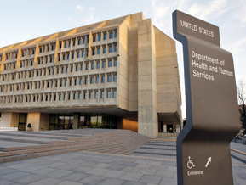
HHS

Slide 24


THANK YOU FOR YOUR SERVICE!

Slide 25
Mission of Health and Human Services
The U.S. Government's principal agency for protecting the health of all Americans and providing essential human services, especially those who are least able to help themselves.
HHS encourages the use of small businesses to achieve its mission.

Slide 26

HHS OPDIVS

Slide 27
300 PROGRAMS
Some highlights include:
Health and social science research
Preventing disease, including immunization services
Assuring food and drug safety
Medicare and Medicaid
Health information technology
Financial assistance and services for low-income families
Improving maternal and infant health
Head Start (pre-school education and services)

Slide 28
HHS Stats
Employees: Approx 85,000
Grants: $400 Billion avg

Slide 29
HHS Contracts
 | ALL | SMALL BUSINESS | % of SB ACHIEVEMENT
Contract Dollars | $21 Billion | *$4.5 Billion | 21.56%
Contract Actions | 93,193 | 41,995 | 45.06%
* More than 18 of the 24 CFO Agencies

Slide 30
What HHS Buys
OTHER PROFESSIONAL SERVICES
BIOMEDICAL (ADVANCED)
OTHER ADP & TELECOMMUNICATIONS SERVICES
AUTOMATED INFORMATION SYSTEM SERVICES
OTHER ADMINISTRATIVE SUPPORT SERVICES

Slide 31
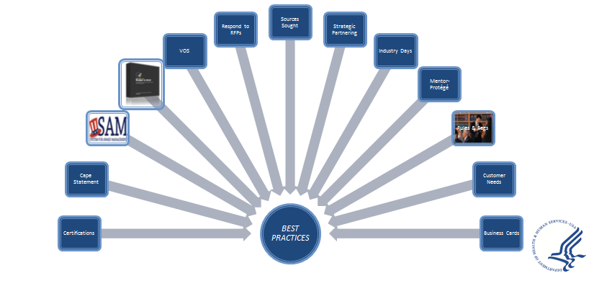
BEST PRACTICES

Slide 32


SAM system

Slide 33

Forecasting Information

Slide 34
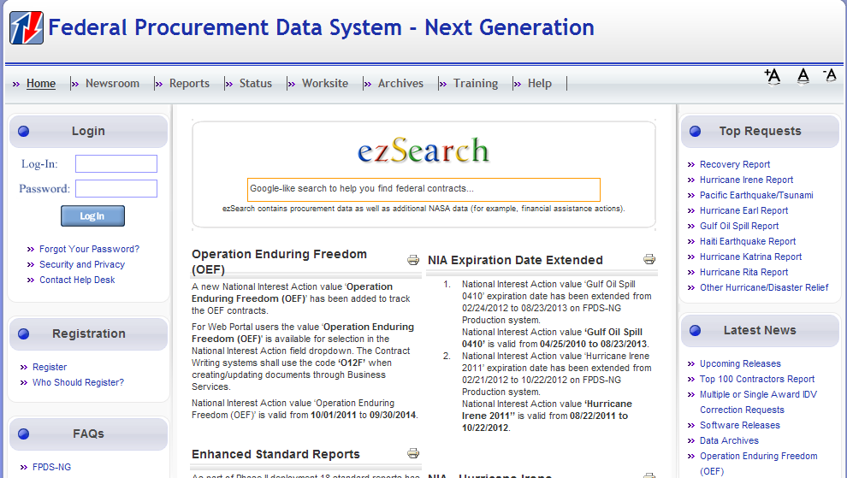
FPDS

Slide 35

Locating Opportunities
COMPANY OFFERS | TOP NAICS AGENCY #1 | TOP NAICS AGENCY #2 | TOP NAICS AGENCY #3 | TOP NAICS AGENCY #4
112990 Animal Production, All Other | HHS | DOD | DHS | EPA
541990 Technical Services, All Other | DOD | HHS | DOI | USAID
541712 R&D, Physical, Engineering and Life Sciences | DOD | NASA | HHS | DOI

Slide 36
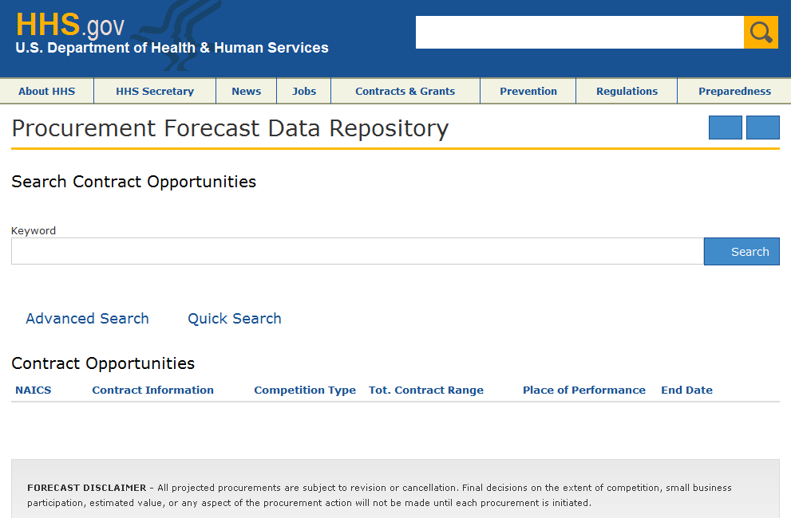
HHS Procurement Forecast Data Repository
http://procurementforecast.hhs.gov/

Slide 37
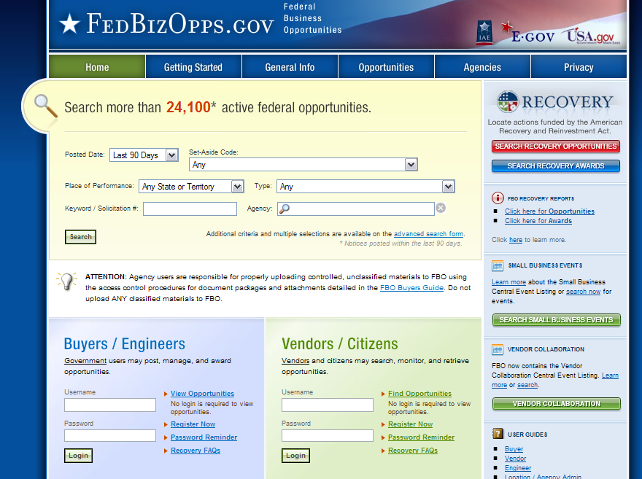
FedBizOpps
http://www.fbo.gov

Slide 38
EBOLA SUPPORT
ASPR – Assistant Secretary for Preparedness and Readiness
CDC – Centers for Disease Control and Prevention
FDA – Food and Drug Administration
NIH – National Institutes of Health
PHS – Public Health Service
www.hhs.gov

Slide 39

EFFECTIVE CAPABILITY STATEMENT
One Page/PDF
Tailored for Audience
Primary NAICS
Core Competencies
Team Members/Subcontractors
Past Performance
Value Proposition
Bullet Points
Spell Check
Remove Jargon
Visually Interesting

Slide 40
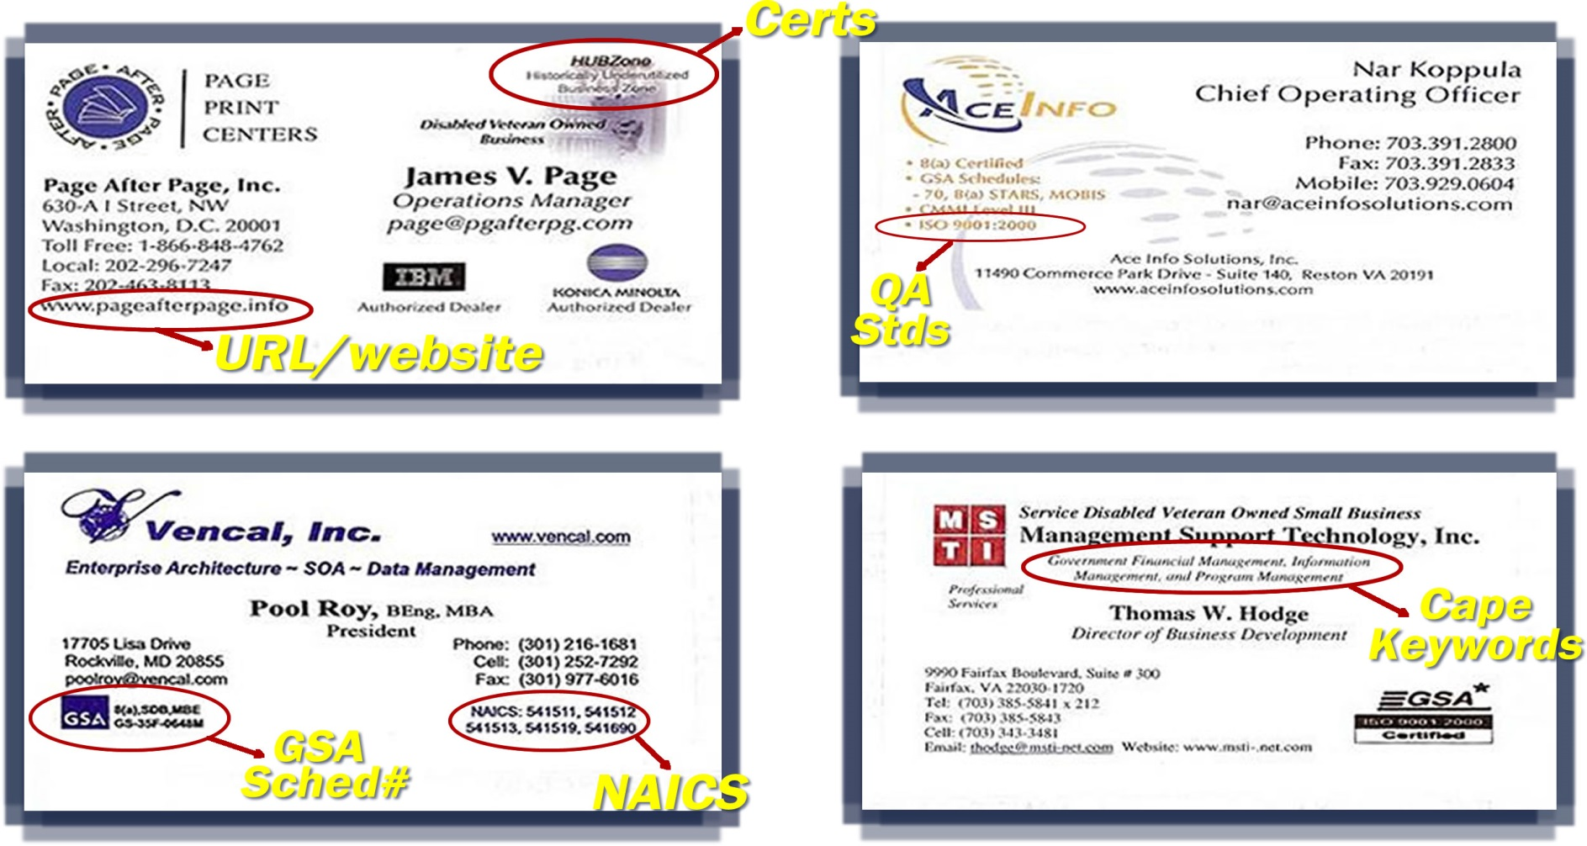
Business Cards (front)

Slide 41
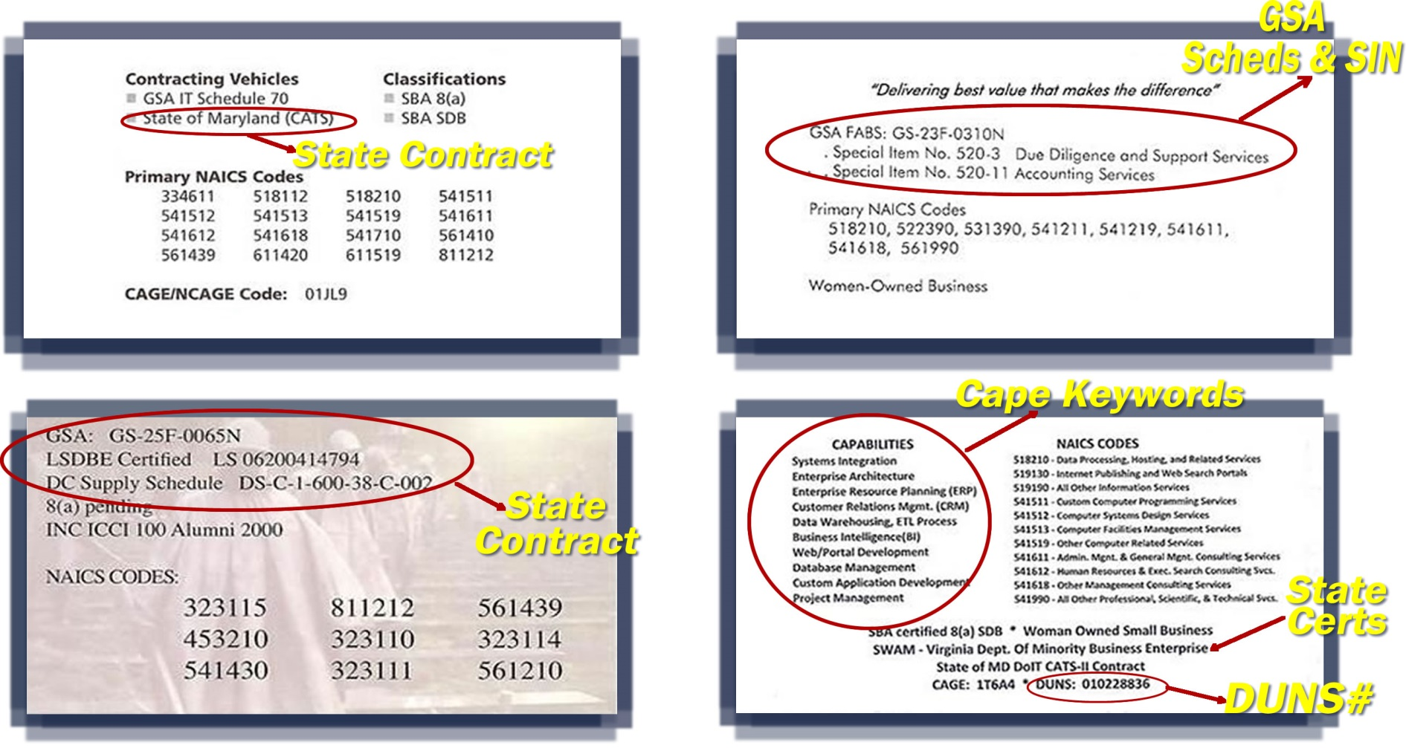
BUSINESS CARDS (back)

Slide 42

NETWORK

Slide 43

STRATEGIC PARTNERING

Slide 44
EXISTING CONTRACTS
NIH Information and Technology Acquisition and Assessment Center (NITAAC)
  Chief Information Officer Solutions and Partners (CIOSP-3)
    $20 Billion set-aside for small businesses
    $20 Billion for small business to compete with other than small
    Streamlined ordering process for program officials
GSA FSS and GWAC Contracts
NASA SEWP
DHS EAGLE

Slide 45

KNOW THE RULES

Slide 46

Do Your Homework

Slide 47
Meeting Customer Needs
Performance Requirements
  Large Businesses
  Small Businesses
Problem Solution
Security Clearances
Differentiating Factors
Innovation
Proven Experience
Strong Financial Position
Long Term Viability
Go Green

Slide 48
In Summary
What Really Works...
Attend Outreach Events
Build Relationships/Network
Know agency mission (which agencies buy your products/services)
Share Information
Understand the rules and regulations
Obtain GSA Schedule
Review Agency SB Program Website
Procurement Forecast
FedBizOpps
Subcontracting Opps (start small)
Respond to Sources Soughts
Proofread your proposal
Submit on time!
Past Performance
Request Debriefings
Patience & Persistence

Slide 49
KNOW THE ORGANIZATION’S POINTS OF CONTACT

Slide 50
BE PREPARED WHEN OPPORTUNITY KNOCKS!

Slide 51

SMALL BUSINESS ARE THE
OF THE ECONOMY

Slide 52




HHS OSDBU
Social Media Websites
HHS Smallbiz
@HHSSmallBiz
http://www.youtube.com/user/HHSOSDBU

Slide 53
HHS OSDBU CONTACT
Anita Allen
(410) 786-9319
anita.allen1@cms.hhs.gov
Website: www.hhs.gov/smallbusiness
Phone: 202.690.7300
Email: sbmail@hhs.gov

Slide 54

QUESTIONS

Slide 55

Tips From the Inside

Slide 56
A Special Message from the CMS Administrator
Andy Slavitt
Acting Administrator,
Centers for Medicare & Medicaid Services (CMS)

Slide 57

Lunch Break Until 1:00 PM

