Slide 1
Good Morning And Welcome 2026 CMS Industry Forum

Slide 2
The Welcome And Opening Remarks Will Begin Soon. Please Take Your Seats.

Slide 3
Welcome and Opening Remarks Douglas Bergevin, Acting Director, Office of Acquisition and Grants Management (OAGM)

Slide 4
Virtual Attendees: Please use this URL to ask your questions for the following presentations: https://www.slido.com Enter code CMS26

Slide 5
Welcome and Opening Remarks Kimberly Brandt, Deputy Administrator & Chief Operating Officer

Slide 6
John Czajkowski Deputy Chief Operating Officer, CMS

Slide 7
Please take this time to scan the QR code and fill out the survey. Virtual attendees: Please use the following URL to access Slido to ask live Q&As during the presentations (https://www.slido.com); Enter code CMS26

Slide 8
Our Next Speaker: Jennifer Johnson, Acting Deputy Assistant Secretary and Senior Procurement Executive, U.S. Department of Health and Human Services

Slide 9




Connecting Industry with the HHS Office of Acquisitions
Jennifer Johnson
Acting Deputy Assistant Secretary & Senior
Procurement Executive
9

Slide 10

Agenda for Today
1
Federal Procurement Overview
Office of Acquisitions Overview
Administration Priorities
Co-Creating the Future of HHS Acquisitions
Federal Procurement Overview
2
Office of Acquisitions Overview
3
Administration Priorities
4
Co-Creating the Future of HHS Acquisitions

Slide 11

FEDERAL PROCUREMENT: The Big Picture
11

Slide 12

So….
The Federal Government Spent…
?
…in 2025 on Federal Procurement.

Slide 13
The Federal Government Spent…
$634,000,000,000
…in 2025 on Federal Procurement.
Bonus points if you can guess HHS spend!

Slide 14

Who We Are: The Office of Acquisitions (OA) OA = Office of the HHS Senior Procurement Executive
14

Slide 15














Overview of OA
HHS OA OVERVIEW
Mission and Vision
Primary Responsibilities
Mission
Advance HHS’s mission by delivering exceptional acquisition support and oversight to Department leadership and Divisions.
Vision
Be a premier acquisition organization in the Federal Government, enhancing the value of the acquisition workforce by fostering synergy, and leveraging resources to create an efficient and collaborative culture of integrity and excellence.
Execute procurement related statutory responsibilities of the Secretary, Deputy Secretary and Chief Acquisition Officer.
Support ~$28B in annual HHS contract spending through policy, workforce, and oversight functions.
Drive cost-efficiency and improved outcomes via category management, workforce development, and business systems.
Build partnerships with Division Heads of Contracting and represent HHS in cross-government acquisition forums.
OA MANAGES AND OVERSEES
Procurement Business Systems
Acquisition Workforce Development
Industry Engagement
Procurement Policy
Oversight of Agency Acquisition Programs
Category Management
Procurement Innovation
Federal Acquisition Support Programs
Vendor Relations
15

Slide 16

Overview of HHS Procurement
HHS OA OVERVIEW
HHS Acquisition By the Numbers
HHS YoY Spend Patterns
FY25 Spend by Division
(In Billions)
OA MANAGES AND OVERSEES
Component | Amount
C M S | $7.9 B
C D C | $7.4 B
N I H | $5.9 B
I H S | $1.8 B
F D A | $1.4 B
A S P R | $1.3 B
A S A | $0.8 B
A C F | $0.7 B
H R S A | $0.5 B
S A M H S A | $0.2 B
A H R Q | $0.1 B
O I G | $0.1 B
Fiscal Year | Total Obligations
FY22 | $41.0 B
FY23 | $40.3 B
FY24 | $39.1 B
FY25 | $28.2 B*
~73%
of HHS Spend is concentrated at the top 3 Divisions - CMS, CDC, and NIH
Procurement Business Systems
Acquisition Workforce Development
Deeper dive…
Industry Engagement
Procurement Policy
Oversight of Agency Acquisition Programs
*HHS saw a $12B reduction from its final FY25 Obligations due to the HHS Cost Efficiency Initiative (HCEI)
Category Management
56.08K
Contract Actions
10K+
Acquisition Workforce Members
10
Divisions w/ Procurement Authority
11+
Acquisition Management Systems
Procurement Innovation
Federal Acquisition Support Programs
Vendor Relations
16

Slide 17




HHS mission → procurement strategy → industry partnership.
Strategy and Oversight
Policy, Innovation, and Systems
Acquisition Workforce

Slide 18
HHS mission → procurement strategy → industry partnership. continued
Strategy and Oversight
Administration Priority Alignment
Executive Orders; OMB guidance; HHS Secretary Priorities
Department-wide Planning (processes, data, systems)
Acquisition Systems Modernization; FPDS V&V oversight
Oversight of acquisition functions
Workforce Certification; Policy Guidance; Procurement Management Reviews
Policy, Innovation, and Systems
Acquisition Workforce

Slide 19
HHS mission → procurement strategy → industry partnership. (continued)
Policy, Innovation, and Systems
Federal Acquisition Regulation (FAR) + HHS Acquisition Regulation
Policy Alerts to the Department; implementation of FAR updates; memos to the HHS acquisition community
Acquisition Business Systems & Programs
Government Purchase Card (GPC) program; Contractor Performance Assessment Reporting System (CPARS); FPDS Reporting
Innovation
IDEAS Lab Program; Category Management Implementation; HHS Spend Dashboard
Policy, Innovation, and Systems

Slide 20
HHS mission → procurement strategy → industry partnership. [continued]
Acquisition Workforce
Training & Upskilling
HHS Acquisition University; Internship/journeyman program (future); Digital-based Acquisition Training
Certification Development & Maintenance
FAC-C/FAC-COR certifications; CLP tracking; government-wide training initiatives
Policy, Innovation, and Systems

Slide 21

HHS in the News… Administration Priorities
21

Slide 22








Numerous Executive Orders and Memos are Profoundly Shaping HHS Acquisitions
Executive Orders | Impact to HHS | HHS’s Actions
Executive Order 14210 Implementing the President's "Department of Government Efficiency" Workforce Optimization Initiative | Calls for restructure of HHS under the Government Efficiency initiative, consolidating activities. | Launch the Procurement Alignment & Collaboration Taskforce (PACT) to start mapping the consolidation of procurement functions across HHS. Advance the modernization and integration of HHS contract writing systems into a standardized system. Begin to cross-train staff to support a leaner workforce.
Executive Order 14222 Implementing the President's “Department of Government Efficiency” Cost Efficiency Initiative | Directs Divisions to assess all contracts and report determinations, targeting $13.6B (or ~33%) in annual savings. | Review over 21,000 contracts as part of the HHS Cost Efficiency Initiative, resulting in $16.3B in annual savings (target was $13.6B). 5,582 contract terminations reported in FY25 Monitor and report (in alignment with Radical Transparency) all terminations in FPDS-NG to ensure the progress of HCEI initiative.
Executive Order 14240 Eliminating Waste and Saving Taxpayer Dollars by Consolidating Procurement | Mandates the consolidation of procurement for common goods and services | Submit agency-wide procurement consolidation proposal to GSA, identifying over 3,600 contracts (~$12.3T in total value) for potential transfer Recommends retirement of HHS NIH Information Technology Acquisition and Assessment Center (NITAAC) program.
Executive Order 14271 Ensuring Commercial, Cost-Effective Solutions in Federal Contracts | Requires HHS to prioritize commercial solutions over custom procurements, cutting costs and accelerating acquisition timelines | Review all open solicitations for non-commercial products/services and FASA compliance. Report annually to OMB on compliance and implementation progress. Encourage commercial solutions and require justification for non-commercial buys.
Executive Order 14275 Restoring Common Sense to Federal Procurement | Overhauls acquisition policies to eliminate non-statutory FAR rules and streamline procurement. | Issue policy deviations to implement deregulated FAR coverage, including combined multi-part deviations. Report quarterly to OFPP on regulatory updates and implementation progress. Pilot new methods using deviations and buying guide strategies to test innovative approaches.
HHS Office of Acquisitions
22
Notes:
Link URL's
https://nam10.safelinks.protection.outlook.com/?url=https%3A%2F%2Fwww.federalregister.gov%2Fdocuments%2F2025%2F02%2F14%2F2025-02762%2Fimplementing-the-presidents-department-of-government-efficiency-workforce-optimization-initiative&data=05%7C02%7Cjlitvack%40guidehouse.com%7Cdf6eeb7fe8814aa5080208dda789a921%7C4ee48f43e15d4f4aad55d0990aac660e%7C0%7C0%7C638850932140383534%7CUnknown%7CTWFpbGZsb3d8eyJFbXB0eU1hcGkiOnRydWUsIlYiOiIwLjAuMDAwMCIsIlAiOiJXaW4zMiIsIkFOIjoiTWFpbCIsIldUIjoyfQ%3D%3D%7C0%7C%7C%7C&sdata=d9BcJ6V1DShgy%2FTyBJ4GdQEOadDx8USXGIGSsYN0LDI%3D&reserved=0
https://nam10.safelinks.protection.outlook.com/?url=https%3A%2F%2Fwww.federalregister.gov%2Fdocuments%2F2025%2F03%2F03%2F2025-03527%2Fimplementing-the-presidents-department-of-government-efficiency-cost-efficiency-initiative%23page-&data=05%7C02%7Cjlitvack%40guidehouse.com%7Cdf6eeb7fe8814aa5080208dda789a921%7C4ee48f43e15d4f4aad55d0990aac660e%7C0%7C0%7C638850932140397048%7CUnknown%7CTWFpbGZsb3d8eyJFbXB0eU1hcGkiOnRydWUsIlYiOiIwLjAuMDAwMCIsIlAiOiJXaW4zMiIsIkFOIjoiTWFpbCIsIldUIjoyfQ%3D%3D%7C0%7C%7C%7C&sdata=6F5YIIH89OqxY0Jx9mK3g1Id%2Bdu25rs927hrGQDSv1Q%3D&reserved=0
https://www.whitehouse.gov/presidential-actions/2025/03/eliminating-waste-and-saving-taxpayer-dollars-by-consolidating-procurement/
https://nam10.safelinks.protection.outlook.com/?url=https%3A%2F%2Fwww.federalregister.gov%2Fdocuments%2F2025%2F04%2F18%2F2025-06835%2Fensuring-commercial-cost-effective-solutions-in-federal-contracts%23page-&data=05%7C02%7Cjlitvack%40guidehouse.com%7Cdf6eeb7fe8814aa5080208dda789a921%7C4ee48f43e15d4f4aad55d0990aac660e%7C0%7C0%7C638850932140407750%7CUnknown%7CTWFpbGZsb3d8eyJFbXB0eU1hcGkiOnRydWUsIlYiOiIwLjAuMDAwMCIsIlAiOiJXaW4zMiIsIkFOIjoiTWFpbCIsIldUIjoyfQ%3D%3D%7C0%7C%7C%7C&sdata=tPlduhx5KcpeXbt41ad5faJF86xmDWdeVYl%2B1gS8s%2Fs%3D&reserved=0
https://nam10.safelinks.protection.outlook.com/?url=https%3A%2F%2Fwww.federalregister.gov%2Fdocuments%2F2025%2F04%2F18%2F2025-06839%2Frestoring-common-sense-to-federal-procurement%23page-&data=05%7C02%7Cjlitvack%40guidehouse.com%7Cdf6eeb7fe8814aa5080208dda789a921%7C4ee48f43e15d4f4aad55d0990aac660e%7C0%7C0%7C638850932140418848%7CUnknown%7CTWFpbGZsb3d8eyJFbXB0eU1hcGkiOnRydWUsIlYiOiIwLjAuMDAwMCIsIlAiOiJXaW4zMiIsIkFOIjoiTWFpbCIsIldUIjoyfQ%3D%3D%7C0%7C%7C%7C&sdata=N%2BWk7zvgr0H9djOa33aTvMKbG6uK6UDRqQcpMun4VlU%3D&reserved=0

Slide 23


Executive Order 14210 Implementing the President's "Department of Government Efficiency" Workforce Optimization Initiative
Impact to HHS
HHS’s Actions
Calls for restructure of HHS under the Government Efficiency initiative, consolidating activities.
Launch the Procurement Alignment & Collaboration Taskforce (PACT) to start mapping the consolidation of procurement functions across HHS.
Advance the modernization and integration of HHS contract writing systems into a standardized system.
Begin to cross-train staff to support a leaner workforce.
HHS Office of Acquisitions
23
Notes:
Link URL’s
https://nam10.safelinks.protection.outlook.com/?url=https%3A%2F%2Fwww.federalregister.gov%2Fdocuments%2F2025%2F02%2F14%2F2025-02762%2Fimplementing-the-presidents-department-of-government-efficiency-workforce-optimization-initiative&data=05%7C02%7Cjlitvack%40guidehouse.com%7Cdf6eeb7fe8814aa5080208dda789a921%7C4ee48f43e15d4f4aad55d0990aac660e%7C0%7C0%7C638850932140383534%7CUnknown%7CTWFpbGZsb3d8eyJFbXB0eU1hcGkiOnRydWUsIlYiOiIwLjAuMDAwMCIsIlAiOiJXaW4zMiIsIkFOIjoiTWFpbCIsIldUIjoyfQ%3D%3D%7C0%7C%7C%7C&sdata=d9BcJ6V1DShgy%2FTyBJ4GdQEOadDx8USXGIGSsYN0LDI%3D&reserved=0

Slide 24

Executive Order 14210 Implementing the President's "Department of Government Efficiency" Workforce Optimization Initiative (continued)
Division Mission Specialized
HHS CPE/SPE
Office of Mission Acquisition Solutions (OMAS)
Procurement Ops Support
HHS Mission
SBC Professional Services
SBC Information Technology
Division Mission Specialized
ARPA-H Contracts
HRSA Contracts
ASPR Contracts
HIS Contracts
CDC Contracts
NIH Contracts
CMS Contracts
FDA Contracts
Policy, Oversight, Workforce, and Compliance
Systems, Data and Acquisition Programs
Suspension and Debarment
Policy, Oversight, Workforce & Compliance
HHS CPO/SPE
Systems, Data and Acquisition Programs
Impact to HHS
HHS’s Actions
Suspension and Debarment
Administratively aligned to OA
Calls for restructure of HHS under the Government Efficiency initiative, consolidating agencies.
Launch the Procurement Alignment & Collaboration Taskforce (PACT) to start mapping the consolidation of procurement functions across HHS.
Advance the modernization and integration of HHS contract writing systems into a standardized system.
Begin to cross-train staff to support a leaner workforce.
Office of Mission Acquisition Solutions (OMAS)
Division Mission Specialized
Procurement Ops Support
ARPA-H Contracts
ASPR
Contracts
CDC Contracts
CMS Contracts
HHS Mission
SBC Professional Services
SBC Information Technology
HRSA Contracts
IHS
Contracts
NIH
Contracts
FDA Contracts
HHS Office of Acquisitions
24
Notes:
Link URL’s
https://nam10.safelinks.protection.outlook.com/?url=https%3A%2F%2Fwww.federalregister.gov%2Fdocuments%2F2025%2F02%2F14%2F2025-02762%2Fimplementing-the-presidents-department-of-government-efficiency-workforce-optimization-initiative&data=05%7C02%7Cjlitvack%40guidehouse.com%7Cdf6eeb7fe8814aa5080208dda789a921%7C4ee48f43e15d4f4aad55d0990aac660e%7C0%7C0%7C638850932140383534%7CUnknown%7CTWFpbGZsb3d8eyJFbXB0eU1hcGkiOnRydWUsIlYiOiIwLjAuMDAwMCIsIlAiOiJXaW4zMiIsIkFOIjoiTWFpbCIsIldUIjoyfQ%3D%3D%7C0%7C%7C%7C&sdata=d9BcJ6V1DShgy%2FTyBJ4GdQEOadDx8USXGIGSsYN0LDI%3D&reserved=0

Slide 25
Executive Order 14222 Implementing the President's “Department of Government Efficiency” Cost Efficiency Initiative
Impact to HHS
HHS’s Actions
Directs Divisions to assess all contracts and report determinations, targeting $13.6B (or ~33%) in annual savings.
Review over 21,000 contracts as part of the HHS Cost Efficiency Initiative, resulting in $16.3B in annual savings (target was $13.6B).
5,582 contract terminations reported in FY25
Monitor and report (in alignment with Radical Transparency) all terminations in FPDS-NG to ensure the progress of HCEI initiative.
HHS Office of Acquisitions
25
Notes:
Link URL’s
https://nam10.safelinks.protection.outlook.com/?url=https%3A%2F%2Fwww.federalregister.gov%2Fdocuments%2F2025%2F03%2F03%2F2025-03527%2Fimplementing-the-presidents-department-of-government-efficiency-cost-efficiency-initiative%23page-&data=05%7C02%7Cjlitvack%40guidehouse.com%7Cdf6eeb7fe8814aa5080208dda789a921%7C4ee48f43e15d4f4aad55d0990aac660e%7C0%7C0%7C638850932140397048%7CUnknown%7CTWFpbGZsb3d8eyJFbXB0eU1hcGkiOnRydWUsIlYiOiIwLjAuMDAwMCIsIlAiOiJXaW4zMiIsIkFOIjoiTWFpbCIsIldUIjoyfQ%3D%3D%7C0%7C%7C%7C&sdata=6F5YIIH89OqxY0Jx9mK3g1Id%2Bdu25rs927hrGQDSv1Q%3D&reserved=0

Slide 26
Executive Order 14240 Eliminating Waste and Saving Taxpayer Dollars by Consolidating Procurement
Impact to HHS
HHS’s Actions
Mandates the consolidation of procurement for common goods and services
Submit agency-wide procurement consolidation proposal to GSA, identifying over 3,600 contracts (~$12.3T in total value) for potential transfer
Recommends retirement of HHS NIH Information Technology Acquisition and Assessment Center (NITAAC) program.
HHS Office of Acquisitions
26
Notes:
Link URL’s
https://www.whitehouse.gov/presidential-actions/2025/03/eliminating-waste-and-saving-taxpayer-dollars-by-consolidating-procurement/

Slide 27
Executive Order 14271 Ensuring Commercial, Cost-Effective Solutions in Federal Contracts
Impact to HHS
HHS’s Actions
Requires HHS to prioritize commercial solutions over custom procurements, cutting costs and accelerating acquisition timelines
Review all open solicitations for non-commercial products/services and FASA compliance.
Report annually to OMB on compliance and implementation progress.
Encourage commercial solutions and require justification for non-commercial buys.
HHS Office of Acquisitions
27
Notes:
Link URL’s
https://nam10.safelinks.protection.outlook.com/?url=https%3A%2F%2Fwww.federalregister.gov%2Fdocuments%2F2025%2F04%2F18%2F2025-06835%2Fensuring-commercial-cost-effective-solutions-in-federal-contracts%23page-&data=05%7C02%7Cjlitvack%40guidehouse.com%7Cdf6eeb7fe8814aa5080208dda789a921%7C4ee48f43e15d4f4aad55d0990aac660e%7C0%7C0%7C638850932140407750%7CUnknown%7CTWFpbGZsb3d8eyJFbXB0eU1hcGkiOnRydWUsIlYiOiIwLjAuMDAwMCIsIlAiOiJXaW4zMiIsIkFOIjoiTWFpbCIsIldUIjoyfQ%3D%3D%7C0%7C%7C%7C&sdata=tPlduhx5KcpeXbt41ad5faJF86xmDWdeVYl%2B1gS8s%2Fs%3D&reserved=0

Slide 28
Executive Order 14275 Restoring Common Sense to Federal Procurement
Impact to HHS
HHS’s Actions
Overhauls acquisition policies to eliminate non-statutory FAR rules and streamline procurement.
Issue policy deviations to implement deregulated FAR coverage, including combined multi-part deviations.
Report quarterly to OFPP on regulatory updates and implementation progress.
Pilot new methods using deviations and buying guide strategies to test innovative approaches.
HHS Office of Acquisitions
28
Notes:
Link URL’s
https://nam10.safelinks.protection.outlook.com/?url=https%3A%2F%2Fwww.federalregister.gov%2Fdocuments%2F2025%2F04%2F18%2F2025-06839%2Frestoring-common-sense-to-federal-procurement%23page-&data=05%7C02%7Cjlitvack%40guidehouse.com%7Cdf6eeb7fe8814aa5080208dda789a921%7C4ee48f43e15d4f4aad55d0990aac660e%7C0%7C0%7C638850932140418848%7CUnknown%7CTWFpbGZsb3d8eyJFbXB0eU1hcGkiOnRydWUsIlYiOiIwLjAuMDAwMCIsIlAiOiJXaW4zMiIsIkFOIjoiTWFpbCIsIldUIjoyfQ%3D%3D%7C0%7C%7C%7C&sdata=N%2BWk7zvgr0H9djOa33aTvMKbG6uK6UDRqQcpMun4VlU%3D&reserved=0

Slide 29


President’s Management Agenda (PMA) Was Released in Dec ‘25
PMA sets clear expectations for how HHS and its divisions acquire solutions in support of mission delivery
Shrink the Government & Eliminate Waste | Ensure Accountability for Americans | Deliver Results, Buy American
Eliminate Woke, Weaponization, and Waste: Cut ineffective and radical programs and funding and prioritize work that puts American citizens first. Downsize the Federal Workforce: Reduce the federal workforce by eliminating unnecessary positions and removing poor performers. Optimize Federal Real Estate: Shrink the Federal real estate portfolio to save American Taxpayers money. | Foster Merit-Based Federal Workforce: Hire based on merit and skills and hold employees accountable for results aligned with Presidential policies. End Censorship and Over-Classification: Promote transparency and eliminate government overreach that infringes on constitutional rights. Demand Partners Who Deliver: Ensure contracts and grants go only to high-performing recipients to advance America First priorities. | Efficiently Deploy the Buying Power of the Federal Government and Buy American: Consolidate procurement and eliminate bureaucracy to maximize taxpayer value and enhance operational efficiency. Leverage Technology to Deliver Faster, More Secure Services: Eliminate bureaucratic barriers and build a government fit for the 21st century.
What it Means for Industry Partners
Under PMA acquisitions are increasingly focused on reducing duplication, accelerating delivery, and maximizing taxpayer value. Ultimately shaping how industry partners are expected to design and scale solutions.
Buy as an enterprise: Solutions should scale and support consolidated, category-based procurement.
Deliver results faster: Flexible, modular offerings that enable rapid deployment and measurable impact are prioritized.
Prove performance: Vendors are expected to demonstrate outcomes, efficiency gains, and value through data and evidence.

Slide 30

Co-Creating the Future of HHS Acquisitions
30

Slide 31





Co-Creating the Future of HHS Acquisitions – With Industry
LISTEN
What are missing? What is working?
LEARN
Data, benchmarks, best practices
CO-CREATE
Shape consolidation, category management, smarter vehicles
DELIVER BETTER
Lower costs, faster timelines, stronger mission impact
31

Slide 32





… and this is how YOU can plug in – with HHS
Respond Early
Differentiate Yourself
Bring Ideas
Be Transparent
32

Slide 33


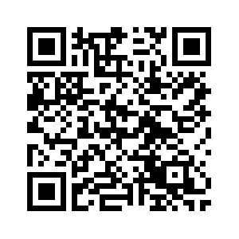
How Vendors Can Stay Informed
GPE “Special Notices”
OSDBU SBCX Site
HHS Forecast
HHS Office of Acquisitions

Slide 34
THANK YOU
Jennifer Johnson
Acting Senior Procurement Executive
Jennifer.Johnson@hhs.gov
34

Slide 35
Please take this time to scan the QR code and fill out the survey. Virtual attendees: Please use the following URL to access Slido to ask live Q&As during the presentations (https://www.slido.com); Enter code CMS26

Slide 36
Our Next Session: Shannon Jackson, Executive Director, Office of Small and Disadvantaged Business Utilization, U.S. Department of Health and Human Services

Slide 37
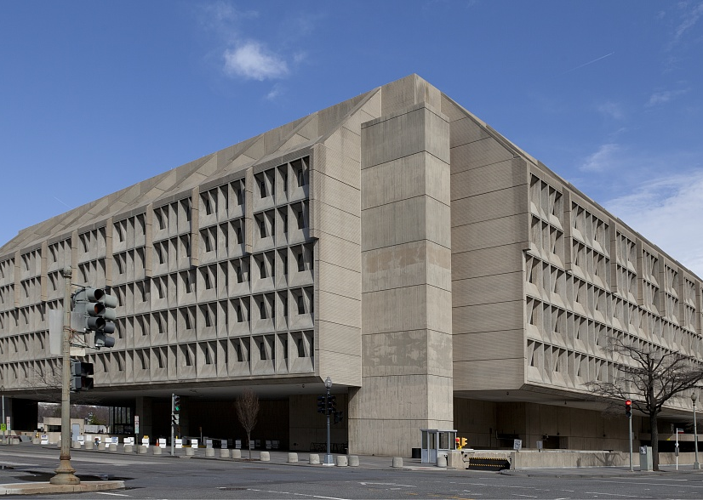

Office of Small and Disadvantaged Business Utilization (OSDBU)
February 2026

Slide 38
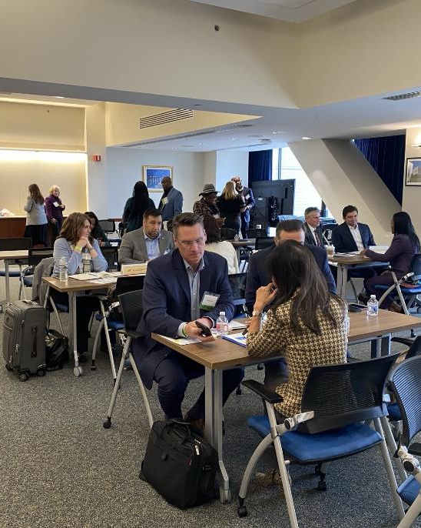
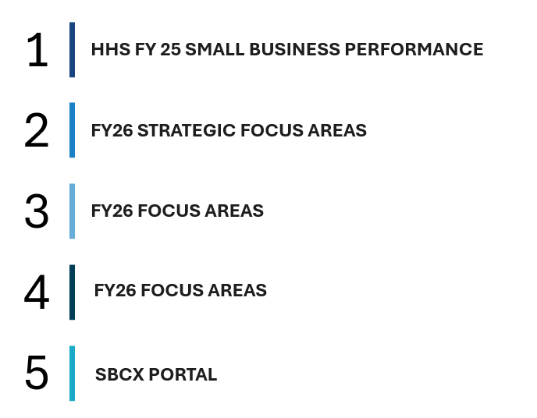
Agenda
Overview of today’s BRIEF
HHS FY 25 SMALL BUSINESS PERFORMANCE
FY26 STRATEGIC FOCUS AREAS
FY26 FOCUS AREAS
FY26 FOCUS AREAS
SBCX PORTAL

Slide 39
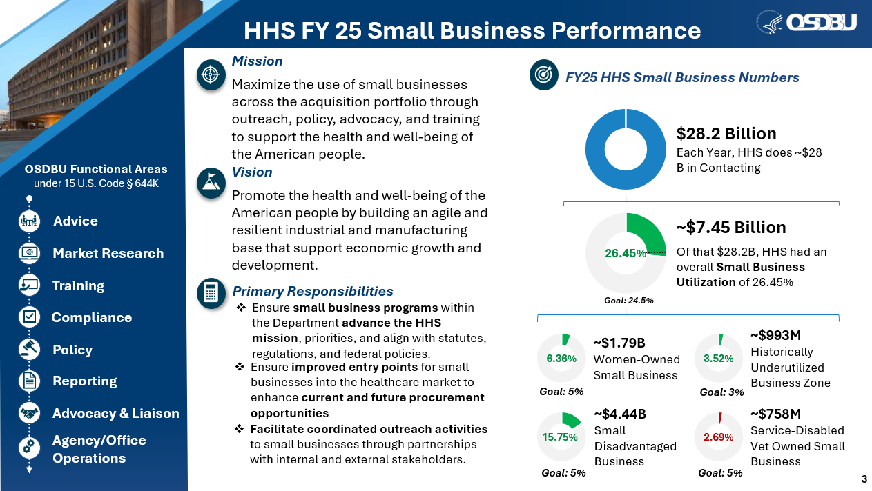
HHS FY 25 Small Business Performance
OSDBU Functional Areas
under 15 U.S. Code § 644K, advice, market research, training, compliance, policy, reporting, advocacy and liaison, agency and office operations.
Mission, Maximize the use of small businesses across the acquisition portfolio through outreach, policy, advocacy, and training to support the health and well-being of the American people. Vision, Maximize the use of small businesses across the acquisition portfolio through outreach, policy, advocacy, and training to support the health and well-being of the American people.
Primary responsibilities
Ensure small business programs within the Department advance the HHS mission, priorities, and align with statutes, regulations, and federal policies.
Ensure improved entry points for small businesses into the healthcare market to enhance current and future procurement opportunities
Facilitate coordinated outreach activities to small businesses through partnerships with internal and external stakeholders.
FY25 H H S Small business numbers, graphic, circle chart showing $28.2 billion each year HHS does $28 B in contracting
Graphic, circle chart showing 26.45% or $7.45 billion of the $28.2 billion went to small business utilization. Exceeding the goal of 24.5%.
Graphic, circle chart showing 6.36% or $1.79 billion went to women owned small business, equal to approximately $1.79B, exceeding the goal of 5%.
Graphic, circle chart showing 15.75% or $4.44 billion went to small disadvantaged business, exceeding the goal of 5%.
Graphic, circle chart showing 3.52% or $993 million went to historically underutilized business zones, exceeding the goal of 3%.
Graphic, circle chart showing 2.69% or $758 million went to service-disabled veteran owned small business, failing to meet the goal of 5%.

Slide 40

HHS FY 25 Small Business Performance continued
OSDBU Functional Areas
under 15 U.S. Code § 644K, advice, market research, training, compliance, policy, reporting, advocacy and liaison, agency and office operations.
Mission, Maximize the use of small businesses across the acquisition portfolio through outreach, policy, advocacy, and training to support the health and well-being of the American people. Vision, Maximize the use of small businesses across the acquisition portfolio through outreach, policy, advocacy, and training to support the health and well-being of the American people.
Primary responsibilities
Ensure small business programs within the Department advance the HHS mission, priorities, and align with statutes, regulations, and federal policies.
Ensure improved entry points for small businesses into the healthcare market to enhance current and future procurement opportunities
Facilitate coordinated outreach activities to small businesses through partnerships with internal and external stakeholders.
FY25 H H S Small business numbers, graphic, circle chart showing $28.2 billion each year HHS does $28 B in contracting
Graphic, circle chart showing 20.86% or $1.65 billion of the $28.2 billion H H S had an overall small business utilization of 20.86%. Failing to meet the goal of 22.5%.
Graphic, circle chart showing 5.84% or $460 million went to women owned small business, exceeding the goal of 5%.
Graphic, circle chart showing 12.89% or $1.01 billion went to small disadvantaged business, exceeding the goal of 5%.
Graphic, circle chart showing 5.13% or $404 million went to historically underutilized business zones, exceeding the goal of 4.5%.
Graphic, circle chart showing 1.56% or $122 million went to service-disabled veteran owned small business, failing to meet the goal of 3%.
4

Slide 41
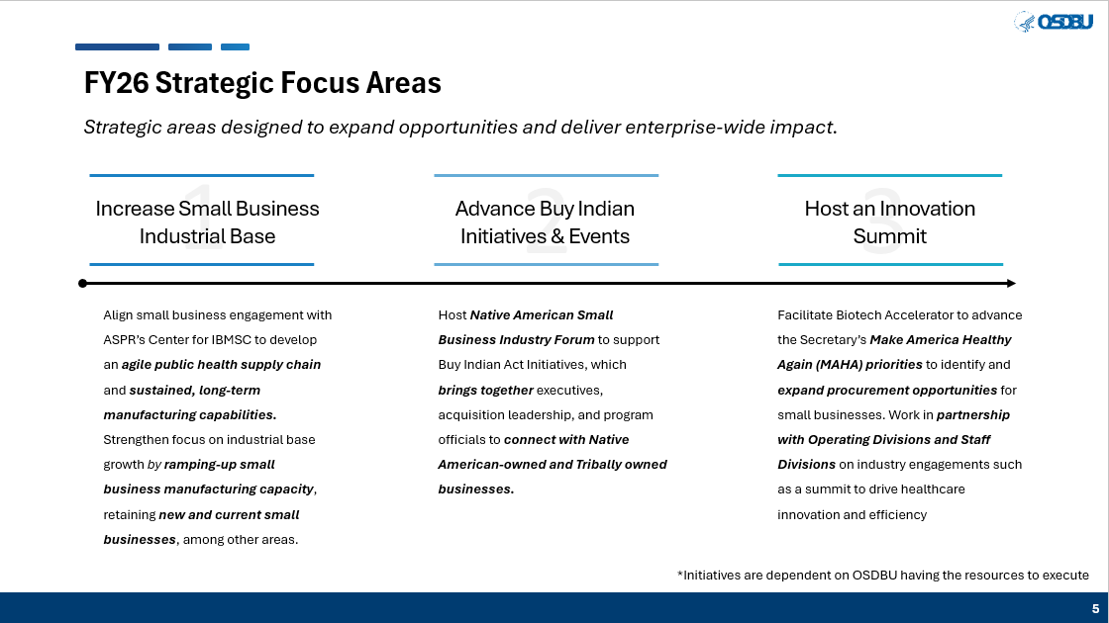
F Y 26 Strategic Focus Areas
Strategic areas designed to expand opportunities and deliver enterprise-wide impact.
Increase Small Business Industrial Base
Align small business engagement with ASPR’s Center for IBMSC to develop an agile public health supply chain and sustained, long-term manufacturing capabilities.
Strengthen focus on industrial base growth by ramping-up small business manufacturing capacity, retaining new and current small businesses, among other areas.
Advance Buy Indian Initiatives & Events
Host Native American Small Business Industry Forum to support Buy Indian Act Initiatives, which brings together executives, acquisition leadership, and program officials to connect with Native American-owned and Tribally owned businesses.
Host an Innovation Summit
Facilitate Biotech Accelerator to advance the Secretary’s Make America Healthy Again (MAHA) priorities to identify and expand procurement opportunities for small businesses. Work in partnership with Operating Divisions and Staff Divisions on industry engagements such as a summit to drive healthcare innovation and efficiency
*Initiatives are dependent on OSDBU having the resources to execute

Slide 42
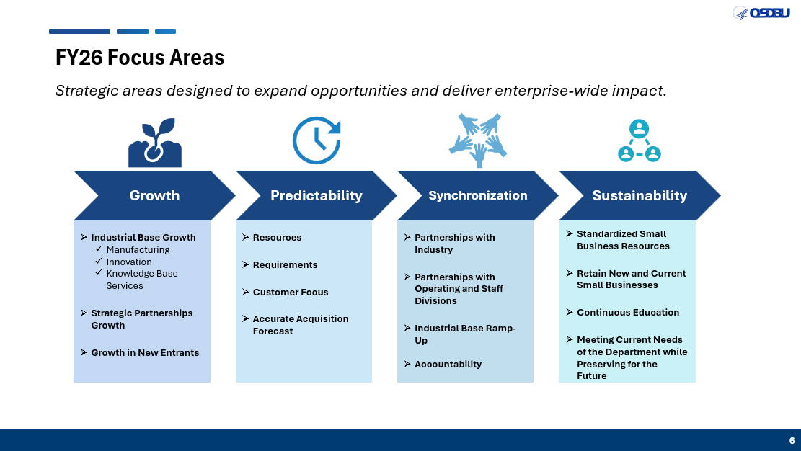
F Y 26 Focus Areas
Strategic areas designed to expand opportunities and deliver enterprise-wide impact.
Growth
Industrial Base Growth
Manufacturing
Innovation
Knowledge Base Services
Strategic Partnerships Growth
Growth in New Entrants
Predictability
Resources
Requirements
Customer Focus
Accurate Acquisition Forecast
Synchronization
Partnerships with industry
Partnerships with operating and staff divisions
Industrial base ramp-up
Accountability
Sustainability
Standardized small business resources
Retain new and current small businesses
Continuous education
Meeting current needs of the department while preserving for the future

Slide 43
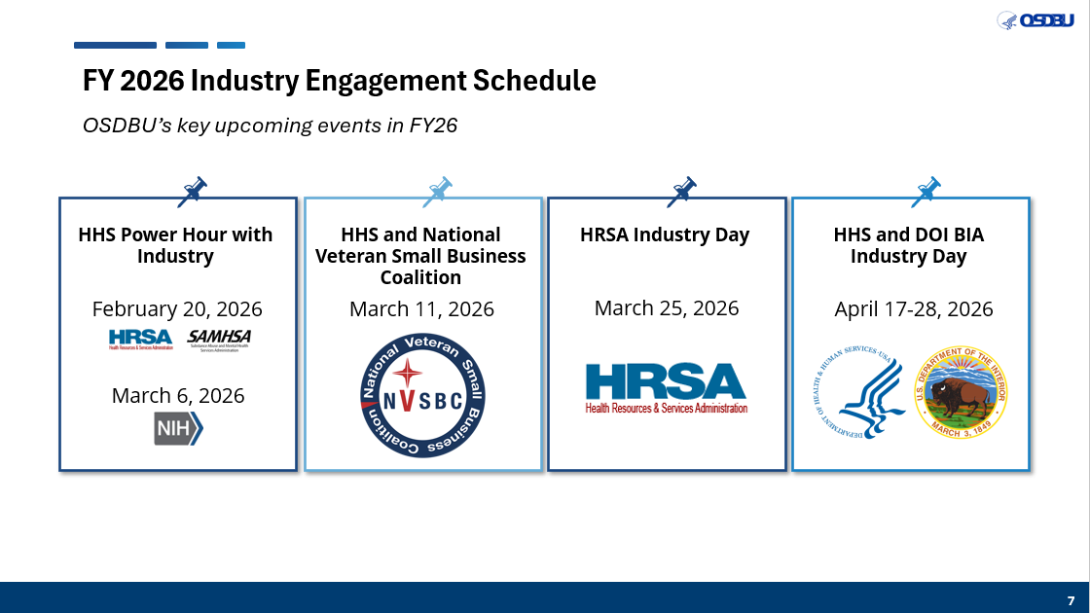
F Y 2026 Industry Engagement Schedule
OSDBU’s key upcoming events in F Y 26.
H H S power hour with industry, February 20th, 2026. Health resources and services administration logo. Substance abuse and mental health services administration logo.
March 2026, National Institute of Health logo.
H H S and National Veteran Small Business Coalition, March 11th , 2026. National Veteran Small Business Coalition logo.
H R S A Industry Day, March 25th , 2026. Health resources and services administration logo.
H H S and D O I B I A Industry Day April 17th – 28th , 2026. Department of Health and Human Services logo. U S Department of the interior logo.
Notes:
Tags: text, events, calendar

Slide 44
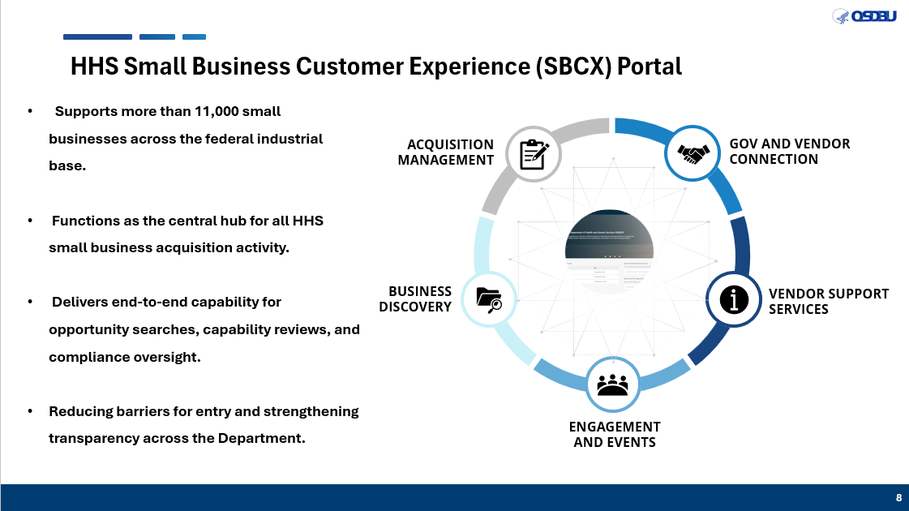
H H S Small Business Customer Experience (SBCX) Portal
Supports more than 11,000 small businesses across the federal industrial base.
Functions as the central hub for all HHS small business acquisition activity.
Delivers end-to-end capability for opportunity searches, capability reviews, and compliance oversight.
Reducing barriers for entry and strengthening transparency across the Department.
Graphic, flowchart, acquisition management, government and vendor connection, vendor support services, engagement and events, business discovery.

Slide 45

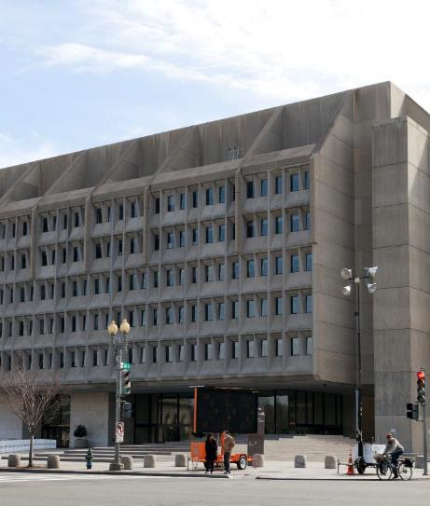
Questions?
Shannon Jackson
Executive Director, Office of Small and Disadvantaged Business Utilization

Slide 46
Please take this time to scan the QR code and fill out the survey. Virtual attendees: Please use the following URL to access Slido to ask live Q&As during the presentations (https://www.slido.com/); Enter code CMS26

Slide 47
We Are Now on a Break. Please Take This Time To Visit The Exhibit Hall. The Next Session Will Begin At 10:40 AM.

Slide 48
Our Next Session: Leveraging AI to Optimize Healthcare Quality and Safety

Slide 49
Leveraging AI to Optimize Healthcare Quality and Safety Mark Plaugher, Director, Information Systems Group (ISG), Center for Clinical Standards and Quality (CCSQ)

Slide 50
Leveraging AI to Optimize Healthcare Quality and Safety
A Call to Action
Center for Clinical Standards and Quality

Slide 51
Center for Clinical Standards & Quality
Who we are:
CCSQ is the national clinical and health care quality leader at the Centers for Medicare & Medicaid Services. Our work will Make America Healthy and improve health outcomes through prevention and wellness, safe and high-quality care, and coverage in our nation's health and long-term care systems.
The work we do:
CCSQ promotes optimal health for patients and long-term care residents by:
Establishing national health and safety regulations for Medicare and Medicaid certified providers, suppliers, and labs, which are assessed and enforced through survey and certification.
Maintaining and leading the agency’s quality measure development and reporting programs and providing quality improvement technical assistance.
Making evidence-based coverage decisions about treatments, procedures, and drugs for people with Medicare.

Slide 52
CCSQ’s Challenge
Scale & Reach
The U.S. spends more on healthcare than any other nation – yet ranks LAST among industrialized countries for most quality metrics.
Congress has established numerous, to improve healthcare quality.
CCSQ collects a staggering amount of data in support of these quality programs.
However, our data is siloed across multiple programs, making it difficult to extract meaningful insights and leverage the full value of information to improve patient outcomes.
CCSQ drives incredible improvements in healthcare quality and outcomes. AI positions us to build on this success and solve challenges that have remained out of reach.
~4,500 Hospitals ~15,000 Skilled Nursing Facilities | ~12,000 Home Health Agencies | ~4,500 Hospices
~1.2M Clinicians (3.5M reporting transactions annually) | ~1M Prescribers of Part D Controlled Substances
~7,600 Dialysis Facilities | 940k ESRD beneficiaries | 43M file transactions measuring quality of care in the last 12 months
All 50 states & territories (survey activity across 17 provider types)
30-40M patient assessments from multiple provider types received annually | retain a repository of 6M
52

Slide 53
How Can Industry Help?
Partner with us to develop innovative solutions that integrate, standardize, and analyze quality data —transforming it into actionable intelligence that drives better healthcare for millions of Americans.
We’re interested in maximizing the value of AI applications. For example, how can we:
Accelerate data standardization and interoperability?
Enable meaningful cross-program analytics?
Transform unstructured data into actionable information?
Improve transparency for providers and patients?

Slide 54
CCSQ-Specific Opportunities: AI Applications
Quality Measurement Modernization
Reduce provider burden through automated data validation and streamlined reporting
Deliver real-time feedback to providers at the point of quality data submission
Enable faster course correction and continuous quality improvement
Innovative Risk Prediction Models
Identify proactive interventions that prevent complications and improve outcomes
Optimize resource allocation to high-need populations
Safety Surveillance & Oversight
Detect early adverse event patterns across programs
Prioritize high-risk cases for timely human review
Accelerate response times for corrective actions
These are just some opportunities for innovation in Quality programs.

Slide 55
CCSQ’s Information Systems Group: Promoting Innovation Through Partnerships
Performance-Based Contracting
Focus on outcomes instead of prescriptive requirements
Encourage creative solutions
Contract Applications
Incorporation of AI metrics into Quality Assurance Surveillance Plans (QASPs)
Emphasis on innovation in CPARS evaluations
Standard contract language in existing and new contracts
Use of betterment evaluation criteria in solicitations to incentivize meaningful, high impact proposals

Slide 56
Closing & Call to Action
CCSQ is committed to responsible, mission-driven innovation that puts beneficiaries first.
AI is a force multiplier —amplifying our ability to deliver safer, higher-quality healthcare at scale.
We're calling on industry partners to join us in this mission. Together, we can co-create transformative solutions that advance quality care for millions of beneficiaries across every care setting.

Slide 57
CCSQ\ISG Acquisition Plan for CY 2026
Contracts | Estimated Award | Term | Contract Vehicle
Hospital Quality Reporting Enhancement & Advancement Technologies (HEAT) | Feb 2026 | 4 Years | ACME BPA
Security Innovation and Operations (SIO) | April 2026 | 5 Years | GSA MAS
Quality Data Analytics Services II (QDAS II) | April 2026 | 5 Years | DASH BPA
Service Center II | June 2026 | 5 Years | 8(a) GSA MAS
Continue to check the CMS Forecast Opportunities posted by OAGM
https://www.cms.gov/about-cms/work-us/business-resources/contract-opportunities
Notes:
Link URL
https://www.cms.gov/about-cms/work-us/business-resources/contract-opportunities-0

Slide 58
Please take this time to scan the QR code and fill out the survey. Virtual attendees: Please use the following URL to access Slido to ask live Q&A’s during the presentations (https://www.slido.com); Enter code CMS26

Slide 59
Our Next Session: Center for Medicare and Medicaid Innovation (CMMI) – CMS Innovation Center: Contract Opportunities and Strategic Updates

Slide 60
CMS Innovation Center: Contract Opportunities and Strategic Updates CMS Industry Day February 19, 2026
60

Slide 61
Overview
Purpose: To help you understand the CMS Innovation Center’s 2025 strategic vision, contracting strategy (especially if you’re new to this space), and 2026 priorities.
Topics
Introduction to the CMS Innovation Center (10 minutes).
2025 Contracting Strategy (8 minutes).
2025/2026 Updates and priorities (5 minutes).
61

Slide 62
What do we do?
CMS Innovation Center
Develop and test new ways to improve the quality of care delivered to Medicare, Medicaid and CHIP beneficiaries, and reduce Federal spending.
62

Slide 63

Vision: To build healthier lives.
Pillars
Promote evidence-based prevention.
Empower people to achieve their health goals.
Drive choice and competition.
Foundational principle: Protect federal taxpayers in all CMS Innovation Center models and other activities.
63

Slide 64
We pursue our vision through model tests.
A CMMI model . . .
Is not Artificial Intelligence or a mathematical algorithm
Pilots a policy and/or payment change and impacts real providers and beneficiaries
Tests new ways to incentivize providers to adopt novel approaches to delivering cost-efficient, high-quality care
May be voluntary or mandatory
Has a set duration (typically five or seven to ten years)
64

Slide 65



A model test can expand in duration and scope if . . .
Costs are reduced, quality remains neutral
Quality improves, costs remain neutral
Quality improves, costs are reduced
65
65

Slide 66
Models are diverse. We have launched over 40 models.
Accountable Care Models
Disease-Specific & Episode-Based Payment Models
State & Community-Based Models
Medicare Advantage and Prescription Drug Models
66

Slide 67
Each model test follows a lifecycle
Cleared
Launch
Idea & Concept
Planning & Design
Solicit & Build
Run, Evaluate, & Expand
Closing
67

Slide 68
The CMS Innovation Center’s Organizational Structure
Three Groups design and operate models
Seamless Care Models Group (SCMG)
Patient Care Models Group (PCMG)
State & Population Health Group (SPHG)
Four Cross-Cutting Groups provide shared services to model teams
Research & Rapid-Cycle Evaluation Group (RREG)
Evaluation
Learning & Diffusion Group (LDG)
Learning
Policy & Programs Group (PPG)
Legal, Quality, Analytics, Comms
Business Services Group (BSG)
Budget, Contracts, Technology
68

Slide 69
Model teams use contractors
Run, Evaluate, & Expand
Idea & Concept
Solicit & Build
Actuarial Contractor
(Vehicle: ARDS)
Application Contractor
(Vehicle: RMADA)
Implementation Contractor
(Vehicle: RMADA)
Monitoring Contractor
(Vehicle: RMADA)
69

Slide 70
Cross-cutting Groups use contractors too
Solicit & Build
Run, Evaluate, & Expand
Quality Contractors (PPG)
(Vehicles: MIDS, RMD, NCQA)
Evaluation Contractor (RREG)
(Vehicle: RMADA)
Learning Contractor (LDG)
(Vehicle: RMADA)
70

Slide 71
Our centralized ops & tech contracts serve multiple models
Software Dev & Related Work (BSG)
Payment (BSG)
Data Aggregation & Acquisition (BSG)
Internal Audit & Analysis, Other Expertise
IPC
CDAC
PAM
IFAC (PPG)
ARDS (BSG)
INSPIRE (BSG)
IDDOC (OIT)
CTS
ISP
AMS
CBOSC
71

Slide 72
Innovation Center Contract Names (1 of 2)
Contract | Purpose | Incumbent
Research Measurement Assessment Design and Analysis (RMADA) IDIQ | Learning, Implementation, Monitoring, Evaluation | Multiple award IDIQ
Measure Instrument Development Services (MIDS) | Design and support quality measures | Yale New Haven
Rapid Measure Development (RMD) | Design and support quality measures | Yale New Haven
National Committee for Quality Assurance (NCQA). | Design and support quality measures | NCQA
Innovation Support Platform (ISP) | Configure and develop technology solutions | Global Alliant
CMMI Technology Solutions (CTS) | Configure and develop technology solutions | Tria/Softrams
CMMI Analysis & Management System (AMS) Contract | Configure and develop technology solutions | ICF
Innovative Design, Development, & Operations Contract (IDDOC) – OIT | Configure and develop technology solutions | Tria/Softrams
Centralized Business Operations Support Center (CBOSC) | Supply help desk services | Tria/Softrams
72

Slide 73
Innovation Center Contract Names (2 of 2)
Contract | Purpose | Incumbent
Innovation Payment Contractor (IPC) | Make non-claims-based-payments | National Government Services
CMMI Data Aggregation Contract (CDAC) | Deliver multi-payer and multi-source data aggregation | Deloitte
Patient Activation Measure (PAM) | Obtain patient assessment data | Phresia
Actuarial Research and Design Services (ARDS) | Deliver actuarial analysis services | Actuarial Research Corporation (ARC)
Integrated Financial Analysis Contract (IFAC) | Deliver financial analysis services | Deloitte
Initiative to Support Promising Research (INSPIRE) | Supply technical assistance | Oak Ridge Associated Universities (ORAU)
73

Slide 74
Several contracts will need to be re-competed over the next three years
2025
2026
2027
RMADA
ARDS
PAM
INSPIRE
CTS
IFAC
74

Slide 75
Operating Principles
Collaboration – Work in partnership with all federal teams and other contractors supporting the model.
Accountability – Join us in protecting the federal taxpayer, deliver on requirements, own mistakes and correct issues.
Transparency – Communicate progress, challenges, risks, and changes openly and promptly.
Tools and data – Use CMS-approved tools in CMS environments.
Innovation – Design solutions that are scalable and sustainable for long-term improvements across models.

Slide 76
What’s new for 2026?
Updates to contracting strategy
Use CMS approved tools in CMS environments
Artificial Intelligence
76

Slide 77
We stopped independent software testing.
We discontinued Independent Verification & Validation (IV&V) Testing
Software development contractors must deliver quality software products without third-party testing.
77

Slide 78
Implementation contractors must use Model Space.
Model Space is the Innovation Center’s Databricks instance.
New implementation contracts will require use of Model Space.
This is important for our efforts to
Support the migration away from SAS.
Simplify sharing across teams and contractors.
Increase re-use.
78

Slide 79
Strategically leverage Artificial Intelligence to serve America’s Health Care Needs
Plan to perform AI work in a CMS environment instead of your corporate environment.
Align with Federal and CMS policies and values
Track and follow the HHS and CMS AI guidance
https://ai.cms.gov/
https://www.hhs.gov/programs/topic-sites/ai/index.html
79

Slide 80
Please take this time to scan the QR code and fill out the survey. Virtual attendees: Please use the following URL to access Slido to ask live Q&A’s during the presentations (https://www.slido.com); Enter code CMS26

Slide 81
Introduce Remainder of the Day Douglas Bergevin, Acting Director and Head of Contracting Activity, Office of Acquisition and Grants Management (OAGM)

Slide 82
Please take this time to scan the QR code and fill out the survey. Virtual attendees: Please use the following URL to access Slido to ask live Q&As during the presentations (https://www.slido.com); Enter code CMS26

Slide 83
We Are Now On A Break For Lunch. Please Head Down To The Cafeteria If You Would Like To Purchase Food. Remember To Visit The Exhibit Hall (Upstairs and Downstairs)

Slide 84
Our Next Session Will Begin at 1:30 PM: Office of Information Technology (OIT) – Modernization with Purpose: Turning IT Investments into Impact

Slide 85
Modernization with Purpose: Turning IT Investments into Impact

Slide 86
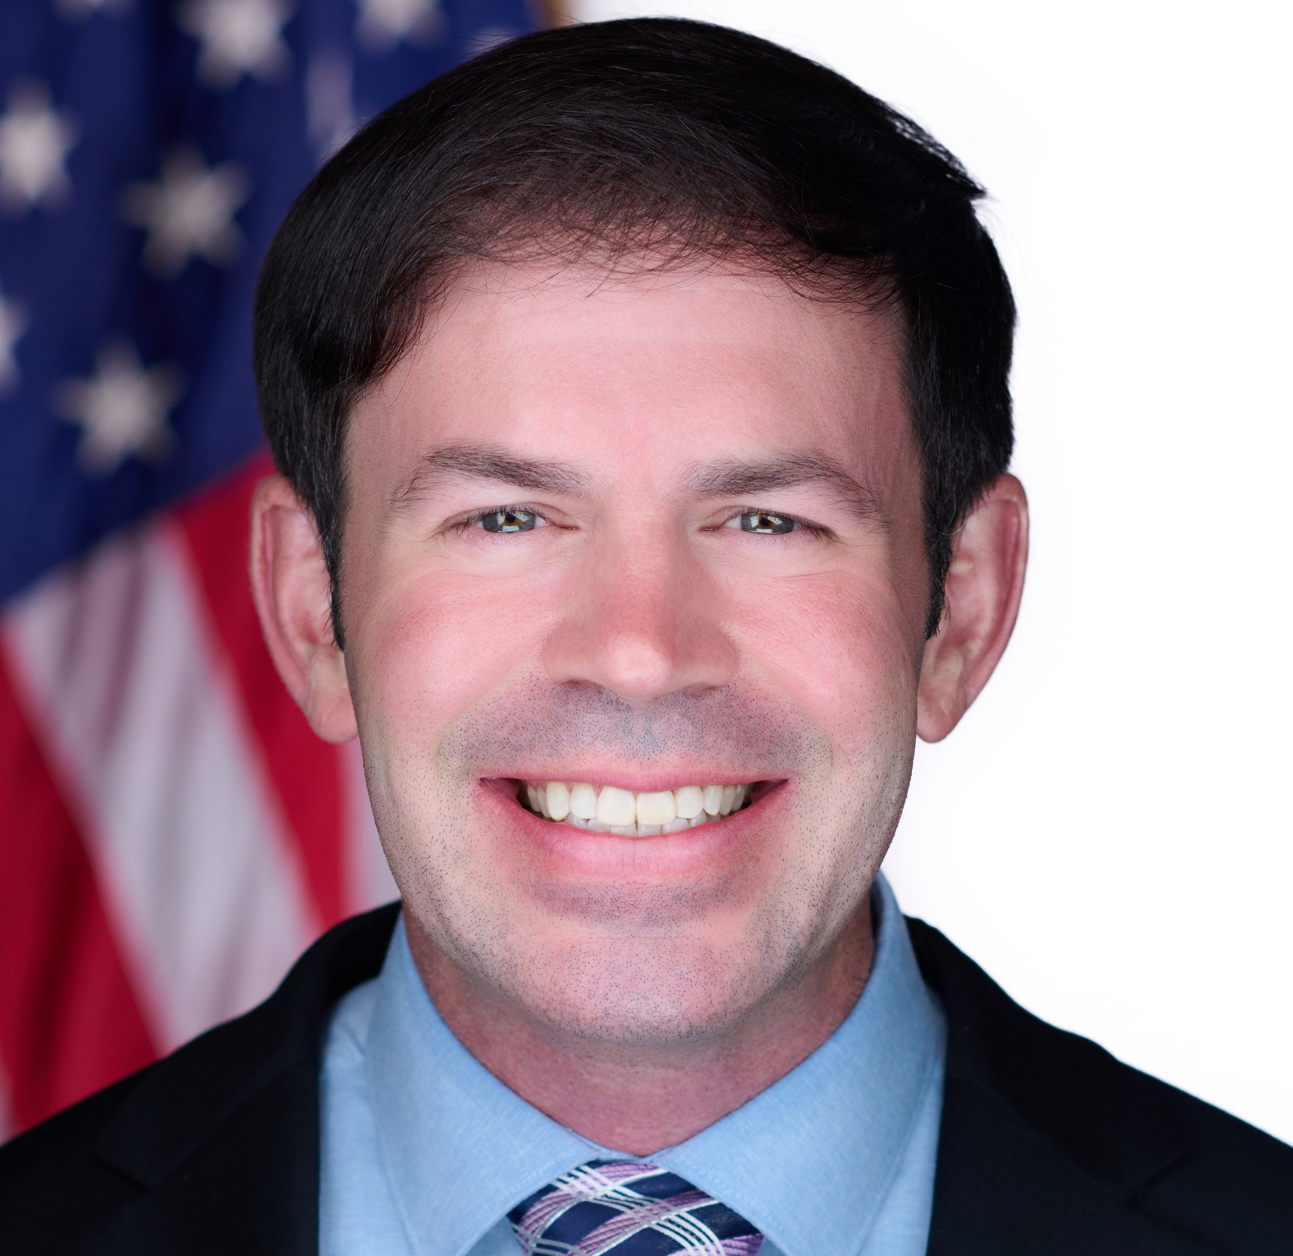

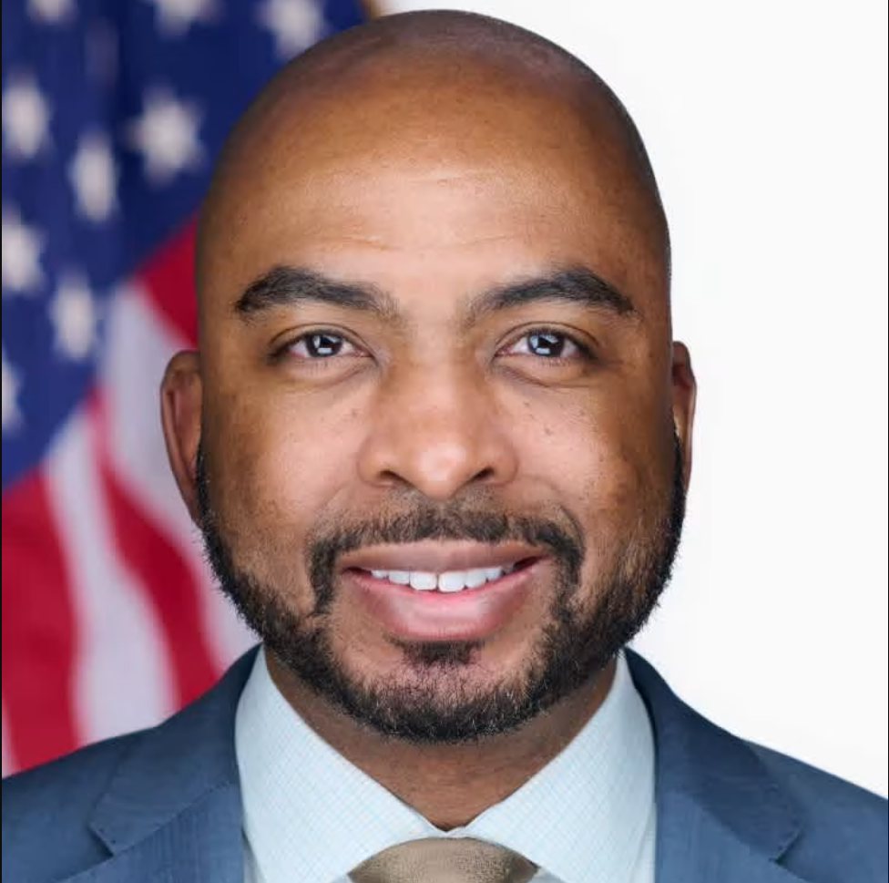


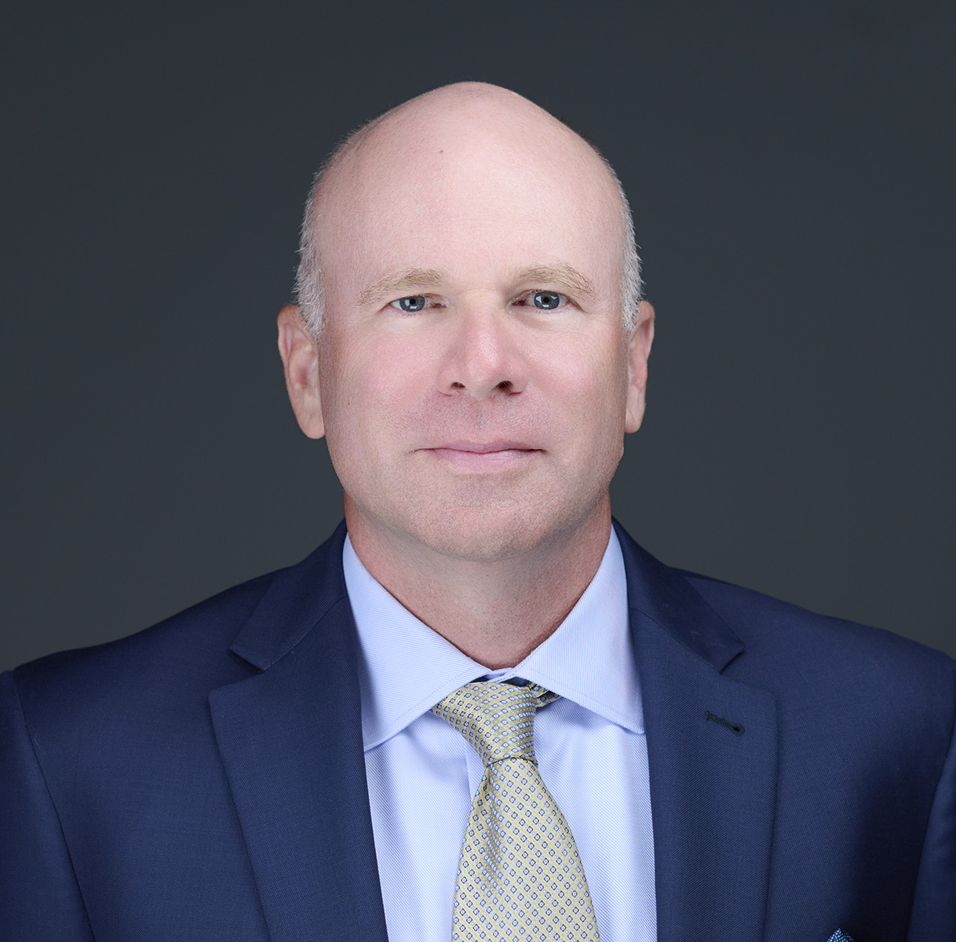
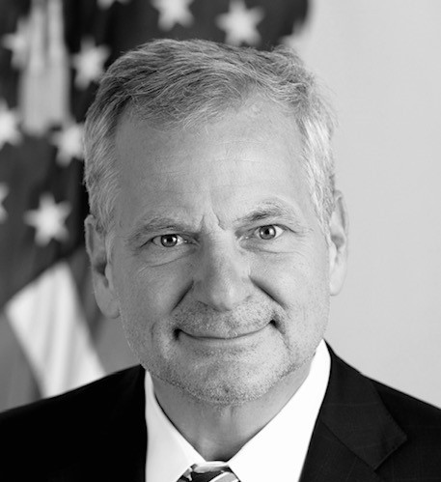
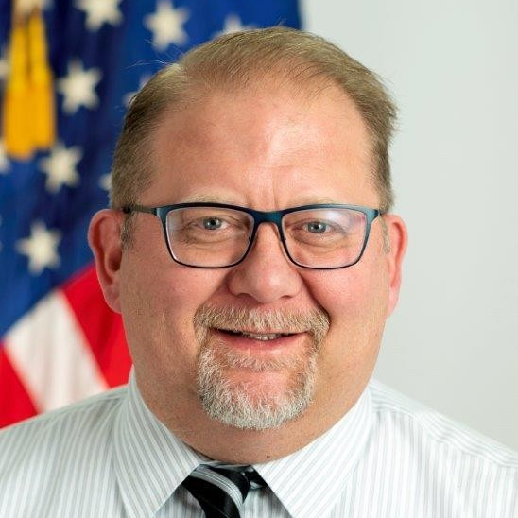

Modernization with Purpose: Turning IT Investments into Impact
Kevin Cummiskey
Director
Data Analytics and Services Group
(CPI)
Kathryn Wetherby
Acting Director
Marketplace Innovation and Technology Group
(CCIIO)
Ashley Corbin
Director Business Services Group
(CMMI)
Wade Zarriello
Acting Director
Infrastructure and User Services Group
(OIT)
Todd Jones
Deputy Director Data and Services Group
(CMCS)
Chris Martin
Director
Financial Management Systems Group (OFM)
Mark Plaugher
Director
Information Services Group
(CCSQ)
Jon Booth
Director
Web and Emerging Technology Group
(OC)
Moderator
Patrick Newbold
Chief Information Officer/ Director, Office of Information Technology
(OIT)

Slide 87
Please send questions to: cms.cio@cms.hhs.gov

Slide 88
Please take this time to scan the QR code and fill out the survey. Virtual attendees: Please use the following URL to access Slido to ask live Q&A’s during the presentations (https://www.slido.com); Enter code CMS26

Slide 89
We Are On A Break. Please Use This Time To Visit The Exhibit Hall. The Next Session Will Begin At 2:30 PM.

Slide 90
Our Next Session: Center for Medicare (CM) – Working with Your COR in 2026

Slide 91
Working with your COR in 2026

Slide 92
Changes affecting the contracting landscape
Mass change of federal staff/federal contractors
FAR Overhaul/FAR Companion Guide/Executive Order
New contracting flexibilities
Multi-step procurements/Down-selecting
Notes:
It is safe to say it has been a roller coaster of a year with a lot of changes, many of which are in the contract/acquisition space so if these topics interest you, you are in the right session.

Slide 93
COR Responsibilities
Contracting Officer's Representatives (CORs) play a critical role in ensuring that contractors meet the technical and cost commitments of their contracts. They facilitate development of requirements and cost estimates; provide technical direction; and assist Contracting Officers in developing and managing their contracts.
Any direction/decisions with cost or contract implications MUST be approved by the COR.
Notes:
My thoughts are to level set what the COR Main Responsibilities are according to contracting rules.

Slide 94
COR – Sample Activities
Act as the “eyes and ears” of the Contracting Officer on the technical requirements of the contract
Work with SMEs to interpret contract requirements, develop new requirements and identify funding sources for increases in level of effort
Provide written and verbal technical direction to the contractor on project prioritization; project scope; interpretation of contract requirements; or reallocation of project resources.
Review and approve contract invoices and spend plans to ensure contractor is within contract budget
Monitor performance reports to ensure contractor is achieving performance expectations
Review and clear derivative documents from Contract to determine if additional CMS clearance is required.

Slide 95
Division Director Responsibilities
Serve as Director for the COR and the SME.
Ensure that directions and/or decisions are in alignment with Agency protocols.
Manage overall Division work to include this work.
Ensure consistency in messaging.

Slide 96
Subject Matter Expert Responsibilities
SMEs provide knowledge and analytical support for their projects/areas of expertise. Examples of SME Activities include:
Provide expertise in the development and refinement of analyses and study plans
Assist in the interpretation of study results and report preparation
Provide recommendations for spending priorities within their project funding line
Act as the “go to” for questions and problems in the subject area that do not have financial or contract ramifications
Understand the language/terms/jargon for research areas as well as requisite knowledge that underlies effective decision-making

Slide 97
Cross-Cutting COR Role and Perspective

Slide 98
Inside the COR Role
What happens in the day of a CMS COR?
What aspects of the COR role are often misunderstood by contractors?
How can industry help the COR do their job?

Slide 99
Early Engagement with your COR

Slide 100
Market Research/Early Engagement
How do you prefer to be engaged?
What elements of a conversation make it a “good” or “bad” conversation for you?
How early in the market research process do you feel industry engagement is most effective?
What differentiates a useful capability statement from a generic one?

Slide 101
Understanding Need & Innovation
What changes have you seen in the way market research and RFPs are conducted?
What indicators show you that a vendor truly understands your mission needs?
How do you evaluate the credibility of emerging technologies during market research?

Slide 102
Navigating the RFP Process
When do you recommend submitting questions for an RFP?
How do you feel about multi-step procurements and down-selecting?
What are the most helpful types of RFP questions industry can submit?
What are common misunderstandings vendors make when reading an RFP?

Slide 103
Evaluating Quality
How do TEPs work?
What do you like and don’t like in proposals?
What characteristics distinguish a high-quality technical proposal?
How do evaluators weigh innovation versus risk?

Slide 104
Award, Transition, and Performance with your COR

Slide 105
Effective Transition
What makes a smooth transition?
What transition deliverables provide the most value?

Slide 106
Operational Execution
What issues do you experience with invoices?
How does contract structure affect work operations?
How do you prefer contractors escalate risks or issues?
What happens if a deliverable will be late? How should we approach you?
How do you feel about CPARS self-assessments?

Slide 107
Working with Consultants and Subcontractors
What is the COR perspective on consultants and subcontractors?
How do CORs balance risk management with promoting innovation?
What makes a contractor stand out as a trusted partner?

Slide 108
Please, take this time to scan the QR code and fill out the survey. Virtual attendees: Please use the following URL to access Slido to ask live Q&As during the presentations (https://www.slido.com); Enter code CMS26

Slide 109
We Have Reached Our Final Break Of The Day. Please Use This Time to Visit The Exhibit Hall. Our Final Session Will Begin At 3:30 PM.

Slide 110
Our Last Session Of The Day: Center for Consumer Information and Insurance Oversight (CCIIO) – Upcoming Contracts for Helping Health Insurance Customers

Slide 111
Agenda
Panel Introduction
Opening Remarks
High-level introduction and overview of select CCIIO contracts
Facilitated Q&A

Slide 112
Today’s Presenters from the Center for Consumer Information and Insurance Oversight (CCIIO)
Beth Parish, Acting Deputy Director for Operations - Opening Remarks
Leslie Wagstaffe, Group Director, Consumer Support Group
Elissa Dines, Director, Division of Consumer Protection Policy
Danielle Ojeda, Dep. Division Director, Marketplace Plan Management Group
Carey Zhuang, Contracting Officer’s Representative (COR), Marketplace Eligibility and Enrollment Group
Lesa Paige, Budget Lead, Marketplace Plan Management Group
Matthew Egerton, Budget Analyst, Business Operations Group - Facilitator

Slide 113
Select CCIIO Contracts (Upcoming Re-Competitions) for today’s presentation & discussion
Federally-Faciliated Exchange (FFE) Oversight
Federal Services Systems Support & Oversight (FSSSO)
HHS - Administered Federal External Review (FERP)
CCIIO Enrollment Resolution and Reconciliation, Form 1095-A Data Reporting (ER&R Contract)

Slide 114
Federally-Faciliated Exchange (FFE) Oversight
This contract provides comprehensive oversight services for insurance agents registered with the Federally-Facilitated Exchange (FFE) as well as Enhanced Direct Enrollment (EDE) platforms. Services include enforcement actions, compliance reviews, technical assistance, and help desk operations for agents, brokers, and Direct/Enhanced Direct Enrollment partners.
Key activities:
Compliance reviews of consent audit documentation.
Operational readiness reviews of EDE platforms.
Data analysis to identify noncompliant agent/broker behavior.
Supporting enforcement actions.
This work supports CMS's goals of marketplace stability and consumer protection while ensuring compliance with Title 45 CFR Part 155. By maintaining oversight of enrollment pathways, this contract safeguards consumer access to quality healthcare through properly regulated marketplace channels."

Slide 115
Federal Services Systems Support & Oversight (FSSSO)
This contract supports:
Federally-facilitated Marketplace (FFM) in-person assister Federal certification training, education, technical assistance, community, and inquiry tracking;
Certified application counselor designated organization (CDO) application processing and tracking;
A technical solution for operations of the Federal independent dispute resolution (IDR) process, No Surprises Help Desk (NSHD), and plan and issuer as well as provider compliance and enforcement investigations;
FFM qualified health plan (QHP) communications and management; and
FFM issuer communications; health plan transparency inquiry management and translations of transparency documents.

Slide 116
HHS - Administered Federal External Review (FERP)
This contract provides support services to:
Operate the HHS-administered Federal External Review Program (FERP) to ensure consumers can appeal an adverse decision by their health plan/issuer to an outside, independent review organization.
Provide medical experts and qualified legal conduct reviews of health plan/issuer decisions to deny a consumer coverage for health care item or service.
FERP is available in the individual and fully insured small and large group health insurance markets in states and territories with no applicable state process for external review (AL, FL, GA, TX, WI, AS, GU, MP, and VI) and to self-insured nonfederal governmental health plans in all states and territories (if the plan operates in a state that does not have jurisdiction over them or has chosen not to submit to the state’s process).

Slide 117
HHS - Administered Federal External Review (FERP) continued
Further:
The contractor engages with claimants
Handles administrative services
Performs internal audits of cases
Engages with self-insured, nonfederal governmental plans, and
Operates a web-based portal for review submission.

Slide 118
CCIIO Enrollment Resolution and Reconciliation, Form 1095-A Data Reporting (ER&R Contract)
This contract supports three distinct lines of mission-critical work required of the Exchanges:
Processing and solving issuer disputes
Resolving Form 1095-A consumer disputes and providing updated Form 1095-As as needed
Providing excellent customer service to resolve complex consumer enrollment and eligibility cases

Slide 119
CCIIO Enrollment Resolution and Reconciliation, Form 1095-A Data Reporting (ER&R Contract) continued
CMS is required to reconcile enrollment records with all participating issuers monthly, per 45 CFR 155.400(d). Through the Enrollment Resolution & Reconciliation (ER&R) process, issuers submit enrollment and payment disputes for research and resolution.
Additionally, section 1502(a) of the Affordable Care Act (ACA) requires the Exchange to submit an annual report to the IRS and furnish Forms 1095-A, to individuals on or before January 31 of each year. The ER&R Contract supports this process through making corrections to Forms 1095-A as needed and issuing updated forms to ensure consumers can file taxes.

Slide 120
Q&A / Discussion
We now welcome Q&As from our audience, both in-person and virtual

Slide 121
Please, take this time to scan the QR code and fill out the survey. Virtual attendees: Please use the following URL to access Slido to ask live Q&As during the presentations (https://www.slido.com); Enter code CMS26

Slide 122
Closing Remarks Douglas Bergevin, Acting Director and Head of Contracting Activity, Office of Acquisition and Grants Management (OAGM)

Slide 123
Thank You For Attending 2026 CMS Industry Forum

