Slide 1
COVERAGE TO CARE RESOURCES
[Presenter’s Name], CMS OMH
[Date MM/DD/YYY]
Notes:
Hello everyone and thank you for joining me today to learn about Coverage to Care and the resources available to you.
(Introduce self)

Slide 2
TABLE OF CONTENTS
  CMS Office of Minority Health . . . . . . . . Page 3
  C2C Resources. . . . . . . . . . . . . . Page 8
  How to Use Health Coverage. . . . . .. . . .Page 16
  Partnering with C2C. . . . . . . . . . . . . . . . Page 34
  Thank You. . . . . . . . . . . . . . . . . . . . . . . Page 41

Slide 3
CMS OFFICE OF MINORITY HEALTH
Notes:
Before we dive into the Coverage to Care (C2C) Initiative, I’d like to provide a brief overview of the CMS Office of Minority Health. The CMS Office of Minority Health oversees the C2C initiative, and other programs aimed at improving health equity and reducing disparities.

Slide 4
CMS OFFICE OF MINORITY HEALTH
The Centers for Medicare & Medicaid Services (CMS) is the largest provider of health insurance in the United States, responsible for ensuring that more than 150 million individuals supported by CMS programs (Medicare, Medicaid, Children’s Health Insurance Program, and the Health Insurance Marketplaces) are able to get the care and health coverage they need and deserve.
The Centers for Medicare & Medicaid Services Office of Minority Health (CMS OMH) offers a comprehensive source of information on optimizing health outcomes and closing gaps in coverage for all people CMS serves.
Notes:
Here is an overview of the Centers for Medicare and Medicaid Services (or “CMS”) and its Office of Minority Health (CMS OMH).
CMS is the largest provider of health insurance in the U.S. and is responsible for ensuring more than 150 million people supported by CMS programs – such as Medicare, Medicaid, the Children’s Health Insurance Program, and the Health Insurance Marketplaces – get the health care coverage they need and deserve.
CMS’s Office of Minority Health is one of eight offices of minority health within the U.S. Department of Health and Human Services. They work with local and federal partners to eliminate health disparities and improve the health of minority populations.

Slide 5




CMS OMH
Mission
The Centers for Medicare & Medicaid Services Office of Minority Health (CMS OMH) leads the advancement of optimal health for all people CMS serves in the development and integration of CMS policies and programs.
Vision
All those served by CMS have achieved their highest level of health and well-being.
Notes:
On this slide, you will see the mission and vision of the CMS Office of Minority Health:
The mission is to lead the advancement and integration of health equity in the development, evaluation, and implementation of CMS’s policies, programs, and partnerships.
The vision is to see all those served by CMS achieve their highest level of health and well-being, and to have eliminated disparities in health care quality and access.

Slide 6
COVERAGE TO CARE (C2C)
What is C2C?
C2C aims to help individuals understand their
health coverage and connect to primary care and
the preventive services that are right for them,
so they can live a long and healthy life.
Notes:
C2C was created with the idea that as people are obtaining health coverage, they will need to know how to use it. Many people have gained coverage in recent years for the first time or the first time in a long time.
C2C resources help consumers understand their health coverage and effectively use it, so they can receive preventive services and primary care from a provider who accepts their coverage. This will help them get the care they need to live a long and healthy life.
Everyone can use C2C resources, regardless of their insurance type.

Slide 7
C2C RESOURCES
5 Ways to Make the Most of Your Health Coverage
Prevention Resources
Roadmap to Better Care
Roadmap to Behavioral Health
Manage Your Health Care Costs
Enrollment Toolkit
Partner Toolkit and Community Presentation
Notes:
There are several C2C resources available including:
The 5 Ways to Make the Most of Your Health Coverage, which is available in 8 languages: English, Spanish, Arabic, Chinese, Haitian Creole, Korean, Russian, and Vietnamese.
Prevention Resources, which highlight how to take advantage of preventive services.
The Roadmap to Better Care, which explains what health coverage is and how to use it. There is also a companion guide, the Roadmap to Behavioral Health, about mental health and substance use services.
The Manage Your Health Care Costs resource provides guidance on how to select the best plan based on what you can afford.
The Enrollment Toolkit is for community partners, assisters, and other people who help consumers enroll in coverage or change their plan. It includes information on guiding consumers to choose the plan that meets their needs and to use their coverage to get the care that they need.
Lastly, there are several C2C resources for partners, including a toolkit with ready-to-use materials, to help spread the word about C2C resources.
I will discuss these materials in more detail later in the presentation.

Slide 8
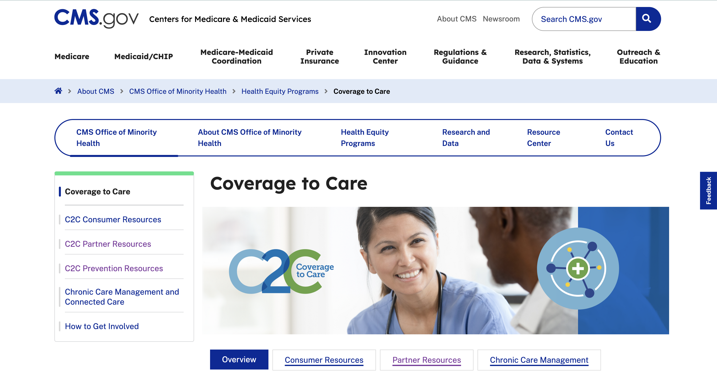
VISIT GO.CMS.GOV/C2C
Notes:
All C2C resources are available on the CMS OMH website. Just visit go.cms.gov/C2C.
Here is a screenshot of the page. Using the navigation pane on the left, you’ll see the C2C page and subpages for consumer, partner, and prevention resources.

Slide 9
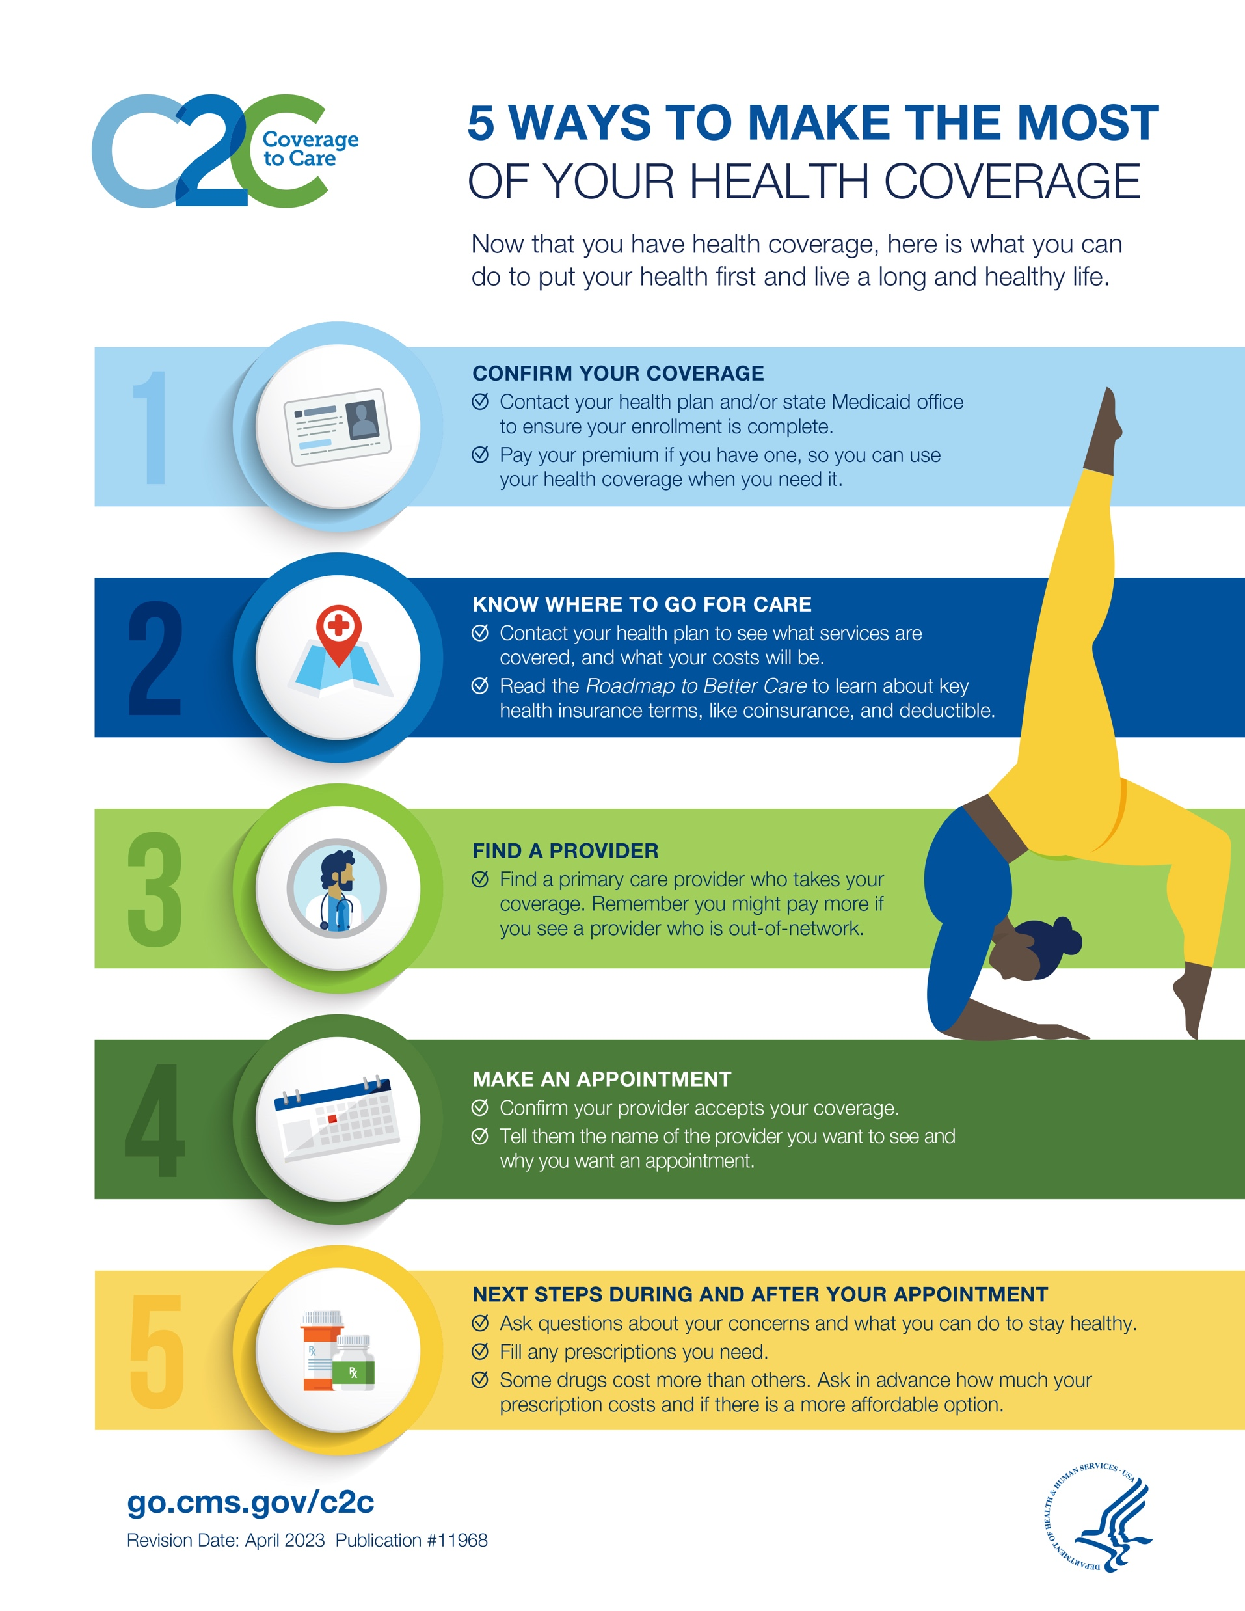
5 WAYS TO MAKE THE MOST
OF YOUR HEALTH COVERAGE
  Quick reference material to start the journey from coverage
  to care
  Available in Arabic, Chinese, English, Haitian Creole, Korean, Russian, Spanish, Ukrainian, and Vietnamese
  5 Ways to Make the Most of Your Health Coverage PDF
Notes:
This is the 5 Ways to Make the Most of Your Health Coverage resource. It highlights five areas to address to make sure you’re making the most of your health coverage.
This resource is also available in the 8 languages you see on the slide.
This breaks down each way you can make the most of your health coverage:
Confirm your coverage – Contact your health plan and/or state Medicaid office to ensure your enrollment is complete and remember to pay your premium if they have one, so you can use your coverage when you need it.
Know where to go for care – Contact your health plan to understand what services are covered and what the costs will be. Review the “Roadmap to Better Care” resource, which provides guidance on key health coverage terms, like coinsurance and deductible.
Find a provider – Choose a health care provider who takes your coverage. You may pay more to see a provider who is out-of-network.
Make an appointment – Confirm if your provider accepts your coverage. Also share the name of the provider you want to see and the reason for your appointment.
Next steps during and after your appointment – Make sure to ask questions about your concerns and what you can do to stay healthy. Remember to fill your prescriptions and ask about the cost in advance, as some medicines cost more than others.

Slide 10
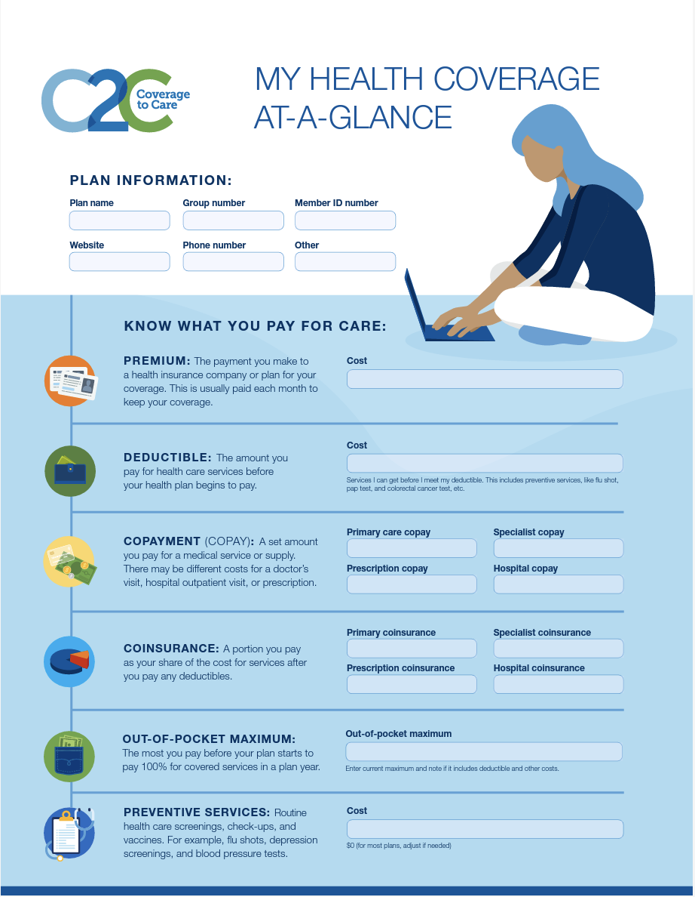
MY HEALTH COVERAGE AT-A-GLANCE
Created the customizable resource in direct response to requests for personalized information from consumers and partners
Includes:
  Plan information
  Know what you pay for care
  Know where to go for care
  Dates to remember, notes
Available in Arabic, Chinese, English, Haitian Creole, Korean, Russian, Spanish, Ukrainian, and Vietnamese
My Health Coverage at-a-Glance PDF
Notes:
Another helpful resource is My Health Coverage at-a-Glance.
You can use this resource to write information specific to your health plan, including:
Plan Information
Copayment Information
Where to go for care
Dates to remember
There’s also a place to take notes.
This helps you keep your personalized information all in one place.

Slide 11
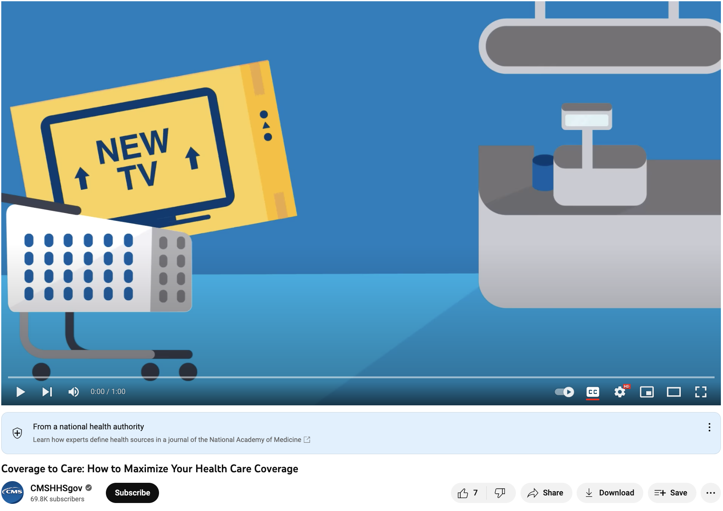
HOW TO MAXIMIZE YOUR HEALTH COVERAGE
Short animation series about how consumers can use their coverage to connect to primary care services
Includes additional animated videos:
  Confirm Your Coverage
  Know Where to Go for Answers
  Find a Provider
  Make an Appointment
  Fill Your Prescriptions
Videos are available in English and Spanish
How to Maximize Your Health Care Coverage Video
Notes:
How to Maximize Your Health Coverage is a short, animated video about how you can use your coverage to connect to primary care services. This is similar to the “5 Ways to Make the Most of Your Coverage” resource, but it is repurposed into a video format, so people can find the information they need in multiple ways.
Several other animated videos follow in succession telling a story about the different ways you can maximize your health coverage.
All videos are available in English and Spanish.

Slide 12

TELEHEALTH: WHAT TO KNOW FOR YOUR FAMILY
Learn about the types of care, how to prepare for an appointment, what to expect, and more
Includes:
  Telehealth basics
  Types of telehealth services
  Steps for using telehealth
  Language interpreter information
Available in Arabic, Chinese, English, Haitian Creole, Korean, Russian, Spanish, and Vietnamese
Telehealth: What to Know for Your Family PDF
Telehealth for Providers: What You Need to Know PDF
Notes:
The Telehealth: What to Know for Your Family resource helps you find the types of care available through telehealth. It also helps you understand how to prepare for an appointment, what to expect during a telehealth visit, and more.
This resource is also available in 8 languages.

Slide 13
HOW TO USE HEALTH COVERAGE
Notes:
The goals of C2C are focused on increasing the consumer’s connection to care and bettering their health outcomes. The main points are them finding a provider, making an appointment, and receiving preventive services.
CMS OMH has several resources available to help, including the C2C’s Roadmap to Better Care.

Slide 14

ROADMAP TO BETTER CARE
Explains what health coverage is and how to use it to receive primary care and preventive services
Includes consumer tools:
  8 Steps to Better Care
  Insurance Card
  Primary Care vs. Emergency care
  Explanation of Benefits
Available in 10 languages including a Navajo version
Roadmap to Better Care PDF
Notes:
The Roadmap to Better Care explains what health coverage is and how to use it to receive primary care and preventive services. It includes 8 steps to bettering your care and a variety of tools.
This is also available in 10 languages, including Ukrainian and a Tribal version with additional information for American Indian and Alaska Native communities.

Slide 15
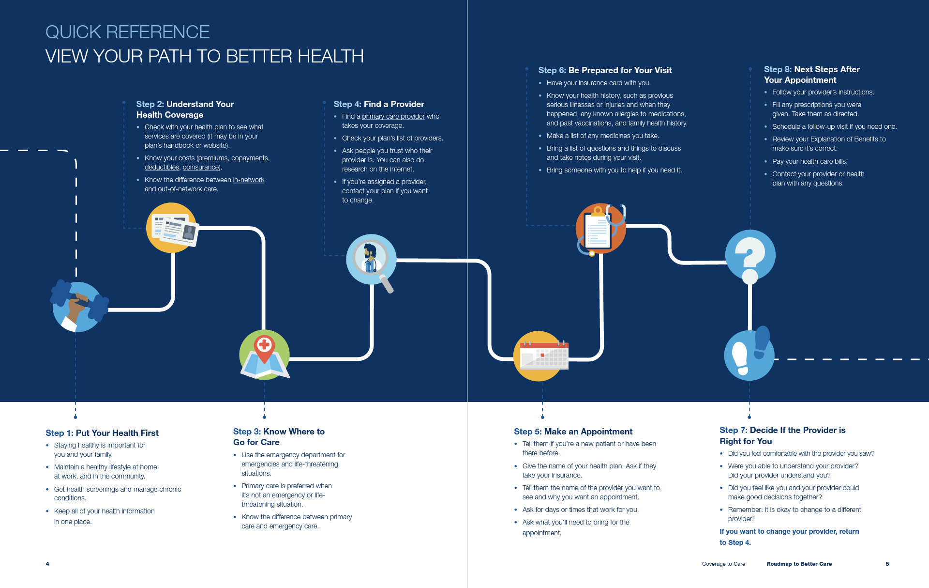
ROADMAP TO BETTER CARE (CONTINUED)
Notes:
This is a screenshot from the Roadmap to Better Care. Many of the other C2C materials available build on the content found in this resource, including prevention and behavioral health resources.
Now, I’ll go through each of the individual steps outlined in the Roadmap.

Slide 16
1. Put Your Health First
Key Points for Consumers
Staying healthy is important for you and your family
Maintain a healthy lifestyle at home, at work, and in the community
Get health screenings and manage chronic conditions
Keep all personal health information in one place
Notes:
Step 1: Put Your Health First.
This step highlights the importance of preventive care as well as the benefits of maintaining a healthy lifestyle, including getting health screenings and keeping your personal health information in one place.

Slide 17
2. Understanding Your Health Coverage
Key Points for Consumers
Review your plan to see what services are covered
Know the difference between in-network and out-of-network
Understand your out-of-pocket costs
Learn key insurance terms:
  Network
  Premium
  Deductible
  Copayment (Copay)
  Coinsurance
Notes:
Step 2: Understanding Your Health Coverage.
This step focuses on the main things you should know about your coverage, including what services are covered, the difference between in-and-out-of-network providers, out-of-pocket costs, and key insurance terms, such as premium, deductible, copayment, and coinsurance.

Slide 18
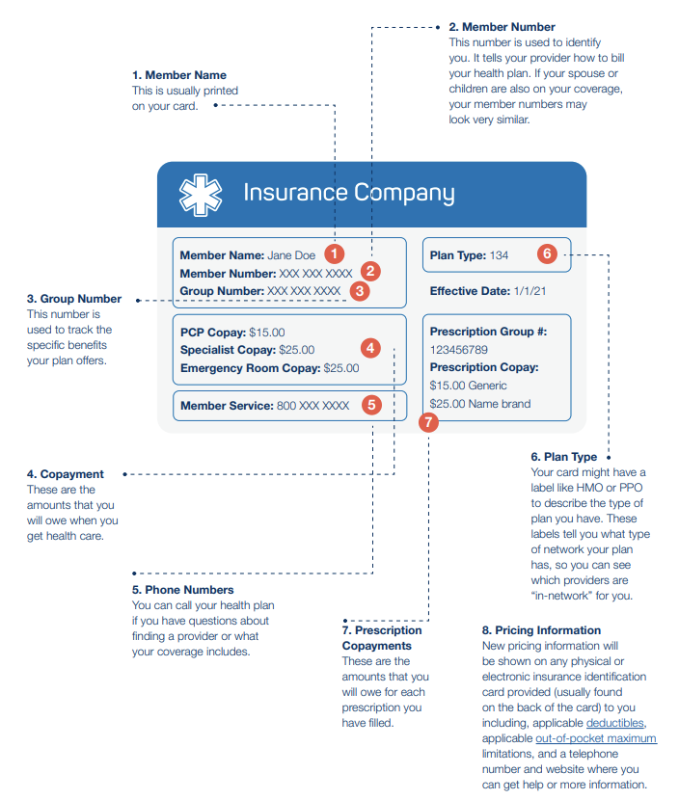
2. Understanding Your Health Coverage (continued)
Key Points for Consumers
You should receive a membership package and insurance card from your health plan or your state Medicaid or CHIP program
If have trouble understanding information on the insurance card, call your health plan for assistance
Notes:
Here is a screenshot of a sample insurance card, where a lot of information can be found about your plan.
If you have any questions, don’t hesitate to call your plan for help.

Slide 19
3. Know Where to Go for Care
Key Points for Consumers
Know the difference between primary care providers, emergency departments, and urgent care centers.
Although you can get health care from many different places, it’s best for you to get routine care and recommended preventive services from a primary care provider.
There are big differences between visits to your primary care provider and visits to the emergency department, such as cost, time spent waiting for care, and follow up.
If you have an emergency or life-threatening situation, call 9-1-1.
Notes:
Step 3: Know Where to Go for Care
This step details the differences between primary care providers, emergency departments, and urgent care centers, and where you should go for care, depending on your needs. For example, its best to get routine care and preventive services from a primary care provider.

Slide 20
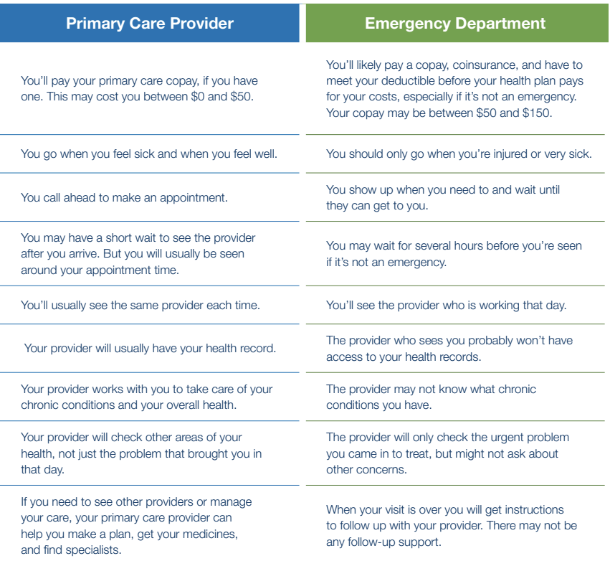
3. Know Where to Go for Care
(continued)
Notes:
Here is a comparison chart explaining the differences between a primary care provider and Emergency Department, with details about when you should seek care through a primary care provider or go to an Emergency Department.

Slide 21
4. Find a Provider
Key Points for Consumers
A provider is a health care professional
A primary care provider (PCP) is who you see for most health problems. They also work with you to get your recommended screenings, keep your health records, help you manage chronic conditions, and link you to other types of providers if you need them.
A specialist will see you for certain services or to treat specific conditions. These include cardiologists, psychologists, allergists, etc.
You may need a referral from your PCP before you see a specialist to have your health plan pay for your visit.
Notes:
Step 4: Find a Provider.
This step covers key terms to know and offers ways to find a primary care provider or specialist.

Slide 22
4. Find a Provider (continued)
Key Points for Consumers
Identify providers in your network
Call your insurance company or state Medicaid and CHIP program or look at their website to find providers in your network who take your health coverage
Ask around
Ask your friends or family if they have providers they like and what they like about them
Pick a provider
Call the provider’s office and ask questions (e.g., Is the provider accepting new patients or patients with your health coverage?)
4. Give them a try
Notes:
Here are a couple of ways to identify providers in your network:
Call your insurance company or state Medicaid and CHIP Program, or look on their website to find in-network providers
Ask friends and family about what providers they go to, and what they like about them
Call provider offices and ask questions about whether they are accepting new patients, and if they take your health coverage

Slide 23
5. Make an Appointment
Key Points for Consumers
When you make your appointment, have your insurance card or other documentation handy.
Mention:
  Your name and if you’re a new patient
  Why you want to see the provider
  The name of your insurance plan
  The name of the provider you’d like to see
  If you have a specific need (like translation or accessible medical equipment)
  The days and times that work for you
Notes:
Step 5: Make an appointment.
This step provides tips for making an appointment with a provider, and important things to mention.

Slide 24
6. Be Prepared for Your Visit
Key Points for Consumers
If this is your first visit to a new provider or you are using new health coverage, make sure to bring a few things with you:
  Insurance card or other documentation
  Photo identification
  Completed forms
  Your copay, if you have one. Ask for a receipt for your records.
The staff may ask you to fill out more forms and read over their privacy policy, which is required by law. It tells you how they will protect and keep your information private.
If you need to change your appointment, contact your provider’s office as soon as possible to avoid costs
Notes:
Step 6: Be Prepared for Your Visit.
This step offers tips on how to prepare for your provider visit, including what you should bring with you, like your insurance card and photo identification.

Slide 25
6. Be Prepared for Your Visit (continued)
Key Points for Consumers
When you see your provider, it is helpful to share your family health history, any available medical records, medications you are taking, and questions or concerns you may have about your health.
You should be able to answer questions like these before you leave your provider’s office:
  How is my health? What can I do to stay healthy?
  What do I do next? Do I need blood work or another test?
  If I need to take medicine, when do I take it and how much do I take? Are there any side effects? Is a generic
  option available?
Ask your provider for written materials you can take home and read. Don’t leave until all your questions have been answered and you understand what to do next.
Notes:
This step also highlights what information you should be prepared to discuss, like your family health history and current medications, as well as some questions you should ask your provider before the end of your visit.

Slide 26
7. Decide if the Provider is Right for You
Key Points for Consumers
Your health and well-being are important and personal. You should have a provider that you can work with, trust, and feel comfortable talking to.
If you were assigned a provider and you want to try someone else, call your health plan or go to their website to make that change.
Notes:
Step 7: Decide if the Provider is Right for You.
This step shares ways you can tell if the provider you chose is right for you. For example, you should have a provider you feel comfortable talking to. This is important so you keep going back to the provider, when healthy or sick.

Slide 27
7. Decide if the Provider is Right for You (continued)
Key Points for Consumers
Did your provider pay attention to what you had to say and speak in a way that made you comfortable?
Did they provide any assistance you asked for? Could you move around in the office and use the medical equipment without barriers?
Did you feel you were treated fairly by your provider and the office staff?
Could you contact your provider or the office staff if you needed to ask a question?
Notes:
These are some other questions to think about as you decide about whether the provider is right for you. [Read some or all questions.]
If you answer no to any of these questions, it could be that a simple conversation with office staff could help. Or, you may wish to return to Step 4 to find a new provider.

Slide 28
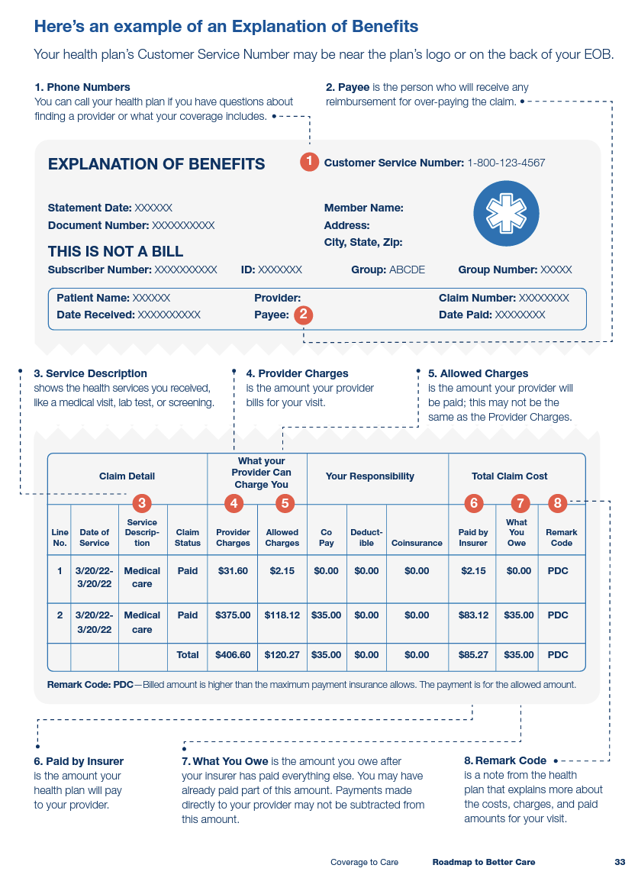
8. Next Steps
Key Points for Consumers
Follow through with your provider’s recommendations
After you visit your provider, you may receive an Explanation of Benefits (EOB) from your insurer
Pay your bills and keep any paperwork
Fill your prescriptions
If you have questions between visits, call your provider
You may receive an Explanation of Benefits (EoB) after your visit. An EoB is a summary of health care charges from the care you or those covered under your policy received. It is NOT a bill.
Notes:
Step 8: Next Steps.
Here are the things you should do following your appointment. For example, following through on your providers recommendations, filling your prescriptions, and paying your bills.
You may also receive an Explanation of Benefits, which is a summary of the health care charges for you or those covered by your policy.
An example of an Explanation of Benefits document is shown on the screen.

Slide 29

ROADMAP TO BEHAVIORAL HEALTH
Offers information specific to mental health and substance use disorder services
Use alongside the Roadmap to Better Care
Outlines 8 steps:
  Understand your behavioral health
  Learn about health insurance
  Where to go for help and treatment
  Find a behavioral health provider
  Make an appointment with a behavioral health provider
  Prepare for your appointment
  Decide if the behavioral health provider is right for you
  Stay on the road to recovery
Available in 8 languages
Roadmap to Behavioral Health PDF
Notes:
The C2C Roadmap for Behavioral Health helps you understand what behavioral health is and how to use your health coverage to receive behavioral health services, such as mental health and substance use disorder services.
You should use this together with the Roadmap to Better Care.
Like the Roadmap to Better Care, this resources outlines 8 steps you should take to use your health coverage for behavioral health services.
These steps include:
Understanding your behavioral health
Learning about health insurance
Where to go for help and treatment
Finding a behavioral health provider
Making an appointment with a behavioral health provider
Preparing for your appointment
Deciding if the behavioral health provider is right for you
Staying on the road to recovery

Slide 30

PREVENTION RESOURCES
The Prevention Resources page focus on prevention and healthy living to be shared with consumers, reposted online, printed or ordered.
All resources are available in eight languages.
Adults Preventive Services Flyer
Women Preventive Services Flyer
Men Preventive Services Flyer
Teens Preventive Services Flyer
Children Preventive Services Flyer
Infants Preventive Services Flyer
Put Your Health First Tabloid
Notes:
The C2C website also includes Prevention Resources, which focus on prevention and healthy living.
These resources are available in multiple languages and for a variety of audiences, including adults, women, men, teens, children, and infants.

Slide 31
PARTNERING
WITH C2C – HOW TO GET INVOLVED
Notes:
C2C has several resources available to partners who are helping people in their communities learn more about their health coverage.
.

Slide 32
USING C2C RESOURCES
Start the Conversation. Use the Roadmap to Better Care as a tool to help people understand their new coverage and understand the importance of getting the right preventive services.
Help Consumers Understand the Resources. The Roadmap to Better Care has a lot of information for consumers. You can help them use it as a resource to refer to as they journey to better health and well-being.
Personalize It. You know your community. Consider adding local resources and information.
Notes:
When using C2C resources, partners can help by starting the conversation with consumers about health coverage and using the Roadmap to Better Care resource as a tool to help them understand their new coverage and the importance of preventive services.
Partners can also tailor the C2C resources to the communities you are working with. You can also add local resources or your own contact information.

Slide 33
WHO IN YOUR COMMUNITY
IS USING C2C RESOURCES?
Congressional Offices
Voter Rights Organizations
Legal Aid Societies
Universities
United Way
State Health Insurance Assistance Program Counselors
Primary Care Associations
Dialysis Facilities
Ryan White HIV/AIDS Program Providers
Libraries
Justice System
Community Health Centers
Hospitals
Insurance Companies
State and County Health Departments
Area Agencies on Aging
Tribal Organizations
Assisters and Brokers
Faith-Based Organizations
Notes:
Here is a list of the organizations who currently use C2C resources. You can see it’s a wide-range of organizations—not just health care groups.

Slide 34

PARTNER TOOLKIT
High-level document offering prospective partners information on how to share C2C materials.
Includes:
  Why the C2C initiative is important
  How to collaborate
  Downloadable and printable resources
  How to plan an event
  Guide on how to draft written content
English and Spanish content
Partner Toolkit PDF
Notes:
This is the partner toolkit. It is a high-level document offering prospective partners information on how to share C2C materials.

Slide 35
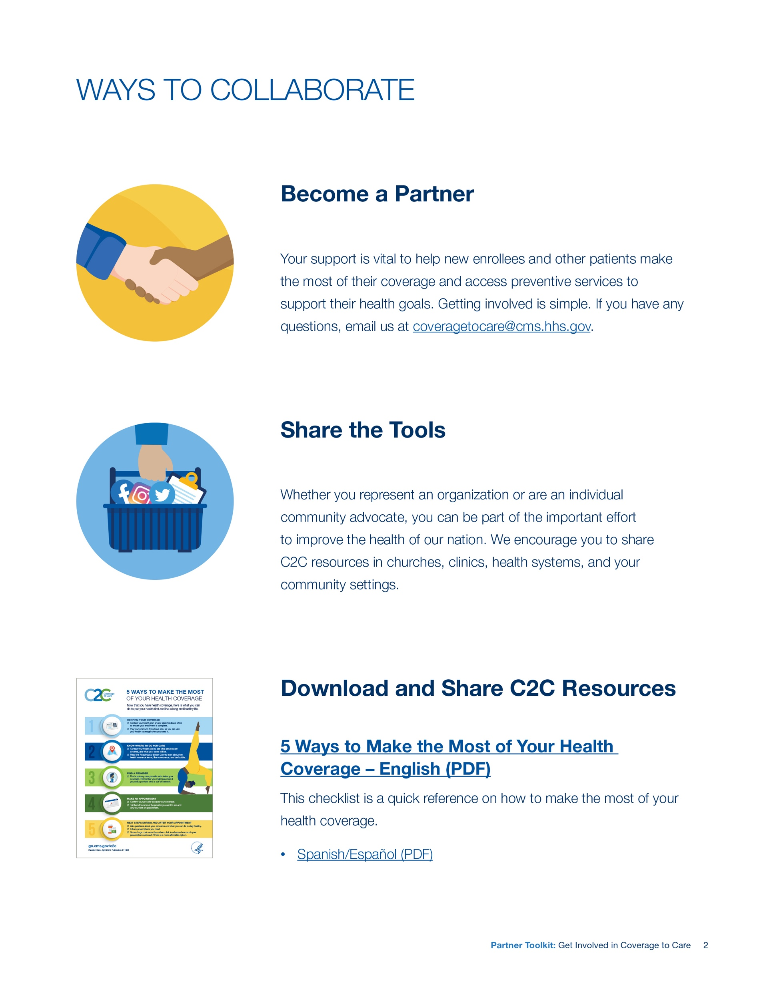
PARTNER TOOLKIT (CONTINUED)
Use the Partner Toolkit
Includes ideas on how to get involved, like hosting events in your community, and resources to share, such as blog posts, newsletter content, social media posts and graphics, and a web badge
Available in English and Spanish
Use the C2C Community Presentation
Overview of the Roadmap to Better Care with all eight steps, including slides, script, and a handout
Available in English and Spanish
Order and share C2C resources at no cost to your organization.
Send stories to coveragetocare@cms.hhs.gov.
Notes:
This toolkit also includes ways to get involved with C2C. It includes examples of events, outreach, and best practices for communicating with consumers. It also comes with pre-written text that can be used for newsletters, emails, blogs, as well as social media posts and graphics; all in English and Spanish.
The C2C Community Presentation is another tool to including in this toolkit. The presentation walks through all 8 steps of the Roadmap to Better Care with a set of prepared slides and a pre-written script.
C2C is always excited to hear from you! We enjoy hearing about best practices, lessons learned, or feedback on resources.

Slide 36
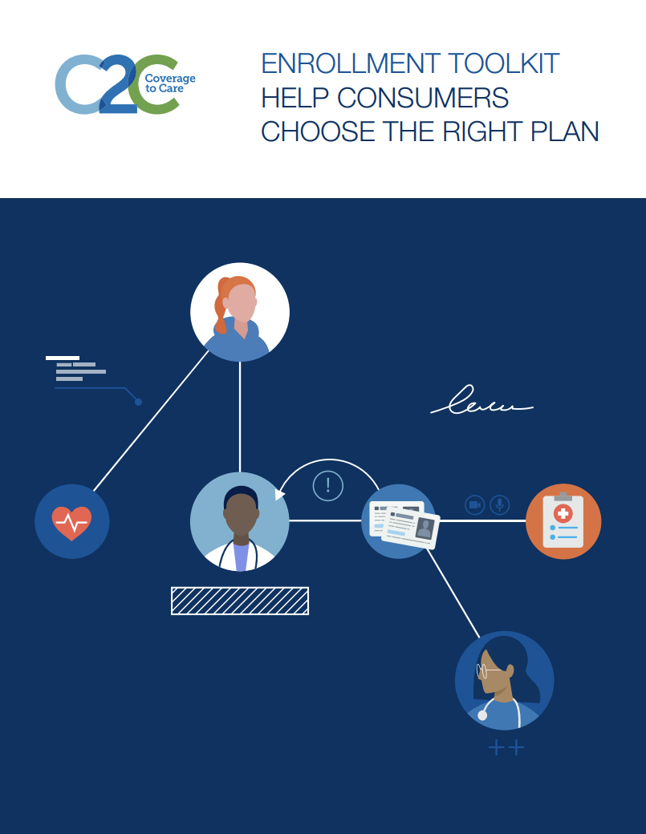
ENROLLMENT TOOLKIT
Toolkit for community partners, assisters, and others who help consumers enroll in coverage or change their plan.
Includes:
  Coverage is important and affordable
  Before choosing a plan
  Know before you enroll
  Next steps after enrolling
  Information for consumers with special circumstances
  Resources for other populations
Enrollment Toolkit PDF
Notes:
Here is the enrollment toolkit. It is designed for community partners, assisters, and others who help consumers enroll in coverage or change their health plan.

Slide 37

MANAGE YOUR HEALTH CARE COSTS
This resource is a series of tools for assisters and other community organizations that helps consumers understand health insurance costs and terms, their own specific health insurance costs, how to plan for health care costs, and how to pay their premiums.
Includes budget tracking as well as health care basics
Manage Your Health Care Costs PDF
Notes:
This resource includes a series of tools for assisters and other community organizations that help consumers understand health insurance costs and terms, their own specific health insurance costs, how to plan for health care costs, and how to pay their premiums.

Slide 38
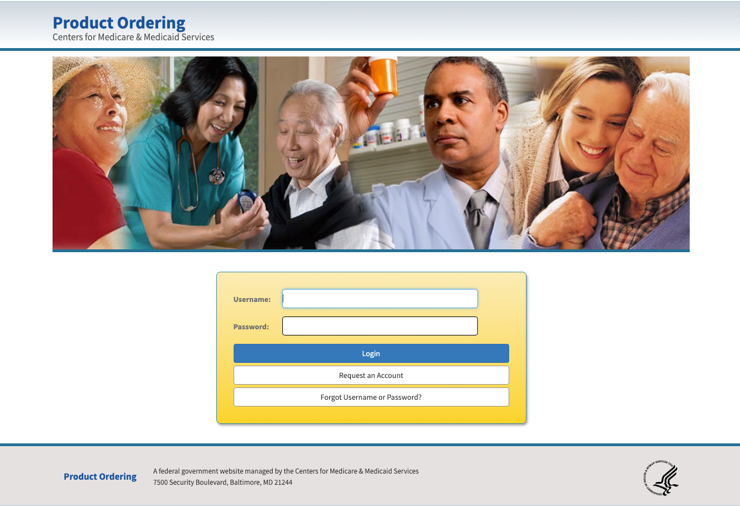
VISIT PRODUCTORDERING.CMS.HHS.GOV
Notes:
Please visit productordering.cms.hhs.gov to order printed materials.

Slide 39
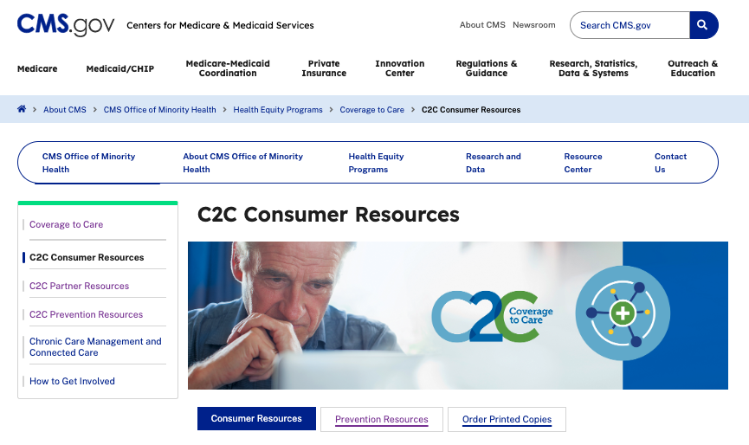
VISIT CMS.GOV FOR CONSUMER RESOURCES
Notes:
For consumer resources, please visit go.cms.gov/c2C

Slide 40
THANK YOU
  Visit our website:
  go.cms.gov/c2c
  Contact us:
  CoverageToCare@cms.hhs.gov
  OMH@cms.hhs.gov
  C2C Listserv:
  http://bit.ly/CMSOMH
Paid for by U.S. Department of Health and Human Services.
Notes:
Please stay up to date on C2C, by signing up for the C2C listserv, visiting the website, or contacting CMS OMH’s C2C team via email. Thank you!

