Slide 1

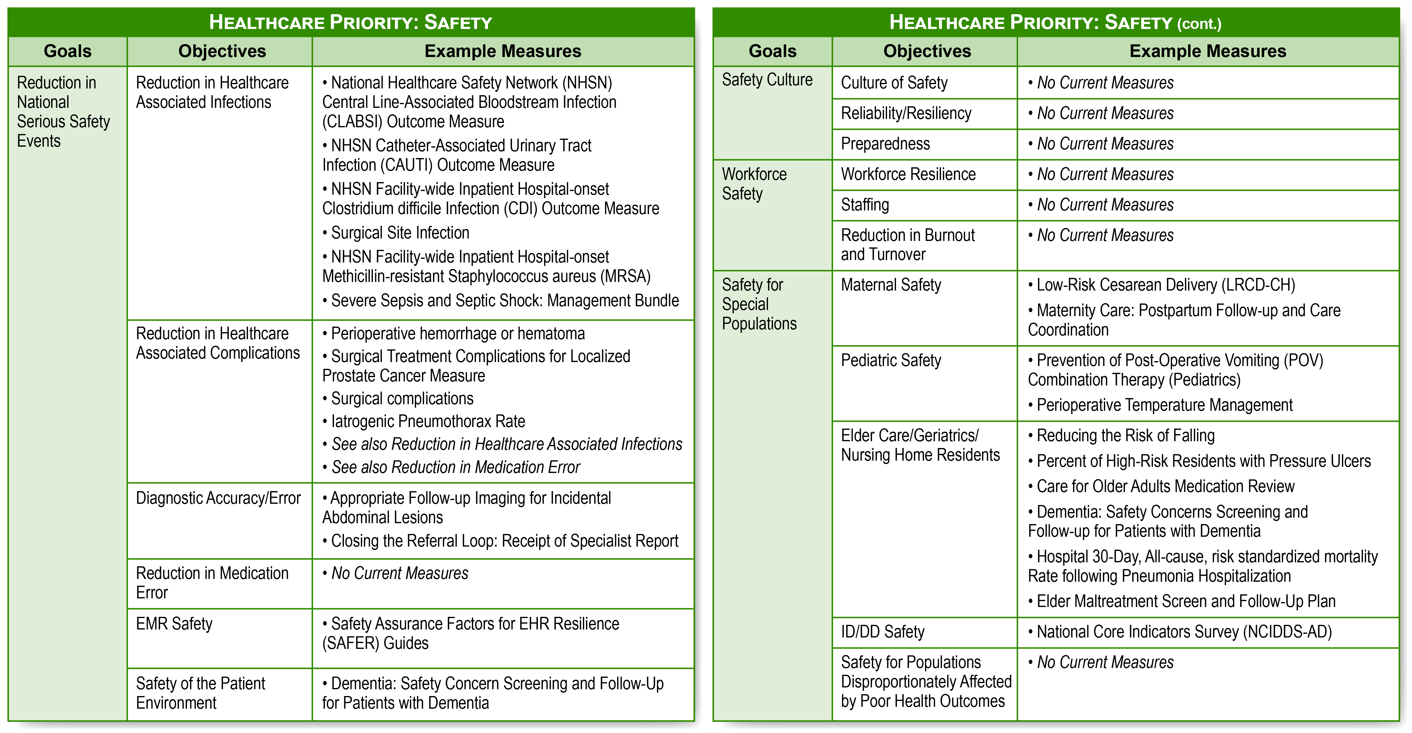
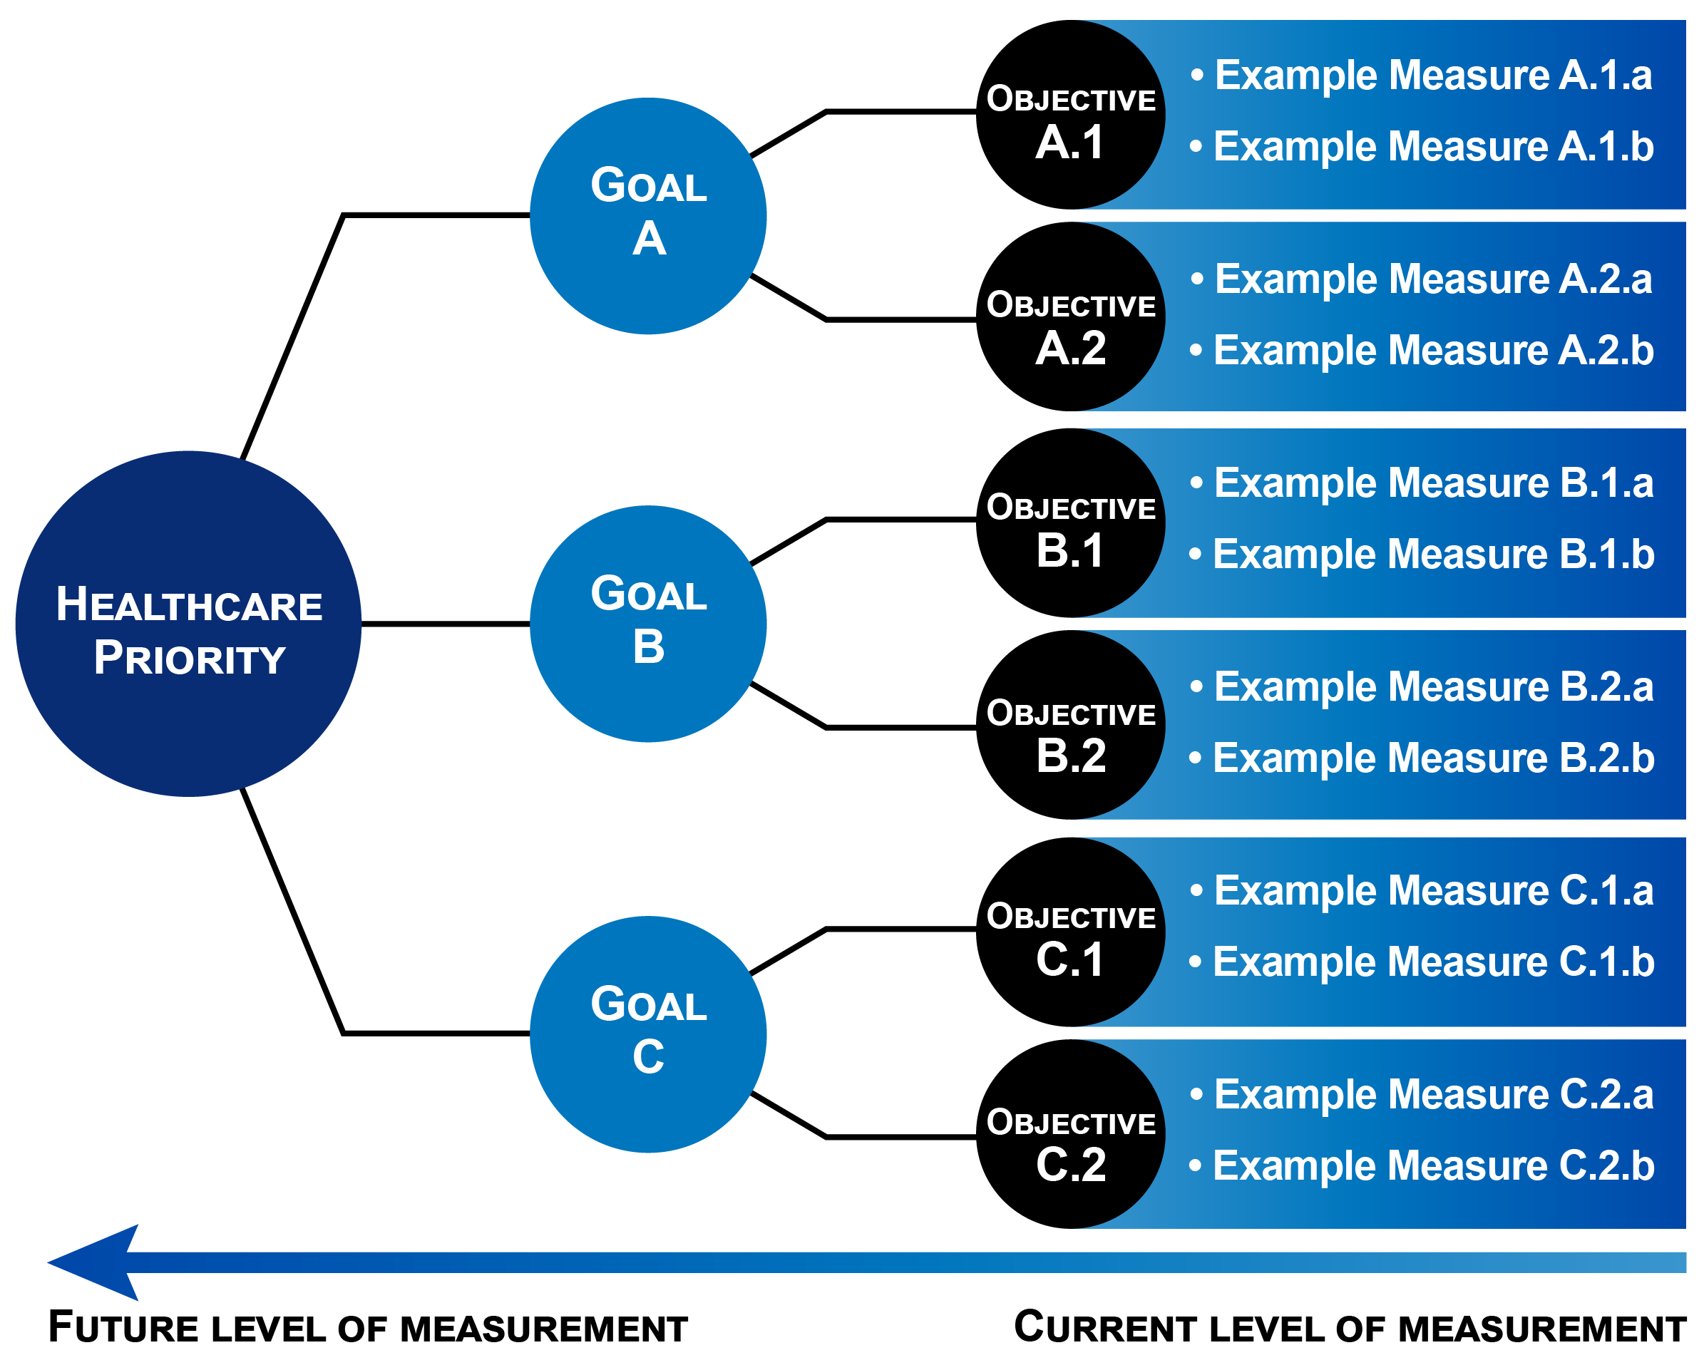

The Cascade of Measures: A Tool for Measure Alignment and Prioritization
Battelle Technical Lead: Meridith Eastman Battelle Support: JJ Knight, Brenna Rabel, Mary Sheehan, Stephanie Zias CMS Technical Lead and COR: Kimberly Rawlings
Overarching Goals
The Cascade of Measures breaks down the healthcare priorities of Meaningful Measures 2.0 into Goals, Objectives, Measure Families, Measure Standards and individual measures (see Figure 1 below). The Cascade provides a means for mapping existing quality measures to the Meaningful Measures 2.0 Framework and can be leveraged by CMS programs to identify possibilities for measure alignment and to prioritize areas for additional measure development. As depicted by the right-to-left arrow at the bottom of Figure 1, the Cascade ultimately will help programs move from existing process and outcome measures to the development of more expansive outcome measures and composites at the Objective and Goal levels.
Figure 2 above shows the Cascade of Measures framework for the Meaningful Measures 2.0 healthcare priority, Safety. Each Goal is comprised of multiple Objectives for which there may be multiple existing quality measures. Findings from literature reviews and stakeholder feedback were integrated to identify appropriate Objectives and Measure Families for each healthcare priority, and individual measures in the CMS Measures Inventory Tool (CMIT) were identified as examples.
Near-Term Goals During the first half of 2022, CMS is planning for agency wide implementation of the Cascade of Measures.
The complete Cascade is available online here https://www.cms.gov/Medicare/Quality-Initiatives-Patient-Assessment-Instruments/QualityInitiativesGenInfo/CMS-Quality-Strategy

