Slide 1
Calendar Year 2018 (CY18) National Risk
Adjustment Data Validation (RADV)
CY18 National RADV
Interim Findings Report Training and User Guide
May 28, 2020

Slide 2
Agenda
COVID-19 Updates
Medical Record Submissions
Interim Findings Report
Interim Findings Reports
Purpose
Overview
Structure
Medicare Advantage (MA) Organization Suggested Actions
Additional Notes
CY18 National RADV Interim Findings Report #2 Timeline
Reminders
NOTE: CMS has updated the National RADV title to
Medicare Part C Improper Payment Measure
(Part C IPM), which will go into effect next year for CY19 improper payment activity.
05/28/2020 National RADV Interim Findings Reports Training 2

Slide 3
COVID-19 Updates and Medical Record Submissions
To address the impact of COVID-19 on the provider community, CMS directed MA Organizations to cease requests for documentation from providers regarding Part C IPM until CMS issues further guidance
This information was released on April 2, 2020 and effective immediately
Information was sent via email and posted to the National RADV module in the Health Plan Management System (HPMS)
Additionally, CMS extended the medical record submission deadline by two weeks to June 22, 2020
05/28/2020 National RADV Interim Findings Reports Training 3

Slide 4
COVID-19 Updates and the Interim Findings Report
CMS is providing the Interim Findings Report (IFR) for informational purposes
MA Organizations should not contact providers for additional documentation based on this report
If a MA Organization already has medical records in its possession, or receives additional medical records, HPMS remains open for medical record submissions
Internal CMS Part C IPM audit activities will continue, including processing and coding medical records submitted up to the June 22, 2020 submission deadline
CMS is continuing to monitor the situation and will issue further guidance as new information becomes available
05/28/2020 National RADV Interim Findings Reports Training 4

Slide 5
Interim Findings Reports - Purpose
IFRs provide preliminary results to MA Organizations on sampled CMS-Hierarchical Condition Categories (CMS-HCCs) substantiated by one or more submitted medical records
These reports provide early feedback and enable plans to decide whether to submit additional medical records for any sampled CMS-HCC(s) not validated during the preliminary review process
Participation in the IFR helps CMS more accurately report the National RADV error rate
MA Organizations will have access to the IFRs via the HPMS National RADV module
05/28/2020 National RADV Interim Findings Reports Training 5

Slide 6
Interim Findings Reports - Overview
The IFR provides interim CMS-HCC(s) results to MA Organizations for all medical record submissions received as of a particular submission cutoff date
All medical records received before the submission cutoff date will undergo medical record review and will appear in the IFR with an outcome
Medical records that are received after the cutoff date may still be listed in the IFR with a status of “pending”
05/28/2020 National RADV Interim Findings Reports Training 6

Slide 7
Interim Findings Reports - Overview
Coding results are preliminary and subject to change until all coding steps are complete
Reports are generated for all MA Organizations that are part of this sample
All submissions received by 11:59 PM, ET on May 15, 2020 will be coded and have an outcome in the May 28, 2020 report
Submissions after May 15, 2020 but before 9 PM, ET on May 25, 2020 will be listed as in process and may have an outcome in the May 28, 2020 report
05/28/2020 National RADV Interim Findings Reports Training 7

Slide 8
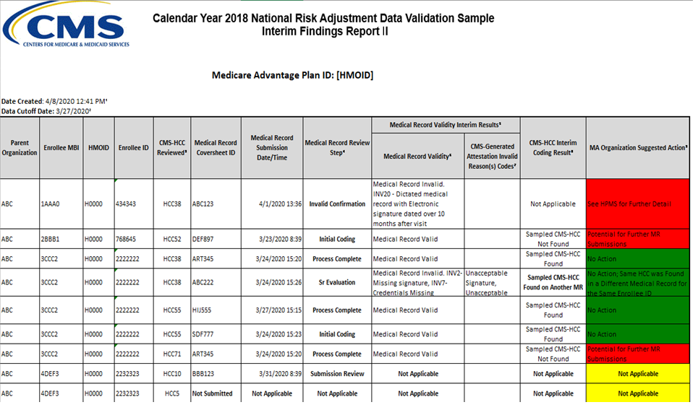
Interim Findings Reports - Structure
05/28/2020 National RADV Interim Findings Reports Training 8
* Fictitious Data

Slide 9
Interim Findings Reports - Structure
The IFR shows:
Parent Organization, Medicare Beneficiary Identifier (MBI), HMOID, and Enrollee ID
CMS-HCC Indicated for Review (2018 CMS-HCC Model (V22))
Coversheet ID and Submission Date/Time
Current Medical Record Review Step (Not Applicable, Submission Review, Senior Evaluation, Invalid Confirmation, Initial Coding and Process Complete)
Interim Medical Record Validity Status (including Medical Record invalid reasons and/or CMS-Generated Attestation invalid reasons, if applicable)
Interim Coding Results (where a sampled CMS-HCC has been found, not found, identified on another Medical Record for same enrollee process, or not applicable)
Suggested Action for your MA Organization
05/28/2020 National RADV Interim Findings Reports Training 9

Slide 10
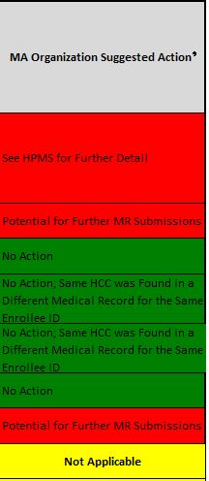
Interim Findings Reports - MA Organizations Suggested Actions
“MA Organization
Suggested Action” Options:
No Action
Potential for Further MR Submissions
No Action; Same HCC was Found in a Different Medical Record for the Same Enrollee ID
See HPMS for Further Detail
Not Applicable (for MRs which have not yet reached initial coding process step)
05/28/2020 National RADV Interim Findings Reports Training 10

Slide 11
Interim Findings Reports - Additional Notes
These reports do not show:
Any additional CMS-HCCs found on the medical record
Final validity results for medical records
National RADV Module – Submissions Tab in HPMS is the definitive source for validity/invalidity status
These reports do show:
Outcomes based on CMS-HCC hierarchies
If a higher manifestation CMS-HCC is found during the coding process, it will appear as “FOUND”
If a lower manifestation CMS-HCC is found during the coding process, it will appear as “NOT FOUND”
05/28/2020 National RADV Interim Findings Reports Training 11

Slide 12
CY18 National RADV Timeline
CY18 National RADV Timeline:
Due to recent concerns and issues related to COVID-19, CMS has decided to:
Extend the submission deadline - CMS has extended the CY18 National RADV medical record submission deadline by two-weeks to June 22, 2020
Reduce burden on providers - CMS has directed MA Organizations to cease communication with providers regarding Medicare Parts C and D audits
CMS is continuing to monitor the situation and will issue further guidance as new information becomes available.
NAT18 IFR 2 Submission Cut-Off Date | May 15, 2020
NAT18 IFR 2 Release Date | May 28, 2020
NAT18 Submission Window Closes | June 22, 2020 at 11:59 PM, PT
05/28/2020 National RADV Interim Findings Reports Training 12

Slide 13
Reminders
Next Steps:
Both IFRs will be available in the National RADV Module – Document Library – Interim Findings Reports in HPMS
If a sampled CMS-HCC was not found on the medical record or the medical record was invalid, CMS strongly encourages MA Organizations to submit another medical record before the final submission deadline on June 22, 2020, to validate the sampled CMS-HCC
Note: If the reason for invalidity is INV2 or INV7 and the medical record is physician/hospital outpatient, the medical record could be resubmitted with a CMS-Generated Attestation form
05/28/2020 National RADV Interim Findings Reports Training 13

Slide 14
Reminders
Safeguarding Protected Health Information (PHI) and Personally Identifiable Information (PII):
Please do not include PHI or PII
Examples: beneficiary names, health insurance claim numbers (HICNs), or Social Security Numbers (SSNs)
Do not send screenshots from the National RADV Module
You may communicate using the Beneficiary enrollee ID or the coversheet ID
Use of these unique identifiers is not a Health Insurance Portability and Accountability Act (HIPAA) violation and does not compromise beneficiary privacy
05/28/2020 National RADV Interim Findings Reports Training 14

Slide 15
Reminders
Submissions Deadline:
Deadline to submit all medical records for NAT18 RADV is 11:59 PM, PT on June 22, 2020
MA Organizations are encouraged not to wait until the last minute to submit medical records; allow enough time to account for any technical issues and CMS feedback and support
MA Organizations may submit and correct medical records to support the CMS-HCCs until the deadline
05/28/2020 National RADV Interim Findings Reports Training 15

Slide 16
Reminders
Submissions Deadline (continued):
CMS plans to provide Final Findings Reports after the Medicare Part C Error Rate has been published in the Department of Health and Human Services (HHS) Agency Financial Report
Final Findings Reports will provide final coding results regarding whether each sampled CMS-HCC was confirmed or not confirmed
Remember, it is important that you try to submit a medical record for each sampled CMS-HCC
Medical records must have dates of service within the data collection year (CY18)
05/28/2020 National RADV Interim Findings Reports Training 16

Slide 17
Reminders
Contact Information:
HPMS User Access Help
Password resets, status on your new account, HPMS login issues, access to the National RADV module
Call CMS Help Desk: 1-800-562-1963
Email: hpms_access@cms.hhs.gov
HPMS Help
For all other HPMS questions not related to user access email: hpms@cms.hhs.gov
National RADV inquiries
For National RADV questions email: nationalradv@cms.hhs.gov
Please do not email PHI or PII to any mailbox
05/28/2020 National RADV Interim Findings Reports Training 17

Slide 18
THANK YOU
05/28/2020 National RADV Interim Findings Reports Training 18

