Slide 1
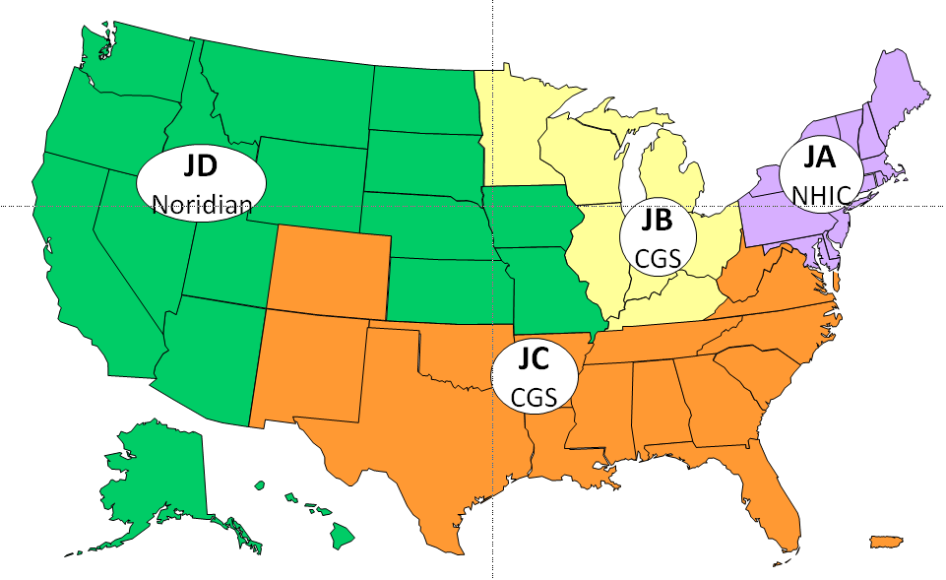
DME MAC Current Jurisdictions As of September 2015

