Slide 1
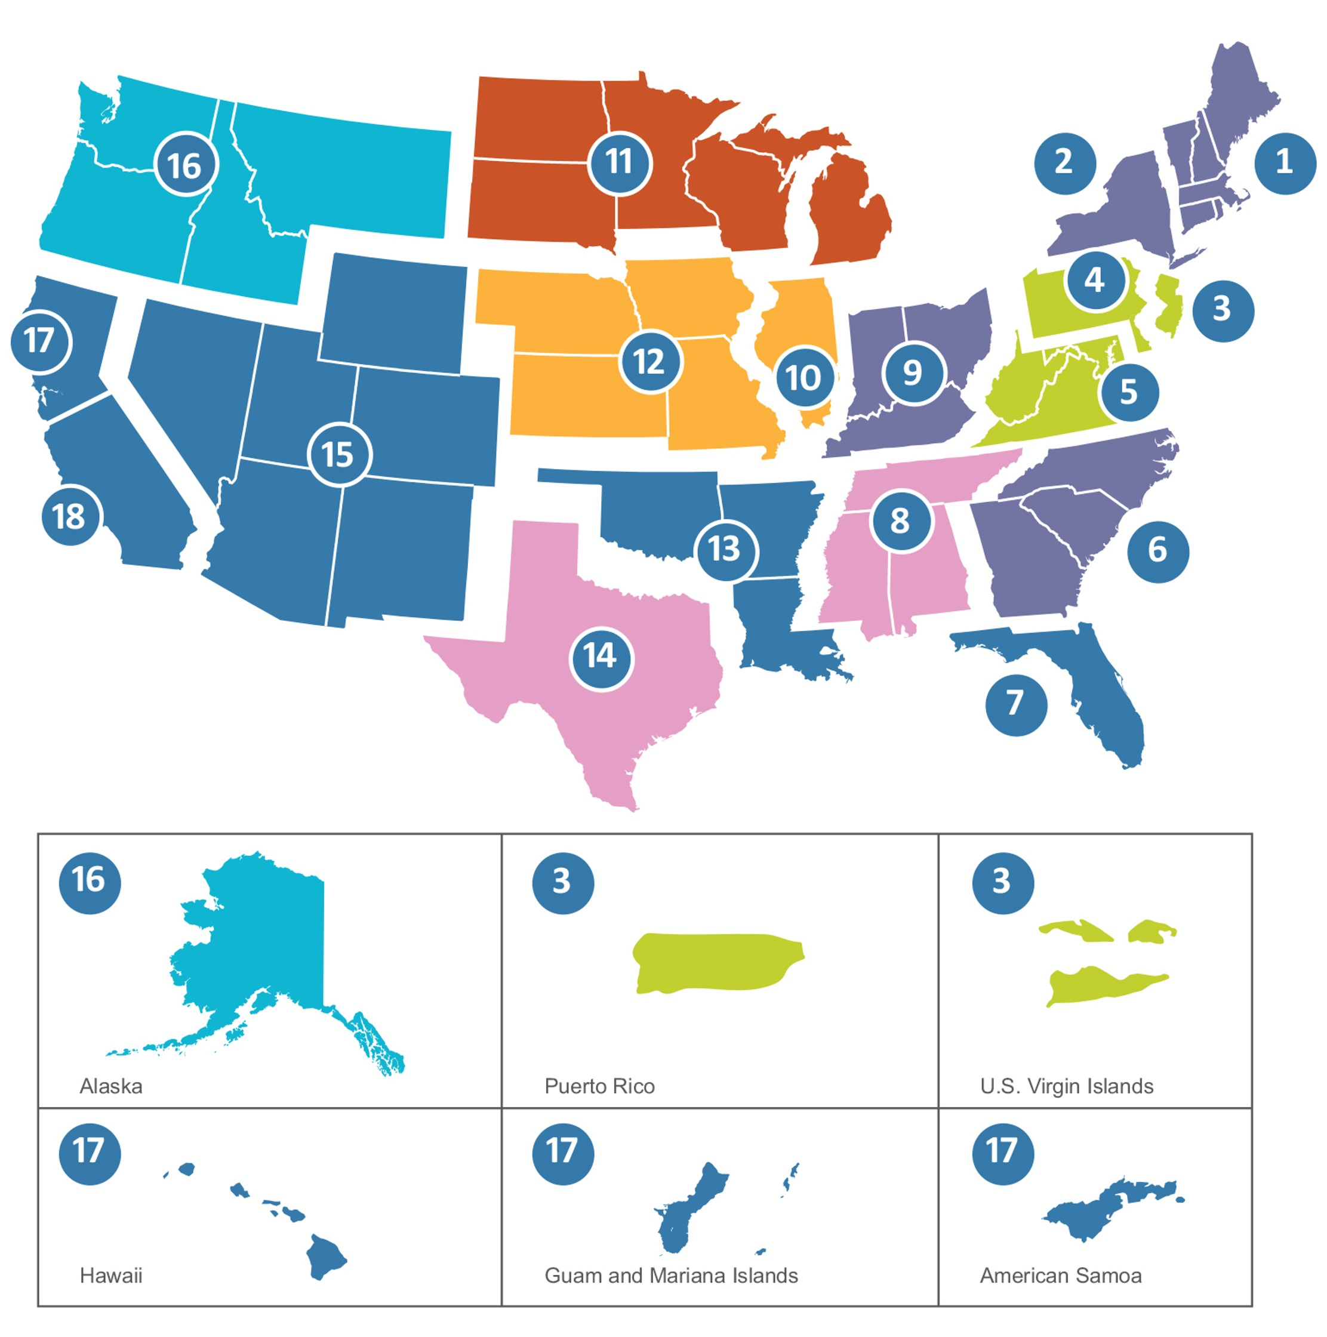






End Stage Renal Disease Network (ESRD) Program
Your ESRD Network Quality Improvement Leaders for Dialysis Facilities
Funded by Medicare under Section 1881 of the Social Security Act, the End Stage Renal Disease (ESRD) Network Program delivers vital support services designed to improve care quality, patient outcomes, and safety for individuals living with kidney failure. Through 18 ESRD Network contractors spanning the United States and its territories, the program functions as both a patient advocate and catalyst for transformation within the dialysis care community. These Networks pursue three key objectives that support the Advancing American Kidney Health (AAKH) Executive Order: preventing 25% of Americans from developing ESRD by 2030, ensuring 80% of newly diagnosed ESRD patients access home dialysis or transplantation by 2025, and expanding the kidney transplant supply twofold by 2030. The ESRD Networks employ multiple strategies —including patient outreach and education, quality enhancement programs for underperforming facilities, evidence-based data analysis, emergency response coordination, and specialized technical support —to drive improvements in patient care by promoting home-based dialysis options, facilitating successful transplants, minimizing hospital admissions, supporting patients' return to work, and guaranteeing that all patient populations receive access to superior kidney care services.
The ESRD Network
The ESRD Network Program operates through regional ESRD Network contractors across 18 designated network areas throughout the United States and its territories. Each Network contractor is responsible for serving all ESRD patients and facilities within their assigned geographic region. Each Network must also coordinate with State Survey Agencies, and other CMS quality improvement contractors operating in their geographic area to ensure comprehensive coverage without duplication of services.
KEY PROGRAM FEATURES
18 Regional Networks
Contractors across designated areas serving all ESRD patients and dialysis facilities nationwide
Quality Improvement Partnership Direct technical assistance and mentorship to low-performing dialysis facilities through community coalitions
Patient Care Navigation
Comprehensive support including education, grievance resolution, and home dialysis/ transplant promotion
KEY BENEFICIARY OUTCOMES
Increased Home Dialysis & Transplantation More patients starting home dialysis or receiving kidney transplants
Reduced Hospitalizations Fewer hospital admissions and emergency department visits
Improved Quality of Life Enhanced patient well-being, vocational rehabilitation, and whole health outcomes
Patient Centered
Evidence Based
Data Driven
Partnership Focused
Sustainable
For More Information
The five-year ESRD Network program remains active through DATE. Please visit ESRD WEBSITE to learn more about the ESRD Network and KHARES Program.

