Slide 1


CMS IT Governance Training
Governance Overview:
What is Governance? Why is it important?
Click the Slide Show image in bottom right bar to begin presentation.
Notes:
Welcome to CMS IT Governance Training, Governance Overview.
What is governance?
Why is it important?

Slide 2

Why does CMS have a governance process?
$2.9 Billion in IT Expenditures in FY 2021
It’s about the
Money
Notes:
CMS spends a great deal of money on IT and it’s taxpayer money. In fiscal year 2021 CMS spent approximately $2.9 billion on information technology.
Overall HHS's IT spend is third only to the DOD and DHS. So, a small percentage improvement in that number can make a big difference in our total expenditure.
We as federal employees are bound to make the most effective and efficient use of taxpayer money that we can.
This requires that we coordinate and plan these large expenditures, so we are not duplicating acquisitions and that we are moving together to modernize and improve our IT environment in accordance with our target system architecture.

Slide 3
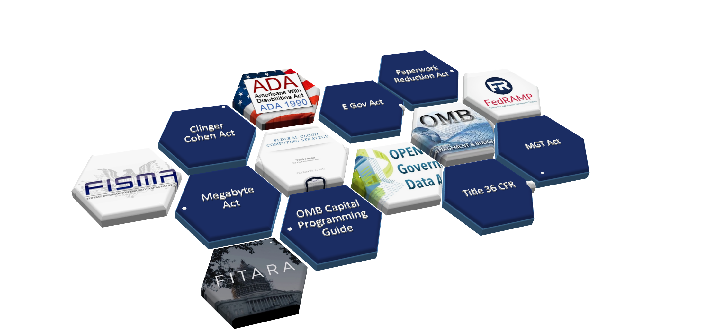
Some Governance Laws and Regulations
Notes:
Historically, federal government IT projects have not gone very well. Large government IT projects are notorious for failure and for cost overruns.
As a result, the response from the Government Accountability Office in Congress has been to impose greater and greater governance requirements on IT projects.
In one example, the GAO identified $1.1 billion in wasted spending on two major projects from 2011 to 2016 for electronic health records and health information systems.
A current health record modernization effort initiated in 2020 is budgeted for $10 billion dollars over 10 years. Effective governance can help ensure that this money is not wasted as well. In order to make the best use of our budget dollars, as well as remain in accordance with all of our governing oversight, we need to communicate about our business needs and plans up front so we can leverage areas of common need. Besides just keeping track of how much is being spent on specific projects, there are guidelines in place for project management, risk assessment, disaster recovery and other areas.

Slide 4
A Strategic Vision for IT
We want our decisions to reflect CMS long-term capital planning goals, and our vision for the future technical portfolio and architecture.
How do we want CMS’ IT Portfolio to evolve?
What technical postures would we like to see adopted?
What acquisition strategies should we pursue?
Notes:
Governance is the means by which CMS supports the planning for various IT initiatives around the agency in order to follow the legislation and guidance that is set by the federal government and by Health and Human Services, and to help project teams be successful
CMS has technical expertise in place to plan where we want to be in the future, what we want our technical platform to look like and what technical tools we want in our portfolio.
There is no magic in transitioning to new platforms. It can be a disruptive process and can take a long time. But if we use our forecasting capabilities and apply them to projects when they are in the planning stages we can build in some of these capabilities so that the disruption is minimized.
However, we can't do that unless we make the connections between the teams planning the project, and the teams that are designing our strategic future for CMS, very early in the process.

Slide 5
You don’t have to re-invent the wheel
Existing CMS expertise
Existing Enterprise Licenses
Enterprise infrastructure
Our problem in the past has been finding out about these resources.
Notes:
CMS has IT resources in place that can be easily reused. But often, components planning a project are unaware of the resources that we already have, or are not familiar with updated capabilities.
The CMS specialists who work with these resources every day have a much better knowledge of what the marketplace can offer.
And we have a lot of great in-house technical resources at CMS. Frequently they are overlooked in favor of the technical expertise that is already in the component's office and that is all too often the contractors. We have many great partnerships with contractors, but ultimately, they are not pledged to the federal government, the way federal employees are and aren’t always aware of all of the available resources

Slide 6
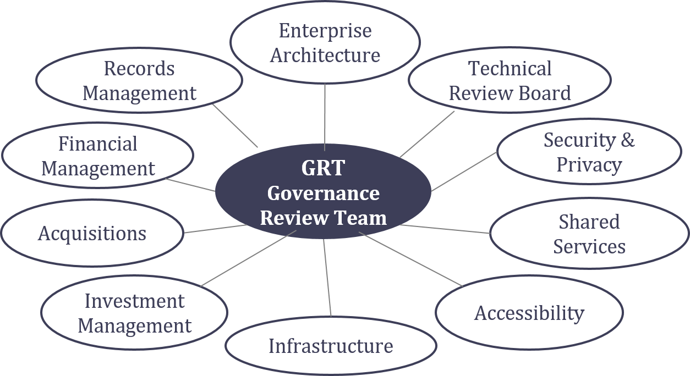
We want to leverage CMS resources
Components of the Governance Review Team (GRT)
Component representatives who have expertise in particular technical solutions may join the GRT as needed.
Notes:
In order to leverage our in-house technical resources, our Target Life Cycle Governance process relies on the Governance Review Team, or GRT, to review projects in the planning process.
The GRT helps project teams explore potential solutions, both in-house and those that will need to be acquired in the markets.
Working with the GRT is a collaborative process. It can provide the project team with alternatives and direction they may not have considered before, or point them toward a solution that is already in-house and may take less time to implement, and cost less.
The GRT will also assist and ensure that the project team is performing their due diligence in researching potential solutions and concepts which is a key part of acquisition planning and part of the governance process.

Slide 7
Why is Governance important?
It’s part of our jobs as Federal Employees to make the best use of taxpayer money that we can.
Governance focuses on helping IT teams achieve their intended outcomes, while simultaneously reducing risk, ensuring technical acceptability, and promoting fiduciary responsibility.
It’s part of our jobs as Federal Employees to make the best use of taxpayer money that we can.
So why not make use of the resources that we already have here at CMS to help follow this guidance?
Notes:
Congress isn't going out of its way to make new laws and regulations without reason.
Many of them were developed in response to IT projects that did not turn out the way they were intended, cost much more than originally expected, or did not turn out at all and were scrapped without the public seeing any benefit from the tax dollars that were spent on them.
We may consider some of the laws and regulations as onerous, but they are still in place to govern the way we spend our IT dollars and to increase our chances of developing an IT system successfully.
CMS’ IT spending is governed by legislation and regulation.
As a federal employee, you are responsible for following these rules and laws.
As a guardian of taxpayer dollars, you are responsible for spending them wisely.
You have many resources available to help you plan your IT projects.
One of the roles of the TLC is to make the connection between you and these technical resources.

Slide 8
Contact Us
For questions about Governance or more information contact IT_Governance@cms.hhs.gov or visit https://www.cms.gov/TLC
Notes:
If you have questions about the CMS governance process, the Target Life Cycle, how to start planning a project, or how to make changes to a project that is already in operation, feel free to reach out to us at IT_governance@cms.hhs.gov. Or visit our website at www.cms.gov/TLC.

