Slide 1
CMS IT Governance Process: Intro to the Target Lifecycle
INFORMATION NOT RELEASABLE TO THE PUBLIC UNLESS AUTHORIZED BY LAW: This information has not been publicly disclosed and may be privileged and confidential. It is for internal government use only and must not be disseminated, distributed, or copied to persons not authorized to receive the information. Unauthorized disclosure may result in prosecution to the full extent of the law.

Slide 2
Target Life Cycle Governance Process
What this course covers:
Section I: What is the TLC?
Section II: Who is the TLC?
Section III: A brief overview of the Four TLC phases

Slide 3
TLC Overview – Section I
Section I
What is the TLC?

Slide 4
Governance Framework
A framework that:
Project Team Responsibility
Promotes business flexibility
Applies situational governance reviews instead of gate reviews
Provides minimal disruption to the system development process
Requires self governance by Project Teams
Notes:
We want to leverage the Systems Development Lifecycle and Project Management methodologies that you are already using, not impose new ones.

Slide 5
Target Life Cycle (TLC)
Planning Your Project
Governance through Enablement
We’ve moved most of the external
oversight up front
You must develop your ideas and direction prior to Acquisition Planning
We’ve developed a team of IT SMEs to act as your consultants for IT planning
Ensures due diligence and sound IT Planning
Notes:
We want to leverage the Systems Development Lifecycle and Project Management methodologies that you are already using, not impose new ones.

Slide 6
Team Responsibility
Methodology Based
There are an almost overwhelming number of governance laws and guidelines with which project teams must comply. Some areas in CMS have dedicated groups to ensure compliance with their particular scope, such as:
Security
Accessibility
For other areas, project teams should follow processes in their specific methodology to fulfill the IT governance requirements

Slide 7
Potential for Audit
Many paths to success
Artifacts and documentation to support the design and development of the system must be available for Audit purposes, preferably on CMS infrastructure, so Project Teams must maintain and track it
Interfacing with other systems, either within or outside of CMS, will require documentation acceptable to both parties
Developing a comprehensive set of templates for CMS’ previous governance framework are perfectly acceptable to use for the TLC
Those optional templates are available on the TLC website, CMS.gov/TLC

Slide 8
Proactive Governance
Proactive governance is the key!
We cannot do this without business and
system owner cooperation
Eliminating formal periodic reviews does not remove the need for the supporting work needed
Every Systems Development Life Cycle (SDLC) has its own process of planning and documenting systems development
Project Managers are now responsible for adherence to the standards of their chosen Project Management Methodology and SDLC that support governance goals

Slide 9
TLC Overview – Section II
Section II
Who is the TLC?

Slide 10
GRT Purpose & Goals
The Governance Review Team
Governance
Review Team
Advises Project Teams:
How to proceed through the IT Governance process
What resources are available to help
How to properly develop and document their Business Case and Alternatives Analysis
How to adhere to required governance oversight
The Project Team is responsible for documenting the proposed solutions in their Business Case, for presentation to the Governance Review Board (GRB)

Slide 11
Governance Review Team (GRT)
Enterprise Architecture
Records Management
Technical Review Board
Governance
Review Team
Component representatives who have expertise in particular technical solutions may join the GRT as needed
Financial Management
Security & Privacy
GRT Governance Review Team
Acquisitions
Shared Services
Investment Management
Accessibility
Infrastructure

Slide 12
GRT Purpose & Goals (cont’d.)
The GRT:
Governance
Review Team
Reviews the business case and alternatives
analysis to ensure the application/ functionality is:
Not duplicative of another effort
Fills a need that's not addressed
Aligns with the CMS IT Portfolio goals
Discusses alternative approaches for implementation (if any) of the desired system functionality or new application
Makes recommendations to the Governance Review Board (GRB)

Slide 13
Governance Review Board (GRB)
The Project Team will present the Business
Case and Alternatives Analysis to the Governance
Review Board (GRB)
This should be a high level presentation of the Business Case and Alternatives, presented by the Business Owner or Manager
The GRB may ask technical questions, so there should be technical staff available at the presentation as well
Governance
Review Team
The GRB does not approve funding for a project, but is a prerequisite for requesting funding.

Slide 14
GRB Membership
Co-Chairs, Office Director or Designee | COMPONENT
CMS Chief Information Officer (CIO) | OIT
CMS Chief Financial Officer (CFO) | OFM
CMS Head of Contracting Activity (HCA) | OAGM
CMS Chief Technology Officer (CTO) | OIT
Governance
Review Board
Voting Members, Group Level or Above | COMPONENT
ACA 3021 Rep | CMMI
Exchanges Rep | CCIIO
Program Operations BDG Chair | OIT
Program Operations BDG Chair | OC
Medicaid / CHIP Rep | CMCS
Fed Admin BDG Chair | OIT/IUSG
Program Integrity BDG Chair | CPI
Program Operations BDG Chair | CMM
QIO Rep | CCSQ

Slide 15
Life Cycle ID (LCID)
Governance
Process
If the GRB approves a project, it will be
issued a Life Cycle ID (LCID)
The LCID signifies that the project/investment was both reviewed and approved by the GRB
If projects do not have a valid IT Life Cycle ID:
OFM will not allocate funding to the project
OAGM will not process contract actions

Slide 16
Project Team
The Project or Program Team:
Is led by CMS employee(s) as Project Sponsor/ Business Owner/Manager
Must have an ISSO (Information Systems Security Officer)
Will be responsible for developing and maintaining systems documentation that satisfies governance requirements
Is encouraged to maintain the documentation on CMS infrastructure so that it is not lost when contractors change
Project Team

Slide 17
TLC Phases - Section III
Section III
A brief overview of the Four TLC Phases

Slide 18
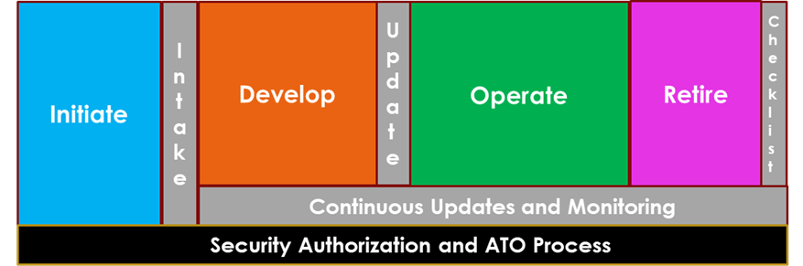
TLC Phase Summary
CMS Target Life Cycle
Phase Summary
Notes:
This illustrates the four phases of all SDLC’s. Note the Security and Authorization bar, which is continuous from project inception to end.

Slide 19
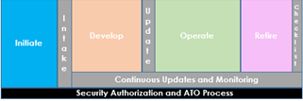
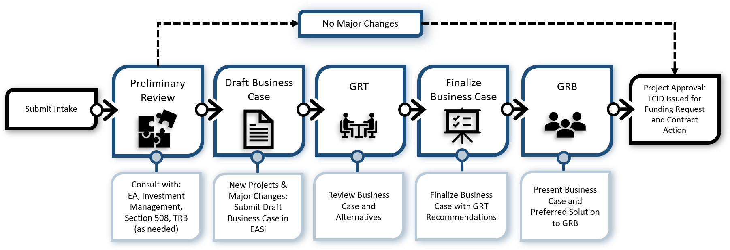
TLC Initiate Phase Process Flow

Slide 20
TLC Initiate Phase – How do I start?
To begin, complete the IT Intake Form located on the CMS IT Governance SharePoint site
The Intake Form will ask:
If your request is for a new system or service, changes/upgrades to an existing system, or a contract re-compete
Your business need and how you are thinking of solving it
Cost changes,
Funding number & source, and
Contract information

Slide 21
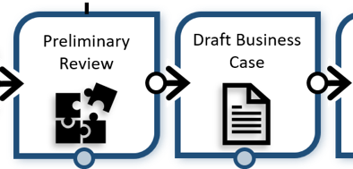
TLC Initiate Phase – What’s Next?
Based on the information provided, and an established set of triggers, such as cost and complexity, we will review and determine next steps.
For existing projects that do not reach trigger thresholds, the Governance Team will issue a LCID with recommendations. No further approval required.
For new or existing projects with costs and/or complexity that exceed established thresholds, the project will continue through the full governance review process. The CMS Governance Review Board (GRB) must approve the project before the Governance team can issue an LCID.

Slide 22
Business Case
General Project Information
Business Need and Justification
Alternatives Analysis
Include an outline/description of each alternative.
Each option should document the unique advantages, disadvantages, and risks for that specific option.
Each alternative should include a five-year cost estimate for development and operations
Governance Review Team Recommendations
*Creation of the Business Case and Alternatives Analysis is inherently governmental work. Contractors may provide assistance in supplying content for the Business Case, but a Federal Employee must write it.

Slide 23
Acquisition Planning
IT Governance must sign off on IT Acquisition Plans (APs).
The IT Governance team will verify that your project has a valid LCID before signing your AP.
If you have a valid LCID, a member of the IT Governance team will sign and return your AP within 1-2 business days.
If your AP does not include a valid LCID, we will reach out to you to submit an Intake Form to begin the IT Governance process.

Slide 24
Initiate Phase Summary
Key Objectives
Clarify business needs
Incorporate GRT input on alternatives
Present Business Case to GRB
Exit Criteria
The Business Case and Alternatives Analysis gets documented
An approved solution gets selected by the Project Team
A Life Cycle ID gets issued
AP signed by IT Governance

Slide 25
Develop Phase
When the Project Team has executed a contract action for development, the Develop Phase begins
The Project Team defines the chosen project/product management methodology and Systems Development Lifecycle Methodology in their contract and planning documentation
The Project Team creates the detailed user stories or requirements, designs and develops the solution, deploys it to a non-production environment, and tests it for compliance with technical and other Federal IT standards and requirements

Slide 26
Develop Phase Summary
Key Objectives
Satisfy information security, privacy, and Section 508 requirements
Exit Criteria
Obtain an Authorization to Operate (ATO)
Successful Testing

Slide 27
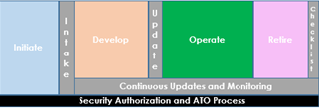
Operate Phase
Once deployed into Production, the Project Team is responsible for maintaining the availability and reliability of the system by ensuring that routine maintenance gets performed and sound security practices get followed
Most projects will be in Development and Operate phases at the same time for most of their life
Any necessary changes or development that are major may require the project to go back to the Initiate Phase to get approval for the additional scope

Slide 28
Operate Phase Summary
Key Objectives
Maintain solution availability and performance
Exit Criteria
Decommission Decision

Slide 29
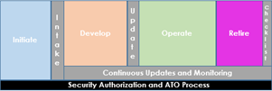
Retire Phase
The Project Team creates and executes a decommissioning plan that complies with Federal guidelines for data disposition, hardware disposition, and any other considerations necessary based on the individual system,
Ensure consultation with Records Management (OSORA)
Other GRT resources are available for consultation on the planning and execution of the plan
The Project Manager attests to the completion of the disposition plan when operations cease

Slide 30
Retire Phase Summary
Key Objectives
Properly retain or dispose of any system materials according to the appropriate retention schedule, including but not limited to: System data, software, hardware, and any other necessary system requirements & configurations
Close out all related contractual actions and agreements
Exit Criteria
Project Manager attestation to the completion of the decommissioning checklist
The Project Manager/Business Owner sends the attestation to the Governance Team

Slide 31
Additional TLC Resources
Governance Review Team
IT_Governance@cms.hhs.gov
Technical Review Board
CMS-TRB@cms.hhs.gov
TLC Website
IT Governance - https://www.cms.gov/TLC
Enterprise Architecture
EnterpriseArchitecture@cms.hhs.gov
Navigator
NavigatorInquiries@cms.hhs.gov

Slide 32
Questions
?
For questions about Governance or more information contact via Mail – IT_Governance@cms.hhs.gov or visit IT Governance - https://www.cms.gov/TLC

