Slide 1
Medicare Part A Cost Report e-Filing Updates
Wednesday, April 22, 2026
Presenters:
Owen Osaghae, CMS
Jolene Nguyen, CGI Federal

Slide 2
Acronyms in this Presentation
BSO - Backup Security Official
CCN - CMS Certification Number
CMHC - Community Mental Health Center
ECR - Electronic Cost Report
ESRD - End Stage Renal Disease
EUS - External User Services
FQHC - Federally Qualified Health Center
FTE - Full Time Equivalent
FYB - Fiscal Year Begin
FYE - Fiscal Year End
GME - Graduate Medical Education
HHA - Home Health Agency
Histolab - Histocompatibility Laboratory
HO - Home Office
IDM - Identity Management system
IME - Indirect Medical Education
IPPS - Inpatient Prospective Payment System
IRIS - Intern and Resident Information System
IRR - Interim Rate Review
LPIC - Limited Purpose Insurance Company
MAC - Medicare Administrative Contractor
MCR - Medicare Cost Report
MCReF - Medicare Cost Report e-Filing system
MFA - Multi-Factor Authentication
NPR- Notice of Program Reimbursement
OPA - Organ Procurement Agency
PHI - Protected Health Information
PII - Personally Identifiable Information
PS&R - Provider Statistical and Reimbursement System
RHC - Rural Health Clinic
SNF - Skilled Nursing Facility
SO - Security Official
STAR - System for Tracking Audit and Reimbursement
TS - Tentative Settlement

Slide 3
Clarification of Terms
When we say “Provider”, we mean Medicare Part A Providers and Home Offices
When we say “Cost Report”, we mean Medicare Part A Cost Reports and Home Office Cost Statements

Slide 4
Agenda
Introductions
Background and Overview
Discuss Updates and Latest Features in MCReF
e-Filing Refresher
Q&A

Slide 5
Business Overview
The Medicare Cost Report (MCR) is used to determine Part A providers’ annual Medicare reimbursable cost.
Providers use a variety of sources (including Provider Statistical and Reimbursement system (PS&R) claim reimbursement data) to create their MCR.
  There are about 57,000 MCRs submitted each year that account for over $250 Billion of Medicare reimbursement.
Regulation specifies deadline for submitting an acceptable cost report
Medicare Administrative Contractors (MACs) have requirements for receiving, accepting, reviewing, auditing, and finalizing cost reports.

Slide 6
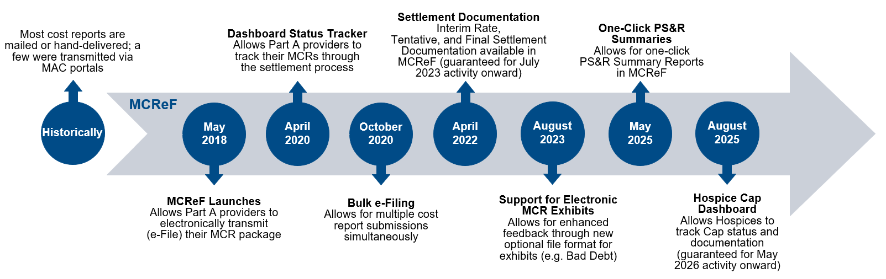
History of Cost Report Submission and Receipt Process

Slide 7
MCReF Usage
  Since 5/1/2018:
    Over 232,000 successful submissions from over 12,000 distinct users
    Median Submission Time: 4.5 seconds
    Over 3,500 providers were able to correct errors with their MCR prior to submission and without the need for correspondence with their MAC, and potentially avoiding the rejection of their MCR
    Tentative Settlement payments issued faster on average for MCReF submissions versus non-MCReF submissions
  CY2025: 76% of all MCR submissions were e-Filed via MCReF
  A few quotes received from MCReF users:
    “In the 25 years I have been doing cost reporting, never have we gotten tentatives this early or have we filed this early, so we know it is all because of MCReF.”
    “I am loving the cost report submission season! MCReF is awesome!”
    “This is a great, centrally located tool for cost report filing statuses, especially when you have multiple facilities and multiple fiscal years.”
    “Finally started using it this year, and kicking myself for not doing it sooner!”
    “…I have been involved in cost reporting since 1983. This is the best initiative that I have seen from CMS to help providers and be more efficient.”

Slide 8
CMS Goal
Enhance the Medicare provider experience
  Continuously improve the cost report filing experience
  Increase transparency to providers through cost report tracking

Slide 9
Advantages of MCReF for Providers
One process for all providers via one submission portal
  Available to all Part A providers regardless of MAC
  Beneficial to chain organizations which have providers at multiple MACs, and any time you change MACs
  Reduces confusion, delays, and time you spend on administrative processes
Direct feedback on the receivability of your MCR submission, and potential for instant acceptance
Tentative Settlement payments issued faster on average for MCReF submissions
Live updates on cost report status from submission through desk review and final settlement, including access to Interim Rate, Tentative, and Final Settlement documentation for activity since July 2023

Slide 10
MCReF – High Level System Changes
One-Click PS&R Summaries: Ready-made PS&R Summary Reports for instant download on the MCReF home page
Hospice Cap Dashboard: Dashboard for tracking Hospice Cap status, detailed view of Cap review dates, and access to Documentation for Cap Determinations

Slide 11
One-Click PS&R Summary Report Download

Slide 12
One-Click PS&R Summary Report Download
PS&R Summary Reports tailored for cost report creation are directly accessible via a one-click download within the Medicare Cost Report e-Filing system (MCReF)
The goal of this is to make acquiring PS&R Summary Reports:
  Easier (one-click, rather than current multi-screen flow for custom requests)
  Faster (immediate download, no queue/inbox)
  Vendor-ready (format and dates coordinated with cost report vendors for plug’n’play simplicity)

Slide 13
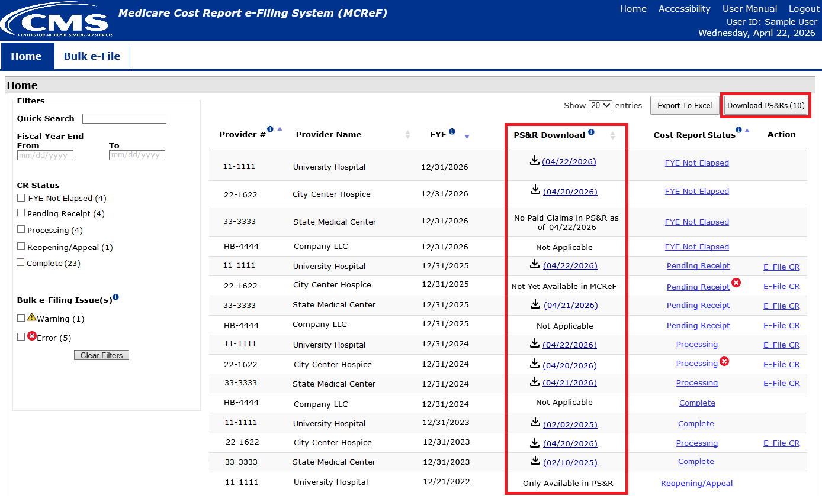
MCReF Home Page

Slide 14
What the One-Click Summaries Contain
All available PS&R Report Types for the provider and any subunits or consolidated FQHCs/RHCs the MAC is currently aware of
  Report package also includes the PS&R 1000 Consolidated Summary report, the 399 Home Health PPS-Part A and Part B Episodes, and supplemental sections as applicable (i.e. 110 DRG Section, 329/339 Patient CBSA Visit Section)
Service Periods
  Encompass 1 full cost reporting period
  Service-period “splits” applied as follows:
    IPPS Hospitals receive a split on 10/1
    The following provider types receive a split on 1/1:
      Cancer Hospitals
      Teaching Facilities
      Based Psych and Rehab units attached to a Teaching Hospital
      Based Swing-Bed SNFs and RHCs
    RHCs receive an additional one-time split on 4/1/2021
All Paid Dates available as of report generation
CSV and PDF format
Note: Before using One-Click Summaries, you should confirm that these defaults meet your particular filing needs

Slide 15
Service Period Date “Splits” Example
For example, assuming a Teaching Hospital with based Psych, RHC, and HHA subunits, and a Cost Reporting Period of 7/1/2024-6/30/2025, the default service periods would be as follows:
Provider | “Splits” on… | Service Period 1 | Service Period 2 | Service Period 3 | Service Period 4
Teaching IPPS Hospital | 10/1 (IPPS) 1/1 (Teaching) | 7/1/2024 – 9/30/2024 | 10/1/2024 – 12/31/2024 | 1/1/2025 – 6/30/2025
Based Psych | 1/1 (Based Psych to a Teaching facility) | 7/1/2024 – 12/31/2024 | 1/1/2025 – 6/30/2025
Based RHC | 1/1 (RHC) | 7/1/2024 – 12/31/2024 | 1/1/2025 – 6/30/2025
Based HHA | None | 7/1/2024 – 6/30/2025

Slide 16
Supported FYEs and Data Refresh Frequency
Functionality provides fresh default PS&R Summary reports for cost reporting periods which meet all 3 of the following criteria:
  FYB is in the past
  FYE is no more than 3 years old
  FYE is not Finalized (e.g. NPR not issued)
Supported FYEs have fresh reports reflecting any changes to the PS&R data made available on a rolling basis:
For FYEs that have aged out (i.e. older than 3 years) or have been Finalized, the reports will cease being updated and MCReF will retain the last copy
For any reports not made available per the guidelines above (including Detail and Miscellaneous), users would continue to request those manually in the PS&R system
For FYEs that are…. | Targeting fresh reports within… | Currently averaging fresh reports…
Not elapsed | 2 months | every 3-4 days
Elapsed, but no accepted cost report | 1 week | daily
Accepted cost report, but not Finalized | 1 month | daily

Slide 17
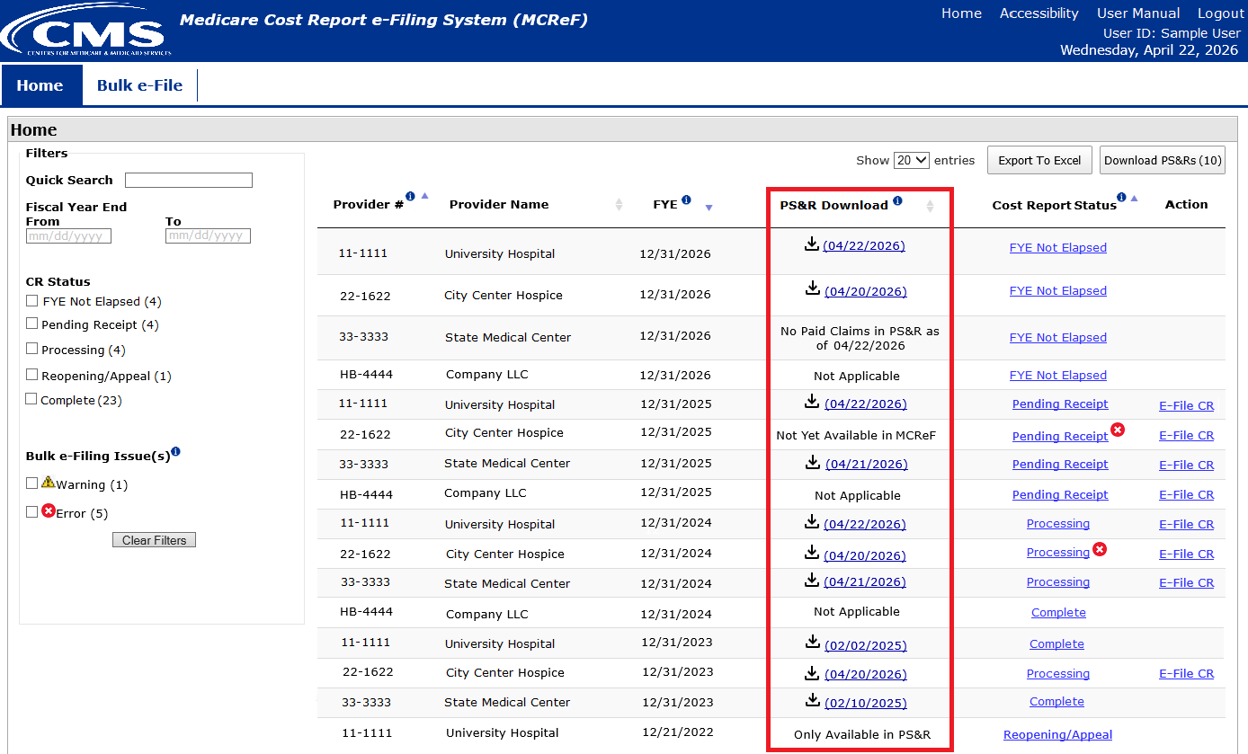
MCReF Home Page

Slide 18
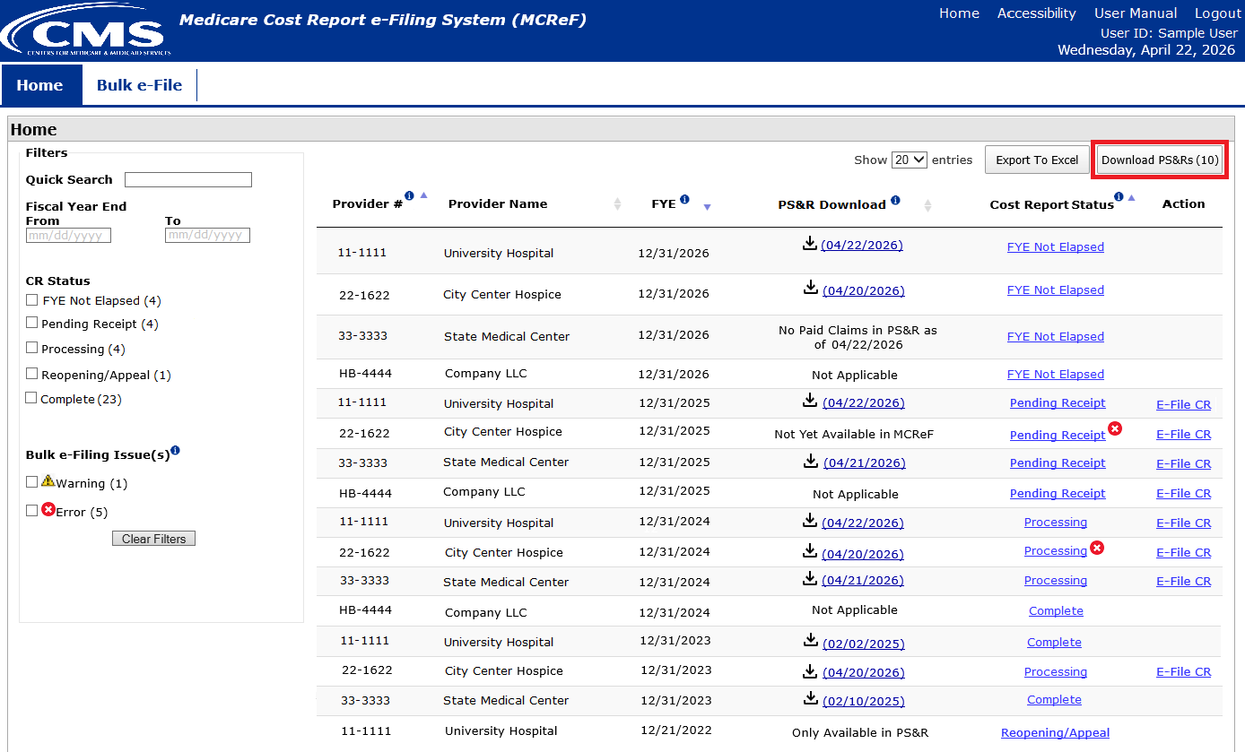
MCReF Home Page

Slide 19
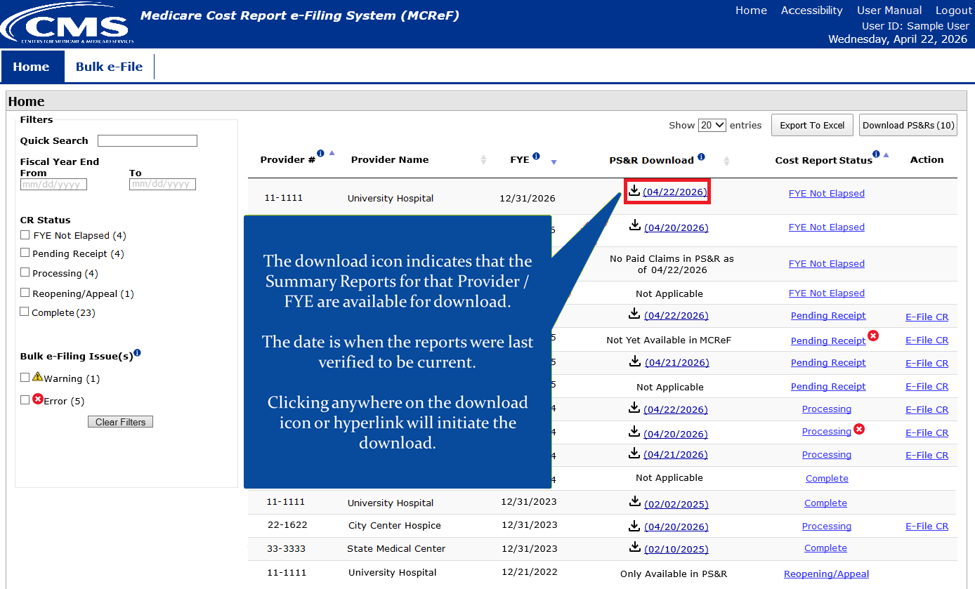
MCReF Home Page

Slide 20
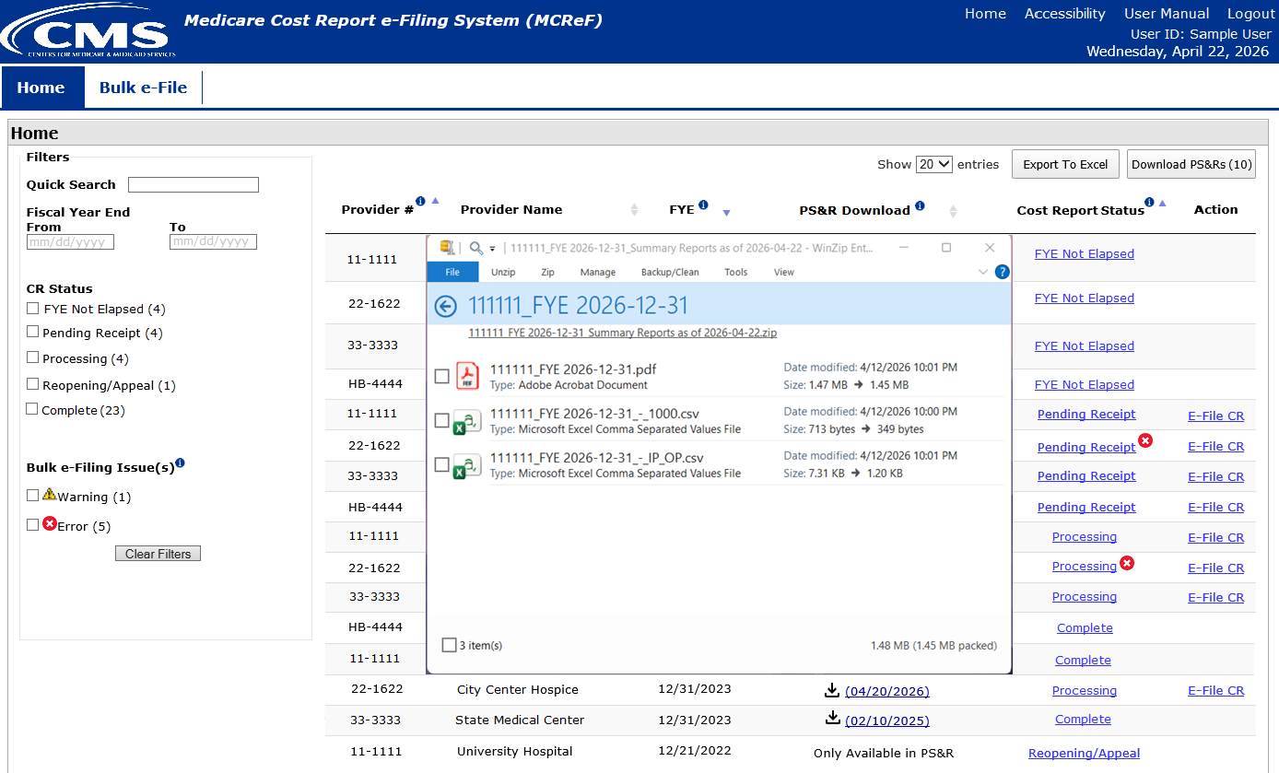
MCReF Home Page

Slide 21
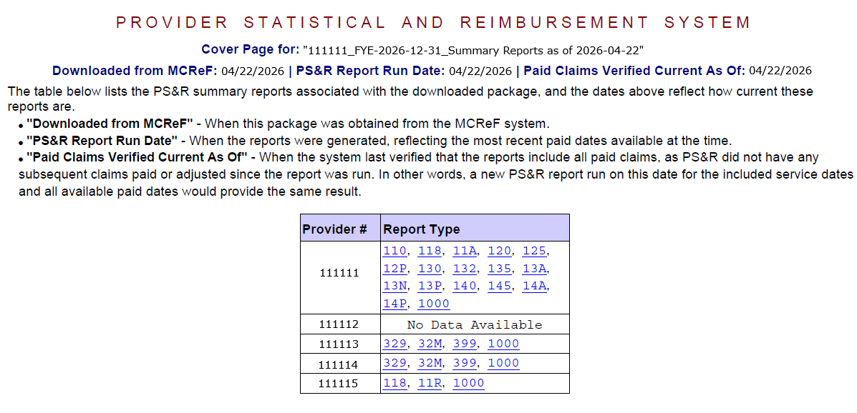
PS&R Report Cover Page

Slide 22
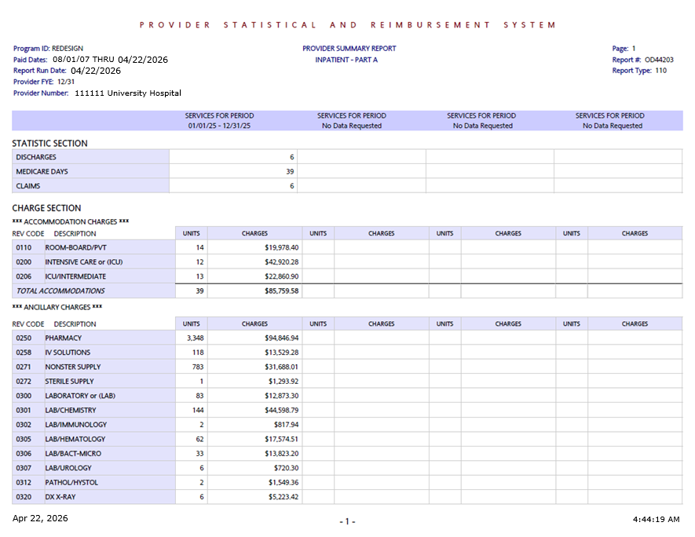
PS&R Report

Slide 23
Paid Claims Verified Current As Of
The system regularly checks One-Click PS&R Summary reports to confirm they are still up-to-date with new claims and any relevant changes to providers, and reflects the most recent day the system confirmed the report was still current as the "Paid Claims Verified Current As Of"
Bottom-line: The Paid Claims Verified Current As Of always means that the report provided is as current as a PS&R report run on that date.
Downloaded from MCReF Date (Today) | PS&R Report Run Date | Paid Claims Verified Current As Of Date | What does this mean?
4/22/2026 | 4/21/2026 | 4/21/2026 | Run yesterday, as good as a manual PS&R run yesterday
4/22/2026 | 1/28/2026 | 4/22/2026 | Run 3 months ago, as good as a manual PS&R run today
4/22/2026 | 2/25/2026 | 4/8/2026 | Run 2 months ago, as good as a manual PS&R run 2 weeks ago

Slide 24
Cost Report Instructions
As of March 16, 2026, the CMS Division of Cost Reporting has updated all cost report forms to use the “Paid Claims Verified Current As Of” date, if present, from the PS&R Reports used to prepare the MCR
Excerpt of update to the Hospital 2552-10:
  “Was the cost report prepared using the PS&R data only? If line 16, either col. 1 or 3 is “Y”, in columns 2 and 4, enter the "Paid Claims Verified Current As Of" date from the PS&R used to prepare this cost report, if present; otherwise enter the “Paid Dates” from the PS&R used (mm/dd/yyyy). (see instructions)”

Slide 25
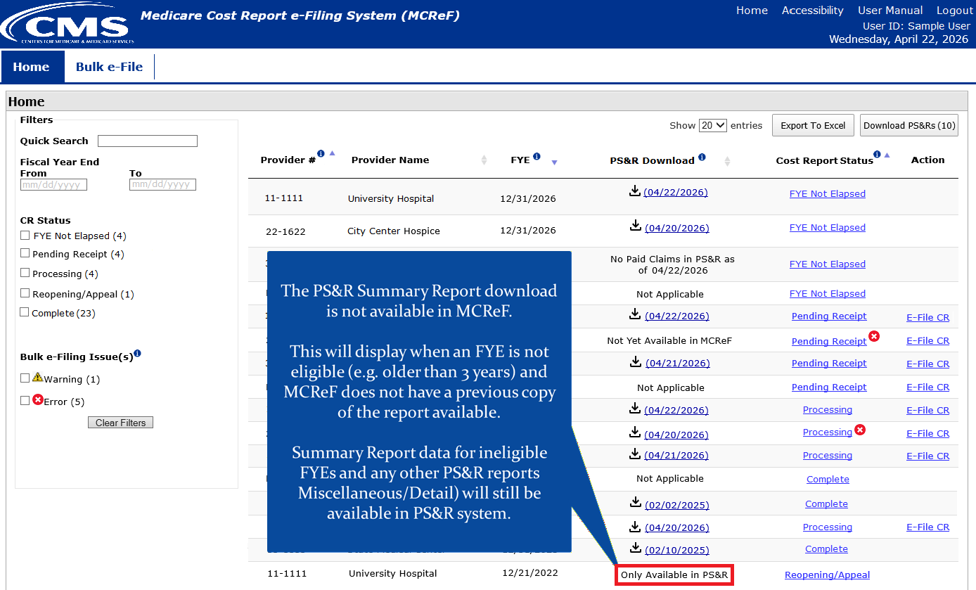
MCReF Home Page

Slide 26
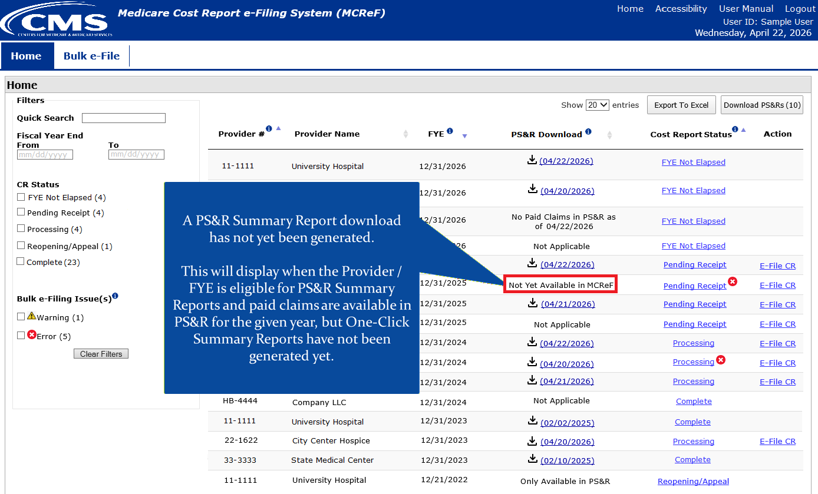
MCReF Home Page

Slide 27
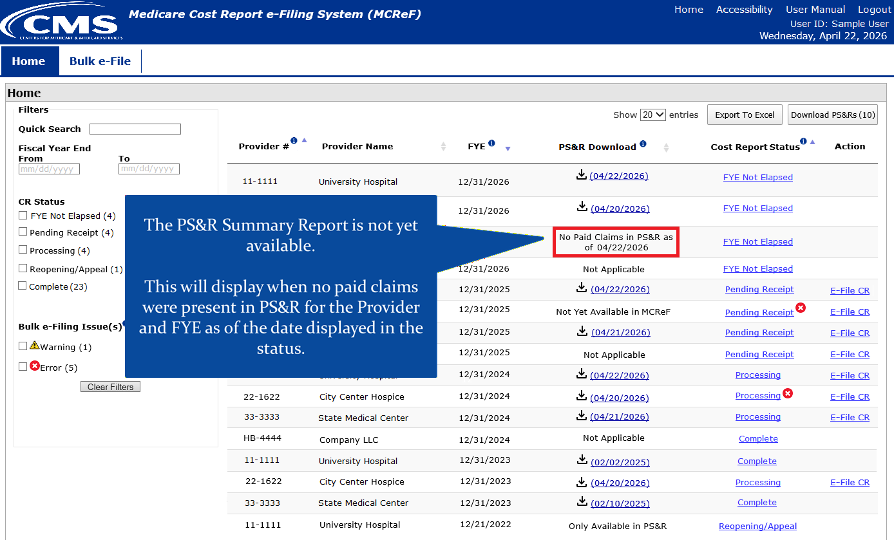
MCReF Home Page

Slide 28
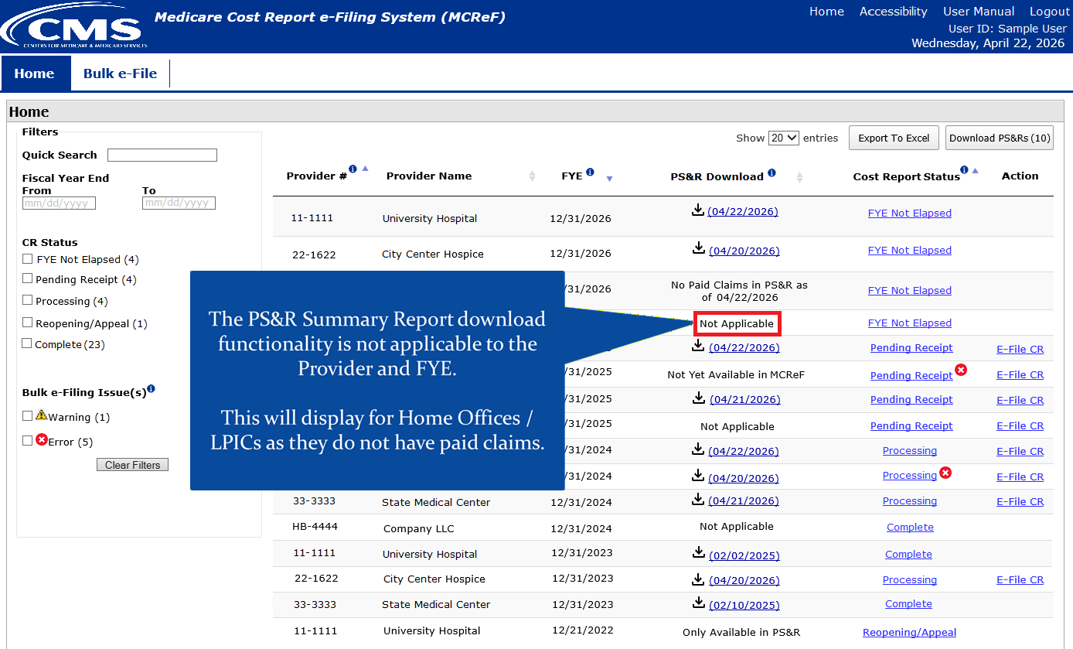
MCReF Home Page

Slide 29
One-Click PS&R Summary Report Download
Available now!
Easy, fast, fresh, and ready for your cost report

Slide 30
Hospice Cap Dashboard

Slide 31
Hospice Cap Dashboard
Goal: Expand MCReF functionality for users with access to Hospice Providers
The Hospice Cap dashboard allow Hospice Providers to track Hospice Cap status, have a detailed view of Cap review dates, and access/download documentation for Hospice Cap Determinations.

Slide 32
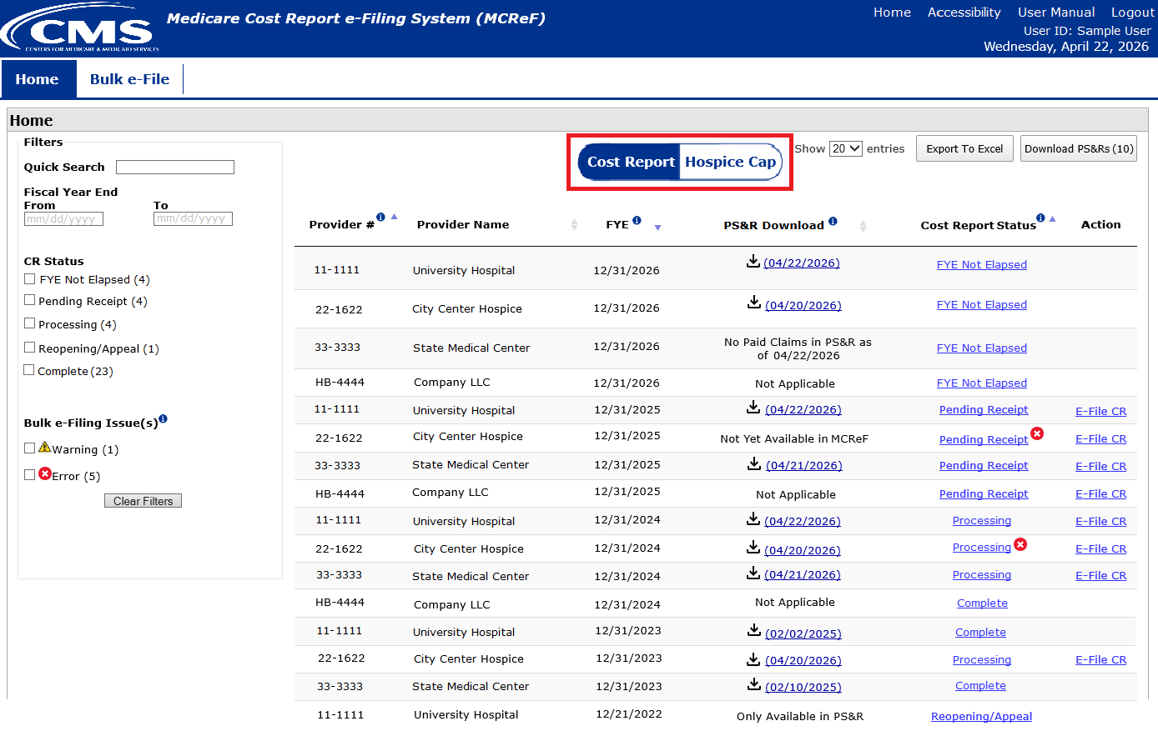
MCReF Home Page

Slide 33
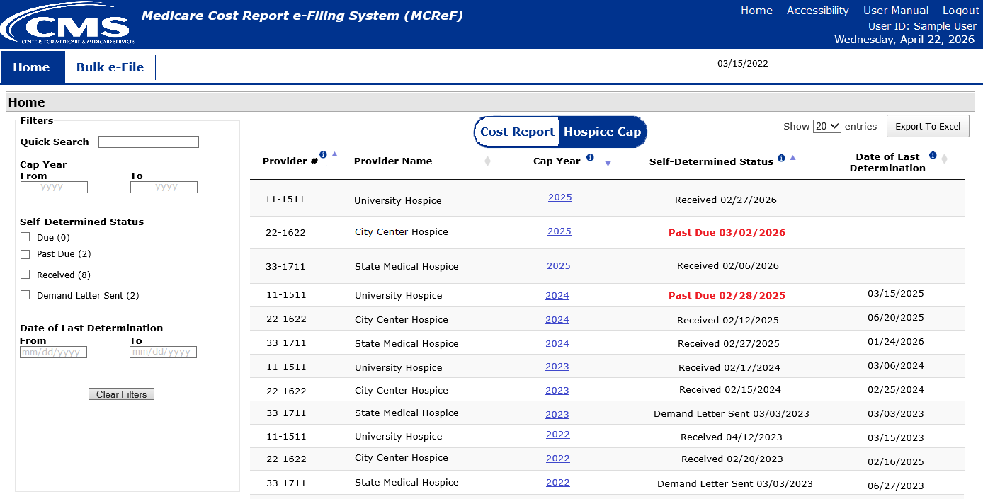
Hospice Cap Dashboard

Slide 34
Hospice Cap Dashboard
*Note: If you are unable to locate your Provider # or Cap Year:
  Confirm that the SO of your organization has properly registered the Provider # (CCN) in question within IDM and that you are registered to the organization with an IDM role which grants access to MCReF.
  If so, and you still don’t see what you’re looking for, contact your MAC.

Slide 35
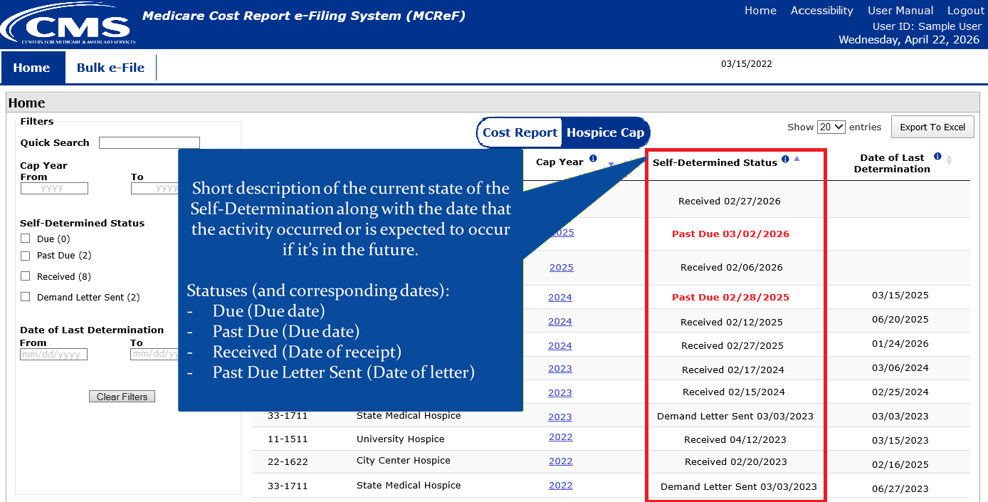
Hospice Cap Dashboard

Slide 36
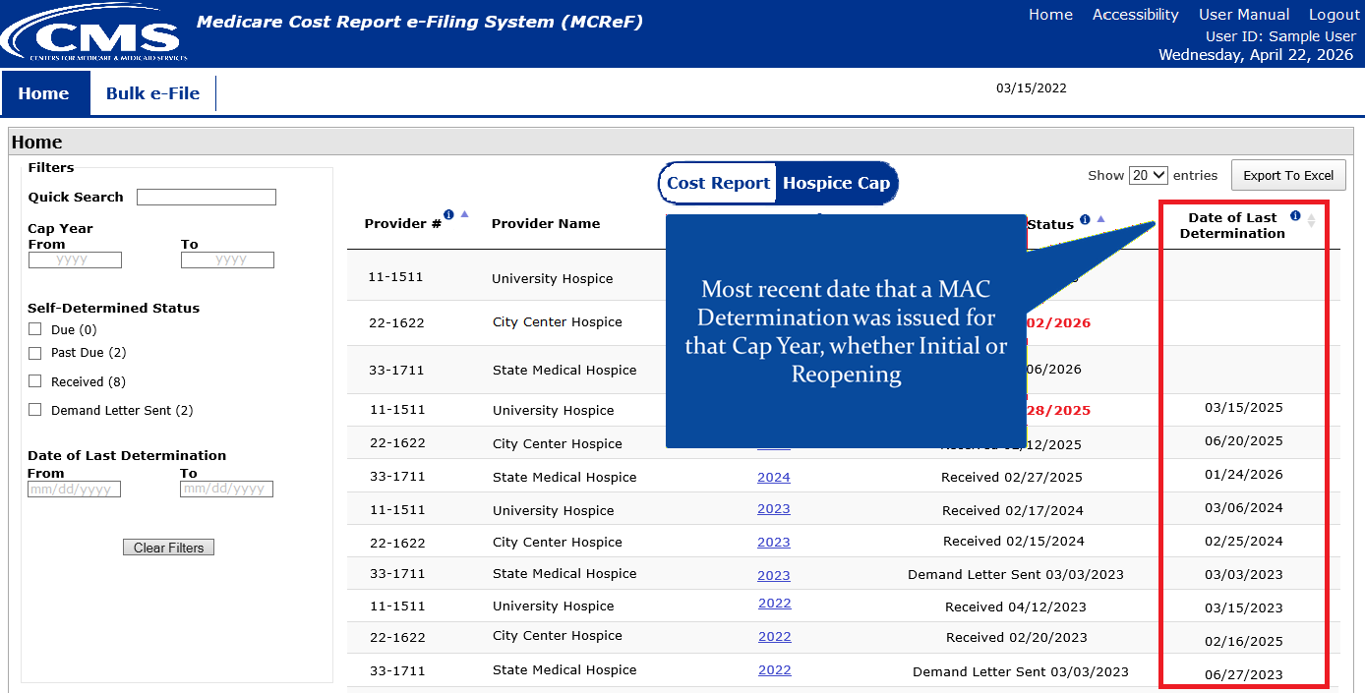
Hospice Cap Dashboard

Slide 37
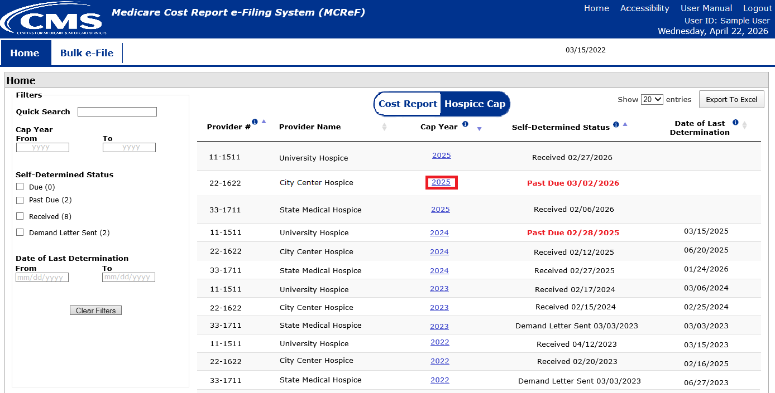
Hospice Cap Dashboard

Slide 38
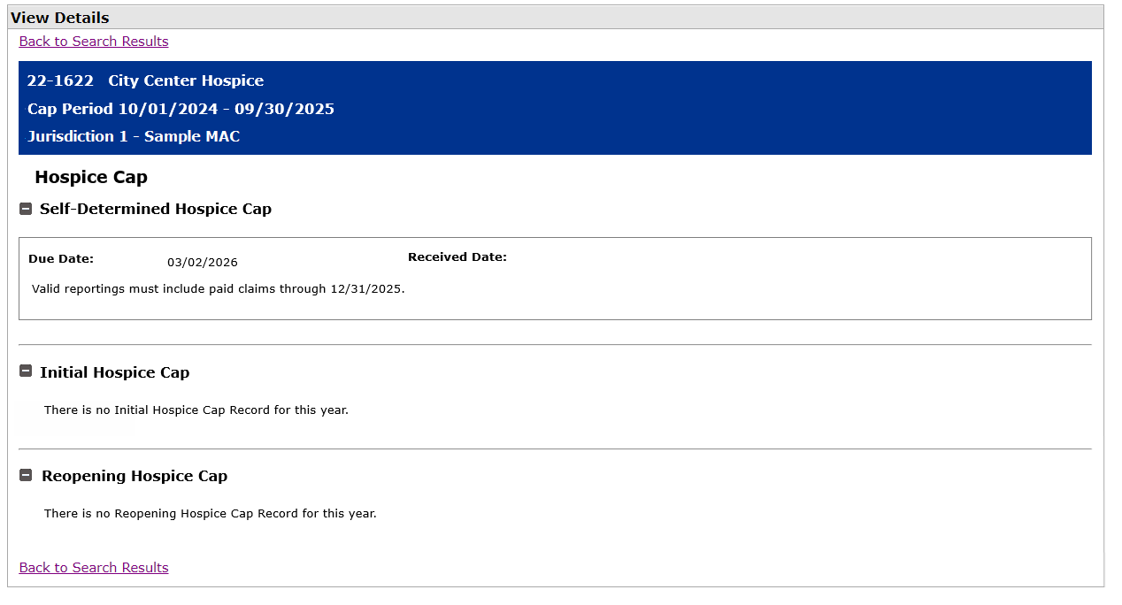
Hospice Cap View Details

Slide 39
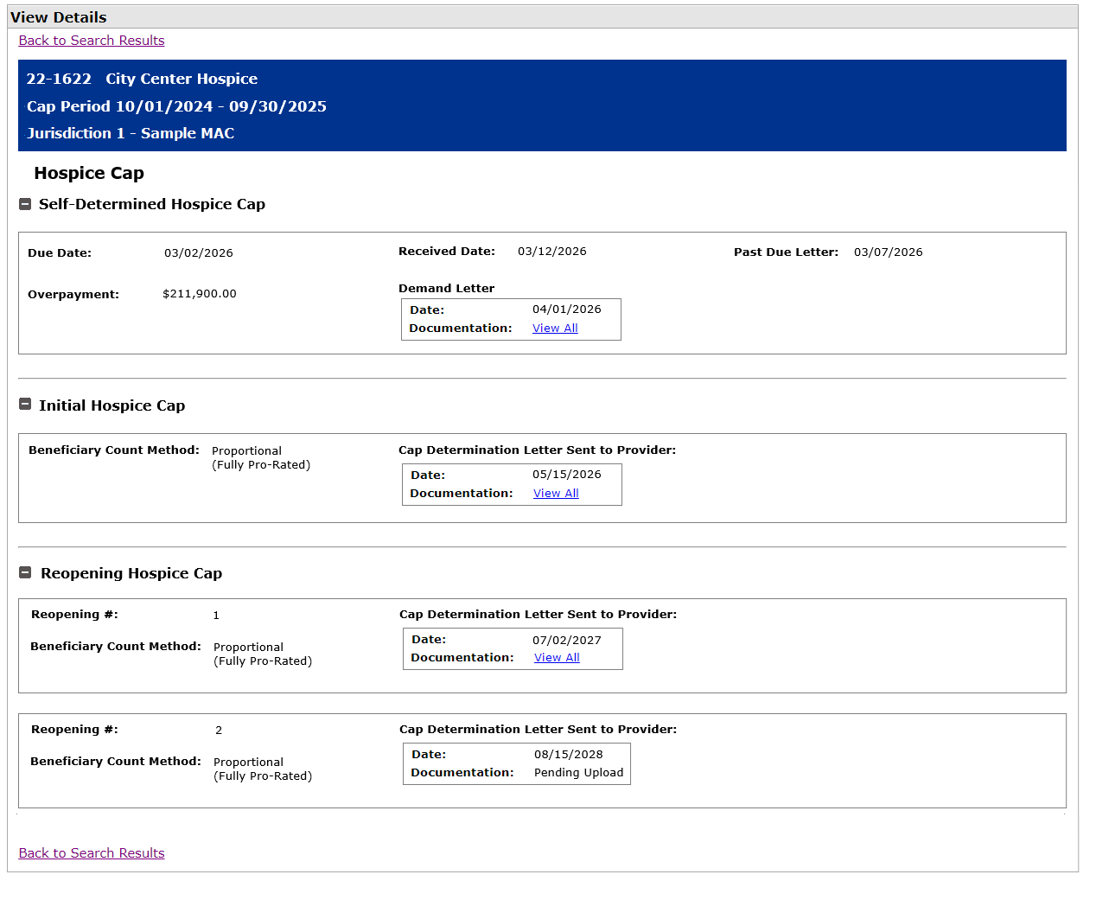
Hospice Cap View Details

Slide 40
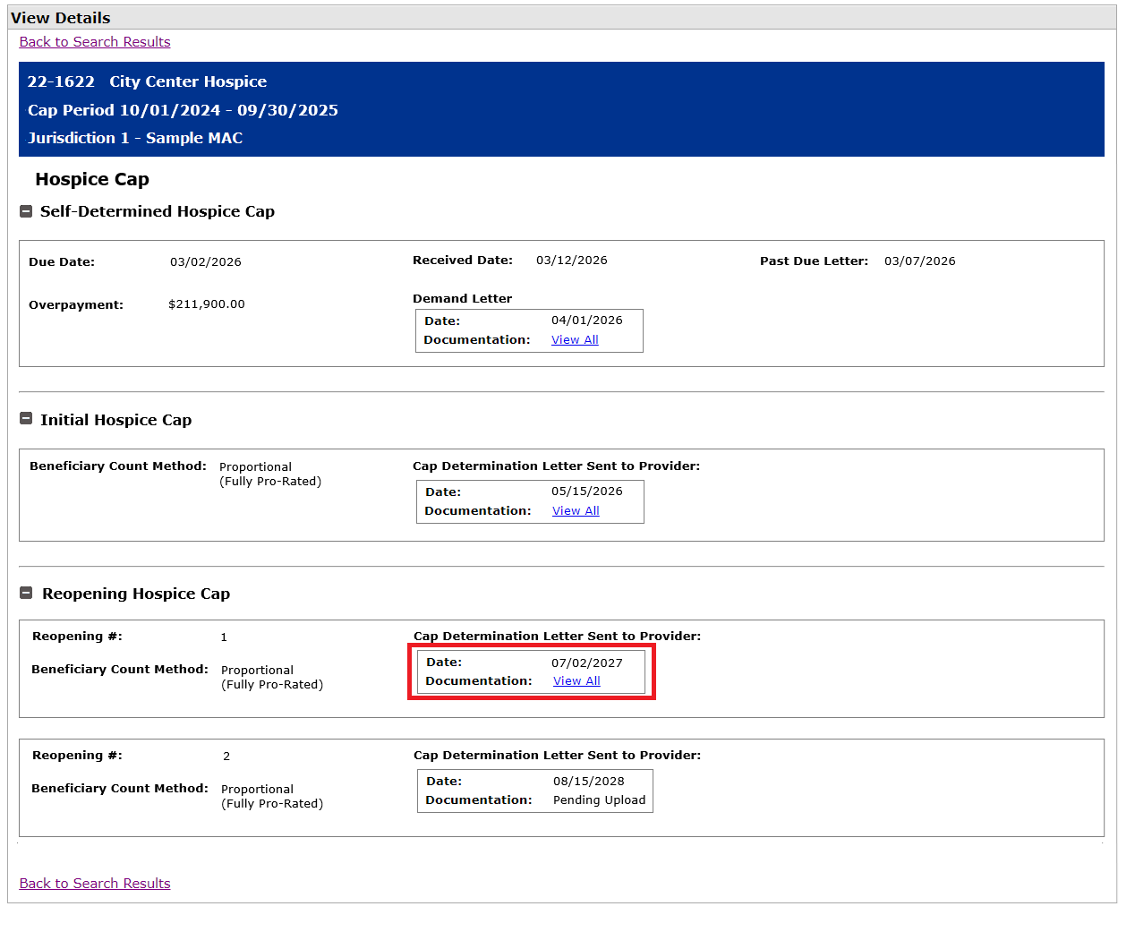
Hospice Cap View Details

Slide 41
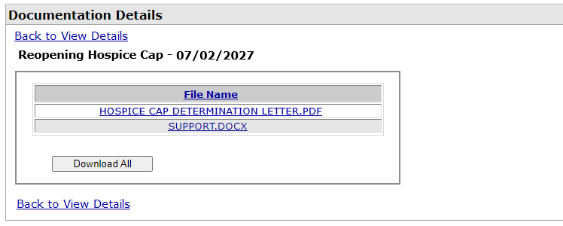
Hospice Cap Documentation Page

Slide 42
Next Steps
Providers should start seeing Hospice Cap documentation, which is guaranteed for activity after May 6, 2026
Long-term: Consider expanding MCReF Hospice Cap support, such as adding the ability to e-file Self-Determinations

Slide 43
MCReF Individual E-File Walkthrough

Slide 44
MCReF Access
MCReF Login: https://mcref.cms.gov
MCReF access requires an account from the CMS Identity Management (IDM) system, tied to the PS&R/STAR Application
  Restricted to IDM PS&R Security Officials (SO) / PS&R Backup Security Officials (BSO) / MCReF Approved Cost Report Filers
  Existing PS&R SOs / BSOs already have access
  Any organization without access must go into IDM, select “Role Request”, choose “PS&R/STAR” from the Application list, and request to set up a PS&R SO.
  Just like Providers filing cost reports, Home Offices should be registered by SOs to file cost statements.

Slide 45
IDM Tips and Updates
To use MCReF, keep your IDM account in good-standing.
  Includes password updates or signing into your account every 60 days to keep it active.
  Timely replacement of SOs and setting up (or requesting to be) a Backup Security Official to simplify transitions.
  If you are an SO, make sure to recertify your users annually to ensure they keep their access.
  IDM credential issues are not a valid reason for late MCR filing.
As of December 2025, IDM now supports Login.gov accounts
  If you’re signing up for the first time, you can choose to use a pre-existing Login.gov account or set one up rather than creating a new IDM account
    Note: With a Login.gov account established, the same IDM processes are still used to obtain roles and approvals, but you may find it easier to maintain and keep track of your Login.gov account
  If you already have both an IDM and a Login.gov account, you’ll eventually be able to merge them and just maintain your Login.gov credentials going forward
For help with any IDM/account issues, contact the PS&R/MCReF IDM support desk:
  If you need assistance identifying the SO of your organization, reach out to the support desk and have the organization’s TIN (Tax Identification Number) handy

Slide 46
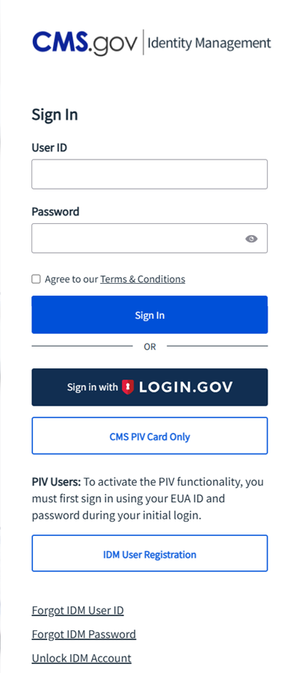
MCReF Login via IDM

Slide 47
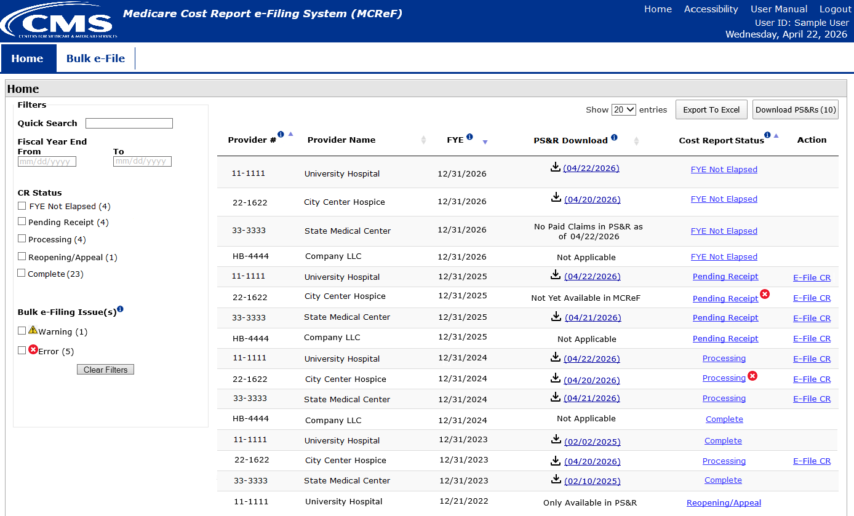
MCReF Walkthrough – Home Page

Slide 48
MCReF Walkthrough – Home Page
*Note: If you are unable to locate your Provider # or Fiscal Year End in the table:
  Confirm that the SO of your organization has properly registered the Provider # (CCN or Home Office ID) in question within IDM and that you are registered to the organization with an IDM role which grants e-Filing privileges.
  If so, and you still don’t see what you’re looking for, contact your MAC.

Slide 49
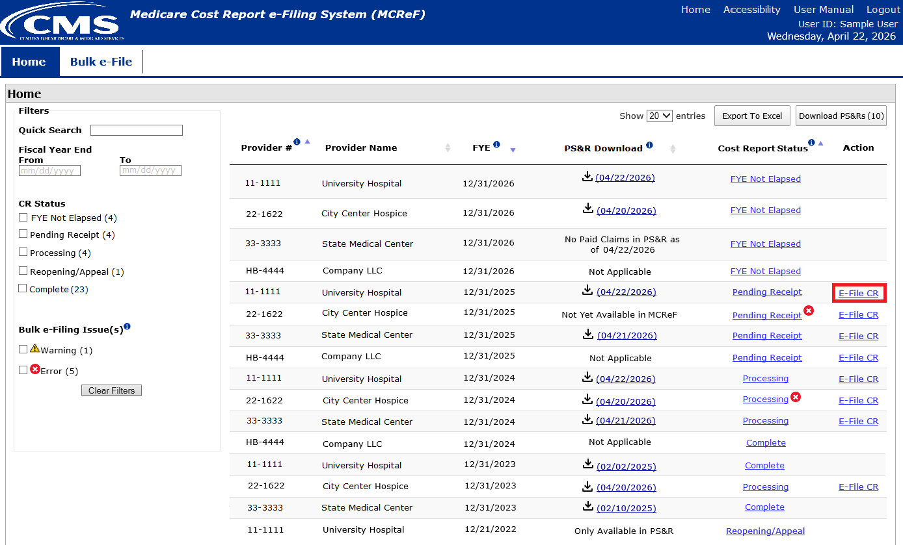
MCReF Walkthrough – Home Page

Slide 50
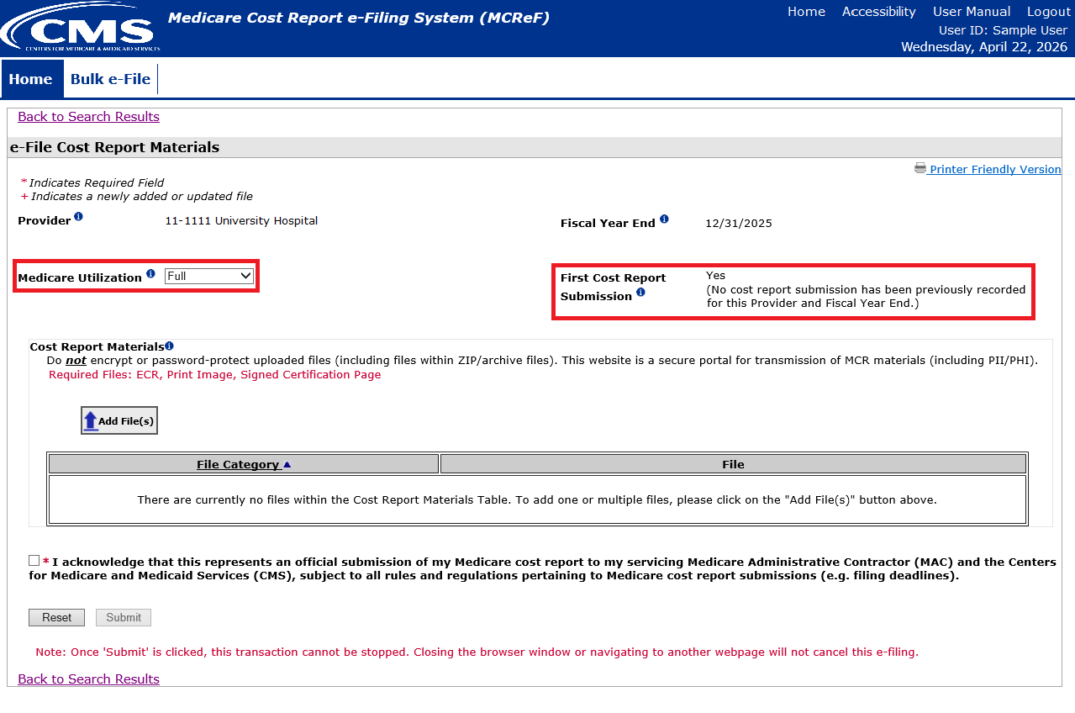
MCReF Walkthrough – Individual e-File

Slide 51
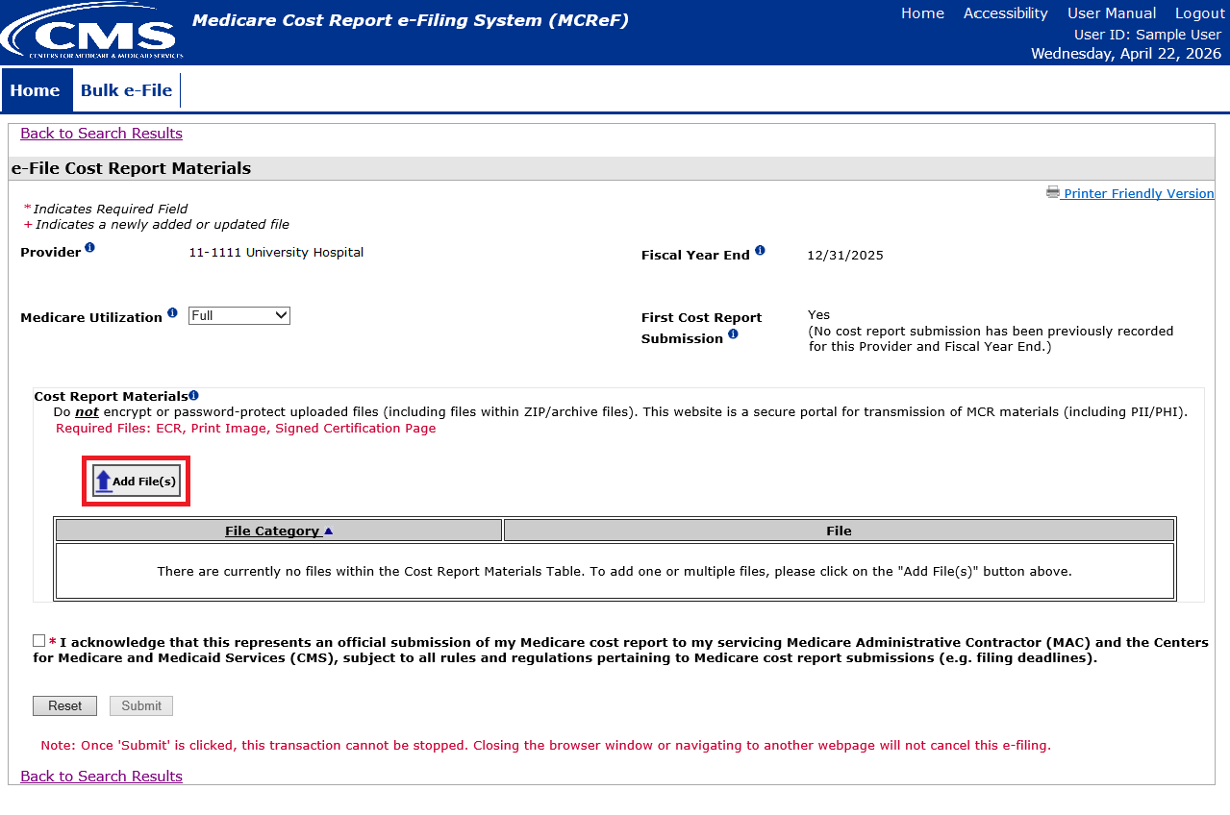
MCReF Walkthrough – Individual e-File

Slide 52
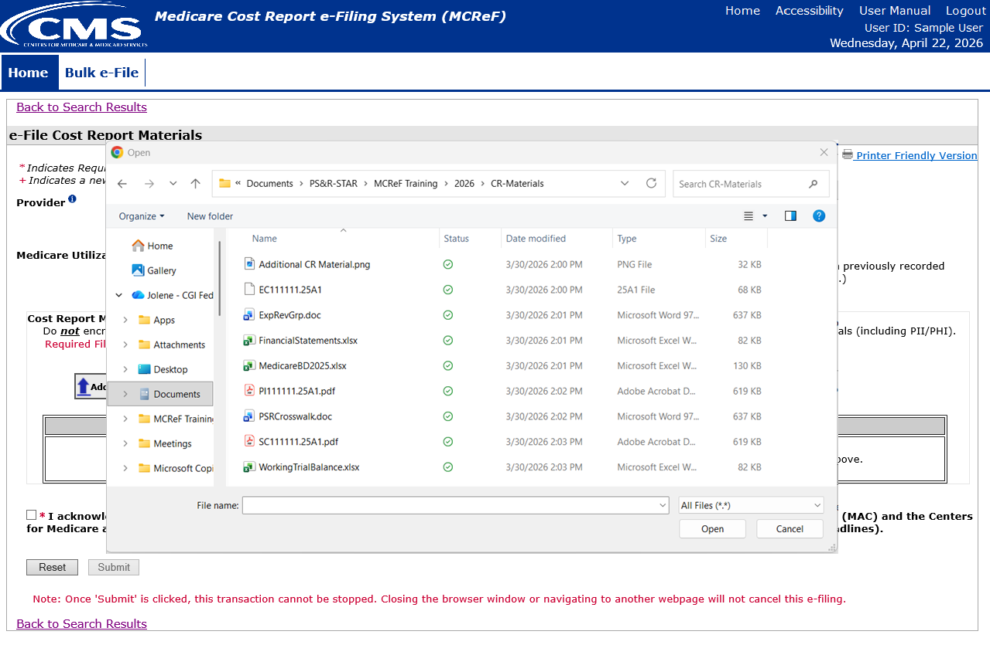
MCReF Walkthrough – Individual e-File

Slide 53
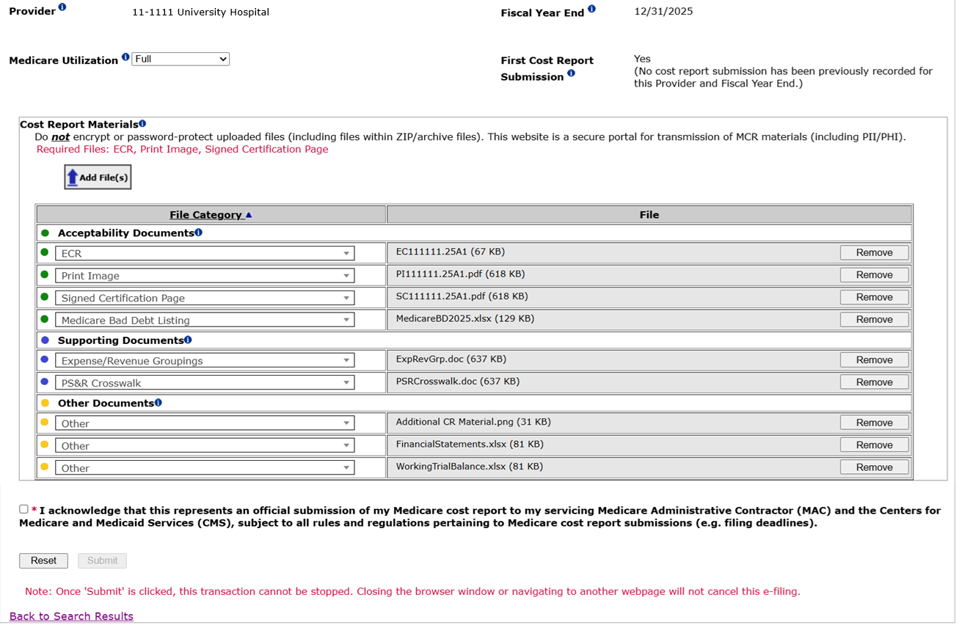
MCReF Walkthrough – Individual e-File

Slide 54
Support for Electronic
Medicare Cost Report Exhibits
CMS has completed their initiative to create standardized, electronic versions of the Medicare Bad Debt Listing, Medicaid Eligible Days, Charity Care Charges, and Total Bad Debt exhibits, they are now fully available for use, and MCReF is setup to receive and process them
  The aim of this initiative is to accelerate cost report settlement
  Adoption of these electronic versions is optional
The specifications for how to create the electronic exhibits and pre-made templates have been posted online (see URL on next slide)
If you use a vendor, consultant, or internal IT system for creating your exhibit listings, ask them about accelerating your cost report acceptance via the new electronic exhibits

Slide 55
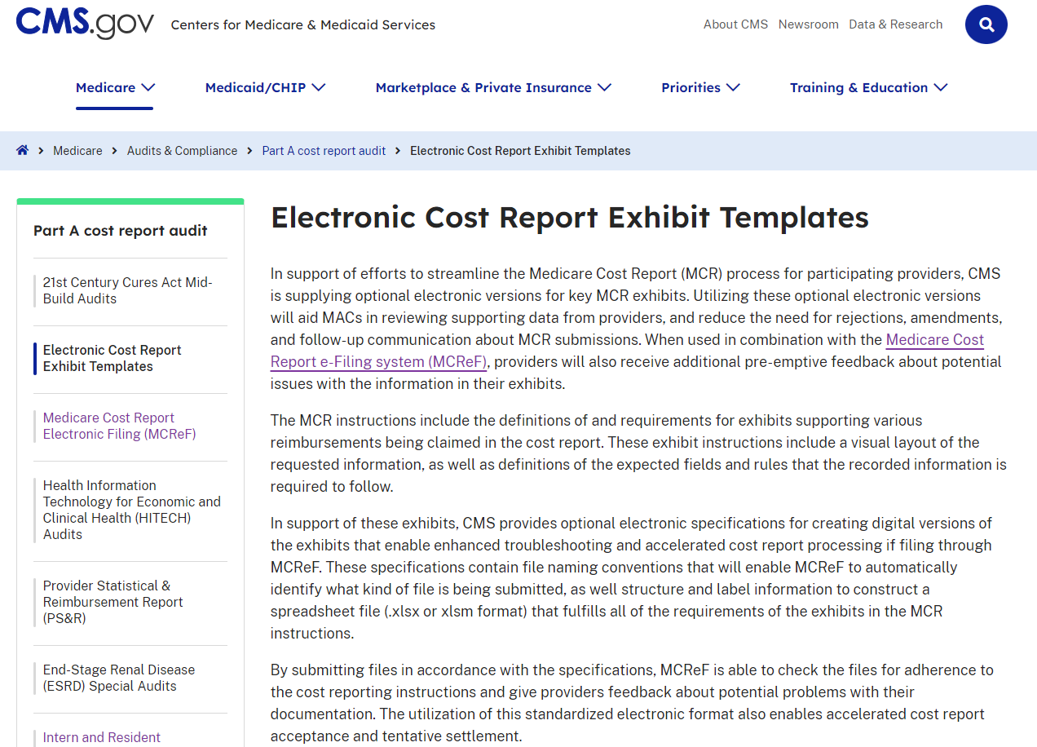
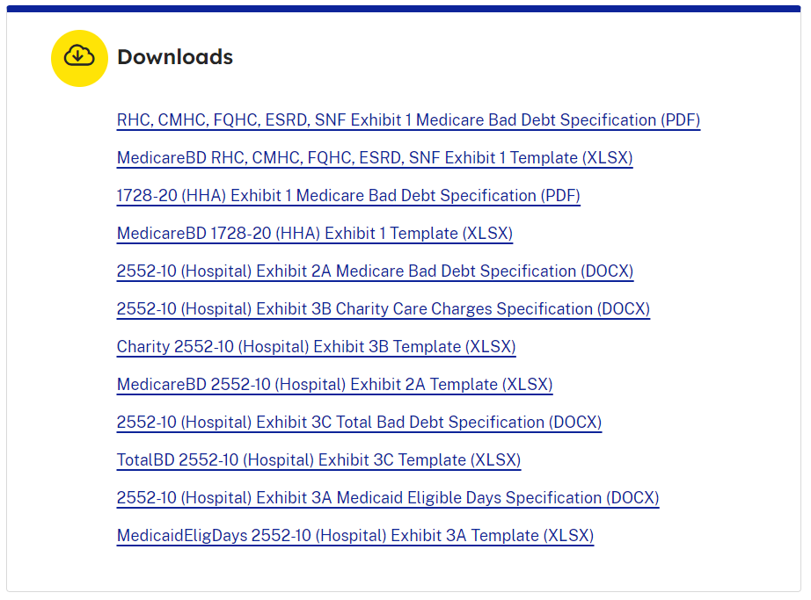
Website for Accessing Templates and Specifications
https://www.cms.gov/medicare/audits-compliance/part-a-cost-report/electronic-cost-report-exhibit-templates
Summary at the top of the page…
… downloads available at the bottom of the page

Slide 56
Support for Electronic
Medicare Cost Report Exhibits
Benefits of following electronic specifications:
  Upfront, live notice of potential issues with your exhibits if filing through MCReF (which, if addressed, minimizes back-and-forth with your MAC)
  Accelerated cost report acceptance and tentative settlement
    With potential for instant acceptance if filing through MCReF

Slide 57
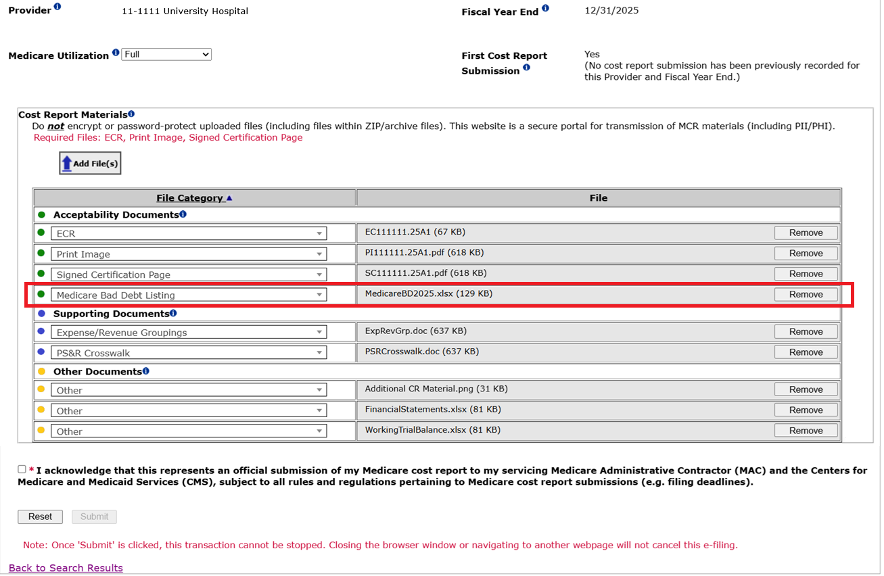
MCReF Walkthrough – Individual e-File

Slide 58
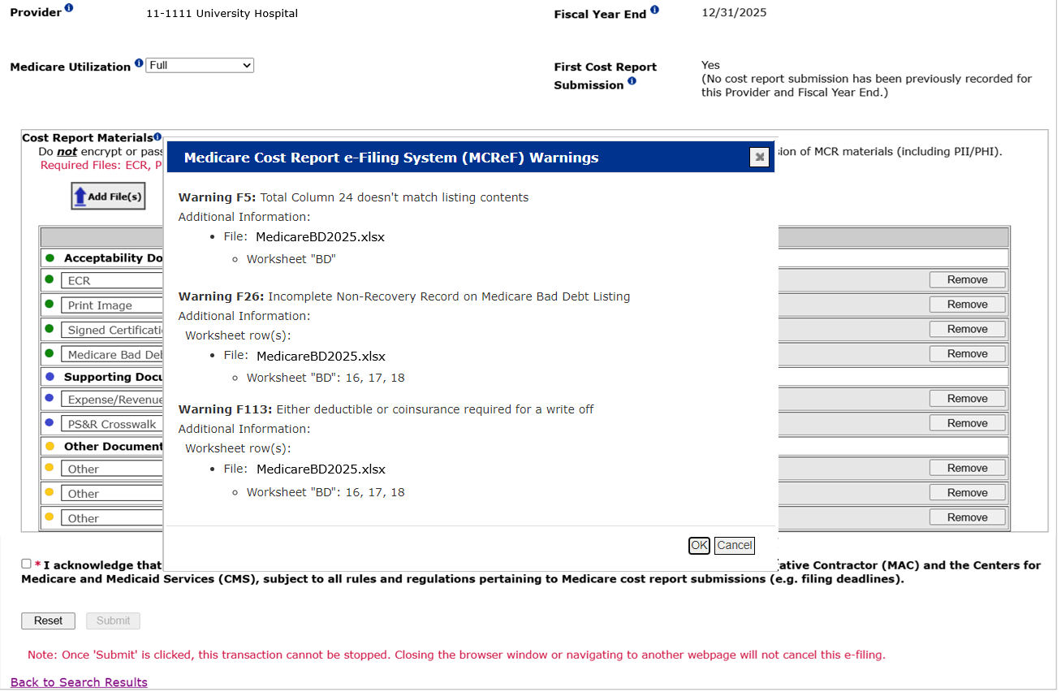
MCReF Walkthrough – Individual e-File

Slide 59
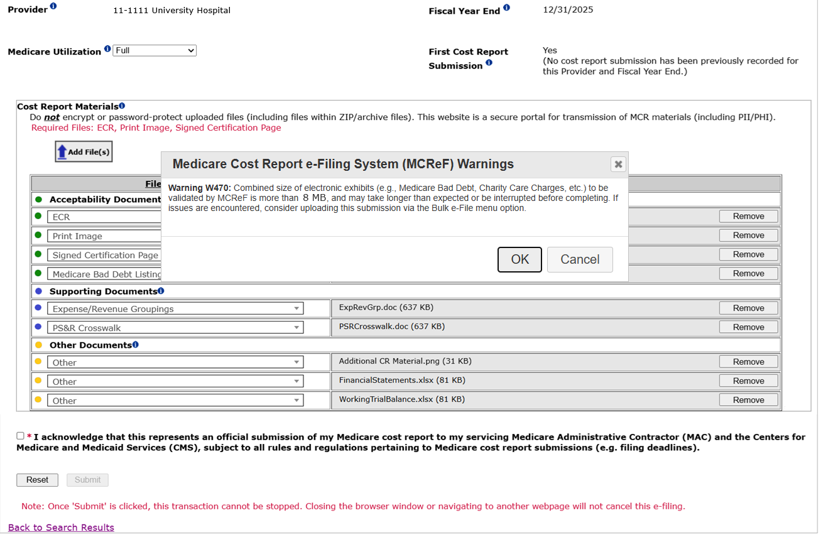
MCReF Walkthrough – Individual e-File
*Note: For submissions with particularly large exhibits (e.g. 8+ MB across these 4 exhibits), you may receive an error if the transaction times out before it is complete. In these cases, you can use the Bulk e-File option to submit a single cost report submission with large exhibits successfully.

Slide 60
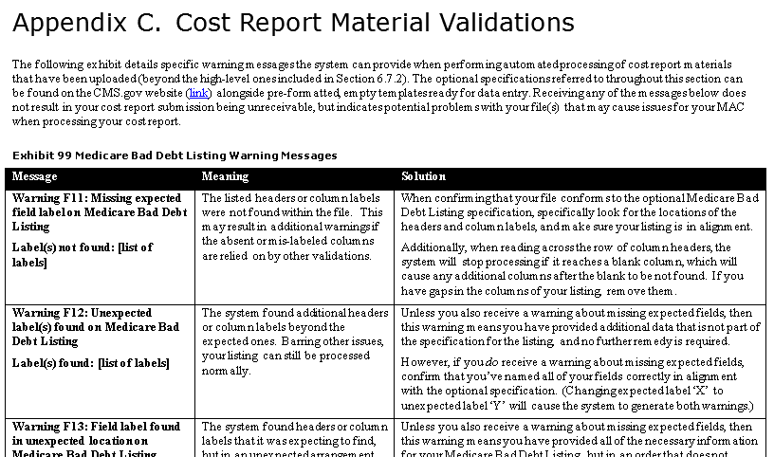
MCReF User Manual Excerpt
Listing of all messages, additional explanation of their meanings, and suggestions for solutions available in the MCReF User Manual:

Slide 61
MCReF Bulk E-File Walkthrough

Slide 62
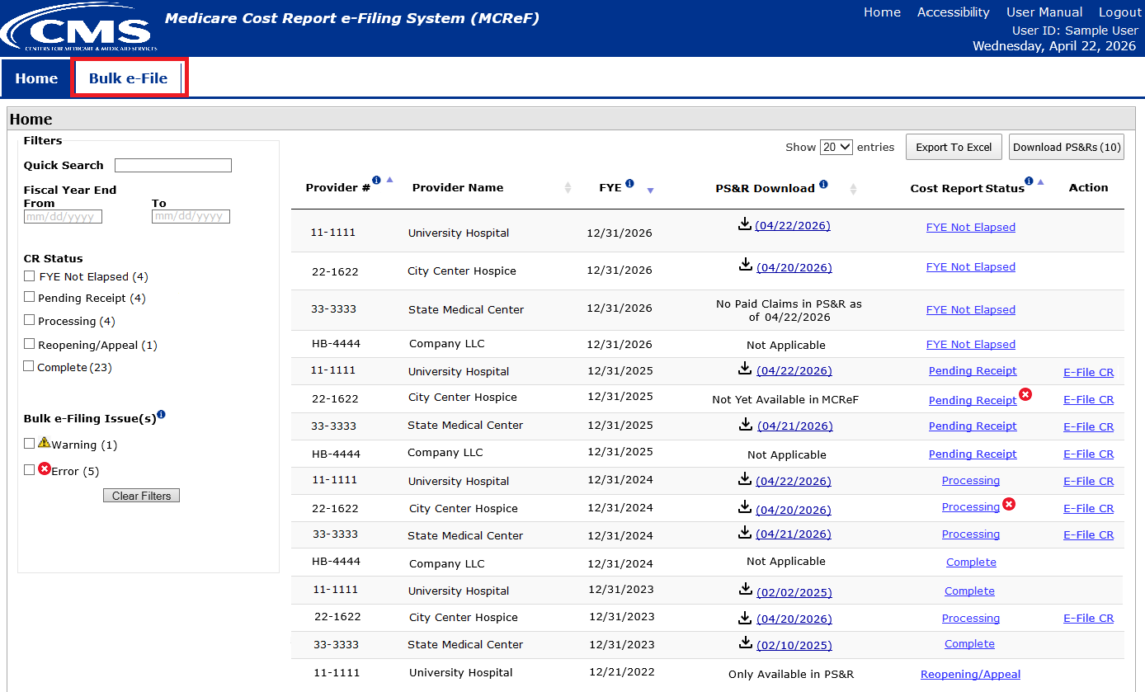
MCReF Walkthrough – Bulk e-File – Bulk Upload

Slide 63
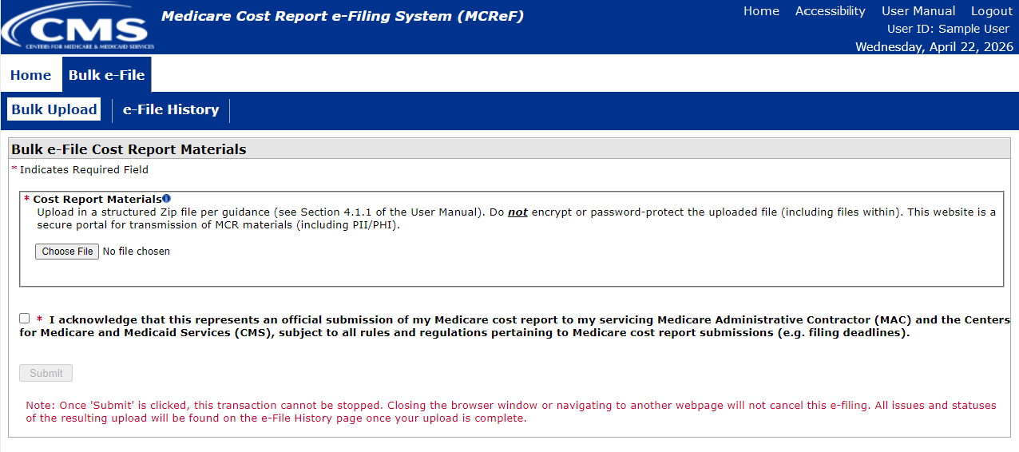
MCReF Walkthrough – Bulk e-File – Bulk Upload

Slide 64
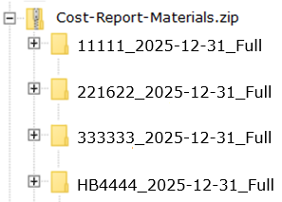

MCReF Walkthrough – Bulk e-File – Bulk File Format
File | Example File Name | Guidance
Main uploaded ZIP file | Cost-Report-Materials.ZIP | The single ZIP file containing a folder for each MCR submission. There is no restriction on how the uploaded ZIP file is named. Format: A single ZIP file File limit: 3 GB
Folder per submission | 111111_2025-12-31_Full | A well-named folder containing the cost report materials for a specific Provider/FYE. Provider # – 6-character CMS Certification Number (without a dash, ‘111111’ not ‘11-1111’) FYE – Fiscal Year End of the cost report being submitted, with the 4-digit year, followed by the month, and then day, separated by hyphens (yyyy-mm-dd) Medicare Utilization – “Full”, “Low”, “No”, or “Vaccine”. If this is not included, the system will assume the submission is a Full Medicare Utilization submission. The Provider #, FYE, and Medicare Utilization should each be separated by a single underscore (_)
Details excerpted from Section 4.1.1 of the MCReF User Manual

Slide 65
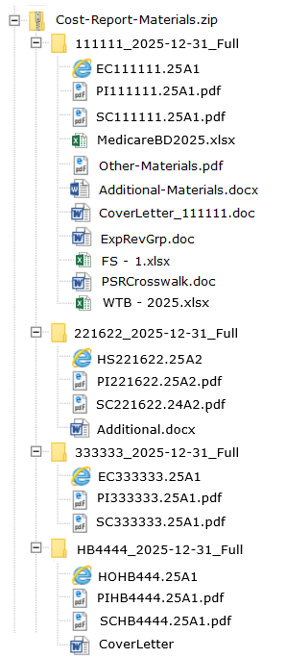
MCReF Walkthrough – Bulk e-File – Bulk File Format
Naming convention detailed in Appendix B of the MCReF User Manual

Slide 66
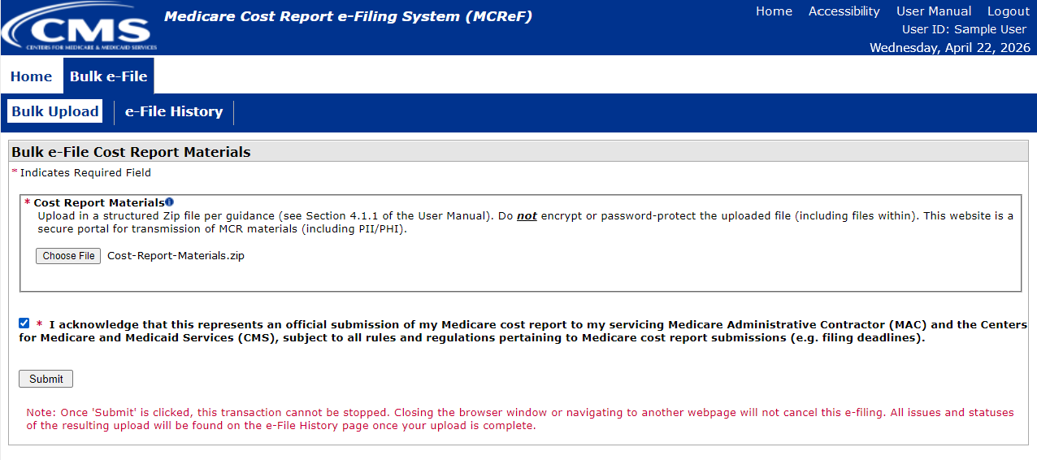
MCReF Walkthrough – Bulk e-File – Bulk Upload

Slide 67
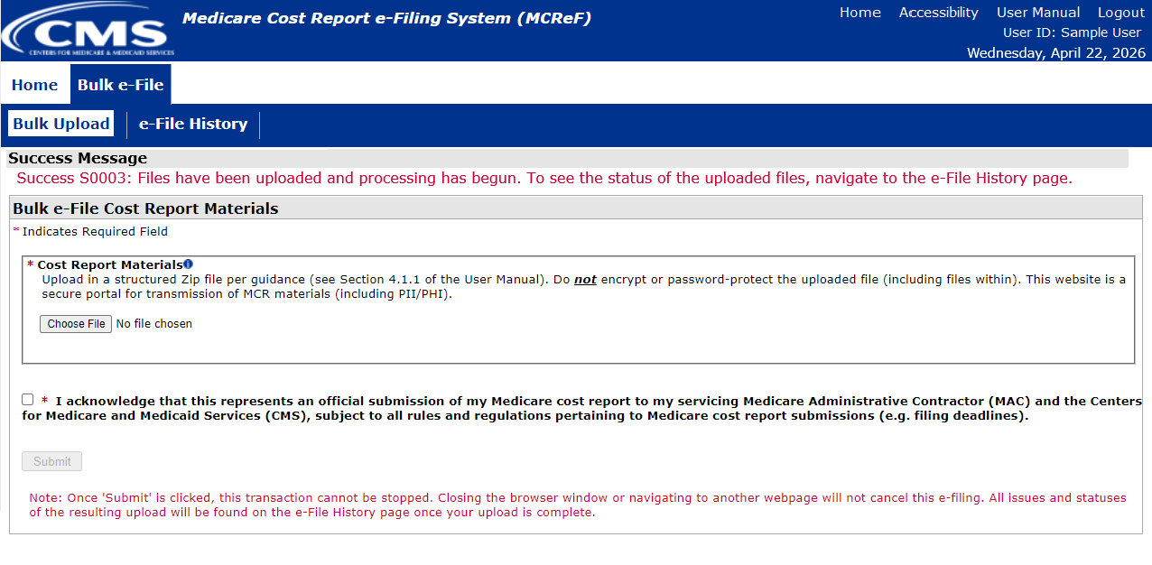
MCReF Walkthrough – Bulk e-File – Bulk Upload

Slide 68
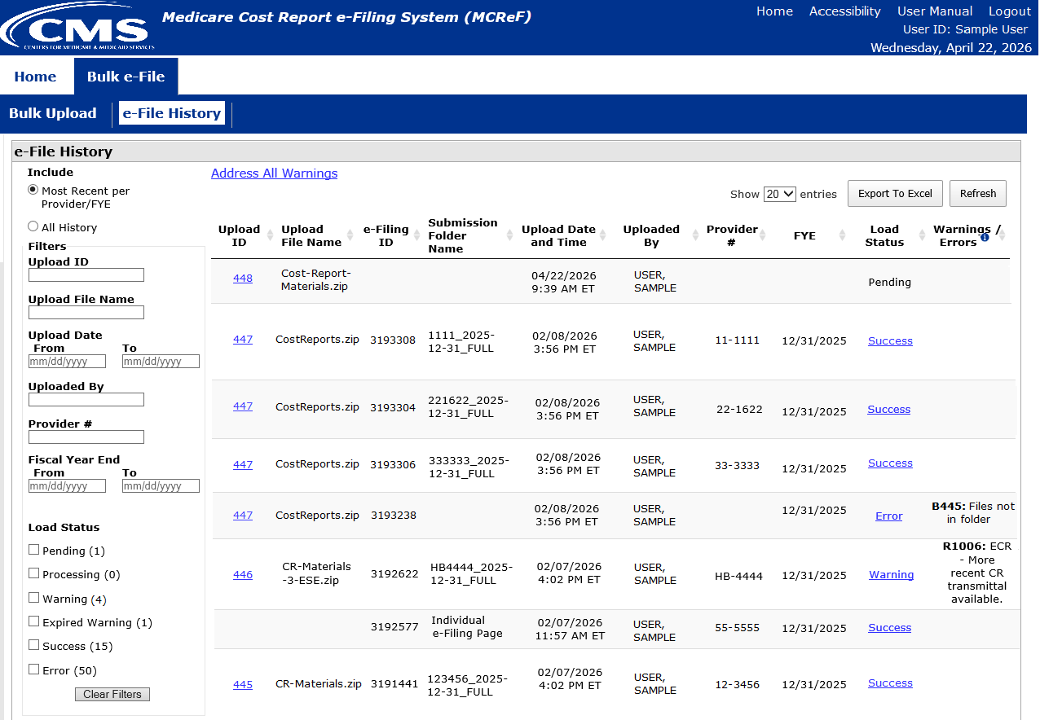
MCReF Walkthrough – Bulk e-File – e-File History

Slide 69
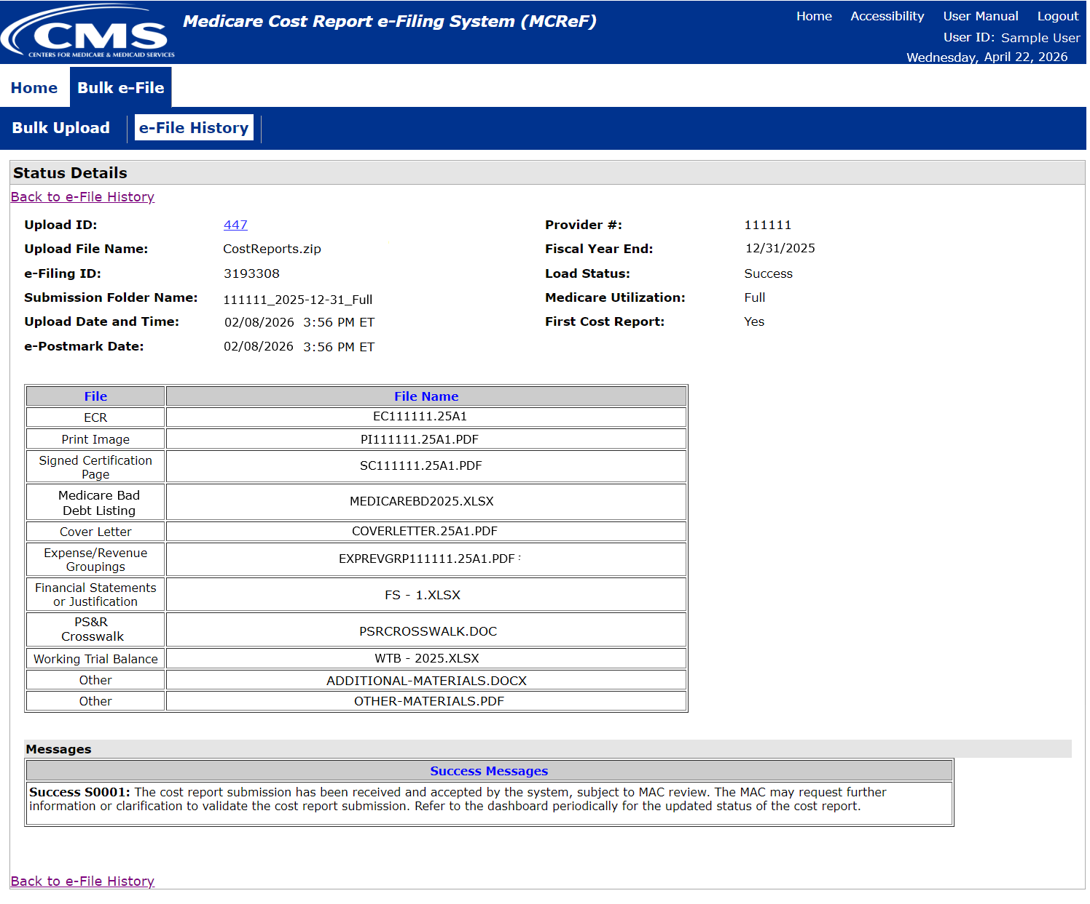
MCReF Walkthrough – Bulk e-File – Status Details

Slide 70
Updates and General Reminders

Slide 71
E-Filing Updates
With the introduction of the 287-22 Cost Statement, Home Office e-filings for FYBs on or after 10/01/2022 have an electronic format which supports e-signature and can be fully e-filed in MCReF (no need to mail in anything if e-filed and e-signed)
  The ‘HO’ electronic cost statement file would be placed in the ECR file slot, just like a cost report ECR file
Size limit increases as a result of user feedback:
  The IRIS file size limit increased to 50MB
  The general size limit increased for single cost report submissions to 1GB and for bulk submissions to 3GB

Slide 72
MCReF General Reminders
  You will receive errors if your submission contains fundamental problems that prevent the system from processing it
  Providers will not receive an extension for system issues preventing e-Filing
  These must be resolved for the submission to be received by the MAC
  You will be warned if:
  MCR submission is late
  You try to upload an MCR generated with outdated software
  There are any potentially missing documents in CR materials
  There are any potential issues with the electronic exhibits
  Rare – If you receive a browser “time out” error:
  If your attachments are stored on a shared or network drive, try downloading them first, and then uploading to MCReF
  If you are doing an Individual e-Filing, try the Bulk e-File option instead

Slide 73
MCReF General Reminders
  Timely receipt of the cost report will be measured based on 11:59 PM ET for the provider’s cost report due date
  Files uploaded are not to be encrypted or password protected. MCReF is a secure portal for transmission of MCR materials (including PII/PHI)
  Duplicate submissions will be rejected by the MAC; only the first MCR received by the MAC will be processed.

Slide 74
Electronic Signatures

Slide 75
Electronic Signature
  2018 IPPS final rule issued in August 2017, authorizes providers to file with an electronic signature effective for FYEs on/after 12/31/2017.
    Note: IPPS final rule does not change the authorized signatories (CFR §413.24(f)(4)(iv)(C))
  CMS has released MCR transmittals which support e-signature for every MCR form (including Home Offices)
    An approved form of e-signature (per the 2018 IPPS final rule) is required for signing and subsequently uploading the “Signed Certification Page” in MCReF

Slide 76
Electronic Signature
  The next few slides provide examples of valid and invalid uses of e-signature
  These examples are not the exhaustive list of all possible valid and invalid uses of e-signature
  Refer to the 2018 IPPS final rule for e-signature guidance

Slide 77
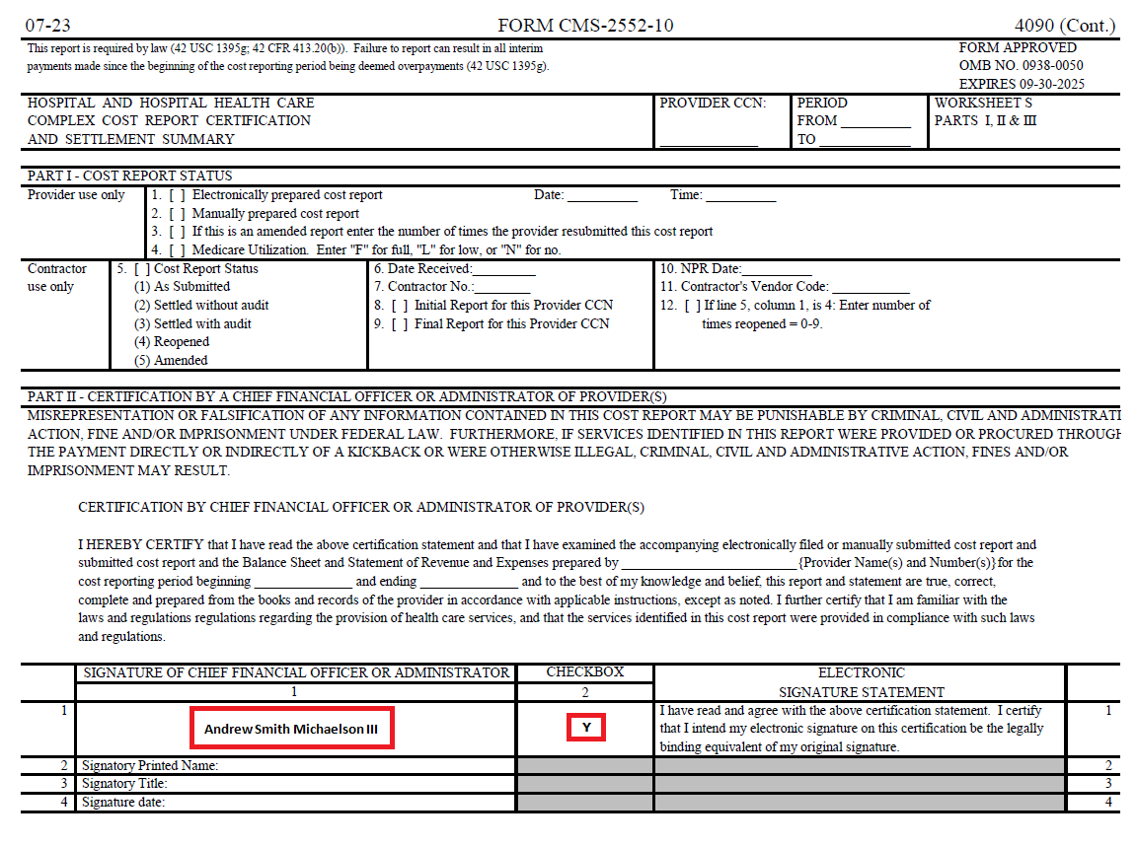
Valid use of e-signature
E-signature checkbox checked and typed First and Last Name

Slide 78
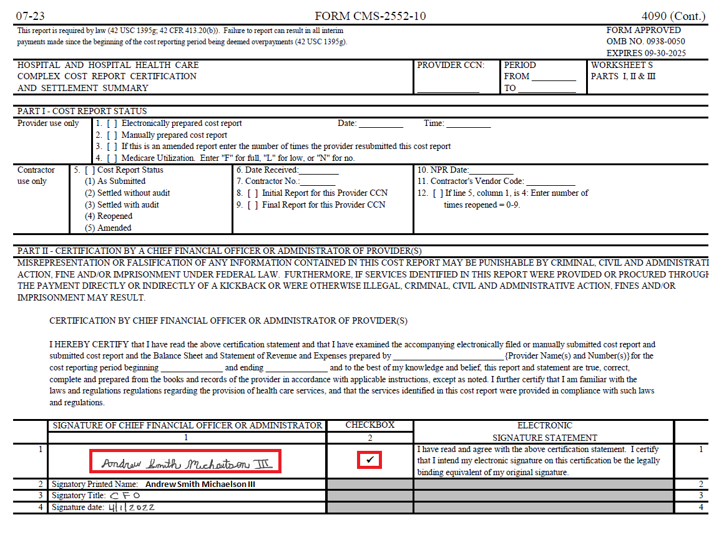
Valid use of e-signature
Printed, e-signature checkbox Checked and Signed, Scanned

Slide 79
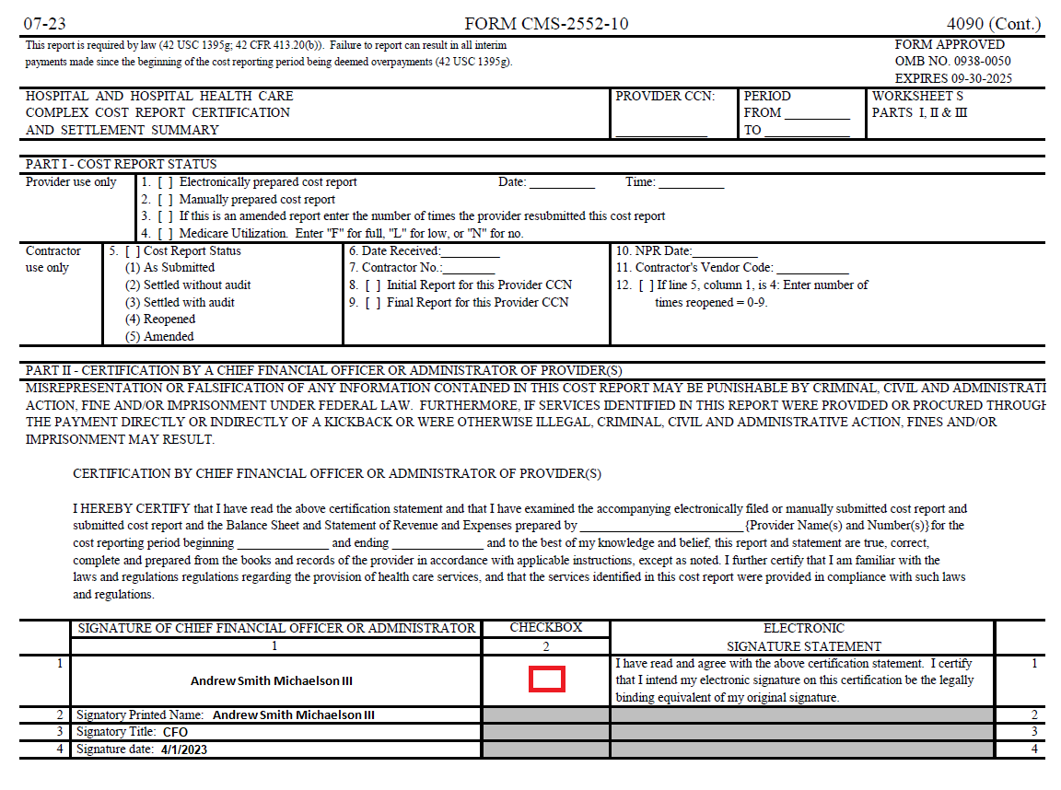
Invalid use of e-signature
E-signature checkbox not checked

Slide 80
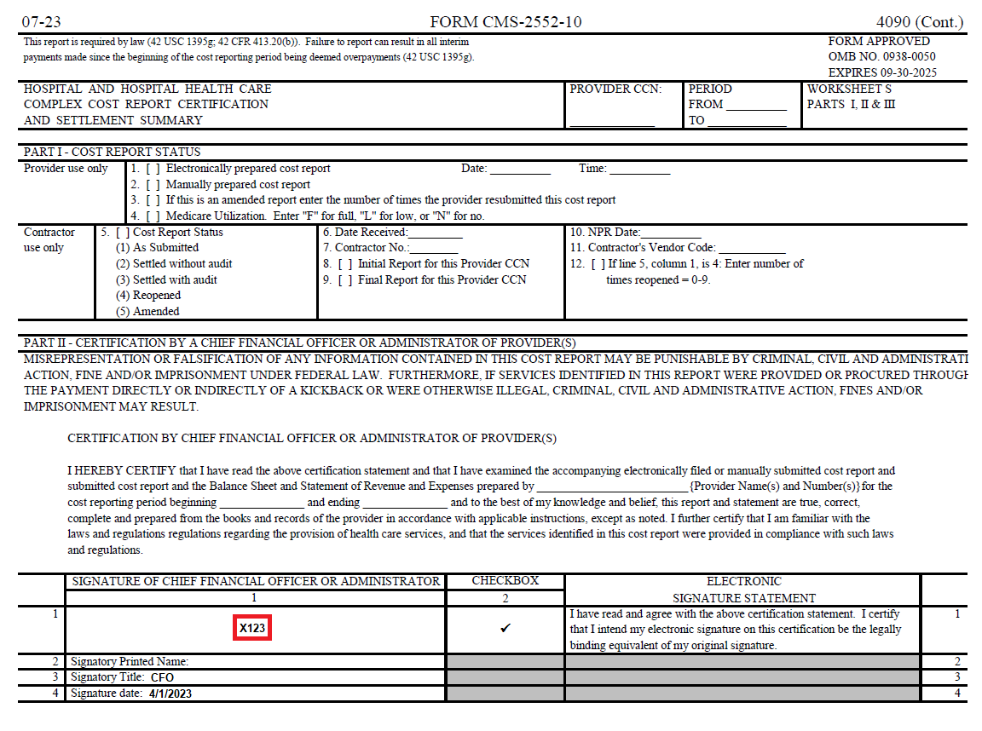
Invalid use of e-signature
Signature must contain First and Last Name

Slide 81
Tips for Accelerating Cost Report Processing

Slide 82
e-Filing Tips for Accelerating CR Processing
  Use MCReF
  e-Sign through the ECR software
  Categorize files appropriately
  Submit exhibits using the optional electronic specifications/templates
  Pay attention to warnings

Slide 83
Future MCReF Enhancements

Slide 84
Continuing Improvements to MCReF
  Simplifying Cost Report Revisions/Amendments
  Save and Resume
  Display of Non-claims Payments Information (e.g. Lump Sum Adjustments)
  Opt-In Push Notifications (e.g. e-mails, texts) about Status Changes and Newly Available Documentation
  e-Filing Reopening Requests
  Simplified reporting of warnings related to cost report and exhibit agreement

Slide 85
MCReF Feedback and Suggestion Poll
Q&A Up Next!

Slide 86
Question & Answer Session

Slide 87
Resources
E-mail questions or ideas for improvements relating to MCReF to:
OFMDPAOQUESTIONS@CMS.HHS.GOV
For any questions relating to your IDM account (role requests, passwords, annual certifications, login, etc…) contact PS&R/MCReF IDM support desk:
  Website: https://eus.cms.gov/home
  e-mail: EUS_Support@cms.hhs.gov
  Phone: 1-866-484-8049 (TTY/TDD: 866-523-4759)

Slide 88
Thank You – Please Evaluate Your Experience
Share your thoughts to help us improve – complete in-webinar poll
Visit:
Medicare Learning Network homepage for other free educational materials for health care professionals
The Medicare Learning Network® is a registered
trademark of the U.S. Department of Health and Human Services (HHS).

Slide 89
Disclaimer
This presentation was current at the time it was published or uploaded onto the web. Medicare policy changes frequently so links to the source documents have been provided within the document for your reference.
This presentation was prepared as a service to the public and is not intended to grant rights or impose obligations. This presentation may contain references or links to statutes, regulations, or other policy materials. The information provided is only intended to be a general summary. It is not intended to take the place of either the written law or regulations. We encourage readers to review the specific statutes, regulations, and other interpretive materials for a full and accurate statement of their contents.

