Slide 1
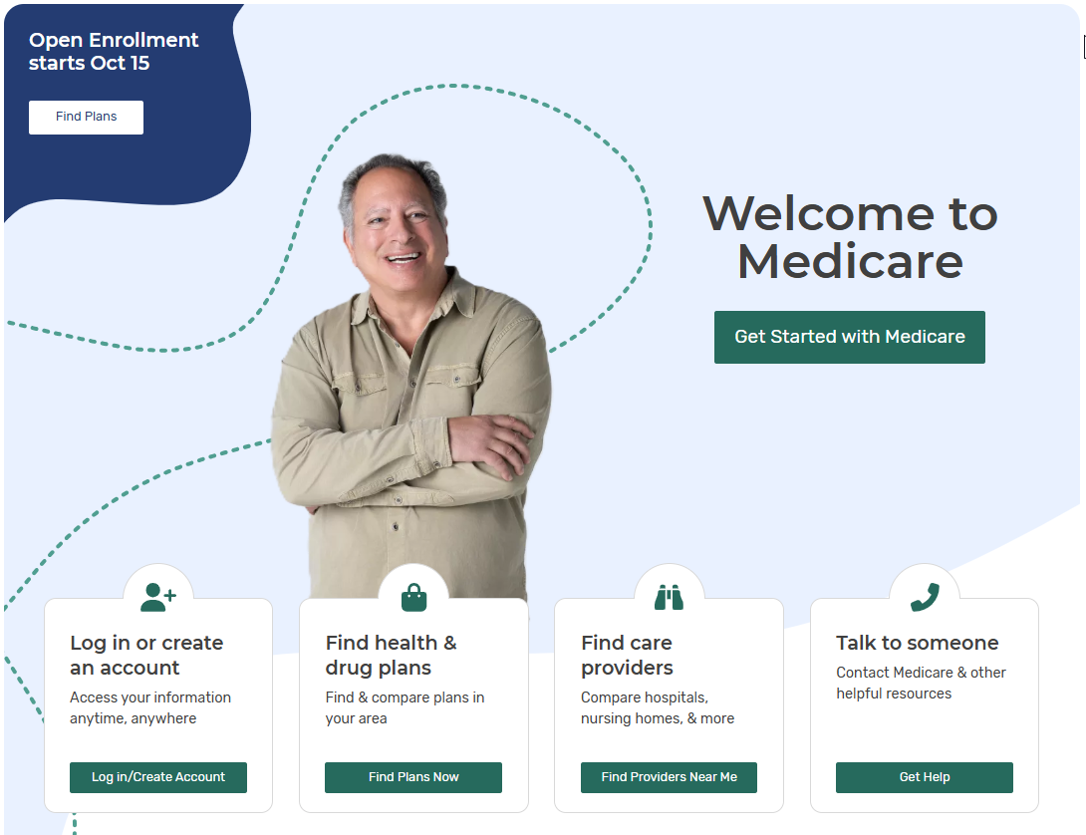
Medicare.gov
Open Enrollment 2025

Slide 2
2025 Open Enrollment (OE) Improvements
Updates to Medicare.gov for 2025 OE continue to modernize the shopping experience, allowing for personalization based on information that matters to you as you choose a Medicare plan.
Includes online account updates aimed at enhancing security and accessibility.

Slide 3
Find Health & Drug Plans at Medicare.gov
  Review and compare plans at Medicare.gov/plan-compare
  An unbiased resource to research plans, get personalized cost estimates, and find information on plan quality
  See quality and customer service ratings from current plan members
  Manage a list of preferred pharmacies, prescriptions and providers
    Log in or create an account to save your preferences, see your current coverage summary, and access your information anytime
Notes:
Partner organizations refer to this resource as Medicare Plan Finder, but on Medicare.gov it’s labeled for users as “Find Health & Drug Plans.”

Slide 4
Medicare.gov Enhancements:
New Provider Network Search
This year, we added provider coverage information for Medicare Advantage plans
For the first time, you can search for plans based on your doctors, and select plans that include your providers in-network
Available to everyone when Open Enrollment starts October 15, 2025
Helps you make more informed selections when browsing Medicare Advantage plans

Slide 5
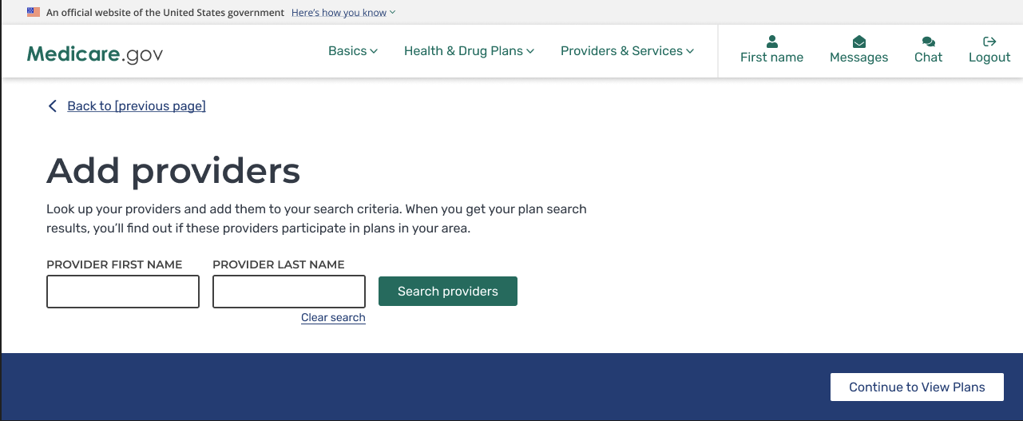
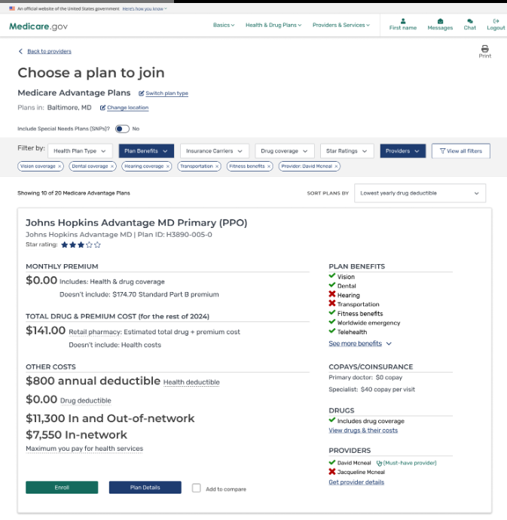
Provider Network Search
You can search for and select providers by first and/or last name.
Once you select provider(s) and view a plan, you’ll see information about whether the provider participates in the plan.

Slide 6
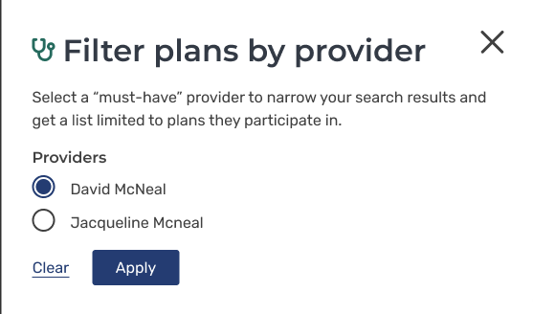
Provider Network - Plan Results
You also have the option to choose a "must-have” provider and see plan results filtered by your "must-have” provider.

Slide 7
Medicare.gov Enhancements:
Added Supplemental Benefits Detail
Added new details on many more supplemental benefits to the display of Medicare Advantage plans to empower your choices
Now you can compare plans based on coverage for services like:
  Wigs for hair loss related to chemotherapy
  Weight management programs
  Home-based palliative care
Added more information on cost-sharing and plan limitations for greater transparency when you’re shopping

Slide 8
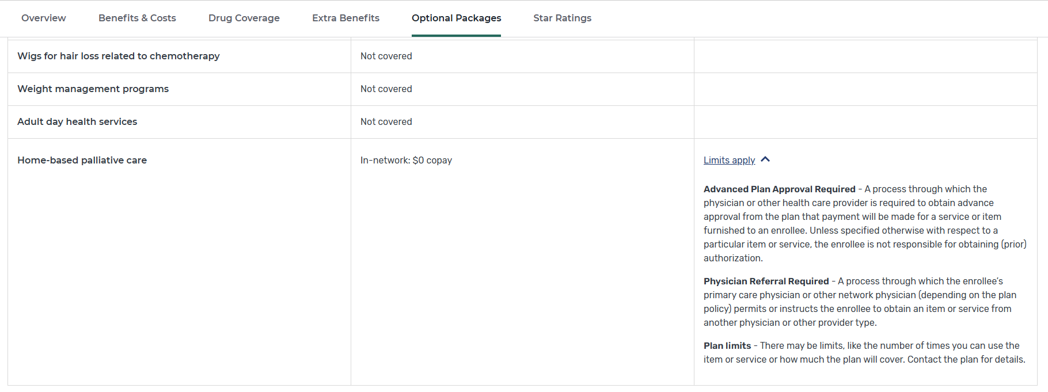
New Supplemental Benefits Detail

Slide 9
Medicare.gov Enhancements:
Added Detail on Part B Premium Reductions
Added more details on Medicare Advantage plans that offer Part B Premium reductions
When available, you’ll see the specific amount of the Part B premium reduction (not just a “yes” or “no”)
Part B Premium data will be available in Fall 2025

Slide 10
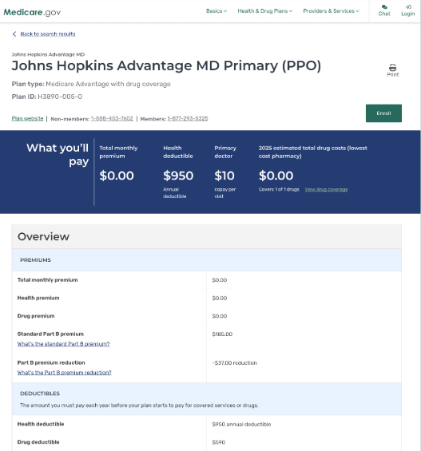
New Detail on Part B Premium Reductions
When available, you’ll see the exact amount of the Part B premium reduction.

Slide 11
Medicare.gov Enhancements:
Updated Star Ratings Display for 2026
Added additional rating dimensions you can use to compare plans
Clarified descriptions of 3 Drug Plan Star Ratings measures
Added 3 new Health Plan Star Ratings measures
      "Improving or Maintaining Physical Health"
      "Improving or Maintaining Mental Health"
      "Kidney Health Evaluation in Patients with Diabetes"

Slide 12
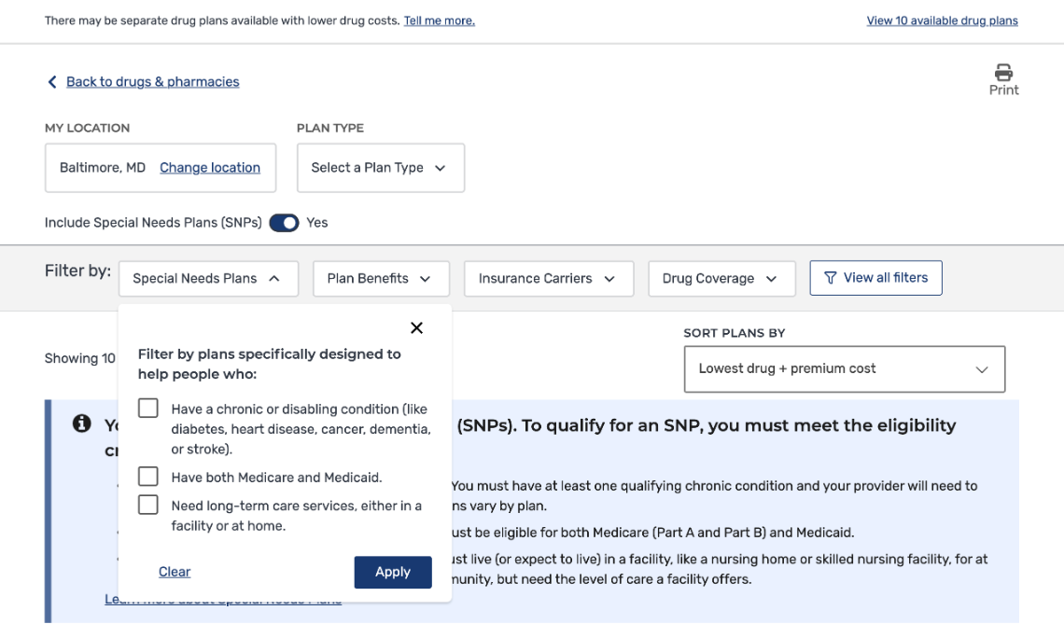
Medicare.gov Enhancements:
Enhanced Ability to Filter Plans
Now you can more granularly filter search
results to narrow down long lists of
potential plans
Improved the Special Needs Plans (SNPs)
filter experience to help you
locate SNPs more easily
  Added SNP "switch" to show/hide
  SNP plans on the Plan Results page for
  Medicare Advantage plans
  When you apply a SNP option, search
  results will only show selected SNP plan types

Slide 13
More Enhancements
Improved messaging and added new alerts for Special Needs Plans
Optimized functionality for the Plan Finder Drug Pricing Estimation Calculator
Enhanced Medicare.gov search ability to make sure you can find the information you’re looking for
Coming later this fall: “Ask Medicare” AI Drug Search
A conversational search experience that provides estimated drug cost and coverage information for people with existing Medicare drug coverage to use when:
  Getting a new prescription
  Looking for ways to reduce your monthly budget for prescriptions
  Considering making a change to your pharmacies or drugs
  Understanding how much a new drug will cost

Slide 14
Online Account Updates
Changes to enhance security and accessibility:
Use Passkeys to Log In
  Gives you more ways to seamlessly access your account (like through face ID or fingerprint) while ensuring security.
Email Required to Create an Account
  An email address is now mandatory for new accounts to make them more secure and limit ability of bad actors to exploit the account creation process.
Multi-Factor Authentication
  Has been optional up until now; will be mandatory for new accounts during OE and mandatory for existing accounts after OE to improve security.

Slide 15
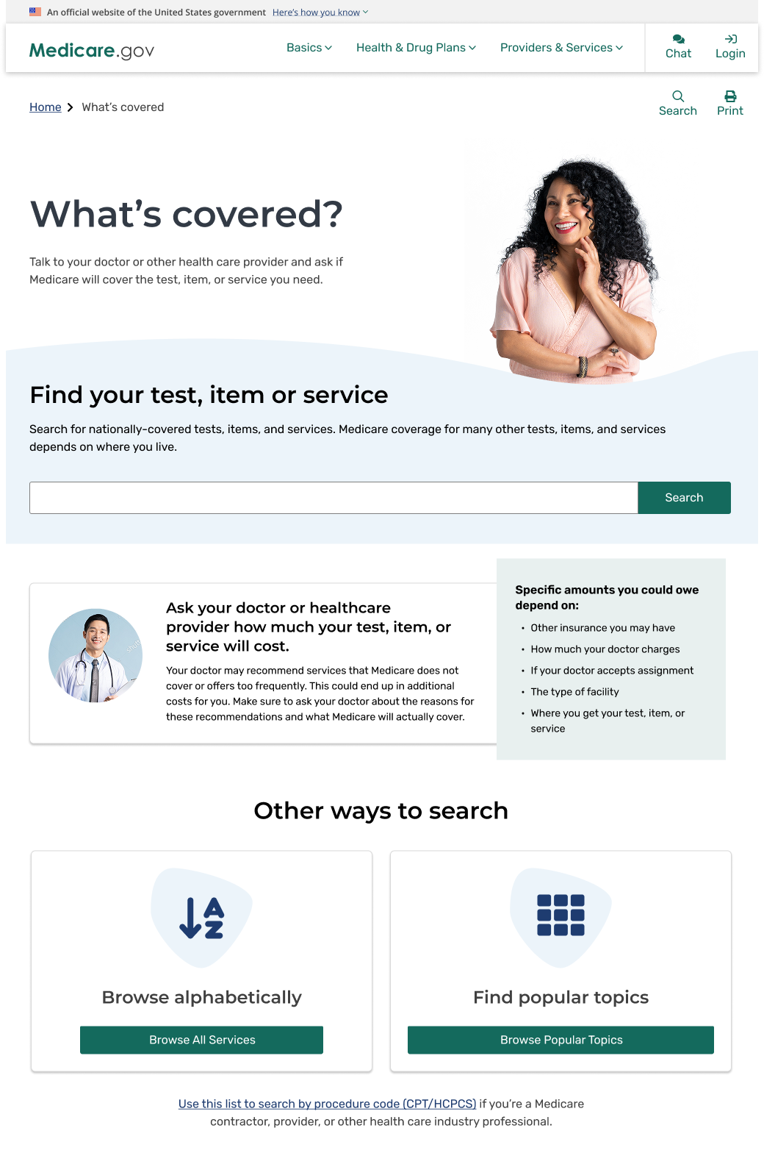
Updates to
“What’s Covered?”
Redesigned landing page with key information about coverage
Now you can browse alphabetically and by content category
Made search bar more noticeable and easier to use
Used structured data to make search results more helpful and easier to scan

