Slide 1

Medicare & Medicaid Fraud, Waste & Abuse Prevention
Notes:
Presenter Notes​
Use Microsoft PowerPoint’s presenter view to check your presentation with speaker notes on one computer (your laptop, for example), while the slides appear on the screen your audience sees (like a larger screen to which you're projecting). For instructions on presenter view, go to: support.microsoft.com/en-us/office/start-the-presentation-and-see-your-notes-in-presenter-view-4de90e28-487e-435c-9401-eb49a3801257​.
Introduction to Content​
The “Medicare & Medicaid Fraud, Waste & Abuse Prevention” presentation discusses Medicare and Medicaid fraud, waste, and abuse prevention.​
Disclaimer​
This presentation was developed and approved by the Centers for Medicare & Medicaid Services (CMS), the federal agency that administers Medicare, Medicaid, the Children’s Health Insurance Program (CHIP), and the Health Insurance Marketplace®.
The information in this module was correct as of September 2026.
This communication was printed, published, or produced and disseminated at U.S. taxpayer expense.

Slide 2

TABLE OF CONTENTS
Topic 1 Overview of Medicare 3-6
Topic 2 Medicare & Medicaid Fraud, Waste & Abuse Overview 7-12
Topic 3 Organizations & Strategies to Detect & Prevent Fraud & Abuse 13-19
Topic 4 How People with Medicare & Medicaid Can Fight Fraud 20-30
Key Points to Remember 31
Appendix:
Medicare & Medicaid Fraud, Waste & Abuse Resource Guide 32-34
Notes:
Presenter Notes​
This presentation, “Medicare and Medicaid Fraud, Waste & Abuse Prevention,” talks about common fraud schemes and how CMS and partner organizations combat fraud, waste, and abuse in health care programs.

Slide 3

TOPIC
1
Overview of Medicare
Notes:
Presenter Notes
Topic 1 explains the parts of Medicare and your Medicare coverage options.
At the end of this topic, you’ll be able to:
Describe Medicare and who it’s for
Identify the parts of Medicare and explain coverage options
The slides in this topic provide a basic context for Medicare. You can add slides as needed from the presentation "Getting Started with Medicare" at CMS.gov/files/document/getting-started-medicare.pptx.

Slide 4

Medicare
Health insurance for:
People 65 or older
Certain people who are under 65 with disabilities
People of any age with End-Stage Renal Disease (ESRD) (permanent kidney failure requiring dialysis or a kidney transplant)
People with ALS (also called Lou Gehrig’s disease)​
NOTE: You must be either a U.S. citizen or U.S. national, a lawful permanent resident (green card holder), a Cuban-Haitian entrant, or lawfully living in the U.S. as a Compact of Free Association (COFA) migrant to get Part A and Part B benefits or join a Medicare health or drug plan.
Notes:
Presenter Notes​
Medicare is health insurance for:
People 65 or older.
Certain people who are under 65 with disabilities who have been getting Social Security Disability Insurance (SSDI) benefits for 24 months.
Individuals with ALS (Amyotrophic Lateral Sclerosis, also called Lou Gehrig’s disease). If you have ALS, you’ll get Medicare automatically the same month you start getting SSDI benefits.
People of any age with End-Stage Renal Disease (ESRD) (permanent kidney failure requiring dialysis or a kidney transplant). For more information on ESRD, visit Medicare.gov/basics/end-stage-renal-disease.
A very small subset of people with an asbestos-related condition associated with a federally-declared environmental health hazard can also get Medicare. Currently, this only applies to people affected by a hazard in Libby, Montana.
You must be either a U.S. citizen or U.S. national, a lawful permanent resident (green card holder), a Cuban-Haitian entrant, or lawfully living in the U.S. as a Compact of Free Association (COFA) migrant to get Part A and Part B benefits or join a Medicare health or drug plan.
For more information on options for people with disabilities, visit Medicare.gov/basics/get-started-with-medicare/before-65.

Slide 5



What Are the Parts of Medicare?
Part A
(Hospital Insurance)
Part B
(Medical Insurance)
Part D
(Drug coverage)
Notes:
Presenter Notes​
The parts of Medicare include:
Part A (Hospital Insurance)
Part B (Medical Insurance)
Part D (Medicare drug coverage)
Part A – Hospital Insurance helps cover:
Inpatient care in hospitals
Skilled nursing facility care
Hospice care
Home health care
Part B – Medical Insurance helps cover:
Services from doctors and other health care providers
Outpatient care
Home health care
Durable medical equipment (like wheelchairs, walkers, hospital beds, and other equipment)
Many preventive services (like screenings, shots or vaccines, and yearly “Wellness” visits)
Part D – Drug coverage helps cover the cost of prescription drugs. Plans that offer Medicare drug coverage (Part D) are run by private insurance companies that follow rules set by Medicare.
Medicare Advantage (also known as Part C) – A Medicare-approved plan from a private company that offers an alternative to Original Medicare for your health and drug coverage. These plans bundle together your Part A, Part B, and usually Part D.

Slide 6
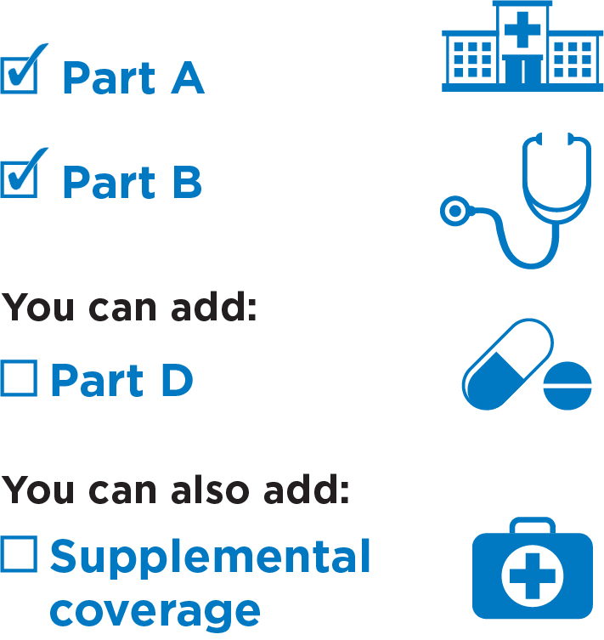
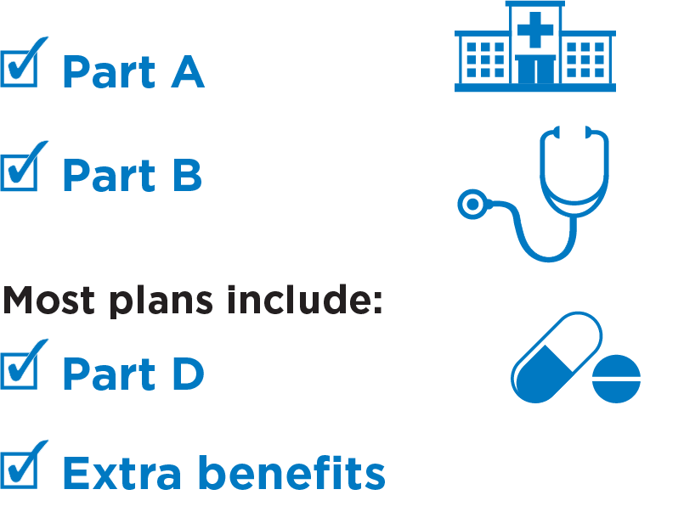
Your Medicare Options
Original Medicare
Medicare Advantage (also known as Part C)
Notes:
Presenter Notes
When you first sign up for Medicare, and during certain times of the year, you can choose how you get your Medicare coverage. There are 2 main ways to get Medicare:
Original Medicare:
Includes Medicare Part A (Hospital Insurance) and Part B (Medical Insurance).
You can use any doctor or hospital in the U.S. that accepts Medicare.
You can join a separate Medicare drug plan to get Medicare drug coverage (Part D).
You can also buy supplemental coverage that helps pay your out-of-pocket costs (like your 20% coinsurance).
You can also add Supplemental coverage. It can help pay some costs that Original Medicare doesn’t. This includes Medicare Supplement Insurance (Medigap), or you may be able to use coverage from a current or former employer or union, or Medicaid (if you qualify).
Medicare Advantage (also known as Part C):
A Medicare-approved plan from a private company that offers an alternative to Original Medicare for your health and drug coverage. These plans bundle together your Part A, Part B, and usually Part D.
You may need to use doctors in its network and get approval (prior authorization) for certain drugs or services.
Usually have different out-of-pocket costs than Original Medicare, including a yearly limit on out-of-pocket costs.
Most plans offer extra benefits that Original Medicare doesn’t cover—like vision, hearing, dental, and more.

Slide 7

TOPIC
2
Medicare & Medicaid Fraud, Waste & Abuse Overview
Notes:
Presenter Notes​
Topic 2 explains fraud, waste, and abuse and who can commit fraud.
At the end of this lesson, you’ll be able to:
Define health care fraud, waste, and abuse
Recognize examples of Medicare and Medicaid fraud
Explain who can commit fraud

Slide 8
Fraud, Waste & Abuse: What’s the Difference?
  Fraud
When someone knowingly deceives, conceals, or misrepresents to obtain money or property from any health care benefit program.
  Waste
Overusing services or other practices that directly or indirectly result in unnecessary costs to any health care benefit program.
  Abuse
When health care providers or suppliers perform actions that directly or indirectly result in unnecessary costs to any health care benefit program.
Notes:
This slide has animation.
Presenter Notes​
Medicare and Medicaid fraud, waste, and abuse affect every American by taking away critical resources from our health care system and making costs rise for everyone. Taxpayer dollars lost to fraud, waste, and abuse harm some of our most vulnerable citizens. Fraud, waste, and abuse differ depending on circumstances, intent, and knowledge.
Fraud occurs when someone knowingly deceives, conceals, or misrepresents themselves or their services to get money or property from a health care benefit program. CMS works to prevent and identify possible fraud. Medicare fraud and Medicaid fraud are criminal acts. Ultimately, our judicial system decides if someone committed an act of fraud. An example of Medicare fraud would be a health care provider who:
Repeatedly and intentionally bills Medicare for services or supplies they didn’t give.
Knowingly bills for services at a level of complexity higher than services actually given or written in the medical records.
Knowingly bills for services or supplies not furnished or provided (or both), including falsifying records to show delivery of such items.
Knowingly orders medically unnecessary items or services for patients.
Pays for referrals of federal health care program beneficiaries.
Bills Medicare for appointments patients fail to keep.
In contrast, waste is overusing services or other practices that directly or indirectly add unnecessary costs to any health care benefit program. Generally, waste isn’t considered a criminal act, but it is the misuse of resources. Examples of waste include:
Using medically-unnecessary services, durable medical equipment (DME), or prescription drugs.
Using more disposable DME or drugs (like syringes, diabetic test strips, disposable diapers or under pads) than needed over a period of time.
Performing a procedure in a more expensive hospital setting when it can be safely done in a provider’s office.
Abuse describes practices that may directly or indirectly result in unnecessary costs to any health care benefit program. Abuse includes any practice that doesn’t give patients medically necessary services or that don't meet professionally recognized standards of care. The difference between abuse and fraud depends on specific facts, circumstances, intent and knowledge. Examples of abuse include:
Charging excessively for services or supplies.
Misusing codes on a claim like upcoding or unbundling codes (upcoding is when a provider assigns an inaccurate billing code to a medical procedure or treatment to increase reimbursement).

Slide 9






Level of Intent
Result in waste: Ordering excessive diagnostic tests
Result in abuse: Improper billing practices (like upcoding)
Result in errors: Incorrect coding that’s not widespread
Inefficiencies
Bending the rules
Result in fraud: Billing for services or supplies that weren’t provided
Mistakes
Intentional deceptions
NOTE: Since our judicial system ultimately determines if an act is fraud, typically we note “potential fraud” until the judicial system has made a decision.
Notes:
This slide has animation.
Presenter Notes​
Honest mistakes can occur. They don’t rise to the level of concern as fraud, waste, and abuse because they're unintended. If the errors become widespread, the effect increases and reflects a systematic problem with an inefficient billing process, which could lead to the level of waste. From there, the level of intent and cost to the system raise to the following classifications. For example, upcoding on billing is abuse, while billing for services or supplies that a beneficiary didn't get is fraud.
NOTE: Since our judicial system ultimately determines if an act is fraud, typically we note "potential fraud" until the judicial system has made a decision.

Slide 10

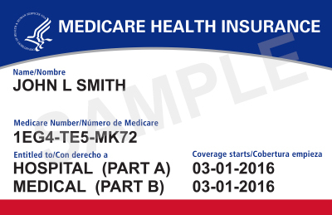
Examples of Possible Fraud
Medicare or Medicaid is billed for services or equipment you never got or you returned.
Someone changes documents to get a higher payment.
A provider intentionally misrepresents dates, descriptions of services, or your identity.
A company intentionally uses false information to mislead you into joining a Medicare health or drug plan.
A provider enrolls you in hospice without your or your family’s permission.
Someone else uses your Medicare or Medicaid card, Medicare Number, or Member ID to bill for services.
Notes:
This slide has animation.
Presenter Notes​
Remember, fraud denotes high-level of intent, someone knowingly and purposefully acted to deceive in order to benefit. Some examples of possible fraud include:
A provider knowingly bills Medicare or Medicaid for services you never got, or for equipment you either never got or you returned
A provider knowingly bills Medicare or Medicaid for services considered impossible (like a provider billing for therapy that totals more than 24 hours within a given day)
Someone intentionally changes documents to get a higher payment
Intentionally misrepresenting dates, descriptions of furnished services, or your identity
A company intentionally uses false information to mislead you into joining a Medicare health or drug plan
A provider enrolls you in hospice without your or your family’s permission
Someone else intentionally uses your Medicare or Medicaid card, or Medicare Number, or member ID to bill for services with or without your knowledge

Slide 11
Beware of Marketing Fraud
Medicare.gov and 1-800-MEDICARE are the official sources of Medicare information. Watch out for people who:
  Pressure you to join their plan by saying you'll lose your Medicare benefits if you don't sign up.
  Say they represent Medicare or give you a service for free.
  Call your home without permission.
  Require you to provide contact information at a plan event.
Medicare is taking quick actions to prevent health care fraud, waste, and abuse. Visit CMS.gov/fraud to learn about success stories fighting fraud.
Notes:
Presenter Notes
There's a higher risk than usual for fraudulent activities during Open Enrollment. Remember that Medicare.gov and 1-800-MEDICARE are the official sources of Medicare information. Medicare has rules about how plans can and can't market their insurance products to you during Medicare’s Open Enrollment Period.
Watch out for people who:
Pressure you to join their plan by saying you'll lose your Medicare benefits if you don't sign up. An agent or broker should never pressure you to join a plan. ​
Say they represent Medicare or give you a service for free.
Call your home without permission. Plans are allowed to send you emails and/or direct mailings, but they aren’t allowed to call you or visit you in person to market their products without your permission. If someone you don’t know calls you about Medicare, hang up.
Require you to provide contact information at a plan event.
Medicare is taking quick actions to prevent health care fraud, waste, and abuse. Visit CMS.gov/fraud to learn about success stories fighting fraud.

Slide 12




Anyone Can Commit Fraud
Doctors, pharmacists, other health care providers, and staff
Durable medical equipment suppliers, hospices, home health organizations, and ambulance services
People with Medicare and/or Medicaid, or people who have stolen their identities
Telemarketing
companies and health plans
Notes:
This slide has animation.
Presenter Notes​
Most people and organizations that work with Medicare and Medicaid are honest, but some aren’t. A small minority of doctors or employees of health care providers may commit fraud or intentionally abuse program rules. We call these people and organizations “problematic providers.”
Sometimes organized crime is at the root of the problem, resulting in financial losses that easily climb into millions of dollars. In less common instances, people with Medicare—or people who have stolen their identities—may commit fraud. CMS is continually taking steps to identify and prosecute offenders.
Along with doctors, pharmacists, and other health care providers and their staff, there have been members of these groups who've committed Medicare and Medicaid fraud, waste, and abuse:
Durable medical equipment suppliers, hospices, home health organizations, and ambulance services
Telemarketing companies

Slide 13

TOPIC
3
Strategies to Detect & Prevent Fraud & Abuse
Notes:
Presenter Notes​
Topic 3 explains what you can do to detect and prevent fraud and abuse.
At the end of this lesson, you’ll be able to:
Recognize fraud schemes
Explain how to protect yourself from fraud
Describe what to do if you have quality of care concerns

Slide 14
Protect Yourself from Medical Identity Theft
Always:
Guard your Medicare and/or Medicaid cards like a credit card.
Check your Medicare Summary Notice (MSN) or Explanation of Benefits (EOB) for errors. If you find errors, call 1-800-MEDICARE.
Hang up if someone calls asking for your Medicare Number or Medicaid Number.
Keep in mind:
If someone promises you free testing, gifts, or money in exchange for your Medicare Number or Medicaid Number, it’s probably a scam.
Applying for or renewing your Medicaid coverage is always free.
Keep your contact information up-to-date with Social Security and your state. If you get a call from someone claiming to be from Medicaid, hang up and call your Medicaid office directly to be sure.
Notes:
This slide has animation.
Presenter Notes​
Medical identity theft is when someone steals or uses your personal information (like your name, Social Security Number, or Medicare Number) to submit fraudulent claims to Medicare and other health insurance companies without your permission. Fraudsters continue to try and bill Medicare and Medicaid for sham tests or treatments and are targeting individuals to illegally get money or Medicare/Medicaid Numbers. For example, if someone asks you for your Medicare Number or Medicaid Number to get a vaccine or booster, it’s probably a scam.
Always:
Guard your Medicare and/or Medicaid cards like a credit card.
When you get health care services, record the dates on a calendar. Save the receipts and statements you get from providers to check for mistakes. If you have Original Medicare and think there’s a billing error or a provider bills you for services you didn’t get, check your Medicare Summary Notice (MSN) or Explanation of Benefits (EOB). If you’re in a Medicare health plan, check the statements you get from your plan. If you find errors, call 1-800-MEDICARE.
Hang up if someone calls asking for your Medicare Number or Medicaid Number.
Keep in mind:
If someone promises you free testing, gifts, or money in exchange for your Medicare Number or Medicaid Number, it’s probably a scam.
Applying for Medicaid is always free. You don’t need to pay anything or provide a credit card number when applying for benefits through your state.
Keep your contact information up-to-date with Social Security and your state. If you get a call from someone claiming to be from Medicaid, hang up and call your Medicaid office directly to be sure.

Slide 15

Preventing Fraud in Medicare Health & Drug Plans
The plan’s giving free meals at a marketing event.
A plan
representative visited my home uninvited and encouraged me to enroll.
Who to call if you have a concern about fraud:
1-800-MEDICARE:
(1-800-633-4227)
TTY:
1-877-486-2048
A plan’s offering cash if I join.
I got an unwanted email without an “opt-out” function.
I’m getting calls and texts from a plan without my permission, and I’m not a member.
A representative tried to talk with me about their plan in the hospital patient room.
Notes:
This slide has animation.
Presenter Notes​
Providers aren’t the only ones who can prevent Medicare fraud. Medicare health and drug plans have responsibilities beyond billing. Plans are responsible for marketing in ways that protect you and the Medicare Program from fraud. This includes the plan’s agents or brokers who represent them.
Here are some examples of activities that Medicare plans and their representatives aren’t allowed to do:
Send you unwanted emails without an “opt-out” function
Visit your home uninvited, to encourage you to join their plan
Call or text non-members (unless you give them permission)
Offer you cash to join their plan (nominal, noncash gifts under $15 are allowed)
Give free meals at sales or marketing events (Plans can offer meals at educational events; marketing events are limited to light snacks and refreshments)
Talk to you about their plan in restricted areas like exam rooms, hospital patient rooms, treatment areas, and pharmacy counters (areas where you get health care)
For more information, visit Medicare.gov/health-drug-plans/health-plans/your-coverage-options/plan-marketing-rules.
To report plans that ask for your personal information over the phone or that call you without your permission to enroll you in a plan, call 1-800-MEDICARE (1-800-633-4227). TTY users can call 1-877-486-2048.

Slide 16
Common Fraud Examples
Remote Patient Monitoring (RPM)
Durable medical equipment (DME) companies and/or telemarketing companies signing up people with Medicare for medical devices like scales, glucose monitors, cardiac rhythm devices, etc., even when they don't need the devices medically
Urinary Catheters
Dishonest DME companies targeting people with Medicare for personal information, then billing Medicare monthly for urinary catheters not needed medically and that may or may not be sent to you
Notes:
Presenter Notes​
Scammers might target you through phone calls, internet ads, and text messages with offers of free services, medical equipment, or gift cards upon confirming your personal information and eligibility for specific Medicare services. Here are 2 common examples of fraudulent services and equipment.
Legitimate remote patient monitoring, or RPM, involves using medical devices like scales, glucose monitors, blood pressure cuffs, cardiac rhythm devices, and other equipment to remotely monitor for anomalies in patients with chronic medical conditions. It's beneficial if you have a condition that might deteriorate quickly, where monitoring can reduce complications, hospitalizations, or death. However, some unscrupulous companies sign people up for RPM even if they don't need it medically. Scammers have several ways to make contact. They may try "cold calling” by phone, place internet ads (“click bait”), or television advertising. These contacts may come from a durable medical equipment (DME) company or pharmacy. They may or may not send you the equipment. If they do send equipment, it might not be Food & Drug Administration (FDA)-approved. They then bill Medicare for set-up, patient teaching, and monthly monitoring of data. Most often, the monthly monitoring never happens, but you're billed monthly anyway.
Scammers might entice you by saying you're “qualified” for items “at no cost” or “free.” For the urinary catheter scam, dishonest DME companies might use your personal information to bill Medicare monthly for urinary catheters not needed medically and that may or may not actually be sent to you.
If you think you're being targeted for the remote patient monitoring scam or urinary catheter scam, keep a record of any suspicious encounters and report them to 1-800-HHS-TIPS (1-800-447-8477) or OIG.HHS.gov/fraud/hotline.

Slide 17
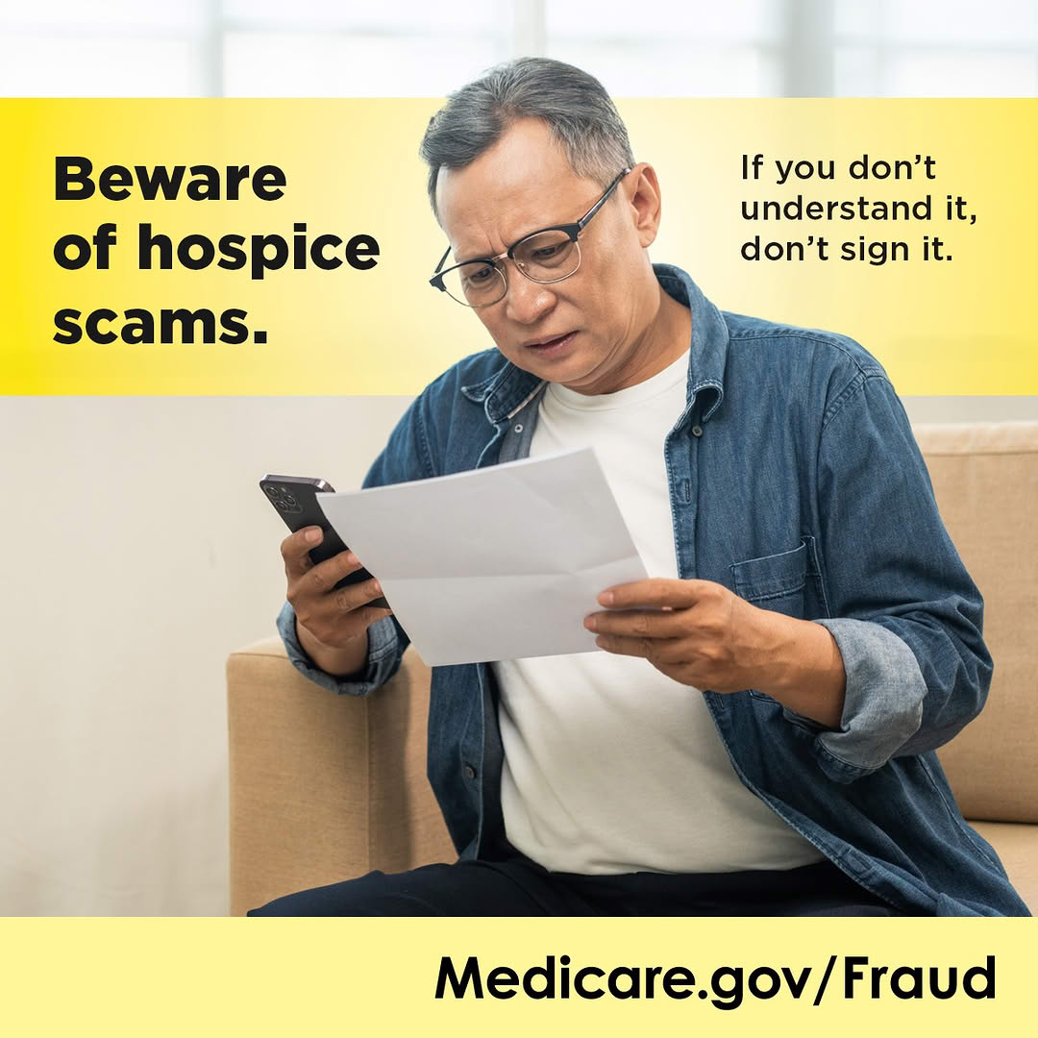
Hospice Fraud
Occurs when Medicare Part A (Hospital Insurance) or Medicaid is falsely billed for any level of hospice care or service
To avoid hospice scams, remember:
  Only your doctor or a hospice doctor can certify you’re terminally ill (with a life expectancy of 6 months or less).
  If you aren't terminally ill, you shouldn't receive hospice care.
  Never accept gifts in return for signing up for hospice services.
  Medicare will never provide “free” services like housekeeping or cooking in return for your Medicare Number.
Notes:
This slide has animation.
Presenter Notes​
Hospice fraud occurs when Medicare Part A (Hospital Insurance) is falsely billed for any level of hospice care or service.
Remember this advice to avoid hospice scams:
Only your doctor or a hospice doctor can certify you’re terminally ill (with a life expectancy of 6 months or less).
If you aren't terminally ill, you shouldn't receive hospice care.
Never accept perks or gifts in return for signing up for hospice services.
Medicare will never provide “free” services like housekeeping or cooking in return for your Medicare Number.

Slide 18
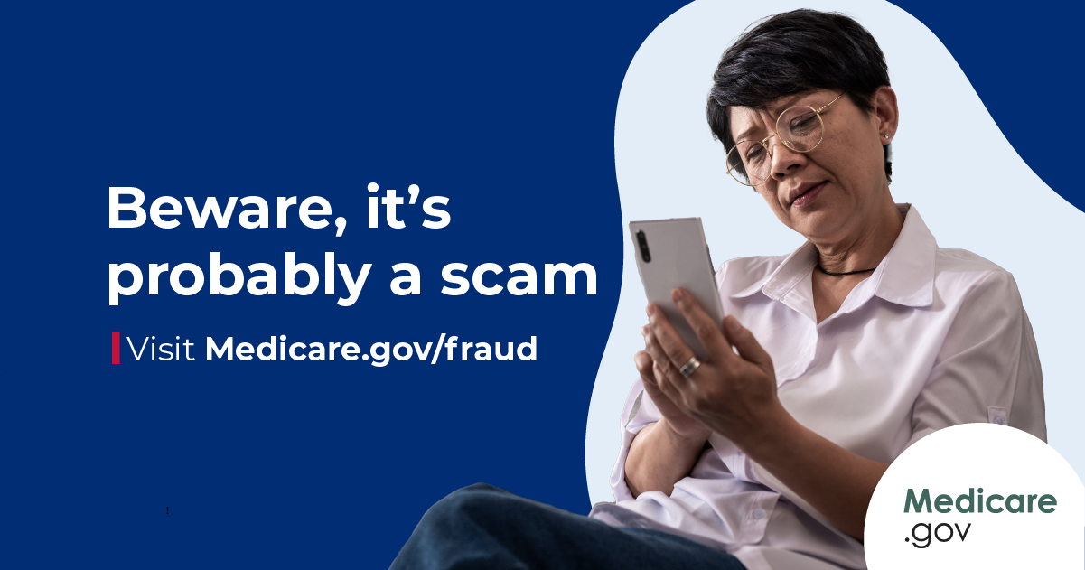
Home Health Fraud
Occurs when Medicare or Medicaid is charged for:
Home health services when you didn't meet Medicare’s or Medicaid's “homebound” criteria
Services that weren't deemed medically necessary by your doctor
Home health services like skilled nursing care and/or therapy services that weren't provided
To avoid home health scams:
Read your MSN or EOB to compare the services Medicare was charged with what you received and report charges on your MSN or EOB for services or visits you didn't get.
Work with your doctor to enroll you in any home health services you may need and to determine medical necessity for these services.
Don't accept gifts (like money, gift cards, or groceries) in return for home
health services.
Don't sign up for housekeeping or medication services from someone who comes to your door claiming they can provide home health services.
Notes:
This slide has animation.
Presenter Notes​
Home health includes a wide range of health care services that you can get in your home for an illness or injury to help you get better, maintain your current condition or level of function, or slow your rate of decline. Medicare covers certain home health services if you’re eligible. For more information about home health coverage, visit Medicare.gov/coverage/home-health-services.
Home health fraud occurs when Medicare or Medicaid is charged for:
Home health services when you didn't meet Medicare's "homebound" criteria. (You can find these criteria at Medicare.gov/coverage/home-health-services.)
Services that weren't deemed medically necessary by your doctor. "Medically necessary" means services or supplies that meet accepted standards of medical practice to diagnose or treat your medical condition.
Home health services like skilled nursing care and/or therapy services that weren't provided
To avoid home health scams:
Read your MSN or EOB to compare the services Medicare was charged with what you received and report charges on your MSN or EOB for services or visits you didn't get.
Work with your doctor to enroll you in any home health services you may need and to determine medical necessity for these services.
Don't accept gifts (like money, gift cards, or groceries) in return for home health services.
Don't sign up for housekeeping or medication services from someone who comes to your door claiming they can provide home health services.

Slide 19





Durable Medical Equipment (DME) Fraud
Potential DME scams:
Calls or visits from people saying they represent Medicare or Medicaid
Phone or door-to-door selling techniques
Requests for your Medicare Number
Getting items you
didn’t order
Notes:
This slide has animation.
Presenter Notes​
There are telemarketing rules for DME. The law prohibits DME suppliers (people who sell equipment like diabetic supplies and power wheelchairs), and anyone representing the supplier from directly selling their products to you, unless given prior consent. This includes contacting you by phone, text message, computer, email, instant messaging, and in-person contact.
Potential DME scams include:
Calls or visits from people saying they represent Medicare or Medicaid
Phone or door-to-door selling techniques
Equipment or service, like “free” diabetic testing supplies, heating pads, braces or orthotics, is offered for free and then you're asked for your Medicare Number for what they claim is “record-keeping purposes”
Being told that Medicare will pay for the item or service if you give them your Medicare Number
Supplies you never ordered are delivered to you, like for urinary catheters
A main goal of these scams is to get your Medicare Number and bill Medicare for services or items that you don’t need or never get. Or they may ship you supplies that you never ordered and then bill your Medicare Number. You’re under no obligation to accept items that you didn’t order and should refuse delivery or return to the sender. Keep a record of the sender’s name and the date you returned the item(s).
Also, Medicare has policies that require suppliers to contact you before they can send you DME refills, to make sure you still need those supplies or need them as frequently as you did before. Medicare now requires documentation indicating you confirmed the need for the refill within the 30-day period before the end of your current supply. Also, Medicare requires you get DME items no sooner than 10 calendar days before the expected end of the current supply.
It’s important to review your MSN or claims statements from your Medicare plan for charges that you don’t recognize. To report suspected DME scams or any other suspected Medicare fraud, call 1-800-MEDICARE (1-800-633-4227). TTY users can call 1-877-486-2048.

Slide 20

TOPIC
4
How We Can Fight Fraud Together
Notes:
Presenter Notes​
Topic 4 explains how to fight and report fraud.
At the end of this lesson, you’ll be able to:
Understand why it’s important to protect personal information
Identify resources to help fight fraud
Explain the 4 Rs for fighting Medicare fraud
Describe how to prevent and report identity theft
Know how to report suspected Medicare and Medicaid fraud

Slide 21

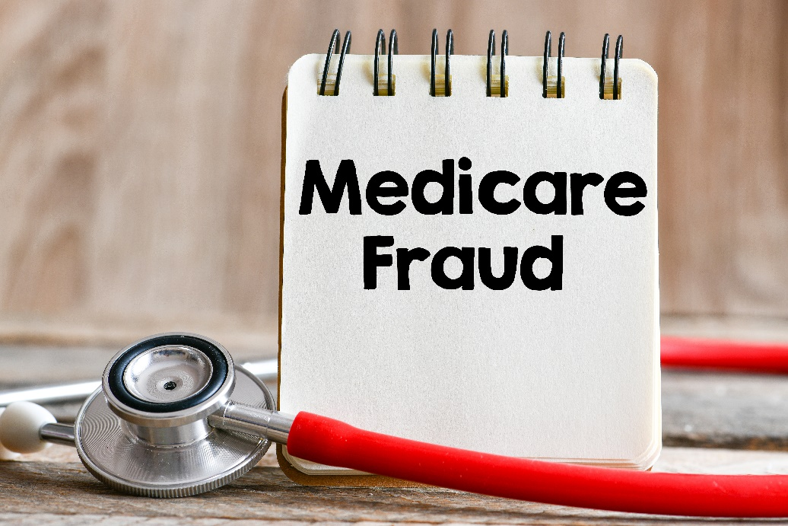


Consequences of Sharing Your Health Care Card or Number
You could be on the hook for cost-sharing, or sharing your number could use up your benefits too soon, when you need them.
You could be charged with health care fraud if you intentionally participated.
You might lose your benefits.
You could be placed into a lock-in or a drug management program.
Notes:
This slide has animation.
Presenter Notes​
There are consequences if you share your health care card or number with anyone other than your health care providers or a trusted caregiver.
Your medical records could be wrong—the next time you go to the doctor, you’ll have to explain what happened, so you don’t get the wrong kind of care.
Your number could be misused for items or services you didn't need. You could be on the hook for cost-sharing, or sharing your number could use up your benefits too soon, when you need them.
If you intentionally participated, you could be charged with health care fraud and spend time in jail if found guilty.
You might lose your benefits.
If you have Medicaid, you can be limited to certain doctors, drug stores, or hospitals. This is called a lock-in program. If you have Medicare drug coverage, you could be placed under a drug management program.
Lock-in may be used for people with Medicaid who are:
Visiting hospital emergency department for non-emergency health concerns
Using 2 or more hospitals for emergency department services
Using 2 or more doctors resulting in duplicated medications and/or treatments
Exhibiting possible drug-seeking behavior, like:
Requesting a specific scheduled medication (narcotics)
Requesting early refills of scheduled medications
Reporting frequent losses of scheduled medications
Using multiple pharmacies to fill prescriptions
For more information about Medicaid fraud prevention efforts, visit Medicaid.gov/medicaid/program-integrity.

Slide 22

The Senior Medicare Patrol (SMP)
Educates people with Medicare on preventing, identifying, and reporting health care fraud
Seeks volunteers to represent their communities
Hears complaints from people with Medicare
NOTE: SMP has active programs in all states, the District of Columbia, Puerto Rico, U.S. Virgin Islands, and Guam. Find help in your state at smpresource.org. Visit smpresource.org/medicare-fraud for resources.
Notes:
Presenter Notes​
Senior Medicare Patrols (SMPs) use outreach, counseling, and education to empower and help you, your families, and caregivers to prevent, detect, and report health care fraud, errors, and abuse. SMPs are grant-funded projects of the U.S. Department of Health & Human Services (HHS), Administration for Community Living (ACL).
SMP work covers 3 main areas:
Conduct outreach and education. SMPs give presentations to groups, show materials at event exhibits, and can work one-on-one with you. The SMP program engages approximately 5,300 volunteers nationally who collectively conduct group outreach events.
Engage volunteers to protect older persons’ health, finances, and medical identity while saving Medicare dollars.
Follow up on complaints that you, caregivers, and family members bring to the SMP. The SMP makes a determination about whether or not they suspect fraud, errors, or abuse. They seek to resolve errors. When they suspect fraud or abuse, they make referrals to the appropriate state and federal agencies for investigation.
There are SMP programs in each state, the District of Columbia, Puerto Rico, Guam, and the Virgin Islands. Each Centers for Medicare & Medicaid Services (CMS) office location has an SMP liaison. SMPs seek volunteers to represent the program in their communities.
For an in-depth overview of the SMP program, and for information for your local area, visit smpresource.org, or call the nationwide toll-free number at 1-877-808-2468. You'll get information about the SMP program and get connected to the SMP in your state for individualized assistance. You can also email them at info@smpresource.org. You can also visit smpresource.org/medicare-fraud for resources.

Slide 23
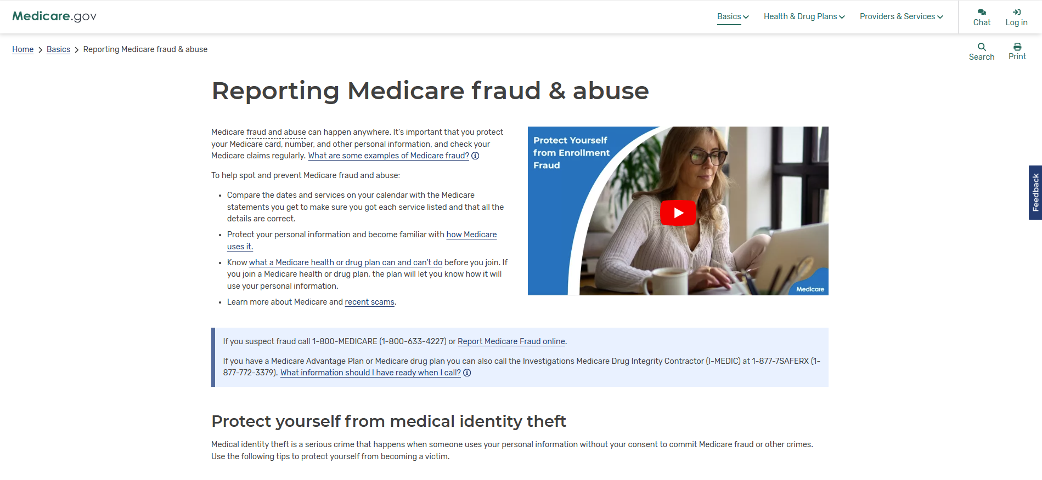
Fraud & Abuse Information on Medicare.gov
Notes:
Presenter Notes​
You’re the first line of defense against Medicare fraud. Visit Medicare.gov/fraud for:
Tips to prevent fraud
How to spot fraud
How to report fraud (to 1-800-MEDICARE, the Medicare Drug Integrity Contractor, or the HHS Office of Inspector General (OIG))
Rules for people selling Medicare plans

Slide 24
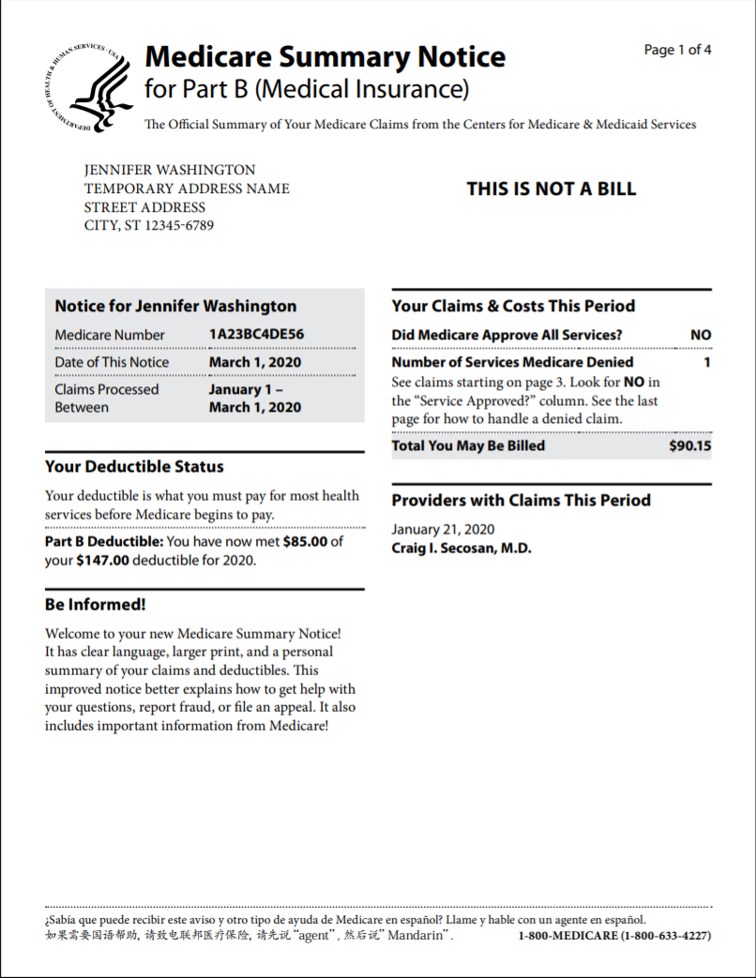
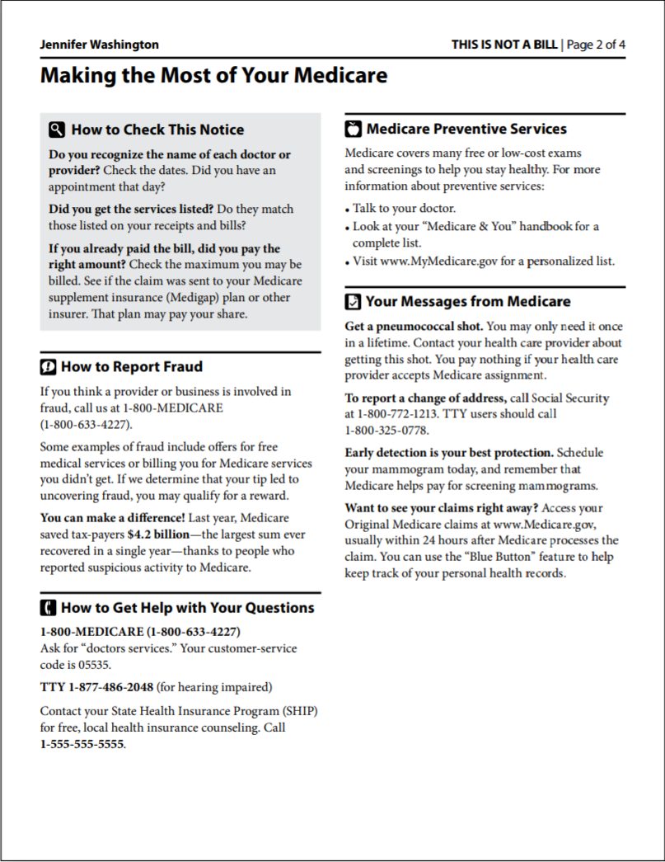
Medicare Summary Notice (MSN)
Notes:
This slide has animation.
Presenter Notes​
Review Medicare Summary Notices (MSNs) you get for Medicare Part A (Hospital Insurance), Medicare Part B (Medical Insurance) and durable medical equipment (DME) carefully.
MSNs show:
All services and supplies that were billed to Original Medicare
What Medicare paid
What you owe each provider
Make sure you got all of the services and supplies listed. If you have other insurance, check to see if it covers anything Medicare didn’t. Keep your receipts and bills and compare them to your MSN to be sure you got all the services, supplies, or equipment. If you paid a bill before you got your notice, compare your MSN with the bill to make sure you paid the right amount. If an item or service is denied, call your doctor’s or health care provider’s office to make sure they submitted the correct information. If not, the office may resubmit. If you disagree with any decision made, you can file an appeal. If you find items listed in your claims that you don’t have a record of, it’s possible that you or Medicare may have been billed for services or items you didn’t get. If you think a charge is incorrect and you know the provider, you may want to call their office to ask about it. The person you speak to may help you better understand the services or supplier you got. Or, your provider may realize a billing error was made.
If you’ve contacted the provider and you suspect Medicare is being charged for items or services you didn’t get, or you don’t know the provider on the claim, report the suspected fraud to 1-800-MEDICARE (1-800-633-4227); TTY: 1-877-486-2048. For more information or to view samples of the Part A, Part B, and/or DME MSNs, visit Medicare.gov/basics/forms-publications-mailings/mailings/costs-and-coverage/medicare-summary-notice.
Part A MSN: Medicare.gov/pubs/pdf/summarynoticea.pdf
Part B MSN: Medicare.gov/Pubs/pdf/summarynoticeb.pdf
DME MSN: Medicare.gov/pubs/pdf/SummaryNoticeDME.pdf
The fastest way to check your MSNs for fraud or errors is to access them electronically. To do so, log into (or create) your secure account on Medicare.gov. We'll discuss going digital with Medicare and signing up for electronic MSNs on the next slide.

Slide 25

Electronic Medicare Summary Notice (eMSN)
You can sign up to get your MSNs electronically (eMSN)
Log into (or create) your secure Medicare account at Medicare.gov/account, and use ID.me, CLEARme.com, or Login.gov to verify your identity and help prevent fraud
You’ll get an email with a link to your MSN for any month you have a processed claim
You don’t have to wait 6 months
You’ll no longer get the mailed
paper copy
Notes:
This slide has animation.
Presenter Notes​
You can sign up to get your MSNs electronically. Log into (or create) your secure Medicare account at Medicare.gov/account.
Use ID.me, CLEARme.com, or Login.gov to verify your identity and help prevent fraud.
Under “Edit my…” select “Account Settings.“
Email and document settings will include options to select paper or electronic versions of the MSN and the “Medicare & You” handbook.
If you choose to get eMSNs, you won’t get printed copies of your MSNs in the mail. You’ll get an email with a link to your MSN for any month you have a processed claim.
eMSNs help you:
Prevent fraud by making sure you’re billed only for the services you’ve gotten
Catch errors in billing and services
Eliminate stacks of paper—save or print only what you need
Track your monthly claims and costs
Check your remaining deductible amount

Slide 26
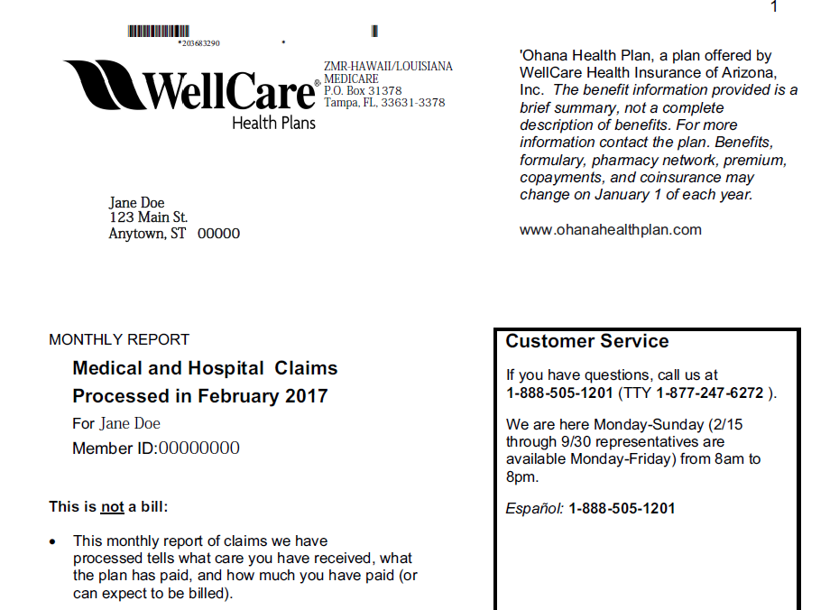
Explanation of Benefits
Sent by Medicare drug plans and Medicare Advantage Plans
Gives you clear and timely information about your claims and costs
Notes:
This slide has animation.
Presenter Notes​
Your Medicare drug plan or Medicare Advantage Plan will send you an Explanation of Benefits (EOB) each month you fill a prescription, visit a health care provider, or file a claim. The EOB gives you a summary of your claims and costs.

Slide 27
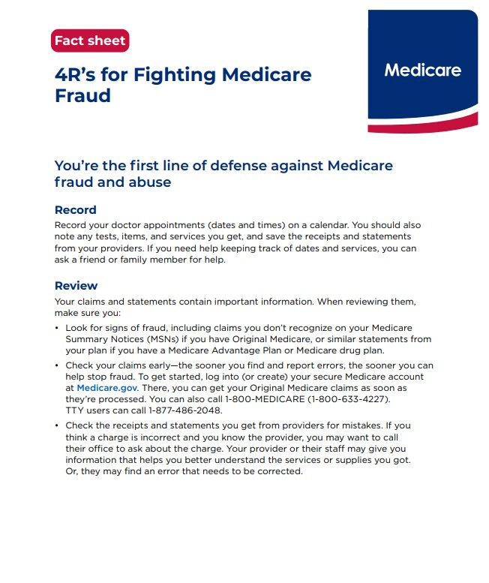
“4 Rs” to Fight Medicare Fraud
Record appointments and services
Review services provided
Report suspected fraud
Remember to protect personal information (“guard your card”)
For more information, visit Medicare.gov/publications to review “4 Rs for Fighting Medicare Fraud” (Medicare Product No. 11610)
Notes:
Presenter Notes​
Next, we're going to talk about the 4 Rs to fight Medicare fraud:
Record the dates of doctor’s appointments on a calendar. Note the tests and services you get, and save the receipts and statements from your providers. If you need help, ask a friend or family member. Contact your local SMP program to get a free “Personal Health Care Journal.” Use the SMP locator at smpresource.org, or call 1-877-808-2468 to find the SMP program in your area.
Review your MSNs or similar statements from your plan for signs of fraud, including claims you don’t recognize. Compare the dates and services on your calendar with the statements your get from Medicare or your Medicare plan to make sure you got each service listed and that all the details are correct. If you see items listed in your claims that you don’t have a record of, it’s possible you, Medicare, or your Medicare plan may have been billed for services or items you didn’t get. To review your Medicare Part A and Part B claims, log into (or create) your secure Medicare account at Medicare.gov, or call 1-800-MEDICARE (1-800-633-4227). TTY users can call 1-877-486-2048. You can get help from your local SMP program with checking your MSNs for errors or suspected fraud. If you’re in a Medicare Advantage Plan or Medicare drug plan, call your plan for more information about a claim.
Report suspected Medicare fraud by calling 1-800-MEDICARE (1-800-633-4227). TTY users can call 1-877-486-2048. Have your Medicare card or Medicare Number and the claim or MSN ready. If you identify errors or suspect fraud, the SMP can also help you make a report to Medicare.
Remember to protect your Medicare Number. Don’t give it out, except to people you know should have it, like your doctor or other health care provider. Never give out your Medicare Number for a special offer. Medicare will never contact you and ask for personal information, like your Medicare Number or bank account numbers. Never let someone use your Medicare card, and never use another person’s card.
For more information, visit Medicare.gov/publications to review “4 Rs for Fighting Fraud,” (CMS Product No. 11610).

Slide 28
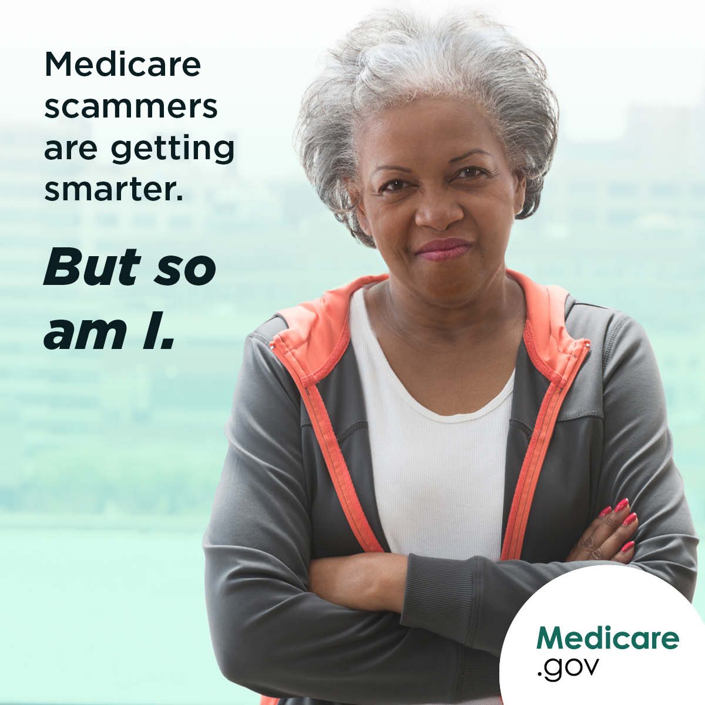
Call Medicare
Call to make a complaint or report fraud
Have this information ready:
  Provider’s name and any identifying number you have
  Information about the item or service, including date and payment amount
  Date on your MSN
  Your name and Medicare Number
Call Medicare if you have concerns:
1-800-MEDICARE (1-800-633-4227). TTY users can call 1-877-486-2048.
Notes:
This slide has animation.
Presenter Notes​
Call Medicare at 1-800-MEDICARE (1-800-633-4227; TTY: 1-877-486-2048) if you need to need to make a complaint or report fraud.
You can use the Interactive Voice Response (IVR) system to access 15 months of Original Medicare claims processed on your behalf.
Carefully review the facts before you report errors, fraud, or abuse.
Have this information ready to report:
Provider’s name and any identifying number you may have
Information on the service or item you’re questioning including the date the service or item was supposedly given or delivered and payment amount approved and paid by Medicare
The date on your MSN
Your name and Medicare Number (as listed on your Medicare card)
The information you give helps Medicare:
Target providers or suppliers with multiple consumer complaints for further review.
Track fraud complaints to show when fraud scams are heating up in new areas.

Slide 29
Identity Theft
An example of identity theft is when someone else uses your personal information, like your Social Security Number (SSN) or your Medicare or Medicaid Number, to commit fraud
Medical identity theft can result in:
  False or missed diagnoses
  Treatment for conditions you don’t have
  Incorrect lab results
  Bills for services you didn’t get
  Denied services or prescriptions
  Inaccurate medical history records
If you think someone is using your information:
  Visit Identitytheft.gov
  Call the Federal Trade Commission’s ID Theft Hotline at 1-877-438-4338
  (TTY: 1-866-653-4261)
  Visit FTC.gov/idtheft to file a complaint online
  If you think someone else is using your Medicare Number, call 1-800-MEDICARE (1-800-633-4227) (TTY: 1-877-486-2048)
Notes:
Presenter Notes​
Along with fraud, you should also be on the lookout for identity theft. An example of identity theft is when someone else uses your personal information, like your Social Security Number (SSN), to commit fraud.
Medical identify theft is a special type of identity theft where someone uses your Medicare or Medicaid Number to submit fraudulent claims to Medicare, Medicaid, or other insurers without your permission. It's a serious crime.
Medical identity theft can result in:
False or missed diagnoses
Treatment for conditions you don’t have
Incorrect lab results
Bills for services you didn’t get
Denied services or prescriptions
Inaccurate medical history record
Call 1-800-MEDICARE (1-800-633-4227) right away if you think someone else is using your Medicare Number. TTY users can call 1-877-486-2048.
If you suspect identity theft, or feel like you gave your personal information to someone you shouldn’t have:
Visit Identitytheft.gov
Call the Federal Trade Commission’s ID Theft Hotline at 1-877-438-4338. TTY users can call 1-866-653-4261
Visit FTC.gov/idtheft for more information about identity theft or to file a complaint online
Watch a Public Service Announcement about Medical Identity Theft from OIG at youtube.com/watch?v=r_RNBFGgw1Q.

Slide 30
Reporting Suspected Medicaid Fraud
Report suspected Medicaid fraud to:
Medicaid Fraud Control Unit
(MFCU)
Office of Inspector General
(OIG)
State Medical Assistance (Medicaid)
office
Notes:
This slide has animation.
Presenter Notes​
If you suspect Medicaid errors, fraud, or abuse, you can report them to one of the following:
Medicaid Fraud Control Units (MFCUs). MFCUs investigate and prosecute Medicaid fraud as well as patient abuse and neglect in health care facilities. You may file complaints of suspected Medicaid fraud directly to an MFCU. Download contacts at OIG.HHS.gov/fraud/medicaid-fraud-control-units-mfcu/files/contact-directors.pdf.
Office of Inspector General (OIG) at the U.S. Department of Health & Human Services (HHS). OIG certifies and annually re-certifies each MFCU. You have 3 ways to report fraud to OIG:
Online: tips.OIG.HHS.gov
Mail: HHS Tips Hotline, P.O. Box 23489, Washington, DC 20026-3489
Phone: 1-800-447-8477 (TTY: 1-800-377-4950)
Your State Medical Assistance (Medicaid) office. Find your state's office at Medicaid.gov/about-us/where-can-people-get-help-medicaid-chip.
Learn more about Medicaid fraud at Medicaid.gov/medicaid/program-integrity.

Slide 31
Key Points to Remember
Differences between fraud, waste, and abuse depend on circumstances, intent, and knowledge.
Fraud schemes change often - check online resources for the most up-to-date information.
Fight fraud, waste, and abuse with the 4 Rs:
Record details about your visits
Review statements
Report suspicious activity
Remember to protect your information
Notes:
Presenter Notes​
To recap, today we discussed:
Differences between fraud, waste, and abuse depend on circumstances, intent, and knowledge.
Fraud occurs when someone intentionally deceives, conceals, or makes misrepresentations to get money or property from a health care benefit program. Ultimately, our judicial system determines if someone committed an act of fraud.
In contrast, waste is the overuse of services, or other practices that, directly or indirectly, add avoidable costs to the Medicare and Medicaid Programs. Generally, waste isn’t considered to be a criminal act, but rather the misuse of resources.
Fraud schemes change often. Check online resources for the most up-to-date information.
Fight fraud, waste, and abuse with the 4 Rs: record, review, report, and remember.
You are the first line of defense when it comes to fighting Medicare and Medicaid waste, fraud, and abuse.

Slide 32

Appendix
Medicare & Medicaid
Fraud, Waste & Abuse
Resource Guide

Slide 33
Medicare & Medicaid Fraud, Waste & Abuse
Resource Guide
Resources
Centers for Medicare & Medicaid Services | Call 1-800-MEDICARE (1-800-633-4227) (TTY: 1-877-486-2048) CMS.gov/fraud Medicare.gov/fraud Medicaid.gov/medicaid/program-integrity Medicaid.gov/about-us/where-can-people-get-help-medicaid-chip
Social Security | SSA.gov/fraud
Senior Medicare Patrol (SMP) | Call 1-877-808-2468 smpresource.org
National Health Care Anti-Fraud Association | nhcaa.org
U.S. Department of Health & Human Services (HHS) Office of the Inspector General (OIG) | Call 1-800-HHS-TIPS (1-800-447-8477) (TTY: 1-800-377-4950) tips.OIG.HHS.gov
Notes:
Presenter Notes​
This resource guide consists of contact information and websites for many of the resources we discussed today for fighting Medicare and Medicaid fraud, waste and abuse.

Slide 34
Medicare & Medicaid Fraud, Waste & Abuse
Resource Guide (continued)
Videos
Stop Medicare Fraud: Protect Your Info and Report Scams
Protect Yourself from Enrollment Fraud
Publications
“Protecting Yourself from Fraud” (CMS Product No. 10111)
“4 Rs for Fighting Medicare Fraud” (CMS Product No. 11610)
To access the publications, visit Medicare.gov/publications and search by keyword or product number.
Notes:
This slide has animation.
Presenter Notes​
This slide shows some more helpful products you can find on Medicare.gov/publications, and videos posted to youtube.com/@CMSHHSgov.

