Slide 1

Medicare
Open Enrollment
September 2026

Slide 2

2 Main Ways to Get Medicare Coverage
Original Medicare:
  Get your health care through Medicare Parts A and B
  Can join a separate drug plan to get Medicare drug coverage (Part D)
  Can see any doctor that takes Medicare anywhere in U.S.
Medicare Advantage:
  Usually bundles health and drug coverage all in one plan
  May offer extra benefits that Original Medicare doesn’t cover - like certain vision, hearing, and dental services
  In many cases, you can only use doctors in the plan’s network

Slide 3

Medicare’s Open Enrollment Period
Runs October 15 – December 7 every year
You can make changes to your health or drug coverage
Compare your options to find the right coverage for you
Notes:
What is Medicare’s Open Enrollment Period? Medicare’s Open Enrollment Period (OEP) runs from October 15 through December 7 each year. During this time, you can make certain changes to your health insurance coverage, including adding, dropping, or changing your Medicare Advantage and Part D coverage.
Open Enrollment is for all people with Medicare, which is health insurance for people 65 or older, certain people under 65 with disabilities, and people of any age with End-Stage Renal Disease (ESRD) or ALS (also called Lou Gehrig’s disease).
Even if you are happy with your current health and drug coverage, Medicare’s Open Enrollment Period is a good time to review what you have, compare it with other options, and make sure that your current coverage still meets your needs for the coming year.
If you've reviewed your options and you're happy with your current coverage, you don't need to do anything.
After December 7th, people with Medicare may have to wait until next year’s Open Enrollment period to review and make changes. This is why we strongly encourage people with Medicare to review their coverage right now. Even if they are happy with their current coverage, they might find something that’s a better fit for their budget or health needs.

Slide 4
Review Your Plan’s Annual Notice of Change
Review your plan’s Annual Notice of Change (ANOC) documents to learn about changes in 2027:
  Costs
  Benefits and coverage rules
  Drug formulary (list of covered drugs)
  Provider and pharmacy networks
Notes:
If you have a Medicare Advantage Plan or a stand-alone Part D plan, read your plan’s Annual Notice of Change (ANOC) and/or Evidence of Coverage (EOC). Review these notices for any changes in a) the plan’s costs, b) the plan’s benefits and coverage rules, or c) the plan’s formulary (list of drugs your plan covers). Make sure your drugs will still be covered next year and that your providers and pharmacies are still in the plan’s network.
If you are unhappy with any of your plan’s changes or your plan’s performance, you can enroll in a new plan. If you want help reviewing your options, contact your State Health Insurance Assistance Program (SHIP) for unbiased health insurance counseling. Contact information for your SHIP is at the end of this presentation or visit shiphelp.org.
You should get your Annual Notice of Change by October 1, 2026.

Slide 5
Open Enrollment: What You Can Do
Join a new Medicare Advantage (MA) Plan
Join a new Part D drug plan
Switch from Original Medicare to MA
Switch from MA to Original Medicare (with or without a Part D plan)
Changes effective January 1, 2027
Notes:
You can make as many changes as you need to your Medicare coverage during Open Enrollment.
Depending on where you live, you may have a right to buy a Medigap policy, which helps pay Original Medicare costs. Limitations apply as to who can buy a Medigap and when. Contact your SHIP to ask about state specific Medigap rights and options.
The last change you make will take effect on January 1, 2027.

Slide 6

Medicare Advantage Considerations
Check if the plan includes Medicare drug coverage.
Review a plan's estimated total costs to you, including premium, deductible, and other out-of-pocket costs.
Check if the plan offers extra benefits, like vision, hearing, or dental coverage
Find out if your health care providers are in the plan's network.
Check star ratings to see how Medicare and other people with Medicare rated the plan's care and services.
Understand how the plan works with other coverage you may have.
Notes:
Ask yourself the following questions before choosing a Medicare Advantage Plan:
How much are your premiums, deductibles, and other costs? How much do you pay for services like hospital stays or doctor visits? Is there a yearly limit on what you could pay out-of-pocket for medical services? Make sure you understand any coverage rules that may affect your costs. A low monthly premium may not always be the best overall value for your specific needs.
Does the plan include Medicare drug coverage?
Plans must cover all medically necessary services that Original Medicare covers. In many cases, you may need to get approval from your plan before it covers certain services or supplies. Does the plan also offer some extra benefits that Original Medicare doesn’t cover—like certain vision, hearing, and dental services?
Do your doctors accept the coverage? Are the doctors you want to see accepting new patients?
Do you have to choose your hospital and health care providers from a network? Do you need to get referrals?
Are you satisfied with your medical care? The quality of care and services offered by plans and other health care providers can vary. How have Medicare and other people with Medicare rated your health and drug plan’s care and services?
Will this plan affect any additional coverage I may have?

Slide 7
Medicare Part D Drug Coverage Considerations
Before you choose a Medicare Advantage Plan that includes drug coverage or a standalone Part D drug plan:
  Review the formulary to see if it covers your drugs
  Check if the plan has restrictions (like prior authorization, step therapy, or quantity limits)
  Check if your pharmacy is in the plan's preferred network or if mail order is available
  Part D out-of-pocket drug costs are capped at $2,400 in 2027
    Once you reach this cap, you pay $0 copay for covered Part D drugs for the rest of the calendar year
Notes:
Ask yourself the following questions before choosing a Medicare Advantage Plan that includes drug coverage or a standalone Part D drug plan:
Does the plan cover all the medications I take?
Does the plan have restrictions on my drugs (i.e. prior authorization, step therapy, or quantity limits)?
Prior authorization means that you must get approval from your Part D plan before the plan will pay for the drug.
Step therapy means that your plan requires you to try a cheaper version of your drug before it will cover the more expensive one.
Quantity limits restrict the quantity of a drug you can get per prescription fill, such as 30 pills of Drug X per month.
How much will I pay for monthly premiums and the annual deductible?
How much will I pay at the pharmacy (copay/coinsurance) for each drug I take?
Is my pharmacy in the plan’s preferred network? You pay the least if you use preferred network pharmacies.
Can I fill my prescriptions by mail order?
What is the plan’s star rating?
If I have retiree coverage, will the Medicare drug plan work with this coverage?

Slide 8


Medigap Policies
Are sold by private insurance companies.
Fill gaps in Original Medicare coverage, like copayments, coinsurance, and deductibles.
Each standardized Medigap policy with the same plan letter:
  Must offer the same basic benefits, no matter who sells it.
  May vary in costs.
Another type of Medigap policy called Medicare SELECT is available in some states (note that Medicare SELECT plans may have limited provider networks).
Plans are different in Minnesota, Massachusetts, and Wisconsin.
Notes:
A Medicare Supplement Insurance (Medigap) policy is an insurance policy that helps fill "gaps" in Original Medicare. Private companies sell these policies. Original Medicare pays for much, but not all, of the cost for covered health care services and supplies. Medigap policies can help pay for some of the costs that Original Medicare doesn't, like copayments, coinsurance, and deductibles.
Some Medigap policies also cover benefits Original Medicare doesn’t cover, like emergency foreign travel expenses. Medigap policies don’t cover your share of the costs under other types of health coverage, including Medicare Advantage Plans, stand-alone Medicare drug plans, employer/union group health coverage, Medicaid, or TRICARE.
All Medigap policies must follow federal and state laws designed to protect you, and policies must be clearly identified as “Medicare Supplement Insurance.” Medigap policies are standardized, and in most states are named by letters, Plans A–N. Each standardized Medigap policy under the same plan letter must offer the same basic benefits, no matter which insurance company sells it. Cost is usually the only difference between Medigap policies with the same plan letter sold by different insurance companies.
In some states, you may be able to buy another type of Medigap policy called Medicare SELECT. If you buy a Medicare SELECT policy, you have the right to change your mind within 12 months and switch to a standard Medigap policy. Note that Medicare SELECT plans may have limited provider networks, which means even if Original Medicare Parts A or B cover a participating provider, your Medicare SELECT plan might not cover the gaps if the provider isn’t in the SELECT plan network.
In Massachusetts, Minnesota, and Wisconsin, Medigap policies are standardized in a different way.
NOTE: Since January 1, 2020, Medigap plans sold to people new to Medicare aren't allowed to cover the Medicare Part B (Medical Insurance) deductible. Because of this, Plans C and F are no longer available to people who were “new to Medicare” on or after January 1, 2020.
If you already have either of these 2 plans (or the high deductible version of Plan F) or you were covered by one of these plans before January 1, 2020, you'll be able to keep your plan. If you qualified for Medicare before January 1, 2020 but you haven’t signed up yet, you may be able to buy one of these plans.
For this situation, “new to Medicare” means people who turned 65 on or after January 1, 2020, and people who got Medicare Part A (Hospital Insurance) on or after January 1, 2020.

Slide 9

Decision: Do I Need a Medigap Policy?
It only works with Original Medicare, right?
Yes.
What if I have other supplemental coverage, like from an employer?
You might not need Medigap.
Can I afford Medicare deductibles and copayments?
Weigh this against how much the monthly Medigap premium costs.
What does the monthly Medigap premium cost?
Premiums can vary.
Notes:
A Medigap policy only works with Original Medicare; Medigap doesn’t work with Medicare Advantage Plans.
If you have other coverage that supplements Medicare, like retiree coverage, you might not need Medigap.
Consider whether you can afford Original Medicare’s deductibles and copayments and weigh this against how much the monthly Medigap premium costs.
You get a 6 month “Medigap Open Enrollment” period, which starts the first month you have Medicare Part B and you’re 65 or older. During this time, you can enroll in any Medigap policy and the insurance company can’t deny you coverage due to pre-existing health problems. After this period, you may not be able to buy a Medigap policy, or it may cost more.

Slide 10
Find Health & Drug Plans at Medicare.gov
Review and compare plans at Medicare.gov/plan-compare
Find quality and customer service ratings from current plan members.
Manage a list of preferred pharmacies, prescriptions and providers.
If you're happy with your current choice, you don't have to do anything.
If you choose a new option for 2027, you can enroll online.
Notes:
Comparing drug and health plan options is easy at Medicare.gov. You can input the list of prescriptions you are taking and do a side-by-side comparison of plan coverage, costs, and quality ratings. If you are happy with your current choice, you don’t have to do anything. If you choose to remain with your drug plan, ensure you confirm your form of payment with the plan.
If you choose a new plan for 2027, you can enroll at Medicare.gov. Get started by clicking “Find health & drug plans”.
To look up and compare plans in your area, visit Medicare.gov/plan-compare. You can do either a personalized search or basic search.
The personalized search requires you to log in to your Medicare account or make an account if you don’t have one. Once you are logged in, you can personalize your results by adding and saving the drugs, pharmacies and providers you use. Note: If using the GLP-1 Bridge Program, you don’t need to add your GLP-1 medication into Medicare.gov/plan-compare when comparing plans.
The basic search requires some personal information like your ZIP code, and your search results won’t be saved or accessible once you close the page.
Once you enter your information, you will be able to compare a list of plans available in your area. Call your SHIP for help comparing your options.

Slide 11

Why Compare Plans on Medicare.gov?
Medicare.gov is the official government website.
It's an unbiased resource to research plans, get personalized cost estimates, and find information on plan quality.
Log in or create an account to save your preferences, review your current coverage summary, and access your information anytime.

Slide 12
Beware of Marketing Fraud
Medicare.gov and 1-800-MEDICARE are the official sources of Medicare information.
Watch out for people who:
  Pressure you to join their plan.
  Say they represent Medicare or give you a service for free.
  Call your home without permission.
  Say that you’ll lose your Medicare benefits if you don’t sign up for their plan.
  Require you to provide contact information at a plan event.
Medicare is taking quick actions to prevent health care fraud, waste, and abuse. Visit CMS.gov/fraud to learn about success stories fighting fraud.
Notes:
Resource:
Medicare.gov/health-drug-plans/health-plans/your-coverage-options/plan-marketing-rules

Slide 13
NEW Updates to Medicare.gov for OE 2027
Answer a few questions to find out if Medicare GLP-1 Bridge might be right for you to get certain GLP-1 medications for $50 per month.
Search our App Library for apps and tools to manage your health.
Use Login.gov, ID.me, or CLEAR™ to sign in to or create your secure Medicare account.
Find providers offering Medicare-covered acupuncture.
Find virtual options for the Medicare Diabetes Prevention Program.
Find new, detailed Pharmaceutical Assistance Program data.
Notes:
Resource links:
GLP-1 Bridge: Medicare.gov/coverage/weight-loss-drugs
App Library: Medicare.gov/health-apps
Medicare Diabetes Prevention Program: Medicare.gov/coverage/medicare-diabetes-prevention-program

Slide 14
NEW Updates to Medicare.gov/plan-compare for OE 2027
View accurate information when your current plan is being terminated or reduces its service area
Get notified if a selected plan will terminate or not renew in December
Alert given when a drug that appears as not covered for a selected supply (e.g., 60 day) is covered for a different supply (e.g., 30 day)
View a plan’s Formulary, Evidence of Coverage, and Summary of Benefits links on the Plan Details page
Clarifying prescription versus over-the-counter hearing aid benefits
View more accurate information on out-of-pocket maximums for people in $0 Dual-Special Needs Program Plans
New preventive services to the “More Extra Benefits” section

Slide 15
What Else is New in the Medicare Program for 2027?
You must now meet certain citizenship, nationality, or immigration status requirements to sign up for Medicare. You must be either a U.S. citizen or U.S. national, a lawful permanent resident (green card holder), a Cuban-Haitian entrant, or lawfully living in the U.S. as a Compact of Free Association (COFA) migrant to get Part A and Part B benefits or join a Medicare health or drug plan.
The new Rural Health Transformation Program helps states make it easier to get the care you need close to home. Medicare is investing in stronger rural health systems nationwide to help states improve facilities, upgrade health technology, and expand reliable care options.
Medicare extended telehealth flexibilities through December 31, 2027. This means you can get telehealth anywhere in the U.S., including your home. Examples of telehealth services include caregiver training, depression screenings, speech therapy, and more.
You may be eligible to join ACCESS, a new care model that may lower your overall costs and give you access to convenient, technology-supported care.
Notes:
You must now meet certain citizenship, nationality, or immigration status requirements to sign up for Medicare. You must be either a U.S. citizen or U.S. national, a lawful permanent resident (green card holder), a Cuban-Haitian entrant, or lawfully living in the U.S. as a Compact of Free Association (COFA) migrant to get Part A and Part B benefits or join a Medicare health or drug plan.
The new Rural Health Transformation Program helps states make it easier to get the care you need close to home. Medicare is investing in stronger rural health systems nationwide to help states improve facilities, upgrade health technology, and expand reliable care options.
Medicare extended telehealth flexibilities through December 31, 2027. This means you can get telehealth anywhere in the U.S., including your home. Examples of telehealth services include caregiver training, depression screenings, speech therapy, and more.
You may be eligible to join ACCESS, a new care model that may lower your overall costs and give you access to convenient, technology-supported care.

Slide 16
Medicare Savings Programs
Medicare Savings Programs (MSPs) can help eligible people pay their Medicare premiums and other costs associated with Medicare
MSPs are administered by [insert state specific contact info]
You can apply for an MSP [insert state specific MSP info regarding when they can apply]
MSPs are authorized for 12 months
[insert state agency] mails renewal packets each year to assess whether people are still eligible
Notes:
Some people may be eligible for the Medicare Savings Program or MSP. This program is for people with limited incomes and resources. The Medicare Savings Program can help eligible individuals pay for their Medicare premiums and other costs associated with Medicare such as deductibles, coinsurance and copayments.
You’ll apply for Medicare Savings Programs through your state. When you apply, your state determines which of the 4 Medicare Savings Program(s) you qualify for. Even if you don’t think you qualify, you should still apply.
In many cases, to qualify for a Medicare Savings Program, you must have income and resources below a certain limit, as described on Medicare.gov.
There are 4 kinds of Medicare Savings Programs:
1.Qualified Medicare Beneficiary (QMB) Program: If you’re eligible, the QMB Program pays for Part A and/or Part B premiums. In addition, Medicare providers aren’t allowed to bill you for services and items Medicare covers, including deductibles, coinsurance, and copayments. and shouldn’t be billed.
2.Specified Low-Income Medicare Beneficiary (SLMB) Program: Pays Part B premiums only.
3.Qualifying Individual (QI) Program: Helps pay Part B premiums only. You must apply each year for QI benefits. Apply as soon as possible since applications are granted on a first-come, first-served basis.
4.Qualified Disabled and Working Individuals (QDWI) Program: Pays Part A premiums only. You may qualify for this program if you have a disability, you’re working, and you lost your Social Security disability.

Slide 17
Part D Low-Income Subsidy (LIS or "Extra Help")
"Extra Help" is a program to help people with limited income and resources pay for Medicare drug coverage costs.
  Eligible for $0 plan premium
  Pay $0 for deductibles
  Reduced cost-sharing for generic & brand-name drugs
  People who qualify won't pay a late enrollment penalty

Slide 18
2026* Income & Resource Limits to Apply for Extra Help
 | Yearly income limit | Resources limit
Single person | $23,940 | $18,090
Married person living with a spouse and no other dependents | $32,460 | $36,100
In some situations, you may qualify even if you have a higher income. For example, if you still work, live in Alaska or Hawaii, or have dependents living with you, the income limits are higher.
*2027 income and resource limits announced in early 2027
Notes:
Source: Medicare.gov/basics/costs/help/drug-costs

Slide 19
What You Pay Under Extra Help in 2027
Plan premium: $0
Plan deductible: $0
Prescriptions filled at one of your plan's participating pharmacies:
  Up to $5.80 for each generic drug
  Up to $14.40 for each brand-name drug
People who get full Medicaid coverage and are in the Qualified Medicare Beneficiary (QMB) program pay no more than $5.00 for each covered drug.
Once your total drug costs (including certain payments made on your behalf, like through the Extra Help program) reach $2,400, you’ll pay $0 for each covered drug.
Notes:
Sources:
Medicare.gov/basics/costs/help/drug-costs
CMS.gov/files/document/2027-announcement.pdf

Slide 20
Qualifying for Extra Help
You automatically qualify for Extra Help if you get:
  Full Medicaid coverage (sometimes called "full dual")
  Supplemental Security Income (SSI)
  Help from Medicaid paying your Medicare Part B (Medical Insurance) premium (Medicare Savings Program, sometimes called "partial dual")
If you don’t automatically qualify, here’s how to apply:
Social Security at SSA.gov/ExtraHelp or
1-800-772-1213;
TTY: 1-800-325-0778
Your State Medical Assistance (Medicaid) office
State Health Insurance Assistance Program (SHIP) at shiphelp.org

Slide 21
Find Medicare providers
Using doctors or other health care providers that accept Medicare can help save on out-of-pocket costs.
To find out if your provider accepts Medicare, check with your provider or visit Medicare.gov/care-compare.
Medicare typically doesn’t pay for items or services you get from a provider that’s opted out of Medicare.
Visit data.cms.gov/tools/provider-opt-out-affidavits-look-up-tool to find providers that have opted out of Medicare.

Slide 22
2027 Open Enrollment Key Points
The Medicare Open Enrollment is October 15 through December 7.
Medicare.gov (and 1-800-MEDICARE) are the official sources for Medicare Open Enrollment.
Plans can change every year. Your health needs can change, too. By comparing all your options, you could save money, find better coverage, or both.
Log in or start an account at Medicare.gov to do a personalized, side-by-side comparison of health and drug plans.
Make sure your prescription drugs are covered.

Slide 23


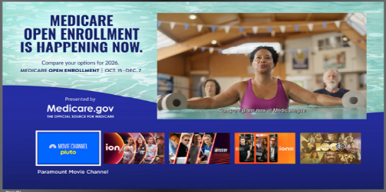
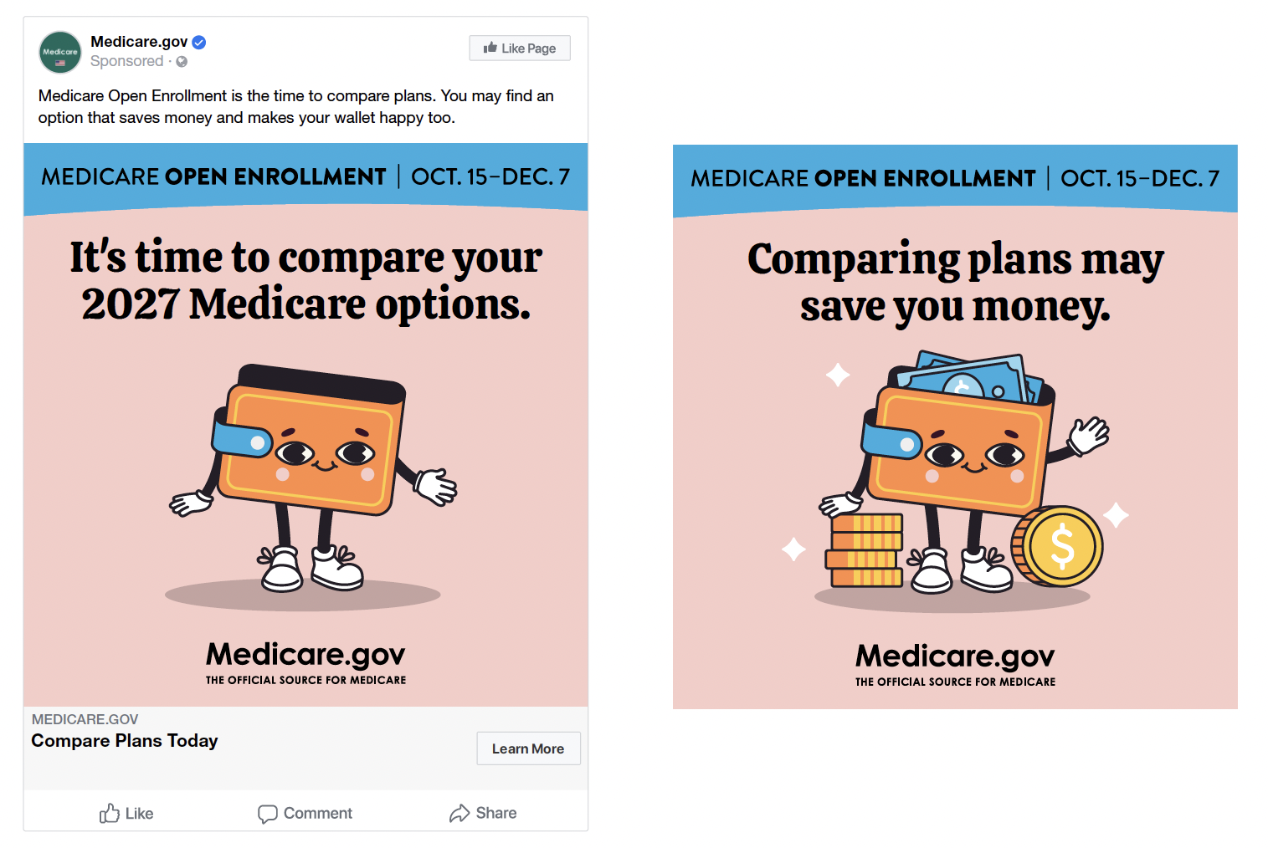

2027 Open Enrollment Outreach Examples
Notes:
Many plans advertise around Open enrollment and so does Medicare. Watch for advertising that promotes Medicare.gov as the “official source” for Medicare information to provide accurate, unbiased information.

Slide 24
Medicare Diabetes Prevention Program (MDPP) Key Points
September – November 2026
MDPP can help you set personal health goals, build habits that last, connect with support from coach and community.
You can choose a class format that works best for you:
  Online, in person, or self-paced classes are available.
Through this convenient, coach-led program, you can learn how to reduce your diabetes risk by making healthier meals, moving more, and building healthy habits.
Available at no cost to you.
Take control of your health on your own terms, schedule, and pace that fits into your life.
“Because I wasn’t pressured or rushed, the changes actually stuck. I’ve kept off the pounds, lowered my blood sugar, and built habits I can sustain.”
Notes:
Research informed us about motivators that resonate with this audience.

Slide 25





Medicare Diabetes Prevention Program Outreach Examples

Slide 26
Medicare “Go Digital” Key Points
September – Early 2027
Your Medicare.gov account gives you access to useful tools that
can help you better manage your Medicare.
Important updates, straight to your inbox with Medicare emails.
Get reminders about Open Enrollment, ways to save costs, and more.
Get key Medicare information fast, whenever or wherever you need it.
See your claims right away - no waiting months for paper statements in the mail.
Track your costs, review your billing, and catch errors faster and easier.
Cut out clutter, print only what you need.
Find important information faster.
Have secure access to your Medicare information.

Slide 27


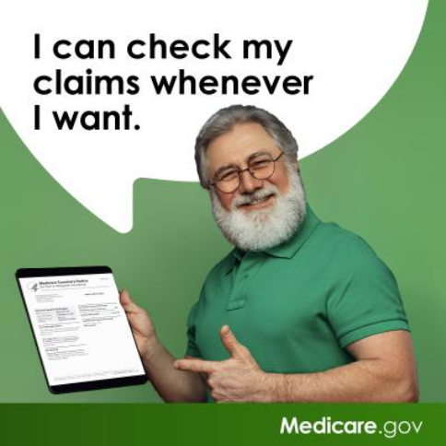
Medicare “Go Digital” Outreach Examples

Slide 28
Medicare Summary Notices (MSNs) at Medicare.gov
No need to wait months to get paper copies of your Medicare Summary Notices (MSNs) - just log into your secure Medicare account at Medicare.gov/account and sign up for electronic MSNs.
  Every month you have processed claims, you’ll get an email with a secure link to your electronic MSN.
Get organized and reduce clutter. You’ll get your Medicare claims statements online faster and more frequently.
Help stop scammers:
Always check your Medicare statements! Getting electronic copies of your statements lets you easily check for fraud.

Slide 29

"Medicare & You" Handbook at Medicare.gov
Sign up to get your next “Medicare & You” handbook electronically. It has all the same information in a searchable electronic version, and available in large type and other formats.
The online version is updated throughout the year, so you’ll always have the most up-to-date information.
You can view it anywhere you take your electronic device, like at your doctor’s office.
If you change your mind later, you can always switch your settings back to “paper” in your Medicare account.

Slide 30
Innovate with Medicare
Medicare regularly develops demonstrations and pilot programs (known as models) to test and measure how well potential changes work. These initiatives focus on areas like quality of care, provider performance, and patient experience.
You may be able to participate in current models, like the Medicare Diabetes Prevention Program (helps you prevent type 2 diabetes), the ACCESS Model for people with chronic conditions or Medicare GLP-1 Bridge that provides access to certain GLP-1 drugs to help you lose weight and improve your health.
  Ask your doctor if they participate in these models.
To learn more about current or future models, visit CMS.gov/priorities/innovation/models or call 1-800-MEDICARE (1‑800‑633‑4227). TTY users can call 1‑877‑486‑2048.

Slide 31
Resources
Medicare.gov
1-800-MEDICARE (1-800-633-4227) (TTY: 1-877-486-2048)
  Available 24 hours a day, including weekends.
  Offers help comparing and enrolling in Medicare Advantage or Drug Plans and supporting ongoing insurance needs.
  If you need help in a language other than English or Spanish, let the customer service representative know.

Slide 32

State Health Insurance Assistance Program (SHIP)
SHIP is a national program that offers free, personalized health insurance counseling to people with Medicare, their families, and caregivers to help them make informed decisions about their care and benefits.
[insert state specific contact info]
Visit shiphelp.org for locations near you
Notes:
Note: this slide could be substituted or supplemented with information about Senior Medicare Patrol (SMP) as needed.

Slide 33
Contact Information
[insert presenter's contact information]

Slide 34
Disclaimer
This information is current at the time of presentation, but the Medicare policy is subject to change.
The contents of this document don’t have the force and effect of law and aren’t meant to bind the public in any way, unless specifically incorporated into a contract.
This document is intended only to provide clarity to the public regarding existing requirements under the law.
This communication was printed, published, or produced and disseminated at U.S. taxpayer expense.

