Slide 1

Plan Year 2026 Health Insurance Marketplace® Registration and Training for New Agents and Brokers
Centers for Medicare & Medicaid Services (CMS)
Center for Consumer Information & Insurance Oversight (CCIIO)
September 16, 2025

Slide 2
Disclaimer
The information provided in this presentation is intended only as a general, informal summary of technical legal standards. It is not intended to take the place of the statutes, regulations, and formal policy guidance that it is based upon. This presentation summarizes current policy and operations as of the date it was presented. Links to certain source documents have been provided for your reference. We encourage audience members to refer to the applicable statutes, regulations, and other interpretive materials for complete and current information about the requirements that apply to them. The contents of this document do not have the force and effect of law and are not meant to bind the public in any way, unless specifically incorporated into a contract. This document is intended only to provide clarity to the public regarding existing requirements under the law.
This document generally is not intended for use in the State-based Marketplaces (SBMs) that do not use HealthCare.gov for eligibility and enrollment. Please review the guidance on our Agent and Broker Resources webpage (http://go.cms.gov/CCIIOAB) and Marketplace.CMS.gov to learn more.
Unless indicated otherwise, the general references to “Marketplace” in the presentation only include Federally-facilitated Marketplaces (FFMs) and State-based Marketplaces on the Federal Platform (SBM-FPs).
This communication was printed, published, or produced and disseminated at U.S. taxpayer expense.

Slide 3

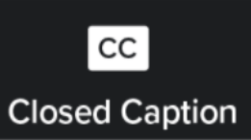
Closed Captioning
This webinar has Closed Captioning available.
To enable Closed Captioning, click the Closed Caption icon in your webinar controls.

Slide 4


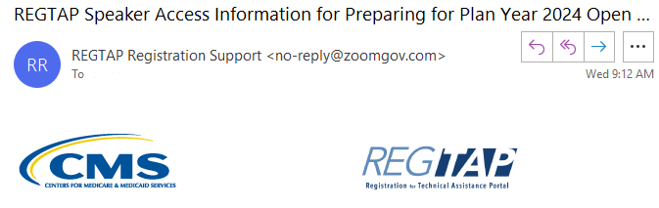
Housekeeping Reminders
If called upon during the Live Question & Answer session, please ask only one (1) question.
To capture links posted in the Zoom Chat, please click on the desired link and bookmark it for future reference.
Webinar and Audio Access Tips have been shared in the Zoom Chat and are listed in the email access details you received from REGTAP Registration Support.

Slide 5


Discussion and Questions
At the end of today’s webinar, we will have a live discussion and question and answer session. You will be able to ask your questions verbally or by written submission in the Q&A tab.
To ask a verbal question:
If you are listening via the Zoom application, click ”Raise Hand” in the webinar controls.
If you are listening via phone, dial star (*) nine (9) to Raise your Hand.
Once your hand is raised, the facilitator will call on the last three (3) digits of your phone number.
When you hear the last three (3) digits of your phone number please dial star (*) six (6) to unmute your line and state your name.
To submit a written question/view written responses:
Type your question in the text box under the “Q&A” tab and click “Send.”
Click on the “My Questions” tab to view written responses to your questions.
Click on the “All Questions” tab to view all questions that received a public response since you’ve been logged into the webinar.
Please note: Due to time constraints, we may not be able to answer all questions posed during today’s session either in writing, or during the live Q&A portion. CMS may use the context of your question to develop outreach materials in the future.

Slide 6
Agenda
1
Introduction
2
Plan Year 2026 Marketplace Registration and Training Process
3
Live Question/Answer Session

Slide 7
Intended Audience
The intended audiences for this presentation include:
Agents and brokers joining the Marketplace for the first time for Plan Year 2026, and
Agents and brokers who participated in a previous Plan Year but did not complete Plan Year 2025 Marketplace registration and training.
Agents and brokers who completed Plan Year 2025 registration and training should register for the upcoming webinar on Thursday, July 24, titled “Plan Year 2026 Health Insurance Marketplace® Registration and Training for Returning Agents and Brokers.” Registration will close at 10:00 a.m. ET the morning of the event, but the slides will be published after for viewing.
"New" agents and brokers who did not complete registration and training for Plan Year 2025 are required to complete the assigned Marketplace training courses for Plan Year 2026 and pass the exams with a 70% score or better through the Marketplace Learning Management System (MLMS) or through an HHS-approved vendor.
Training is optional for agents and brokers who only intend to participate in Small Business Health Options Program (SHOP).
All agents and brokers who wish to participate in the Marketplace must read and accept the applicable Marketplace Agreements with CMS on the MLMS.

Slide 8
Intended Audience (continued)
Note: Attending this webinar does NOT fulfill the requirements for completing the Marketplace registration and training on the MLMS. New agents and brokers are required to complete the full registration and training for the current plan year.

Slide 9
Introduction to Agents and Brokers for Plan Year 2026
Welcome to the Marketplace for Plan Year 2026!*
To the extent permitted by states, licensed agents and brokers assist consumers in applying for insurance affordability programs, including the premium tax credit and cost-sharing reductions, and enrolling in qualified health plans (QHPs) through the Marketplace.
Agents and brokers also play a crucial role in educating consumers about the Marketplace, both during the annual Open Enrollment Period (OEP) and throughout the Plan Year.
Prior to assisting consumers, agents and brokers should:
Understand the standards under 45 CFR § 155.220**, which authorize agents and brokers to assist consumers with selecting and enrolling in QHPs offered through the Marketplace.
Be familiar with 45 CFR § 155.260***, which outlines the limits on how agents and brokers may use any information gained as part of providing assistance to a consumer.
*45 CFR § 155.20 defines “Plan Year” as a consecutive 12-month period during which a health plan provides coverage for health benefits. A Plan Year may be a calendar year or otherwise.
**To read 45 CFR § 155.220, click here: https://www.ecfr.gov/current/title-45/subtitle-A/subchapter-B/part-155/subpart-C/section-155.220
***To read 45 CFR § 155.260, click here: https://www.ecfr.gov/current/title-45/subtitle-A/subchapter-B/part-155/subpart-C/section-155.260

Slide 10
Plan Year 2026 Health Insurance Marketplace® Registration and Training for New Agents and Brokers

Slide 11
Step 1: Create a CMS Enterprise Portal Account
Create a CMS Enterprise Portal Account.
Request the Agent and Broker Training Access Role.
Complete Remote Identity Proofing through the Identity Management (IDM) System.
Complete the Agent and Broker Profile on the MLMS via the CMS Enterprise Portal.
Complete Marketplace Training on the MLMS or through an HHS-approved Vendor via the CMS Enterprise Portal.
Read and Accept the Applicable Marketplace Agreement(s) on the MLMS.
Confirm Completion of all Registration Steps by logging back into the CMS Enterprise Portal and printing the Completion Certificate.

Slide 12
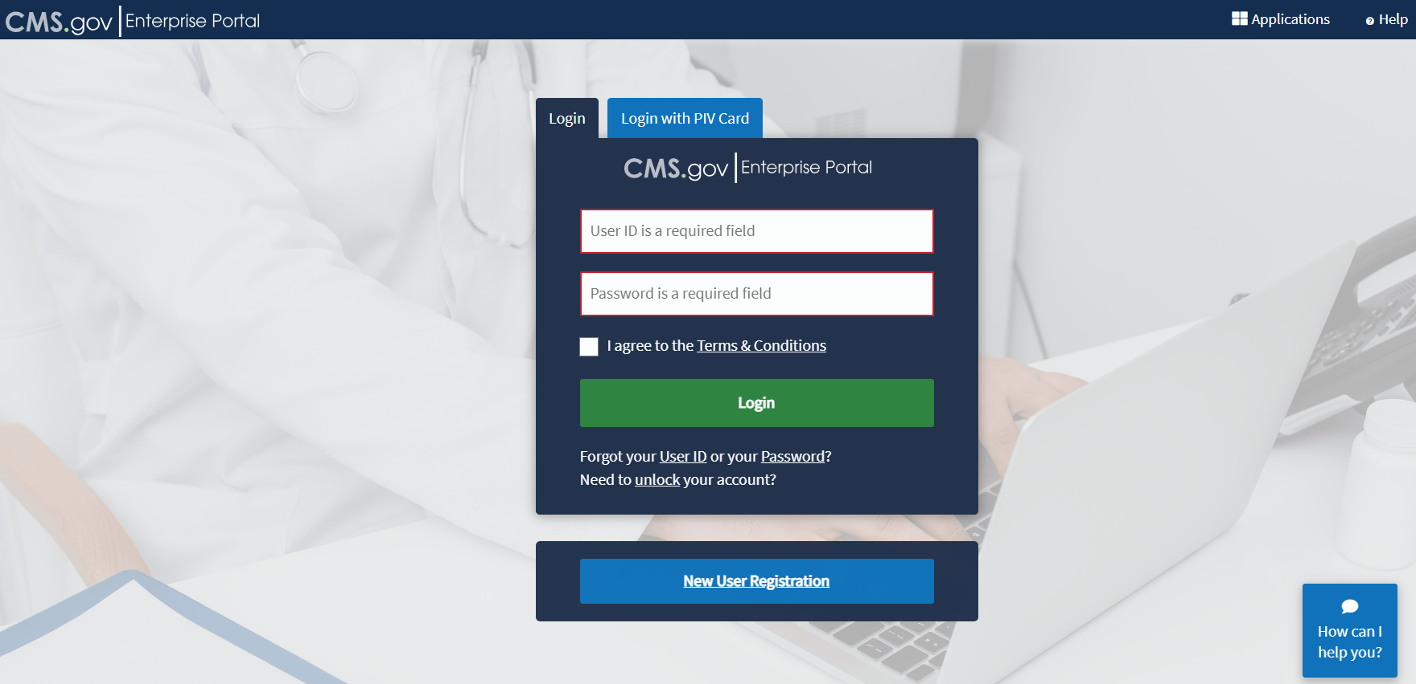
Step 1: Create a CMS Enterprise Portal Account (continued)
If an agent or broker does not already have a CMS Enterprise Portal account*, they should navigate to https://portal.cms.gov and click the “New User Registration” button.
*Agents and brokers that already have a CMS Enterprise Portal account do not need to create a new one. Agents and brokers should log in with an existing FFM User ID and password and proceed to Step 2. For agents and brokers who are unsure if they already have an FFM User ID and password, see this “Avoiding the Creation of a Duplicate CMS Enterprise Portal Account” resource.

Slide 13
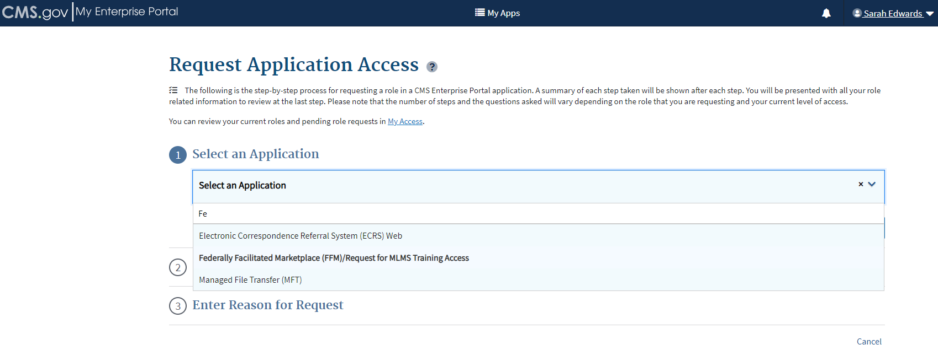
Step 1: Create a CMS Enterprise Portal Account (continued)
Enter “Fed” into the Access Catalog search bar.
Select the “Federally Facilitated Marketplace (FFM)/Request for MLMS Training Access” Application and click “Next.”

Slide 14
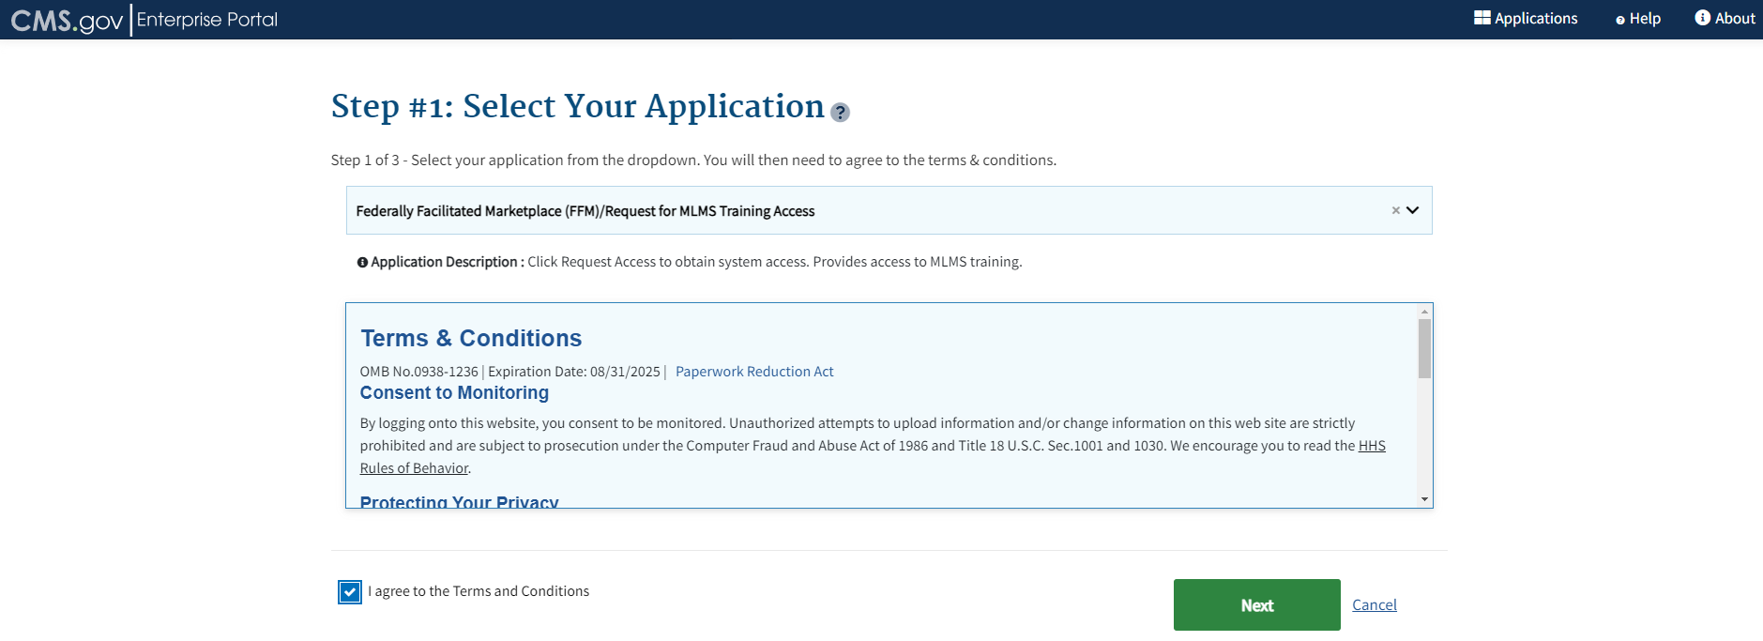
Step 1: Create a CMS Enterprise Portal Account (continued)
After reading and agreeing to the Terms & Conditions, click the check box next to “I Agree to the Terms and Conditions“ and then click “Next.”

Slide 15
Step 1: Create a CMS Enterprise Portal Account (continued)
New users trying to create a CMS Enterprise Portal Account must start with the online identity proofing process. Navigate to the CMS Enterprise Portal login webpage at https://portal.cms.gov and ensure you have provided the following identity proofing information:
Full Legal Name | You must use your full legal name as listed on your identity documents. Do not use nicknames.
Social Security Number (SSN) | Ensure that the SSN field is filled in correctly.
Date of Birth | Ensure that the Date of Birth field is entered accurately (month/date/year).
Current Residential Address | You must use your personal/residential/home address where you receive utility bills or credit card statements. Do NOT use your business address.
Personal Phone Number | Enter a personal landline phone number (if you have one) or a cell phone that you personally pay to use. Do NOT use your business phone number.
Personal Email Address | Enter a personal email address. Do NOT use your business email address.

Slide 16
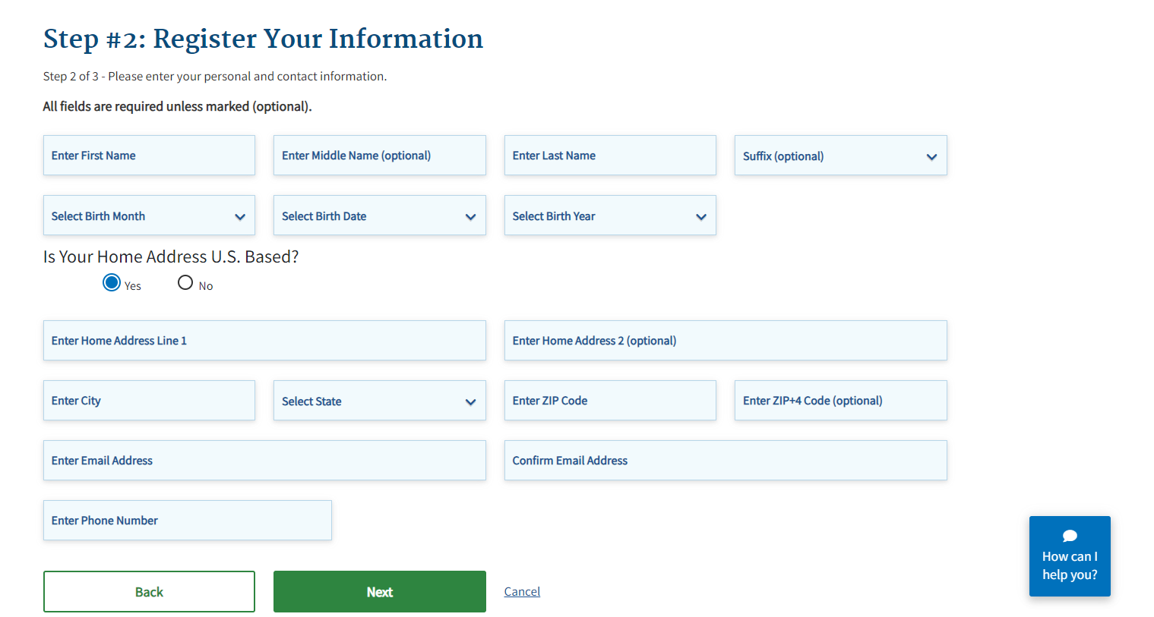
Step 1: Create a CMS Enterprise Portal Account (continued)
Enter the requested information and click “Next.”

Slide 17

Step 1: Create a CMS Enterprise Portal Account (continued)
REMINDER: Agents and brokers must provide their personal home addresses, personal phone number, and personal email address to successfully Identity Proof. Do not provide work information or information for your business entity!

Slide 18
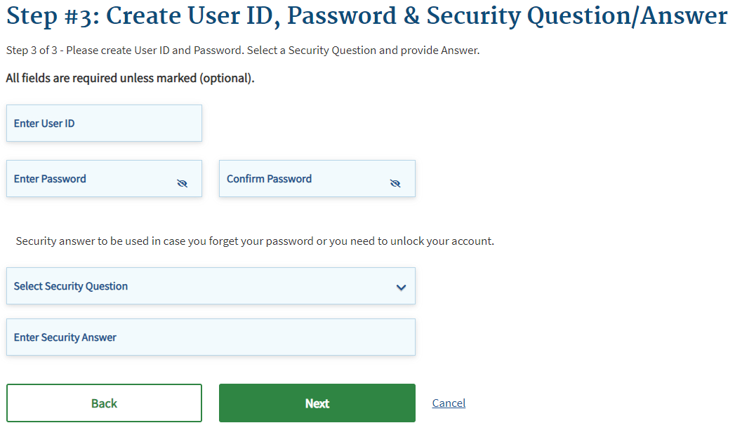
Step 1: Create a CMS Enterprise Portal Account (continued)
Create an FFM User ID and password.
Choose challenge questions and provide answers, then click “Next.”
Remember: Passwords, security questions and multi-factor authentication information must NEVER be shared with others.

Slide 19
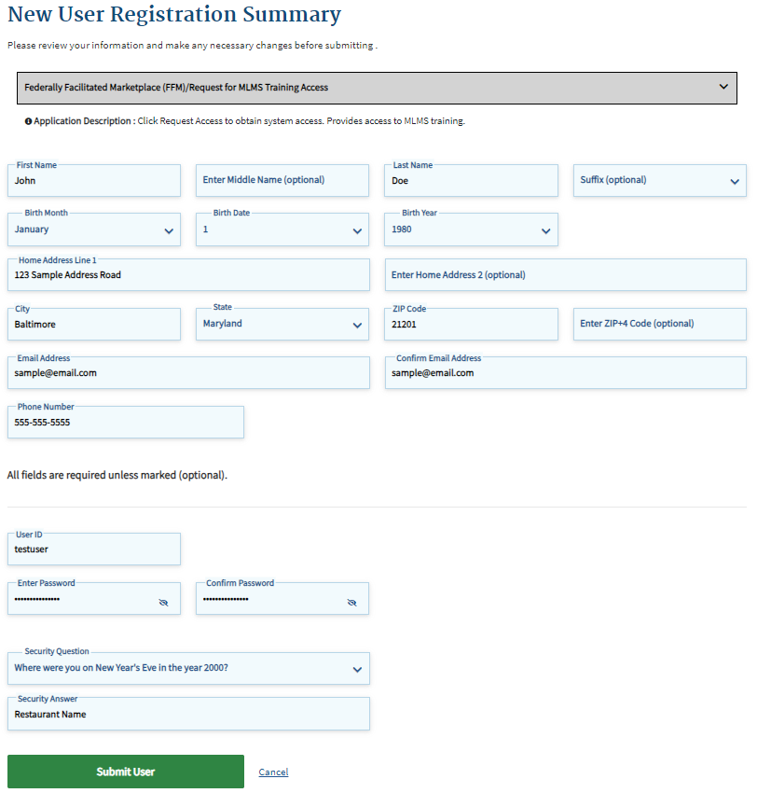
Step 1: Create a CMS Enterprise Portal Account (continued)
Review the information entered, make any necessary changes, and then click “Submit User.”

Slide 20
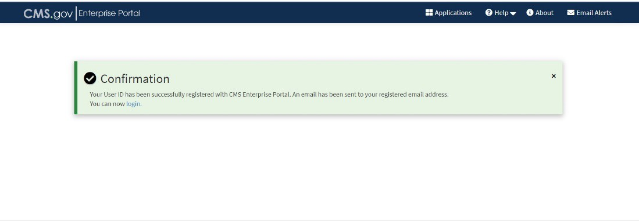
Step 1: Create a CMS Enterprise Portal Account (continued)
The Confirmation page is displayed to acknowledge successful registration.
The agent or broker will receive an email at the address listed in their account, notifying them that their account was successfully created.
Note: You will be required to log in every 60 days for your account password to remain active. After 60 days of inactivity, users will have to reset their passwords to regain access to their account.

Slide 21
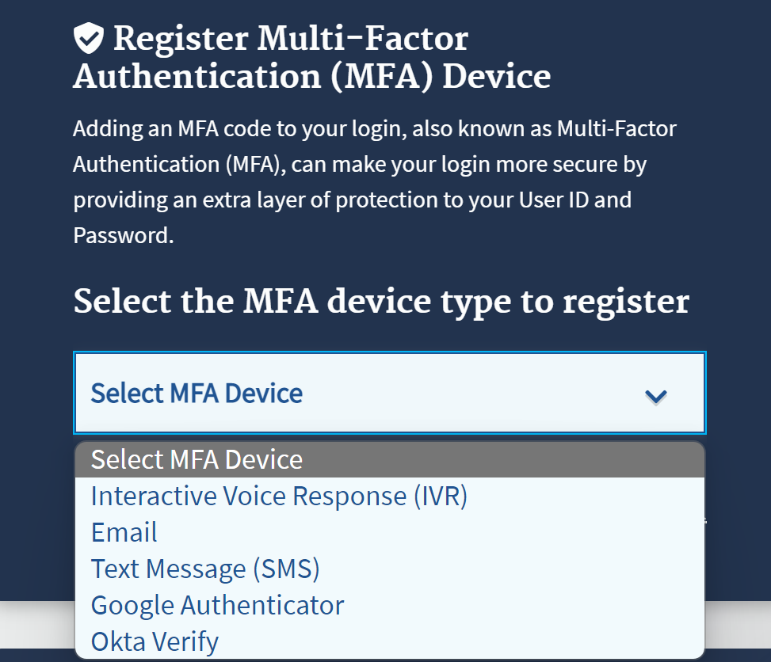
Step 1: Create a CMS Enterprise Portal Account (continued)
Multi-factor Authentication (MFA) is required for all agents and brokers. The first time an agent or broker logs in after creating an account, they will be prompted to select an MFA device. The agent or broker will receive a code through this device each time they log in.

Slide 22
Step 2: Request the Agent and Broker Training Access Role
Create a CMS Enterprise Portal Account.
Request the Agent and Broker Training Access Role.
Complete Remote Identity Proofing through the IDM System.
Complete the Agent and Broker Profile on the MLMS via the CMS Enterprise Portal.
Complete Marketplace Training on the MLMS or through an HHS-approved Vendor via the CMS Enterprise Portal.
Read and Accept the Applicable Marketplace Agreement(s) on the MLMS.
Confirm Completion of all Registration Steps by logging back into the CMS Enterprise Portal and printing the Completion Certificate.

Slide 23
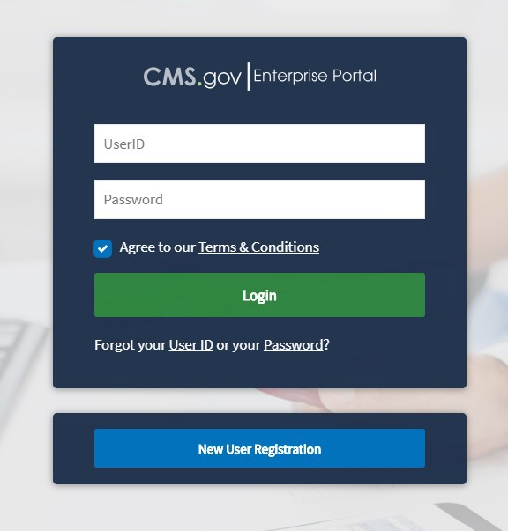
Step 2: Request the Agent and Broker Training Access Role (continued)
Once an account creation notification is received via email, or after waiting a few minutes for the system to update, log back into the CMS Enterprise Portal at https://portal.cms.gov.
Enter the FFM User ID and the password created when setting up the CMS Enterprise Portal account in Step 1.
After reading the terms and conditions, click the check box next to “Agree to our Terms & Conditions” and then click “Login.”
Note: Even if an agent or broker participated in the Marketplace for prior Plan Years 2014 through 2024, they will need to request the FFM Agent and Broker training access role when they log in to their CMS Enterprise Portal account if they did not complete registration for Plan Year 2025.

Slide 24
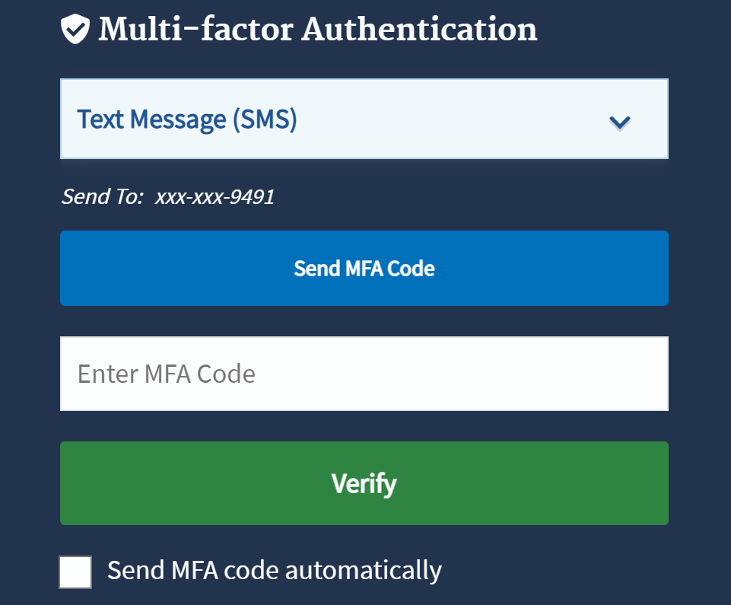
Step 2: Request the Agent and Broker Training Access Role (continued)
Upon log in, the agent or broker will be prompted to enter an MFA code received through the device registered in Step 1.

Slide 25
Step 2: Request the Agent and Broker Training Access Role (continued)
Once logged in, on the “My Portal” page, click the “Add Application” button to access the Application Catalog.

Slide 26
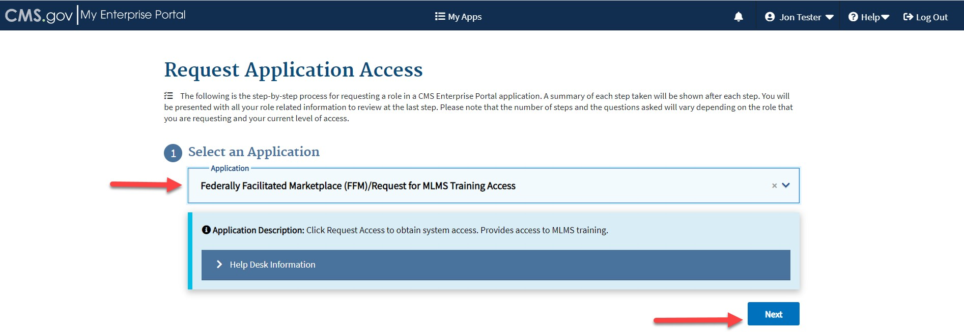
Step 2: Request the Agent and Broker Training Access Role (continued)
Enter “Fed” into the Access Catalog search bar.
Select the “Federally Facilitated Marketplace (FFM)/Request for MLMS Training Access” Application and click “Next.”

Slide 27
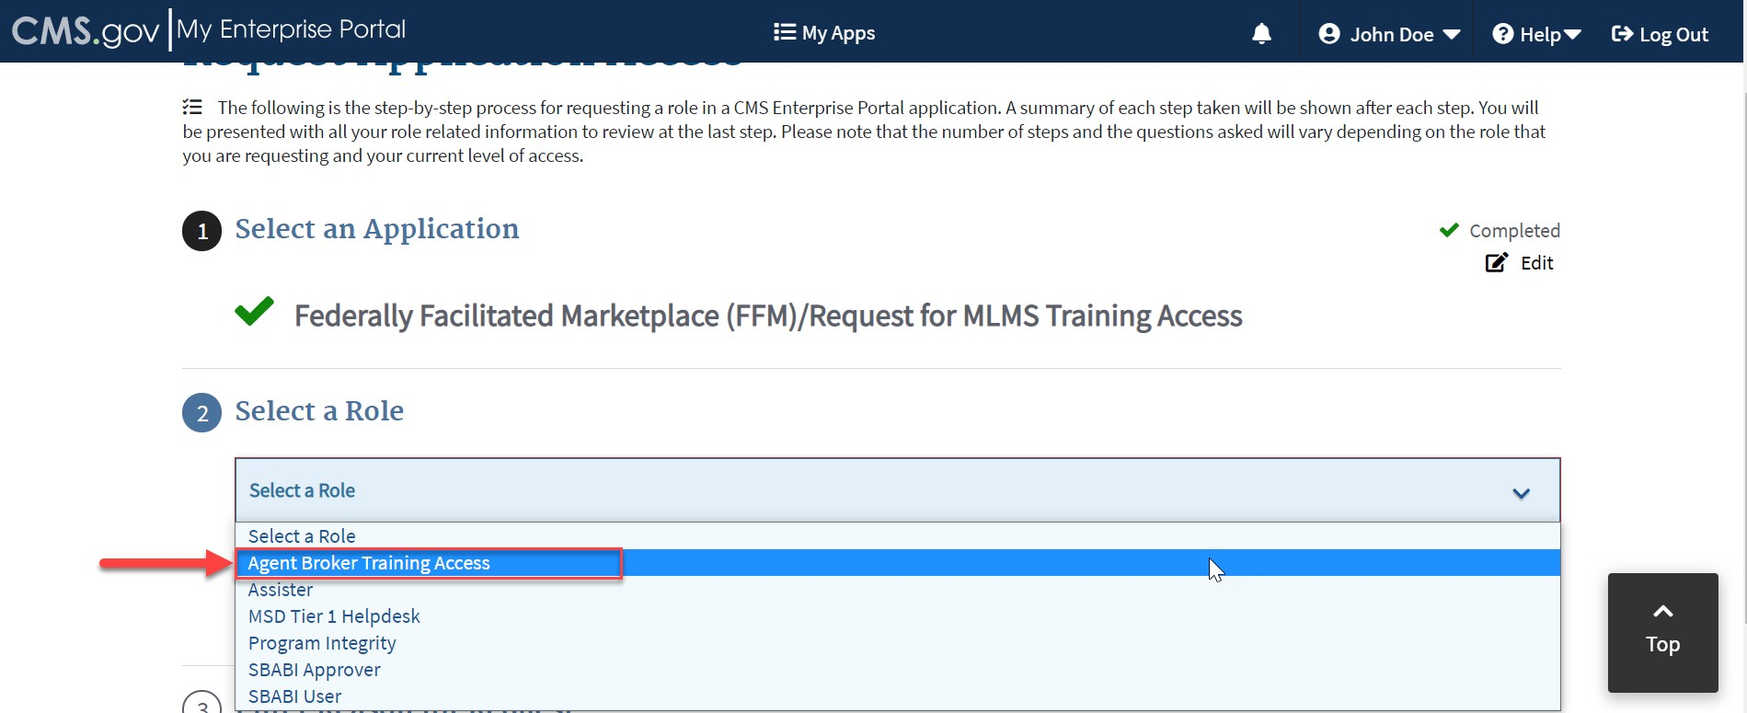
Step 2: Request the Agent and Broker Training Access Role (continued)
Select “Agent Broker Training Access” from the “Select a Role” drop-down menu.
Click the “Next” button.

Slide 28
Step 3: Complete Remote Identity Proofing through the Identity Management (IDM) System
Create a CMS Enterprise Portal Account.
Request the Agent and Broker Training Access Role.
Complete Remote Identity Proofing through the IDM System.
Complete the Agent and Broker Profile on the MLMS via the CMS Enterprise Portal.
Complete Marketplace Training on the MLMS or through an HHS-approved Vendor via the CMS Enterprise Portal.
Read and Accept the Applicable Marketplace Agreement(s) on the MLMS.
Confirm Completion of all Registration Steps by logging back into the CMS Enterprise Portal and printing the Completion Certificate.
Reminder: You must ensure consumer information is entered accurately and completely, and the consumer’s personal information must be used for the home address, phone number, and email address -not a business' information!

Slide 29
Step 3: Complete Remote Identity Proofing through the IDM System (continued)
If you fail to successfully identity proof, you may be directed to contact Experian.
Take note of the Review Reference Number, e.g., IDM-FFM-123456 and call Experian at the number provided.
Please note that users are allowed to have only one CMS Portal account and sharing of credentials is strictly forbidden.
If you are a returning user and have forgotten your FFM user ID or password information, click on the “Forgot your User ID or your Password?” link under the “Login” button on the CMS Enterprise Portal login webpage at https://portal.cms.gov.
If you have a CMS Portal account from a previous employer, do not create a second account. Instead, you must update the information in your existing CMS Portal account.
If you have attempted all of the above and still are unable to successfully identity proof, please contact the Marketplace Service Desk (MSD) for further assistance at 1-855-267-1515.

Slide 30
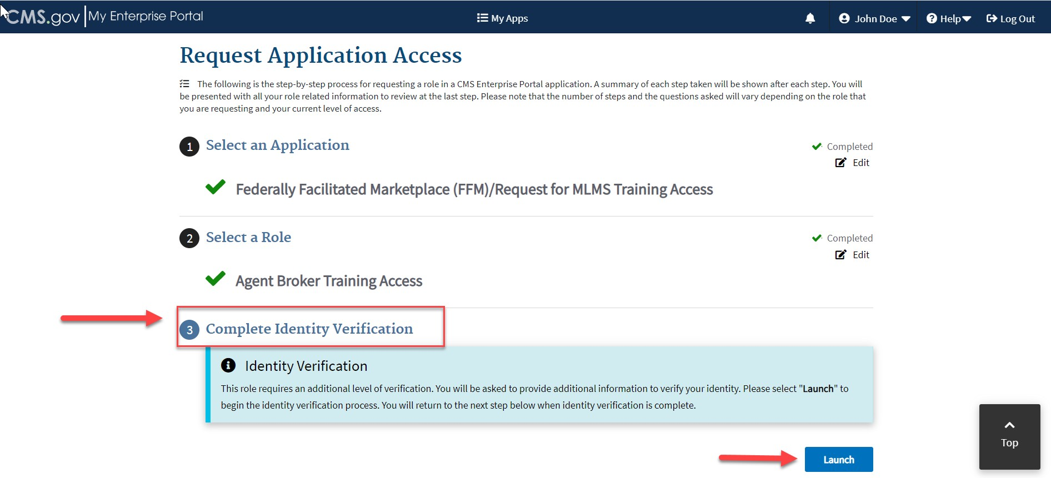
Step 3: Complete Remote Identity Proofing through the IDM System (continued)
Click the blue “Launch” button to launch Identity Proofing.

Slide 31
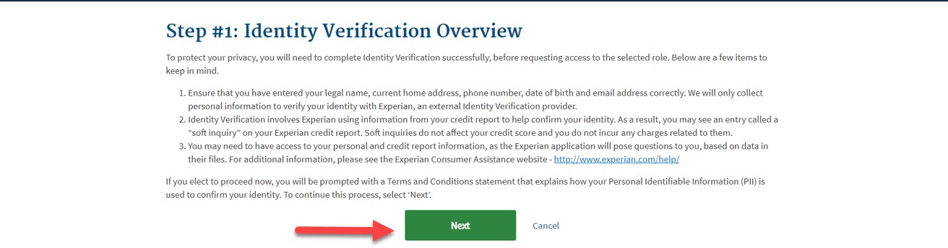
Step 3: Complete Remote Identity Proofing through the IDM System (continued)
Step #1: Identity Verification Overview
After reading the instructions, click “Next.”

Slide 32
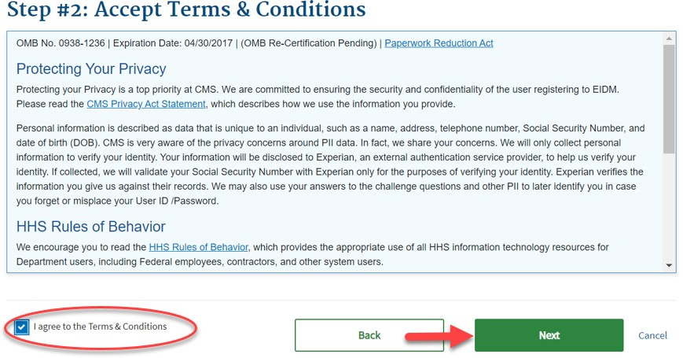
Step 3: Complete Remote Identity Proofing through the IDM System (continued)
Step #2: Accept Terms & Conditions
After reading the Terms and Conditions, click "I Agree" and “Next.”

Slide 33
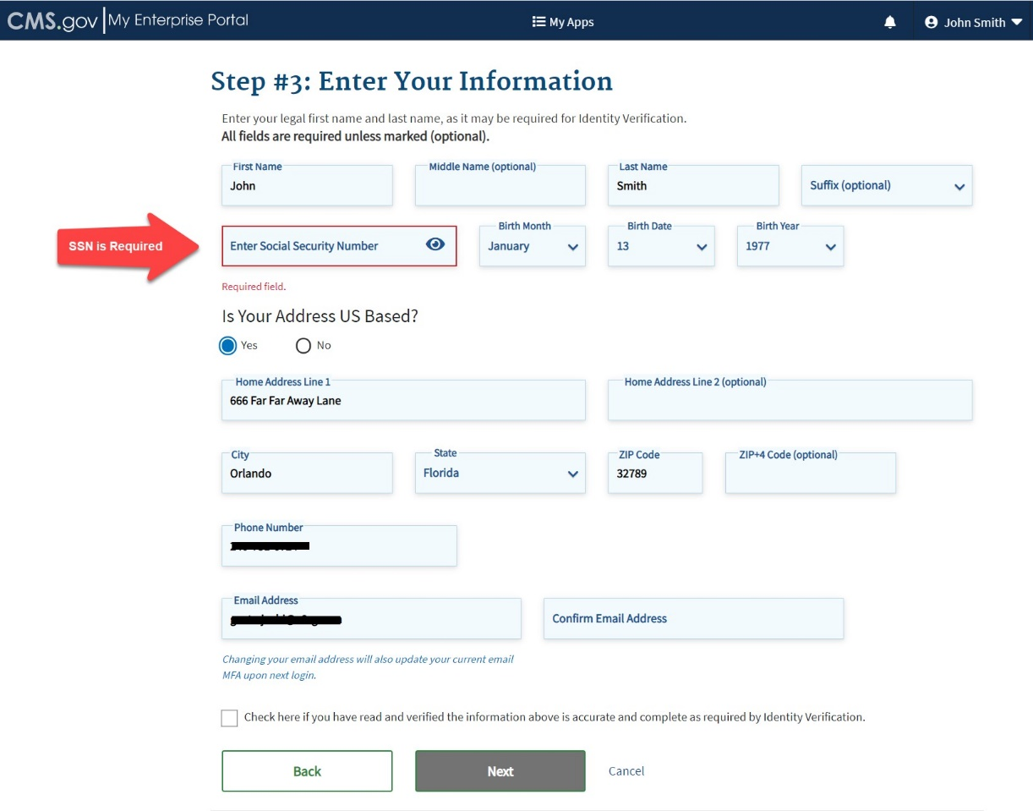
Step 3: Complete Remote Identity Proofing through the IDM System (continued)
Step #3: Enter Your Information
Confirm the information that automatically populates and enter any missing information (e.g., confirm email address, enter Social Security number).
Then check the box to confirm you have read and verified the information is correct and click “Next” to submit the information for verification.

Slide 34
Step 4: Complete the Agent and Broker Profile on the MLMS via the CMS Enterprise Portal
Create a CMS Enterprise Portal Account.
Request the Agent and Broker Training Access Role.
Complete Remote Identity Proofing through the IDM System.
Complete the Agent and Broker Profile on the MLMS via the CMS Enterprise Portal.
Complete Marketplace Training on the MLMS or through an HHS-approved Vendor via the CMS Enterprise Portal.
Read and Accept the Applicable Marketplace Agreement(s) on the MLMS.
Confirm Completion of all Registration Steps by logging back into the CMS Enterprise Portal and printing the Completion Certificate.

Slide 35
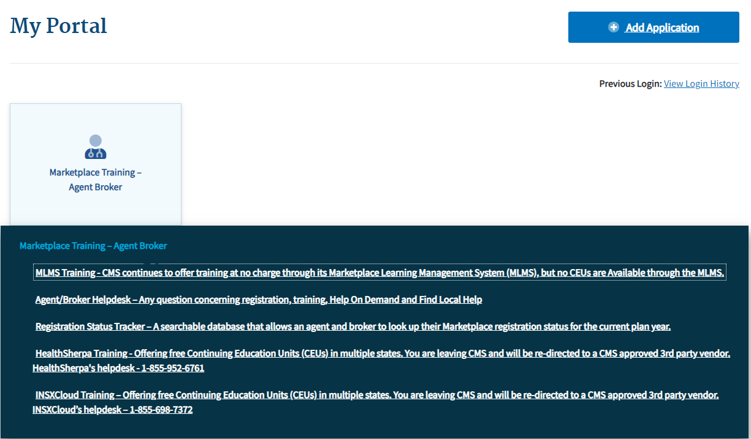
Step 4: Complete the Agent and Broker Profile on the MLMS via the CMS Enterprise Portal (continued)
After completing identity proofing, an agent or broker will need to create their MLMS profile prior to beginning training.
To access the MLMS profile and the CMS-developed training, click on the “Marketplace Training – Agent Broker” tile, and then select the “MLMS Training” option.

Slide 36
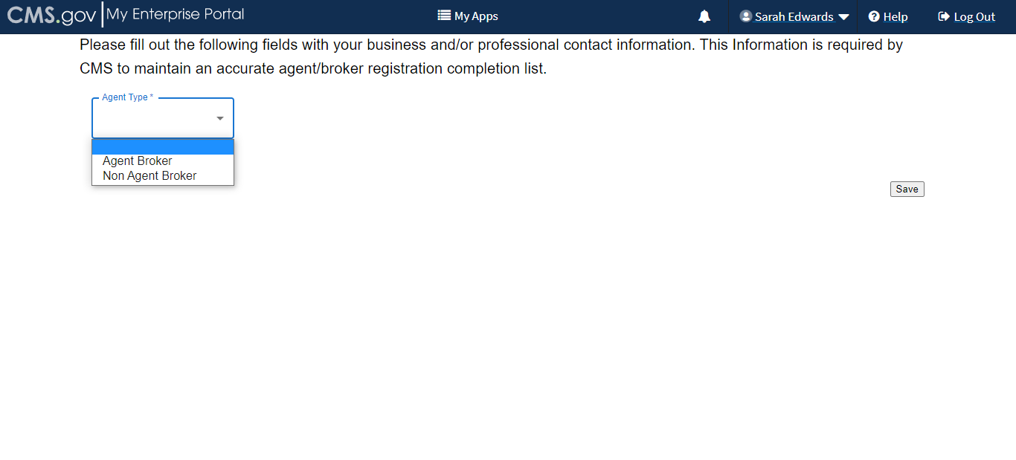
Step 4: Complete the Agent and Broker Profile on the MLMS via the CMS Enterprise Portal (continued)
Select a user role from the two available options.
If you do not intend to assist consumers with enrolling in Marketplace coverage, select the "Not an Agent Broker" role in the drop-down menu at the top of your agent/broker profile. You can return to this section of your agent/broker profile at any time to update this selection if you do intend to assist consumers with Marketplace coverage in the future.
Note: If you do not return to your profile to update your selection, you will not be eligible to participate in the Marketplace for Plan Year 2026 or to receive compensation for assisting consumers with Marketplace enrollments.

Slide 37
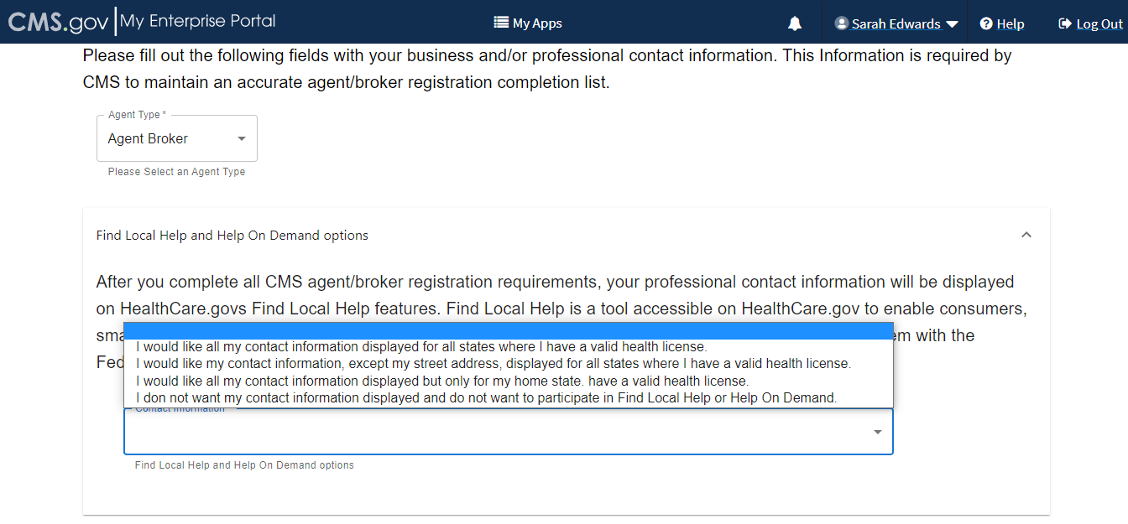
Step 4: Complete the Agent and Broker Profile on the MLMS via the CMS Enterprise Portal (continued)
The information agents and brokers use to complete their MLMS profile will be used to populate Find Local Help at HealthCare.gov and Help On Demand so consumers can find them for assistance. Find Local Help is also available in Spanish.
Note: Help On Demand is a referral system that quickly connects consumers seeking enrollment assistance on HealthCare.gov with Marketplace-registered, state-licensed agents and brokers in their area who can provide immediate assistance with plan selection and enrollment.

Slide 38
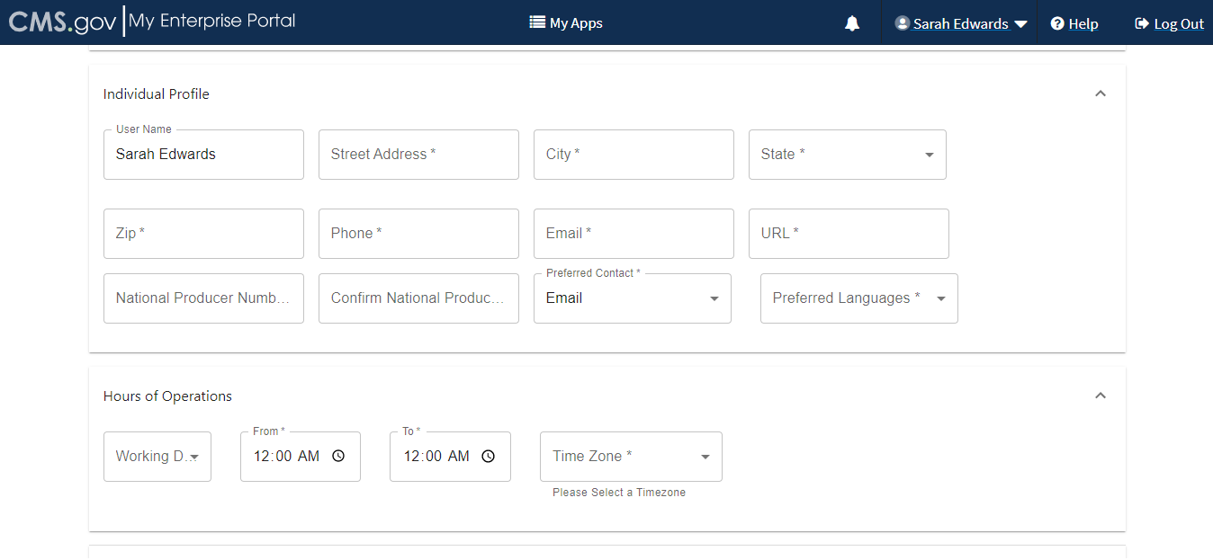
Step 4: Complete the Agent and Broker Profile on the MLMS via the CMS Enterprise Portal (continued)
The MLMS profile page will appear for an agent or broker to complete their role and business and/or professional contact information.
John Doe

Slide 39
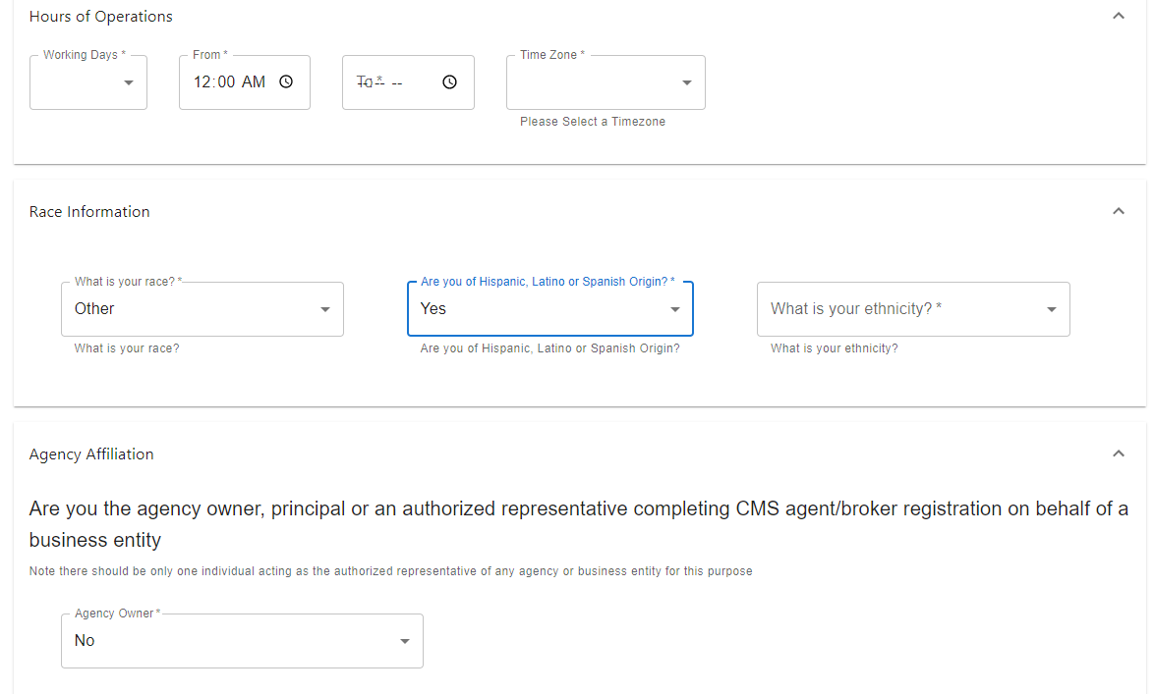
Step 4: Complete the Agent and Broker Profile on the MLMS via the CMS Enterprise Portal (continued)
Three race and ethnicity questions will appear, where an agent or broker will have the option to attest to personal race and ethnicity information. This information helps CMS identify the various diverse agent/broker communities assisting consumers with Marketplace coverage.

Slide 40
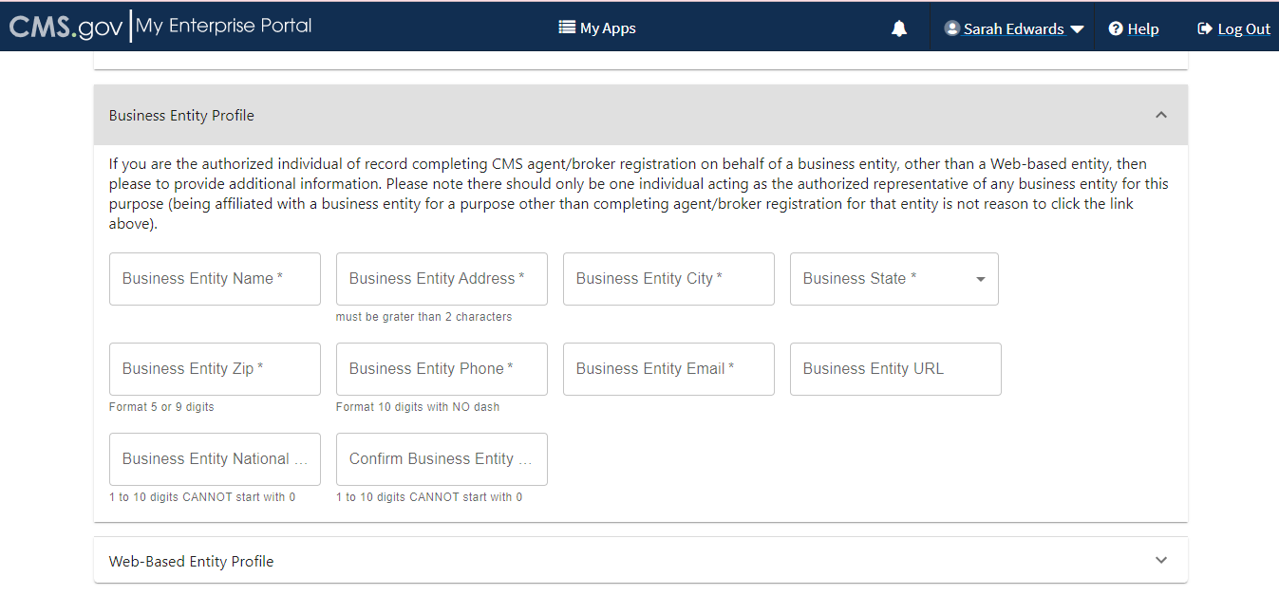
Step 4: Complete the Agent and Broker Profile on the MLMS via the CMS Enterprise Portal (continued)
Agents and brokers who also act as the authorized representative* for a business entity or web-broker can add the business entity’s or web-broker’s National Producer Number (NPN) by clicking the appropriate “+” link at the bottom of the profile page.
Agents and brokers can list up to three NPNs in the MLMS profile.
*An agency may only designate one user to act as the authorized representative for the business or web-broker entity for MLMS training completion.

Slide 41
Step 4: Complete the Agent and Broker Profile on the MLMS via the CMS Enterprise Portal (continued)
When completing or updating the MLMS profile, agents and brokers should only enter a business or web-broker NPN if:
The NPN is tied to a business entity – such as an LLC, corporation or partnership – that is registered with a state for the purpose of selling health insurance.
The agent or broker is the authorized individual or agent in charge associated with that entity’s state license.
Note: Agents and brokers should not enter an individual NPN in the business or web-broker field of the MLMS profile. There should only be one individual acting as the authorized representative of any web-based entity. Being affiliated with a business or web-based entity (i.e. employed or contracted agent or broker) is not reason to enter data here.

Slide 42
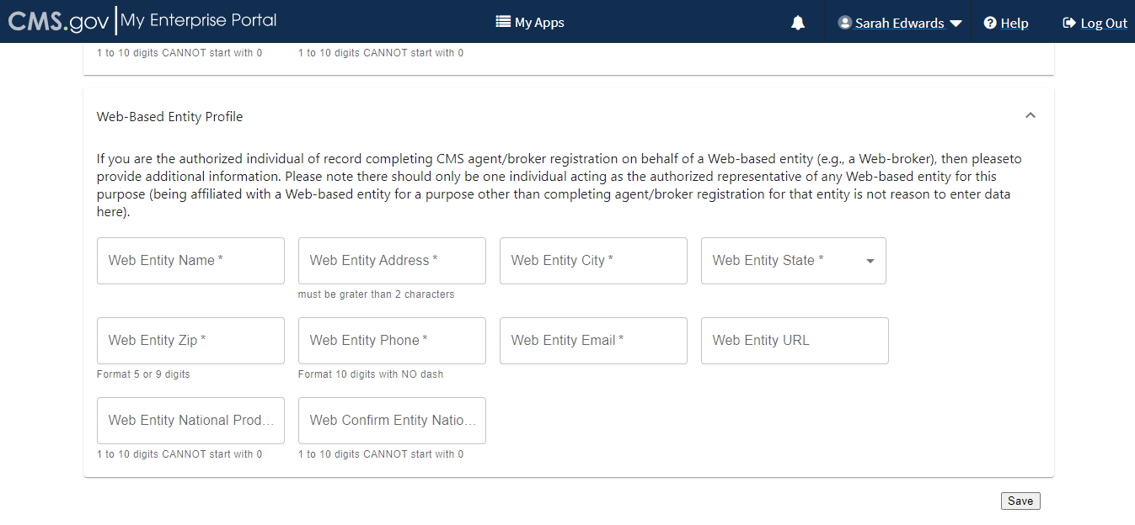
Step 4: Complete the Agent and Broker Profile on the MLMS via the CMS Enterprise Portal (continued)
Enter the information for affiliated web-brokers or business entities.
Note: Only those who sign a web-broker agreement should complete the web-broker profile.
Any individual NPN entered in the business or web-broker NPN field of the MLMS profile screen will be removed.
If and agent or broker lists the business entity or web-broker NPN on their profile, these will be added to Registration Completion List once training has been completed.

Slide 43
Step 4: Complete the Agent and Broker Profile on the MLMS via the CMS Enterprise Portal (continued)
An agent or broker must enter a correct NPN in their MLMS profile to receive credit for completing Marketplace registration.
The NPN can be up to 10 digits long and must not begin with a zero.
The NPN must not include any special characters or letters.
The NPN is not the same as a state license number. Be sure to use an NPN, not a state license number.
To update the NPN, an agent or broker can click the “Complete Agent and Broker Training” hyperlink and update the information in their MLMS profile.
Agent and broker NPNs can be found at https://nipr.com/help/look-up-your-npn.
Be sure to confirm the NPN is correct in the MLMS profile. Entering an inaccurate NPN could result in denial of compensation/credit by an issuer.

Slide 44
Step 4: Complete the Agent and Broker Profile on the MLMS via the CMS Enterprise Portal (continued)
Once all profile information has been entered, click “Save.”

Slide 45
Step 4: Complete the Agent and Broker Profile on the MLMS via the CMS Enterprise Portal (continued)
General MLMS Information
CMS validates NPNs against data stored in the National Insurance Producer Registry (NIPR) Public Database: https://www.nipr.com/.
Results of this NIPR NPN validation appear on the public Agent and Broker Federally-facilitated Marketplace Registration Completion List (RCL): https://data.healthcare.gov/ffm_ab_registration_lists
The RCL is updated daily.

Slide 46
Step 4: Complete the Agent and Broker Profile on the MLMS via the CMS Enterprise Portal (continued)
General MLMS Information
NPN validation occurs during the annual registration process in the MLMS and is only applicable to the current Plan Year. If an agent or broker does not maintain a valid NPN, their agreements with the Marketplace may be terminated.
To be validated, agents and brokers must:
Have a valid state license;
Have a valid health-related line of authority (LOA): https://nipr.com/licensing-center/add-a-line-of-authority in their resident state; and
Have an active status for their health-related LOA.

Slide 47
Step 4: Complete the Agent and Broker Profile in the MLMS via the CMS Enterprise Portal (continued)
Line of Authority Validation Requirements for Marketplace Agents and Brokers
Updated agent/broker licensure validation methodology went into effect beginning in plan year 2023 to ensure agents and brokers have a valid health-related line of authority (LOA) in their resident state.
Each state Department of Insurance (DOI) determines the requirements for agents and brokers in their specific state. CMS validates the status of an agent’s or broker’s licensure through the NIPR on a weekly basis. Specifically, licensure validation is determined by checking license status and the presence of a valid health LOA in the resident state for each agent or broker.
Note: Some states, such as Florida, Hawaii, New Mexico, Texas, Utah, Vermont, Wisconsin, and Wyoming, require ABs to have an appointment with a health insurance carrier before their NPN can be validated.
Note: Agents and brokers who do not have an approved health-related LOA, as determined by their resident state, will not be able to access Marketplace systems and will not be able to assist consumers with Marketplace activities for plan year 2026.

Slide 48
Step 4: Complete the Agent and Broker Profile in the MLMS via the CMS Enterprise Portal (continued)
Agents and brokers can take several steps now to check and see if they need to take further action.
Check resident state requirements for Appointment Level LOA, Approved Class Type and/or Approved License Level LOA at https://data.healthcare.gov/AB-NIPR-Health-Line-Of-Authority.
Then, agents and brokers can go to NIPR at https://nipr.com/licensing-center/add-a-line-of-authority and use the “Look Up Your National Producer Number (NPN)” tool at the bottom of the page to check their personal licensure information for their resident state.
If agents and brokers do not have the required resident state LOA, they can use the links to “Add a Line of Authority” and work directly with their resident state DOI regarding licensing requirements.
The validation of agents’ and brokers’ licenses will be reviewed weekly following completion of the required annual agent and broker Registration and Training. Agents and brokers can check the RCL at https://data.healthcare.gov/ab-registration-completion-list to confirm that their NPN is listed and the “NPN Valid (Current Year Only)” reflects “Y” for yes prior to assisting consumers with enrollment.

Slide 49
Step 5: Complete Marketplace Training on the MLMS or through an HHS-approved Vendor via the CMS Enterprise Portal
Create a CMS Enterprise Portal Account.
Request the Agent and Broker Training Access Role.
Complete Remote Identity Proofing through the IDM System.
Complete the Agent and Broker Profile on the MLMS via the CMS Enterprise Portal.
Complete Marketplace Training on the MLMS or through an HHS-approved Vendor via the CMS Enterprise Portal.
Read and Accept the Applicable Marketplace Agreement(s) on the MLMS.
Confirm Completion of all Registration Steps by logging back into the CMS Enterprise Portal and printing the Completion Certificate.

Slide 50
Step 5: Complete Marketplace Training on the MLMS or through an HHS-approved Vendor via the CMS Enterprise Portal (continued)
For the Plan Year 2026 Individual Marketplace Agent and Broker Training for new agents and brokers, the following core training modules are available:
Welcome to the Marketplace
Assisting Consumers After Enrollment
Marketplace Coverage
Maintaining Compliance
Enrolling Consumers in Coverage
An optional Small Business Health Options Program training course is also available for agents and brokers who wish to participate in the Small Business Health Options program.

Slide 51
Step 5: Complete Marketplace Training on the MLMS or through an HHS-approved Vendor via the CMS Enterprise Portal (continued)
There are knowledge checks associated with each lesson of the training modules intended to measure understanding of the training content.
Following the core training, agents and brokers will be prompted to complete the Marketplace training exam.
This exam consists of 10 questions that will test understanding of the concepts presented in the training.
Agents and brokers must pass the exam with a 70% score or better to receive credit for taking the course.

Slide 52
Step 5: Complete Marketplace Training on the MLMS or through an HHS-approved Vendor via the CMS Enterprise Portal (continued)
There are two free options for completing Plan Year 2026 training:
CMS-developed training through the MLMS (Individual Marketplace and Small Business Health Options Program [SHOP]); (No Continuing Education Units [CEUs]), or
HHS-approved vendor HealthSherpa (Individual Marketplace only). CEUs offered for this training. An agent or broker only needs to complete training one time for each plan year.

Slide 53
Step 5: Complete Marketplace Training on the MLMS or through an HHS-approved Vendor via the CMS Enterprise Portal (continued)
The approved vendor is required to offer CEUs in a minimum of five states where the Marketplace operates (45 CFR § 155.222).
Agents and brokers can use these CEUs to meet state licensure requirements for continuing education.
There is no fee for HHS-approved vendor CEUs.
For more information on individual state CEU requirements, check with the respective state Department of Insurance.
Training is only required for participation in the Individual Marketplace.
Agents and brokers who participate in the SHOP are encouraged, but not required, to complete SHOP training.
SHOP curriculum is not available through the HHS-approved vendor.

Slide 54
Step 5: Complete Marketplace Training on the MLMS or through an HHS-approved Vendor via the CMS Enterprise Portal (continued)
After completing their MLMS profile, agents and brokers will be redirected to the MLMS landing page.
Click the "Open Curriculum" option in the "Your Transcript" box.
As agents and brokers complete training modules, the next launch link will become visible.

Slide 55
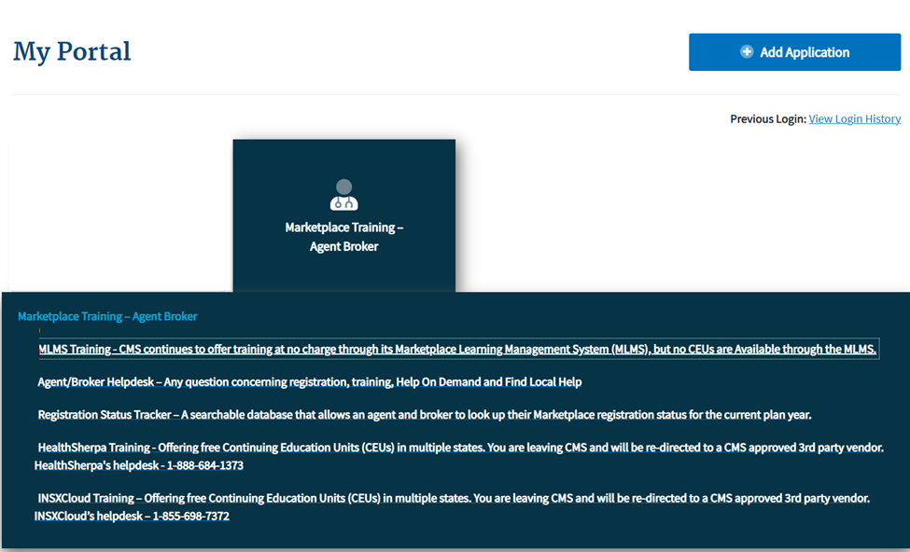
Step 5: Complete Marketplace Training on the MLMS or through an HHS-approved Vendor via the CMS Enterprise Portal (continued)
If agents and brokers choose to complete training through the HHS-approved vendor, they must access the training via the CMS Enterprise Portal. Agents and brokers cannot go directly to the vendor’s website to access the training content.
Click the Marketplace Training – Agent Broker tile and select the Vendor Training option shown below, and the CMS Enterprise Portal will redirect to their website.

Slide 56
Step 5: Complete Marketplace Training on the MLMS or through an HHS-approved Vendor via the CMS Enterprise Portal (continued)
Once an agent or broker completes training through the HHS-approved vendor, they will be directed to log back into the CMS Enterprise Portal to complete registration, including signing the applicable Marketplace Agreement(s) on the MLMS.

Slide 57
Step 6: Read and Accept the Applicable Marketplace Agreement(s) on the MLMS
Create a CMS Enterprise Portal Account.
Request the Agent and Broker Training Access Role.
Complete Remote Identity Proofing through the IDM System.
Complete the Agent and Broker Profile on the MLMS via the CMS Enterprise Portal.
Complete Marketplace Training on the MLMS or through an HHS-approved Vendor via the CMS Enterprise Portal.
Read and Accept the Applicable Marketplace Agreement(s) on the MLMS.
Confirm Completion of all Registration Steps by logging back into the CMS Enterprise Portal and printing the Completion Certificate.

Slide 58
Step 6: Read and Accept the Applicable Marketplace Agreement(s) on the MLMS (continued)
Agents and brokers must execute the Agreement(s) associated with the Marketplace(s) they are participating in:
Individual Marketplace General Agreement
Individual Marketplace Privacy and Security Agreement
SHOP Privacy and Security Agreement

Slide 59
Step 6: Read and Accept the Applicable Marketplace Agreement(s) on the MLMS (continued)
An agent or broker must request the FFM Agent and Broker Training Access role and complete/update their MLMS profile information, complete identity proofing*, and complete the required training and exams before they can sign the Agreement(s).
Once an agent or broker has completed the training (which is required for the Individual Marketplace and optional for SHOP), they will need to sign the Agreement(s).
*Note: Agents and brokers who do not log into the MLMS for more than a year will have their account deactivated, requiring them to complete identity proofing again when they return. Returning individuals with a deactivated account should ensure they are using the same FFM User ID they used previously and that their SSN is populated in IDM.

Slide 60
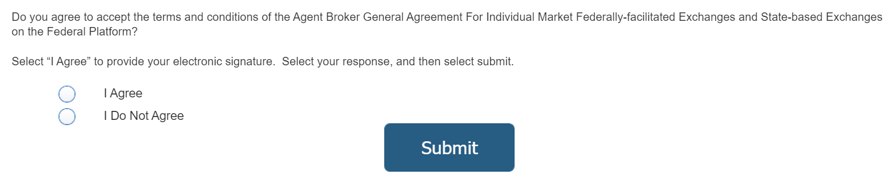
Step 6: Read and Accept the Applicable Marketplace Agreement(s) on the MLMS (continued)
After launching the appropriate Agreement module, review the Agreement language and click “I Agree” at the end of the Agreement to provide an electronic signature and review and accept the terms of the Marketplace Agreement.

Slide 61
Step 7: Confirm Completion of all Registration Steps by logging back into the CMS Enterprise Portal and printing the Completion Certificate
Create a CMS Enterprise Portal Account.
Request the Agent and Broker Training Access Role.
Complete Remote Identity Proofing through the IDM System.
Complete the Agent and Broker Profile on the MLMS via the CMS Enterprise Portal.
Complete Marketplace Training on the MLMS or through an HHS-approved Vendor via the CMS Enterprise Portal.
Read and Accept the Applicable Marketplace Agreement(s) on the MLMS.
Confirm Completion of all Registration Steps by logging back into the CMS Enterprise Portal and printing the Completion Certificate.

Slide 62
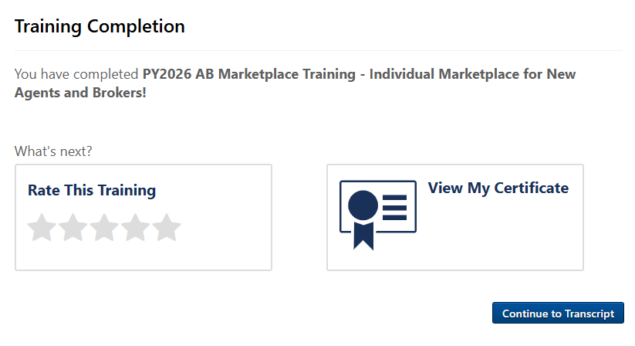
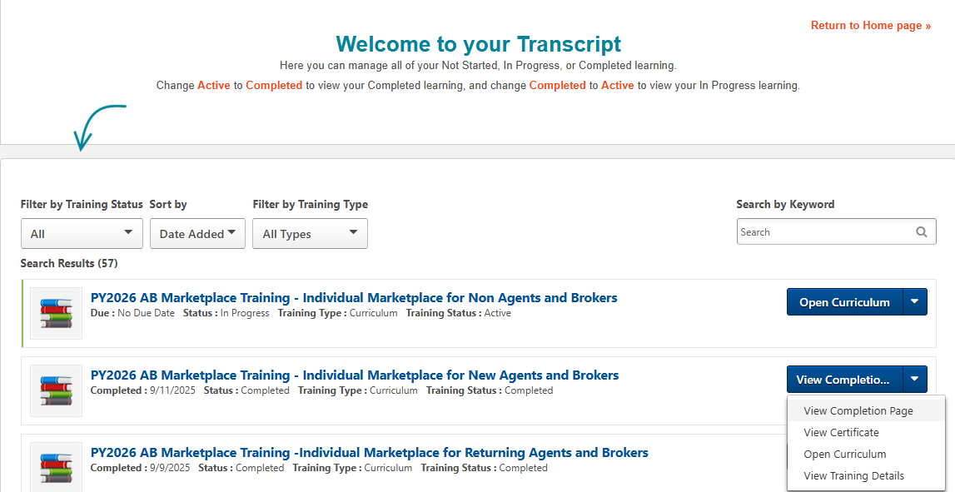
Step 7: Confirm Completion of all Registration Steps by logging back into the CMS Enterprise Portal and printing the Completion Certificate (continued)
After completing the required Agent Broker Curriculum Training and examinations, agents and brokers can access their certificate from the Transcript page. Navigate to the transcript and select “Completed” from the status drop-down. Select the blue “View Completion Page” button next to the desired course. On the Completion page, select “View My Certificate.”
Note: Agents and brokers can also view the certificate of completion without going to the completion page. Under the “View Completion” button there is a menu for both completion page and direct launch of certificate.

Slide 63
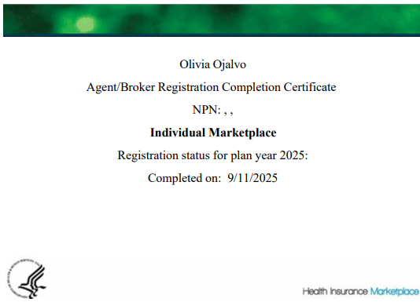
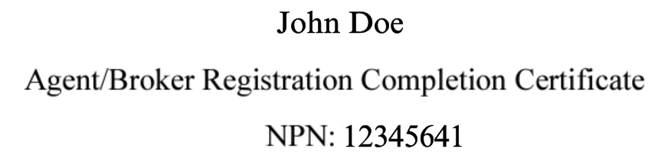
Step 7: Confirm Completion of all Registration Steps by logging back into the CMS Enterprise Portal and printing the Completion Certificate (continued)
The Registration Completion Certificate will include:
Agent’s or broker’s name
Agent’s or broker’s NPN(s)
The market segment(s) for the certificate
The Plan Year for the certificate
Completion date of FFM registration
Issuers may request to view the Registration Completion Certificate(s). However, issuers are instructed to review the Agent and Broker FFM Registration Completion List (RCL) to confirm the registration status of agents and brokers.

Slide 64
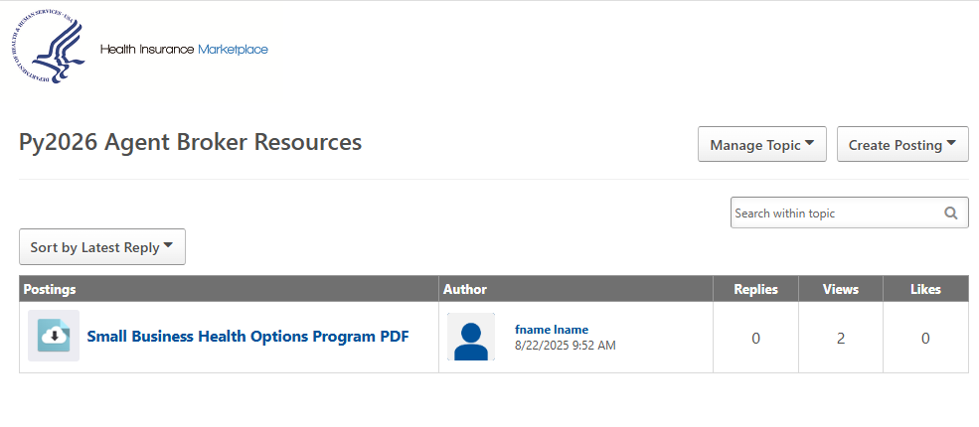
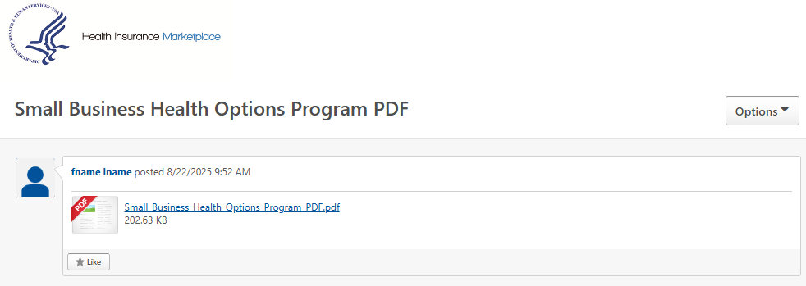
Step 7: Confirm Completion of all Registration Steps by logging back into the CMS Enterprise Portal and printing the Completion Certificate (continued)
To download a PDF file of the full training content after completion, agents and brokers should:
Locate the Training Resources menu.
Select the "Topics" tab.
Select the folder titled “Py2026 Agent and Broker Resources."
Select the name of the file; this will open to a page where the agent/broker will be able to select the PDF file of the training content.
5

Slide 65
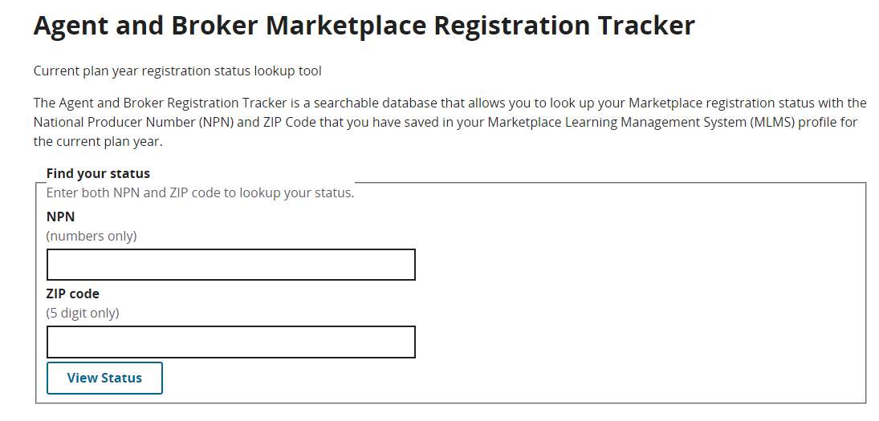
Step 7: Confirm Completion of all Registration Steps by logging back into the CMS Enterprise Portal and printing the Completion Certificate (continued)
Agents and brokers should also confirm that their information appears on the RCL: https://data.healthcare.gov/ffm_ab_registration_lists.
Information may take one to two business days to appear on the RCL after completing all registration and training steps. For those opting to display their information on Find Local Help, it may take up to three business days to update.
If the NPN does not appear, go to the Marketplace Registration Tracker (https://data.healthcare.gov/ab-registration-tracker/) to check Marketplace registration status.
Enter an NPN and ZIP code.
Information is updated daily by 5:00 PM ET.
If additional assistance is needed, send an email to: FFMProducer-AssisterHelpDesk@cms.hhs.gov.

Slide 66

Reminders for Logging in to Your CMS Portal Account
Remember, only the person creating a CMS Enterprise Portal account may use their login credentials.
Sharing login credentials is not allowed, including for credentials used to access approved Classic DE and EDE partner’s websites.
Passwords and MFA access must never be shared with others.
Agents and brokers should check that their EDE or DE account is correctly linked to and integrated with their personal CMS Enterprise Portal account.
CMS has required all EDE partners to ensure that each agent and broker using their platform must reauthenticate (similar to a banking application) to confirm only you are using your personal CMS Portal account every 12 hours. You are prohibited from being logged in on different devices or using multiple sessions with the same credentials.

Slide 67
Live Question/Answer Session

Slide 68
Discussion and Questions
At the end of today’s webinar, we will have a live discussion and question and answer session. You will be able to ask your questions verbally or by written submission in the Q&A tab.
To ask a verbal question:
If you are listening via the Zoom application, click ”Raise Hand” in the webinar controls.
If you are listening via phone, dial star (*) nine (9) to Raise your Hand.
Once your hand is raised, the facilitator will call on the last three (3) digits of your phone number.
When you hear the last three (3) digits of your phone number please dial star (*) six (6) to unmute your line and state your name.
To submit a written question/view written responses:
Type your question in the text box under the “Q&A” tab and click “Send.”
Click on the “My Questions” tab to view written responses to your questions.
Click on the “All Questions” tab to view all questions that received a public response since you’ve been logged into the webinar.
Please note: Due to time constraints, we may not be able to answer all questions posed during today’s session either in writing, or during the live Q&A portion. CMS may use the context of your question to develop outreach materials in the future.

Slide 69

Webinar Session Survey
CMS welcomes your feedback regarding this webinar and values any suggestions that will allow us to enhance this experience for you.
Shortly after this call, we will send a link to you for a convenient way to submit any ideas or suggestions you wish to provide that you believe would be valuable during these sessions. Please take time to complete the survey and provide CMS with any feedback.

Slide 70

Agents and brokers are valued partners to all of us at CMS for the vital role you play in enrolling consumers in qualified health coverage.
We thank you for the trusted advice, support, and assistance you provide throughout the year and wish you continued success throughout the year!

