Slide 1

Plan Year 2026 Health Insurance Marketplace® Registration and Training for Returning Agents and Brokers
Centers for Medicare & Medicaid Services (CMS)
Center for Consumer Information & Insurance Oversight (CCIIO)
September 18, 2025

Slide 2
Disclaimer
The information provided in this presentation is intended only as a general, informal summary of technical legal standards. It is not intended to take the place of the statutes, regulations, and formal policy guidance that it is based upon. This presentation summarizes current policy and operations as of the date it was presented. Links to certain source documents have been provided for your reference. We encourage audience members to refer to the applicable statutes, regulations, and other interpretive materials for complete and current information about the requirements that apply to them. The contents of this document do not have the force and effect of law and are not meant to bind the public in any way, unless specifically incorporated into a contract. This document is intended only to provide clarity to the public regarding existing requirements under the law.
This document generally is not intended for use in the State-based Marketplaces (SBMs) that do not use HealthCare.gov for eligibility and enrollment. Please review the guidance on our Agent and Broker Resources webpage (http://go.cms.gov/CCIIOAB) and Marketplace.CMS.gov to learn more.
Unless indicated otherwise, the general references to “Marketplace” in the presentation only include Federally-facilitated Marketplaces (FFMs) and State-based Marketplaces on the Federal Platform (SBM-FPs).
This communication was printed, published, or produced and disseminated at U.S. taxpayer expense.

Slide 3

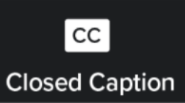
Closed Captioning
This webinar has Closed Captioning available.
To enable Closed Captioning, click the Closed Caption icon in your webinar controls.

Slide 4


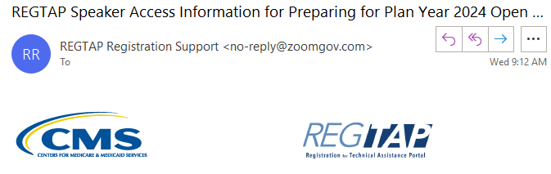
Housekeeping Reminders
If called upon during the Live Question & Answer session, please ask only one (1) question.
To capture links posted in the Zoom Chat, please click on the desired link and bookmark it for future reference.
Webinar and Audio Access Tips have been shared in the Zoom Chat and are listed in the email access details you received from REGTAP Registration Support.

Slide 5


Discussion and Questions
At the end of today’s webinar, we will have a live discussion and question and answer session. You will be able to ask your questions verbally or by written submission in the Q&A tab.
    To ask a verbal question:
    If you are listening via the Zoom application, click ”Raise Hand” in the webinar controls.
    If you are listening via phone, dial star (*) nine (9) to Raise your Hand.
      Once your hand is raised, the facilitator will call on the last three (3) digits of your phone number.
      When you hear the last three (3) digits of your phone number please dial star (*) six (6) to unmute your line and state your name.
    To submit a written question/view written responses:
    Type your question in the text box under the “Q&A” tab and click “Send.”
    Click on the “My Questions” tab to view written responses to your questions.
    Click on the “All Questions” tab to view all questions that received a public response since you’ve been logged into the webinar.
Please note: Due to time constraints, we may not be able to answer all questions posed during today’s session either in writing, or during the live Q&A portion. CMS may use the context of your question to develop outreach materials in the future.

Slide 6
Agenda
1
Introduction
2
Plan Year 2026 Marketplace Registration and Training Process
3
Live Question/Answer Session

Slide 7
Intended Audience
    The intended audience for this presentation is agents and brokers who successfully completed Plan Year 2025 Marketplace registration and training and are returning for Plan Year 2026.
      Returning agents and brokers are required to complete an abbreviated refresher training, pass an exam and execute the applicable Marketplace Agreements.
    Agents and brokers who participated in a previous Plan Year but did NOT complete Plan Year 2025 Marketplace registration and training are not eligible for “What's New for Returning Agents and Brokers” training and must complete the full Individual Marketplace training for Plan Year 2026.
    Agents and brokers who are returning to the Marketplace after participating in a previous year should have already completed identity proofing and, if so, do not need to repeat this step again.
      However, these individuals should ensure they are using the same FFM User ID they used previously and should ensure their contact information and national producer number (NPN) are correct in their Marketplace Learning Management System (MLMS) profiles.

Slide 8
Intended Audience (continued)
    Note: Attending this webinar does NOT fulfill the requirements for completing the Marketplace registration and training on the MLMS. Returning agents and brokers are required to complete registration and training for the current plan year and will be automatically enrolled in a shorter training.

Slide 9
Plan Year 2026 Health Insurance Marketplace® Registration and Training for Returning Agents and Brokers

Slide 10
Step 1: Update the Agent and Broker Profile in the MLMS via the CMS Enterprise Portal
To participate in the Marketplace for Plan Year 2026, agents and brokers must complete the following actions:
Update the Agent and Broker Profile in the MLMS via the CMS Enterprise Portal.
Complete Marketplace Training on the MLMS or through an HHS-approved Vendor via the CMS Enterprise Portal.
Read and accept the applicable Marketplace Agreement(s) on the MLMS.
Confirm completion of all registration steps by logging back in to the “Agent and Broker Registration Status” page on the CMS Enterprise Portal and printing the completion certificate.

Slide 11
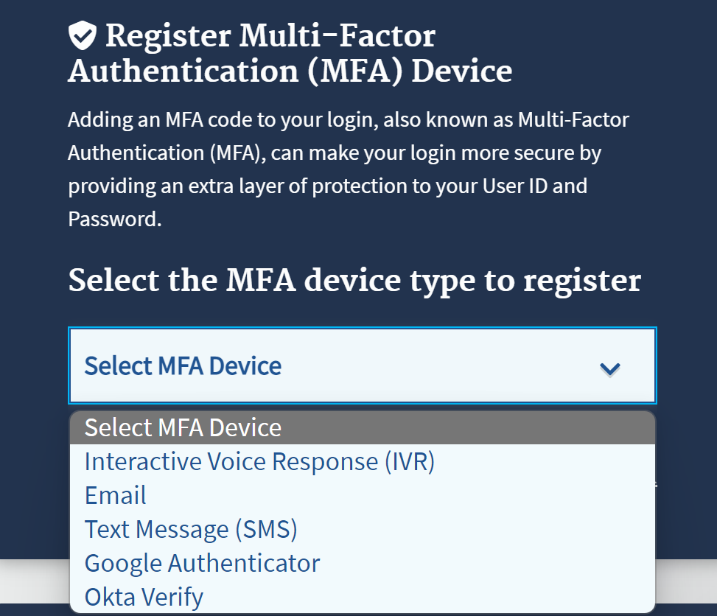
Step 1: Update the Agent and Broker Profile in the MLMS via the CMS Enterprise Portal (continued)
    Multi-factor Authentication (MFA) is required for all agents and brokers. If an agent or broker has not already done so, they will be prompted to select an MFA device when they log in to the CMS Enterprise Portal. The agent or broker will receive a code through this device each time they log in.

Slide 12
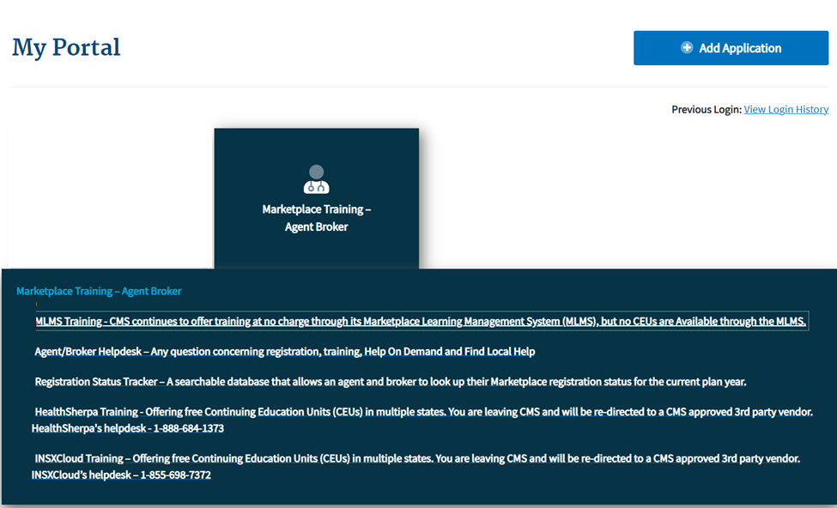
Step 1: Update the Agent and Broker Profile in the MLMS via the CMS Enterprise Portal (continued)
    To access both the CMS-developed training and training offered through the HHS-approved vendor, click the Marketplace Training – Agent Broker tile and select either the MLMS Training or Vendor Training option.*
    If agents and brokers select the Vendor Training option, they will be re-directed to the HHS-approved vendor’s website.
    *To review and update their MLMS profile, agents and brokers will need to select the MLMS Training option.

Slide 13
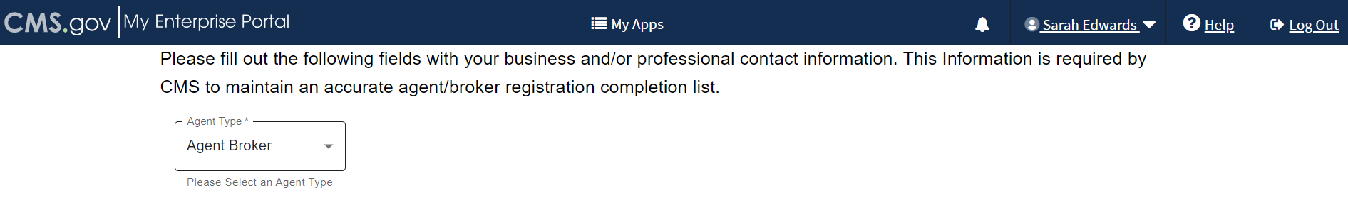
Step 1: Update the Agent and Broker Profile in the MLMS via the CMS Enterprise Portal (continued)
    Select a user role from the two available options.
    If you do not intend to assist consumers with enrolling in Marketplace coverage, select the "Not an Agent Broker" role in the drop-down menu at the top of your agent/broker profile. You can return to this section of your agent/broker profile at any time to update this selection if you do intend to assist consumers with Marketplace coverage in the future.
    Note: If you do not return to your profile to update your selection, you will not be eligible to participate in the Marketplace for Plan Year 2026 or to receive compensation for assisting consumers with Marketplace enrollments.

Slide 14
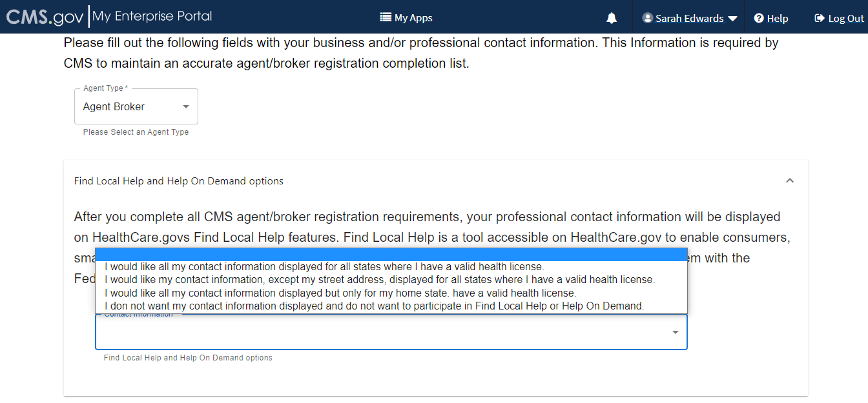
Step 1: Update the Agent and Broker Profile in the MLMS via the CMS Enterprise Portal (continued)
    The information agents and brokers use to complete their MLMS profile will be used to populate Find Local Help at HealthCare.gov and Help On Demand so consumers can find them for assistance. Find Local Help is also available in Spanish.
    Note: Help On Demand is a referral system that quickly connects consumers seeking enrollment assistance on HealthCare.gov with Marketplace-registered, state-licensed agents and brokers in their area who can provide immediate assistance with plan selection and enrollment.

Slide 15
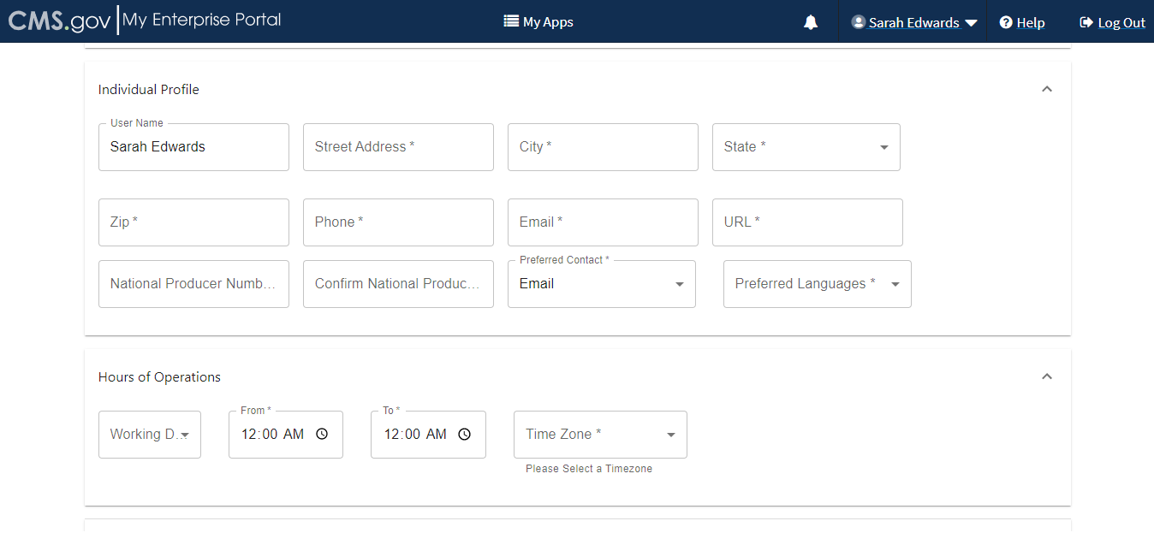
Step 1: Update the Agent and Broker Profile in the MLMS via the CMS Enterprise Portal (continued)
    The MLMS profile page will appear in a separate window for agents and brokers to update their profile information.
John Doe

Slide 16
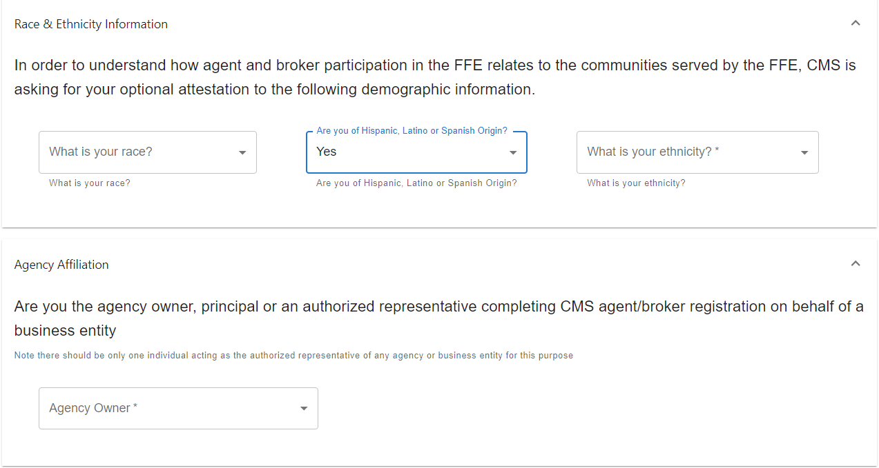
Step 1: Update the Agent and Broker Profile in the MLMS via the CMS Enterprise Portal (continued)
    Three race and ethnicity questions will appear, where an agent or broker will have the option to attest to personal race and ethnicity information. This information helps CMS identify the various diverse agent/broker communities assisting consumers with Marketplace coverage.

Slide 17
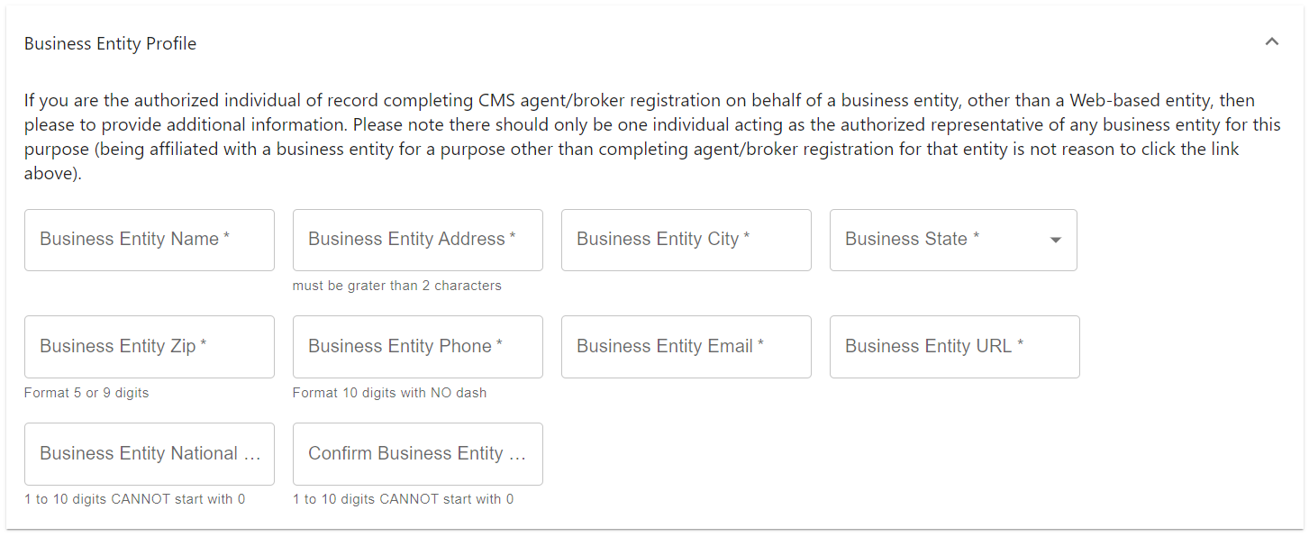
Step 1: Update the Agent and Broker Profile in the MLMS via the CMS Enterprise Portal (continued)
    Agents and brokers who also act as the authorized representative* for a business entity or web-broker can add the business entity’s or web-broker’s National Producer Number (NPN) by clicking the appropriate “+” link at the bottom of the profile page.
    Agents and brokers can list up to three NPNs in the MLMS profile.
    *An agency may only designate one user to act as the authorized representative for the business or web-broker entity for MLMS training completion.

Slide 18
Step 1: Update the Agent and Broker Profile in the MLMS via the CMS Enterprise Portal (continued)
    When completing or updating the MLMS profile, agents and brokers should only enter a business or web-broker NPN if:
      The NPN is tied to a business entity – such as an LLC, corporation or partnership – that is registered with a state for the purpose of selling health insurance.
      The agent or broker is the authorized individual or agent in charge associated with that entity’s state license.
    Note: Agents and brokers should not enter an individual NPN in the business or web-broker field of the MLMS profile. There should only be one individual acting as the authorized representative of any web-based entity. Being affiliated with a business or web-based entity (i.e. employed or contracted agent or broker) is not reason to enter data here.

Slide 19
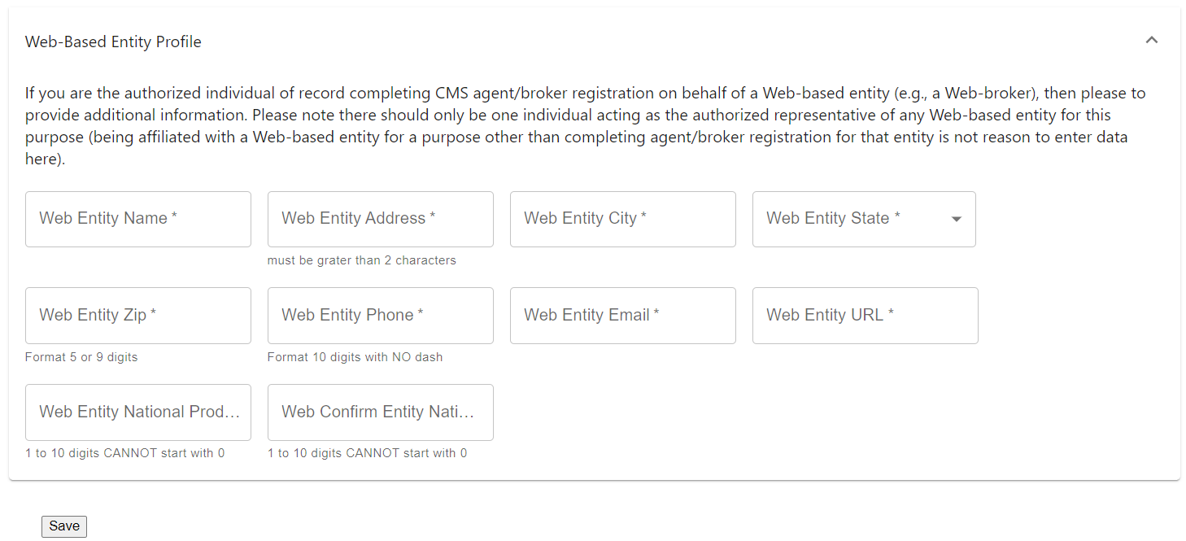
Step 1: Update the Agent and Broker Profile in the MLMS via the CMS Enterprise Portal (continued)
    Enter the information for affiliated web-brokers or business entities.
      Note: Only those who sign a web-broker agreement should complete the web-broker profile.
      Any individual NPN entered in the business or web-broker NPN field of the MLMS profile screen will be removed.
    If and agent or broker lists the business entity or web-broker NPN on their profile, these will be added to Registration Completion List once training has been completed.

Slide 20
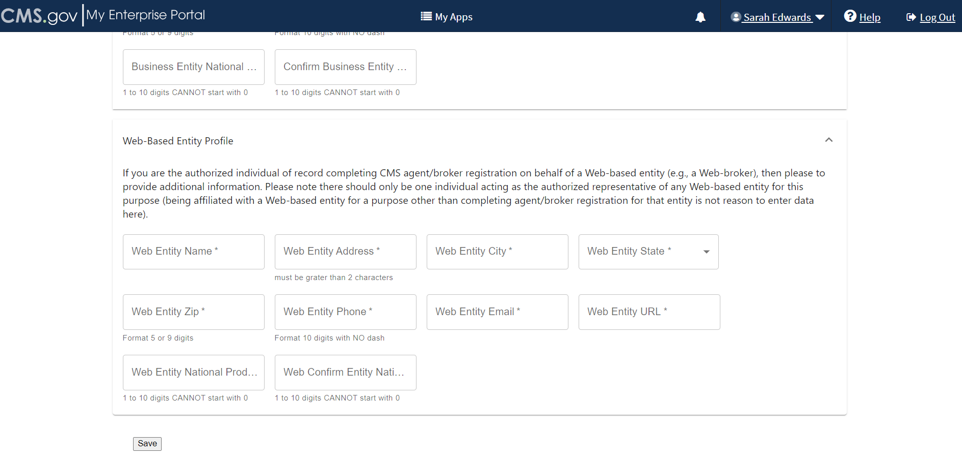
Step 1: Update the Agent and Broker Profile in the MLMS via the CMS Enterprise Portal (continued)
    Once agents and brokers have entered all their profile information, click “Save.”

Slide 21
Step 1: Update the Agent and Broker Profile in the MLMS via the CMS Enterprise Portal (continued)
    Agents and brokers must enter a correct NPN in their MLMS profile to receive credit for completing Marketplace registration.
      The NPN can be up to 10 digits long and must not begin with a zero.
      The NPN must not include any special characters or letters.
      The NPN is not the same as a state license number. Be sure to use an NPN, not a state license number.
      To update the NPN, agents and brokers can click the “Complete Agent and Broker Training” hyperlink and update the information in the MLMS profile.
      Agent and broker NPNs can be found at www.nipr.com/PacNpnSearch.htm.
    Be sure to confirm the NPN is correct in the MLMS profile. Entering an inaccurate NPN could result in denial of compensation/credit by an issuer.

Slide 22
Step 1: Update the Agent and Broker Profile in the MLMS via the CMS Enterprise Portal (continued)
    General MLMS Information:
    CMS validates NPNs against data stored in the National Insurance Producer Registry (NIPR) Public Database: https://www.nipr.com/.
      Results of this NIPR NPN validation appear on the public Agent and Broker Federally-facilitated Marketplace Registration Completion List (RCL) https://data.healthcare.gov/ffm_ab_registration_lists
      The RCL is updated daily.

Slide 23
Step 1: Update the Agent and Broker Profile in the MLMS via the CMS Enterprise Portal (continued)
    General MLMS Information:
    NPN validation occurs during the annual registration process in the MLMS and is only applicable to the current Plan Year. If an agent or broker does not maintain a valid NPN, their agreements with the Marketplace may be terminated.
    To be validated, agents and brokers must:
      Have a valid state license;
      Have a valid health-related line of authority (LOA) (https://nipr.com/licensing-center/add-a-line-of-authority) in their resident state; and
      Have an active status for their health-related LOA.

Slide 24
Step 1: Update the Agent and Broker Profile in the MLMS via the CMS Enterprise Portal (continued)
    Line of Authority Validation Requirements for Marketplace Agents and Brokers:
    Updated agent/broker licensure validation methodology went into effect beginning in plan year 2023 to ensure agents and brokers have a valid health-related line of authority (LOA) in their resident state.
    Background: Each state Department of Insurance (DOI) determines the requirements for agents and brokers in their specific state. CMS validates the status of an agent’s or broker’s licensure through the NIPR on a weekly basis. Specifically, licensure validation is determined by checking license status and the presence of a valid health LOA in the resident state for each agent or broker.
    Note: Some states, such as Florida, Hawaii, New Mexico, Texas, Utah, Vermont, Wisconsin, and Wyoming, require ABs to have an appointment with a health insurance carrier before their NPN can be validated.
    Note: Agents and brokers who do not have an approved health-related LOA, as determined by their resident state, will lose their access to Marketplace systems and will not be able to assist consumers with Marketplace activities for plan year 2026.

Slide 25
Step 1: Update the Agent and Broker Profile in the MLMS via the CMS Enterprise Portal (continued)
    Agents and brokers can take several steps now to check and see if they need to take further action.
      Check resident state requirements for Appointment Level LOA, Approved Class Type and/or Approved License Level LOA at https://data.healthcare.gov/AB-NIPR-Health-Line-Of-Authority.
      Then, agents and brokers can go to NIPR at https://nipr.com/licensing-center/add-a-line-of-authority and use the “Look Up Your National Producer Number (NPN)” tool at the bottom of the page to check their personal licensure information for their resident state.
      If agents and brokers do not have the required resident state LOA, they can use the links to “Add a Line of Authority” and work directly with their resident state DOI regarding licensing requirements.
    The validation of agents’ and brokers’ licenses will be reviewed weekly following completion of the required annual agent and broker Registration and Training. Agents and brokers can check the RCL at https://data.healthcare.gov/ab-registration-completion-list to confirm that their NPN is listed and the “NPN Valid (Current Year Only)” reflects “Y” for yes prior to assisting consumers with enrollment.

Slide 26
Step 2: Complete Marketplace Training on the MLMS or through an HHS-approved Vendor via the CMS Enterprise Portal
Update the Agent and Broker Profile in the Marketplace Learning Management System (MLMS) via the CMS Enterprise Portal.
Complete Marketplace Training on the MLMS or through an HHS-approved Vendor via the CMS Enterprise Portal.
Read and accept the applicable Marketplace Agreement(s) on the MLMS.
Confirm completion of all registration steps by logging back in to the “Agent and Broker Registration Status” page on the CMS Enterprise Portal and printing the completion certificate.

Slide 27
Step 2: Complete Marketplace Training on the MLMS or through an HHS-approved Vendor via the CMS Enterprise Portal (continued)
    Returning Individual Marketplace agents and brokers are eligible to take a condensed training (Marketplace Training for Returning Agents and Brokers) to complete the Individual Marketplace training requirement.*
    The required portion of Marketplace Training for Returning Agents and Brokers takes approximately one hour to complete.
    Returning agents and brokers will be automatically enrolled in Marketplace Training for Returning Agents and Brokers, but can enroll in additional curricula, such as Small Business Health Options Program (SHOP) training or the full Individual Marketplace training, as desired.
*Training is only required for participation in the Individual Marketplace. Agents and brokers who participate in the SHOP are encouraged, but not required, to take SHOP training.

Slide 28
Step 2: Complete Marketplace Training on the MLMS or through an HHS-approved Vendor via the CMS Enterprise Portal (continued)
    The curriculum for the Marketplace Training for Returning Agents and Brokers consists of one required training module and one required exam.
    Following the training, agents and brokers will be prompted to complete the Marketplace training exam.
    This exam consists of 10 questions that will test understanding of the concepts presented in the training.
    Agents and brokers must pass the exam with a 70% score or better to receive credit for taking the course.

Slide 29
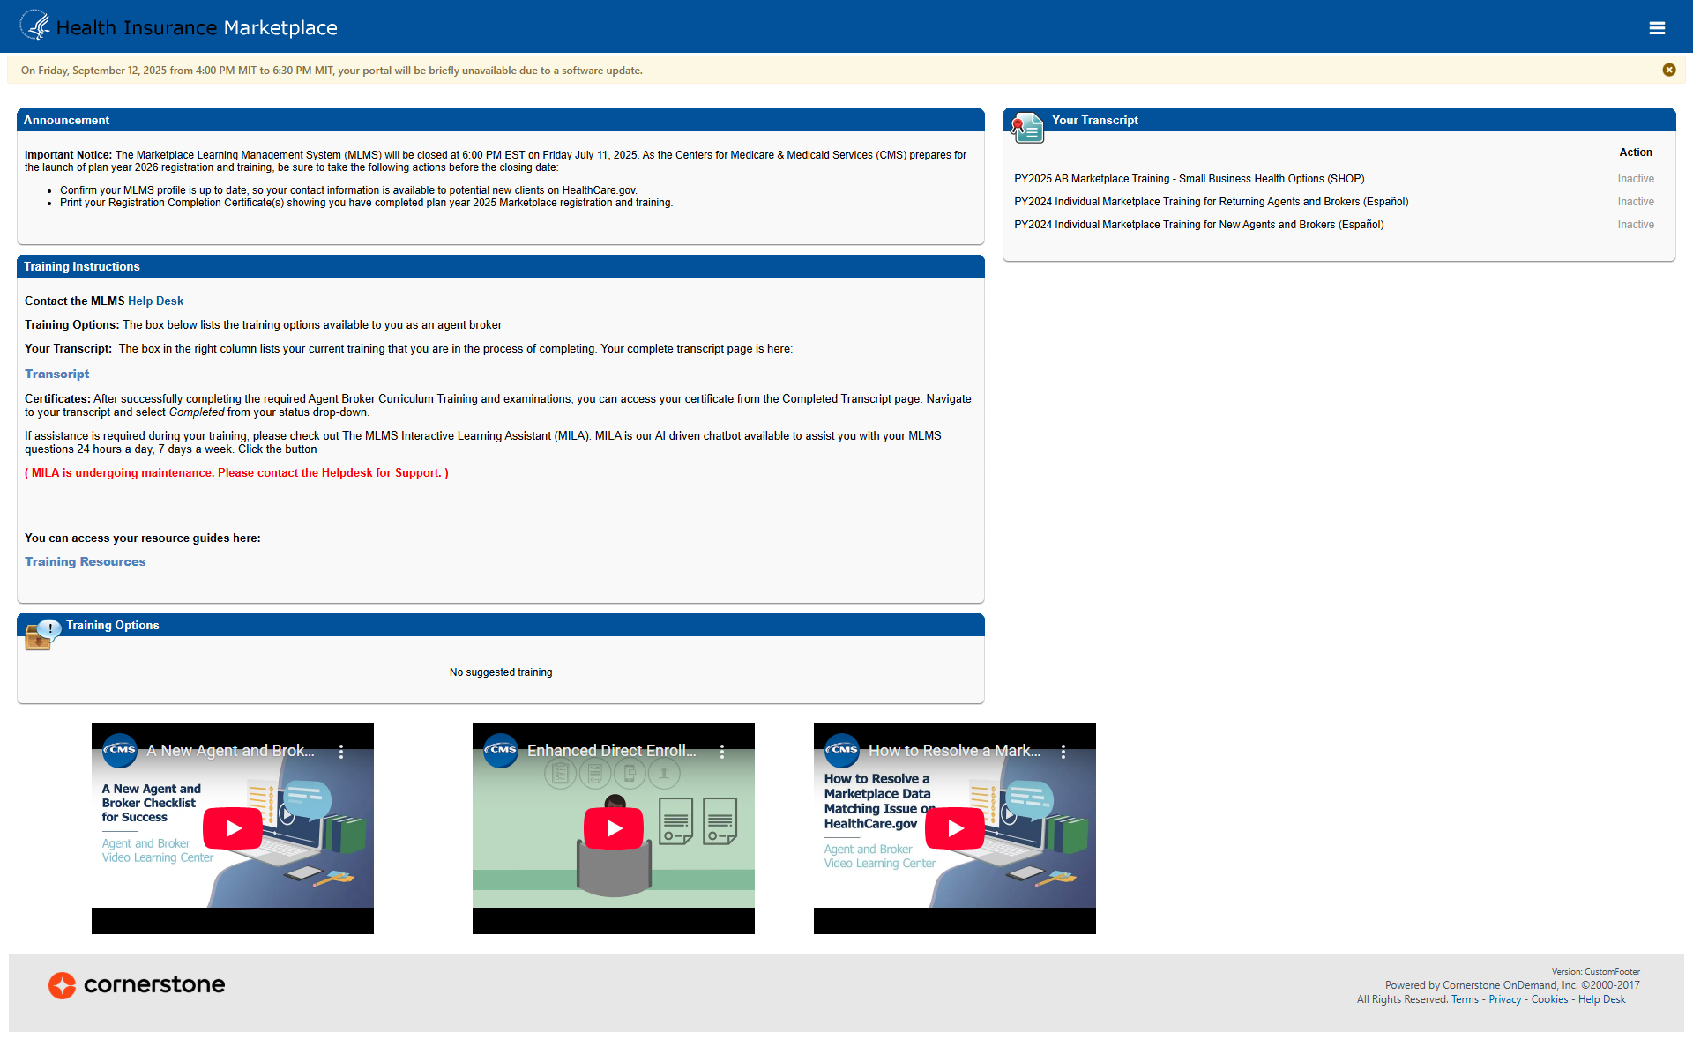

Step 2: Complete Marketplace Training on the MLMS or through an HHS-approved Vendor via the CMS Enterprise Portal (continued)
    The full training curriculum is available in the "Training Options" widget on the agent and broker welcome page.

Slide 30
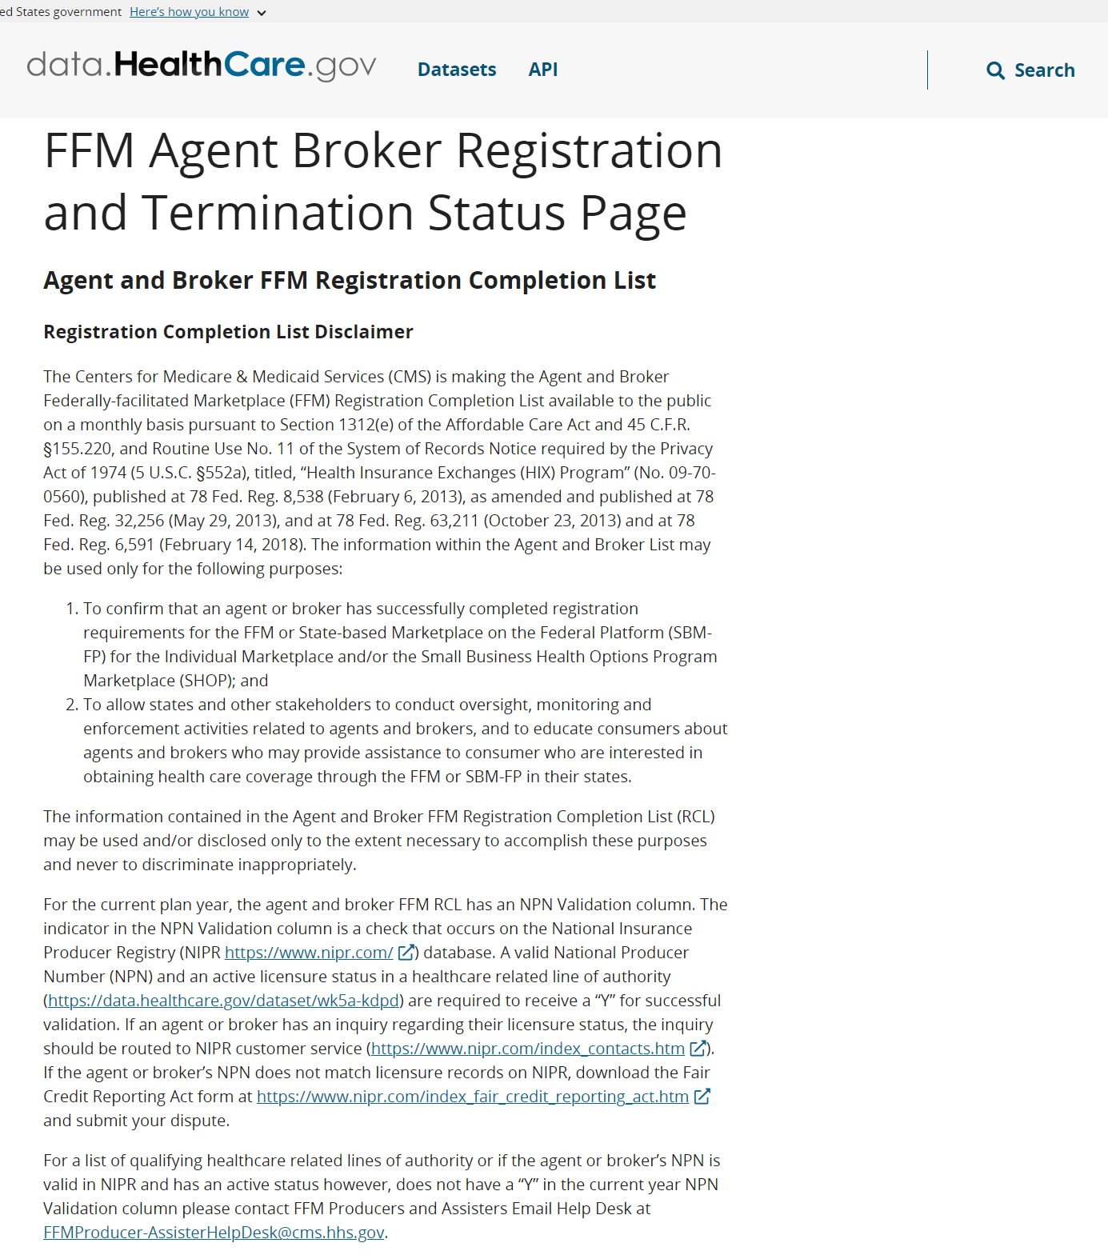
Step 2: Complete Marketplace Training on the MLMS or through an HHS-approved Vendor via the CMS Enterprise Portal (continued)
    To ensure an agent or broker is eligible for Marketplace Training for Returning Agents and Brokers, they should confirm that their NPN appears on the Agent and Broker FFM Registration Completion List https://data.healthcare.gov/ffm_ab_registration_lists for plan year 2025.
    If an agent or broker believes they completed the plan year 2025 registration and training process, but do not find their name on the RCL, they can send an email to FFMProducer-AssisterHelpDesk@cms.hhs.gov for additional assistance.

Slide 31
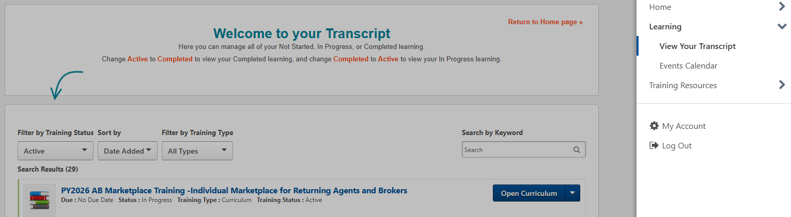
Step 2: Complete Marketplace Training on the MLMS or through an HHS-approved Vendor via the CMS Enterprise Portal (continued)
    Returning agents and brokers will automatically be assigned to the returning training. Agents and brokers will navigate to "View Your Transcript" and will see the returning curriculum in "Active" status.

Slide 32
Step 2: Complete Marketplace Training on the MLMS or through an HHS-approved Vendor via the CMS Enterprise Portal (continued)
    There are two free options for completing Plan Year 2026 training:
      CMS-developed training through the MLMS (Individual Marketplace and Small Business Health Options Program [SHOP]); (No continuing education units [CEUs]), or
      HHS-approved vendor HealthSherpa (Individual Marketplace only). CEUs offered for this training.
    An agent or broker only needs to complete training one time for each plan year.
    The approved vendor is required to offer CEUs in a minimum of five states where the Marketplace operates (45 CFR § 155.222).
      Agents and brokers can use these CEUs to meet state licensure requirements for continuing education.
      There is no fee for HHS-approved vendor CEUs.
      For more information on individual state CEU requirements, check with the respective state Department of Insurance.

Slide 33
Step 2: Complete Marketplace Training on the MLMS or through an HHS-approved Vendor via the CMS Enterprise Portal (continued)
    If agents and brokers choose to complete training through the HHS-approved vendor, they must access the training via the CMS Enterprise Portal. Agents and brokers cannot go directly to the vendor’s website to access the training content.
    Click the Marketplace Training – Agent Broker tile and select the Vendor Training option shown below, and the CMS Enterprise Portal will redirect to their website.

Slide 34
Step 2: Complete Marketplace Training on the MLMS or through an HHS-approved Vendor via the CMS Enterprise Portal (continued)
    Completing Marketplace training through the HHS-approved vendor still requires agents and brokers to execute the applicable Agreement(s) on the MLMS prior to assisting consumers.
    Once an agent or broker completes training through the HHS-approved vendor, they will be directed to log back into the CMS Enterprise Portal to complete registration, including signing the applicable Marketplace Agreement(s) on the MLMS (Step 3).
    Reminder! Agents and brokers cannot enroll consumers in Marketplace coverage or be compensated for their work until they return to the MLMS and complete all of the steps in the registration process.
Note: Agents and brokers who do not log into MLMS for more than a year will have their account deactivated, requiring them to complete identity proofing again when they return. Returning individuals with a deactivated account should ensure they are using the same FFM User ID they used previously, and their Social Security number (SSN) is populated in IDM.

Slide 35
Step 3: Read and accept the applicable Marketplace Agreement(s) on the MLMS
Update the Agent and Broker Profile in the MLMS via the CMS Enterprise Portal.
Complete Marketplace Training on the MLMS or through an HHS-approved Vendor via the CMS Enterprise Portal.
Read and accept the applicable Marketplace Agreement(s) on the MLMS.
Confirm completion of all registration steps by logging back in to the “Agent and Broker Registration Status” page on the CMS Enterprise Portal and printing the completion certificate.

Slide 36
Step 3: Read and accept the applicable Marketplace Agreement(s) on the MLMS (continued)
    Agents and brokers must execute the Agreement(s) associated with the Marketplace(s) they are participating in:
      Individual Marketplace General Agreement
      Individual Marketplace Privacy and Security Agreement
      SHOP Privacy and Security Agreement
    An agent or broker must update their MLMS profile information and complete the required training and exams before they can sign the Agreement(s).

Slide 37
Step 4: Confirm completion of all registration steps by logging back in to the CMS Enterprise Portal and printing the completion certificate
Update the Agent and Broker Profile in the MLMS via the CMS Enterprise Portal.
Complete Marketplace Training on the MLMS or through an HHS-approved Vendor via the CMS Enterprise Portal.
Read and accept the applicable Marketplace Agreement(s) on the MLMS.
Confirm completion of all registration steps by logging back in to the CMS Enterprise Portal and printing the completion certificate.

Slide 38
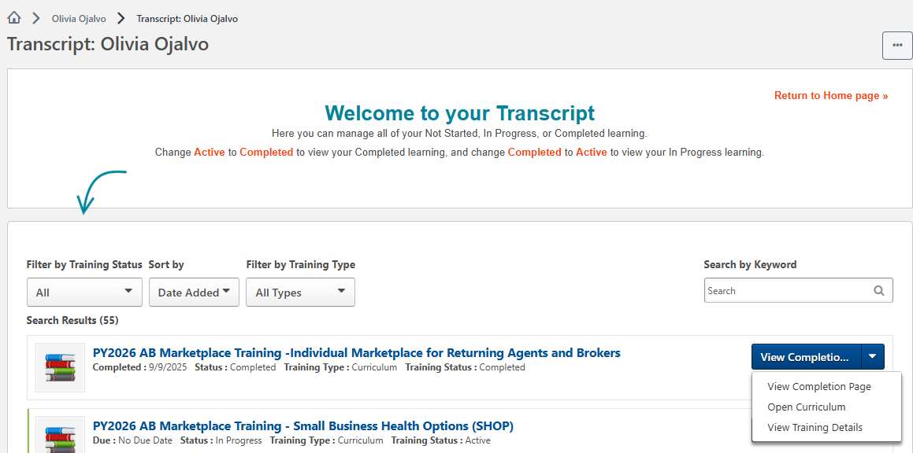
Step 4: Confirm completion of all registration steps by logging back in to the CMS Enterprise Portal and printing the completion certificate (continued)
    After completing the required Agent Broker Curriculum Training and examinations, agents and brokers can access their certificate from the Transcript page. Navigate to the transcript and select “Completed” from the status drop-down. Select the blue “View Completion Page” button next to the desired course. On the Completion page, select “View My Certificate.”
    Note: Agents and brokers can also view the certificate of completion without going to the completion page. Under the “View Completion” button there is a menu for both completion page and direct launch of certificate.

Slide 39
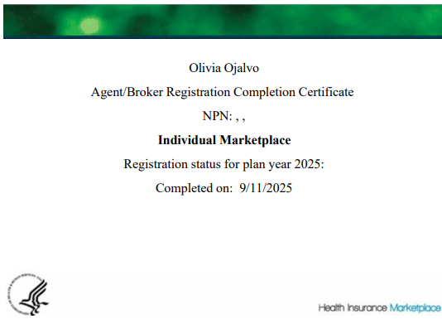
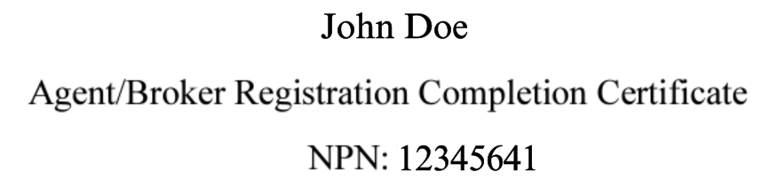
Step 4: Confirm completion of all registration steps by logging back in to the CMS Enterprise Portal and printing the completion certificate (continued)
    The Registration Completion Certificate will include:
      Agent’s or broker’s name
      Agent’s or broker’s NPN(s)
      The market segment(s) for the certificate
      The Plan Year for the certificate
      Completion date of FFM registration
    Issuers may request to view the Registration Completion Certificate(s). However, issuers are instructed to review the Agent and Broker FFM Registration Completion List (RCL) to confirm the registration status of agents and brokers.

Slide 40
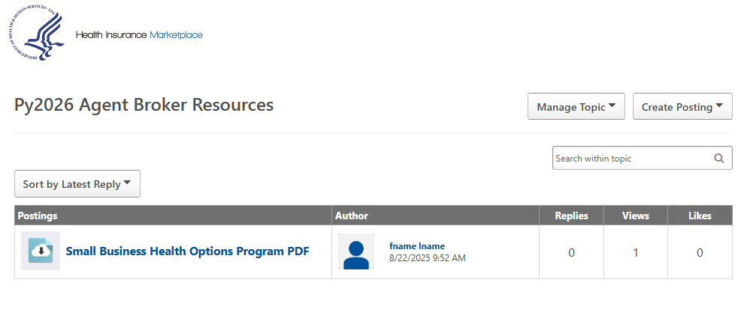
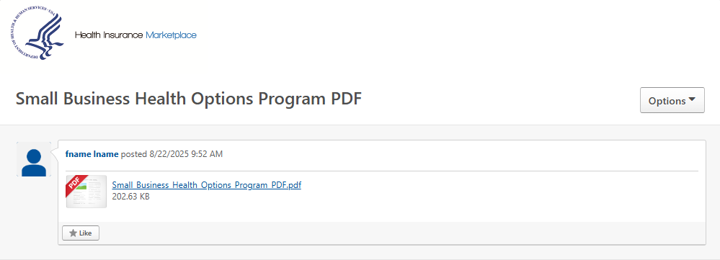
Step 4: Confirm completion of all registration steps by logging back in to the CMS Enterprise Portal and printing the completion certificate (continued)
    To download a PDF file of the full training content after completion, agents and brokers should:
    Locate the Training Resources menu.
    Select the "Topics" tab.
    Select the folder titled "Py2026 Agent and Broker Resources."
    Select the name of the file; this will open to a page where the agent/broker will be able to select the PDF file of the training content.

Slide 41
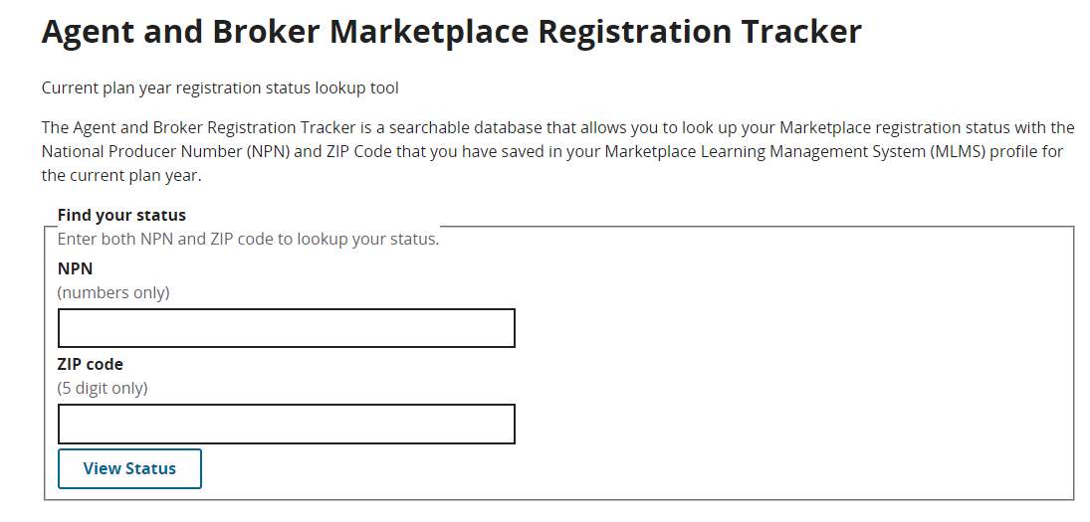
Step 4: Confirm completion of all registration steps by logging back in to the CMS Enterprise Portal and printing the completion certificate (continued)
    Agents and brokers should also confirm that their information appears on the RCL (https://data.healthcare.gov/ffm_ab_registration_lists)
    Information may take one to two business days to appear on the RCL after completing all registration and training steps. For those opting to display their information on Find Local Help, it may take up to three business days to update.
    If the NPN does not appear, go to the Marketplace Registration Tracker (https://data.healthcare.gov/ab-registration-tracker/) to check Marketplace registration status.
      Enter an NPN and ZIP code.
      Information is updated daily by 5:00 PM ET.
    If additional assistance is needed, send an email to: FFMProducer-AssisterHelpDesk@cms.hhs.gov.

Slide 42

Reminders for Logging in to Your CMS
Portal Account
    Remember, only the person creating a CMS Enterprise Portal account may use their login credentials.
    Sharing login credentials is not allowed, including for credentials used to access approved Classic DE and EDE partner’s websites.
    Passwords and MFA access must never be shared with others.
    Agents and brokers should check that their EDE or DE account is correctly linked to and integrated with their personal CMS Enterprise Portal account.
    CMS has required all EDE partners to ensure that each agent and broker using their platform must reauthenticate (similar to a banking application) to confirm only you are using your personal CMS Portal account every 12 hours. You are prohibited from being logged in on different devices or using multiple sessions with the same credentials.

Slide 43
Live Question/Answer Session

Slide 44
Discussion and Questions
At the end of today’s webinar, we will have a live discussion and question and answer session. You will be able to ask your questions verbally or by written submission in the Q&A tab.
    To ask a verbal question:
    If you are listening via the Zoom application, click ”Raise Hand” in the webinar controls.
    If you are listening via phone, dial star (*) nine (9) to Raise your Hand.
      Once your hand is raised, the facilitator will call on the last three (3) digits of your phone number.
      When you hear the last three (3) digits of your phone number please dial star (*) six (6) to unmute your line and state your name.
    To submit a written question/view written responses:
    Type your question in the text box under the “Q&A” tab and click “Send.”
    Click on the “My Questions” tab to view written responses to your questions.
    Click on the “All Questions” tab to view all questions that received a public response since you’ve been logged into the webinar.
Please note: Due to time constraints, we may not be able to answer all questions posed during today’s session either in writing, or during the live Q&A portion. CMS may use the context of your question to develop outreach materials in the future.

Slide 45

Webinar Session Survey
CMS welcomes your feedback regarding this webinar and values any suggestions that will allow us to enhance this experience for you.
Shortly after this call, we will send a link to you for a convenient way to submit any ideas or suggestions you wish to provide that you believe would be valuable during these sessions. Please take time to complete the survey and provide CMS with any feedback.

Slide 46

Agents and brokers are valued partners to all of us at CMS for the vital role you play in enrolling consumers in qualified health coverage.
We thank you for the trusted advice, support, and assistance you provide throughout the year and wish you continued success throughout the year!

