Slide 1


CMS IT Governance Training
IT Project Baselines
Click the Slide Show image in bottom right bar to begin presentation.
Notes:
Welcome to CMS’ IT Governance Training, IT Project Baselines.
In this brief presentation we’ll explain what a project baseline is, how it is established, and how it is used.

Slide 2
What is a Project Baseline?
CMS IT Governance Review Board (GRB) approval ✓
Approved Project Plan
  Cost
  Schedule
  Scope
Used for project tracking
Notes:
A project baseline are the cost, schedule, and scope metrics of an approved project plan.
When the CMS IT Capital Planning function approves your project, they also approve a certain planned spending level and timeline, or roadmap, along with the project scope itself.
Those metrics become your project’s baseline and CMS’ IT Governance function tracks them per federal Capital Planning and Investment Control, or CPIC, rules during the Control and Evaluate phases of CPIC.
For more information on CPIC and how CMS uses the Target Life Cycle, or TLC, framework to implement CPIC, more training videos are available at the TLC Training Library on CMS.gov slash TLC.

Slide 3
Project Baseline Example:
Cost Baselines
 | FY 2021 Estimated Cost | FY 2022 Estimated Cost | FY 2023 Estimated Cost | FY 2024 Estimated Cost | FY 2025 Estimated Cost | 5-Year Estimated Costs
Development | $1,000,000 | $500,000 |  |  |  | $1,500,000
Licensing |  | $100,000 | $100,000 | $100,000 | $100,000 | $400,000
Operations & Maintenance |  | $500,000 | $800,000 | $800,000 | $800,000 | $2,900,000
TOTAL | $1,000,000 | $1,100,000 | $900,000 | $900,000 | $900,000 | $4,800,000
FY 2021 Budget Request: $1,000,000
FY 2022 Budget Request: $1,100,000
Notes:
Let’s look at an example of a Project’s Cost Baseline.
If on your Business Case you estimate that in Fiscal Year 2021 your project will be in the Development phase of the TLC at an estimated cost of $1 million dollars, if the project is approved by the CMS IT Governance Review Board, that cost estimate becomes your FY21 cost baseline.
Similarly, if that Business Case shows that in Fiscal Year 2022, you will complete development, meaning you go live in production, and your estimated costs for the fiscal year are now split between licenses, development, and operations and maintenance, which may include continued minor development and releases for agile projects, your total fiscal year costs would become that project’s FY22 cost baseline.
The FY21 and FY22 cost baselines should then inform your budget request for FY21 and FY22.
And while project cost baselines are your best estimate, they do help to guide later project discussions, to include CMS Budget Development Group discussions.

Slide 4
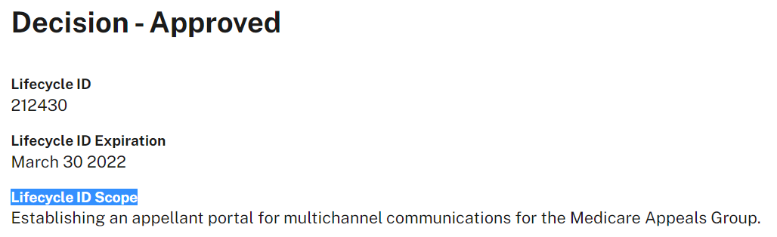
Project Baseline Example:
Scope & Schedule Baselines
Target Completion Date (in Production): March 30, 2022
Project Scope: Approved by GRB and recorded via Life Cycle ID
Notes:
Next, let’s look at an example of a Project’s Scope and Schedule Baselines.
If on your Business Case you estimate that your Target Completion Date for the project is March 30th of 2022, meaning that that is when you go live in production, that would then serve as your project’s schedule baseline.
As for the scope, the CMS IT Governance Review Board, as the agency’s capital planning body, is initially approving a specific body of work for your project, in this example, the development of a public-facing web portal.
That specific effort, building the web portal, then becomes your baseline project scope.
You can find your project’s baselines in the EASi system and they are also recorded in CMS’ IT Portfolio Management Tool, Folio.

Slide 5
How are Baselines Used?
To ensure Capital Planning decisions are reflected in Budget and Contract requests
To evaluate project changes according to their Return-on-Investment
To ensure project changes are in line with CMS’ enterprise IT strategy and goals
Notes:
Now that we understand what baselines are, let’s look at how they’re used.
As it is CMS’ IT Capital Planning process that establishes the project baselines, CMS expects the approved plan to be what moves forward in the acquisitions and budget process.
CMS’ IT Governance function reviews each IT acquisition as well as Requests for Additional Funding, or RAFs, to ensure that they are consistent with the established baselines
If there is a significant variance from the cost, schedule, or scope baselines, your project may need further GRB approval.
That approval often just involves a brief update and discussion with the GRB as to why the project is headed in a different direction from what the GRB previously approved.
The GRB will then weigh any plan changes from a cost – benefit perspective and provide approval accordingly.
The overall goal is to ensure that the CMS leaders that are responsible for overseeing CMS’ IT Portfolio have a good handle on the health of IT projects and that CMS plans strategically for any changes, in line with other efforts going on across CMS.

Slide 6
How are Baselines Used?:
Example
Existing Baseline
FY22 Cost: $1.1M
FY23 Cost: $900K
Scope: Development of Web Portal
Target Completion Date (in Production): March 30, 2022
GRB variance approval ✓
New Baseline
FY22 Cost: $3M
FY23 Cost: $1.5M
Scope: Development of Web Portal w/ Dashboard capabilities
Target Completion Date (in Production): September 30, 2022
Notes:
So, for example, let’s say you determine that the web portal you are building really needs dashboarding abilities added to enhance the public’s user experience.
Instead of spending $1.1 million in FY22, you will actually need $3 million to make it happen, hitting both a cost and scope baseline variance trigger.
You would then need to discuss with the GRB why that planned change is a good use of CMS resources, and whether or not existing dashboarding services could be leveraged.
If they agree with your proposal, the GRB would then provide approval for the baseline variance before proceeding. The added scope, any needed schedule change, and the $3M total, as well as any needed adjustments to the following year’s planned cost would then become your new baseline.

Slide 7
Contact Us
For questions about IT Governance, or more information, you may contact us at IT_Governance@cms.hhs.gov.
For more information, or to access the other trainings mentioned, as well as numerous other trainings and information we provide, please visit IT Governance - https://www.cms.gov/TLC.
Notes:
For questions about IT Governance, or for more information, you may Contact us at IT underscore Governance at CMS dot HHS dot gov
For more information, or to access other trainings and information, please visit www dot CMS dot gov slash TLC

