Slide 1
Payment Error Rate Measurement (PERM)
Introduction to PERM
Centers for Medicare & Medicaid Services

Slide 2
Agenda
PERM Overview
Methodology Overview
Roles and Responsibilities
Differences Between RY 2023 and RY 2026 Cycles
RY 2026 Process Details
Best Practices
Communication and Collaboration
Contact Information
Appendix: History of PERM

Slide 3
PERM Overview

Slide 4
Legal Basis for Measuring Medicaid and CHIP Improper Payments
The PERM program measures and reports a national improper payment rate for Medicaid and the Children’s Health Insurance Program (CHIP) to comply with the requirements of the Payment Integrity Information Act (PIIA) of 2019.
  PIIA of 2019

Slide 5
PERM Contractors
The Lewin Group is the PERM Statistical Contractor (SC)
Empower AI Inc. is the PERM Data Processing and Medical Review Contractor (RC)
Booz Allen Hamilton is the PERM Eligibility Review Contractor (ERC)

Slide 6
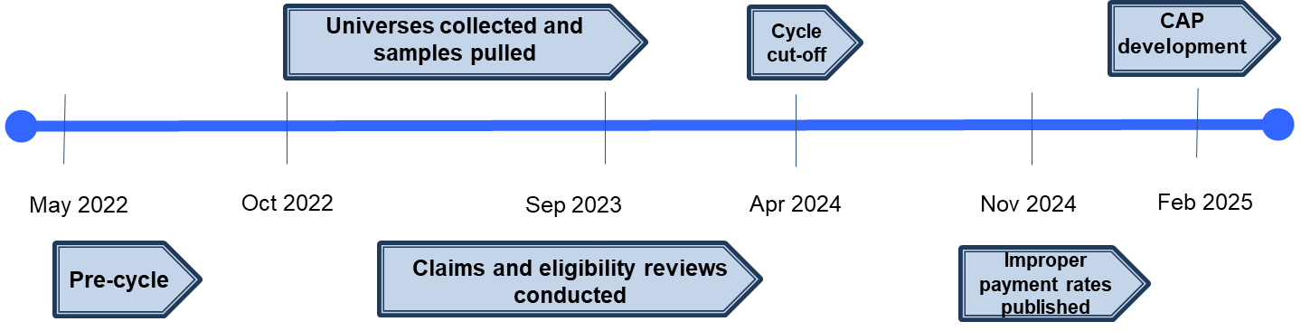
PERM Cycle Progression
Process of sampling, reviewing payments, calculating and reporting improper payment rates takes more than 2 years.
Fee-for-service (FFS) claims and managed care capitation payments are collected for a full year – July 1, 2024 through June 30, 2025.
  Payments receive a Data Processing (DP), Medical review (MR), and/or eligibility review.
  Findings are used to calculate improper payment rates.
  States receive findings and develop Corrective Action Plan (CAP).
RY 2026 PERM Cycle Timeline
May 2024
Oct 2024
Sept 2025
April 2026
Nov 2026
Feb 2027

Slide 7
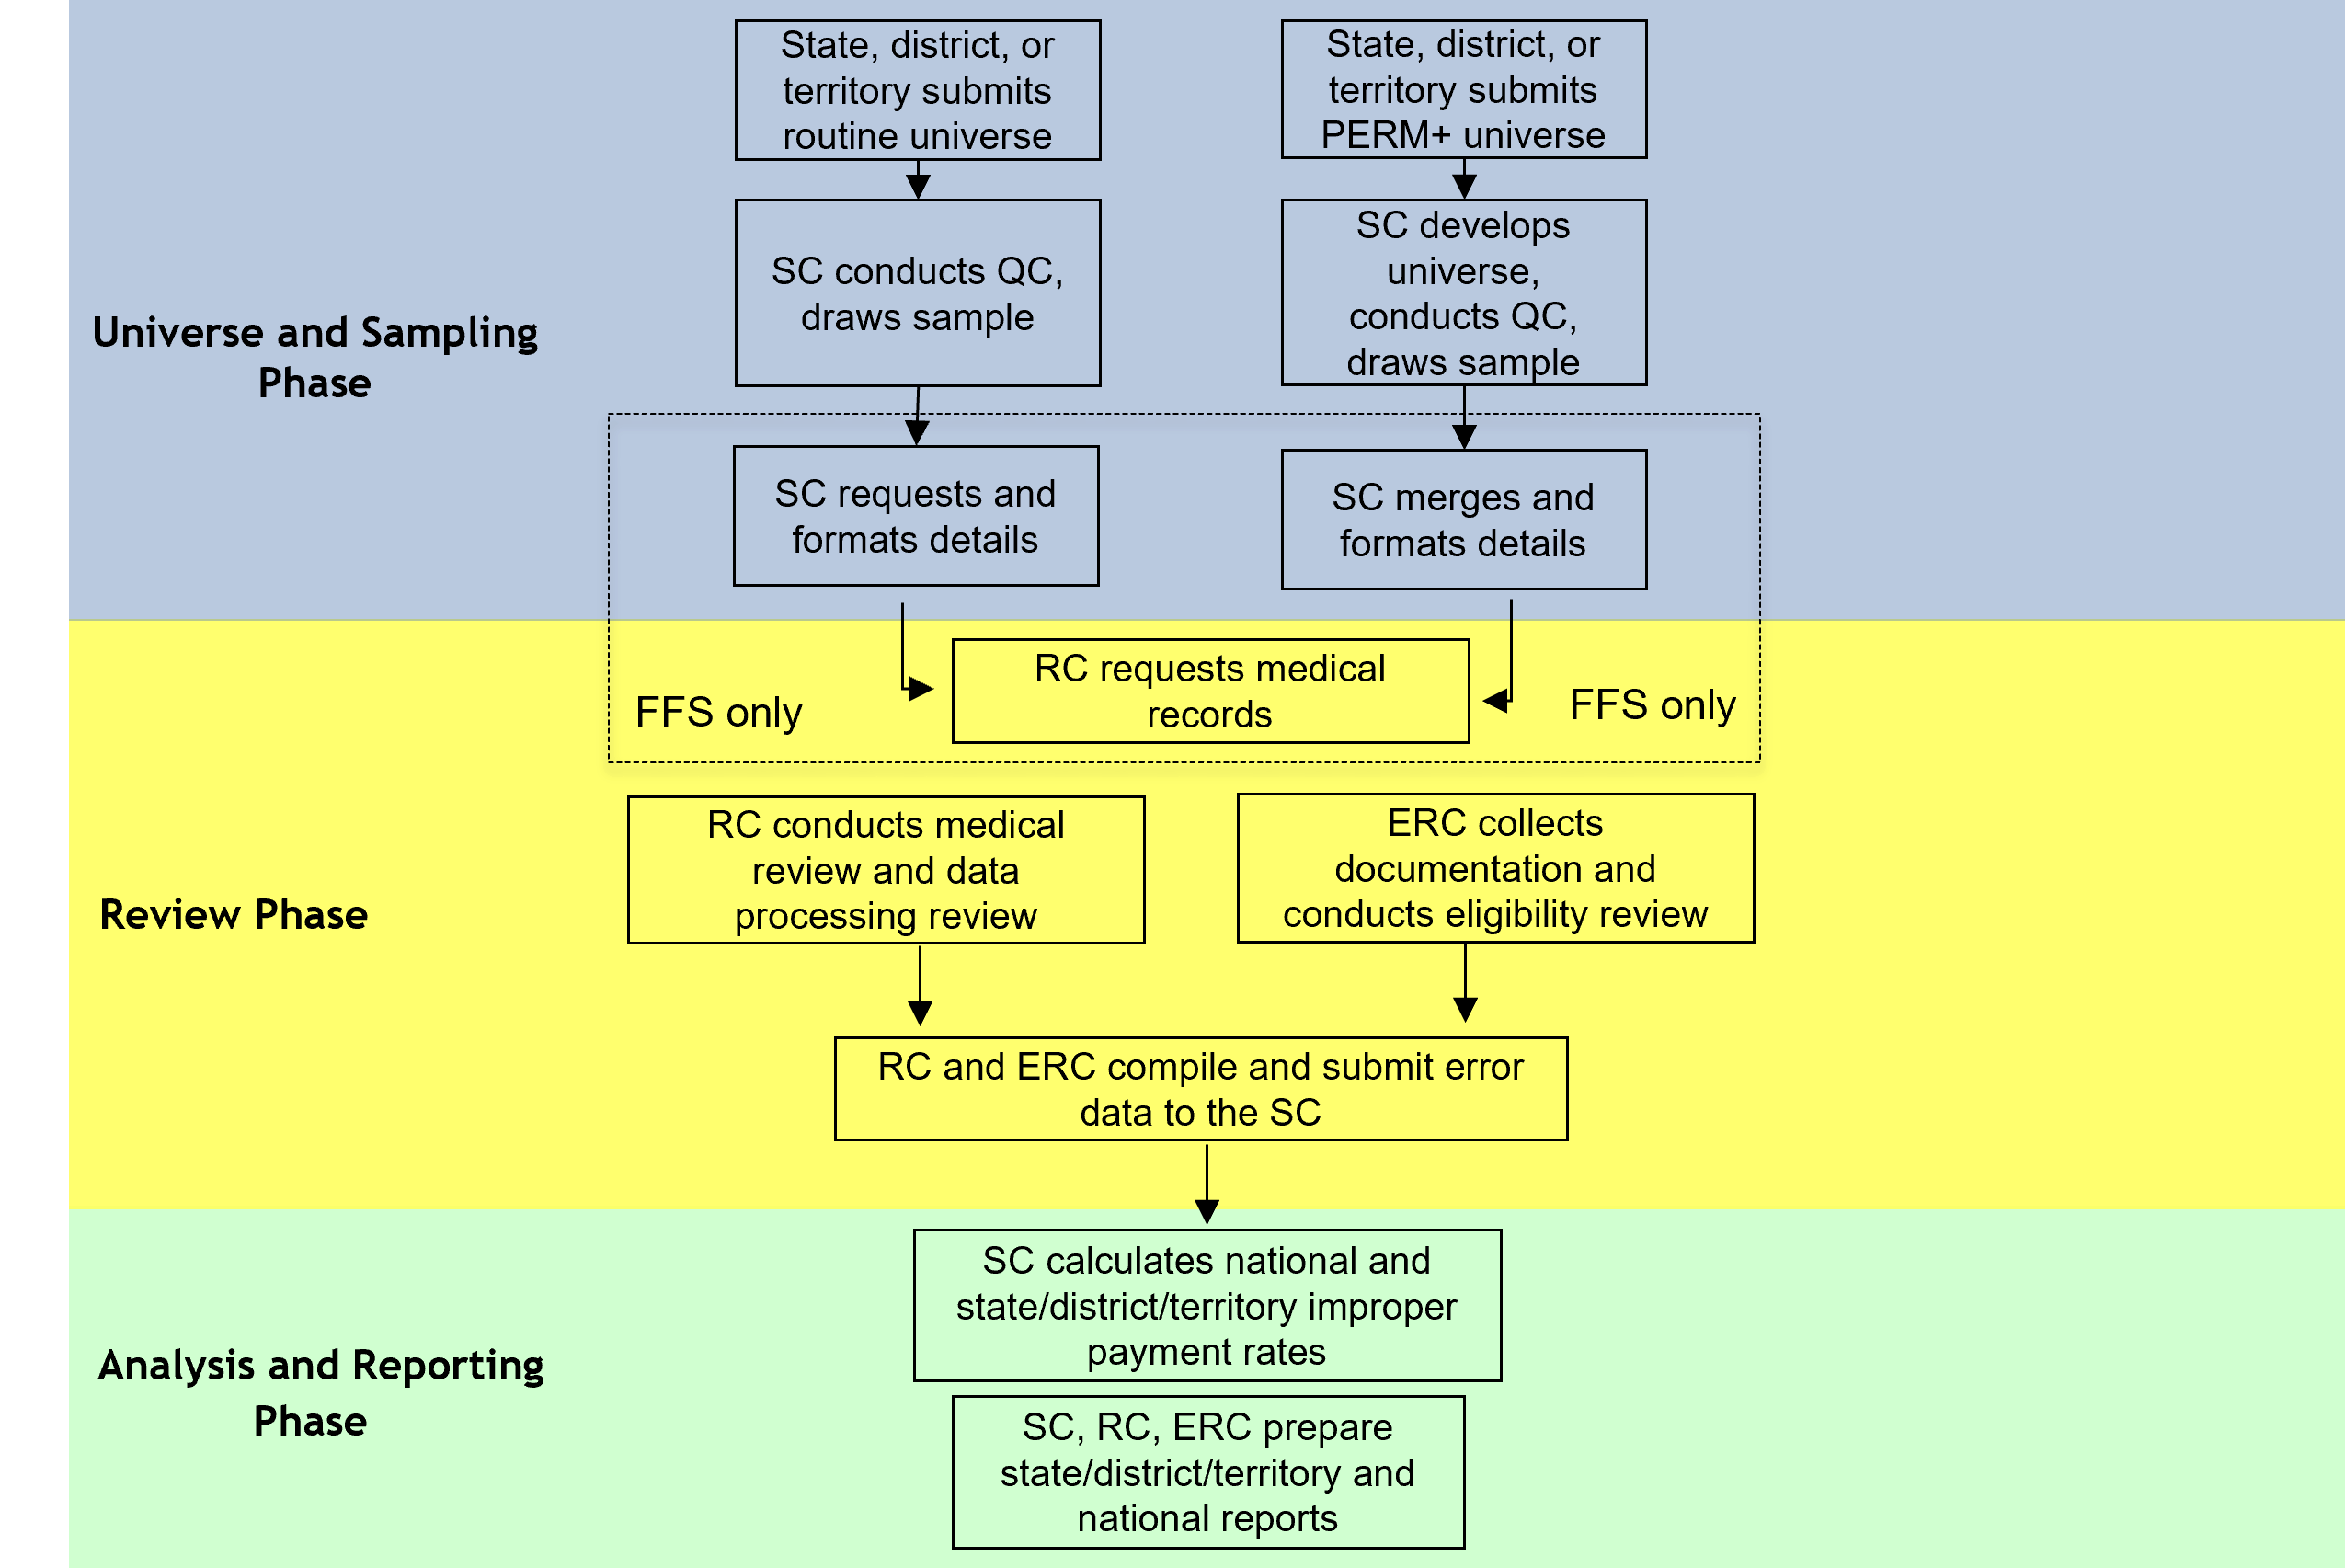
Claims and Payment Measurement
Routine PERM vs. PERM+

Slide 8
PERM Methodology Overview

Slide 9
Measuring Payment Errors in Medicaid and CHIP
The goal of PERM is to measure and report an unbiased estimate of the true improper payment rate for Medicaid and CHIP.
Because it is not feasible to verify the accuracy of every Medicaid and CHIP payment, CMS uses a statistically valid methodology that samples a small subset of payments, then extrapolates to the “universe” of payments.
PERM uses a two-stage sampling approach:
  CMS uses a 17- or 18-state rotation per cycle (each state is reviewed once every 3 years).
  From within each state, district, or territory, a stratified random sample of payments is selected.
  The sampled payments are reviewed for errors.
  Use the findings to estimate a national improper payment rate.

Slide 10
Measuring Payment Errors in Medicaid and CHIP (cont’d)
CMS calculates the national-level improper payment rate by using the latest improper payment rates from each state Medicaid program and CHIP from the most current cycle and the previous two cycles.
The national-level rate includes the most recent rates for all 50 states and the District of Columbia.

Slide 11
PERM State/District/Territory Rotation
Cycle | Medicaid and CHIP States Measured by Cycle
Cycle 2 (RY26) | Alabama, California, Colorado, Georgia, Kentucky, Maryland, Massachusetts, Nebraska, New Hampshire, New Jersey, North Carolina, Rhode Island, South Carolina, Tennessee, Utah, Vermont, West Virginia
Cycle 1 (RY25) | Arkansas, Connecticut, Delaware, Idaho, Illinois, Kansas, Michigan, Minnesota, Missouri, New Mexico, North Dakota, Ohio, Oklahoma, Pennsylvania, Virginia, Wisconsin, Wyoming
Cycle 3 (RY24) | Alaska, Arizona, District of Columbia, Florida, Hawaii, Indiana, Iowa, Louisiana, Maine, Mississippi, Montana, Nevada, New York, Oregon, Puerto Rico, South Dakota, Texas, Washington

Slide 12
PERM Review Types and Sample Sizes
PERM samples are selected from distinct universes for two programs:
  Programs: Medicaid (Title XIX) and CHIP (Title XXI).
  Universes: FFS and Managed Care.
Claims selected from the FFS universe are subject to as many as three different reviews:
  DP, MR, and Eligibility.
Payments selected from the managed care universe are subject to as many as two different reviews:
  DP and eligibility.
PERM will use a cycle sample size each year that caps the number of samples selected from FFS and managed care as well as the number of eligibility reviews.
The cycle sample size will be distributed across states based on their latest expenditures and improper payment results.
All review results are reported via the State Medicaid Error Rate Findings (SMERF) system, a web-based application hosted by the RC.

Slide 13
Roles and Responsibilities

Slide 14
CMS PERM Team Responsibilities
Program Oversight and Support:
  Structure the parameters for measurement through legal and policy decision-making processes.
  Oversee the operation of PERM and PERM contractors to ensure that CMS meets its regulatory requirements.
  Ensure the measurement remains on track and work with states when challenges occur.
Communication and Information Sharing:
  Host monthly cycle calls.
  Provide guidance and technical assistance to states throughout the process.
  Provide educational resources for Medicaid and CHIP providers.
  Provide direct communication and support by assigning each state a CMS liaison.
Review, Resolution, and Recovery of Improper Payments:
  Review state requested appeals of error findings.
  Provide states with summary reports to develop corrective actions and the Final Errors for Recovery (FEFR) reports.

Slide 15
General State Responsibilities
Overall PERM Support:
  Provide a representative to spearhead PERM who will coordinate state staff and ensure essential staff attend relevant meetings, as well as provide contractors with necessary data and information and keep them apprised of any state issues.
  Educate state staff and vendors for the Medicaid Management Information System (MMIS) or other data sources on the PERM process and data requirements.
  Notify CMS and contractors in advance of any program changes, including new or ended programs, new reimbursement methodologies, or new systems.
  Provide timely and thorough responses to questions on the state submitted data and review issues to support the PERM timeline.
  Participate in the cycle kick-off meeting, education webinars, all-state, and monthly cycle calls with CMS.
  Notify contractors of any Data Use Agreements, Business Associate Agreements, or Non-Disclosure Agreements requiring completion.
  Assist contractors in obtaining systems access.

Slide 16
SC Responsibilities
Collect and Review State FFS and Managed Care Universes:
  Conduct Intake Meetings with each state.
  Collect paid, zero dollar paid, and denied FFS and managed care universe data from states on a quarterly basis.
  Verify data documentation against data submission.
  Perform quality control review on submissions to ensure universes are accurate, compliant, and complete.
  Develop and implement sampling unit build (for PERM+).
  Determine correct sampling units (Header/Fixed/Line) for each type of claim/service.
  Request clarification or additional submissions, as necessary.
  Conduct CMS 64/21 reconciliation to ensure all required data are included in review.
Select Samples and Format Claims:
  Select random samples from the universes on a quarterly basis.
  Request sample details from states for sampled FFS claims for routine PERM states and build details for PERM+ states.
  Format and verify all mandatory fields needed for RC and ERC review.
  Deliver samples and details to the RC and ERC.

Slide 17
SC Responsibilities (cont’d)
Improper Payment Rate Calculation and Reporting:
  Calculate the component (FFS, managed care, eligibility) improper payment rates at the state, cycle, and national levels for Medicaid and CHIP.
  Conduct analysis for corrective actions.
  Assist in preparing final reports.

Slide 18
State Responsibilities to the SC
Assign a PERM point of contact:
  Also, identify a primary data contact, if different than the primary PERM contact.
Universe Quality Control and Data Submission:
  Review claims and payment data submission instructions.
  Provide accurate data documentation (e.g., file layouts, variable field decodes), claims and payment data to the SC.
  Conduct a quality control review of claims, payment, and provider data prior to submission of the quarterly universes to ensure completeness of data and compliance with PERM specifications.
Participate in meetings with SC:
  Data submission instruction meeting.
  Data intake meeting.
  CMS 64/21 intake meeting.
  Details intake meeting.
  Regularly scheduled and ad hoc calls to respond to data questions.

Slide 19
State Responsibilities to the SC (cont’d)
Convene Subject Matter Experts (SMEs), as needed:
  Participate in calls.
  Respond to specific data, program, or policy questions.
Respond timely to questions on universe and details QC.
Support the CMS 64/21 comparison:
  Include financial staff familiar with reports.
Support the SC in developing and approving sample unit build (PERM+) and payment level (Routine PERM).
Support the SC in developing strata mapping for Fixed, Medicare Crossover, and Aggregate payments.

Slide 20
RC Responsibilities
Prepare for DP and MR:
  Facilitate state implementation by confirming readiness prior to reviews, providing IT support, and overall reducing state burden.
  Research, collect, and request Medicaid and CHIP state policies, including relevant state and federal regulations, program information, fee schedules, systems, and billing manuals.
  Conduct orientations for all states on DP, MR, and Medical Record Requests (MRR) processes.
  Conduct DP and MR:
  Request medical records from providers.
  Conduct case collection and DP reviews on all sampled payments.
  Conduct medical/coding reviews on relevant sampled FFS payments.
  Maintain the SMERF system, conduct SMERF training webinars, and provide state access to SMERF to track activities and findings.
  Schedule, facilitate, and provide minutes for bi-weekly check-in calls.

Slide 21
RC Responsibilities (cont’d)
Finalize Review Findings and Support Improper Payment Rate Calculation and Reporting Process:
  Report final review findings to the state through Sampling Unit Disposition (SUD) reports on the 15th and 30th of each month or as directed by CMS.
  Review and respond to requests for Difference Resolution (DR) and repricing.
  Process documentation for appeal requests for CMS review.
  Notify the state of final overpayment errors for recovery purposes at the end of the cycle after DP, MR, and eligibility reviews are completed.
  Compile and submit final findings to the SC.
  Assist in preparing final reports.

Slide 22
State Responsibilities to the RC
Support the Claims Review Process:
  Educate providers on the PERM process and assist with medical record collection.
  Have appropriate state staff thoroughly complete and return questionnaires in a timely manner.
  Assist the RC with accessing state policies for review.
  Work with the RC to grant remote system access timely to prevent review delays.
  Assist the RC with DP reviews within the prescribed timeframes.
  Monitor PERM IDs on the pending documentation list.
  Respond timely to RC requests for documentation.
Review, Resolve, and Address Improper Payment Findings:
  Track errors, request DRs/appeals for disputes of findings, and re-price partial errors.

Slide 23
State Responsibilities to the RC (cont’d)
Participate in meetings with the RC and CMS, including:
  SMERF system training.
  DP orientation.
  MR/MRR orientation, and
  State check-in meetings.

Slide 24
ERC Responsibilities
Prepare for Eligibility Case Reviews:
  Research state and federal Medicaid and CHIP policies and procedures.
  Request from the state any policies that are not publicly available.
  Align state eligibility categories with the appropriate federal categories and Federal Medical Assistance Percentage (FMAP) rates.
  Populate and provide the following documents to the state for review:
    Policy survey.
    Intake protocol with COVID-19 Questionnaire.
    System access questionnaire.
    Eligibility category mapping.
  Conduct an Intake Meeting with the state.
  Coordinate with the states to obtain remote access to eligibility systems.
  Provide the Eligibility Case Review Planning Document based on state’s specific systems, processes, and policies and submit to state to review for accuracy.

Slide 25
ERC Responsibilities (cont’d)
Conduct Eligibility Case Reviews:
  Request copies of hard-copy case files, when necessary.
  Gather information from the eligibility and document management systems, including electronic verifications.
  Request additional documentation from the state, as needed.
  Review eligibility case actions in accordance with federal and state policies.
  Host regular biweekly check-in meetings with the state.
  Coordinate with the RC when scheduling reviews and check-in meeting to ease state burden when possible.
  Support the RC by coordinating and providing available eligibility information necessary to conduct DP reviews.
  Report Eligibility Case Review Findings:
  Report review findings to the states through SUD reports via SMERF on the 15th and 30th of each month.
  Review and respond to requests for DR.
  Package appeal requests for CMS review.

Slide 26
State Responsibilities to the ERC
Assign a state eligibility point of contact.
Participate in meetings with the ERC and CMS:
  Eligibility Case Review Intake Meeting.
  System access meetings, as needed.
  Biweekly check-in meetings and other ad hoc meetings (throughout the case review process).
Review and assist with the completion of documents as requested by the ERC, including the Policy Survey, Intake Protocols, System Access Questionnaire, Eligibility Category Mapping, and the Eligibility Case Review Planning Document.
Provide remote access to eligibility and documentation management systems.
Provide state eligibility policies, including eligibility waivers, and COVID-19 Unwinding policies as requested.
Provide guidance related to systems, policy, and other pertinent topics.
Assist in obtaining documentation that is not available through system access.
Review errors as they appear in SUD.
Submit requests for DR and appeal within the prescribed timeframes, if needed.

Slide 27
Differences Between
RY 2023 and RY 2026 Cycles

Slide 28
SC Processes: New to Cycle 2
New field required in either the PERM+ universe submission or in the routine PERM details submission:
  Capitation Reason Code
  Federal Medical Assistance Percentage (FMAP) (optional but noting for awareness)

Slide 29
RC Processes: New to Cycle 2
Earlier focus on system access, training, and privacy/security training.

Slide 30
RC Processes: New to Cycle 2 (cont’d)
New state Educational Resources available under the Tools menu in SMERF:
  Fast Fact guides on a variety of subjects: state report on MR missing documentation, state role in MR, overview of MR process, MR documentation for physician visits in nursing facilities, etc.
New MR missing documentation Errors (MR1/MR2) report developed so states can easily and efficiently identify all MR1 and MR2 errors in the SMERF system.
Updates to the SMERF Medical Record Requests Status to provide additional details on records status. The new features will be covered in depth during SMERF overview trainings.
New mailbox dedicated to provider inquiries for MRR is listed on the MRR letters. No medical records, protected health information (PHI), and/or personally identifiable information (PII) should be sent to this address -
  PERMRC_ProviderInquiries@empower.ai

Slide 31
ERC Processes: New to Cycle 2
Error Codes and Qualifiers:
  The ERC will use updated error codes and qualifiers for the review findings. The ERC expects only minor changes from the RY 2023 error codes and qualifiers.
Ongoing Documentation Submission:
  As we did in RY23, the ERC will accept additional documentation until the end of the cycle for cases with missing and insufficient documentation errors.
    States will continue to have 30 calendar days to submit documentation.
    If the state has not responded within 30 days, the ERC will move forward with completing our case review.
    Documentation to address ER1, ER2 and ER3 errors will be accepted until cycle cut-off.
Independent Verification
  In addition to the ADR process, the ERC will accept additional information and verifications to independently verify the eligibility of the beneficiary. The ERC will look for any information that supports beneficiary eligibility despite the state not maintaining documentation of verification.
COVID-19 Public Health Emergency Unwinding Period
  The ERC will apply any States’ processes for “unwinding” from the continuous eligibility condition of the PHE including unwinding SPAs, waivers and other CMS-approved flexibilities to our reviews when appropriate and if they apply to case actions under review.
  The ERC will work with the state to gather and understand any policy or process changes prior to beginning reviews. The ERC will provide the state with a pre-populated COVID-19 questionnaire for state review and approval as part of the Eligibility Intake Process.

Slide 32
SC Process Details

Slide 33
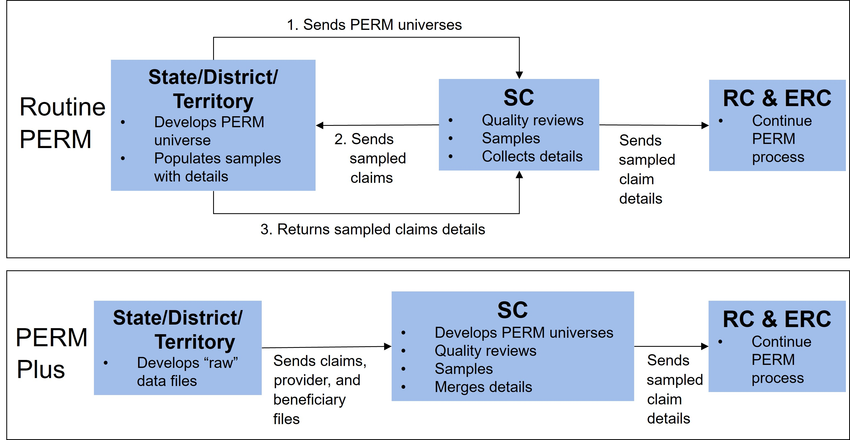
SC: Universe Collection and Sampling
State
State

Slide 34
SC: Universe Collection
PERM independently samples payments from four universes or program areas:
  Medicaid FFS.
  CHIP FFS.
  Medicaid managed care.
  CHIP managed care.
The PERM universe contains Medicaid and CHIP service payments that are fully adjudicated by the state that are matched by federal funds each quarter except those which are excluded.
  Includes individual claims, capitation payments, and payments processed outside of MMIS or made in aggregate for multiple services.
  Includes expansion program data.
  Excludes claim adjustments, administrative payments, state-only expenditures, and certain payments as defined in regulation.
Certain fields (e.g., date paid, amount paid) have PERM-specific definitions that are important for consistency.

Slide 35
SC: Sampling
Both FFS and managed care universes are stratified prior to sampling.
RY 2026 will use the following stratification approach:
  FFS is stratified into 5 dollar-weighted strata (including $0 paid) with one additional strata for claims that are only capable of receiving DP review (e.g., fixed payments, Medicare premiums, and Medicare crossovers).
  Managed care is stratified into 5 dollar-weighted strata.
The SC will calculate state-specific sample sizes for each claim component in each state.
Final sample sizes will be sent on May 31st.

Slide 36
SC: Improper Payment Rate Calculation
For each state, improper payment rates are estimated separately for Medicaid and CHIP:
  Improper payment rates are estimated using a sample of claims.
FFS, managed care, and eligibility rates are calculated separately (where applicable).
The FFS and managed care rates are combined to make the claims rate based on the state expenditures of each program.
The claims rate is then combined with the eligibility rate.

Slide 37
RC Process Details

Slide 38
State Medicaid Error Rate Findings (SMERF)
SMERF is the single system for the state to view DP, MR, and eligibility findings.
Tracks all sampled unit workload, reviews pending information, reviews completed, and final results for all review types.
Provides real-time information on status of record requests and receipts and progress of reviews for DP, MR, and eligibility reviews.
View eligibility, DP, and MR findings through the SUD reports published on the 15th and 30th of each month.
State access includes ability to create and/or download reports, file for DR and CMS appeals.
Training and access to the SMERF system is provided before records are requested or reviews are started.

Slide 39
RC: Collection of State Policies
Send initial email to state prior to implementation:
  Explain policy collection process and timeframes.
  Establish policy contacts with each state.
Collect policies from state websites (as many as publicly available), including any COVID-19 related policies.
Submit policy questionnaires and Master Policy Lists to state for review and updates.
Confirm Master Policy List is comprehensive and complete before MR.
Upload policies into SMERF system.
Check for policy updates throughout the cycle.

Slide 40
RC DP Review Process Details

Slide 41
RC: Remote State System Access
The PERM Final Rule of 2017 requires states to grant federal contractors access to all systems that are required to facilitate the completion of reviews; including, FFS claims payments, Health Insurance Premium Payment (HIPP) payments, Medicare buy-in payments, aggregate payments, capitation payments, per member per month payments, and provider enrollment information that is not included in the payment system, and any imaging systems that contain images of paper claims and Explanations of Benefits (EOBs) from third party payers or Medicare.
The RC will collect documentation to support DP reviews by directly accessing the state systems.
  In addition, the state may have to provide documentation securely if all necessary documentation is not available via system access (e.g., paper files).
The RC will coordinate with the state to obtain system access by:
  Gathering information about each system from the state.
  Completing any processes necessary to access the state systems.
  Taking any required training.

Slide 42
RC: DP Reviews
DP reviews are conducted on each sampled FFS claim, fixed payment, and managed care payment.
The RC validates that the claim was processed correctly based on information found in the state’s claims processing system and provider files.
DP webinars are scheduled with each state prior to reviews.
  Review state system(s) questionnaire completed by states.
  Review any special programs (waivers, etc.).
  Determine and gather desk aids, manuals, and website links needed for training DP reviewers.
  Review Risk-Based Screening (RBS) Assessment.
  Establish tentative dates to begin reviews.
The state tracks pending DP reviews through SMERF and receives automated notices for overdue pending information needed to complete reviews.

Slide 43
RC: DP Reviews – Beneficiary Review
Reviewer reviews and verifies the following:
  Beneficiary ID.
  Date of Death.
  Date of Birth/Age.
  County of Residence.
  Gender.
  Citizenship Status.
  Living Arrangements.
  City/Zip code (if needed to determine managed care status).
  Aid category/program eligibility and effective dates, (relative to sampled dates of service).
  Managed care/health plan enrollment.
  Patient Liability/level of care, if applicable.
  Medicare and/or other insurance coverage (TPL).

Slide 44
RC: DP Reviews – Verification of Provider Enrollment
Only reviewed when provider is required to be enrolled.
The DP team reviews and verifies the following:
  Provider Name.
  Provider National Provider Identifier (NPI) Number.
  Registration/enrollment.
  Provider License (if required).
  Clinical Laboratory Improvement Amendment (CLIA) Certification (if required).
  Type/specialty.
  Provider and Service Location.
  Provider Sanctions/Suspension Periods.
  Office of Inspector General (OIG) List of Excluded Individuals and Entities (LEIE) verification check conducted independently.
  Compliance with provider enrollment/RBS requirements under the Affordable Care Act (ACA).
  Provider revalidation.
  RBS Independent Verification

Slide 45
RC: DP Reviews – Verification of Accurate Payment
Reviewers determine the following:
  The payment was for a covered service.
  The payment was accurately calculated.
  To ensure these two requirements are met and complete, reviewers will:
    Verify timely filing requirements.
    Review reference screens with service parameters*.
    Review reference screens with rates†.
    Verify service coverage determination.
    Review prior authorization requirements.
    Verify prior authorizations issued‡.
* National Drug Code (NDC), procedure codes, revenue code, etc.
† Diagnosis Related Group (DRG), NDC, per diem, provider contract, procedure codes, revenue codes, Relative Value Unit (RVU), etc.
‡ Service codes, effective dates, units, rates, etc.

Slide 46
RC: DP Reviews – Verification of Accurate Payment (cont’d)
Reviewers will independently price each sampled payment manually to determine if the payment was made in accordance with published state policies and rates in effect for the dates of service under review.
Reviewers will need access to the rates that were in effect for the dates of service for claims under review, including those housed outside of MMIS.
Reviewers will also need:
  Information about how the state calculates each type of payment.
  The ability to complete a duplicate check to ensure the same service was not paid more than once or to multiple providers for the same dates of service.
  Hard copy paper claims or the ability to view the scanned image of the paper claim to verify accurate transference of information to the payment system.
  To view any adjustments made within 60 days of the original sampled claim payment date.
  Access to value code tables or a data dictionary of codes used in the system if not contained in system help.

Slide 47
RC: DP Reviews - Managed Care Capitation Payment
Reviewers will review all beneficiary information listed under FFS review.
Reviewers will also need access to:
  Capitation rates.
  Capitation payment history screens.
  Geographical service areas (counties, zip code).
  Managed care contract for sampled claims.
  Population carve-outs.
  Service carve-outs.
  Rate cells.

Slide 48
RC MR Process Details

Slide 49
RC: MRR
The RC holds MR/MRR orientations with the states to review the MRR processes before starting calls to providers.
The RC uses the provider and MR point of contact information received in the details files submitted by the states to contact providers and send request letters.
Provider information is verified during the initial live call. If the provider cannot be reached, state support is needed to help identify the correct contact information.
Initial letter request packets sent to providers include:
  CMS letter (with authority to request records).
  PERM fax cover sheet with specific list of requested documentation (unique to each claim category).
  Claim summary data provided for specific claim sampled.
  Instructions with different options for record submission.

Slide 50
RC: MRR (cont’d)
Providers have 75 calendar days to send in medical records:
  The RC will follow-up with reminder calls and reminder letters at 30 days, 45 days, and 60 days, if the record has not been received.
  A 75-day non-response letter is sent to providers via certified mail if no MR documentation has been received. MR1–No Documentation error is cited if no records are received.
  If documentation is submitted and is missing information, the RC sends an additional documentation request (ADR) letter to the provider.
Providers have 14 calendar days to send in documentation in response to ADR:
  Reminder calls/letters are sent at 7 days if an ADR response was not received.
  If no ADR response is received, a 15-day non-response letter is sent. MR2– Document Absent from the Record error is cited is documents are missing from the record.
  If an ADR response is received but does not include all the requested items, an Incomplete Information letter is sent to the provider specifying the missing item(s) and an MR2 error is cited.
States receive copies of all letters to providers on a weekly basis via the RC’s Secure File Transfer Protocol (SFTP).
Late documentation for MR1/MR2 errors can be accepted until the cycle cut-off date.

Slide 51
RC: MR
Orientations are held for all cycle states to include:
  MR process.
  MRR process.
  DR/Appeals process.
  MR/policy questionnaire, as needed.
Conducted only on sampled FFS claims.
Utilizes claims data submitted by state, records submitted by providers, and collected state policies.
Validates whether the claim was paid correctly by assessing the following:
  Adherence to federal and state guidelines and policies related to the service type.
  Completeness of medical record documentation to substantiate the claim.
  Medical necessity of the service provided.
  Validation that the service was provided as ordered and billed.
  Claim was correctly coded.

Slide 52
ERC Eligibility Review Process Details

Slide 53
ERC: Collection of State Policies
Download policies from public websites (as much as possible), including any COVID-19 PHE Unwinding related policies.
Request from the state any policies that are not publicly available, including any COVID-19 PHE Unwinding related policies.
Use information gathered to populate the Policy Survey.
Submit the Policy Survey to states for review.
Check for policy updates throughout the cycle.

Slide 54
ERC: State Remote System Access
The ERC will collect case documentation by directly accessing the state systems.
  In addition, states may have to provide documentation via the ERC’s SFTP if all necessary documentation is not available via system access (e.g., paper files).
The ERC will coordinate with the states to obtain system access by:
  Gathering information about each system from the states.
  Completing any documents, such as data use agreements, system access forms, and/or background check information necessary to access the state systems.
  Taking any required trainings.

Slide 55
ERC: Eligibility Case Review Planning Document
  The purpose is to have a shared document among the state, the ERC, and CMS that outlines necessary components of the cycle activities and provides details necessary for conducting eligibility case reviews
  The Planning Document includes information such as:
  State, CMS, and ERC points of contact.
  State characteristics.
  State eligibility systems summary.
  State eligibility verification requirements.
  Active waiver and mitigation plans for eligibility.
  State eligibility categories and FMAP rates.
  Paper case file collection process.
  PERM tasks and timeline.
  DR and appeals process.
  Eligibility category mapping.
  System access questionnaire.
  MAGI verification plan.
  COVID-19 Questionnaire.
  Any additional state-specific information.

Slide 56
ERC: Eligibility Reviews
Determine case action(s) and action date(s) for review; the review will include:
  The most recent determination or redetermination prior to the date of service; and
  Any changes in circumstance that required an action if it occurred prior to the date of service of the sample claim.
Access and review information used by the state to process the case in the form of system screenshots and case documents that support the eligibility determination.
Review eligibility elements against federal and state policies in place at the time of the action under review and determine if the case is correct or if a payment error should be cited.

Slide 57
ERC: FMAP Collection
The FMAP rate will be collected by the ERC to identify federal dollars assigned to a claim for each type of PERM review based on the eligibility category and the date the claim was paid.
States will have the opportunity to review and validate the FMAP assigned to claims when review findings are posted to SMERF. States can request changes to the FMAP rate for specific claims to ensure payments are calculated as accurately as possible.

Slide 58
ERC: Pending Documentation Requests
Upon the ERC’s initial review of the information collected, the ERC may identify cases with missing information or incorrect timeframes in which the ERC will request the state to provide the documentation.
  The ERC will also answer any questions about the documentation request during the regularly scheduled bi-weekly check-in calls.
States will be notified of a pending documentation request via the SMERF system as an EP1.
States will submit the requested documentation to the ERC via its SFTP within the requested timeframe.
Note: During the RY26 cycle, states will be allowed to submit missing documentation for ER1, ER2, and ER3 errors throughout the cycle until cycle cut-off.

Slide 59
ERC: Eligibility Data Transfer to the RC
Eligibility source information will be gathered by the ERC via screen-prints to assist the RC with DP reviews.

Slide 60
Best Practices

Slide 61
Best Practices for State:
Working with the SC
Assign a dedicated contact person for all communications.
Include relevant staff in all PERM meetings:
  For general intake meetings, it is important that all departments that will be pulling data or responding to questions about PERM data be in attendance.
  If vendors will be pulling and/or submitting PERM data, they should be included in intake meetings and calls with the SC.
  All relevant financial staff should be included in the CMS 64/21 intake meetings.
  The universe build and payment level meeting should include all relevant staff.
Check FTP compatibility before submitting the Q1 data:
  This includes encrypting, password-protecting, and uploading file.
Submit test data to ensure that the submission can be read and reviewed by the SC:
  State should perform quality checks to make sure data fields are uniformly populated with valid values.
  State should compare data documentation submitted with data – file layouts and variable decodes – are all up to date and accurate for timeframe of data supplied.
  Note any additional variables included in the data submission to assist state staff or the SC in identifying correct claims.

Slide 62
Best Practices for State:
Working with the SC (cont’d)
Keep a list of all data sources and ensure that data from all sources are included in the state transmission each quarter:
  Identify the relevant staff who are involved in the data analysis portion of the project and involve them from the start of the cycle.
Include subject matter experts as part of the PERM team early in the cycle to gain clear understanding of data submission instructions and PERM requirements.
Refer to information from the previous cycle, as appropriate, to resolve issues and answer questions.
Participate in regular meetings with the SC to resolve data issues if there are significant complications or delays.
Perform a round of CMS-64/21 reconciliation early in the cycle to ensure that corrections in data submission can be made for the remaining quarters.
When submitting anything to the SC via the SFTP, please email the PERMSC.2026@lewin.com inbox to alert the SC of this submission as well as provide a password to open the documents if needed.

Slide 63
Best Practices for State:
Working with the SC (cont’d 2)
For PERM+ states, work with the SC to identify the most efficient method of submitting data, which may include submitting some data through a routine PERM method.
For PERM+ states, verify that beneficiary and provider information given to SC in separate files are able to be correctly merged onto the claims file.
Establish a stream of communication or dialogue from the beginning of the cycle with your SC contact.
Ask questions proactively.
Have helpful information related to PERM readily available to share with your staff:
  SC contact list.
  Data submission instructions.
  Details submission instructions.

Slide 64
Best Practices for State:
Working with the RC
Allocate resources to PERM throughout the cycle at each phase of the project (policy collection, provider record requests, DP and MR).
Correct any issues identified from the last PERM measurement cycle.
Collaborate with the RC to explain the state programs, data, and policies.
State subject matter experts from the appropriate state departments attend and participate in check-in calls.
Complete and return questionnaires thoroughly and return promptly.
Establish system access for the RC early:
  Identify all systems required by the RC.
  Provide all required system access forms as soon as possible.
  Designate an individual to work with RC on system access.
  Identify all security/privacy training reviewers will need to complete.
Provide systems training to DP reviewers.
Monitor the DP P1 list and provide documentation in response to the pending documentation requests timely.

Slide 65
Best Practices for State:
Working with the RC (cont’d)
If the state routinely purges claims:
  Have the purge process held until after PERM reviews.
  If already purged prior to sampling, identify all purged sampled claims and have the full claim re-populated in the system prior to the start of DP reviews.
Keep provider licensing information updated in the MMIS system.
Update provider contacts in MMIS for claims sampled for PERM before the state submits quarterly detail data to the SC. If the state later discovers a change in the provider contacts after submitting detail data to the SC, provide the RC with updated provider contact information.
Send outreach letters to each sampled provider about the PERM program and MRR processes before medical record requests begin.
Identify a contact person for corporate medical organizations, school systems, and state fiscal agencies.

Slide 66
Best Practices for State:
Working with the RC (cont’d 2)
Develop teams to assist with locating and contacting providers, when needed.
Track all MRR in SMERF to assure providers’ timely responses.
Contact providers on all non-response errors (MR1s for no documentation and MR2s for document(s) absent from record) to submit requested documentation.
Encourage providers to contact the RC with questions about the MRR letters at PERMRC_ProviderInquiries@empower.ai. *Remind them not to send records, PHI, and PII to this email address.
Use the Advance Error Notice notification from SMERF to review all errors cited and determine if a DR request should be filed within 25 business days of the SUD report.
Utilize the DR process to formally request repricing or, if that timeframe has expired, submit a request for repricing to the RC via email and submit appropriate documentation before cycle cut-off.
Review all DR decisions where errors were upheld and determine if an appeal should be filed within 15 business days of the SUD report.

Slide 67
Best Practices for State:
Working with the ERC
Engage a cross-functional state PERM eligibility team that includes policy, systems, claims, program integrity, IT, and operations:
  Ensure appropriate team members attend biweekly check-in calls.
Establish remote system access for the ERC:
  Identify all systems required by the ERC.
  Provide all required system access forms or data use agreements as soon as possible.
  Designate an individual to work with ERC on system access.
Support the collection of Medicaid, CHIP and COVID-19 PHE Unwinding policies:
  Identify policies not publicly available and submit to the ERC.
  Review Policy Survey promptly and provide feedback.
  Notify the ERC of any changes throughout the cycle.
Respond to the request to review the Intake Protocol, System Access Questionnaire, and Eligibility Category.
Review, ask, and respond to questions involving the eligibility case review process.

Slide 68
SFTP Reminder
SFTP sites will be used to transfer data that contain PHI and/or PII and other relevant documentation with the SC, RC, ERC and the state.
Each contractor has a different SFTP site and will use the PERM State Contact Survey to identify state users and coordinate access.
Any state questions about either the SC, RC, or ERC SFTP should be coordinated directly with the respective contractor.

Slide 69
Communication and Collaboration

Slide 70
Communication and Collaboration
RY 2026 PERM Cycle 2 Calls:
  The cycle calls will occur on the third Thursday of each month from 2-3:00pm Eastern Time.
  First cycle call will be held in May or June.
Regular State Check-in calls:
  Will be scheduled with each state by contractors.
CMS PERM Website:
  CMS PERM - Cycle 2.
  PERM Manual.
  PERM RY 2026 Cycle 2 Kick-off Presentation.
PERM Corrective Action Plans - CMS Division of State Partnership:
  PERMCAPS@cms.hhs.gov

Slide 71
PERM State Liaison
Contact Information
Cycle 2 States​ | CMS PERM State Liaison​
Alabama, New Hampshire | Anita Moore; Anita.Moore@cms.hhs.gov
California, Vermont | Dan Weimer; Daniel.Weimer@cms.hhs.gov
Colorado | Ray Antoine; Ray.Antoine@cms.hhs.gov
Georgia, Rhode Island | Gwynne Warren; Gwynne.Warren@cms.hhs.gov
Kentucky | Misha Patel; Misha.Patel@cms.hhs.gov
Maryland | Aileen Almario; Aileen.Almario@cms.hhs.gov
Massachusetts | Dan Hendricks; Daniel.Hendricks@cms.hhs.gov
Nebraska, North Carolina | Caitlyn Brown ; Caitlyn.Brown@cms.hhs.gov
New Jersey | Angela Jones; Angela.Jones3@cms.hhs.gov
South Carolina | Elise Hanks-Witaszek; Elise.HanksWitaszek@cms.hhs.gov
Tennessee, Utah | Alan Mahmuljin; alan.mahmuljin@cms.hhs.gov

Slide 72
SC Contact Information
The Lewin Group
PERM Statistical Contractor
3237 Airport Rd.
LaCrosse, WI 54603
703-269-5500
All PERM correspondence should be directed to our central PERM inbox:
PERMSC.2026@lewin.com

Slide 73
RC Contact Information
Empower AI, Inc.
PERM Review Contractor
8701 Park Central Drive, Suite 400-B
Richmond, VA 23227
Customer Service Telephone Line: 800-393-3068
Providers can submit inquiries regarding MRR letters.
This email is not for submission of medical records, PHI or PII.
PERMRC_ProviderInquiries@empower.ai
Direct general inquiries to our central PERM inbox:
PERMRC_2026@empower.ai
Direct SMERF access inquiries to:
SMERFaccounts@empower.ai
Send inquiries about documentation to:
PERMRC_DOCS@empower.ai

Slide 74
ERC Contact Information
Booz Allen Hamilton
20 M Street SE
Washington, DC 20003
Phone: 202-203-3700
All PERM correspondence should be directed to:
PERM_ERC_RY2026@bah.com

